Slide 1
MgtOp 470—Business Modeling with Spreadsheets
Professor Munson
Topic 10
Analytics in Sports

Slide 2
“Using Bivalent Integer Programming to Select Teams for Intercollegiate Women’s Gymnastics Competition”
College gymnasts must be assigned to events according to the following rules:
  Four events: vault, uneven bars, balance beam, and floor exercise
  Each team can enter up to six gymnasts per event
  Top five scores included in the team score
  Must be at least four all-around participants

Slide 3
The Problem
Coach must compute expected scores for different lineups
This is an onerous combinatorial problem of nontrivial magnitude
Competitions are often extremely close, so heuristics may not work well enough (1% from optimal may reduce score by 1.8 points)
Potential heuristics?

Slide 4
Notation for the Model
Let N be the number of team members
Let S_{ij} = expected score of gymnast i in event j
X_{ij} = 1 if gymnast i is a specialist in event j
Y_{i} = 1 if gymnast i is an all-arounder

Slide 5
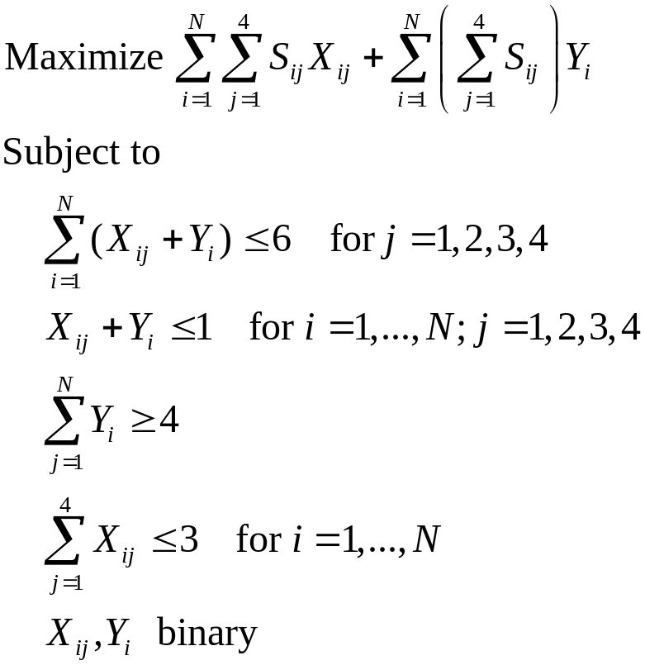
The Formulation

Slide 6
Issues
Program can be written as an LP by adding 0.0001 to the objective function coefficients of the Y variables
What should S_{ij} represent?

Slide 7
Other Issues
Is there a better objective function?
Program can easily be re-run to account for injuries
Results are useful to explain to the participants themselves why the selections were made (e.g., must have 4 all-arounders)
Model may provide alternate optima that could allow for rotations

Slide 9
“Assigning Season Tickets Fairly”
Problem: Friends purchase a block of Seattle Mariners season tickets for all 81 games and must divide them amongst themselves
Solution: Mixed-integer programming (modification of the assignment problem)

Slide 10
Difficulties with Simple Rankings
If want one game in a series, member might rank all three highly and then get all three!
Games might not be spread out over the season
Persons traveling from out of town might want the whole series
Generally harder for the computer to solve than a binary program with many constraints

Slide 11
Some Extra Constraints
No more than one game in any three-week stretch
No more than one game per month
Have the games spread out over the season
No more than one game in each series
No more than one game in each weekday series
No more than two games on any weekend
No more than one pair of tickets per home stand
No more than one game against any given opponent
No games in April
A game with all four tickets in August
At least two days between any two games
Games with all four tickets should occur on Thursday, Friday, Saturday, or Sunday
No games while on vacation
No games with all four tickets on school nights
Games for both Friday and Saturday or for neither

Slide 12
Notation for the Model
Let n = number of participating buyers
Let p_{i} = number of games for which person i wanted 2 tickets
Let q_{i} = number of games for which person i wanted 4 tickets
Let p_{ij} = 1 if person i is assigned 2 tickets to game j
Let q_{ij} = 1 if person i is assigned 4 tickets to game j
Let α_{ij} = weight that person i assigns to game j
Let e = average satisfaction of the most dissatisfied person
Let c = a large number (10,000)

Slide 13
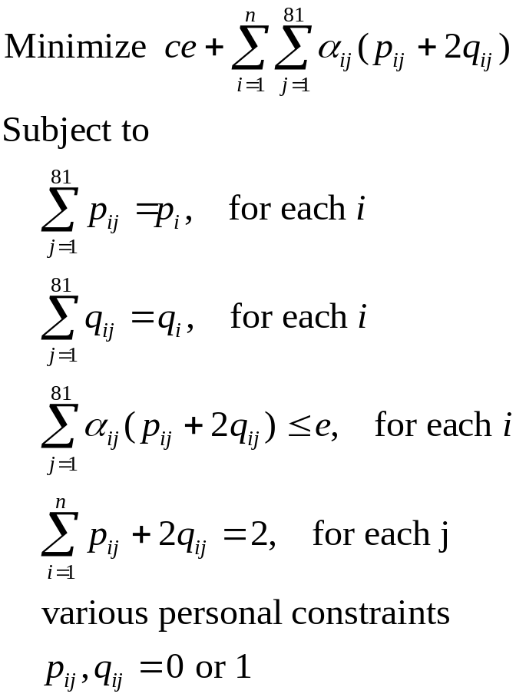
The Formulation

Slide 14
Conclusions
This approach effectively incorporated multiple objectives
Solution time was unwieldy, but near-optimal solutions worked well
Most tickets were assigned to people who really wanted to go
Should there be limits/rules regarding personal constraints?

Slide 15
“Scheduling the Chilean Soccer League by Integer Programming”
Soccer is Chile’s most popular sport
But in the early 2000s, fan support began to waiver
Also, the current manual schedule lacked fairness, created poor travel conditions for teams and TV, and generated poor end-of-season matchups
An integer programming model came to the rescue

Slide 16
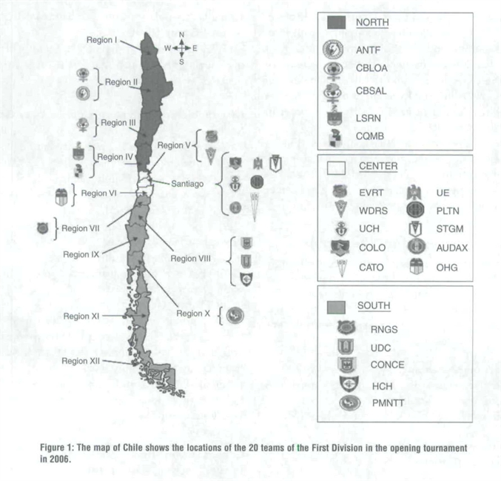
Map of Chile

Slide 17
League Conditions in Chile
Two Divisions: First (20 teams) and Second (12 teams)
Two Seasons: Opening and Closing
First Division is divided into 4 groups
Three dominant teams: All of their games are shown on TV; plus 1-2 other TV games per week
19-week regular season
2 teams from each group make the playoffs

Slide 18
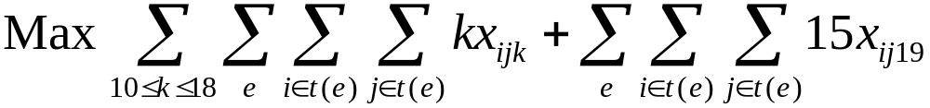
Objective Function
Objective: Push “decisive” games towards the end of the season (feasibility more important than optimality)
Let x_{ijk} = 1 if team i plays at home against team j in round k
Let t(e) = set of teams in group e

Slide 19
Constraints
Basic Scheduling
  Each team must play each other team once
  Either 9 or 10 games must be at home
Home and Away Sequence
  No more than two consecutive home games
  No more than two consecutive away games
  1st 2 games must alternate home-away and last 4 games must alternate home-away

Slide 20
More Constraints
Home Game Balance Against Group Rivals
  Two group opponents played at home and 2 away
Geographic Constraints for Double Away Game Sequences
  No 2-game trips from North (South) to South (North)
  At least one game in own region

Slide 21
Even More Constraints
Constraints on the Three Highly Popular Teams
  Must play either COLO at home and UCH away or vice-versa
  The 3 popular teams must play between weeks 10 and 16
  Each of the three plays exactly one home game against the other two
TV Constraints
  The 3 teams must play in Central or either North/South (but not North and South in same wk.)
  None plays away from home during first 5 rounds (summertime when mobile TV is less available)

Slide 22
Still More Constraints
Constraints on Strong Teams
  No team may play 2 straight games against the set of four strongest teams
  Games between the 4th best team and the three best must be played between rounds 4 and 18
Crossed Teams
  Teams that share the same stadium cannot both be home during the same week
Regional Classic Matchups
  Regional rivals must play between rounds 8 and 18

Slide 23
Can You Believe More Constraints?
Santiago Games
  Santiago must host between 2 and 4 home games each week (there are 7 teams from Santiago)
  The four least popular Santiago teams should not play each other during the first five rounds (summertime) because attendance would be low
Tourism-Related Constraints
  Each team in a tourist area (e.g., the beach) plays at home against at least one of the popular teams during the first five rounds (summertime)

Slide 24
Impacts
35% rise in attendance during the first year
74% increase in rival game attendance
More than 100% revenue increase in certain regions
TV stations saved money
NO COMPLAINTS!!!

