Slide 1
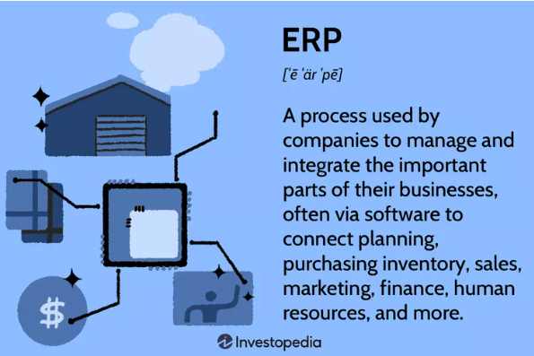
What is ERP? Enterprise –level software
Departmental systems (e.g., purchasing/ warehouse, QC, HR, manufacturing, etc.) can be connected with middleware (to handle data flows and updates)
or
a software provider can create one big system (SAP) where each module shares the same database. ($$$)
Allowing paperless workflows

Slide 2
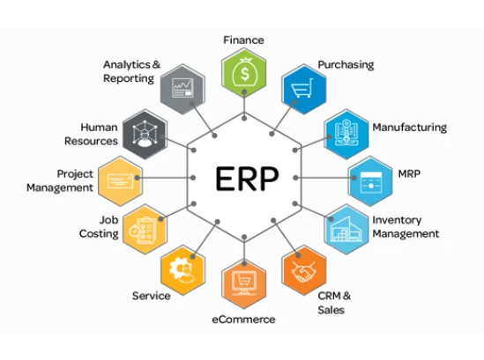
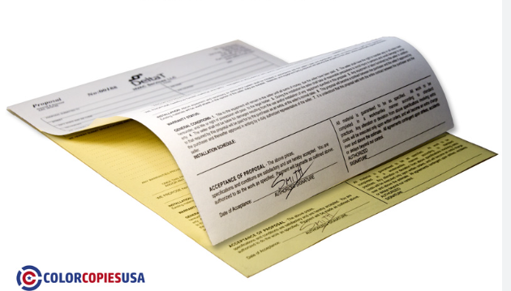
Enterprise Systems
A big database and set of pre-programmed applications to run the processes in many departments.
Benefit? Everyone shares the same transaction information, and changes in one system (e.g. MFR) update another (e.g., Purchasing and Inventory Mgmt.)
Image source ProjectLine.ca

Slide 3
ERP Systems Connect Departments and Processes to manage resources
The firm that manages resources the best wins (e.g., NFL)
Money – the working capital of the company must be used to pay employees, sub-contractors, and raw materials, and inbound/outbound logistics (Financial systems)
Employees – skilled labor – a plan is needed to ensure the right number of skilled employees are available. Hiring, training and retention plans are part of HCM
Assets (machinery, robots, components, raw materials) – Financial module inside ERP systems plan asset usage in production to maximize the value they provide. Connections to employees and vendors banks is also included.

Slide 4
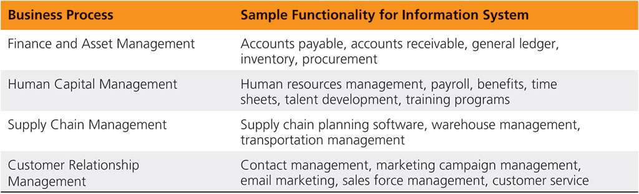
Types of Enterprise Systems

Slide 5
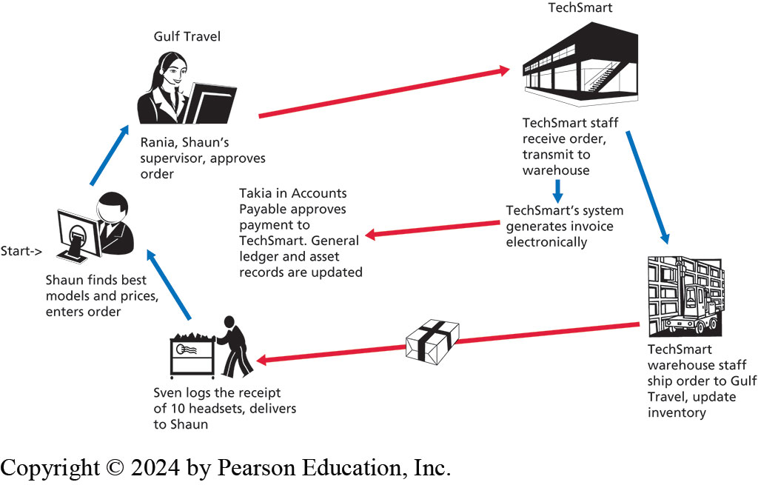
An example of an ERP system at work. Biz Process Reengineering has been used to create apps that support and simplify work processes. All needed info is shared digitally.

Slide 6
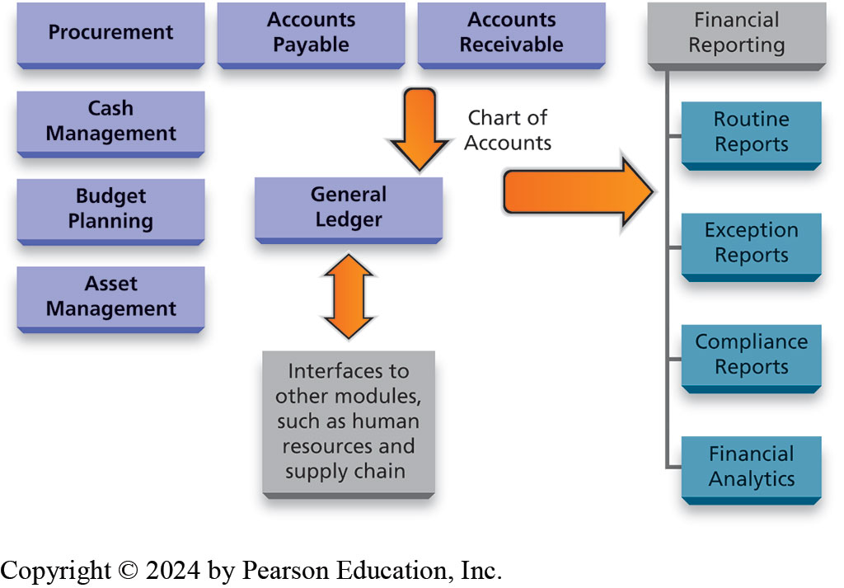
The modules of Finance & Asset Mgmt System
This system could be stand-alone or part of the ERP system
MBE
MBWA

Slide 7
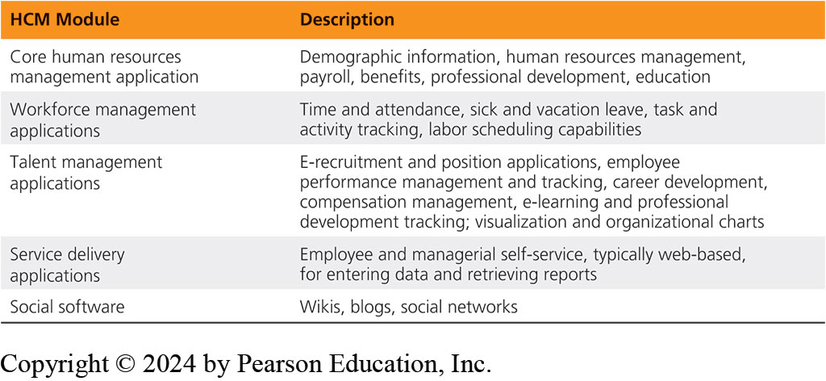
Human Capital Mgmt
ID vacancies, ID talent, recruit talent, pre-employment screening/profiling, hiring, upskilling/developing talent, cross-training, succession management, payment/rewarding/incentivizing. NFL/NBA

Slide 8
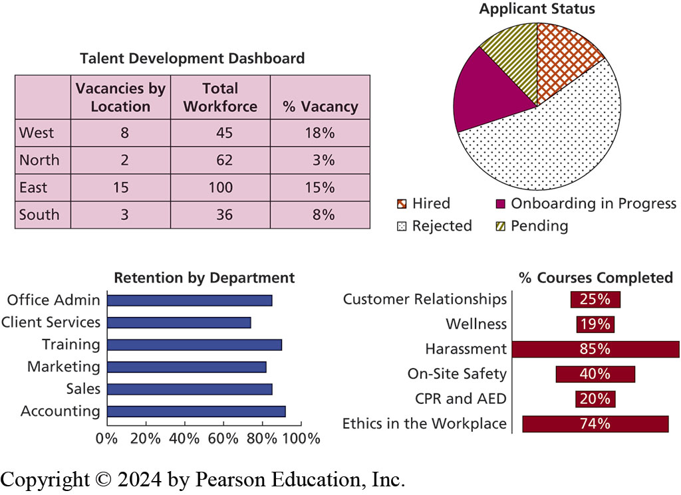

Slide 9
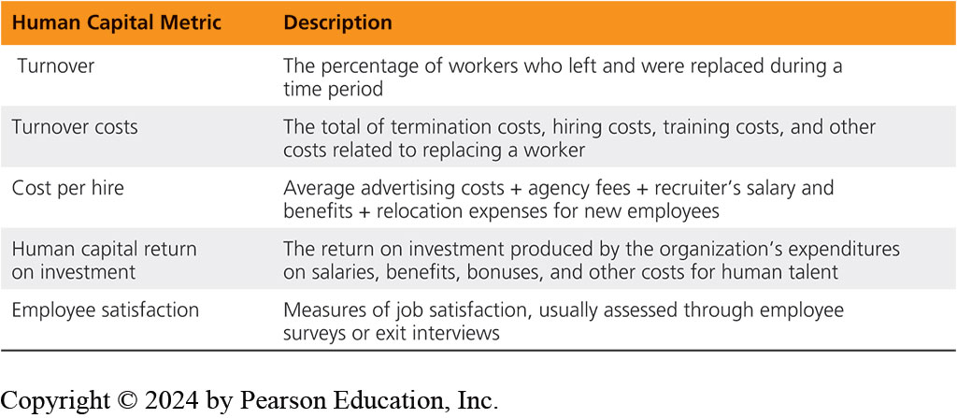
Bossware, snoopware

Slide 10
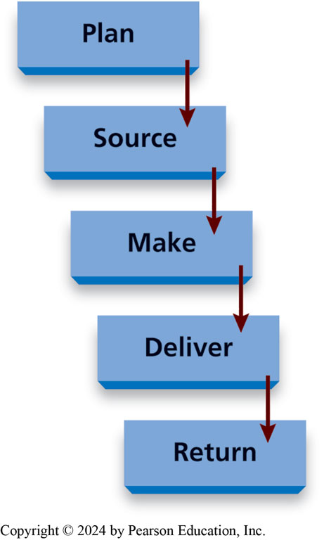
Different Ways to Conceptualize the Systems
ERP Systems include purchasing but external processes of in-bound shipping of raw materials and parts (and monitoring of vendor performance is performed in separate supply chain software)
ERP Systems include CRM and sales, but product delivery, contracting with of 3PL logistics providers (shippers) are performed in separate supply chain
The textbook’s author rolls all processes together into the SCM concept (see image – sourcing and delivery are part of the SCM, rather than external to the ERP. So the term SCM is used differently.

Slide 11
SCM Integration with MFR is useful because
Product versions change
Vendors need to be rated (quality, reliability, etc.)
Supply chains change (cost of shipping, routing, disruptions etc.)
Chosen vendors in the Supply chain change
GeoPolitical changes (de-globalization)
Product and material shortages
Shipping gluts (2021)
IOT makes inventory management easier
Robotics Integration

Slide 12
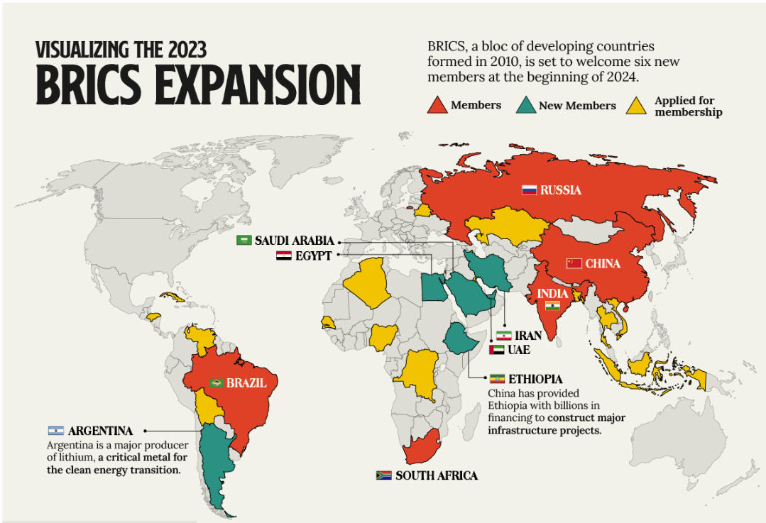
We are witnessing de-globalization which effects supply chains and is driving re-shoring and friend-shoring
Image Source
Visual
Capitalist

Slide 13
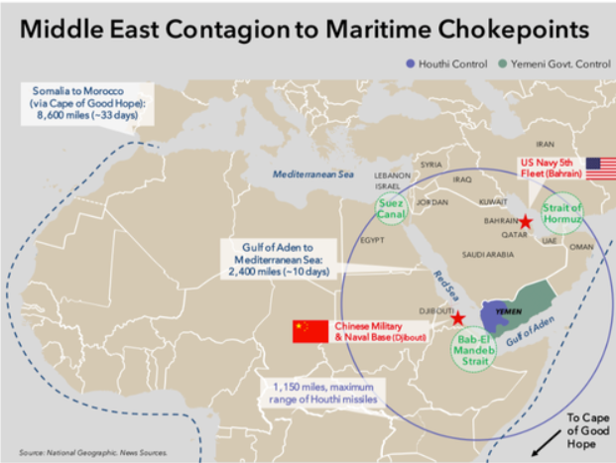
Current Events in Supply Chain Management

