Slide 1
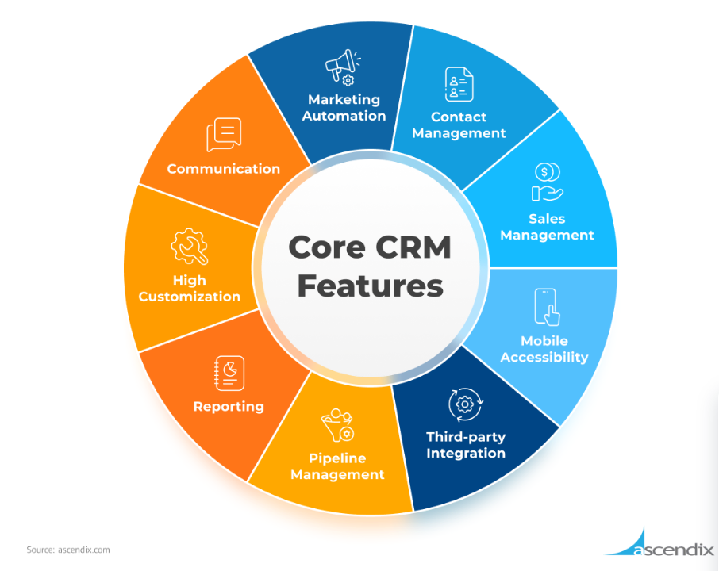

Slide 2
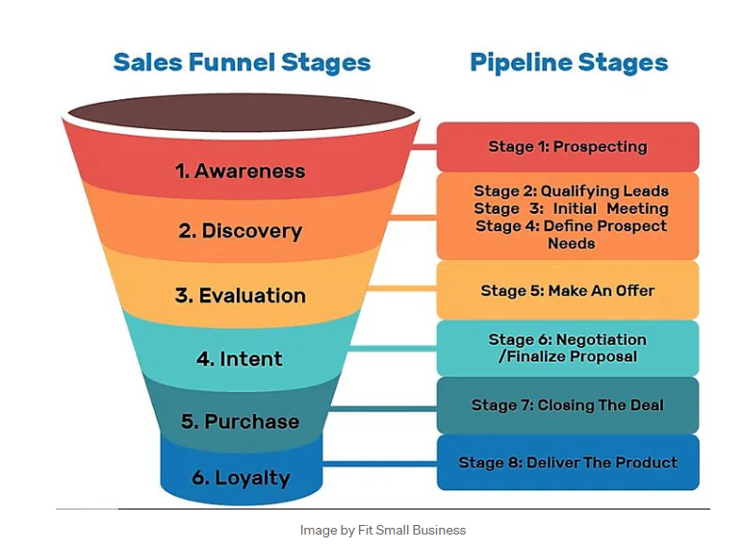
CRM Systems are used to manage the sales funnel
https://linda-lopeke.medium.com/the-differences-between-a-sales-pipeline-funnel-and-process-95588c4a8c22

Slide 3
CRM Systems (great for B2B and B2C)
tracks customer relationships as well as facilitates marketing, sales, e-commerce, analytics, and service processes. Rather than buy many systems that don’t talk to each other a CRM has ONE database and many modules, each that share data.
tracks website visitors, and predicts sales based on customer profiles
Track leads, prepare custom orders (e.g., bundles and discounts), track sales, track delivery experience, funnel service problems back to ERP system for product re-design. Funnel sales history back to marketing plans for advertising purchases.
leverage the customer data available to craft more meaningful and engaging experiences

Slide 4
CRM Systems – integrated data management
CRM systems help to predict changing customer preferences, to enable production of products that are selling, and stop production of products that are selling too slowly.
CRM systems enable real-time insights about your customers based on behavioral, demographic, and transactional data as well as engagement and customer feedback (e.g. survey data).
This allows your team to apply these insights for targeted and personalized sales, marketing campaigns, support, and more.

Slide 5
CRM Features – workflows and reporting
Can be used to set-up digital workflows to route ‘paperwork’ for processes for example a marketing manager may start a workflow saying “I need 3 ideas for a new Instagram story featuring our hiking projects”
This request would not need to be made verbally at a meeting, rather a workflow can be started and the brand manager, then graphic designer, then legal receiving the task, with a dropbox for returning ideas to the requester
Customizable reports with no SQL
E-mail templates can also be used to ‘stay in touch’

Slide 6
CRM Features - service
customer service and support can be easier by the CRM recommending certain actions to reps (all service reps receive the same support info online, rather than needing a verbal meeting – for example the fix to a new software bug)
The CRM can suggest personalized product support for customers, and automating support when possible with bots to save reps time

Slide 7
CRM Features – Is there any privacy concern?
We know every click you made on our website
We know how long you looked at each product
We know how often you return to our website to look at any product
We know what discounts you succumb to
We know everything you said on our Facebook groups (etc.)
We know when your purchased products need maintenance and need to be updated or replaced
We may write very specific email advertisements to you..
…sooo how are you liking the red pajamas you purchased (or received as a gift) last week, take a look at these matching slippers!
Is this normal?

