Slide 1


Introduction to Information Systems
Fifth Edition
Chapter 12
Information Systems Project Management and Strategic Planning
Copyright © 2023, 2021, 2018, 2015, 2012 Pearson Education, Inc. All Rights Reserved
Notes:
Projects that involve information systems need skilled oversight, and poor project management is often the reason new information systems go awry. The IS strategic plan is a roadmap that clarifies how information systems contribute to the company’s mission and strategy for the future, and what needs to be done to protect the organization’s assets and ensure its success.

Slide 2
Learning Objectives
12.1 Define a project, and explain how time, cost, and scope affect it.
12.2 Describe the five processes of project management.
12.3 Explain how project management software helps managers affect it.
12.4 Identify the main factors that cause projects to succeed or fail.
12.5 Explain the importance of strategic planning for information systems, and describe the issues that the plan should address.
12.6 Explain how the human element affects strategic planning.
Notes:
The material in this chapter will enable you to:
12.1 Define a project, and explain how time, cost, and scope affect it.
12.2 Describe the five processes of project management.
12.3 Explain how project management software helps managers affect it.
12.4 Identify the main factors that cause projects to succeed or fail.
12.5 Explain the importance of strategic planning for information systems, and describe the issues that the plan should address.
12.6 Explain how the human element affects strategic planning.

Slide 3
Projects vs. Processes
Projects | Processes
Temporary activity specific purpose and deliverables Own budgets and timelines Unique Uncertain | Repeated activity (ie pick/pack/ship) Efficient and cost effective Streamlined and predictable
Notes:
A project is a temporary activity that is launched for a specific purpose, to carry out a particular objective. Projects are temporary, with their own budgets, timelines, and sponsor. In contrast, a business process is a series of events designed to deliver a product or service that is repeated over and over. Projects are unique, but processes are recurring.
Projects are one of a kind, and they involve uncertainty because people are doing things that are new to them, so their predictions about how long tasks will take may be well off the mark. In contrast, a process should be tweaked so that the underlying activities are streamlined, efficient, predictable, and cost effective.
Project management skills are essential for projects incorporating information systems. But many activities in IT are business processes that repeat, and they should be made as streamlined, routine, and as cost effective as possible.

Slide 4
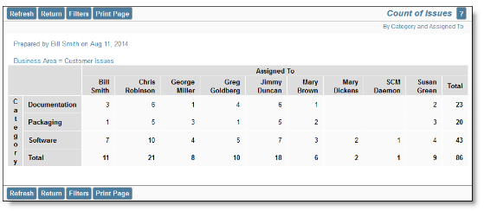
Organizing labor for projects is complex
From extraview.com

Slide 5
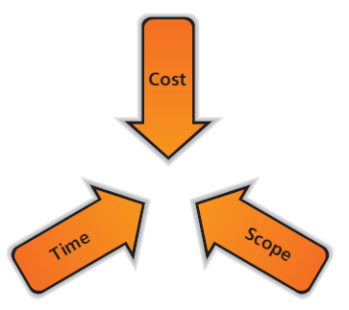
Triple Constraint
Increasing the scope of the project, increases the time it takes and the cost.
To decrease the cost, decrease the scope (cut initial features)
To make initial delivery schedule (decrease time) cut scope (functionality)
If you allow scope creep then you need more time and more cost.
What does a PM do if the budget is spent and the delivery date is next week?
Notes:
Every project is constrained by three fundamental forces: time, cost, and scope. These three are interrelated, and if one changes, the others are affected. Often one of the constraints is fixed for a particular project, so the other two forces must be adjusted if change is needed. For a project proposal requesting $150,000, a manager might say $100,000 is the limit, not a penny more—thus fixing the costs. The project’s scope can be reduced instead, the time could be lengthened, or both. In some situations, the time constraint is critical.

Slide 6
Project Management Processes
Initiating • Monitoring Planning • Closing Executing
Notes:
Project management is a systematic approach to project planning, organizing, and managing resources, resulting in a project that successfully meets its objectives. It requires knowledge and skills in many areas, and a clear understanding of the processes that underlie a successful project. Every project has five underlying processes that require management: initiating, planning, executing, monitoring and controlling, and closing.

Slide 7
Initiating
Clarify the objectives of the project
Clarify and check the ROI for the project
Set project length, scope, cost,
Acquire budget approval
Get backing of Sr. Mgmt.
Define criteria for success (results needed, ie installing new robotic inventory system will result in a 50% reduction in time for pick/pack/ship process)

Slide 8
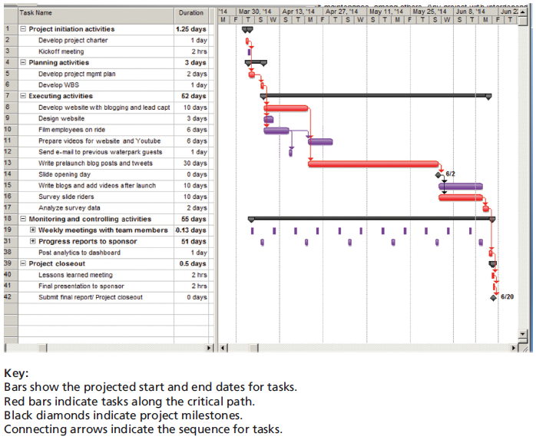
Planning
Project management plan includes org chart, description of work steps,
scope of work, cost breakdowns
Deliverables (products, service, docs)
Work breakdown structure
Gantt chart (sequenced list of tasks, with start and end dates, and ID dependencies)
Does scope get frozen?
Notes:
The planning processes should start very early with the overarching project management plan. This will be the roadmap and guide for executing the project, and it describes the components needed to ensure success. The plan will include an organizational chart, a detailed description of the work to be performed, information about the schedule, details about meetings and reviews, success metrics, and notations about any information systems or project monitoring tools that will be used. It should also identify the deliverables, which are the products, documents, or services that will be delivered to the sponsor during the course of the project. The project management plan touches on several areas that affect all projects, and for larger ones, some of the areas need sub-plans of their own.
The project management plan will also include strategies for managing time, quality, human resources, communications, cost, risk, and overall integration. Several documents are especially critical to the planning process, such as the scope statement, which clarifies the scope and provides a work breakdown structure (WBS). This is an orderly listing of actual tasks that the project team must complete to produce the project’s deliverables. Another is the Gantt chart, which lists the tasks on the WBS along with each task’s projected start and finish dates in graphical format.

Slide 9
Planning
Critical
path
red line
Notes:
The planning processes should start very early with the overarching project management plan. This will be the roadmap and guide for executing the project, and it describes the components needed to ensure success. The plan will include an organizational chart, a detailed description of the work to be performed, information about the schedule, details about meetings and reviews, success metrics, and notations about any information systems or project monitoring tools that will be used. It should also identify the deliverables, which are the products, documents, or services that will be delivered to the sponsor during the course of the project. The project management plan touches on several areas that affect all projects, and for larger ones, some of the areas need sub-plans of their own.
The project management plan will also include strategies for managing time, quality, human resources, communications, cost, risk, and overall integration. Several documents are especially critical to the planning process, such as the scope statement, which clarifies the scope and provides a work breakdown structure (WBS). This is an orderly listing of actual tasks that the project team must complete to produce the project’s deliverables. Another is the Gantt chart, which lists the tasks on the WBS along with each task’s projected start and finish dates in graphical format.

Slide 10
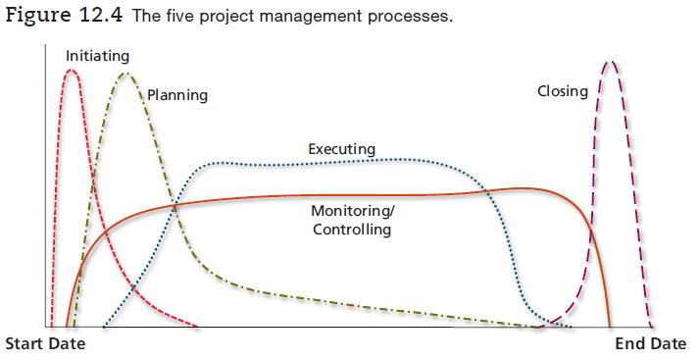
Project Management Processes
Notes:
Project management is a systematic approach to project planning, organizing, and managing resources, resulting in a project that successfully meets its objectives. It requires knowledge and skills in many areas, and a clear understanding of the processes that underlie a successful project. Every project has five underlying processes that require management: initiating, planning, executing, monitoring and controlling, and closing.

Slide 11
Why do projects fail?
Lack of senior mgmt support and champion (can’t get resources), can’t get muscle (Bill Gates Sr.)
Lack of stakeholder involvement (no clear paypack)
Unclear requirements (fuzzy/vague requirements)
Technology problems (connecting software systems is more chaotic and complex than expected)
World is more chaotic and complex than expected
Scope creep and excessive customization
Unclear roles and responsibilities
Unrealistic timeframes
Poor communications or poor change management
Did not analyze software or HW components

Slide 12
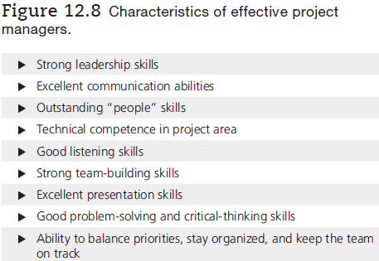
Role of Project Manager
PMI.org
Notes:
The project manager (PM) needs leadership skills, excellent communication abilities, and strong team building skills. Although technical competence in the task at hand is valuable, “people” skills are equally so. The job is demanding, and project success can depend so heavily on the PM’s skills which is why many organizations require professional certification, especially for those charged with managing large projects. The Project Management Institute (PMI) offers programs to certify project managers who can demonstrate their qualifications and agree to PMI’s code of professional conduct and ethics.
Another knowledge area project managers must master is change management, which refers to the process by which employees in an organization make the transition from the existing work processes to the new ones. Much change accompanies the introduction of new information systems, particularly when some processes are drastically revised or eliminated through business process management efforts.

