Slide 1


Introduction to Information Systems
Fifth Edition
Chapter 9
Knowledge Management and E-Learning
Copyright © 2023, 2021, 2018, 2015, 2012 Pearson Education, Inc. All Rights Reserved
Notes:
Information systems do a superb job of turning data into information, but the processes of creating, organizing, sharing, and acting on meaningful knowledge are more challenging. An organization’s assets—land, inventory, cash on hand—are all listed on its balance sheet and are relatively easy to valuate. Its intellectual capital isn’t listed, even though it might be the most valuable asset of all.

Slide 2
Learning Objectives
9.1 Describe the three types of intellectual capital and show how both explicit and tacit knowledge contribute to intellectual capital.
9.2 Describe the steps in launching a knowledge management (KM) program, providing examples of the applicable technologies.
9.3 Explain how the human element can pose challenges for knowledge management projects and how managers can overcome those challenges.
Notes:
The material in this chapter will enable you to:
9.1 Describe the three types of intellectual capital, and show how both explicit and tacit knowledge contribute to intellectual capital.
9.2 Describe the steps in launching a knowledge management program, providing examples of the applicable technologies.
9.3 Explain how the human element can pose challenges for knowledge management projects and how managers can overcome those challenges.
9.4 Describe several different approaches to e-learning.
9.5 Explain how e-learning programs are created, including use of a learning management system and learning analytics.

Slide 3
Knowledge (N)
Facts, information and skill acquired by a person or organization, through experience, education or training. The awareness or familiarity, gained by experience of a fact or situation. Knowledge is a by-product of experience.
What is the old way to gain knowledge at work? Training programs, OJT, mentoring, experience (from repetition, buying coffee (15-min chat) with someone who has more experience).
N is surface level or deep (ie heart procedure)
N is tacit (unrecorded) or explicit (documented). Many experts make you pay fees for their tacit knowledge, in sports a lot of learning is verbally from experts (ie. backstance)

Slide 4
Intellectual Capital – a Firms stored knowledge
Includes all the intangible assets and resources of an enterprise that are not captured by conventional accounting reports but still contribute value to the business and provide competitive advantage
Knowledge Management – systems and processes that record the intellectual capital so that the organization holds the intellectual capital and is not beholden to the experts that have the intellectual capital (ie tacit knowledge
Notes:
Intellectual capital (IC) includes all the intangible assets and resources of an enterprise that are not captured by conventional accounting reports but that still contribute to its value and help it achieve competitive advantage. The term arose to highlight the notion that intangible factors, such as the knowledge and expertise of employees, are assets just like other kinds of capital that a firm can apply to the production of goods and services and that help determine its market value. In many cases, it is the one asset that truly distinguishes a successful company from its competitors.

Slide 5
Intellectual Capital – a Firms stored knowledge
Collective knowledge of an organization (e.g., coaches, managers, players, employees, alumni)
An asset that enables better decision making
Smarts and experience that enable org. excellence
Collective intelligence < important than courage to use it
A) Human capital – competencies and knowledge(N) possessed by employees (mostly tacit unrecorded N)
B) Social capital - wealth of business relationships, charisma, referent power, can this ever be copied or saved?
C) Structural capital – documented best practices, scripts, (patented) processes (form the contents of the KM system)
Notes:
Intellectual capital (IC) includes all the intangible assets and resources of an enterprise that are not captured by conventional accounting reports but that still contribute to its value and help it achieve competitive advantage. The term arose to highlight the notion that intangible factors, such as the knowledge and expertise of employees, are assets just like other kinds of capital that a firm can apply to the production of goods and services and that help determine its market value. In many cases, it is the one asset that truly distinguishes a successful company from its competitors.

Slide 6
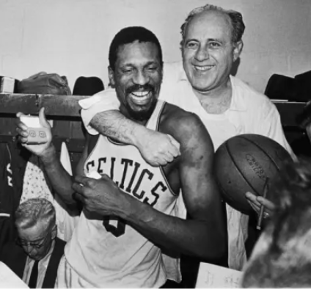
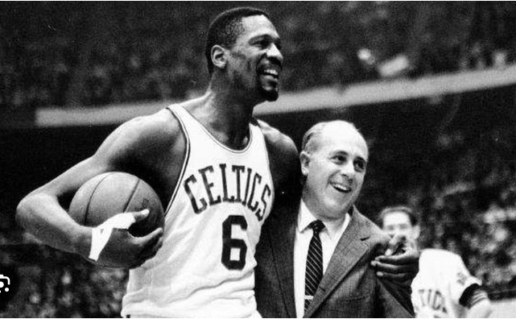
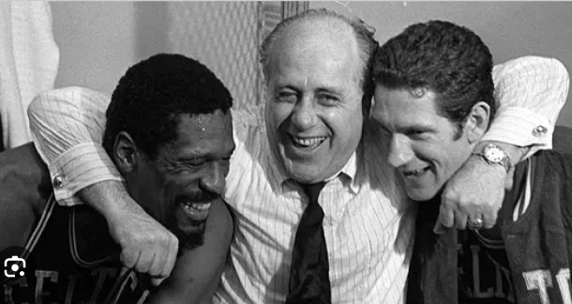
Intellectual Capital
Human capital – competencies and knowledge(N) possessed by employees (mostly tacit unrecorded N)
It can be a mistake for a young manager to over-rely on their own knowledge and opinion
If you have veterans at work (employees with many years service), they are likely to have untapped, deep tacit knowledge about processes.
Notes:
Intellectual capital (IC) includes all the intangible assets and resources of an enterprise that are not captured by conventional accounting reports but that still contribute to its value and help it achieve competitive advantage. The term arose to highlight the notion that intangible factors, such as the knowledge and expertise of employees, are assets just like other kinds of capital that a firm can apply to the production of goods and services and that help determine its market value. In many cases, it is the one asset that truly distinguishes a successful company from its competitors.

Slide 7
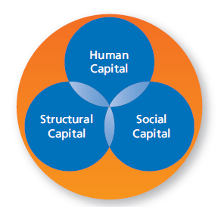
Types of Intellectual Capital
Structural capital is hard to organize and load into a KM system as it is strewn about the disk storage of firms, and
Structural capital exists in emails, contracts, manuals, meeting minutes. How to scrape this together and document it? BTW who does quality control?
The people that can create the structural capital are often too busy doing the work that generates the revenue.
The goal is to codify tacit human capital, recording it, and turning it into structural capital (org. knowledge)
Notes:
Three main types of intellectual capital reflect the ways human beings contribute intellectual power to an organization.
Human capital includes the competencies and knowledge possessed by the organization’s employees.
Social capital describes the number and quality of all the relationships an organization’s employees maintain, not just with one another but with clients, customers, suppliers, and prospective employees.
Structural capital includes the vast storehouse of knowledge about business processes, procedures, policies, contracts, transactions, patents, research, trade secrets, and other aspects of the organization that are (or can be) documented and stored electronically.

Slide 8
Types of tacit knowledge
How to tune a guitar
How to lay down a bass line (or drum rhythm) behind a guitar melody
That little dance move that makes you special
How to study for exams
How to fix the old Subaru when it starts to over-heat
How to use humor to diffuse a situation
How to remain calm when talking to ***
How to pitch/hit a curveball, the shimmy of a running back
How to build wealth
Geologist reading of the amount of gold/copper in the mine
???
Notes:
Intellectual capital (IC) includes all the intangible assets and resources of an enterprise that are not captured by conventional accounting reports but that still contribute to its value and help it achieve competitive advantage. The term arose to highlight the notion that intangible factors, such as the knowledge and expertise of employees, are assets just like other kinds of capital that a firm can apply to the production of goods and services and that help determine its market value. In many cases, it is the one asset that truly distinguishes a successful company from its competitors.

Slide 9
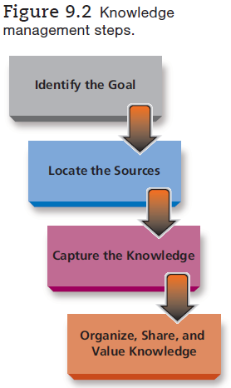
Knowledge Management
KM is a system to manage IP (intellectual property) and Intellectual capital
KM systems can help employees solve known problems, and to enrich the decision-making ability of employees
An example is to remind new consultants solving problems to ask the client why 7 times
Notes:
Knowledge management (KM) refers to a set of strategies and practices organizations use to become more systematic about managing intellectual capital. It is also a field of study in which researchers investigate all the roles these intangible assets play, how they contribute to competitive advantage and productivity, and how human behavior interacts with efforts to capture and share knowledge.
There are four steps in a knowledge management project. The first step is to identify the precise goal of the project, which can best be determined by studying the organization’s specific needs. A specific goal with clear aims is more likely to achieve success. The nature of the intellectual capital the organization hopes to capture also guides later steps in the process, such as the methods to capture it and technologies used.

Slide 10
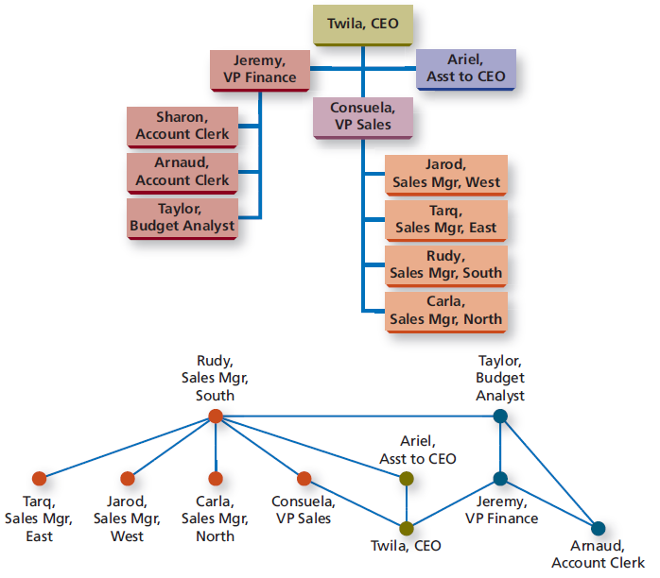
Locate Expert Sources
Expertise can be found using Social network analysis, rather than org. charts Communities of practice allow doctors, professionals to share knowledge (which is different than co-workers sharing knowledge)
Notes:
Once the organization has identified its goal, it needs to locate its sources of relevant knowledge. For projects focused on explicit knowledge and structural capital, much may already be in electronic form, though scattered about in different formats and media types. The tacit knowledge that employees may not even know they possess is more challenging to locate. Much of it is in the minds of the company’s experts. Locating these sources means finding the experts, wherever they may be working in the organization.
Expert location systems are one way to apply technology to finding knowledge. Many expert locator tools draw on directories, in which each employee maintains an online profile that includes details about education, projects, publications, or other hints of expertise. Expert location systems can crawl through databases, websites, email, project summaries, and other electronic documents to find relevant expertise.
Social network analysis maps and measures the strength of relationships between individuals and groups, represented as nodes in the network. The measures provide insights into network clusters and the roles different people play as leaders, influencers, or connecting bridges to other networks. These connections are apart from any individual’s actual position on a formal organizational chart. Experts who earn respect and recognition and who are also willing to provide assistance will show dense connections in such maps.

Slide 11
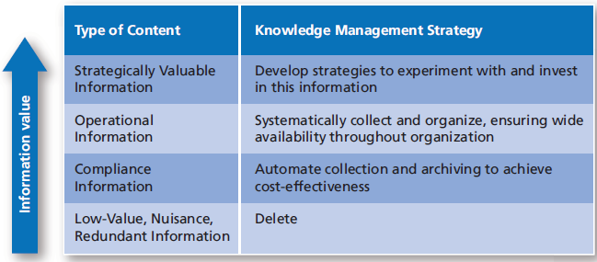
Organize, Share, and Value Knowledge
After you capture useful knowledge, you don’t discard it, it needs to be saved into the data warehouse, report repository, or enterprise content management system (ECM)
Notes:
The bits and pieces of knowledge that emerge from all these meeting notes, interviews, documents, and videos will be like a chaotic library with no searchable catalog until they are organized into some kind of repository.
An overarching approach to organizing intellectual capital is enterprise content management (ECM), which is designed to help organizations gain control over all kinds of content that might be in the form of documents,
videos, web pages, social media posts, or images and then manage changes, updates, or archiving. The software to manage enterprise content may come in the form of a master suite with a variety of integrated capabilities, or as various content services targeting specific needs.
Document management systems may also include extensive content-management features, along with the tools to convert paper-based records into well-organized electronic libraries. Using optical character recognition (OCR), which reads typed text, the systems can quickly do much of their own indexing and tagging to process paper forms. The software reads specific zones to decipher document identifiers and shows the scanned form along with the fields the software has read, so human beings can verify the results.
Documents and other kinds of content are not always valuable or useful, and much that is captured should be edited or just tossed out. Valuating entries in a knowledge base created by employees is also an important
effort. Some organizations engage users to judge the value of entries, by using rating systems.

Slide 12
Can KM and Structural Knowledge help?
KM systems are great for training new employees (case studies, training vdo, etc.) KM systems are scalable.
Young people are often over-confident (a bias that can hurt decision-making, eg the stock market always goes up) or lack confidence
KM can be used to codify and document best practices, into standard operating procedures (SOP’s) which can (like analytics) be used to check rookie over confidence and encourage others that their DM instincts were correct
Structural knowledge can be codified into scripts, checklists (FAA), best practices (training programs), workflows, forms to bring new employees up to speed quickly
KM systems can give low-skilled customer service reps the knowledge needed to diagnose and fix customer problems

Slide 13
Different workforces?
When talking about technology to support a workforce it is important to remember there are different workforces
a) office workers (creatives, experts, knowledge workers, ‘paper-pushers’).
b) skilled technicians (electricians, HVAC, plumbers, machine operators, robotics technicians, repair specialists …people that install, upgrade and fix machinery)
Office workers rely on their wit and wisdom and work ethic to advance. There are more HR issues, and ‘personalities’
Skilled technicians are typically ‘no nonsense’ professionals, they are more likely to support each other (within a company), share knowledge and seek it (because time is $$)

Slide 14
A new workforce?
In the past employees specialized in their roles, were part of a team, and were trained and cross-trained. It was common for employees to work 10+ years at the same company and employee loyalty was encouraged (for example celebrating births and birthdays).
Knowledge management was easier as there was less turnover. There may also have been more pride in a job well done, so employees embraced continuous improvement
In the current economy, employees move around more (voluntarily such as fleeing cities, or involuntarily being treated as project workers)
Due to higher turnover, and globalization, both capturing knowledge and ‘routinizing’ (dumbing down) jobs is common

Slide 15
Why is KM important?
Technology-based innovation makes work processes more complex. Competition is also higher due to globalization. Therefore employees need more guidance (recorded best practices, training programs, and technical support)
Harnessing the intelligence of an organization allows it to live and breath inspiration into new generations of rookies
Miami Heat Culture (7:10) will live far after Pat Riley retires (discipline, direction, structure, defense, compete)
KM systems are scalable, mentoring is not.
KM systems allow a company to survive when experts depart

Slide 16
Human influence
Employees may not want to share their trade secrets, or knowledge because it is their competitive advantage and reason for employment. (M-1)
Older employees often have a strong self-preservation motivation (due to increased responsibility) and are therefore unlikely to share their expertise
Young employees often don’t want advice from older employees and prefer to self-learn from Google or KM systems
???

Slide 17
Will KM project work?
Olympics basketball team?
FIBA Country team?
Factory manufacturing vacuum cleaners
Factory manufacturing Tesla’s (do robots share knowledge with each other and with humans?)
Landscaping company?
Advertising agency?
Law firm - Legal services agency?

Slide 18
Larger picture?
Processes that can be routinized can be documented well
Routinized processes can be off-shored or robotized
Firms need to lower costs of production at all times, not because they want to but because they have to. Competition is fierce, and often the competitor has 1/3 the labor costs (thanks globalization).
It used to be common to promote the expert to management, so that they are responsible for a work team and therefore freely share their insight and tacit knowledge

Slide 19
Larger picture?
With work often more project oriented and short term, expertise is hired (perhaps consultants) or it walks out the back door. (itemized invoice)
Does the worker have more or less power (ie job security) when a KM system is available?
A) more power because they can seek counsel and learn about processes, and receive checklists (ex: how to prepare a budget)
B) less power because when the expertise is documented you can replace the human more easily. Also when problem-solving is routinized, wages cannot rise

Slide 20
Larger picture?
What would the UAW say about KM?
If your firm builds a KM system will you use it?
Depends on the job
Some jobs need KM systems (ie repair techs, purchasing experts/buyers, machine operator, etc. ???)
Depends on if knowledge becomes stale or useless when processes change
If you are the new supervisor of people twice your age, how will you encourage them to
a) use the KM system (Pride = I know what I am doing!)
b) contribute to the KM system

Slide 21
Random thoughts on gaining knowledge
Its hard to gain knowledge when you attention span is puny.
Gain knowledge in different modes (video, books, experience, talking, podcast, observing, etc.) relieves fatigue
You have to be relentless to pursue elusive knowledge
Practice asking questions
Knowledge is often gained by rough experiences (ie being passed over for a promotion)
Tacit knowledge learned from an experienced employee
Project debriefing sessions are touted but often neglected

Slide 22
Random thoughts on gaining knowledge
Knowledge is often learned through mistakes and failures, these are often covered up and employees re-assigned elsewhere.
How can this hard-earned knowledge be documented?

Slide 23
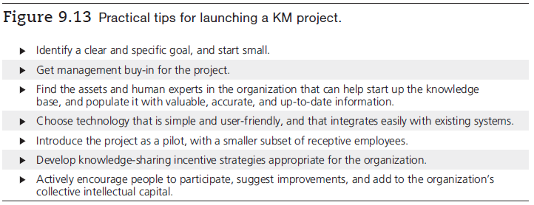
Practical Tips
Notes:
After years of lessons learned, practical tips have emerged that will help projects get off to a solid footing and avoid mistakes of the past, including:
Identify a clear and specific goal, and start small.
Get management buy-in for the project.
Find the assets and human experts in the organization that can help start up the knowledge base, and populate it with valuable, accurate, and up-to-date information.
Choose technology that is simple and user-friendly, and that integrates easily with existing systems.
Introduce the project as a pilot, with a smaller subset of receptive employees.
Develop knowledge sharing incentive strategies appropriate for the organization.
Actively encourage people to participate, suggest improvements, and add to the organization’s collective intellectual capital.

