Slide 1
Sharing your Ideas
Lewis County MFP Training
May 6, 2021

Slide 2
Consumer Behavior
Asking consumers to change, replace or learn new methods of preserving food.
Old habits sometimes die hard!
Be prepared for them not to accept or like your recommendations
HOWEVER:
  Until the food is consumed, there is a chance that you can influence the safe preservation methods or to decide to eat or not eat a certain food.

Slide 3

Stages of Change
Pre contemplation – Not Ready
Contemplation – Getting Ready
Preparation - Ready
Action – Made Changes
Maintenance – Habit
Notes:
Pre-contemplation: unaware of the need to change, and have no plan to make the changes
Contemplation: beginning to understand there is a problem, recognize they may need to change, and start to look at the pros and cons of their continued action.
Preparation: ready to tak action in the immediate future and make begin taking small steps towards change
Action: have made the changes to the practice or modified their behavior
Maintenance: people sustain the practice changes and coninue with the behavior from here forward

Slide 4
Resistence- Argumentative
Remind them of:
  Health and Safety aspects of the recommendations
  They are free to make their own choices
  You are providing evidence based and researched information that assures the safety of the product.
  "I am sorry you don't like my recommendations, but they are based on research that assures the food is safe and healthy for you and your family"
  "We recommend that you follow these evedence based recommendations, but it is your decision ultimately on what risk you and your family are willing to take."

Slide 5
Who are you serving?
Caution of potential risks when serving to certain individuals
Accepting risks for oneself is one thing....
Do they want to pass that risk on to others they may be serving or giving the food item to.
When giving food include: processing method, time and preparation/heating recommendations
Family
Seniors
Pregnant woman
Young child
Immino Compromised

Slide 6

Giving Advice …. getting started
Share what you know
1
From what you learned
What you have experienced
Don't Guess – use references
Refer when you don't know
2
No one has all the answers
Be confident
3
Truse yourself
Be sympathetic
4
Be understanding
Give rassurance for their health and safety
Speak in confident tone
Share what resources you used
Contact another MFP or Extension professional

Slide 7
Professionalism
Be friendly and business like
Identify yourself as a WSU Extension volunteer
Smile when you speak
Avoid saying "you can't do tht" or "you HAVE to"
NEVER GUESS – use reference materials
Personal experieces only if they support a recommendation or help them understand the importance
Be firm, don't let them ask you to approve their methods

Slide 8
Where to start...
Acknowledge all questions are legitimate questions
There are no 'stupid' questions
Be cheerful and accpting
Be prepared to take notes of the conversation and questions asked.
Ask open ended questions and let them tell the story
Be patient and listen
Ask questions when there are gaps, but not fill in the gaps for them.
Offer to call them back if you need to do research or call another MFP

Slide 9
Become a detective
Get enough information to be able to determine what kind of question it is.
Which category does the question fall into:
Quality
Safety
Procedure
If more than one category, answer quality first, followed by safety and procedures

Slide 10
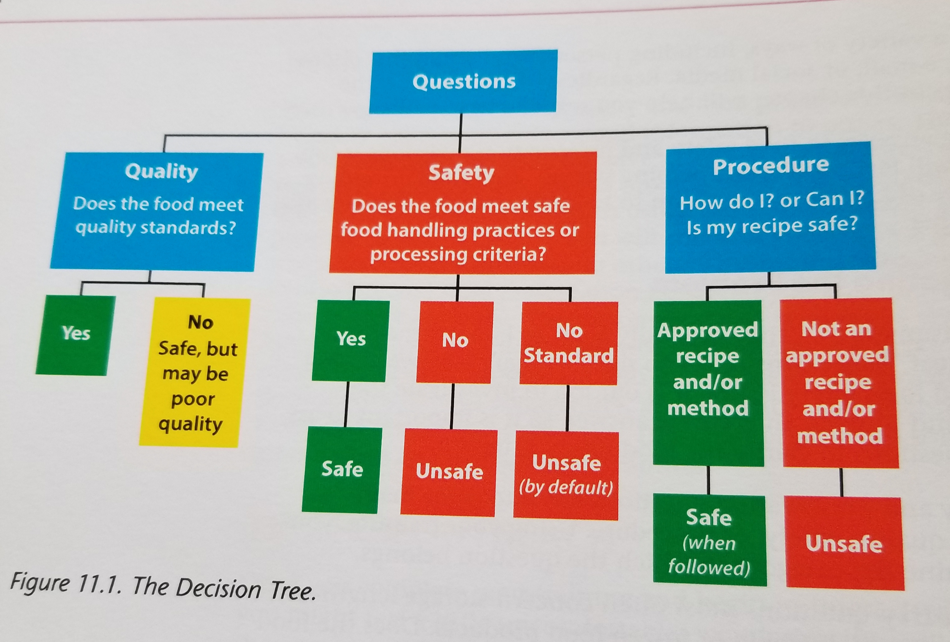

Slide 11
Suggested questions:
Describe what you did?
When did you do it?
How did you process it – describe the process
How has it been stored up to this point?
What is the source of the recipe or information?
When did you have your pressure gauge tested last?
Other?

Slide 12
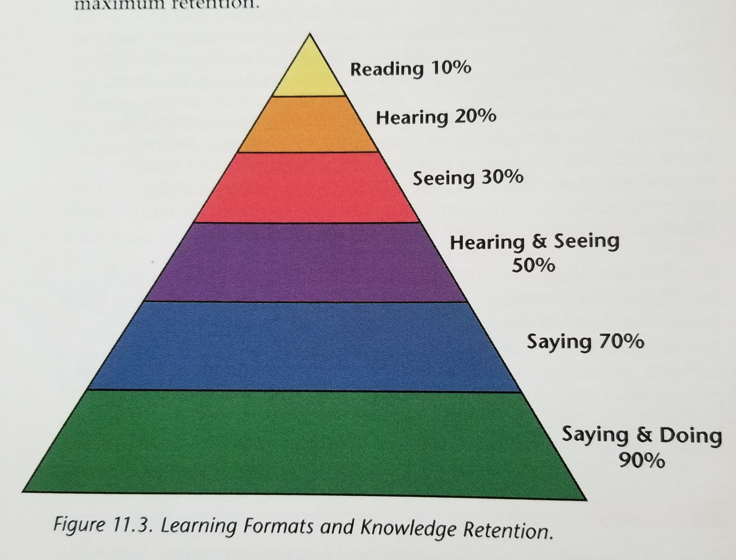
How do people reatin information
If you hear about a thing,
  You soon forget it.
If you see it done,
  You'll remember half.
If you do it yourself,
  You'll remember all of it for only then is it a part of you

Slide 13
Evaluating Resources
What is the source of the recipe or procedures?
Is there research behind it and where from?
Do they have references to more information?
Do they demonstrate food safety principles?
  Washing hands, keeping area clean, etc
Is it entertaining or educational or both?
Are there missing things?
Does it make assumptions on your knowledge?

Slide 14

Let’s look at a couple and evaluate

Slide 15
Volunteer Activities in Lewis County
Gauge clinics
Phone Clinics
Classes
Newsletters
Facebook – WSU one
Website – WSU one

Slide 16
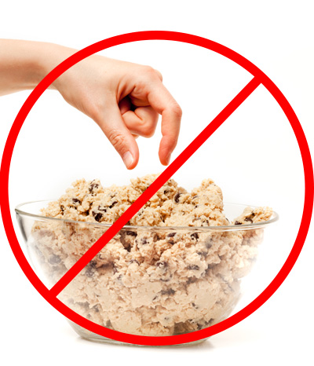
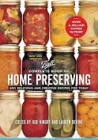

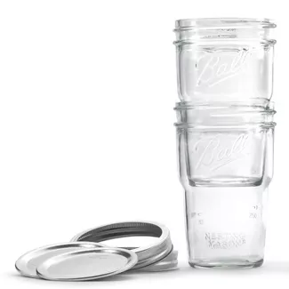
Updates/News
Flour – Avoid eating products with raw flour – Salmonella!!!
  fyi,.extension.wisc.edu – Before you Bite
New Ball Complete Guide to Canning – May 1, 2020
  Changed recommended use of fresh lemon juice to bottled lemon juice
Testing Electric Pressure Cookers – research papers
  Research showing why not to be used as a canner
New Ball Nesting Jars

Slide 17
Resources
Classes & Updates
  OSU MFP updates
    May 11 – 2pm; June 16 1pm; July21 1pm; August 18 1pm
  Jackson County Oregon - Food Preservation 101 – https://beav.es/3qi
  Lane County Master Food Preservers – MFP Mondays
  University of Idaho - https://uidaho.co1.qualtrics.com/jfe/form/SV_5yID4t34MwDEuCG
Facebook
  Home Food Preservers
  OSU Extension Service Food Preservation
  Master Food Preservers - Jackson County Oregon
  Lane County Master Food Preservers – MFP Mondays
Websites
  NCHFP
  University of Wisconsin
YouTube
  Thrifty Chic

Slide 18
Lab Experiments
Jams/Jellies using Pamona’s pectin
Pie Filling – 25-30 minutes
Vegetable Soup mixture – pints 60 minutes
Pickled vegetable using pasteurization method – 30 minutes

