Slide 1
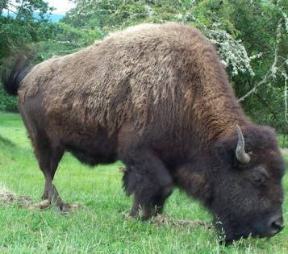
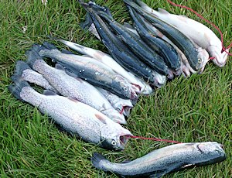
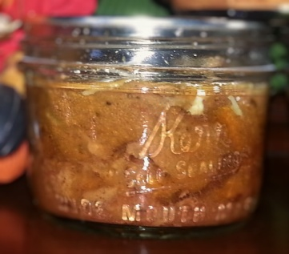
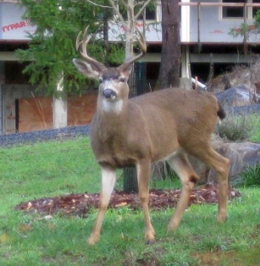
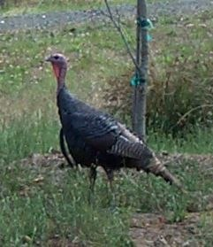
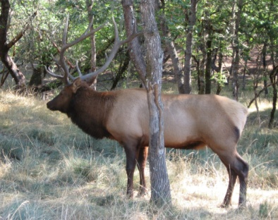
How to Preserve Meat, Fish and Poultry
Washington State University
Terri Emrich
2024
FOOD SAFETY & PRESERVATION

Slide 2

Preserving Your Meats in a variety of ways…..
Freezing
Smoked meat or fish
Jerky
Pressure Canning
Notes:
These slides are not finished, modify, change as needed but make sure all the ADVERTISED subjects are covered as in the headers in the slides. Of course there are not enough blank slides added for your presentation so build away! Please send Sandy and I the final copy as Sandy does want to approve it before you use it.

Slide 3
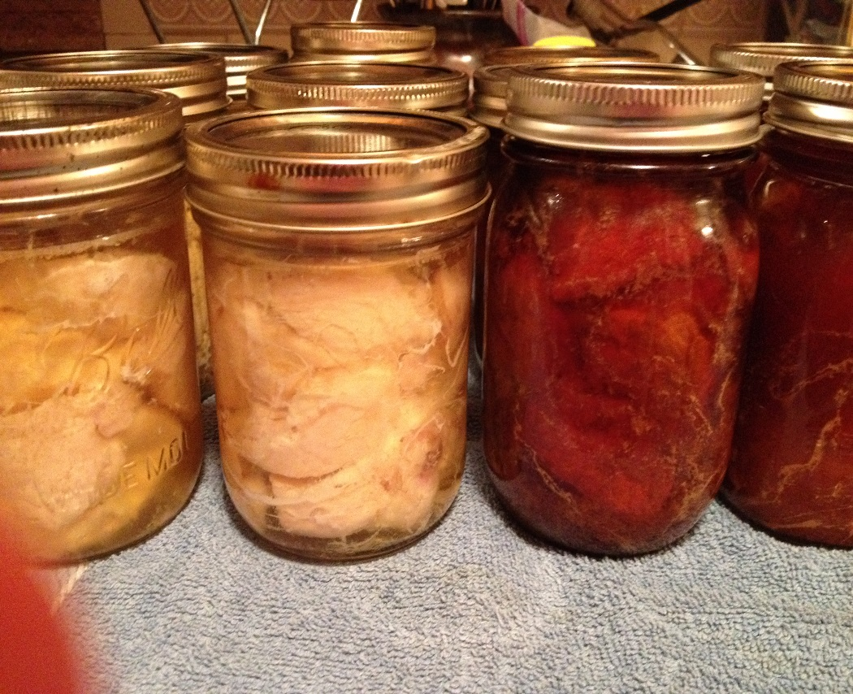
Welcome to Preserving Meat, Poultry and Seafood!!
Today’s class is going to cover an overview of a variety of topics related to preserving meats for best quality and safety for home consumption.
If you feel you need more information about specific processes, please see instructor at the end of class ☺ !
Notes:
Is this slide needed…too many words, these would be the words I would put in notes for teacher to say. If you want to list what you are going to cover that would be good, but that is on the first slide. So maybe these are notes for the first slide?

Slide 4
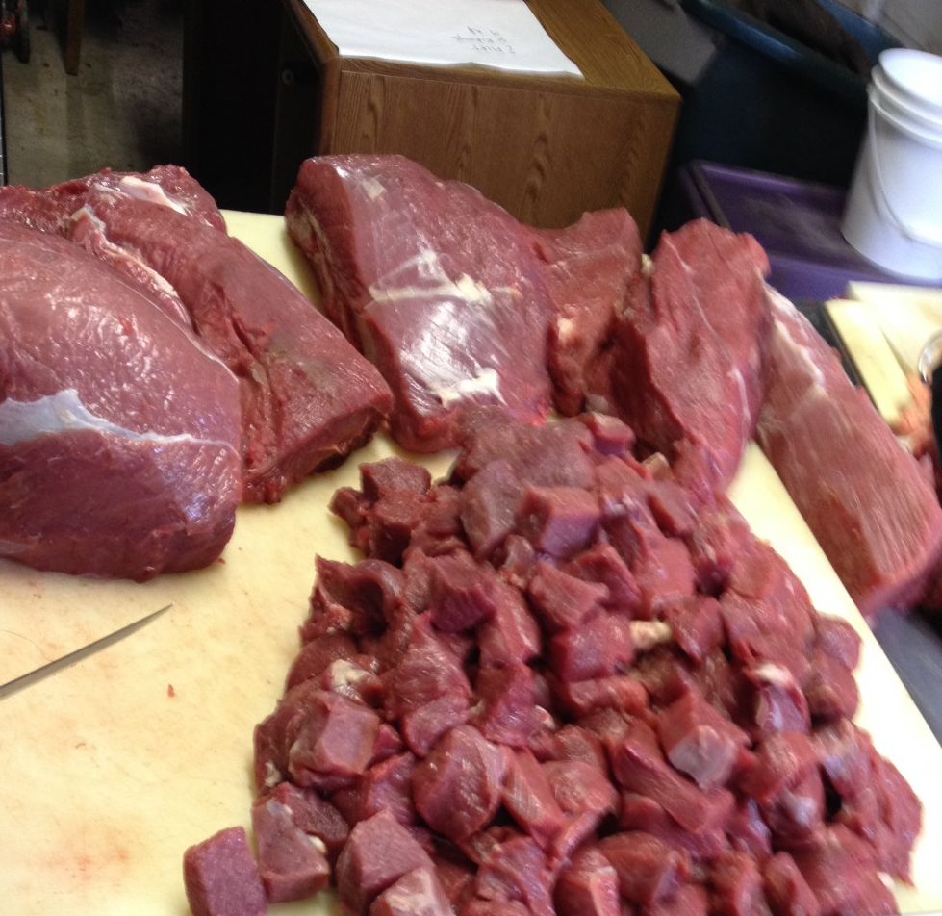
Food Safety Considerations
For Meats

Slide 5
Handling your raw food product:
It is important to know that meat, poultry and fish have been safely handled throughout processing.
Fish and shellfish are the most perishable of all raw foods, and require careful handling to maintain safety and quality.
Meat starts to deteriorate as soon as it is harvested, it’s imperative to follow safe handling procedures.
Quality WILL NOT improve with processing.
Notes:
Here are some notes for this slide. Add or whatever you need……
I wouldn’t mix the statement of longer processing time here when you are talking about handling the product.

Slide 6
Potential Foodborne Illnesses
All meat products have the potential to cause food borne illness.
You must handle with care to assure you are eliminating risk of unsafe foods.
Bacteria
  Salmonella
  E.Coli
  Listeria
  Botulism
Parasites

Slide 7
Handling the Raw food product:
Handling raw meat or fish can cause spread of food poisoning bacteria.
Use specific knives, cutting boards, and equipment dedicated for raw meat or fish only.
Wash well with hot soapy water followed by sanitizing with bleach solution and air dry.
Wash hands well before touching anything else.
Take off apron or clothing.

Slide 8
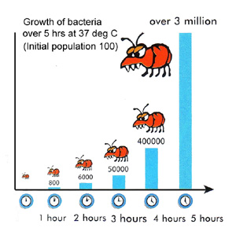
Handling Meats and Seafood
Temperature Danger Zone (TDZ)
40º -140º F
Above 40º F bacteria can double every 20 minutes
Freezing does not kill bacteria
Notes:
Freezing puts the bacteria to sleep, and when back to temps above 40 degrees will begin to multiply again.
The most dangerous temperatures are between 70 and 120 degrees.
Enzymes in fish will continue to work while frozen, just slower.

Slide 9
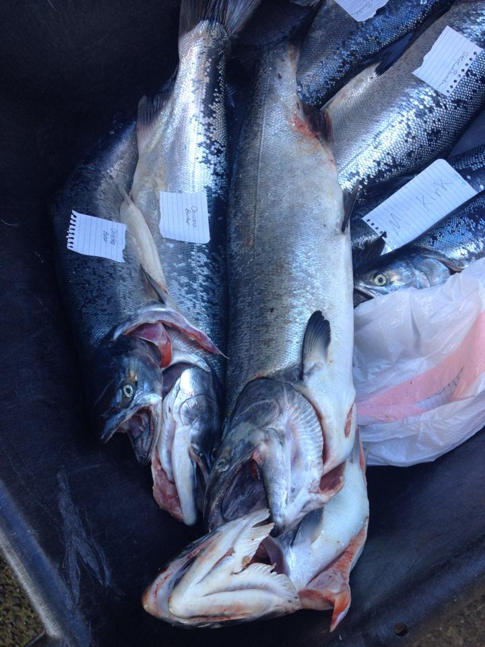
Freezing Your Meats

Slide 10
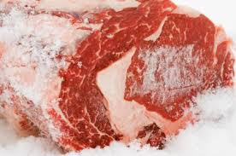
How Safe if Freezing?
Food will be
as safe to eat
when thawed as it
was just before
freezing (if thawed
correctly).

Slide 11
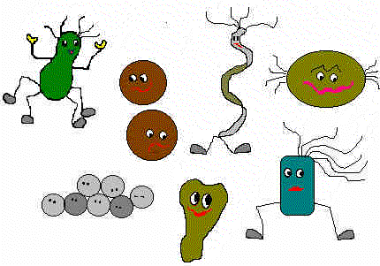
Why So Safe?
Microbial growth (pathogens and spoilage bacteria) stops at 28°F.
Chemical changes occur at a very reduced rate.

Slide 12
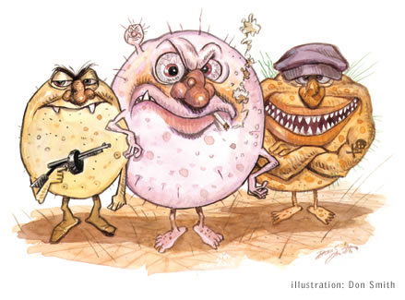
Safety of Frozen Foods
Freezing does destroy some bacteria and parasites.
Because all organisms are not destroyed, good food handling skills are needed to control bacterial during thawing and once thawed.

Slide 13
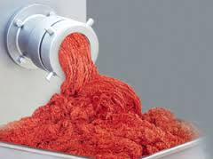
Freezing Meat, Poultry and Seafood
Process Meat to freeze while fresh.
Portion into meal sizes.
Freezer needs to be 0⁰ F or below.
Frost free freezers are higher temperature.
Consider freezer temperature when considering packaging.
Ground Meats need to be frozen immediately.

Slide 14
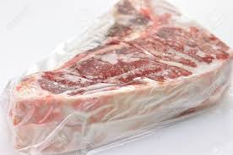
Freezing Meat Packaging
Choose appropriate packaging for your meats
  Heavy Duty freezer wrap
  Aluminum Foil
  Plastic Wrap
  Plastic Freezer Bags
Double layer wrapped items in freezer plastic bags for additional protection.
Best quality when consumed within a year.

Slide 15
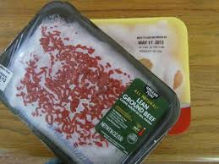
Unsuitable Packaging for Freezing
Those that are not Moisture-vapor proof enough
Waxed Paper (Waxed Butcher
paper is okay)
Paper or Milk Cartons
Rigid cartons with cracks or
poor fitting lids
Re-use of plastic dairy or meat containers
Any containers labelled for ‘storage’ vs ‘freezing’

Slide 16
Freezing Meat, Seafood and Poultry
Freeze only the amount your freezer can freeze in 24 hours.
  Utilize sheet pan method, or shallow layer
  Place in single layers until frozen
  2-3 lbs. per cubic ft. at a time, overloading will slow freezing time
  Remember slower freezing time makes larger ice crystals
Notes:
To kill parasites in fish, is that the same for wild game and birds?

Slide 17
Freezer Containers and Wraps
Airtight containers
Moisture proof containers
Kinds of wrap for meats
Seafood…DON’T put in milk cartons or blocks of ice.
Be sure to glaze the fish to prevent air from drying out seafood.
Freezing seafood whole does not stop enzymes, tissues may soften, reducing quality.
Notes:
Describe a little more..just ideas on this slide…may need to expand to containers/wraps for various kinds of wild game, birds and seafood

Slide 18
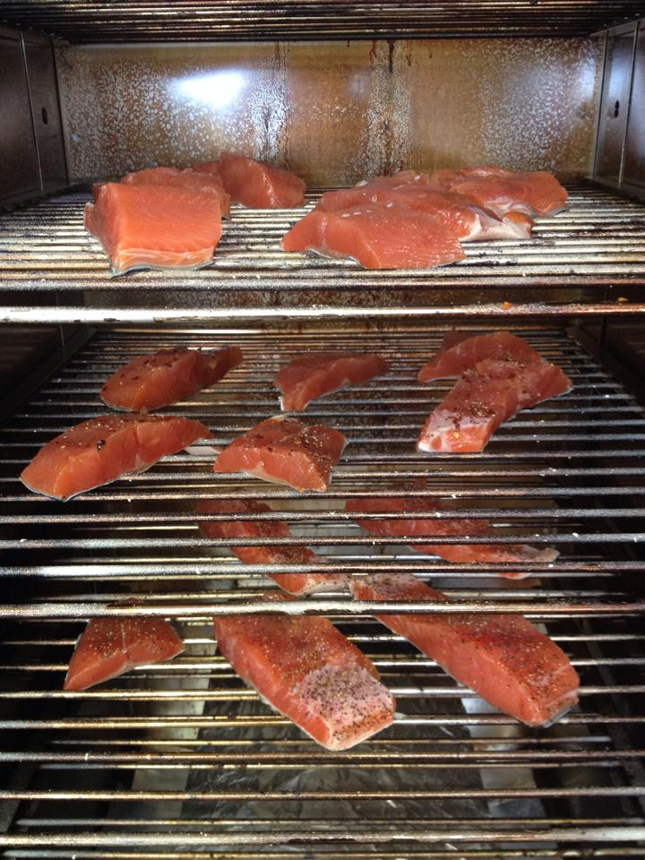
Smoking Your Meats for
Added Flavor

Slide 19
Smoking Meat, Seafood and Poultry
Smoking meats is NOT a preservation method, but a flavor enhancing method.
Follow Approved recipes for smoking
  Can be found on extension websites
Always preserve your smoked meats by freezing, canning, or refrigerating for the recommended amount of time.
Smoked meats are not shelf stable.

Slide 20
Smoking Large Cuts (Beef/Pork)
Flavor can be added by smoking according to tested recipes.
Large pieces of meat can be brined or rubbed with seasoning.
Smoke between 225º-300º F for safety.
Internal final temperature needs to be 165ºF
Used approved meat thermometers.

Slide 21
Smoking Big Game
Flavor can be added by smoking according to tested recipes.
Large pieces of meat can be brined or rubbed with seasoning.
Smoke between 225º-300º F for safety.
Internal final temperature needs to be 165ºF
Used approved meat thermometers.

Slide 22
Smoking Game Birds
Use approved recipes
Fowl can be brined with salt and sugar
Follow heating and smoking instructions to get proper ratio of heat and smoke.
Final Internal Temperature must be 165º F
Refrigerate or Freeze for preserving

Slide 23
Smoking Fish and Seafood
Start with fresh fish, cleaned of all blood, excess scales, etc.
Keep cold and cut fish into pieces according to desired final size.
Brine fish in approved brine solution
  1 cup salt to 7 cups water is acceptable for 2-3 lbs fish.
Small fish can brine for 30 minutes, while 2-3” chunks will take 2 hrs.

Slide 24
Smoking Fish
Rinse Fish after brining and allow to air dry for one hour to form a pellicle (shiny tacky surface).
Smoke Fish for up to 2 hrs at 90ºF
Increase heat until fish is minimum 150ºF (160ºF preferred) and holds for 30 minutes.
Your smoker should reach temp for 200º-225ºF to accomplish this, otherwise you can use oven at that temp within 2 hours of smoking fish.
Little Chief smoker doesn’t reliably heat enough.
Notes:
160 and not confuse them with two temperatures. Check the publication for the official temperature.
The making sure the smoker is the right temp is a good point. How do they know that? Internal thermometer?
Good reminder that the little chief doesn’t always reach the correct temps.

Slide 25
Smoking Fish Considerations
Fully smoked Fish is not suitable for canning.
Smoking fish too long and dry isn’t safe for preserving the product, must be frozen.
Smoked fish should be refrigerated no longer than 3 weeks.
Follow approved recipes and methods for the variety of seafood you are smoking.

Slide 26
Smoking Fish for CANNING
Fish can be lightly smoked prior to canning process – not the same as regular smoking.
Follow brining instructions.
Smoke for up to 2 hours and remove.
Do NOT Taste, as product is not fully cooked at this stage.
Can use the 10% weight loss to tell when its ready for the canner.
Process as per approved canning instructions.

Slide 27
Smoking Poultry
Use approved recipes
Fowl can be brined with salt and sugar
Follow heating and smoking instructions to get proper ratio of heat and smoke.
Final Internal Temperature must be 165º F
Refrigerate or Freeze for preserving

Slide 28
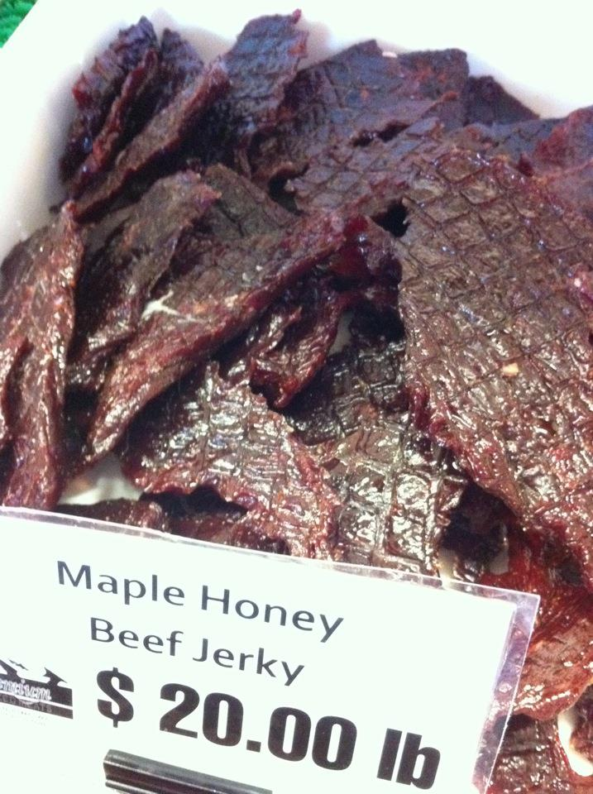
Making Jerky
Safely

Slide 29
Making Jerky at Home
Use approved methods/recipes for success.
Jerky must be properly produced in order to eliminate E. Coli and Salmonella pathogens.
Assume all meat carries potential bacteria that will cause illness when not properly handled.
Notes:
Add whatever you need or want.

Slide 30
Making Game Jerky at Home
Jerky must be properly produced in order to eliminate E.Coli and Salmonella pathogens.
Wild game meat should be frozen at 0⁰F for at least 30 days prior to making jerky in order to kill any possible parasites in the meat.
Assume all wild game carries potential bacteria that will cause illness when not properly handled.
Notes:
Add whatever you need or want.

Slide 31
Safe Jerky Preparation Methods
Two methods for destroying pathogens that could be in meat jerky:
  Post-drying in the oven to 160º F
  Precooking the meat during marinating to 160ºF
Follow instructions for recommended dryness of finished product.

Slide 32
Jerky Preparation – Equipment Selection
Use only approved methods of drying, including Electric Dehydrators or Oven Drying methods.
Electric Dehydrator should have variable heat, fan speed and air movement for effective operation.
Oven Drying must be done in an oven that will maintain 145º F to 155º F for proper drying process.

Slide 33
Making Jerky at Home
Post Drying Method
  Easiest way to produce safe jerky
  Immediately upon completion of dehydration, place meat strips on baking sheet.
  Heat strips at 275º F for 10 minutes
  Remove, cool and condition them prior to packaging.

Slide 34
Making Jerky at Home
Precooking Method #1
  Prepare Marinade and heat in a saucepan to boiling.
  Add a few meat strips and reheat to a simmer while stirring. Simmer 1 ½ to 2 minutes.
  Meat should reach 160ºF
  Remove strips and finish all strips in this method.
  Dehydrate as recipe directs

Slide 35
Making Jerky at Home
Precooking Method #2
  Preheat oven to 325ºF
  Place marinated or seasoned/flavored raw meat strips on baking sheet, not touching each other.
  Heat strips until they reach 160º F (165º F for poultry).
  The method requires use of a thin tipped thermometer.
  Begin drying process as recipe directs.

Slide 36
Making Jerky at Home
Drying Jerky
  Preheat oven or dehydrator to 145º F to 155º F
  Arrange strips on trays or baking racks.
  Dry jerky for a minimum of 4 hours or until properly dried.
  Precooked meat will dehydrate faster.
  Properly dried jerky will bend with slight splintering of the meat fibers.
  Condition jerky for best quality.

Slide 37
Storing Your Jerky
Properly dried jerky will last about 3 months in the refrigerator
May be placed into portion size freezer packaging and frozen for best quality.
Vacuum sealed packages still require freezing or refrigeration for the recommended amount of storage time.

Slide 38
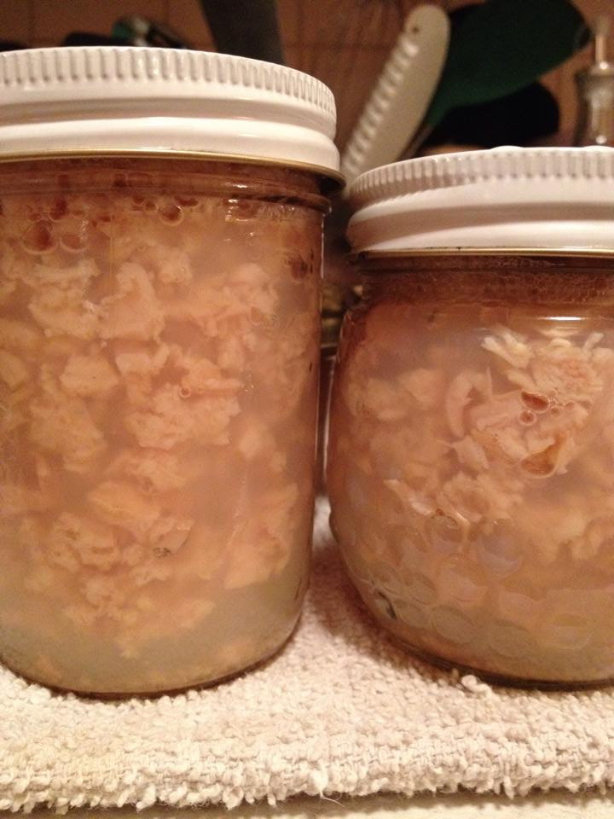
Pressure Canning
Meats, Poultry and Seafood

Slide 39
Why Pressure Can Meats?
Meat is a low acid food that harbors botulism spores which can cause foodborne illness if not properly processed
Boiling Water Bath canners only reach 212 degrees F and it is necessary to reach 240 degrees F in order to properly kill bacteria.
Pressure canners can get food to 240 degrees F at 10.5 lbs. pressure at sea level

Slide 40
PRESSURE CANNER PROCEDURES
Heat Pressure Canner
Warm Jars
Prepare food for jars
Pack jars
Place in pre-heated canner
Bring canner to boil
Close petcock
Raise to pressure
Set time
Cool & take jars out of canner

Slide 41
PACKING
Raw Pack
Raw food is placed in jar, covered with boiling water
Get less food in jar
Saves some time in preparation
Hot Pack
Food heated briefly, removes air, making easier to pack
More food in jar
Fewer jars needed

Slide 42
Methods of Canning Meats
Determine your desired finished product.
Can be packed raw or cooked, according to recipe
Can be ground, following recipes.
Trim any gristle, bruises, and fat from the meat before canning.
Meat can be frozen and properly thawed prior to canning if necessary.
Pack jars according to recipe and remove bubbles, wipe rims and add lids and rings, process.

Slide 43
What can be added to recipes safely?
Items prepared with untested recipes should NOT be canned; freeze these foods instead.
What can you add to a canning recipe without changing the safety/acceptability of that recipe?
  Bacon?
  Vegetables?
  Fresh Herbs?
  Dried Herbs?
  Fruits?
  Garlic?
  Chili Peppers?
  Oil-packed Sun Dried Tomatoes?

Slide 44
Pressure Canning
Items prepared with untested recipes should NOT be canned; freeze these foods instead.
What can you add to a canning recipe without changing the safety/acceptability of that recipe?
  Bacon? No
  Vegetables? No
  Fresh Herbs? No
  Dried Herbs? Yes
  Fruits? No
  Garlic? Dried Only
  Chili Peppers? Dried Only
  Oil-packed Sun Dried Tomatoes? No
Notes:
Great reminder slide

Slide 45
Field to Home Fish and Seafood
Try to keep seafood alive as long as possible
Remove entrails ASAP
Keep in ice chest or in ice cold water
Fish can be immediately frozen whole and bled and entrails removed when thawed….
However quality of the fish is compromised.
Notes:
When you freeze the fish whole with the entrails in the enzymes in them will continue to feed on the flesh of the fish. This will soften the meat around the gut. It reduces the quality of meat not preferred.

Slide 46
Canning Fish
Thoroughly bleed fish just as you would for cooking.
Soak in salt water or lemon juice before canning.
  Lemon juice prevents discoloration in light seafood
Cut into pieces that fit the jars.
Use ½ pint jars only.
Place seafood skin side in.

Slide 47
Pressure Canning Fish (PNW 194)
Fresh Fish may be canned in Pressure Canners only! Follow approved recipes!!
Pints or Half Pint size jars only to be used.
Keep Fish refrigerated until ready to use.
Pack jars with clean,3 ½” lengths, leaving 1 inch headspace. Add canning salt if desired.
Wipe rims and adjust lids
Pressure can for proper time and pressure. according to approved method/recipe. (adjust for altitude)

Slide 48
Pressure Canning Fish (PNW 194)
Salmon:
Glass-like crystals of magnesium ammonium phosphate sometimes form in canned salmon. These crystals usually dissolve when heated, and are perfectly safe to eat. There is no way for the home canner to prevent their formation.
Tuna:
May be canned either pre-cooked or raw. Pre-cooking removes most of the strong-flavored oils. The strong flavor of dark tuna flesh affects the delicate flavor of white flesh. Many people prefer not to can dark flesh. It may be used as pet food.
Notes:
Have fun and remember to send the final to Sandy and I : -)

Slide 49
Canning Smoked Seafoods
Lightly smoked salmon, trout and other fish may be safely canned. Safe processing times for canning other smoked seafood, such as oysters, have not been determined for home use. These products MUST BE frozen.
Use approved recipes and processing times specific to the fish you are canning.
Flavor your canned fish only after processing, when you are ready to eat it.
Notes:
I would split this slide.Firs discuss the smoking of salmon or tuna etc and how that is processed for a longer amount of time. And then discuss the preservation of the shellfish and that it needs to be frozen. To much information on this slide.

Slide 50
Canning Smoked Fish vs Fresh Fish
Smoked fish for canning must follow procedures for LIGHTLY smoking fish. Do not can fully smoked fish.
Must be canned immediately or refrigerated not more than one day before canning.
Must NOT be eaten or sampled prior to canning.
Smoked fish requires 110 minutes processing time.
Canning smoked fish will cause some moisture loss, change color and increase smoked flavor.

Slide 51
How to Preserve Game and Fish
Washington State University
2021
FOOD SAFETY & PRESERVATION

Slide 52
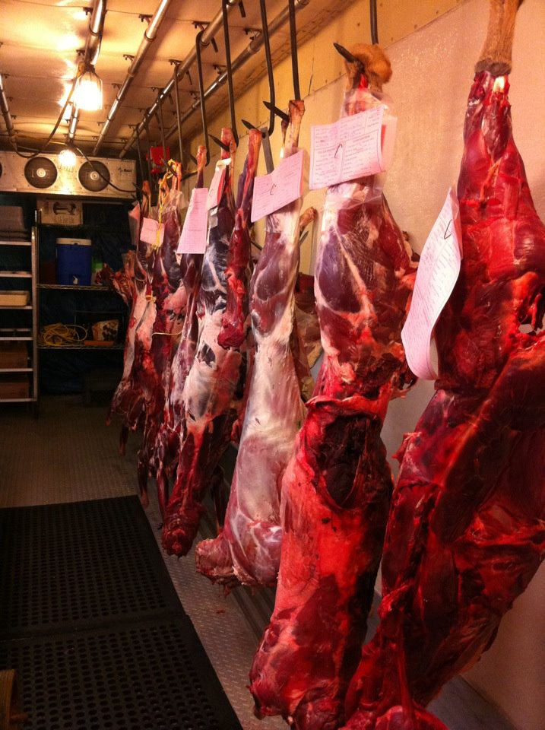
Welcome to Preserving Game and Fish!
Today’s class is going to cover an overview of a variety of topics related to preserving wild game for best quality and safety for home consumption.
If you feel you need more information about specific processes, please see instructor at the end of class ☺ !
Notes:
Is this slide needed…too many words, these would be the words I would put in notes for teacher to say. If you want to list what you are going to cover that would be good, but that is on the first slide. So maybe these are notes for the first slide?

Slide 53
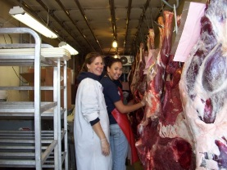
Food Safety Considerations
For Your Harvest

Slide 54
Handling your raw food product:
It is important to know that meat, wild game, poultry and fish have been safely handled throughout processing. Unsafe handling fan lead to contamination with food poisoning bacteria such as Salmonella, Listeria and Esherichia coli (E. coli).
Fish and shellfish are the most perishable of all raw foods, and require careful handling to maintain safety and quality. Fish and shellfish can be significant sources of food poisoning bacteria such as Clostridium botulinum, and require a LONGER PROCESSING TIME in a pressure canner than do other foods canned at home.
Notes:
Here are some notes for this slide.

Slide 55
Handling the Raw food product:
Handling raw meat or fish can cause spread of food poisoning bacteria.
Use specific knives, cutting boards, and equipment dedicated for raw meat or fish only.
Wash well with hot soapy water followed by sanitizing with bleach solution and air dry.
Wash hands well before touching anything else.
Take off apron or clothing.

Slide 56
Handling Meat in the Field
Be prepared to handle meat safely in the field.
Ice and / or ice chests
Water for hand washing and cleaning
Soap
Paper towels
Extra containers for rinsing/washing
Food Thermometers are recommended

Slide 57
Field to Home Large Game
IN THE FIELD :
Bleed Animal as soon as it is downed.
Dress Animal as soon as possible
  Remove hide to allow air access
  Remove entrails from cavity to chill
Hang carcass, quarter, or otherwise piece out.
Goal is to get meat temperature to 40⁰F or below within 5 hours.
Notes:
I’m not a hunter, so these questions may be obvious, but things you may want to mention. Not necessarily needed on the slide, just part of the discussion.
When hanging, is there a temperature requirement based on danger zones etc?
What happens if not dressed soon enough? What is soon enough?
Remind of handwashing at end of dressing, how difficult is that out in the field. Options out there?

Slide 58
Field to Home Large Game
SAFETY FIRST !
Know outside temperatures and react accordingly
  50º degrees vs 80º degrees
  Use ice in ice chests or pack cavities
  Quarter or piece out for faster chilling
Use Game bags (fabric) not tarps or plastic bags
  Allow air to circulate to the meat
  Keep flies and bees away

Slide 59
Field to Home Game Birds
Immediately remove entrails.
Birds can be placed into plastic bags and chilled.
Do not group in large quantities for better chilling.
Birds can be plucked warm or chilled.
  Pluck small amounts of feathers at a time to reduce tearing of skin.
Can use scalding method on fresh larger birds to loosen feathers.
Notes:
What does it men to not group large quanities for better chilling?

Slide 60
Scalding to assist plucking larger birds
Dip Game birds in hot water (145ºF) until feathers loosen to make feather removal easier.
It is not advised to scald birds which have been frozen, or held for several hours after harvest as this may result in tearing of skin and fatty tissues.
Notes:
This causes the tissues connecting the feathers to soften and will allow them to slip off easily.

Slide 61
Aging Wild Game
Aging is the process of holding the meat at
34º-37º F for 7-14 days.
Aging allows enzymes to breakdown proteins thus making meat more tender.
Never age the following animals:
  Animals improperly field dressed
  Animals stressed during hunt/extensively shot
  Animals under one year old

Slide 62
How to approach canning game (PNW 367)
Large game animals are canned like beef and small game animals and birds are canned like poultry. Follow directions for type of pack and preparation. For hot pack, wild game can benefit from tomato juice.
You may also soak strong-flavored wild meats for 1 hour in brine containing 1 Tablespoon salt per quart of cold water. Rinse. Remove large bones and prepare as directed for canning.
Notes:
Change whatever you need to on this slide, this is just a suggest to incorporate if you would like.

Slide 63
Pressure Canning Wild Game
Must use Pressure canner NOT water bath to reach 240⁰ F. internal temperature.
Have gauges checked yearly for safety.
Weighted gauge vs Dial Gauge and instructions
May do pints or quarts, follow approved methods.
Reusing commercial jars (mayo etc.) NOT recommended.
For processing times over 60 minutes, you must have 4 inches of water in the canner, not less.

Slide 64
Methods of Canning Wild Game
Determine your desired finished product.
Can be packed raw or cooked, according to recipe
Can be ground, following recipes.
Trim any gristle, bruises, and fat from the meat before canning.
Freeze meat and thaw safely before canning if you aren’t able to can within a few days of harvest.
Pack jars according to recipe and remove bubbles, wipe rims and add lids and rings, process.

Slide 65
Freezing Your Harvest

Slide 66
Freezing Wild Game
Process Meat to freeze while fresh.
Portion into meal sizes.
Freezer needs to be 0⁰ F or below.
Frost free freezers are higher temperature.
Consider freezer temperature when considering packaging.
Ground Meats need to be frozen immediately.

Slide 67
Freezing Game Packaging
Choose appropriate packaging for your game
  Heavy Duty freezer wrap
  Aluminum Foil
  Plastic Wrap
  Plastic Freezer Bags
Double layer wrapped items in freezer plastic bags for additional protection.
Best quality when consumed within a year.

Slide 68
Freezing Wild Game/Fish/Birds
To kill parasites – Freeze at or below 0ºF for 1 month. Use an approved thermometer to verify the temperature.
Freeze only the amount your freezer can freeze in 24 hours.
  Utilize sheet pan method, or shallow layer
  Place in single layers until frozen
Notes:
To kill parasites in fish, is that the same for wild game and birds?

Slide 69
Freezing Wild Game/Birds/Seafood
Freeze ground meat as soon as possible after grinding.
Grinding exposes more surface area to bacterial exposure.
Remove as much air as possible from packaging to prevent freezer burn.
Use frozen game within a year for best quality.

Slide 70
Freezer Containers and Wraps
Airtight containers
Moisture proof containers
Kinds of wrap for meats
Seafood…DON’T put in milk cartons or blocks of ice.
Be sure to glaze the fish to prevent air from drying out seafood.
Freezing seafood whole does not stop enzymes, tissues may soften, reducing quality.
Notes:
Describe a little more..just ideas on this slide…may need to expand to containers/wraps for various kinds of wild game, birds and seafood

Slide 71
How to approach canning game:
Large game animals are canned like beef and small game animals and birds are canned like poultry. Follow directions for type of pack and preparation. For hot pack, wild game will benefit from tomato juice.
You may also soak strong-flavored wild meats for 1 hour in brine containing 1 Tablespoon salt per quart of cold water. Rinse. Remove large bones and prepare as directed for canning.

Slide 72
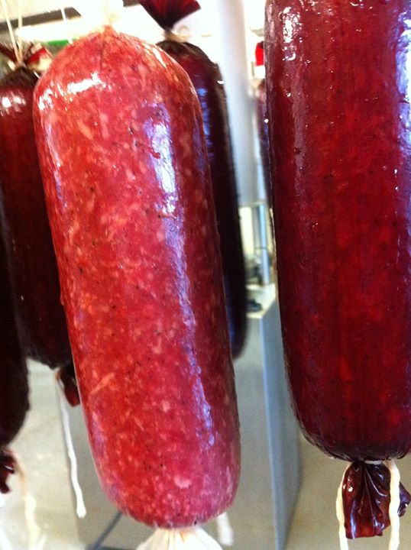
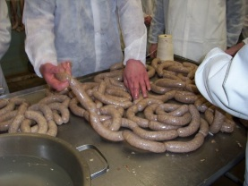
Fresh and Smoked Sausages from your Harvest

Slide 73
Making Game Sausage
Fresh sausage is uncooked, ground meats and spices.
Examples are
  Breakfast Sausage
  Italian Sausage
  Bratwurst
Cooked Sausages are meat, spices, and preservatives, that are normally in casings, and smoked/cooked prior to consumption.
Examples are:
  Summer Sausage
  Pepperoni
  Polish Sausage

Slide 74
Fresh Game Sausage
Fresh Ground Sausage requires some addition of fat to the lean game meat. 10-15% is normal.
Breakfast Sausage, Italian and other bulk flavors.
Single grind meat and fat using coarse grind.
Hand mix in seasonings thoroughly adding a small amount of water to help seasonings blend and sausage to hold together.
Package in ½ - 2# increments using proper freezing wrap methods.

Slide 75
Fresh Game Sausage
May use Beef fat, Pork Fat, or Pork shoulder as the fat component.
Must be consumed once refrigerated within 7 days, otherwise freeze immediately.
Can be bulk or can be stuffed into fresh casings.

Slide 76
Smoked Game Sausage
Equipment needed:
  Meat Grinder
  Sausage Stuffer
  Large food grade tubs/bowls for mixing or heavy duty mixer
  Casings (according to your final use)
  Smokehouse or Oven that can process the sausage to its final temps of 165º F
  Meat Thermometer

Slide 77
Ingredients Needed for Cooked Sausages
Meat – most any variety of game will make flavorful sausage. Freshness will always determine the quality of finished product. Meat should be frozen 30 days below 0º F to kill potential parasites.
Water
Salt
Sugars
Phosphates
Spices
Nitrite (Cure)

Slide 78
Nitrites and Sausage Making
Cooked Sausages required use of Nitrites to give shelf stability as well as good color and flavor.
Nitrites can be harmful when used in too high of quantity. The amount typically needed for small batch sausages can be as low as ½ tsp.
Its recommended that home processors use pre-blended commercial mixes.

Slide 79
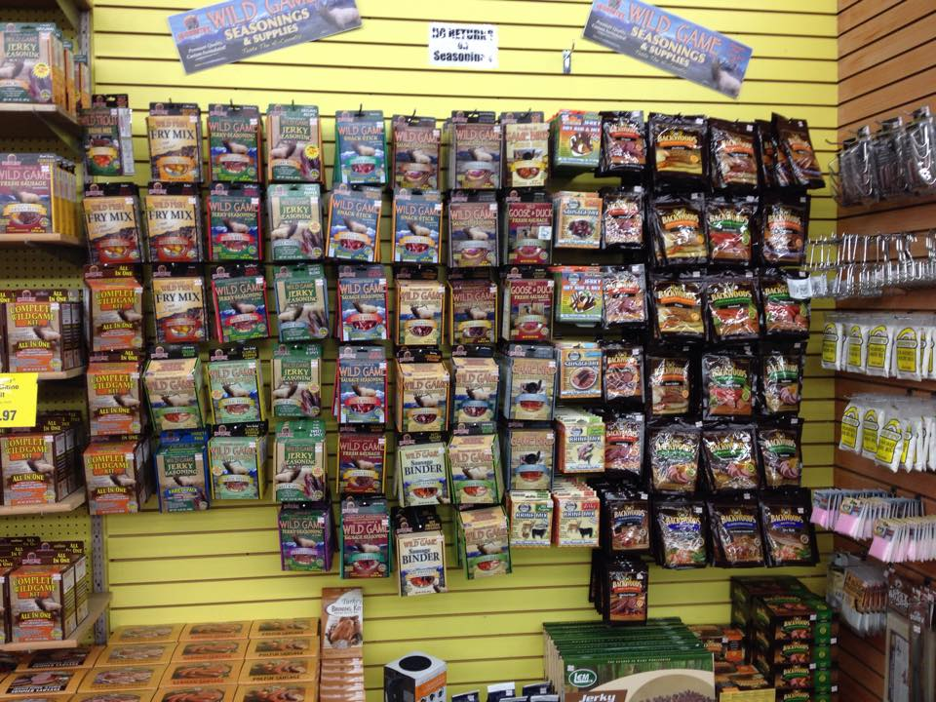
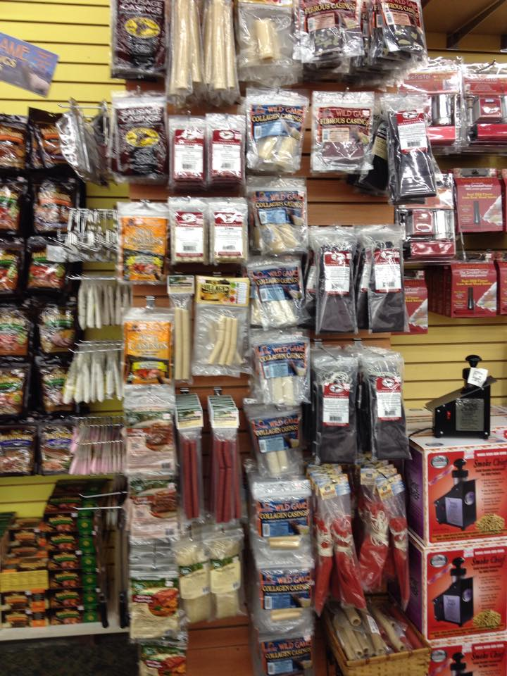
Products to help get started
There are a large variety of products commercially available to help you start making stuffed sausages.
Check out sporting goods stores, or also some meat processing supply websites.

Slide 80
Basic Procedures of Cooked Sausages
Start with approved recipe or mix, and follow directions closely.
Grind meat coarsely ½” plate once.
Add seasonings over meat, and hand mix it in, grind again with fine plate 3/16”.
Mix sausage for allotted amount of time (over mixing will affect sausage texture).
Stuff Sausage into casings.

Slide 81
Tips for Success in Sausage Making
Pay close attention to cleanliness. Keep work areas sanitized and clean all areas that raw meat has contacted. (1 Tbsp bleach to 1 Gallon water).
Use fresh ingredients, and for meat that has been frozen, do not thaw it out too much, you will lose weight.
Use an approved meat thermometer (thin tip is best) and pay close attention to final internal temp.
Cool as quickly as you can.

Slide 82
Lesson Review
Proper Procedures are critical!!
Use good food safety practices
Bring home a safe kill!
TDZ (Temperature Danger Zone) 40⁰-140⁰F
Wash hands and all equipment, towels and clothing when done working.
Smoking is not a preservation method.
Preserve by
  Freezing - Canning - Drying

Slide 83

This Photo by Unknown Author is licensed under CC BY-NC

