Slide 1
Pressure Canning Session 1 Sandy Brown Faculty Emeritus

Slide 2
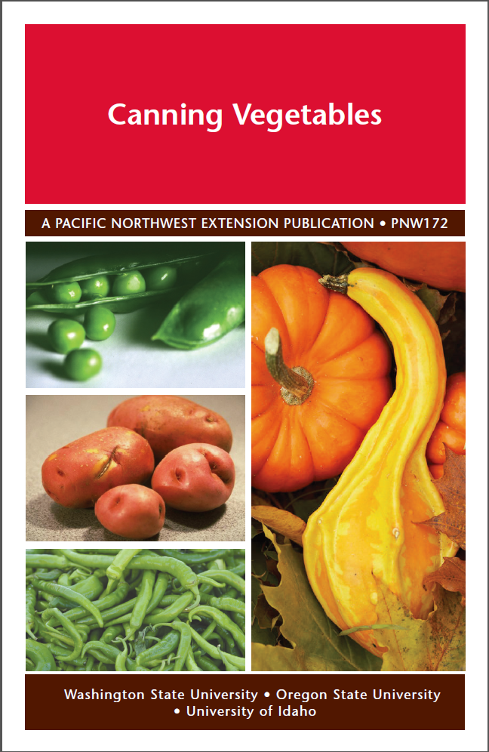
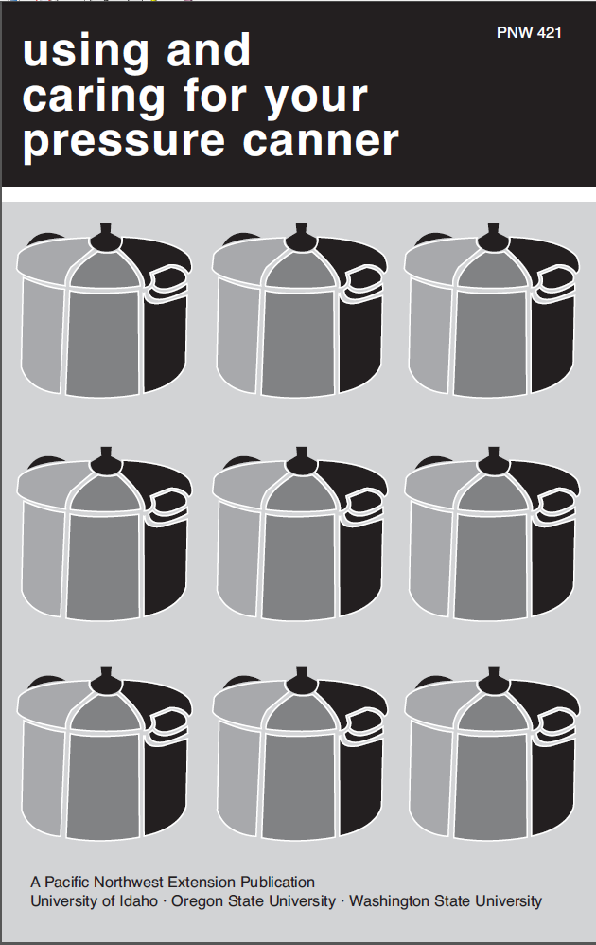

Slide 3
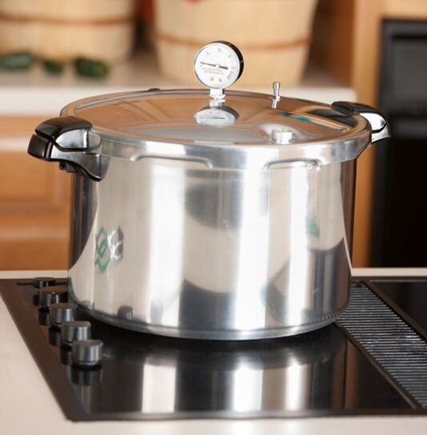
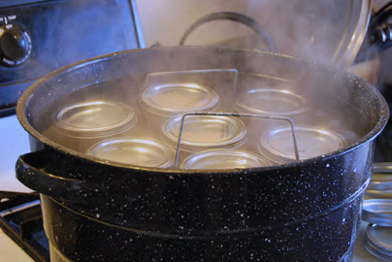
There are 2 acceptable methods for canning foods at home.
Pressure Canning for Low Acid Foods (higher than pH 4.6)
Pressure Canning for High Acid Foods (pH 4.6 and lower)

Slide 4

Clostridium Botulinum
Found in the soil
Washington and Alaska have the highest rates
Spores found on most fresh food
Vegetative cells become spores
Spores are resistant to heat, chemicals and stress
Spores germinate back to vegetative cells that produce a neurotoxin within 3-4 days in the correct environments
Moist food - temps between 40°F and 120°F
Low acid - <2% oxygen

Slide 5
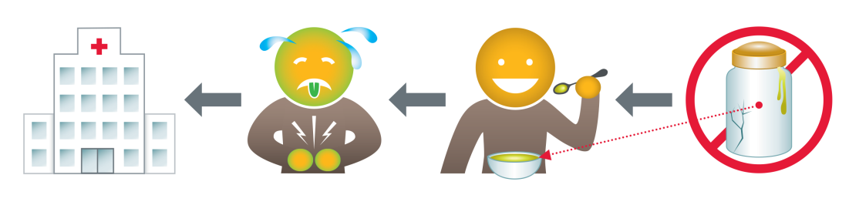
Botulism toxin is produced by a bacteria called Clostridium botulinum.
Moist, low-acid food
40°F to 120°F
Less than 2% oxygen
Botulism Spore
Very Heat Resistant
Botulism Vegetative Cell grows and produces toxin
Notes:
Botulism spores are on most fresh food surfaces. They are usually harmless because they multiply and produce toxin only when there is no oxygen available.
Botulism toxin is produced by bacteria called Clostridium botulinum.The bacteria and toxin can often be found in home canned foods that have not been properly prepared, unrefrigerated homemade foods such as salsa, garlic and herbs in oil, and traditionally prepared salted or fermented seafood.Very small amounts, even a small taste,can cause severe illness and death.
Illness from botulism toxin can happen within a few hours or up to 10 days after eating food containing Clostridium botulinum.Symptoms of illness can include double or blurred vision, drooping eyelids, slurred speech, difficulty swallowing, dry mouth, and increasing muscle weakness usually affecting the upper part of the body, but then moves down to the legs. The toxin can paralyze breathing muscles which can cause death. If you have any of these symptoms, especially after eating home-canned food, go to a hospital immediately.
Symptoms
Difficulty swallowing
Speech
Breathing issues
Double vision
Death
Costs for each case is $1,681,000
Medical, pain, sufferings and functional disability

Slide 6
Preventing the growth of Botulism
Temperatures at 240°F or 10.5 PSI
Time needed to destroy bacteria ranges from 20 – 160 minutes.
Exact time depends on:
Food being canned
The temperature of the food in the jar
Size of the jar

Slide 7
MOST TOXIC SUBSTANCE KNOWN!!!
1 gram of crystalline botulism toxin can kill more than 1 million people if dispersed and inhaled evenly.
1 paper clip weighs 1 gram!

Slide 8
Botulism
Symptoms
Difficulty swallowing
Speech
Breathing issues
Double vision
Death
Costs for each case is $1,681,000
Medical, pain, sufferings and functional disability

Slide 9
Listen to a woman who experienced Botulism poisoning!

Slide 10

THOUGHTS?

Slide 11
Time needed to destroy harmful bacteria ranges from 20-120 minutes
Food
Size of jar
Temperature of food in jar
Notes:
Processing times are scientifically determined. Several factors influence the length of time home-canned products must be processed. Therefore, it is extremely important to follow a tested recipe for canning tomatoes and tomato products (such as spaghetti sauce). Changes in the amount or type of ingredients and method of preparation can influence the processing conditions needed to guarantee safety. For example, adding vegetables to a tomato sauce recipe can change acidity, and overcooking can change consistency and density. Products that are not prepared according to the research-based instructions in this publication should be frozen.

Slide 12
The boiling point of water decreases as altitude increases. Make sure to know your altitude and use proper processing time or canner pressure.
USDA Complete Guide to Home Canning Page 1-10

Slide 13
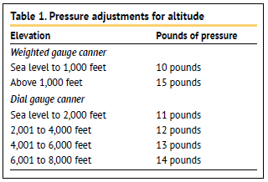
Pressure adjustments must be made for altitude for pressure canning.
See page 10 of PNW 172 Canning Vegetables

Slide 14
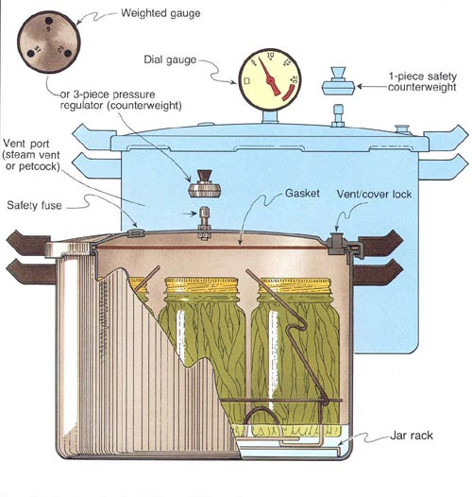
PARTS OF A PRESSURE CANNER
Kettle with a rack
Lid
Lid gaskets
Vent port
Safety Plug
Pressure Gauge
USDA Complete Guide to Home Canning Page 1-19

Slide 15
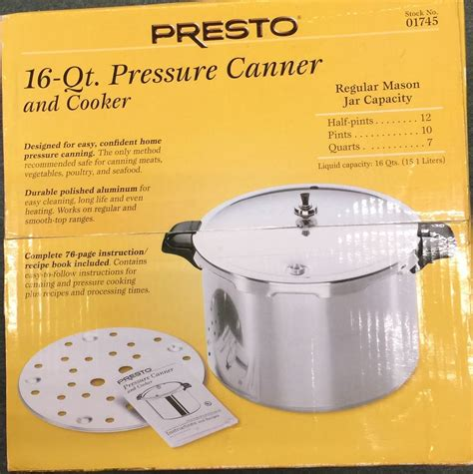
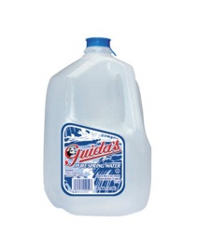
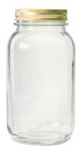
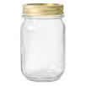
Pressure canners are sized by volume of water they can hold
4 gallons water
OR
7 quart jars
OR
10 pint jars

Slide 16
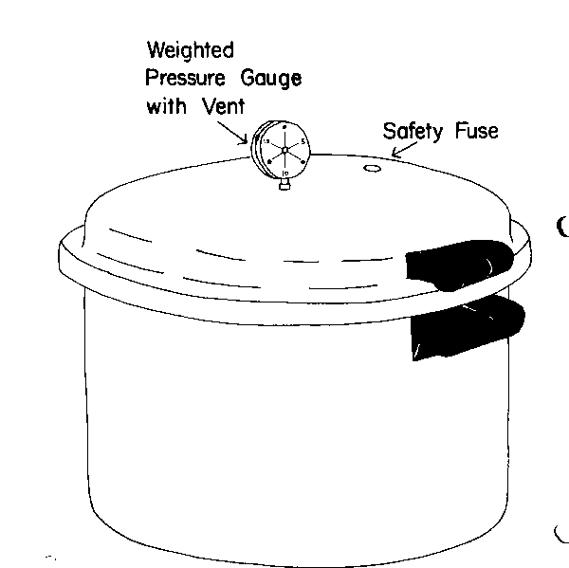
TYPES OF PRESSURE CANNERS
Pressure canner with self seal gasket

Slide 17
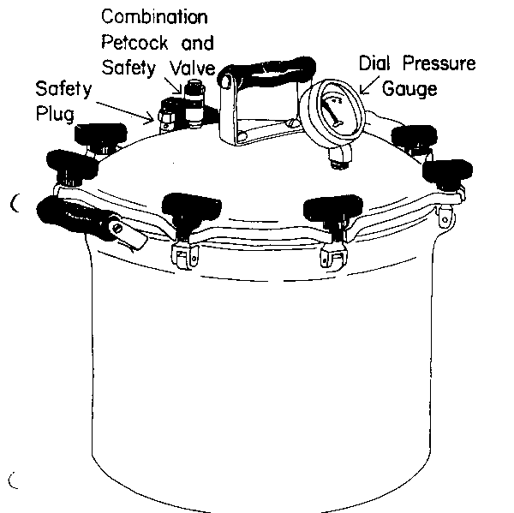
TYPES OF PRESSURE CANNERS, cont.
Pressure Canner with Thumb-Nut Closure

Slide 18
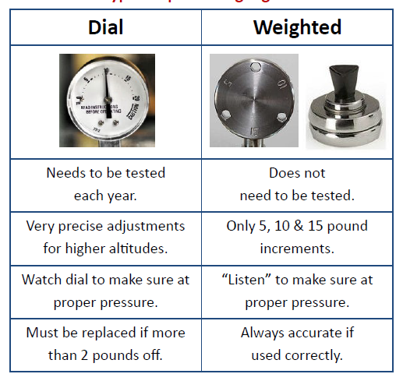
There are 2 types of pressure canner gauges.

Slide 19
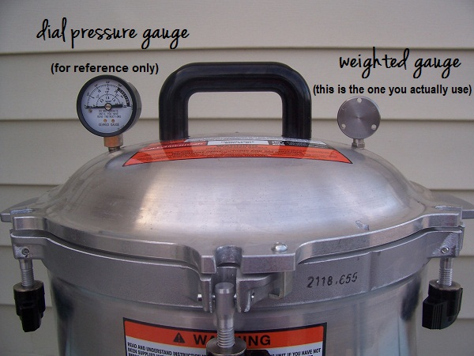
2 updates for the So Easy to Preserve “Canning Vegetables”
https://www.theprairiehomestead.com/2012/08/how-to-use-a-pressure-canner-part-2.html
Notes:
Newer models of the All American canner have both regulator weights (weighted gauge) and the dial gauge. The manufacturer of this canner now wants only the weighted gauge used for canning and not the dial gauge. (So Easy to Preserve video insert)
https://extension.psu.edu/pressure-canner-dial-gauge-testing:
The weight is more accurate than the gauge and customers should use the weight in order to determine if they are at the needed pressure. If the weight begins to rock at the desired pressure and the gauge is off by more than 2 psi the company recommends replacing the gauge. The gauge is now used as a reference to know when the unit is at 0 psi and can safely be removed.

Slide 20
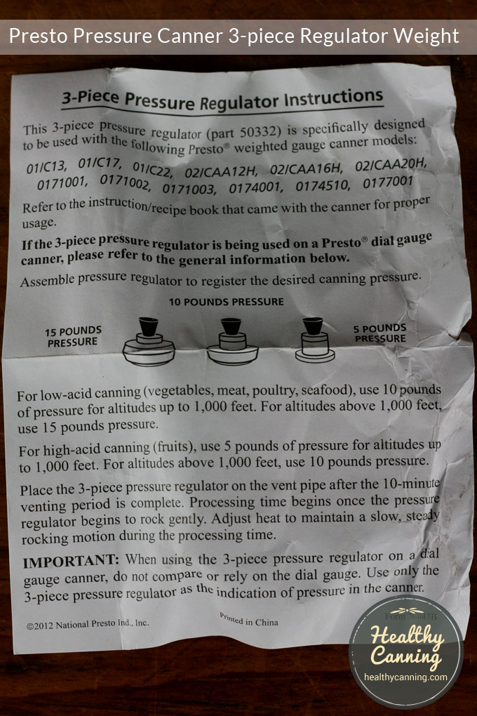
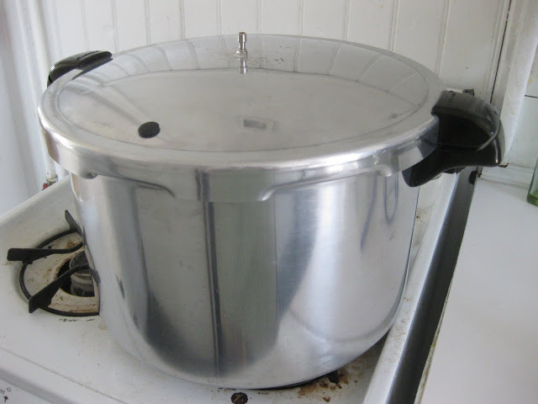
2 updates for the So Easy to Preserve “Canning Vegetables”
Notes:
The second is the statement that one type of weighed gauge canner, with a 3-piece gauge, is “not currently being manufactured.” Since these videos were produced, the company began manufacturing and selling this canner style again.

Slide 21
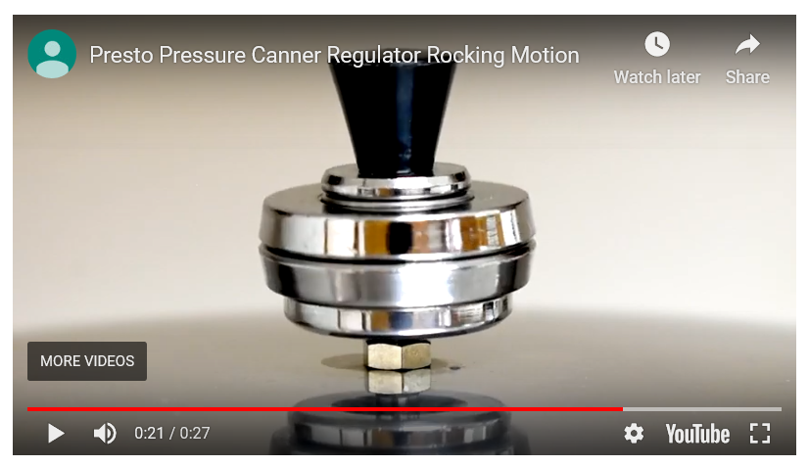
https://youtu.be/MXNIojGg8IE

Slide 22
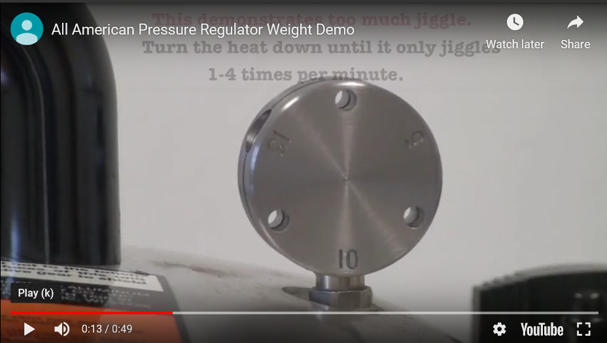
The “round” type of weighted gauge should only rock several times a minute.
https://youtu.be/xUIdWvtiVrc

Slide 23
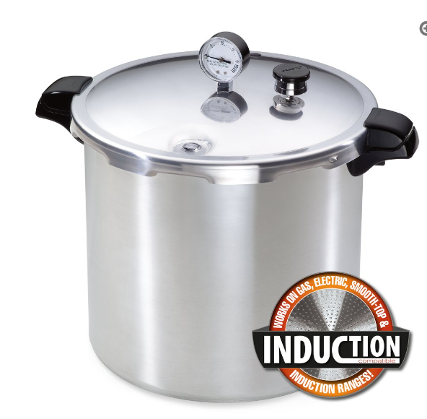
Presto also now has an induction pressure canner.

Slide 24
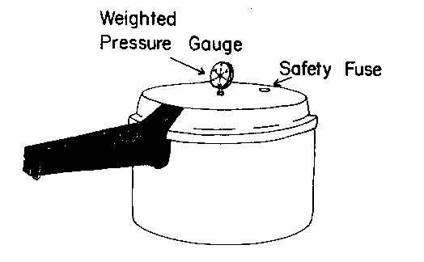
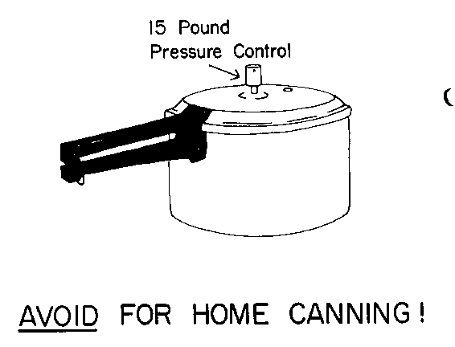
PRESSURE CANNER vs. PRESSURE COOKER
To be considered a pressure canner for USDA processes, the canner must be big enough to hold at least 4 quart-size jars.
Pressure cookers/saucepans with smaller volume capacities are not recommended for use in canning.
Enough heat may not be delivered during pressurizing and the cool-down period in smaller pressure cookers/saucepans.
Pressure Saucepans / Cookers:

Slide 25
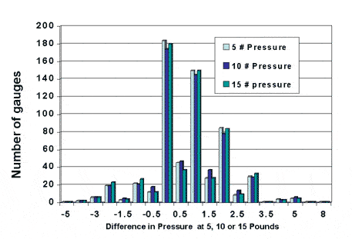
Nebraska Cooperative Extension tested 634 gauges over 25 years.
Pressure differences ranged from -5 to + 8 pounds.

Slide 26
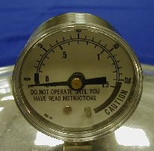
36% of the gauges were inaccurate and needed to be replaced.

Slide 27
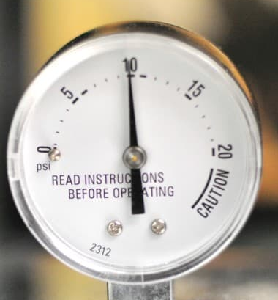
Most tested high, leading to under processing of low-acid foods.
A gauge testing 2 pounds high: 10 pounds is really _____ pounds?

Slide 28
Gauge errors affect sterilization values.
1 pound error = 10% decrease
2 pound error = > 30% decrease
Notes:
1 pound error in a 20-minute process causes over 10% decrease in sterilizing value.
2 pound error a 30% decrease.

Slide 29

3 out of 4 home canners do not test their dial gauges.

Slide 30
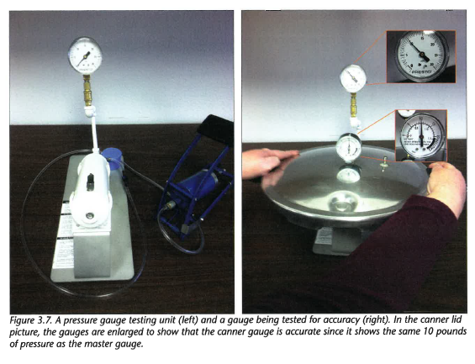
Dial Pressure Gauges Need to Be Checked Annually.

Slide 31
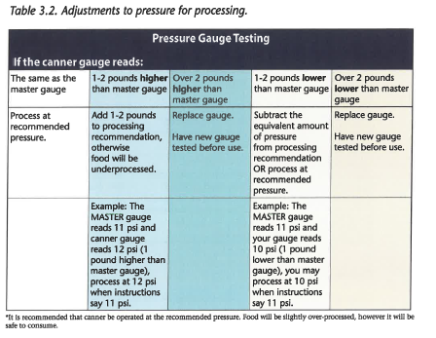
See page 3-11 in your Master Handbook

Slide 32
In Class Activity
What adjustments should be made for these dial gauges?
Dial gauge reads 2 pounds lower than master gauge
Is there a risk of over or under processing?
Dial gauge reads 4 pounds higher than master gauge
Dial gauge reads 1 pound higher than master gauge
Is there a risk of over or under processing?
Dial gauge reads 3 pounds lower than master gauge

Slide 33
PRESSURE CANNER PROCEDURES
Heat Pressure Canner
Warm Jars
Prepare food for jars
Pack jars
Place in pre-heated canner
Bring canner to boil
Close petcock
Raise to pressure
Set time
Cool & take jars out of canner

Slide 34
PACKING
Raw Pack
Raw food is placed in jar, covered with boiling water
Get less food in jar
Saves some time in preparation
Hot Pack
Food heated briefly, removes air, making easier to pack
More food in jar
Fewer jars needed

Slide 35
GETTING STARTED
Add 2-3 inches of hot water to canner.
Place filled jars on the rack.
Put a second rack between layers of jars and stagger the jars.
Fasten lid securely with weight off or petcock open.

Slide 36
VENTING THE CANNER
Also called “exhausting” the canner.
As the water boils in the canner, the “empty” space becomes a mixture of steam and air.
The temperature of a steam/air mixture is lower than the temperature of pure steam.
Venting eliminates (“exhausts”) the air so processing takes place in a pure steam environment.
Process times are intended only for a pure steam environment.

Slide 37
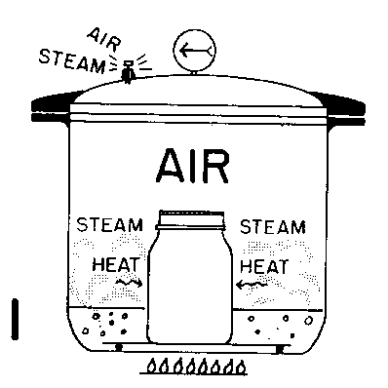
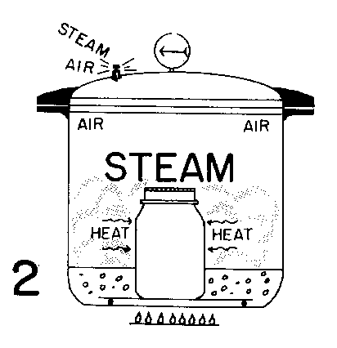
PRESSURE CANNER PROCESSING
Leave the ventport open.
Pipe where weighted gauge or dead weight will go.
Steam is vented for a full 10 minutes.
Turn the heat on high.
When water boils, steam will start to come out of open vent.
Wait until there is a constant, strong funnel of steam, then start timing 10 minutes.

Slide 38
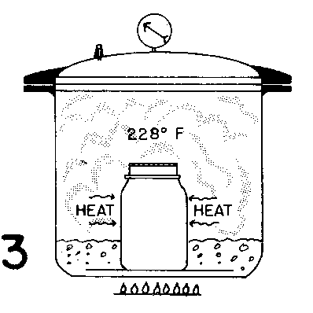
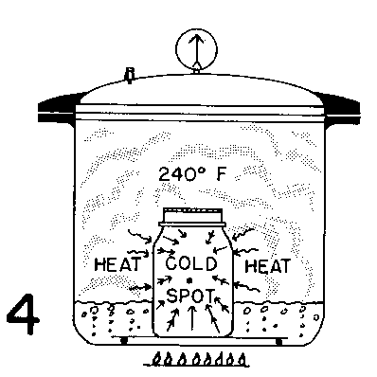
PRESSURE CANNER PROCESSING, cont.
Petcock is closed, pressure builds.
At the end of the 10 minutes, place weight in place to start pressurizing the canner.
Start counting process time when correct pressure is reached.
Steam reaches 240 at 10 1/2 lbs. at sea level, 12 lbs. at 2000 ft. alt.
Watch the pointer on the dial gauge to reach 11 pounds pressure
A weighted gauge will jiggle only 2-3 times per minute.

Slide 39
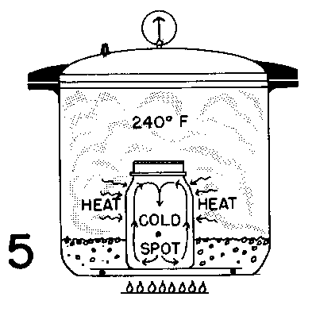
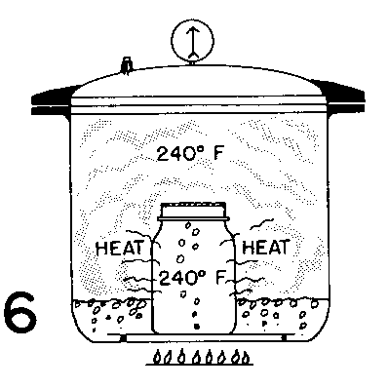
PRESSURE CANNER PROCESSING, cont.
Heat transfers into jar by convection and conduction.
Time required depends on:
Size of the jar
Type of food
Hot or raw pack
How heat transfers through the food
How long it takes the center of the food to reach 240° F.

Slide 40
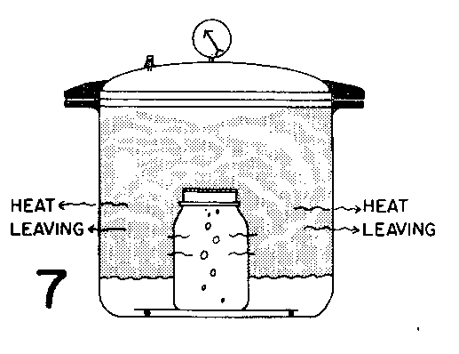
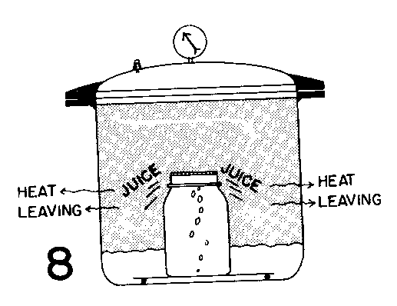
PRESSURE CANNER PROCESSING, cont.
Turn off heat at end of processing.
Let pressure drop to 0 psig naturally.
30 minutes for pints
45 minutes for quarts
May take less time on thinner gauge canners.
Removed from heat, pressure should decline gradually
If pressure drops rapidly, liquid is pulled from jars

Slide 41
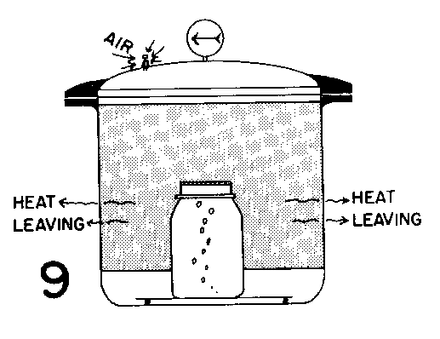
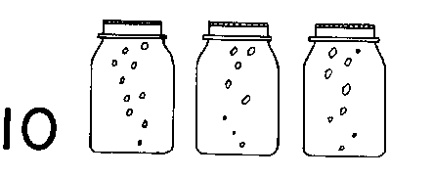
PRESSURE CANNER PROCESSING, cont.
Once pressure drops, remove weight or open petcock.
Wait about 1-2 minutes after pressure drops to 0 psig to make sure all pressure is gone. (For some canners, check that locks in handles are released.)
Remove weight or open petcock. Wait 10 min.
Open canner. Be careful of steam!
Remove jars and allow to cool.
Food will continue to boil when removed from canner
Cool jars 12 to 24 hours, undisturbed on a padded surface or rack.
Check that jars have sealed.

Slide 42
VEGETABLES
Select clean firm ripe vegetables at peak.
Most vegetables can be slightly immature.
Select the amount you can use in 2-3 hrs.
Greens are more difficult to preserve.
Frost bitten veggies lose quality but safe
EXCEPT tomatoes.

Slide 43
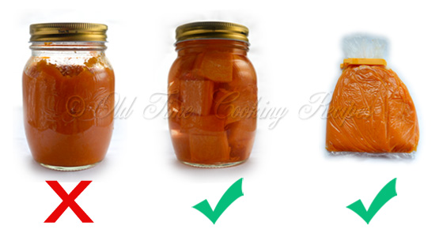
Safe processing times and pressure have not been determined for mashed or pureed pumpkin and squash because the product is too dense.
https://www.kitchennostalgia.com/canning_and_preserving/canned-pumpkin-pie-filling.html
Notes:
More info from the National Center for Home Food Preservation:
Why do you say not to can mashed or pureed pumpkin or winter squash? Home canning is not recommended for mashed or pureed pumpkin or winter squash. While there were directions in older, now historical USDA publications, they were withdrawn after expert review with publication of the Complete Guide to Home Canning in 1989. This remains the basis of Extension recommendations today, even with updated versions of this book. There has not been investment in the research desired to offer a home canning process. USDA publications prior to 1989 that had directions for canning mashed winter squash are now considered out-of-date.
A review of many USDA vegetable canning processes with studies conducted at the University of Minnesota in the 1970's indicated that there was too much variation in viscosity among different batches of prepared pumpkin purees to permit calculation of a single processing recommendation that would cover the potential variation among products (Zottola, et.al., 1978). USDA subsequently decided to withdraw their old recommendation; unfortunately, no further research has been conducted to determine a home canning recommendation. Pumpkin and winter squash are low-acid foods (pH>4.6) capable of supporting the growth of Clostridium botulinum bacteria which can cause the very serious illness, botulism, under the right storage conditions. If the bacteria are present and survive processing, and the product has a high enough water activity, they can thrive and produce toxin in the product.
Reference: Zottola, E. A., Wolf, I.D., Norsiden, K.L. and D.R. Thompson. 1978. Home canning of food: Evaluation of current recommended methods. Jn. of Food Science 43:1731.

Slide 44
Combination Foods
Use only researched recipes
.
Don’t make up your own mixtures.
Mixing veggies and using longest processing time NO LONGER RECOMMENDED
No way of being sure of the pH and heat transfer of the combo products

Slide 45
Canned Veggies
Mixed Veggies in PNW 172
Any veggies can be used
Exception of leafy greens, dried beans, cream style corn, winter squash or sweet potatoes
Don’t use more than original quantity

Slide 46
Canning Dry Beans
MUST be Pressure Canned following approved recipe!
Two methods to rehydrate beans
1. Place beans in a large pot cover with water and let stand in a cool place 12-18 hrs then drain
2. Cover beans with boiling water in a saucepan and boil 2 minutes. Remove from heat and soak 1 hour then drain
PNW 172 Canning Vegetables Page 11

Slide 47
Hot Packing Beans
Either method of rehydrated beans need to be covered with water and gently boiled 30 minutes.
Fill Hot beans into hot jars, leaving 1 inch headspace, and salt is desired, Fill Jar to 1 inch headspace with boiling water or sauce from approved recipes
Pressure Can according to approved recipe for your altitude.

Slide 48
Canned Meats/Veggies (Soups)
Recipe in PNW 361 (will get next week)
Any mixture of veggies, dried beans or peas, meat or poultry can be used in this recipe
Follow direction carefully.
The solid ingredients can only comprise ½ of the jar volume
The remaining is broth
No noodles, rice, milk or thickeners

Slide 49
Sample Soup Instructions
Soups must be Hot Packed!
Choose your favorite soup ingredients of
Vegetables (must be cannable veggies)
Meats or Poultry
Dried Beans (must be rehydrated)
Prepare each veggie and meat as if you were hot pack canning it.
Combine ingredients and cover with water or stock/broth and boil 5 minutes

Slide 50
Sample Soup Instructions, Continued
*** DO NOT ADD
Milk, Cream
Rice
Flour or any other thickener
Pasta or Noodles
Fill jars ½ with solid mixture and then fill with liquid leaving 1 inch headspace
Pressure Can according to directions for altitude

Slide 51
SAFETY OF HOME CANNED LOW ACID FOODS
If current recommendations are followed explicitly, all critical control points taken, boiling before use is not necessary.
If any doubt, boil for 10 minutes.
Thick foods for 20 minutes.
Must be a full rolling boil for 10 minutes.
NOTE: Although botulism spore is very heat resistant, botulism toxin can be destroyed by heat.

Slide 52
CRITICAL CONTROL POINTS
Dial gauge was tested in current year.
Canner was vented for 10 minutes before closing petcock.
Pressure was adjusted for altitude.
Current recommendation for processing time was used.

