Slide 1
Preparation and Canning of Pickled and Fermented Foods Washington State University Sandy Brown Faculty Emeritus

Slide 2
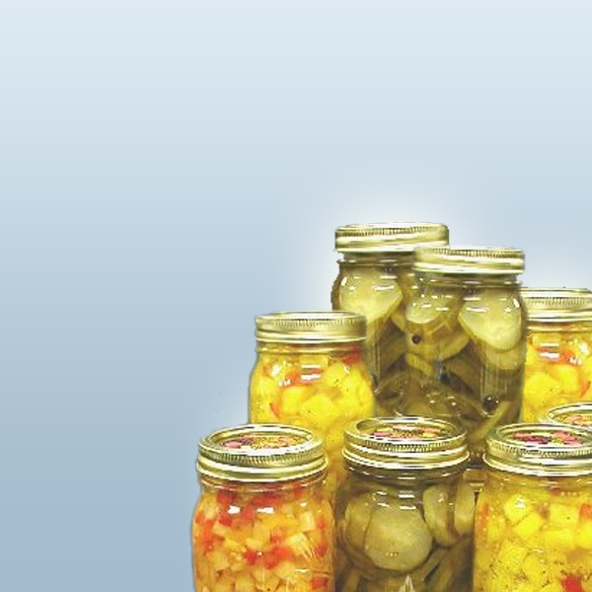
INTRODUCTION
The many varieties of pickled and fermented foods are classified by ingredients and method of preparation.
In this lesson we’ll cover:
Acidified vegetables
Fresh pack pickles and pickled fruits and vegetables
Relishes, salsa, and chutneys
Fermented Foods, Dill Pickles, and Sauerkraut

Slide 3
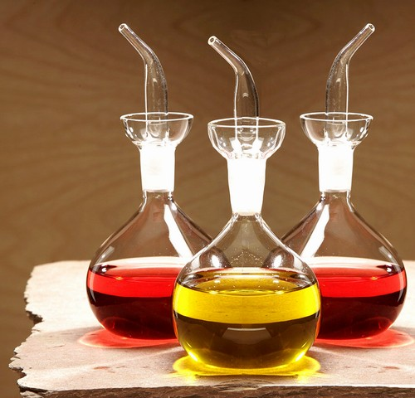
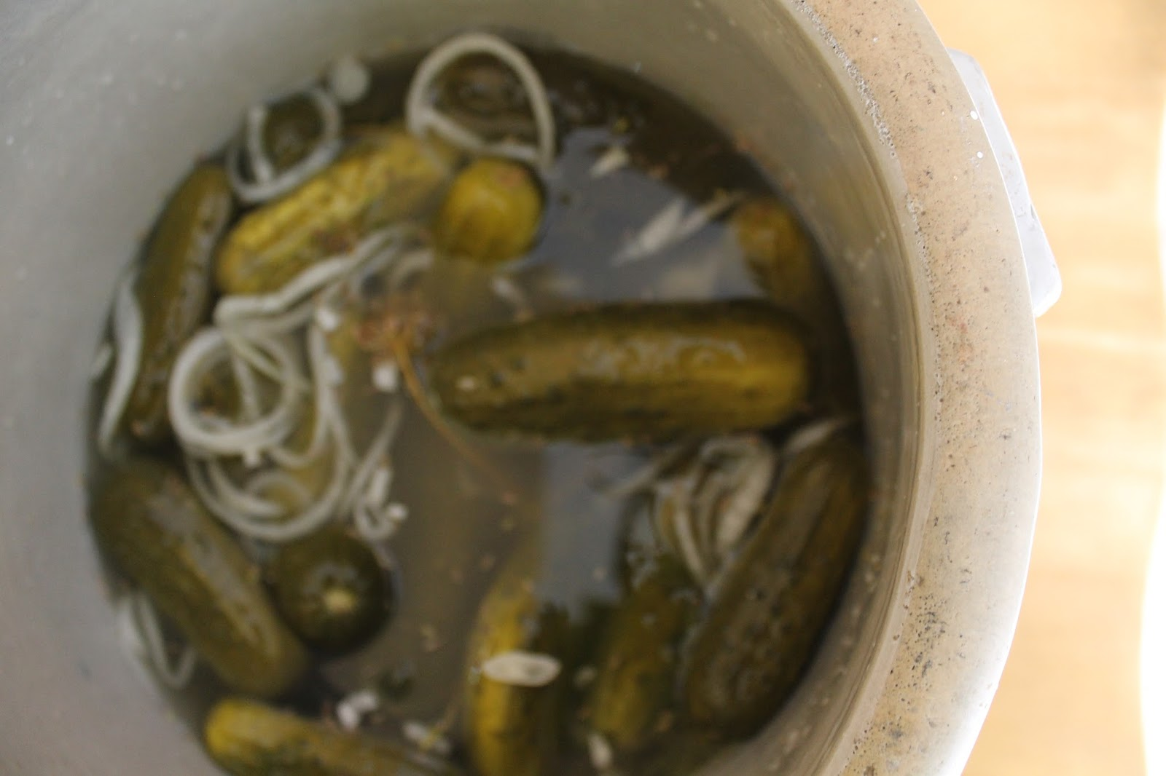
Pickled and Fermented foods:
Relies on added acid to lower pH
Allows foods to process in boiling water canners
Done by: Addition of vinegar
By growth of acid-producing bacteria
Important for safety, but also taste and texture
This Photo by Unknown Author is licensed under CC BY-SA-NC
This Photo by Unknown Author is licensed under CC BY-SA-NC

Slide 4
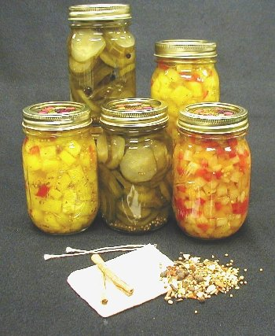
4 Types of Pickled Products
Fresh Pack or Quick Process
Refrigerator
Fermented
Fruit Pickles
Relishes
Pickled Protein Foods
Other Fermented Products
Notes:
Explain the difference between the pickled products: see PNW 355 – Page 1-2
Fresh Pack – uses vinegar to raise the acid level to make them safe to can
Fermented – salt solution produces the curing process; acid is produced as lactic acid bacteria grow
Fruit Pickles – whole or sliced fruit simmered in spicy-sweet-sour syrup (pickled pears, watermelon rind, crabapples)
Relish – Chopped fruits or vegetables seasoned and cooked in a spicy vinegar solution

Slide 5
REFRIGERATOR PICKLES
Pickles or pickled vegetables made for immediate consumption and stored in refrigerator.
Either fermented or vinegar acidification
Not heat processed

Slide 6
FERMENTED REFRIGERATOR DILLS
Cucumbers immersed in salt brine solution with garlic and spices
Held at room temperature for one week.
Then stored in refrigerator to be consumed
Listeria pathogens increased during fermentation
Refrigeration decreases them slowly
After 3 months, pathogens still there
NOT RECOMMENDED PROCESS

Slide 7
FRESH PACK REFRIGERATOR PICKLES
Boiling brine poured over cucumbers
Product sored in refrigerator
Listeria does not grow with pH 4.4 or below
Recipes are formulated for this pH
There is still a risk for some populations
Recommend you heat pickles to 160° F, cooled before consuming.

Slide 8
QUICK or FRESH PACK PICKLES – Heat processed
Quick or fresh pack pickles:
Are easy to prepare and have tart flavor.
Include acetic acid (in vinegar) which lowers the acidity of vegetables to below 4.0 and is a preservative.
Must use vinegar that is at least 5% acetic acid.
May or may not cure in salt for several hours.
Should always be made according to the directions in a tested recipe
Most important you should never vary the amount of vinegar called for.

Slide 9
FERMENTED PICKLES & SAUERKRAUT
Salt used in making fermented sauerkraut and brined pickles not only provides characteristic flavor but also is vital to safety and texture.
In fermented foods, salt favors the growth of desirable bacteria while inhibiting the growth of others.
Natural bacteria produce lactic acid
End result should be a pH < 4.0
Requires 2 -3 % salt solution (by weight) for 2 - 6 weeks
Caution: Do not attempt to make sauerkraut or fermented pickles by cutting back on the salt required.

Slide 10
OLD RECIPES – Handed down, or Internet
Best to use tested recipes
5% Vinegar ration 1:1 vinegar/liquid ratio or more
Older recipes not this proportion
Older vinegars were often 7% or better
To update an old recipe, add some 5% vinegar to meet the ratio of 1:1 ration vinegar/liquid ratio

Slide 11
PICKLED FRUITS
Pickled fruits are:
Whole or sliced fruits simmered in a spicy, sweet-sour syrup, i.e.,
Pickled Peaches
Pickled Pears
Pickled Watermelon rind
Very easy to make and preserve.

Slide 12
RELISHES, CHUTNEYS & SALSA
Relishes
Made of chopped fruits and/or vegetables, seasoned, and cooked to a desired consistency in a spicy vinegar solution.
Chutney
A relish-type condiment that includes several different varieties of sauce-type foods, drawn from traditional East Indian cuisine.
Chopped fruit or vegetables, simmered with spices, onion, sugar and vinegar.
Salsa
A spicy sauce of chopped, usually uncooked vegetables or fruit, especially tomatoes, onions, and chili peppers, used as a condiment.

Slide 13
PICKLED PROTEIN FOODS
Pickled Eggs and Fish
Process MUST be done in the refrigerator
Uses a fully cooked product
No canning recommendations
Only store in refrigerator

Slide 14
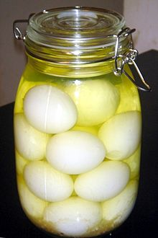
Pickled Eggs
Hard cooked eggs
Soaked in vinegar, salt and spices
1997 botulism in eggs at room temperature
Entire process MUST be done under refrigeration
Never prick or poke holes in eggs
Takes 2-4 weeks for full pickling
Keep eggs refrigerated at all times
Use within 3-4 months
This Photo by Unknown Author is licensed under CC BY-SA

Slide 15
Pickled Fish
Usually will salt cured before pickling
Removes or slows bacteria growth
Reduces water content
Firms muscle protein
Reduces enzyme activity
Inactivates parasitic worms

Slide 16
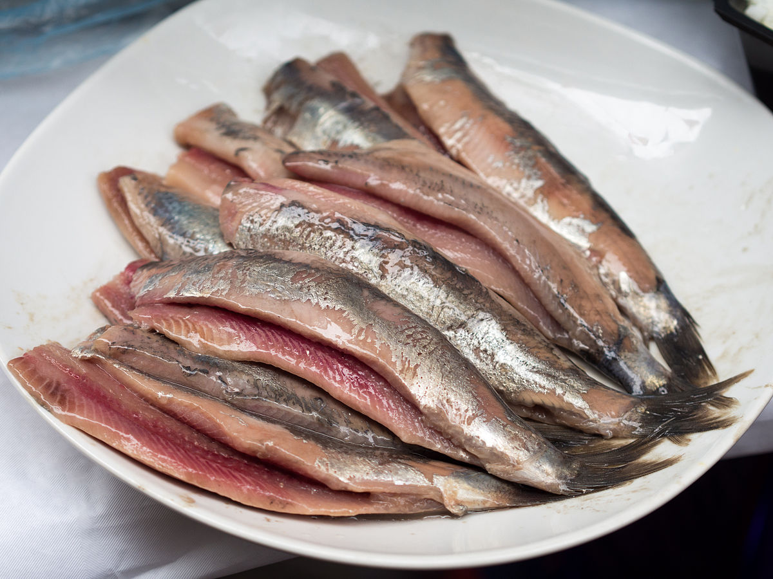
Pickling Fish Process:
After Curing:
Cover with an acidic pickling solution
Hold in refrigerator at 38 degrees F or below
Hold for 1-2 weeks
Freeze for longer storage
This Photo by Unknown Author is licensed under CC BY-SA

Slide 17
Other Fermented Foods
There are no researched safe recipes for heat processing other traditional fermented foods
Traditional fermented foods like Kimchi, etc are to be refrigerated and treated as a fresh food product

Slide 18
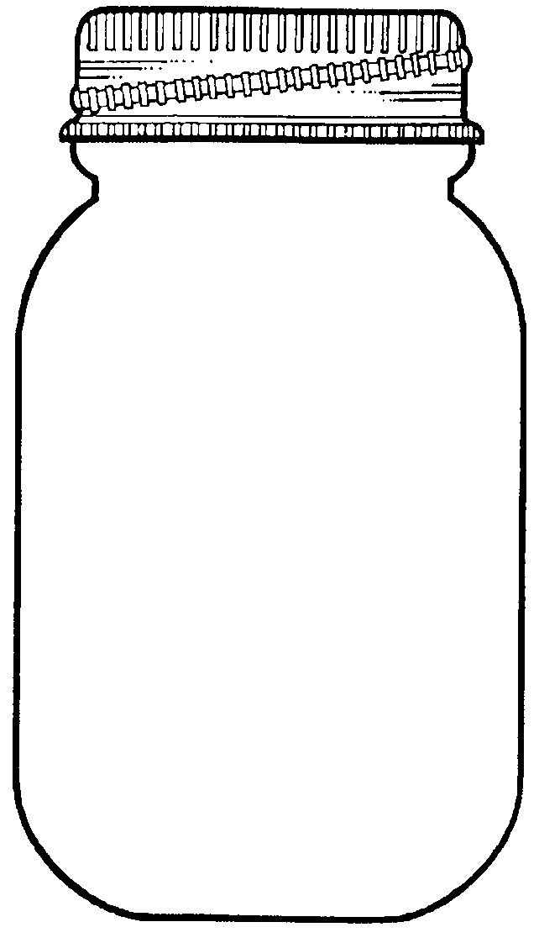
Pickling Ingredients
Cucumbers
Vinegar
Salt
Sugar
Spices
Garlic
Water
Notes:
PNW 355 has a very good explanation for each ingredient on page 3-4. Please refer to this information for a quick review if you decide to use this slide.

Slide 19
SELECTING PRODUCE FOR PICKLING & FERMENTING
Quality of the end product depends on freshness of ingredients.
Fruits/vegetables should be:
Prepared within 24 hours of harvesting or refrigerated immediately
Washed well in cold water
Do not use any produce that shows any evidence of mold.

Slide 20
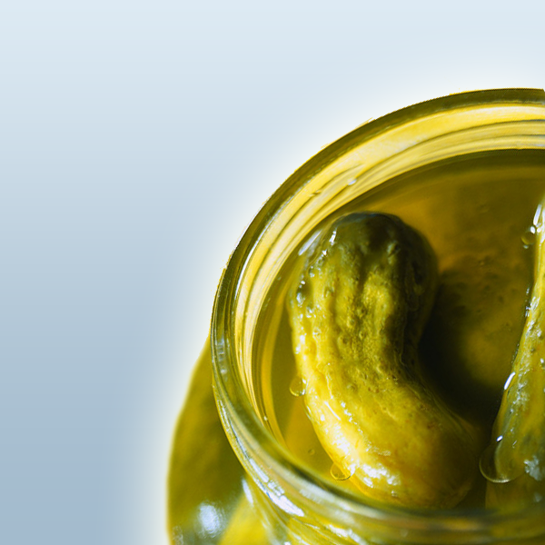
SELECTING CUCUMBERS
Use pickling variety cucumbers only!
Do not use cucumbers that are:
Immature
Waxed
A slicing variety
Always remove the blossom ends.

Slide 21
Critical Controls for Cucumbers
Pickling variety cucumbers
Picked early in the morning
Prepared within 24 hours
No more than 2 inches in diameter
Length: 1½” for gherkins; 4” for dills
Odd shapes for sliced product or relishes
No signs of deterioration
Blossom end removed
Notes:
More details in PNW 355 – but this is good basic information to review.

Slide 22
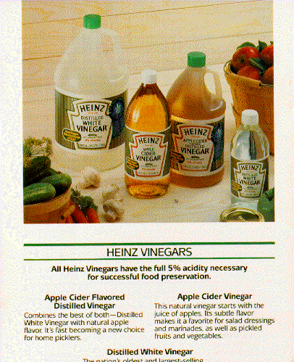
VINEGAR FOR CANNING
Must be of 5% acidity.
Acceptable vinegars include:
Cider vinegar
May darken white or light colored fruits/veggies
Mellow flavor
White vinegar
Sharp flavor
Wine & Malt Vinegar
May be used – be sure of acidity
Do not use homemade vinegar as it has an unknown acidity level.

Slide 23
Commercial Pickle Juices for Canning ???
Yes for refrigerator pickles only!
Acidity is unknown so not for canning pickles
Watch for spoilage

Slide 24
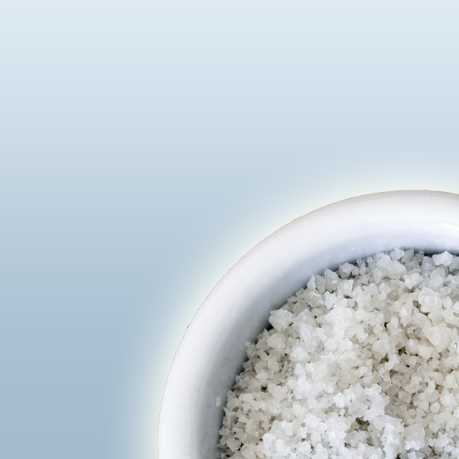
SALTS FOR CANNING
Pickling And Canning Salt
Pure, granulated
No anticaking or iodine
Kosher Salt
No iodine or anticaking
Measures differently
Morton Lite Salt
Mixture of Potassium and Sodium chloride
Used for sweet and fresh pack pickles

Slide 25
SALTS TO AVOID WHEN CANNING
Iodized Table Salt
Contains iodine and anticaking agents
May interfere with fermentation
May make brine cloudy
Sea Salt
Substituted by weight
Some impurities and could affect quality
Rock Salt
Contains impurities – DON’T USE!
Sour Salt
Contains citric acid and salt
Used as water softener
Flaked Salt – Density varies
Use by weight – 1cup table salt = 10.2 ounces

Slide 26
LOW-SALT PICKLES
“Quick or fresh pack” pickles may be made with reduced or no salt.
Reduced-sodium salts such as “Lite Salt” may be used in quick process pickle recipes.
Approved reduce sodium sweet pickles in PNW355 or USDA guide.
Fermented pickles or sauerkraut must use the salt called for in the recipe to assure safety.

Slide 27
SPICES
Use fresh spices
Use whole spices and tied in cheesecloth bag and removed before packing
Powdered spics are less desirable Causes produce to darken
Liquid becomes cloudy
Can alter spices to preference
Can omit, but not preferred for flavor quality
Increase dried spices by 1 teaspoon per quart if desired.

Slide 28
SELECTING OTHER INGREDIENTS
Sugar - white or brown
Brown gives more mellow taste.
White a tart flavor
Fresh dill
Picked as soon as flowers begin to open
1 teaspoon seed = 1 dill head
Garlic
Cure at room temperature 2-4 weeks.
Uncured will turn green, blue, purple.
Commercial minced garlic 1 teaspoon = 2 med cloves

Slide 29
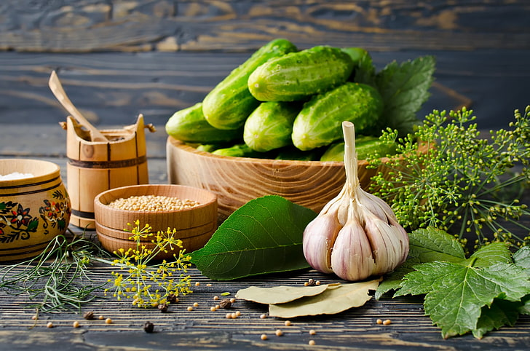
Garlic
Fresh Garlic – cure for 2-3 weeks before use
Uncured Garlic will turn blue, green or purple
Not a safety issue
Commercial crushed garlic has been acidified and safe
1 teaspoon = 2 medium cloves

Slide 30
Hard Water
Fermented Pickles
May interfere with lactic acid formation
Quick Pickles
Interfere with curing process
Home Softened Water
Not recommended
How to Soften
Hard Water
Boil 15 minutes, cover and let sit for 24 hours
Remove scum and pour into another container, leaving sediment in bottom

Slide 31
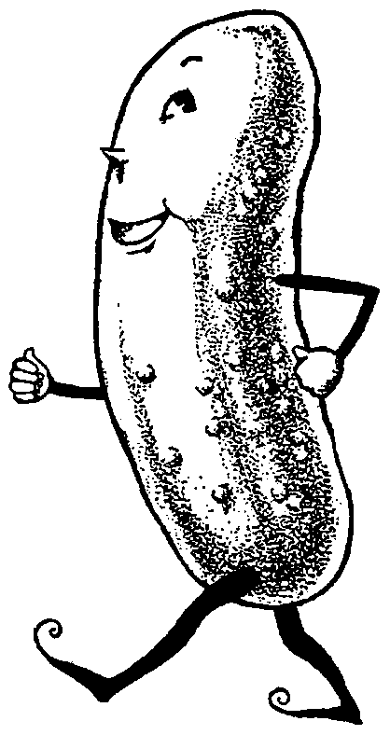
WHAT MAKES CRISP PICKLES?
Fresh, just picked cucumbers
Pickling cucumbers
2” in diameter
Blossom end removed
Up-to-date tested recipes
Crisping Agents ???
Notes:
Crisping agents are not necessary if these guidelines are followed.

Slide 32
CRISPING AGENTS: PICKLING LIME
Use only with Quick Pack Pickles
Must be food grade.
Source of calcium to firm pickles
Sold as
‘slaked’
’hydrated’
‘household’
’pickling’
Do not use: ‘agricultural’ ‘burnt’ or quick – not food grade.
It is a strong base that neutralizes acid, so tested recipe must be followed carefully.
Used only as a soak solution.
Rinse well using limewater solution.
Pickling
Lime

Slide 33
Using Lime for crisping
Use lime-water solution for soaking 12-24 hours before pickling.
Excess lime absorbed by cucumbers must be removed to make safe pickles.
Lime absorbed will raise the pH and increase chance of Botulism.
To remove lime solution before pickling:
Drain lime-water solution
Rinse
Re-soak cucumbers in fresh water for 1 hour
Repeat rinsing and soaking stops 2+ times

Slide 34
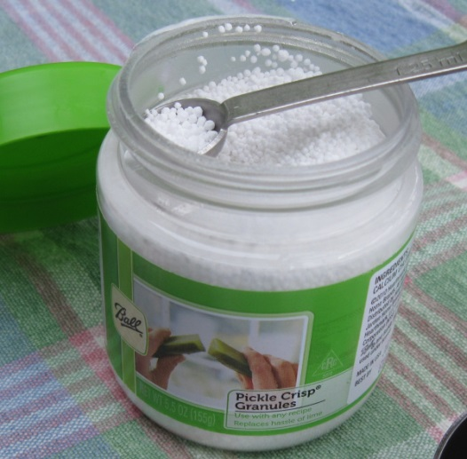
Pickle Crisp
Calcium Chloride
Binds the water to keep
product crisp.
Pickle Crisp by Ball
Calcium Chloride in brewing
supplies
Can also be used in other vegetables like potatoes to keep firm

Slide 35
CRISPING AGENTS: ALUM
Sold in spice section.
Used to firm fermented pickles.
No effect until after pickles are fermented.
Does not improve quick pack pickles.
Used only as a soak solutions and rinse well.
Too much will give pickles a bitter flavor.
May cause digestive upset.

Slide 36
CRISPING AGENT: GRAPE LEAVES
Called for in some older recipes.
Possibly inhibit enzymes that soften cucumbers.
Caution: Leaves contain tannins that contribute a bitter flavor to pickles.

Slide 37
OILS
Oil in canning is not recommended
Oil interferes with the ability to seal and heat penetration.
Recipes have been developed for:
3-bean salad
Marinated whole mushrooms
Marinated peppers
Uses ½ to 2 cups of olive or salad oil

Slide 38


Slide 39
Equipment for Fermenting
Acceptable
Stoneware crocks
Unchipped enamel
lined pans
Stainless steel
Glass bowl or jar
Food grade plastic
container
Unacceptable
Plastic garbage containers
Plastic bags not food grade
Metal containers
Chipped enamel lined pans
Notes:
Unacceptable equipment for fermenting will react with the acid or salt and affect the quality (color change) and safety of the pickles.
Plastic garbage containers have been treated to control odor; non-food grade plastic bags will impart a flavor or chemical into the food; metal containers will react with the salt and/or acid and make undesirable flavor changes and affect the safety of the pickles.
If the stoneware crock has a crack larger than your finger nail, plant flowers in it and don’t use it to ferment. Always bleach a crock, rinse and air dry before using it for fermentation.
If in doubt about the quality of the crock, where it was made or potential glazing, don’t use it!

Slide 40
Equipment For Heating Pickling Liquids
Acceptable
✓ Unchipped enamel
✓ Stainless steel
✓ Glass
✓Aluminum
Unacceptable
 Copper
 Brass
 Galvanized steel
 Iron
Notes:
Unacceptable equipment for heating liquids will react with the acid or salt and affect the quality (color change) and safety of the pickles.

Slide 41
Weights for fermented foods
Vegetables must be covered with 1-2 inches of brine
Jars
2-3 sealed quart jars filled with water
Brine filled bags
2-gallon food grade plastic bag
Brine 1 ½ T salt /quart of boiling water
Cover container with clean, heavy towel to prevent insects and mold to enter

Slide 42
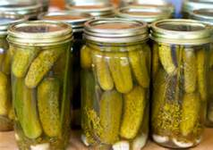
HEAT PROCESSING PICKLES
Recommended for all pickled products
Destroys spoilage organisms
Inactivates enzymes that may affect flavor, color and texture.

Slide 43

BOILING WATER BATH CANNER
Use of boiling water canner as used for other high acid foods.
Arrange in canner half filled with water, Add hot water to a level of 1-2 inches above jars
140° F (raw pack)
180° F (hot pack)
Bring water to a boil and process recommended times.
Immediately remove jars from canner at end of processing.

Slide 44
LOW TEMPERATURE PASTEURIZATION
May produce better quality texture since product receives less heat
MUST be carefully managed to avoid possible spoilage
Requires close supervision

Slide 45
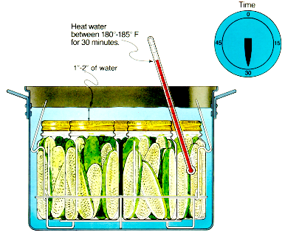
LOWER-TEMPERATURE PASTEURIZATION
Place jars in a canner filled half-way with warm water (120°–140° F )
Add hot water to a level of 1-2 inches above jars
Heat water to maintain a temperature of 180°F to 185°F for 30 minutes
Temperatures higher than 185°F may cause unnecessary softening of pickles
May use this method to process all size jars up to a quart.

Slide 46
“OPEN KETTLE” CANNED PICKLES
The open kettle method (no heat processing after jars are packed) is NOT recommended because it may result in a high rate of spoilage.

Slide 47
QUICK PACKED – PRE-TREATMENTS
Brining:
Soaked in salt water prior to pickling.
Removes grassy flavors.
Draws water and air out of the vegetables to enhance the uptake of the pickling solution.
Provides a firmer, better flavored pickle
Icing:
Cover vegetables with ice for 3-4 hours
Aids in hydrating
Helps with firming
Lime Water Soak
Helps with firmness
Increased pH
Must be rinsed carefully
Triple rinse

Slide 48
QUICK PACK PICKLES
After pre-treatment:
Drain and pack into clean, hot jars
Cover with a boiling hot pickling solution
Must contain adequate vinegar to lower the pH to 4.0 or lower
Process in a boiling water canner

Slide 49
MAKING FERMENTED PICKLES & SAUERKRAUT
Vegetables in salt brine for 4-6 weeks
Quality depends on freshness of ingredients, presence of natural sugars and desired bacteria.
Controls used in fermentation to prevent growth of undesirable yeasts and molds include:
Correct salt concentration.
Keeping air off surface.

Slide 50
Fermenting Crocks or Vessels?
Crocks work well and have for number of years
No cracks
Needs a weight on top
Fermenting Vessels
Allows fermentation gases to escape while preventing air getting in.
Prevents mold growth
Easier to manage – scum is rare

Slide 51
Making the Brine
Measure the salt and water carefully
Brine too salty, bacteria die
Not salty enough, spoilage organisms grow and spoil pickles.
Make with cold or room temperature soft water
Hard water will interfere with fermentation

Slide 52
STEPS FOR FERMENTED PICKLES & VEGETABLES
Vegetables must be covered with brine during the fermentation
Use a heavy plate or large glass lid.
A bag of dried beans.
A bag of brine solution (4 ½ T salt / 3 quarts water).
Cucumbers are kept in brine 4-6 weeks
Lactic-acid bacteria naturally present convert sugars in cucumbers to lactic acid.
Lactic acid is preservative and gives pickles a unique flavor.

Slide 53
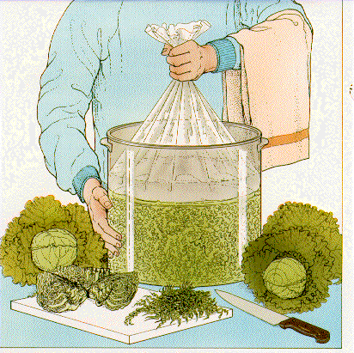
STEPS FOR FERMENTED PICKLES & VEGETABLES, cont.
Keeping air off surface of fermenting vegetables

Slide 54
FERMENTED PICKLES
Keep pickles at 65 F to 80 F
Temperature will determined fermentation time.
Above 80°F, pickles may spoil.
If scum forms, it must be removed daily.
If pickles become soft, slimy or develop a disagreeable odor DISCARD them.
Remove scum daily if needed
Will spoil if left
Will soften pickles

Slide 55
IDEAL FERMENTATION
During fermentation bubbles rise to surface
When fermentation stops no more bubbles
When cucumber is cut, no rings or white spots
Brine will be cloudy
Clear brine 1 - 3 days.
Cloudy brine and gas 2 - 4 days.
Cloudy brine and no gas 5 - 6 days.
Pickles ready to eat after 10 - 12 days.

Slide 56
STORAGE OF FERMENTED PICKLES
May be stored in original container for 4-6 months
Must be refrigerated
Surface scum and molds removed regularly
Canning or heat processing more reliable

Slide 57
Processing Fermented Products
Heat process fermented pickles when the pickles taste tart
When ready:
Pour off the brine
Heat brine to boiling and simmer for 5 minutes
To reduce cloudiness strain brine through filter
Put pickles in jars and cover with brine.
Water bath or low temperature pasteurize

Slide 58
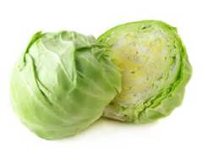
SAUERKRAUT
For the best sauerkraut, use firm heads of fresh cabbage.
Shred cabbage and start kraut between 24 and 48 hours after harvest.
Fall cabbage has highest sugar content and creates best fermentation.
Made by the “dry salt” method
Salt draws liquid from cabbage.
Use 3 Tablespoons salt
to 5 pounds cabbage

Slide 59
SAUERKRAUT
About 10 pounds of cabbage = 4 quarts of kraut
Wash heads and remove outer leaves
Cut in halve and remove core
Equipment for cutting should not bruise the cabbage
Electric meat slicer works great
Shred to the thickness of a quarter
Don’t grind the cabbage
Do not blanch the cabbage

Slide 60
Dry Salt method
Salt put on cabbage to draw juice from the cabbage
Use pure medium coarse pickling salt or granulated salt
Iodized salt will discolor or darken kraut
10 pounds cabbage requires 3.6 – 4 oz of salt or 6 Tablespoons
Mix salt with cabbage and let stand until juice covers kraut

Slide 61
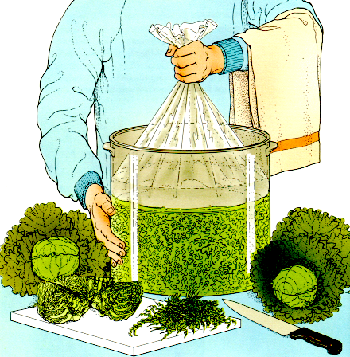
Keeping Air Off Surface of Fermenting Vegetables
Pack cabbage in container, cover with brine
Brine –1 ½ Tbsp.
salt/quart of water
Fill bag with brine
Seal bag around edges of container
Notes:
This picture shows how a bag is used seal the top of the fermenting container. When it is filled with brine it seals around the edges.
A “zip-lock” bag will not work because it is a square bag and it will not mold around a circle. It needs to be a food storage bag that comes with a twisty or a turkey roasting bag, not a sealing bag with a zipper.

Slide 62
WEIGHTS
Plastic bag filled with brine
Plate with weight
Cover container with lid or clean towel to prevent mold or
other contamination
Notes:
If people want to use a plate as a method for sealing the container, a canning jar with brine will need to be placed on the plate to hold the cabbage below the brine. Every couple of days the plate needs to be removed to clean the scum off of it where bacteria has started to grow. Carefully remove the plate, wash it and return to the container being careful not to disturb the fermenting cabbage.

Slide 63
Fermenting Kraut
Store the cabbage/brine mixture at 70°F -75°F
Will take 3-4 weeks
At lower temps may take 5-6 weeks
Temperatures lower than 60°F fermentation may stop
Temperatures above 75°F kraut may become soft
Taste kraut to determine if fermented enough for your tastes.

Slide 64
As Kraut ferments:
Gas bubbles will rise to the top
If packed to full liquid may spill over
First week will smell rotten – don’t toss it!
Keep cabbage covered with brine
If more is needed boil first and then cool
1 ½ Tablespoons alt to a quart of water

Slide 65
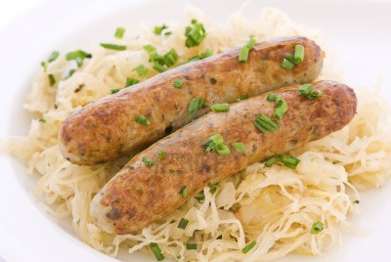
Fully Fermented Kraut
Keep covered in refrigerator
Process in boiling water bath
Practice good food safety habits
Notes:
Sauerkraut can be processed in a boiling water bath (raw pack or hot pack) or stored in the refrigerator. Always remember to use a clean fork to remove sauerkraut from the jar.

Slide 66
PICKLE PROBLEMS
CHAPTER 6
PAGES 19 - 22

Slide 67
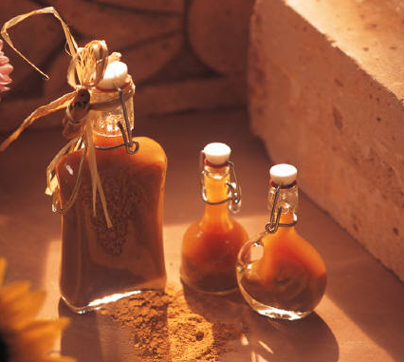
FLAVORED VINEGARS
Vinegar is high acid and does not support Botulism spores
Some can support E coli bacteria and some molds
Flavoring materials can be herbs, spices, fruits or vegetables

Slide 68
CONTAINERS
Glass and free of cracks or nicks
Must be sealed with a screw band lid, cap or cork
Wash and sterilize before using
Fill the jars while they are still warm

Slide 69
Wash all fruits and vegetables
Small fruits and vegetables may be halved or left whole.
Fresh herbs wash, blot dry with paper towel.
Dip in a sanitizing solution of 1 teaspoon bleach per 6 cups water
Rinse well in cold running water and pat dry
Improves quality for use with vinegars
ONLY TIME THIS BLEACH DIP IS RECOMMENDED!

Slide 70
VINEGARS
Apple cider vinegar is good with fruits
Distilled white best with herbs
Red and white wine vinegars – garlic and tarragon
Warning – rice and wine vinegars contain protein that provides medium for bacterial growth

Slide 71
PREPARING VINEGARS
Place fruits herbs or spices in sterilized jar
Per pint – 2-4 sprigs of fresh herbs, 3 Tablespoons of dried herbs 1-2 cups of fruit or vegetables.
Heat vinegar to just below boiling (190F)
Pour over the herbs and cap tightly.
Allow to stand 3-4 weeks

Slide 72
Strain vinegar through filter 1-2 times or clear
Pour strained vinegar into clean sterilized jar
Add sprig of fresh herbs or berries
Seal tightly.
Store in refrigerator for best retention of flavors
Best quality for 2-3 months in a cool room
6-8 months in the refrigerator
Mold fermentation, cloudiness throw it away without tasting it.

Slide 73
Garlic and Herbs in Oil
NOT SAFE
Good environment for botulism growth.
Store at refrigerator temperatures for 2-4 days
Never at room temperature
Commercial products are acidified.

Slide 74
Infused Oils with Herbs and Garlic
Chopped garlic, rosemary, oregano, basil
Soak in a 3% acidic solution for 24 hours
Use Citric Acid only
No research done using Lemon Juice or Vinegar
See chart in PNS664 page 2
Drain herbs/garlic before putting into the oils

Slide 75
Adding Herbs/Garlic to oil
Olive oil best for Garlic
1 part herb to 10 parts oil
Can vary this as you wish, but over time flavor will get stronger
Flavor reached in 1-10 days at room temperature
Can heat oil for faster flavor
No warmer than 140 F for 5 minutes

Slide 76
Storage of infused oils
Take out herbs or garlic when oil reaches the flavor that you prefer
Store at room temperature in a dark cool location
OR
In refrigerator or freezer

Slide 77
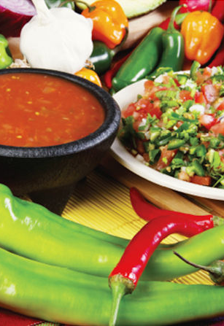
Salsa Recipes for Canning PNW 395

Slide 78
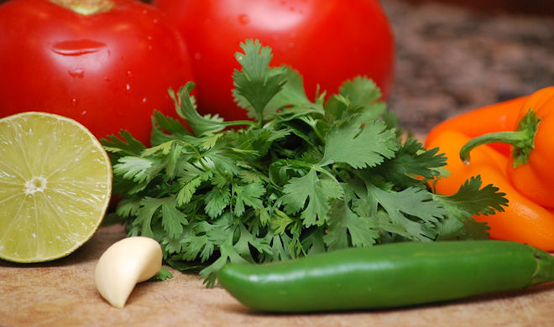
Salsas are a mixture of high and low acid foods.
Notes:
Salsas are a mixture of high and low acid foods. So they need to be acidified properly for water bath canning to prevent botulism.
If the mixture is too low in acidity it needs to be treated as a low acid food. This requires extra lab testing to develop recommendations for processing to eliminate the risk of botulism.
To avoid botulism either follow the recipes and recommendations in this publication. Freezing is the only other safe option for home preservation of untested or original salsa recipes.

Slide 79
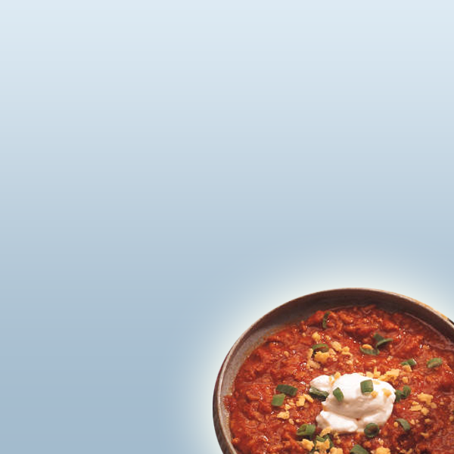
MAKING SALSA FOR CANNING
When making salsa for canning be sure to:
ONLY USE RECIPES TESTED FOR CANNING.
Use quality ingredients.
MUST be water bath canned
No pressure canning times developed

Slide 80
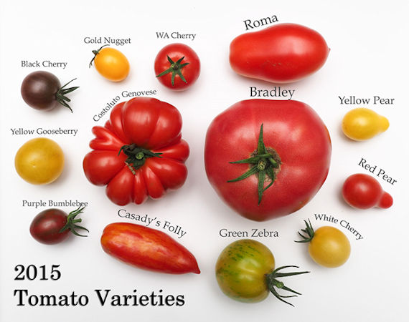
Tomato type affects the quality of your salsa your salsa.
Notes:
Any variety or color of tomato can be used in the recipes. Even under ripe tomatoes can be used. Again, use only high quality tomatoes and don’t use tomatoes from frozen or dead vines. Canning is not a good way to use spoiling or overripe tomatoes.
Both slicing and Roma or paste tomatoes will make a flavorful product, but the Romas have a meatier flesh and will make a thicker salsa.

Slide 81
MAKING SALSA: ACCEPTABLE ALTERATIONS
TOMATOES
Any tomato variety can be used
Paste tomatoes will make a thicker salsa
Slicing tomatoes will make a more watery salsa
Always select tomatoes in good condition
Never from a frost bitten vine

Slide 82
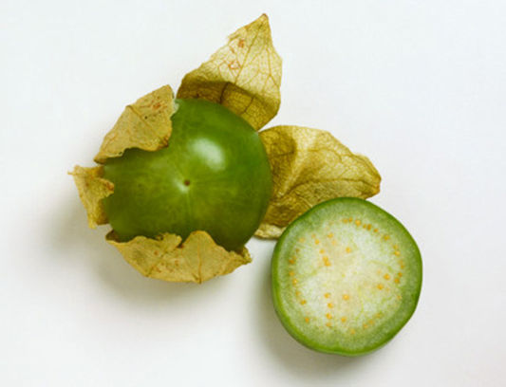
Tomatillos can be substituted for tomatoes.
Notes:
Tomatillos are known as Mexican husk tomatoes. You do need to remove the outer husk but peeling and seeding isn’t necessary.

Slide 83
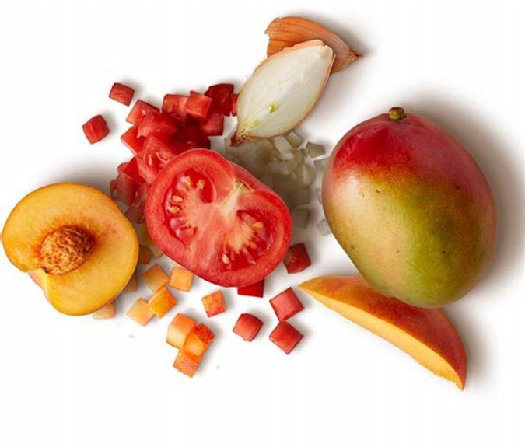
Some research-tested salsa recipes for canning contain fruit.
Notes:
When using a recipe from this publication make sure to use the fruit in the quantity and quality given in the recipe and follow preparation directions.
Don’t use ripe fruits when green or unripe fruits are listed in the recipe. This can lower the final acidity level of the salsa and could result in an unsafe canned product.
It is also unsafe to substitute fruits unless it says so in the recipe.
If you want to use a different or riper fruit, simple follow a basic tested recipe for canning salsa and add the fruit when serving.

Slide 84
FRUITS
Use fruits in the condition described in recipe
When calls for green or unripe DO NOT use ripe fruits
This will change final acidity of the mixture.
Remember that unripe fruit is higher in acid than ripe fruit.

Slide 85
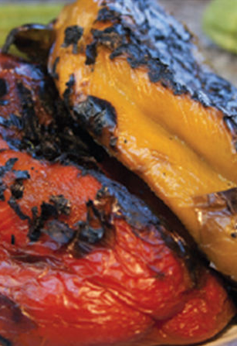
Any type of pepper can be substituted for another.
Notes:
You can use any type of pepper to create the taste and heat that you desire. Just don’t go over the total amount of peppers called for in the recipe.
Even bell peppers can be substituted for hot peppers for a milder salsa.
However, make sure to consider the size of the pepper. For example, the same number of whole green bell peppers would not be equivalent to the same number of smaller peppers like jalapenos.
Canned chilies can also be used in place of fresh. See page 3 of your Salsa handout for instructions.
Jalapeno is the most popular hot pepper. There are not set standards for naming peppers and chiles, peppers, and chile peppers are used interchangeably in the recipes.
In general, chile is used for hot peppers which can be milk, medium or hot. Sweet or bell peppers do not have heat compounds.
The skin of long green chiles may be tough and can be removed by heating the peppers. Usually if the peppers are finely chopped this isn’t an issue.
Hot peppers usually don’t need to be peeled, but a lot of heat is in the seeds so that can be removed if you want to avoid an overly hot salsa.
Do be careful when working with hot peppers. The juice and seeds can be very irritating to the skin. We recommend you wear plastic or rubber gloves and make sure not to touch your eyes and face. Mangos can also be irritating for some people’s skin.

Slide 86
PEPPERS
Any type of pepper can be substituted in a salsa recipe
Use any combination of hot or mild peppers to create desirable flavor
DO NOT INCREASE THE TOTAL AMOUNT OF PEPPERS IN A RECIPE

Slide 87
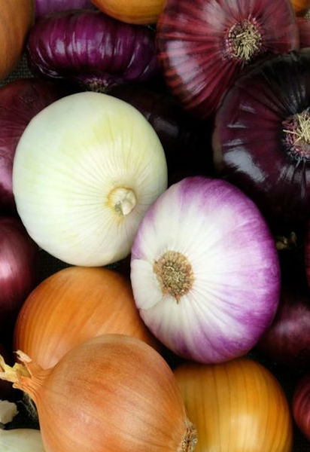
Red, yellow, or white onions can be used interchangeably. Do NOT increase the quantity Only use Green onions when in recipe
Notes:
Any type of bulb onion can be used for salsa for canning. Just don’t go over the total amount in the recipe. Green onions should not be used unless they are specifically listed in the recipe.

Slide 88
ACIDS
Do not reduce the amount of vinegar or lemon juice
Bottled lemon or lime juice can be substituted for vinegar
DO NOT substitute vinegar for lemon or lime juice

Slide 89
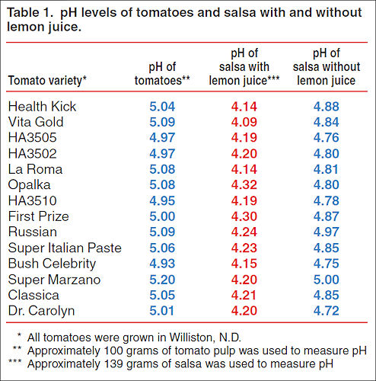
Acids must be added for safely canned salsa.
Notes:
https://www.ag.ndsu.edu/publications/food-nutrition/why-add-lemon-juice-to-tomatoes-and-salsa-before-canning
As you can see from this chart, many tomatoes these days are well above the low acid cut off of a pH of 4.6.
The pH of salsa made from these tomatoes are also well above a pH of 4.6. Canning these salsas without acidifying properly creates an unsafe product that could cause botulism.
If a recipe calls for vinegar, make sure it has at least 5% acidity. White vinegar doesn’t add color to the salsa but it has a tart taste. Cider vinegar can be milder but can also make the final color darker. Flavored or specialty vinegars are fine to use as long as they are labelled as 5% acidity or higher.
If the recipe calls for lemon or lime juice, make sure to use bottled juice rather than fresh.

Slide 90
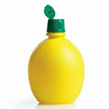
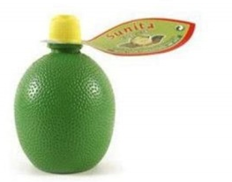
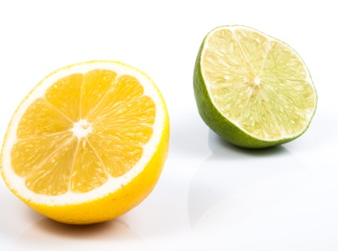
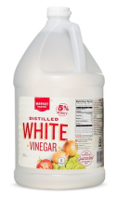
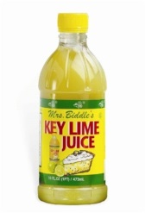
All acids are not created equal!
Recipe | Substitution | Safe?
 |  | YES
 |  | NO
 |  | NO
 |  | NO
Notes:
If a recipe calls for lemon juice, lime juice may be substituted.
Fresh lemon or lime juice should not be used since the acid level is not standardized.
Lemon and lime juice are higher in acid, so even 5% vinegar cannot be substituted safely in canned salsa recipes.
But lemon or lime juice can be substituted for vinegar.
Key lime juice should not be used;

Slide 91
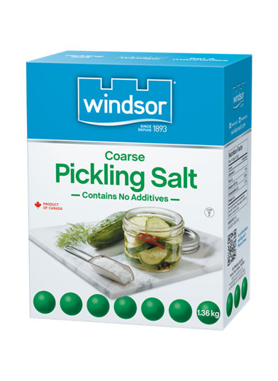
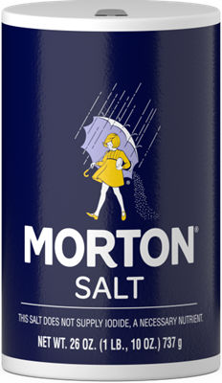
Pickling, canning or non-iodized table salt can be used in salsa recipes.
Notes:
We don’t recommend regular table salt for canned salsas. Salt can be left out if you would like.

Slide 92
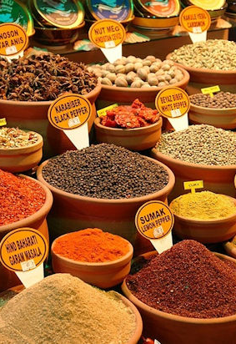
The amounts of dried herbs or spices can be altered.

Slide 93
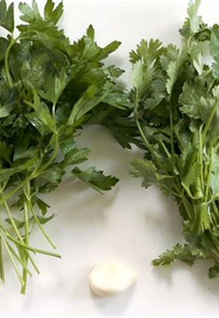
Adding or increasing fresh herbs or garlic is not safe.
Notes:
It is not safe to add or increase the amounts of fresh herbs or garlic before canning. This can lower the acid level.

Slide 94
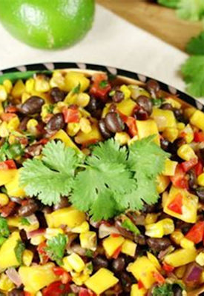
Additional ingredients can be added just before serving.
Notes:
It is unsafe to add thickener to salsa before canning, but feel free to thicken just before serving.
This can be done by pouring off some of the extra liquid, adding cornstarch clear jel or tomato paste.
Using a past tomato can also help with getting a thicker salsa.
Many people like to add corn, black bean, fresh cilantro or fruit just before serving.

Slide 95
THICKING SALSAS
Do not thicken before canning
Add commercial tomato paste to thicken BEFORE serving
Or use Clear Jel BEFORE serving

Slide 96
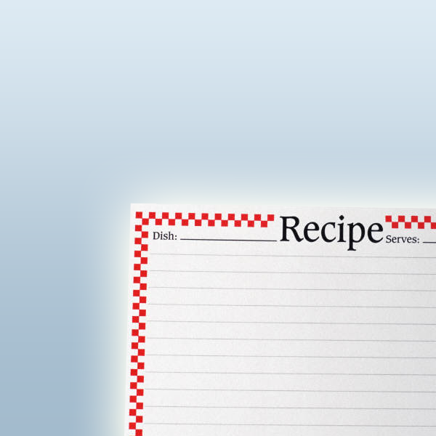
MAKING SALSA: PERSONAL RECIPES
What to do with personal recipes for salsa?
Don’t make it for canning!!
Freeze it for safety.

Slide 97
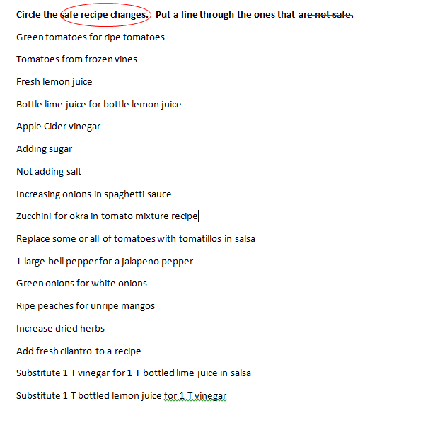
Let’s review safe substitutions

Slide 98
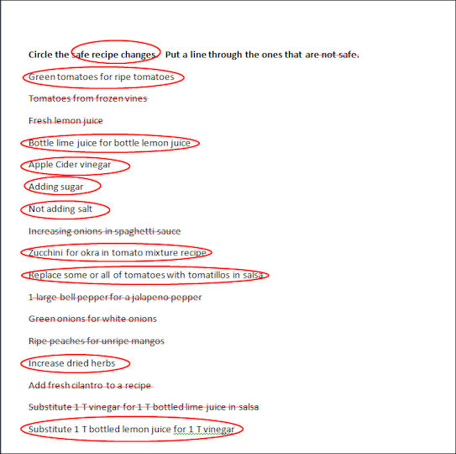

Slide 99

Questions/Comments
Time ???

