Slide 1

Jams & Jellies
(Making & Preserving Fruit Spreads)
Washington State University
Sandy Brown
Faculty Emeritus
Notes:
Slide set updated by Jennifer Kootstra – Spring 2018

Slide 2
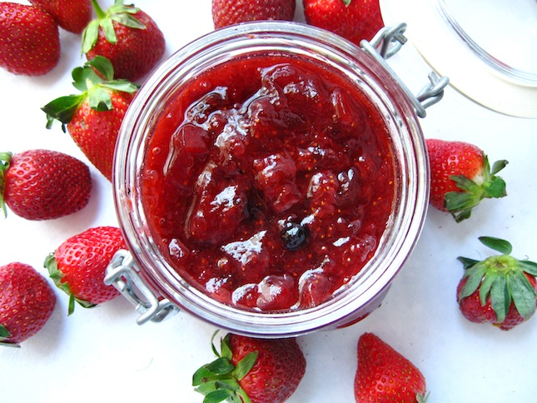
History of Fruit Spreads
Dates back to 18th Century
First commercial pectin – liquid in 1908
Hit the consumer market in 1923
Modified pectin's for low sugar – 1980’s

Slide 3
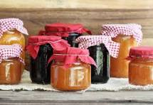
Categories of Fruit Spreads
Jellied Products
  Traditional full sugar/pectin product
Fruit Concentrates
  Sugar concentrates but little or no pectin
Reduced or No-Sugar Products
  Low sugar or no sugar
  Thickened with alternative thickeners

Slide 4
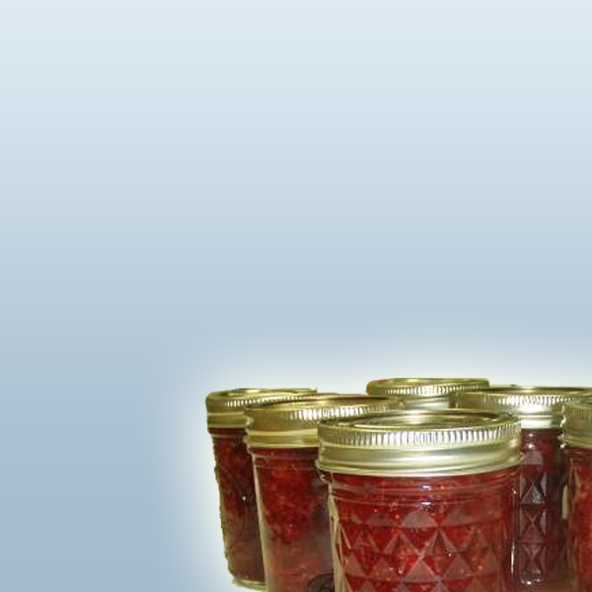
Jellied Products
Jellies - made from fruit juice; firm textured; clear; holds shape
Jams - thick, sweet spreads made by cooking crushed or chopped fruits with sugar; less firm than jellies
Conserves - jam-like products that may be made with a combination of fruits. They may also contain nuts, raisins or coconut.
Preserves - small, whole fruit or uniform size pieces in a clear, slightly gelled syrup. The fruit should be tender and plump.
Marmalades - soft fruit jellies containing
small pieces of fruit or peel (often citrus)
evenly suspended in the transparent jelly.

Slide 5
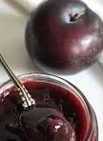
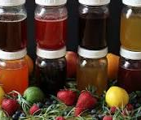
Fruit Concentrates
Preserved with sugar, but no pectin
Butters – Spread from concentrated fruit juice or pulp and sugar thickened through evaporation
Fruit Syrups – Fruit juice or pulp with sugar heated to syrup consistency – pourable
Fruit Honey – Cooking fruit juice or pulp with sugar until honey consistency

Slide 6
Reduced or No-Sugar Fruit Spreads
Little or no sugar added and must use thickener alternative
Modified pectins – Low-methoxyl pectin that set without sugar
Pectin Substitutes – Carbohydrate based; starches or vegetable gums or protein-based gelatins

Slide 7
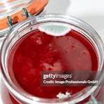
Safety of Fruit Spreads
Depends on sugar content and method of prep
Traditional fruit spreads –
  Low water activity due to high sugar content
  High acid fruit used
  MOLD – common with air present
  YEAST – wine like flavor, bubbling
  PREVENT by heat processing product

Slide 8
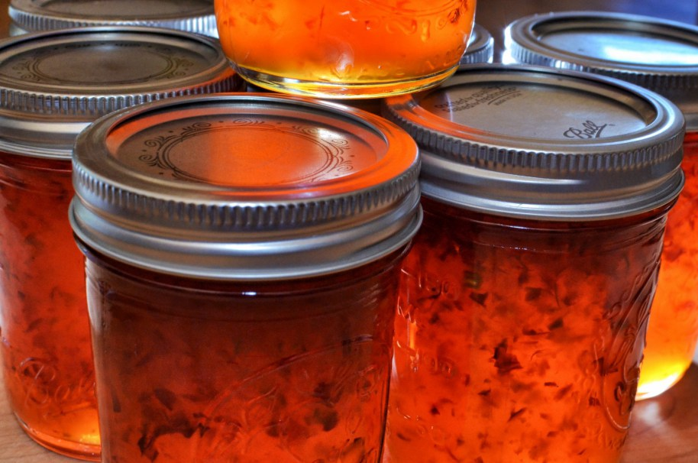
Vegetable based Fruit Spreads
Traditional pectin recipes usually enough acid
Usually acid (vinegar) is added
High amounts of sugar helps protect pathogen growth
This Photo by Unknown Author is licensed under CC BY-SA-NC

Slide 9
Safety of Fruit Spreads
Uncooked products
  Stored in refrigerator or freezer
Reduced or no Sugar
  Spoil more quicky – lack of sugar; acid level lower
  Use only high acid fruits
  Avoid low acid fruits or vegetables
Fruit Concentrates
  Use only high acid fruits and full sugar
  Avoid low acid fruits/veggies or reduced or no-sugar

Slide 10
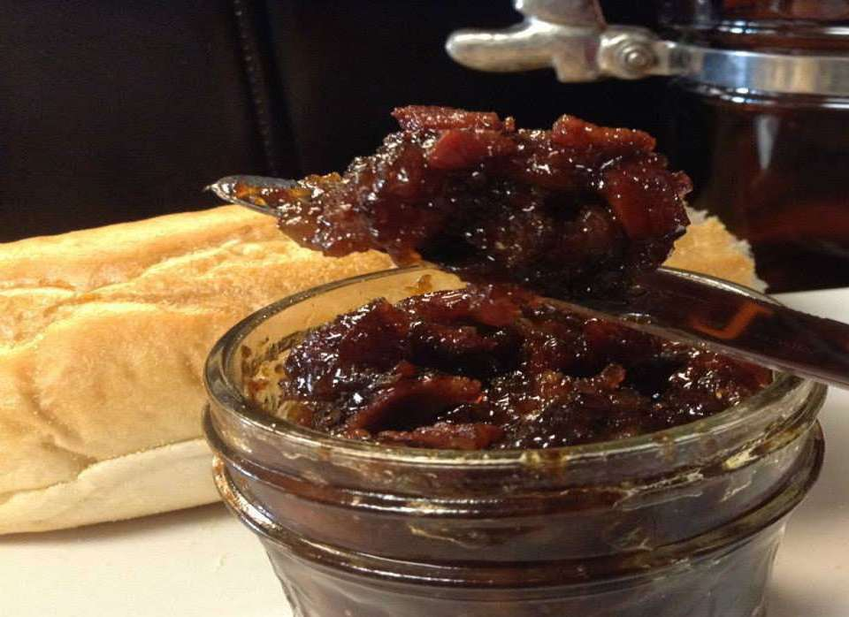
Safe Recipes
Use reputable sources for recipes
Full sugar/pectin products
Product gels- proves that enough sugar and acid
Watch out for Creative recipes
  Refrigeration best choice
  Cautious of low acid products
This Photo by Unknown Author is licensed under CC BY-SA-NC

Slide 11
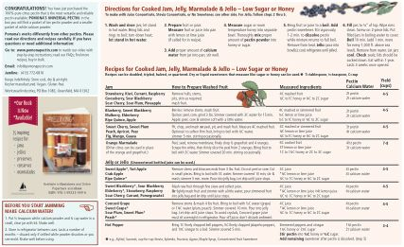
SOURCES FOR RECIPES
Pectin package inserts
So Easy to Preserve
WSU publications
USDA website: http://nchfp.uga.edu/
Recipes from many sources are generally safe as long as they are using high acid foods.

Slide 12
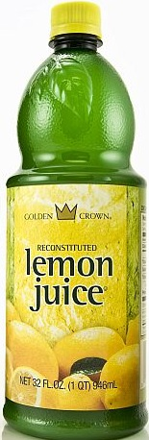
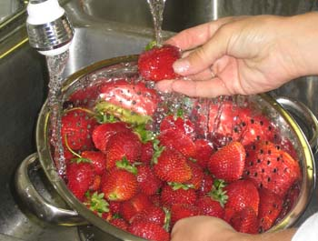
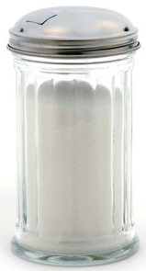
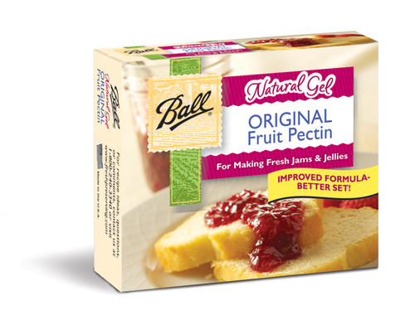
NECESSARY INGREDIENTS
For successful jellied products, a proper ratio of the following is needed:
  Fruit
  Gelling agents
  Acid
  Sugar
Notes:
We will talk about each of these individually.

Slide 13
FRUIT
Gives the product its flavor, and color.
Some pectin and acid.
Flavorful fruits are the
best because sugar
will dilute the flavor.
Use ripe or under ripe
  Acid and pectin levels higher
Over ripe fruit – may not gel

Slide 14
Elderberries – Safe??
NO....average pH is 4.92
Cannot make juice, syrup, or canned berries
Jam only when ingredients are weighed.
Jam – 16 ounces berries to 18.9 ounces sugar
Jelly – 16 ounces berries to 19.5 ounces of sugar
Can add more sugar if desired, NOT less
Lemon juice for gel formation not pH

Slide 15
Frozen, Canned, Dried fruits
Freeze fruits without sugar
Or note how much sugar is added
Measure and package amounts needed for recipe
Thaw fruit before making jams/jellies
Commercial products have less pectin – will be softer
Dried fruit – rehydrate in water before making jams

Slide 16
PECTIN
Pectin, working with sugar and acid, creates the jell in jelly.
Most fruit spreads contain about 1% pectin by weight.
Some fruits contain enough natural pectin to form a gel.
Slightly under ripe fruit contains more pectin than fully ripe.
Notes:
You don’t always have to add pectin to a recipe. It depends on the fruit. Follow the recipe.

Slide 17
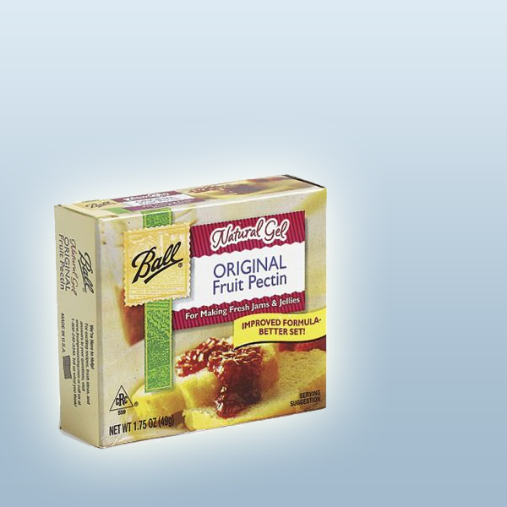
COMMERCIAL PECTIN
Commercial pectin contains dextrose, acid and sometimes product stabilizers.
Dry Pectin
MCP
Sure-Jel
Sure-Jel Light
Ball
Mrs. Wages
Liquid Pectin
Certo
Notes:
Pectin has a shelf life. Be mindful of the expiration date.

Slide 18
ADVANTAGES OF COMMERCIAL PECTIN
Less cooking, larger yield.
More natural fruit flavor.
Gel is more predictable. Eliminates the need to test for doneness.
May be stored in a cool, dry place.
Notes:
Jams and jellies made with the addition of commercial pectin use a short-boil process and produce a larger yield, take less time to prepare, and have a more predictable outcome.

Slide 19
Forms of Commercial Pectin
Powdered Pectin:
  Mixed with unheated fruit or juice
  Heated to boil and then add sugar
Liquid Pectin:
  Added to hot cooked fruit and sugar mixture
  Not interchangeable

Slide 20
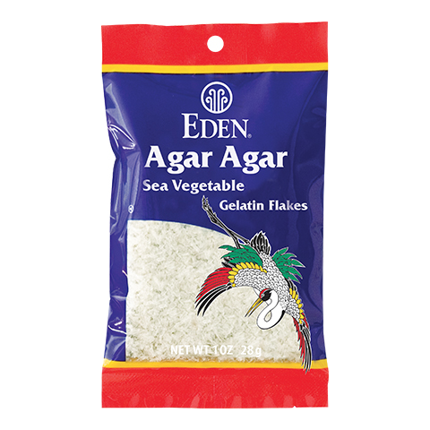
Pectin Substitutes – used for reduced sugar products
Vegetable Gums
  Xanthan gum or locust bean gum
Agar Flakes
  Derived from seaweed
  Cannot be heat processed
Starch Based Thickeners
  Clear jel products
Gelatin
  Similar to gelatin products
  Refrigerate only – up to 4 weeks

Slide 21
Acid
Needed for flavor and gel formation
Usually comes from fruit
Added when using fruit lower in acid
Acid higher in under ripe fruits
Too much acid – gel weeps

Slide 22
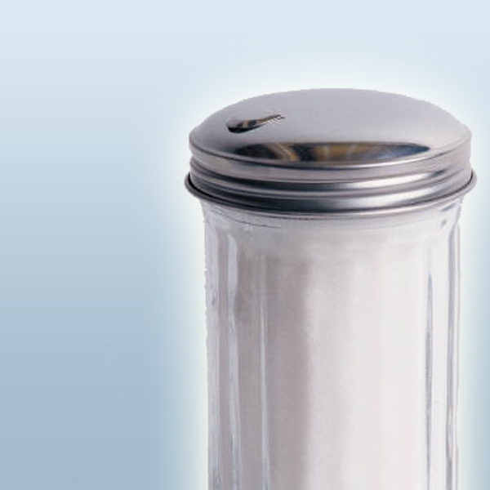
SUGAR
Sugar helps form gel, is a preserving agent, has a firming effect on fruit, and contributes to flavor.
Percent Needed by Weight:
  < 65% sugar the gel will be weak and runny
  65 - 68% - ideal
  Sugar > 68% - will not dissolve – resulting in crystals and grainy texture

Slide 23
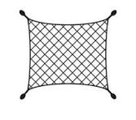
GEL STRUCTURE – FORMING A NET
Sugar is necessary for pectin to form framework of fibers or structure to hold liquids.
Amount of pectin influences the denseness of the framework of fibers.
Acid determines the
toughness of the fibers.
Notes:
Pectin is a naturally-occurring plant fiber found in most fruits. Pectin molecules are long and flexible; when they form cross-links, they trap and bind water, causing the jam or jelly to form a gel.

Slide 24
USING “OTHER” SUGARS
Corn Syrup
  Can replace part of the sugar
  ¼ of sugar using no added pectin
  ½ of sugar using powdered pectin
  2 cups of sugar using liquid pectin
Honey
  ½ of sugar can be replaced in recipes without added pectin
  2 cups honey can replace 2 cups sugar in recipes with pectin added

Slide 25
Sugar Substitutes
Artificial sweeteners don’t work as regular sugar does
Must use an alternative pectin or thickener
Cooked jams/Jellies
  Use heat stable sweeteners (Stevia or Sucralose)
Saccharin based will be bitter
Aspartame loses its sweetness when heated

Slide 26
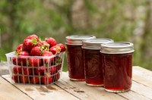
PRESERVING FOODS FOR SPECIAL DIETS
Low-Sugar Jams & Jellies
Sugar promotes gel and is preservative.
Low sugar jam and jelly requires use of special products.
Keeping quality is lessened without sugar.
Different Consistency
  Softer
  More like gelatin dessert
This Photo by Unknown Author is licensed under CC BY-SA-NC

Slide 27
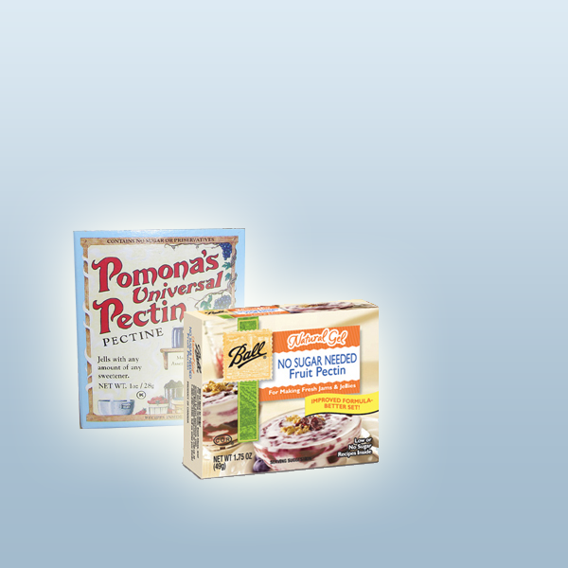
LOW SUGAR or NO SUGAR FRUIT SPREADS
Use recipe developed for low or no sugar spread. Don’t reduce or eliminate the sugar in a regular recipe.
Recipe should call for modified pectin, alternative jelling agent, or long boiling.

Slide 28
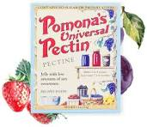
Pamona's Pectin
Used to make low sugar gel products
Made from peel of lemon, lime, oranges
Allows you to use as much sweetener as you would like.
Calcium substance used for gelling
Make up the calcium liquid separately
Added after pectin, sugar, and fruit are mixed.
Keep track of your recipe as you go along.
Product is processed
Allows you to make larger batches

Slide 29
PRESERVING FOODS FOR SPECIAL DIETS
Jams Made With Gelatin
Make small batches.
Keep in the refrigerator.
DO NOT FREEZE OR CAN.
Not stable at room temperature.
Refrigerate for up to 4 weeks.

Slide 30
LARGER BATCHES OF JAM & JELLY
Follow manufacturer's directions
  Pectin will vary in weight and specific instructions from manufacturer to manufacturer.
  Best results should be obtained by following manufacturer’s recipes and instructions.
Do not double recipes for jam or jelly.
  Longer cooking time may cause jell failure.
Larger containers should not be used.
  Larger than ½ pint size may cause weaker jell.

Slide 31
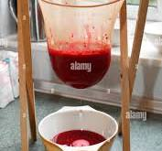
PREPARING FRUIT FOR JELLY USING JELLY BAG
Wash in cold running water
Don’t allow the fruit to stand in water
Slice fruit, add water and heat to boiling
Pour into a jelly bag, or several layers of cheesecloth
Allow to drip freely for clearest jelly
Squeeze bag for more product
Notes:
From OSU Ext Publication SP 50-455: Cellulose Pulp Method - An easy and fast way to prepare the juice is by mixing crushed prepared fruit with cellulose pulp made from unscented, white facial or toilet tissue. For every three cups of crushed fruit you plan to make into juice, use 1 cup of cellulose pulp (recipe follows). Mix the cellulose pulp with the crushed fruit and heat to the boiling point. Drain through a jelly bag. The cellulose pulp acts like a filter to help keep the jelly bag from clogging and clears the juice. The cellulose filter allows you to be able to squeeze the bag and get all the juice from the fruit.

Slide 32
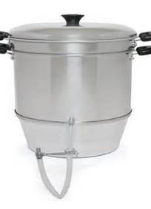
Preparing Juice using Juicer
Wash fruit well and place in the top of juicer
Fill the bottom pan with water.
Be sure to clamp off the spout
Steam until the fruit is dry
Place a jar or pot under the spout and release the juice.
Ready to process as juice, make into jelly, syrup or fruit honey

Slide 33
STEPS IN JAM or JELLY MAKING
Sterilize jars or not
Prepare two-piece lids
Prepare jelly or jam according to manufacturer’s instructions
Test for doneness
Fill Jars allowing the recommended headspace
Process in boiling water for 5 or 10 minutes
Uncover, remove from heat, rest 5 minutes
Remove from canner and cool upright for 12 hours or overnight
Remove screw bands, wash jars, label and store
Notes:
If you process for 10 minutes or more you don’t need to sterilize the jars. So save yourself the time and effort to sterilize and process 5 minute jams and jellies for 10 minutes.

Slide 34
MAKING JAMS & JELLIES WITH ADDED PECTIN
Use fresh fruits or juices
Commercial canned or frozen fruit juice
Use powdered or liquid pectin
Follow their specific directions
Requires less cooking and larger yield
More natural flavors
Eliminates temperature checking and risk of failure.

Slide 35
MAKING JELLY WITHOUT ADDED PECTIN
Prepare juice.
  ¾ ripe to ¼ under ripe fruit
  Don’t Use Commercial canned or frozen fruit juices – low in natural pectin.
  Juice fruits
  1 pound fruit yields about 1 cup clear juice.
Add sugar in large kettle (oversized kettle needed to prevent splatters).
Bring to boil while stirring rapidly and constantly.
Continue to boil to jellying point.

Slide 36
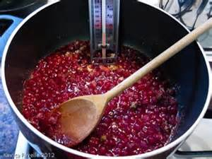
TESTING FOR DONENESS – TEMPERATURE TEST
Use a jelly or candy thermometer
Boil until mixture reaches the correct temperature
Sea Level 220° F
1,000 feet 218° F
2,000 feet 216° F
3,000 feet 214° F
4,000 feet 212° F
5,000 feet 211° F
6,000 feet 209° F
Notes:
Is anyone above 2000 ft? Page 7-14 in the handbook has elevations up to 8000 ft.

Slide 37

TESTING FOR DONENESS – SHEETING TEST
Dip a cool metal spoon into the boiling mixture.
Raise spoon 12 inches above pan, out of steam.
Turn spoon sideways.
Should form two drops and flow together and sheet or hang off the edge.

Slide 38
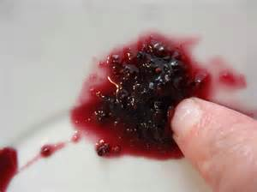
MAKING JAM WITHOUT ADDED PECTIN
Use fully ripe fruit, wash and crush.
Measure berries and sugar and bring to a boil stirring constantly.
Continue to boil until mixture thickens.
Test for doneness using the temperature test or the refrigerator test.

Slide 39
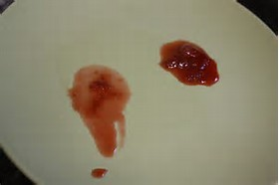
TESTING FOR DONENESS – REFRIGERATOR TEST
Remove jam mixture from heat.
Pour a small amount of jam on a cold plate and put in the freezer.
If mixture jells, it is ready.
Allowing jam to cool before filling jars will help it thicken.
Stir during the cooling process to mix pieces of fruit evenly.

Slide 40
Methods of processing or sealing jars of gelled products
Water bath process for 5 minutes
Water bath process for 10 minutes
Paraffin wax on top covered with a lid
Use 2 piece lid and ring and turn jars upside down
Use 2 piece lid and ring, cover with a towel overnight

Slide 41
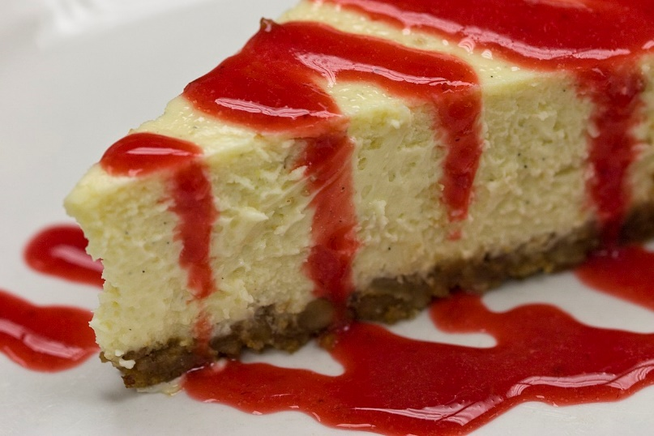
Remaking Fruit Spreads
Page 7-23 in handbook
Open containers and remake with additional ingredients
Fruit spreads that are softer or not set are SAFE
Use as syrup or dessert toppings

Slide 42
CRYSTALS IN JELLY
Too much sugar
Sugar not dissolved
Cooked too slowly
Cooked too long
Tartrate Crystals
  Found in grapes naturally
  Refrigerate grape juice 2-5 days before making jelly
  Strain juice in coffee filter or jelly bag

Slide 43
ADJUSTING FIRMNESS
Lots of fruit will differ in ripeness, acidity, natural pectin, therefore, jam or jelly may not be uniformly consistent.
If making more than one batch of jam or jelly from same lot of fruit, adjust ingredients as needed in subsequent batches.
With Added Pectin
  Use ¼ to ½ cup more fruit to make a softer product.
  Use ¼ to ½ cup less fruit to make a firmer product.
Without Added Pectin
  Shorten the cooking time to make a softer product.
  Lengthen the cooking time to make a firmer product.

Slide 44
FREEZER JAM
Freezer jam is not cooked or processed, thus it retains the taste and bright color of the fresh fruit.
Easier to make.
Must be stored in freezer.
Keeps weeks in refrigerator.
1 - 3 years in freezer.
Look for recipes in pectin packages.

Slide 45
PROBLEMS & SOLUTIONS FOR FREEZER JAM
Too Firm -
  Stir to soften
Separating -
  Stir to blend
Too Soft
  Bring to boil and cool to thicken

Slide 46
Fruit Butters
Made with acidic fruits only
Relies on evaporation of the fruit pulp to thicken
Combined with sugar, lemon juice and spices
Slowly cooked to a smooth consistency
Cooked until mixture rounds up on a spoon
Stovetop, crock pot, microwave.
Heat process for shelf stability
NO Pumpkin butter ---unless frozen

Slide 47
Fruit Syrups
Made from flavorful fruits or mixtures of fruits
Various consistency – thin, medium or slightly gelled
Mix equal amounts of fruit puree or juice and sugar
Boil and stir for 2 minutes
Add lemon juice and piecing if desired
Pints or half-pints processed for 10 minutes

Slide 48
Fruit Honey
Sweet fruit product consistency of honey
Uses washed sound pieces of fruit, and peelings
Cover with water and cook slowly until soft
Place in cheesecloth to press out the juice
Boil juice
Add sugar – ½ as much as there is juice
Boil until consistency of honey
Process in sterilized jars for 5 minutes.

Slide 49

Troubleshooting Fruits Spreads
Group Discussions
Page 7-24 to 7-26!!!

Slide 50


Slide 51
Homework
Review and organize the PowerPoint, handbook and other handouts
Answer questions on quiz handouts attached. (Remember it is not what you remember or memorize but knowing how and where to find the answers!)
Read Chapter 6 in Handbook –Pickling
Come up with a couple good questions about basic canning, and equipment
Review social media sites or You Tube Videos on basics of canning, equipment, canning

