Slide 1

Canning Basics Canners & Jars Washington State University Sandy Brown Faculty Emeritus

Slide 2

LET'S REVIEW
OSU video...anything new?
New Questions – put in the chat please?
Study Questions..... break out groups

Slide 3
PRESERVATION HISTORY
Canning as a food preservation method started in:
1809 1820 1790 1831 1920
27% of people preserve foods at home
Nearly ½ of home canners get information from family and friends
Recipes developed before 1988 are NOT recommended.

Slide 4
DETERMINING WHICH CANNING METHOD TO USE
The canning method that is approved for a food depends on the type of food.
Most important factor to consider is the acidity level of the food being canned.
“Acid Foods” - those that contain acid
“Low Acid Foods” Those with very little or no acid
“pH” is the measure of acidity
The lower the pH the more acid the food.
The higher the pH the less acid the food

Slide 5
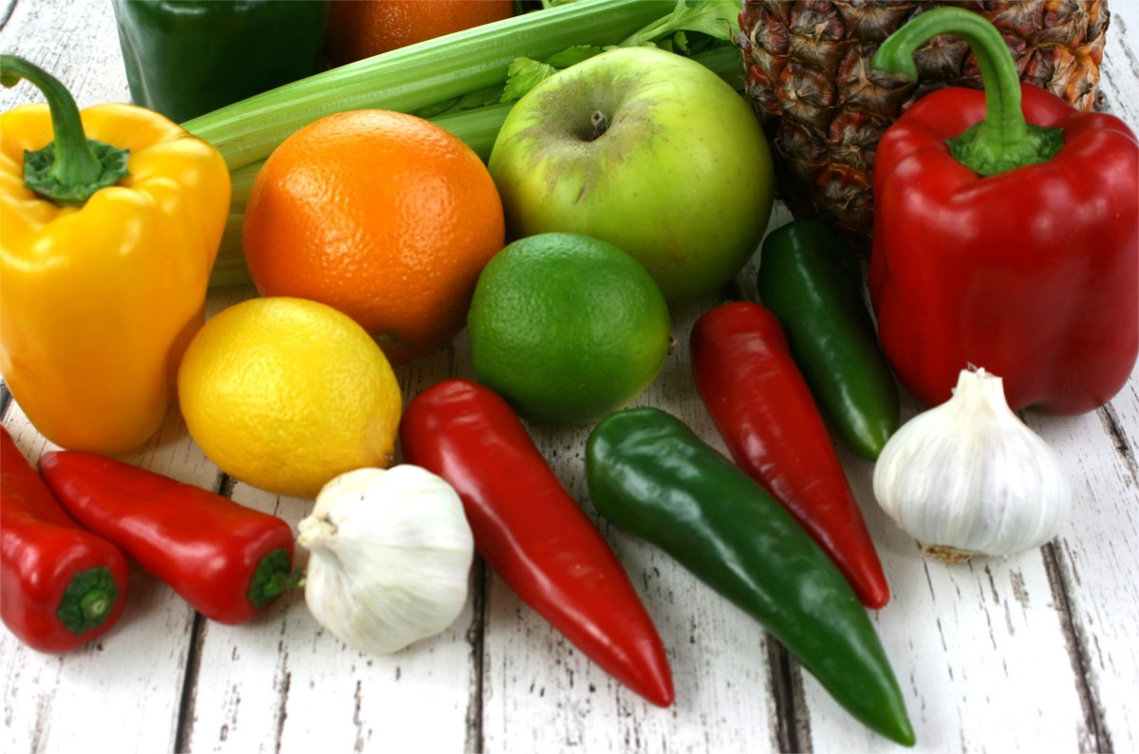
ACIDITY LEVEL OF FOODS
pH level of common foods:
2.0 lemons
2.9 vinegar
3.9 pears
4.0-4.6 tomatoes
5.0 pumpkins, carrots
5.6 asparagus
NOTE: 4.6 is the lowest acidity level for safely using the boiling water canning method
This Photo by Unknown Author is licensed under CC BY-SA

Slide 6
ACID FOODS
Acid Foods have a pH of 4.6 or lower.
Acidic enough to block growth of bacteria.
Includes:
Most berries, grapes
Apples, pears, nectarine, peaches, apricots
Rhubarb
Generally, all fruits, jams and jellies.
Pickled products (foods that have large amounts of added acid).
Sauerkraut
Exceptions:
Figs – 4.6
Asian pears – 4.7
Melons – 6.2 – 6.3
Bananas – 4.6
Papaya – 5.1
Tomatoes – 4.6 or higher

Slide 7
Processing Times and Acidity
Processing Times are impacted by Acidity Levels
Less time is needed when acid levels are high
Takes less time to destroy bacteria and spoilage organisms.
Refer to Table 3.1 on page 3.3 in handbook

Slide 8
Measuring pH is precise and conducted in controlled environments.
Litmus paper is NOT a substitute for a pH meter
pH meters must be calibrated before each use.
Determining
pH

Slide 9
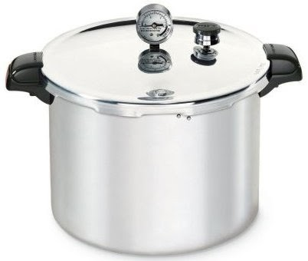
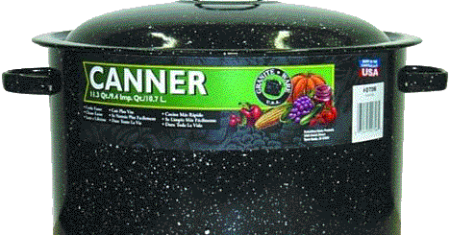
Boiling Water Canning Versus Pressure Canning
Boiling Water Canner
For all acid foods
Most fruits
Jams/Jellies
Fruit Juices
Pickled Foods
Pressure Canning
All Low Acid Foods
Meats
Fish
Poultry
Vegetables

Slide 10
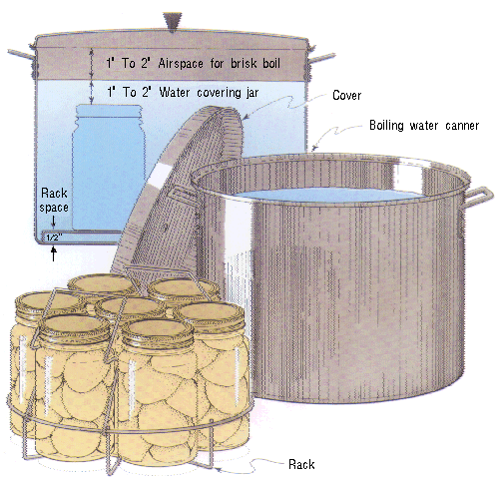
BOILING WATER BATH CANNERS
Used to process high-acid foods only.
Can be any deep kettle or pot that:
Has a tight fitting lid.
Has a rack to hold jars off the bottom of the pot.
Is deep enough to cover jars with 1”-2” of boiling water.
Made of aluminum or porcelain-covered steel.

Slide 11
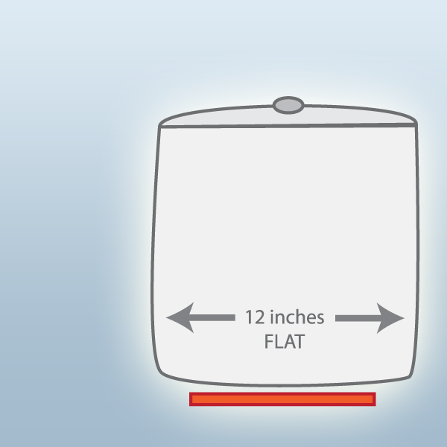
BOILING WATER CANNERS – SIZE & TYPE
Needs to have a flat bottom
Must make contact with cook top
No more than 4 inches wider than burner surface.
With solid element or smooth tops, no more than 1 – 2 inches wider than burner surface or follow manufacturer's directions.

Slide 12
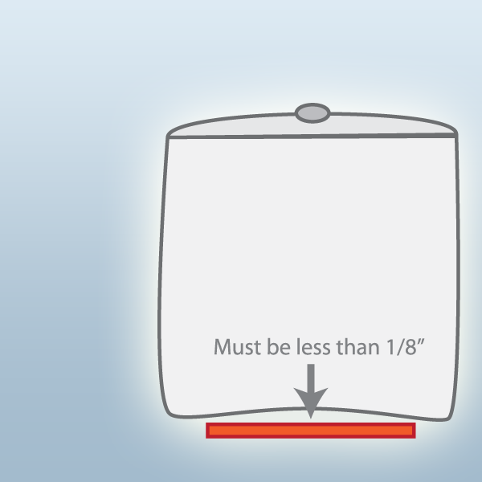
BOILING WATER CANNERS – SIZE & TYPE
Concave Bottom Canners:
Lightweight aluminum pots have concave bottoms.
If concavity is more than 1/8 inch it will not heat well enough.
Concave bottomed pans can be used on gas ranges.

Slide 13
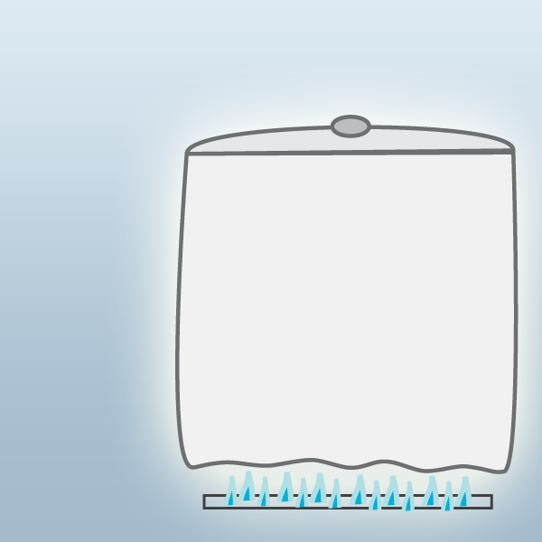
BOILING WATER CANNERS – SIZE & TYPE
Ridge Bottomed Canners:
Are best used on a gas range top.

Slide 14

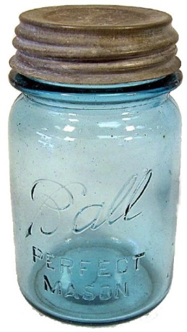
Canner sizes
Described by volume of water they hold
16 quart holds 16-quarts of water
Most water bath canners hold 7quarts or 8-9 pints
Half gallon jars are too tall for most canners
Can process 2 layers of jars
Place wire rack between jar layers
Water MUST cover top jars by 1-2 inches
This Photo by Unknown Author is licensed under CC BY

Slide 15
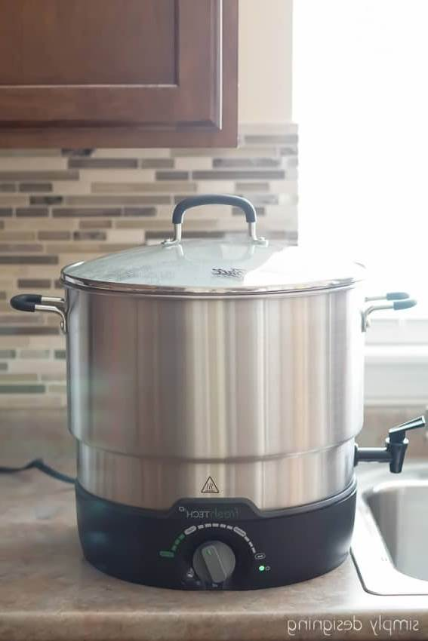
Electric Water Bath Canner
A large Canner that sits on counter to preserve foods
Contains a rack, temperature control, lid and diffuser.
Can set the temperature to heat water and hold it
Then turn up when ready to process
Diffuser works to even out the temperature of water
Glass lid to see when it is boiling.
Waterspout to empty canner easily
This Photo by Unknown Author is licensed under CC BY-SA-NC

Slide 16
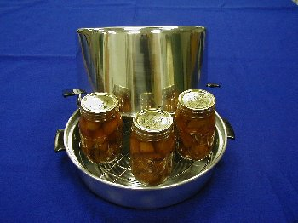
STEAM CANNERS
Not recommended in WASHINGTON
Cold Spots
Release of Steam
Jar Breakage
Under processing
Uneven cooking
Steam Burns
No Researched processing times
WSU Cooperative Extension does not recommend using steam canners

Slide 17
Check out these videos
Steam canning Tutorial
https://www.youtube.com/watch?v=FCtNeVh5Gcw
Steam Canning Approved Atmospheric Steam Canner
https://www.youtube.com/watch?v=oLzraNT0FLA

Slide 18


Slide 19
OPEN KETTLE CANNING
“Open Kettle” canning is when food is heated only
NOT RECOMMENDED.
Temperature doesn’t kill spoilage organisms.
Bacteria may be transferred into jar.
Air remains in jar and can cause spoilage.

Slide 20
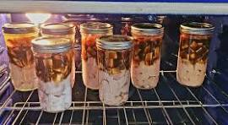
OVEN CANNING
Oven canning is not recommended for the following reasons:
Jars may explode.
Temperature not hot enough to safely preserve food.

Slide 21
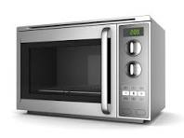
MICROWAVE CANNING
Some Jams and Jellies have specific recipes developed for using a microwave oven.
Herbs can be dried in the microwave.
Small amounts of vegetables can be blanched.
Used to heat pickling or canning liquids to boiling.
Regular Canning not recommended because:
Temperatures not high enough
Pressure not possible
Jars break

Slide 22
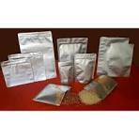
Pouch Canning
Special pouches are put in canners to process several at a time
No research on processing times
Heat penetration different than jars
Often cold spots move around
When over filled, they can burst
Move around during processing
NOT RECOMMENDED

Slide 23
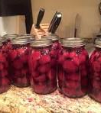
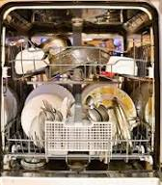
DISHWASHER “CANNING”
Processing in a dishwashing cycle is NOT recommended.
Temperature of the water during the cleaning and rinsing cycle is far below what is required to kill organisms
Results in under processing.

Slide 24
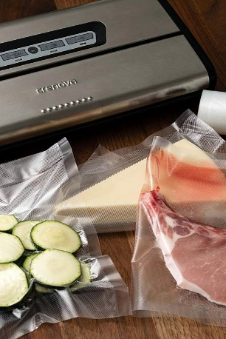
VACUUM PACKAGING MACHINES
Not a substitute for heat processing of home-canned foods!
Extends storage time of refrigerated, dried and frozen foods.
Vacuum packaged foods MUST be refrigerated or frozen.
This Photo by Unknown Author is licensed under CC BY-SA

Slide 25
DRY CANNING – Dried grains and flours
Putting dried foods into jars
Lids applied before or after heating
Heated in the oven at 200 Degrees F
Not a preservation method, but a packaging method
NOT RECOMMENDED

Slide 26
WHAT IS THE CONCERN?
Unknown if food is sterilized
May cause a vacuum seal
Enough heat and time to kill bacterial or mold spores – questionable
Does not remove all the oxygen from the jar
May trap some condensation moisture in jar
Heating could reduce the quality of the food

Slide 27

DRY CANNING VEGETABLES AND MEATS?
Product put into jars without any liquid
Processed for same time as with liquid
Produces a better-quality product
BUT is it safe?
Liquid over the food is REQUIRED for the expected heat penetration during processing.
Bacteria and spores ar emore ensitive to wet heat than dry heat
Risk of Botulism is very high using this method!!!

Slide 28
Dry Canning
https://www.youtube.com/watch?v=uZ86oKostBM
Take some notes for Discussion groups:
Any misinformation or questionable information
Anything that can be confusing?
Thoughts and Ideas about her messages?

Slide 29
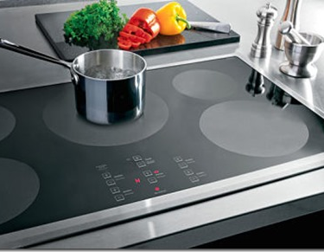
CANNERS ON SMOOTH TOP STOVES
YES or NO?
Flat bottom pot contact
Potential Issues:
Damage to the cooktop
Maintaining consistent heat temperatures
Limitations on size and design of canners
All-American canners may be too heavy for glass stove tops.

Slide 30
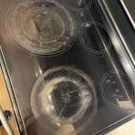
DAMAGE TO THE COOKTOP
Excessive heat reflects down on the surface
especially when canner is larger than burner
Range of damage
Discoloration of white tops
Burner damage
Cracking of the burner/cooktop
Scratching when slid or pulled across the cooktop
Some pressure canners not able to build up pressure

Slide 31
OVER-HEAT PROTECTIONS
Many cooktops have automatic cut off when heat is excessive
Product will be under processed and cannot be salvaged
Processing time must be continuous

Slide 32
MANUFACTURER RECOMMENDATIONS
Contact manufacturer
They may have suggestions for equipment
Describe
the size of canner needed to be used
how long it must stay on high heat
how long it must sit to cool
what material the canner is made of

Slide 33
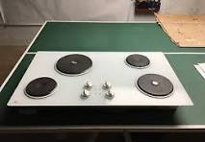
Solid Element Burners
Requires heavy gauge, flat, smooth-bottomed canners
No more than 1-2 inches overhang beyond the element
Some pressure canners are too large
Measure the concavity of canner.
Place straight edge across the canner bottom
Measure the distance to the canner bottom
No more that 1/8th inch

Slide 34
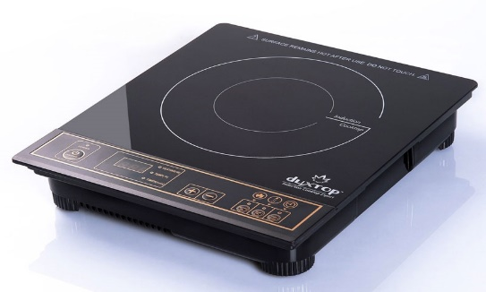
Induction cooktops
Elements appear as circular patterms on ceramic glass
Magnetic field generates heat into a magnetic cooking pot
Only pots made of
Cast iron
3-ply stainless steel that contains a carbon steel core
Enameled steel
Enamel coated cast iron
If a magnet is strongly attracted to the bottom of the pan, it will work

Slide 35

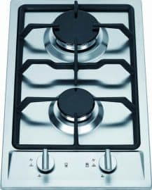
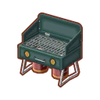
Liquid Propane or Gas Ranges
When heat source is too hot, the canners will warp
Not recommended to use a liquid propane burner or gas range over 12,000 BTU’s

Slide 36
APPROPRIATE JARS & LIDS FOR HOME CANNING
Mason-type, threaded, home canning jars are best.
Sizes include:
4-ounce, half-pint, pint, 1 ½ pint, quart, ½ gallon
Half gallon only for juices
Standard jar mouth size:
Wide mouth – 3 inches
Regular mouth – 2 3/8 inches
Use only size specified in reliable instructions.

Slide 37
NOT RECOMMENDED FOR HOME CANNING
Metal Cans
Not recommended for home canning.
One-time use.
Much more costly than jars.
Require special sealing equipment not available to home canners.
One-trip Jars
Made of thinner glass that is not tested for thermal shock.
Length of threads on lip and rounded sealing edge make getting a good seal difficult.
NEVER use for pressure canning.

Slide 38
PREPARATION OF JARS
Check for cracks and chips; don’t use if nicked or scratched.
Wash empty jars in hot water and soap; rinse well and keep hot until used.
If jars have mineral deposits, soak them in vinegar water. (1 cup per gallon water)

Slide 39
Heating Jars
Pre-Heat jars to prevent breaking
Heat in large pot of water or in canner
Use the dishwasher
DO NOT pre-heat in the oven
Pre-sterilize jars
Used on product processed less than 10 minutes
Boil for 10 minutes
Add 1 minute for each 1,000 feet above sea level

Slide 40
REASONS JARS BREAK
Common reasons:
Thermal shock
Pressure Breakage
Impact Breakage
Other Reasons:
Using one-trip jars
Imperfections in the jar
Using old jars
Life expectancy is 13 years

Slide 41
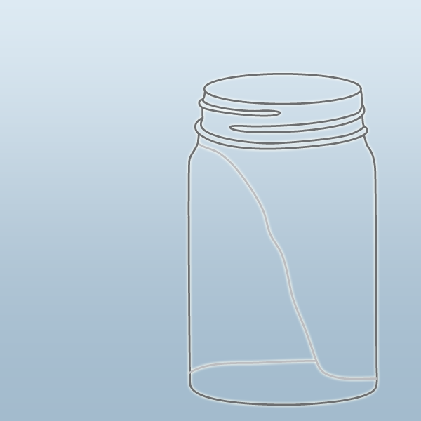
REASONS JARS BREAK – THERMAL SHOCK
Causes for jars breaking due to thermal shock include:
Packed with cold food then into boiling water
No rack in canner
Splattering hot jars with cold water
Cooling on cold surface or draft

Slide 42
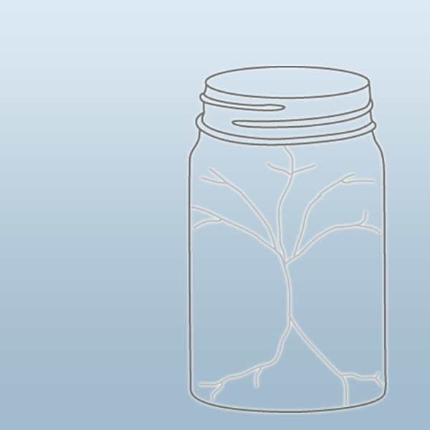
REASONS JARS BREAK – PRESSURE BREAK
Causes for pressure breaks in jars include:
Too little headspace
Unsteady heat in pressure canner
Decreasing pressure too fast in pressure canner
Using oven for processing
Oven Canning

Slide 43
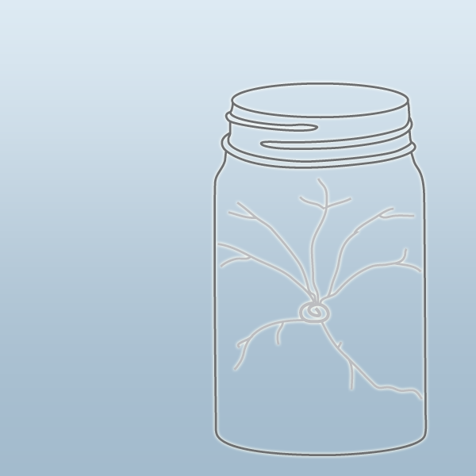
REASONS JARS BREAK – IMPACT BREAKAGE
Causes for impact breaks in jars include:
Using jars that have invisible damage from rough handling.
Using sharp metal knife to remove air bubbles.

Slide 44
LIDS & RINGS FOR HOME CANNING JARS
Two Piece Lids
Flat metal disc with sealing compound on edge.
Wash in warm soapy water ...NO heating needed
Rings
Necessary to hold flat lid on.
Remove after processing.
No rust or bends in the rings
Only need as many rings as the number of loads you can do in a 24-hour period

Slide 45
Lid Brands – Good or Bad
Ball
Denali
Pur
Two Lumps of Sugar
ForJars
Superb
Country Classic
Many more.....

Slide 46
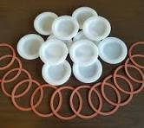
Tattler Lids
Plastic lid and rubber ring
Used more than once
Harder to tell if sealed
If used, follow manufacturers recommendations.
Not recommended as we have no research on their safety and use.
University of Idaho is doing current research on their safety and uses.

Slide 47
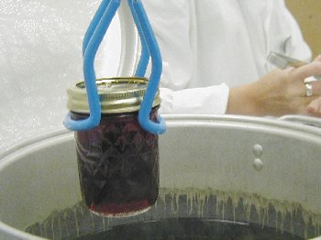
OTHER UTENSILS
Funnel
Ladle
Bubble Freerer
Jar Lifter
Clean Damp Cloth
Potholders
Towels
Timer

Slide 48
DETERMINING PROCESSING TIME
Factors that influence the processing time for home canned foods, include:
Style of food and size of pieces
Thickness and density
Added ingredients (starch, fat, bones)
Liquid to solid ratio
Initial temperature
Size and shape of jar
Processing temperature
Altitude
Number of spoilage organisms in product
These factors influence the length of time it takes to adequately heat the coldest spot in the jar.

Slide 49
Impacts of Altitude
As altitude increased, the boiling point of water decreases
Boiling Water Canning
Add additional processing time
1,001 – 3,000 feet add 5 minutes
3,001 – 6,000 free add 10 minutes
Pressure Canning
Increase in pounds pressure needed
Change pounds pressure at 2,000 feet

Slide 50

SESSION BREAK
Time for a break!

Slide 51
SELECTING FOOD FOR CANNING
When selecting food for home canning, always:
Choose good quality, fresh foods.
Discard diseased or moldy.
Process within hours of harvest.
Rinse, Don’t Soak.
Rinse 1-3 times.
Preservation will NOT improve the quality of the produce you begin with.

Slide 52
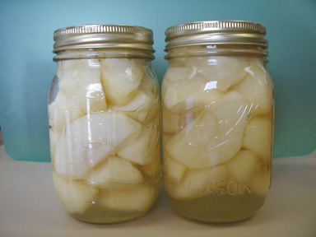
CANNING FRUITS
Use only high-quality products in sound condition.
Sugar improves quality - texture, taste, is not necessary for safety.
To prevent darkening during preparation, pretreat fruit in one of the following baths:
Dissolve six 500 mg. Vitamin C tablets in 1 gallon of water.
Mix 1 Tbsp Bottled Lemon Juice in a gallon of water.
Commercial Ascorbic Acid

Slide 53
CANNING FRUITS – RAW PACK
“Raw Pack” means that jars are filled tightly with freshly prepared, unheated food.
Results:
Less food in jar
Tastes fresher
Fruit may float
Trapped air may cause discoloration during storage.
Foods that loose shape in cooking are easier to handle in raw pack.

Slide 54
CANNING FRUITS – HOT PACK
“Hot Pack” means that food is brought to a boil, then simmered 3-5 minutes, and packed hot into jars.
Results:
More food in jar
Food may taste slightly ‘cooked’
Less oxygen results in better color and nutrient retention.
Less likely to “float.”

Slide 55
LIQUIDS USED TO FILL JARS
Any kind of liquid can be used to cover fruits when home canning.
Best liquids are sugar syrups:
Light
Medium
Heavy
Other liquids that can be used include fruit juices from concentrates, or fruit; alcohol/liquors or water.
No matter which liquid used, must be boiling.

Slide 56
PRESERVING FRUITS FOR SPECIAL DIETS
Sugar improves flavor and texture, not necessary for safety.
Water or natural fruit juice may be used in place of sugar syrup. Try one of these:
Peaches in orange juice
Pears and apples in apple or pineapple juice
Berries in cranberry juice

Slide 57
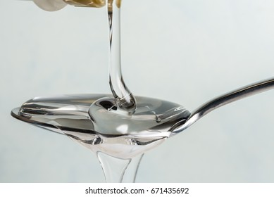
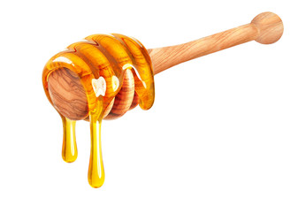
SUBSTITUTE SWEETNERS
Corn Syrup
Can replace up to half the sugar in syrups for canned fruits. Use only light corn syrup for neutral flavor and appearance.
Honey
May be substituted for sugar in canned and frozen fruits. Because it is sweeter, try using half the amount of sugar called for.

Slide 58
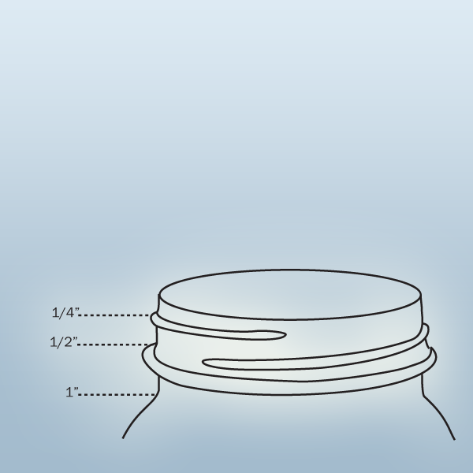
HEADSPACE
Space between the top of the food and top of the lid.
Headspace required depends on food and pack style.
More headspace is needed for:
Starchy foods that swell more
Foods that need to be pressure canned
Too little headspace:
Food expands and bubbles over jar rim and may prevent a seal.
Too much headspace:
Food may discolor
Excess air may allow mold to grow.

Slide 59
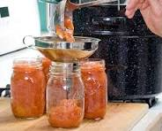
PROPER CANNING PRACTICES
Pack Jars Correctly
Use a canning funnel to make filling easier and less messy.
Pack hot or raw, according to instructions and avoid overfilling.
Cover with a boiling liquid.

Slide 60
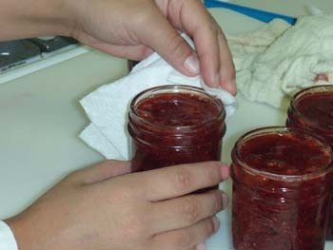
PROPER CANNING PRACTICES
Sealing the Jars Correctly
Release air bubbles
Using a bubble freer, or
Plastic straight utensil
Adjust headspace
Clean jar rim with a clean cloth
Place heated flat lid on rim.
Place ring over lid and tighten.

Slide 61
PROPER CANNING PRACTICES
Applying the Correct Lid Torque
Tighten ring until you feel resistance.
Re-position and tighten.
Too loose – liquid loss and seals may fail.
Too tight – air cannot vent, food will discolor, lids may buckle.

Slide 62
PIE FILLINGS
Yes, you can preserve pie fillings!
DO NOT USE :
Tapioca
Flour
Cornstarch
They cause the filling to be too thick
Heat cannot penetrate to safely kill organisms
Pie fillings may separate

Slide 63
SO, WHAT SHOULD I USE ?
CLEAR JEL
Derived from cornstarch
Thickens easily, doesn’t break down during processing
Use regular Clear Jel, not instant
Not available at grocery stores
3 cups equals one pound. Requires 1 ½ to 2 cups per batch of 6 to 7 quarts
Can also be used as thickener in jams and jellies

Slide 64
STEPS IN BOILING WATER BATH CANNING
Fill canner halfway with water.
Preheat water to 140° F for raw packed foods, 180° F for hot pack foods.
Load properly filled jars into canner rack, then lower rack into water.
Add more boiling water if needed, so 1-2” of water covers jars.
Cover canner with lid.
Turn heat to high until water boils vigorously.

Slide 65
. STEPS IN BOILING WATER BATH CANNING, cont.
Set time for required time.
At end of time, turn off heat. Remove lid.
Let stand for 5 minutes
Use jar lifter to lift jar straight out of canner
Set on towel or wooden cutting board
Do NOT tighten lids
Cool 24 hours without touching

Slide 66
TESTING FOR A GOOD SEAL
After 24 hours.....
Press middle of lid. It should not spring up.
Tap lid with spoon. If it sounds dull, it may not be sealed. (Food stuck to lid may cause dull sound.)
Hold at eye level and look for lid to be concave - curved down slightly in center.

Slide 67
Storing Jars
Take the rings off and wash
Wash the jars well to get any residue off the jars.
Store in a dry, cool, dark location (50-70 degrees)
Avoid temperature flucuations or above 90 degrees
DO NOT STACK jars

Slide 68
Discussion Group Topics
Group Terri – What causes liquid loss? Is the food safe or does it need to be reprocessed?
What do you do to prevent liquid loss.
Group Kristin: What are some signs of spoilage in canned foods. How would you dispose of it?
Group Laurie: What causes seal failures. What do you do with them? What would you do to prevent seal failures?
Group Sandy: How do you know food is safe in a jar? Why would a jar lid buckle? Is it a safe seal?

Slide 69
CANNING PROBLEMS – SEAL FAILURES
CAUSE
Old or reused lids
Damaged rim
Spoilage due to improper processing
Food particles on rim
PREVENTION
Buy new lids
Check rim
Use correct time and method
Wipe rim before closing, use correct torque

Slide 70
CANNING PROBLEMS – SEAL FAILURES, cont.
Other reasons jars don’t seal include:
Non-standard jars used
Nicks and cracks on edge
Rims not cleaned
Lids not pretreated correctly
Food packed too tight
Headspace incorrectly
Air bubbles
Rings tightened incorrectly

Slide 71
WHAT TO DO IF A SEAL FAILS
Foods that were under processed, or if a jar fails to seal may be reprocessed if done within 24 hours.
Alternatives to reprocessing:
Refrigerate and use within few days.
Freeze for use later.
DO NOT REPROCESS IF:
Jar sealed after processing and lost it during storage.
Foods were under processed or not processed correctly and held over 24 hours.

Slide 72
CANNING PROBLEMS – LIQUID LOSS
Jar packed to tightly
Not enough headspace
Starchy foods absorbed liquid
Not removing air bubbles
Jars not covered with 2” water
Removing jars too quickly from boiling water

Slide 73
DETERMINING IF FOOD IS SAFE TO EAT
Was it canned by up-to-date instructions from reliable source and followed explicitly?
Is jar sealed?
Are there no obvious signs of spoilage?
Is the liquid clear?

Slide 74
SIGNS OF SPOILAGE
Incorrectly processed low acid food should be considered spoiled, even if it appears normal.
Cloudy canning liquid (may also be caused by salt additives or minerals in water).
Strange odor.
Mold growth.
Jar not sealed.

Slide 75
DISPOSING OF SPOILED CANNED FOODS
High acid foods
May be flushed down toilet or put in garbage disposal with lots of water.

Slide 76
Tomatoes….
Tomatoes have various pH levels
Recommendations changes in 1988
Lengthened to ensure tomato varieties were safe
Raw pack option added
More packing methods developed
Acidification a must

Slide 77
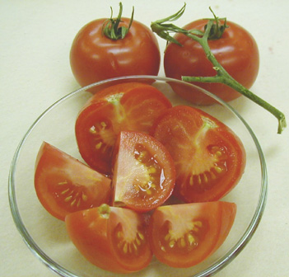
CANNING TOMATOES
Select disease free, vine-ripened tomatoes
Do not can tomatoes from dead or frost-killed vines.
Do not can overripe tomatoes – too low in acid.
Green tomatoes are more acidic than ripened fruit.
Tomatillos can be canned using regular tomato canning procedures.

Slide 78
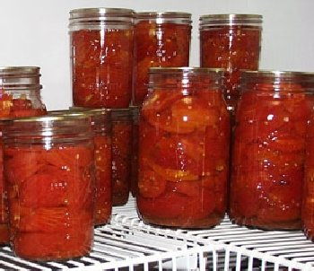
METHODS OF CANNING TOMATOES
Crushed
Whole/halved in water
Whole/halved in tomato juice
Raw in own juice
All methods seem to produce similar products.
Refer to PNW 395
Canning Tomatoes

Slide 79
MAKING TOMATOES SAFE
Add bottled lemon juice to each jar of tomatoes.
1 Tablespoon per pint
2 Tablespoons per quart
OR use ¼ tsp. citric acid crystals per pint or ½ tsp. citric acid crystals per quart
Cannot substitute juice from lemons or vinegar.
Additional acid will not help overripe tomatoes.
Add sugar if too tart (1t/pint; 2t/quart)

Slide 80
Water Bath or Pressure Can Tomatoes?
Either one…
Have equivalent organism kill rates
Heat not enough in either to kill botulism spores…… So acid is required to all products.
Some products only recommend one processing method so safety would be the reason.

Slide 81
Tomato Juice
Homemade Juice will separate
Pectinase breaks down Pectin in the tissues that cement the cells
Commercially heated to boiling in seconds to destroy the pectinase
Then the pectin holds the tomato cells together to makes a thick juice.

Slide 82
METHODS FOR MAKING TOMATO JUICE AT HOME
Cold break
Crushing tomatoes before heating.
Enzymes break down the pectin that holds tomato cells together, causing liquid and pulp to separate.
Hot break
Tomatoes heated to nearly boiling very quickly
Enzymes and pectinase are destroyed before they have a chance to break down the pectin.
Blender juice
Never puree raw tomatoes in blender to make juice.
Enzymes break down the pectin that holds tomato cells together, causing liquid and pulp to separate.

Slide 83
CANNING TOMATO MIXTURES
Tomatoes are not acidic enough to be able to process tomato mixtures in a boiling water bath canner
Always use a pressure canner for any product that has tomatoes and any other low-acid vegetable.
Tomato/Vegetable juice – 22# tomatoes to 3 cups vegetables

Slide 84


Slide 85
HOMEWORK
For October 16th Class
Review social media sites or You Tube Videos on any topics we have covered so far in class. Food safety, Freezing, drying, basics of canning, equipment, canning acid foods or tomatoes, dry canning, etc. Keep track of the link to share with group in the chat next week.
When reviewing consider​:
Accuracy of information ​
Appealing to watch and listen or read ​
What is something new that you learned or that
Was it eye catching (good or bad), fun​, boring, entertaining,
Were there any red flags or inaccuracies?​
Would you recommend this site, why or why not.
Be sure to look for the little things around the kitchen, techniques being used, details.

Slide 86
HOMEWORK – to be discussed on October 23rd
Review and organize the PowerPoint, handbook and other handouts
Answer questions on quiz handouts attached. (Remember it is not what you remember or memorize but knowing how and where to find the answers!)
View Dry Canning video https://www.youtube.com/watch?v=uZ86oKostBM
Or any other dry canning YouTube video
Thoughts, accurate or not?
OPTIONAL: View the OSU video on Tomatoes – 1 hour 20 minutes https://oregonstate.app.box.com/s/i9a6kh7o7a32688cq9n6iav0gyig8m0f/file/774618697670

