Slide 1
Basic Practices of Freezing Food
Washington State University
Sandy Brown
Faculty Emeritus

Slide 2
WHY FREEZING?
Advantages:
Easiest form of preservation for most foods.
Less time consuming than canning or drying.
Provides product closest to fresh
Good natural color and flavor retention.
Best nutritive value retention.
Adds convenience to food preparation.
Proportions can be adapted to needs unlike other methods.
Kitchen remains somewhat cool and comfortable.
Disadvantages:
Texture of some foods is undesirable because of changes due to the freezing process.
Product loses quality more quickly.
Initial investment and cost of maintaining a freezer is high.
Storage space is limited by how much the freezer will hold.

Slide 3
FREEZER FACTS
Determining the appropriate freezer size:
  One cubic food holds 35 pounds of frozen food.
  Freeze 4-6 cubic feet of food per person.
Freezer Facts
  Stand-alone freezers maintain 0°F or below.
  Refrigerator freezers only maintain about 15°F.
  Defrost when frost is ½ inch thick.
  Thick ice increases energy costs and reduces storage space.
  Keep freezer full for best storage and energy use.

Slide 4
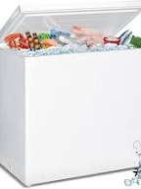
Types of Freezers
Chest
Requires more floor space
Can store more food
More energy efficient
Should maintain 0°F or lower
Have to manually defrost 1-2 times/year
  Be sure it has a drain to make this easier

Slide 5
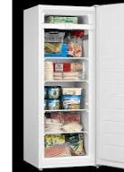
Types of Freezers
Upright
Requires less floor space
Uses 25-40% more energy
Frost-free freezers
  Only upright models
  Uses more energy
  Less work to maintain

Slide 6
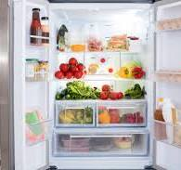
Refrigerator Maintenance
Buy smallest refrigerator that meets your needs
Clean condenser coils each year
Have a cool, dry place with adequate circulation space for freezer.
Set to maintain temperatures of 40°F
Keep free of odors
Don’t use solvent cleaners or abrasives.

Slide 7
Freezer Features
Light or alarm that signals when off or temperature is too warm
Lock (especially with small children)
Drain for defrosting
Removable shelves, bins or baskets
Rollers/wheels for moving
Temperature control dial

Slide 8
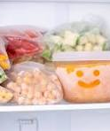

How Long is food safe in the Freezer?
As long as food went into the freezer safe
The food has never thawed
It will be safe....

Slide 9
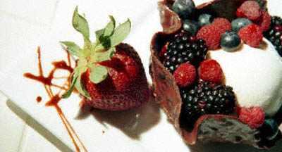
How Safe if Freezing?
Food will be
as safe to eat
when thawed as it
was just before
freezing (if thawed
correctly).

Slide 10
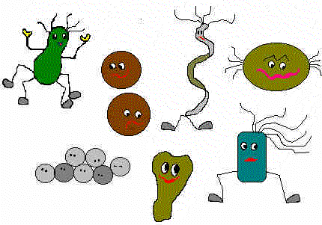
Why So Safe?
Microbial growth (pathogens and spoilage bacteria) stops at 28°F.
Chemical changes occur at a very reduced rate.

Slide 11
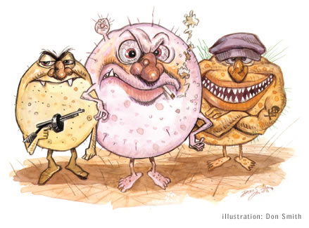
Safety of Frozen Foods
Freezing does destroy some bacteria and parasites.
Because all organisms are not destroyed, good food handling skills are needed to control bacterial during thawing and once thawed.

Slide 12
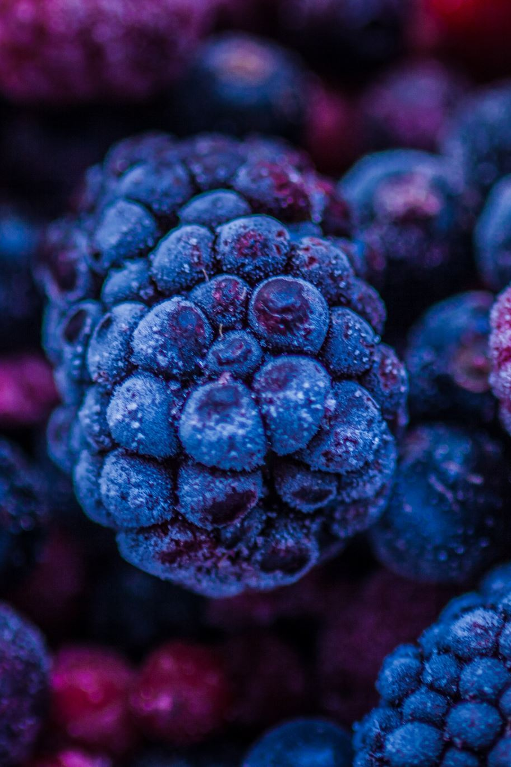
FREEZING PRINCIPLES
There are four factors responsible for most of the quality losses of frozen foods:
  Enzymes
  Air
  Ice Crystals
  Evaporation of Moisture

Slide 13
ENZYMES
Cause chemical and physical changes in plant tissues.
These changes encourage fruits and vegetables to mature and/or spoil.
Freezing only slows the enzyme action.
Heating will kill the enzymes action.

Slide 14
AIR – elimination of helps protect flavor
Excluding air will prevent enzyme action
  covering in liquid
  using an ascorbic acid solution
  Vacuum sealing
Some enzymes react when oxygen is present.
Causes fruit to turn brown.
Deteriorates flavor in fats and oils
Will also prevent freezer burn.

Slide 15
ICE CRYSTALS
Ice crystals are responsible for textural changes in frozen foods.
  The water in food freezes and expands.
  Ice crystals cause the cell walls of fruits and vegetables to rupture, making them softer when thawed.
Goal is to form the smallest ice crystals as possible.
  Food held at -10°F have smaller ice crystals than food at 0°F
Maintaining constant freezer temperatures prevents large ice crystals.
Refrigerator freezers and self-defrosting freezers often have fluctuating temperatures.
  This causes ice crystals to thaw and refreeze making larger ice crystals each time.

Slide 16
EVAPORATION OF MOISTURE
Freezer burn – tough and dry, but safe.
  Loss of moisture results in loss of color, flavor and texture, but it does not make the food unsafe to eat.
Food should be packaged well to prevent moisture loss.

Slide 17
FOOD PACKAGING FOR FREEZING
Moisture-vapor resistant.
Durable and leak proof.
Resistant to cracking at low temperatures.
Resistant to oil, grease, water.
Able to protect foods from absorbing odors and off-flavors.
Easy to seal and label.
Food will come out easily.

Slide 18
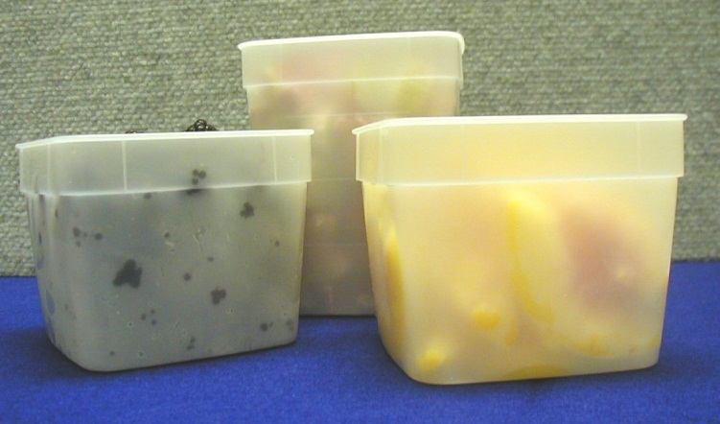
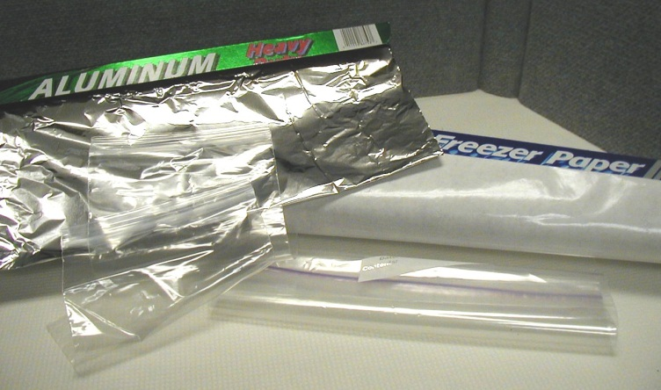
FOOD PACKAGING CHOICES
Sealable rigid containers
  Good for all packs, especially liquid.
Flexible plastic bags or wrapping
  Good for dry-packed foods.
Laminated freezer papers or containers
  Good for dry packed meats, fish and poultry.

Slide 19
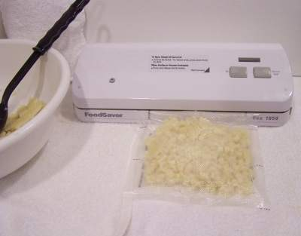
Vacuum Packaging Machines
Use freezer weight
packaging bags.
Pre-frozen or slightly frozen foods sometimes work better for sealing.

Slide 20
UNSUITABLE CONTAINERS
Those that are not moisture-vapor proof enough.
Waxed paper.
Paper or milk cartons.
Rigid carton with cracks or poor fitting lids.
Re-used plastic dairy or meat containers (e.g. cottage cheese, yogurt, deli-meat containers)
Any containers used for ‘storage’ versus ‘freezing’

Slide 21
Headspace for Frozen Foods
Foods with Liquid:
Foods without liquid:
Wide opening: ½-inch per pint: 1 inch per quart
Narrow opening: ¾-inch per pint; 1 ½-inch per quart
½ inch for all containers
Foods that pack loosely need no headspace (e.g. green beans or broccoli)

Slide 22
FREEZING QUALITY FOODS
Set the freezer to 0°F or below 24 hours in advance.
Chill foods before freezing and freeze as soon as packaged.
Freeze 2-3 pounds per cubic foot at a time – overloading with unfrozen food will slow freezing time.
Remember slow freezing causes larger ice crystals.

Slide 23
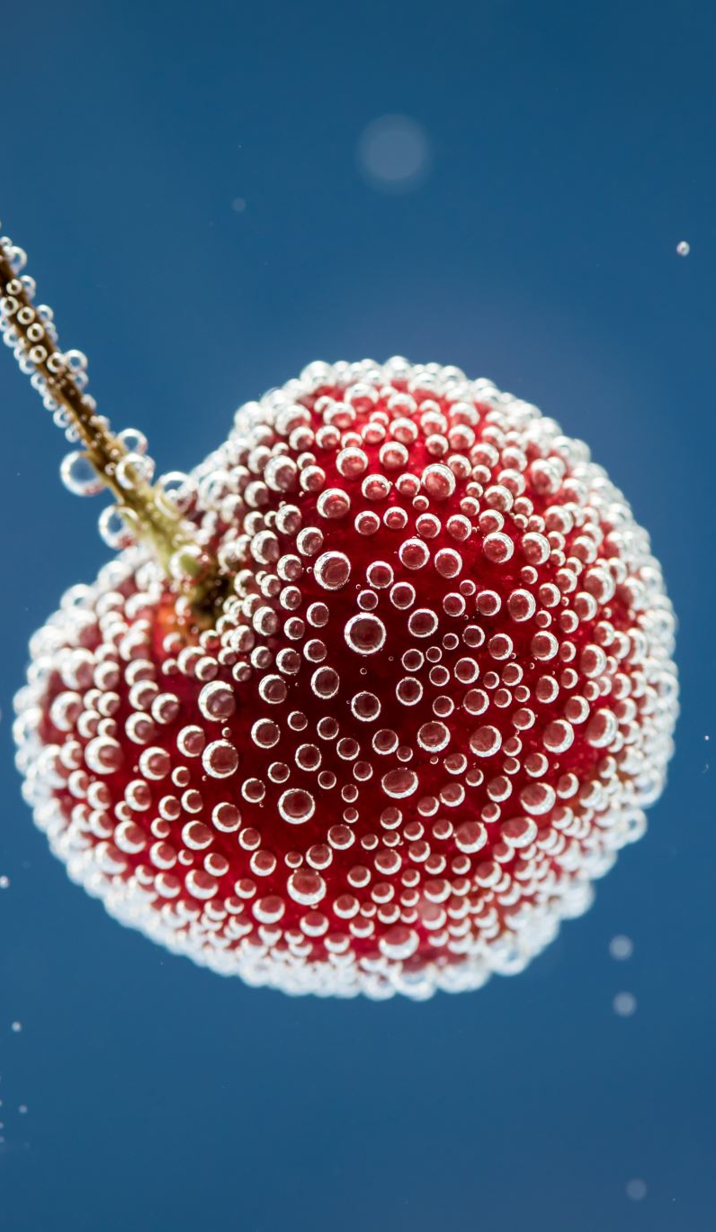
SELECTING & PREPARING FRUITS FOR FREEZING
Select fruit that is ripe, and firm.
  Under ripe fruit will be bitter or off flavor.
  Overripe fruit will have little flavor and mushy texture.
Wash fruit well, rinsing in several changes of water.
  Don’t let sit in standing water
  Washing will:
    Decrease microorganisms
    Remove surface dirt
    Decrease pesticide residue
    Decrease insects
    Can see bruises

Slide 24
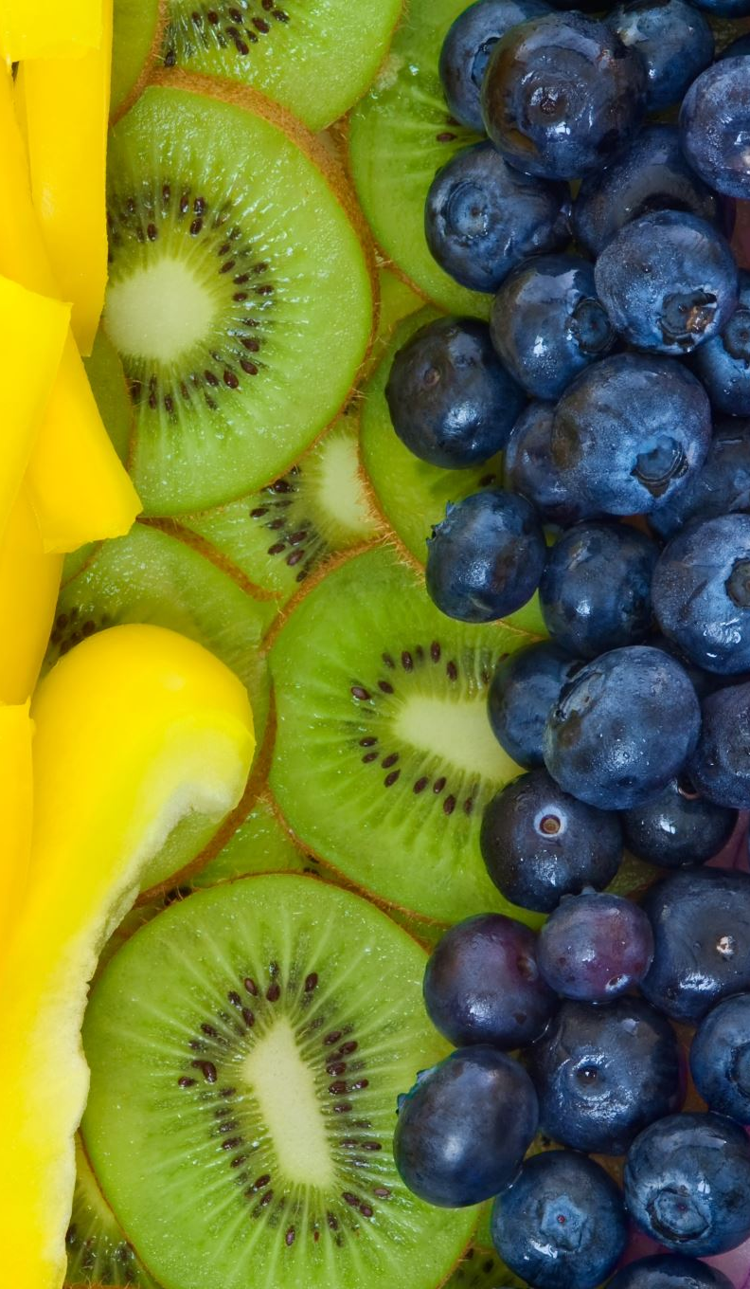
PRETREATING FRUITS FOR FREEZING
To prevent darkening of light colored fruits pretreat with one of the following:
  Ascorbic Acid (Vitamin C)
    Available at drugstores in table, crystals and powder forms.
    Soak fruit in mixture for 2 minutes.
  Ascorbic Acid Mixtures (Fruit Fresh or Ever Fresh)
    Sugar mixed with ascorbic acid or citric acid.
    Follow package directions.
  Lemon or Orange Juice
    Will help for time during preparation but not for long storage periods.
    May mask flavor of fruit.
  Salt and vinegar solutions
    No longer recommended.
    Will prevent browning, but will become gray over time.
    If using salt use 2 Tablespoons per gallon water.

Slide 25
PACKING FRUITS FOR FREEZING
Type of pack depends on intended use of fruit.
  Without Sugar
    Texture may be softer.
  Dry Pack
    Sugar coats fruit & preserves flavor.
  Sugar or Syrup Pack
    Retains flavor & texture.
  Liquid Pack
    Covering fruit with any liquid provides mixed results.

Slide 26
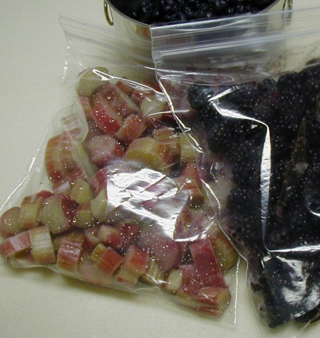
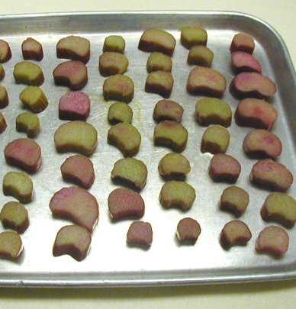
FREEZING WITHOUT SUGAR
Also called Individual Quick Freeze (IQF)
Berries, cherries, grapes should be frozen in single layer to prevent fruit from sticking together.
Freeze until firm 4-6 hours.
Place in package.
Will pour out of container easily when frozen.
  Serve frozen as snacks.
  Thaw for salads or desserts.

Slide 27
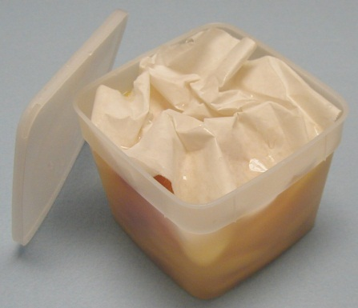
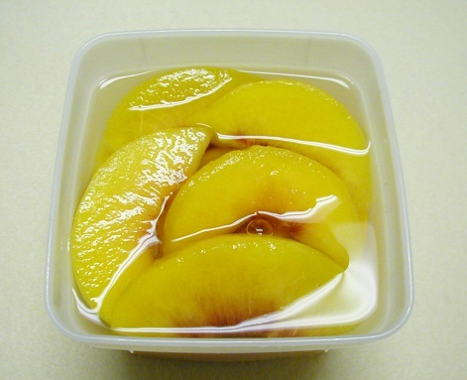
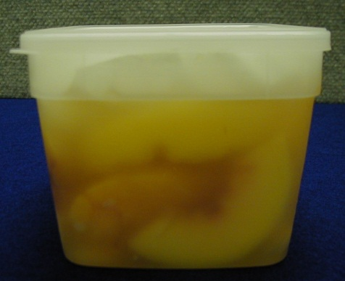
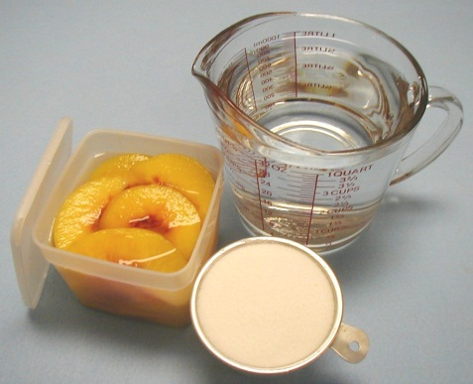
SYRUP PACKED
30% syrup (2 ¼ c. sugar + 5 ¼ c. water)
Light syrups for mild flavored fruit
Heavier syrup better for sour fruits.
Use 2/3 cup syrup for each pint of fruit.
Syrup can be made of sugar, corn syrup, or honey to desired strength of sweetness.
  Dissolve sugar in cool or warm water
  Cool warm syrup before using.
Fruits should be covered with syrup.

Slide 28
SUGAR PACKED
Used on juicy fruits or those used for desserts.
Use 1 cup sugar for 2-3 pounds fruit.
Sugar and fruit gently mixed until sugar has dissolved.
Let sit a few minutes and pack into containers.
Mark containers with how much sugar is used.

Slide 29
Unsweetened Pack
Pack prepared fruit in containers:
  Without liquid or sweetening
  OR
  With water containing 1 tsp. ascorbic acid per quart of water.
  These fruits will be softer and less flavor.

Slide 30
Artificial Sweeteners
ARTIFICIAL SWEETNERS
Safe but alter product quality
  No color protection
  Now shape retention
  Product freezes harder
  Thaws more slowly
  May become bitter

Slide 31
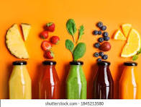
FREEZING JUICES
Extract juice by crushing fruit and straining or use a steam juicer.
Sweeten juice if desired.
Pour into containers.
Seal and freeze.
NOTE: For Grape juice
  Let stand overnight in refrigerator.
  Strain sediment before freezing.

Slide 32
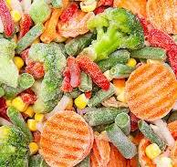
FREEZING VEGETABLES
FREEZING VEGETABLES
Select young, tender, high-quality vegetables at best stage to be eaten fresh.
Process on day harvested.
Wash in cool water before removing skins or shells.
Wash small lots at a time, lifting out of water.
DO NOT SOAK.
Work in small quantities, preparing as directed.

Slide 33
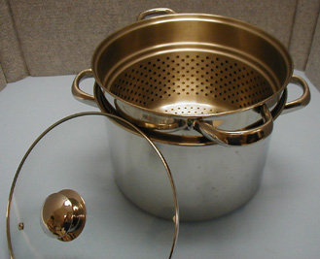
BLANCHING VEGETABLES FOR FREEZING
Purpose
  is to kill enzymes that continue to mature foods
  Clean surface of dirt and microbes
Quality of the produce is better maintained when blanched before freezing.
Be sure not to cook, but heat throughout.
Always cool vegetables after
blanching to stop the cooking
process.
NOTE: Under-blanching can be harmful;
it will stimulate enzymes and not destroy
them. Check required blanching times
for each food.

Slide 34
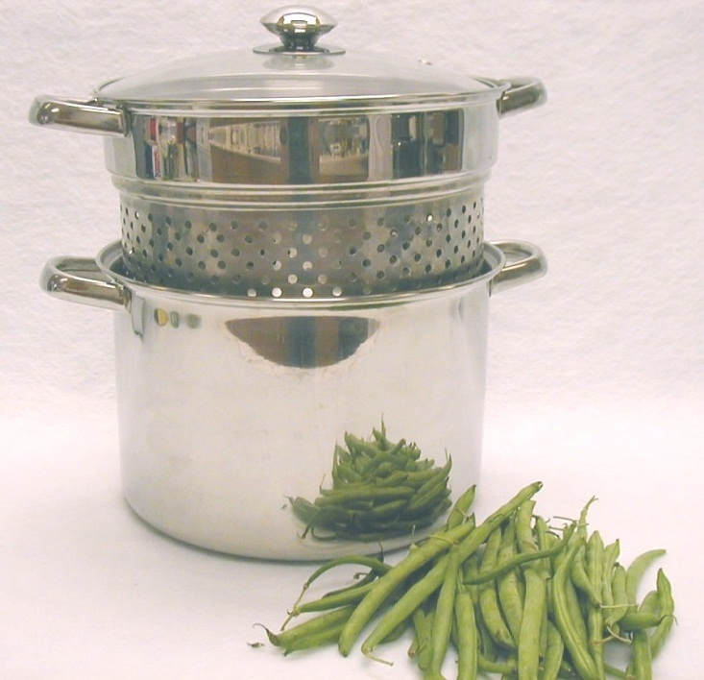
BLANCHING METHODS
Boiling Water Blanching
1 gallon water per pound of food
Leafy greens require 2 gallons per pound
Put into actively boiling
water, and cover
Count time when water boils
Place in ice water for same
amount of time as blanching
Drain, dry and package

Slide 35
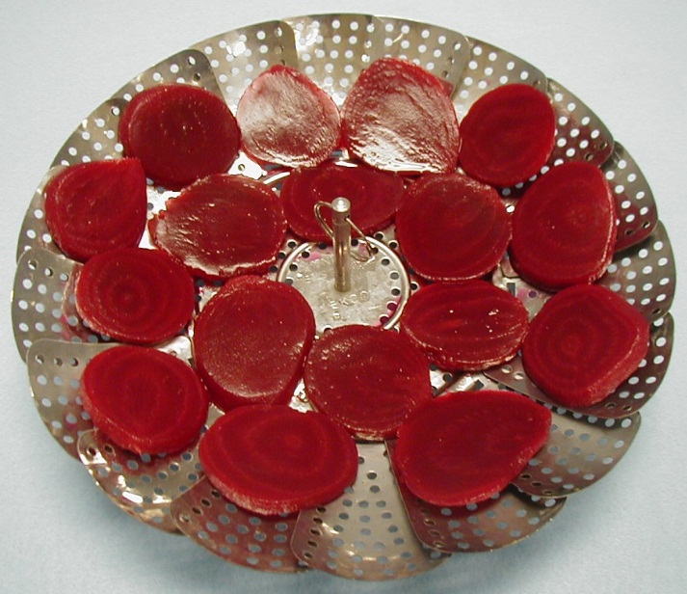
BLANCHING METHODS, cont.
Steam Blanching
Bring 1 inch water to a rolling boil
Place vegetables in colander or steam basket and suspend over the boiling water
Cover and heat vegetables
Time is 50% more than
water blanching
Cool in ice water for same
length of time used for
blanching
Drain, pat dry and package

Slide 36
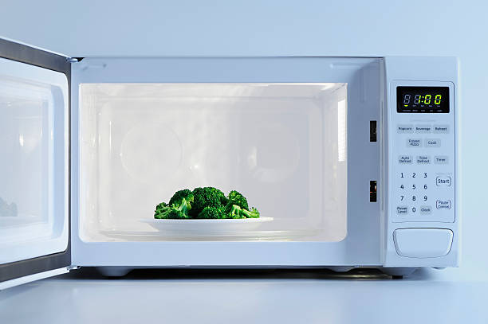
BLANCHING METHODS, cont.
Microwave Blanching
Not recommended
It is a QUALITY issue, not a SAFETY issue.
Enzymes are not inactivated completely
Usually does not save time
Try in small quantities and test quality after freezing

Slide 37
PACKING VEGETABLES FOR FREEZING
Pack food tightly in containers.
Allow room for expansion during freezing.
Squeeze out all air as possible.
Label with product name and date.
Also include other ingredients used in freezing to label.

Slide 38
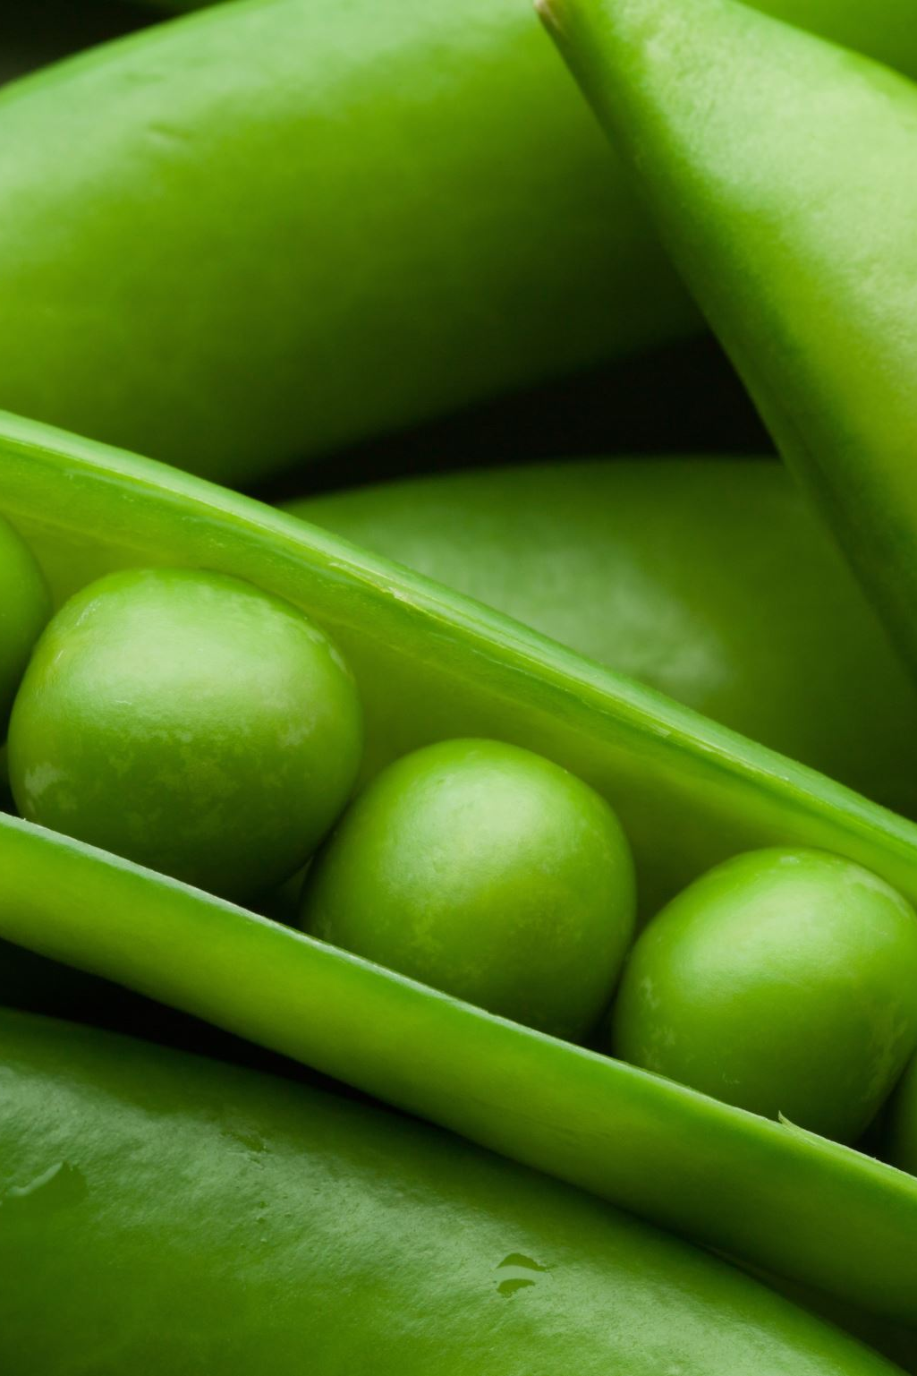
Packing Vegetables
Tray Pack or IQF pack
  Place blanched vegetables on shallow tray and freeze
  When frozen package and freeze.
  Green beans, peas, corn and mixed vegetables work well.

Slide 39
GENERAL TIPS FOR FREEZING VEGETABLES
Blanch cauliflower in boiling water with 1 Tablespoon of lemon juice.
Mature onions freeze raw diced or sliced
Peppers do not need to be blanched.
Flatten whole peppers to remove air
Freeze peppers with waxed paper between peppers.
Frozen raw, whole tomatoes become watery.
Cooked tomatoes freeze well

Slide 40
FREEZING MEAT & SEAFOOD
Freeze fresh, high-quality products.
Package in quantities to be cooked at one time.
Fresh meats should be wrapped or re-wrapped for quality
Fatty meats and fish, cured meats and shellfish have short quality life (3 months)
Other meats have longer life for quality (1 yr. or longer if double wrapped.
Place on freezer shelf and do not stack until frozen.

Slide 41

Recommended wraps
Bags – moisture-vapor resistant, flexible at low temperatures
Aluminum foil – moisture-vapor resistant, use heavy duty locker or freezer grade
Plastic Wrap – moisture vapor resistant, strong and flexible at low temperatures. Use heavy duty wrap
Laminated paper – moisture vapor resistant, but not flexible at low temperatures
NOT RECOMMENDED: waxed cardboard cartons, hard plastic containers

Slide 42
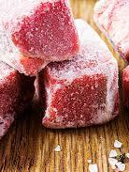
F
FREEZING MEATS
Select cuts or sizes in portion sizes
Be sure they are flat
Wrap tightly and press out air
Seal using a drugstore fold.
When using plastic freezer bags, press air out and secure well

Slide 43
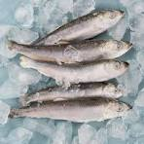
FREEZING FISH
Wash, remove scales and cut into steaks, fillets or leave whole.
Glaze to protect against drying and loss of flavor
  Freeze unwrapped fish on tray in freezer.
  Dip frozen fish in cold water to glaze.
  Repeat glazing 2-3 times.
Wrap in moisture vapor resistant wrap, seal, date and freeze.

Slide 44
Freezing Dairy Foods
Pasteurized homogenized milk
  1/2 gallon – 1 month
Cream
  (> 40% butterfat) – 3-4 months
  Best for making ice cream or cooking
  Doesn’t whip well
Butter, Margarine, Lard:
  Up to 6 months
  Freeze in original cartons or in freezer bag

Slide 45
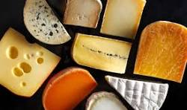
Freezing Dairy Food cont.
Freezing Cheese:
  Hard cheeses
    Pieces of ½ pound or less
    Becomes crumbly when thawed ..so slice or grate before freezing
  Cream cheese
    Freezes well when blended with heavy cream and used for dips
  Specialty cheeses
    Bleu cheese becomes crumbly but still usable
  Uncreamed cottage cheese
    Freeze quickly to avoid water separation when thawed.

Slide 46

Freezing Seasonings
Can be difficult
Pepper, cloves, garlic, green pepper, imitation vanilla and some herbs may become strong and bitter
Celery seasoning may get stronger
Herbs and spices may change flavor
Salt may lose flavor
When preparing foods to be frozen, may need to consider seasoning AFTER thawing.

Slide 47

DO NOT FREEZE
  Cabbage
  Lettuce
  Celery
  Cucumber
  Radishes
  Baked or boiled potatoes

Slide 48
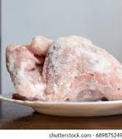
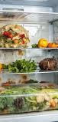
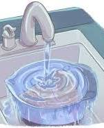
Three acceptable methods for thawing frozen foods:
In the refrigerator
  Be sure it doesn’t drip on other food when thawed
Under running cool water
Cold Water changed every 30 minutes
In the microwave
  Food must be cooked immediately
  Be sure not to cook the food while defrosting

Slide 49
REFREEZING
  Texture will not be as good!
Refreeze foods that are not warmed above 40°F
If they contain ice crystals, they are cold enough to refreeze.
There will be a loss of quality after food has been thawed and refrozen.
Dispose foods that are:
  Warmer than 40°F
  Contaminated by raw meat juices

Slide 50
HELP – MY FREEZER STOPPED RUNNING!!
Don’t open the freezer.
Cover the freezer with blankets.
Use 2 ½ pounds dry ice within 2 days if power is not restored.
Food will stay frozen longer when:
  The freezer is full
  More solid pieces of food

Slide 51
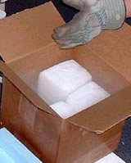
Freezer Emergencies
If power interruption longer than 1- 2 days:
Use dry ice:
  50 lbs. - keeps full 20 cubic foot freezer for 3 to 4 days.
    50 lbs. - keeps half-full freezer for 2 to 3 days.
Notes:
If power is not to be resumed within one to two days or if the freezer is not back to normal operation in that time, use dry ice to keep the temperature below freezing and to prevent deterioration or spoilage of frozen foods. To locate dry ice, check with local food companies, chemists or druggists.
When dry ice is obtained quickly after a power interruption, 50 pounds of dry ice should keep the temperature of food in a full 20 cubic foot freezer below freezing for three to four days. Twenty-five pounds of dry ice should hold the temperature in a half full 10 cubic foot freezer for two or three days. (Rule=2.5 pounds dry ice per cubic foot capacity of the freezer.)

Slide 52

Time for Questions

