Slide 1
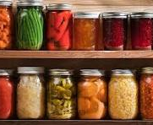
Welcome! 2024 Master Food Preserver Training

Slide 2

Introductions
Name or Nickname
Years of experience in canning
Why you want to take this training?
Something you want us to know about you that is fun, unique or interesting

Slide 3

Welcome!
Sandy Brown
38 years as WSU Extension Faculty
Retired 7 years
Hobbies: travel, crafts, baking and preserving
One husband, daughter and son-in-law and Grand dog
browns@wsu.edu

Slide 4
TRAINING OUTLINE
8-weeks – Sept. 25th – Nov 20th
11am – 3:30pm
September 25th Basic Food Safety and Microbiology – chapters 1 & 2
October 2nd Freezing & Dehydration – chapters 8 & 9
October 9th Basics of Canning and equipment /Canning Acid Foods (Fruits, pie fillings and Tomatoes) Chapters 3 and 4
October 16th Check in & Review – 11am - noon
October 23rd Jams, Jellies, Syrups and Juices chapter 7
October 30th Pickles, relishes ad salsa – Chapter 6
November 6th Canning Low acid Foods – equipment, Veggies, soups, stews
November 13th Canning & Smoking Meats & Seafood
November 20th Sharing what you learned – answering calls, information tables, gauge testing, social media and more!!!

Slide 5
WEBSITE
There will be a website that will contain all your materials
You will access them from that site and download from there if you wish.

Slide 6

Class Day!
Welcome!
Review previous weeks class
PowerPoint slides and discussion
Small group work
Q&A sessions

Slide 7
Training Expectations
Attend 40 hours of virtual training
Pass a final exam with 85%
Volunteer 45 hours within first year
Prior to class receive the handouts
After class: PP slides, additional handouts, links
Homework: written questions and social media assignments

Slide 8
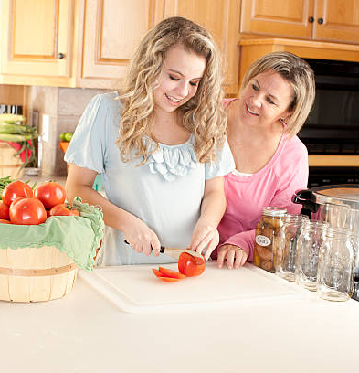
Volunteer Activities
Volunteer 45 hours
Ideas:
Gauge testing clinics
Q&A sessions at stores or farmers markets
Classes
Bread and Jam camp for youth
Other ideas?

Slide 9

Zoom Considerations
Please keep your camera on
Mute speaker unless speaking
Use Chat room with your questions
Will allow for discussion in small groups

Slide 10
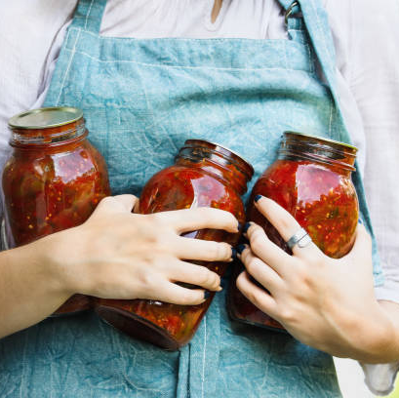
Pre-Quiz
Break into groups
Given questions
What are your answers?
Moderator for each group to help with the answers.
Good Luck

Slide 11

Questions about????
Class schedule
Quizes and final exam
Class attendance
Homework
Hands on classes
Other???

