Slide 1
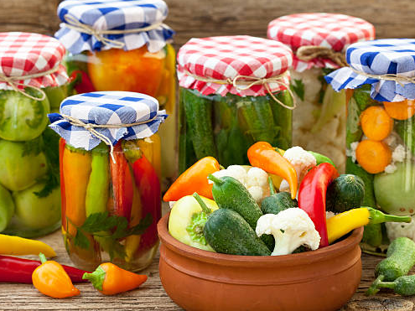
Welcome!
2024 Master Food
Preserver Training

Slide 2


Why do people want to Preserve Foods?
FOOD SAFETY & PRESERVATION

Slide 3
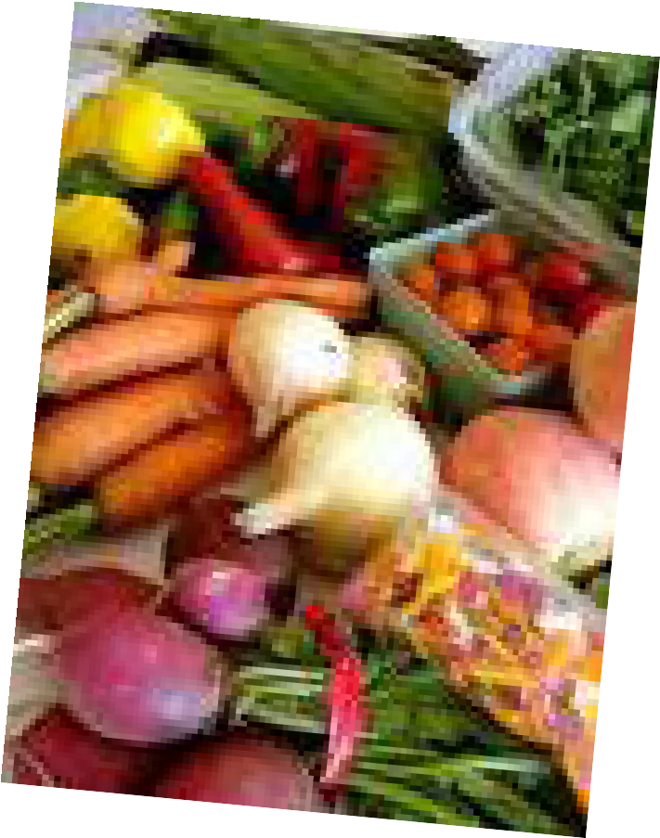
People report they preserve their own foods because…..
Gardens producing more that can eat at the time
Better Nutrition
Quality of food
More variety through the year
Controls added ingredients
Yields to personal preferences
Enjoyment and personal satisfaction
Fun with Friends
Saves money ????

Slide 4
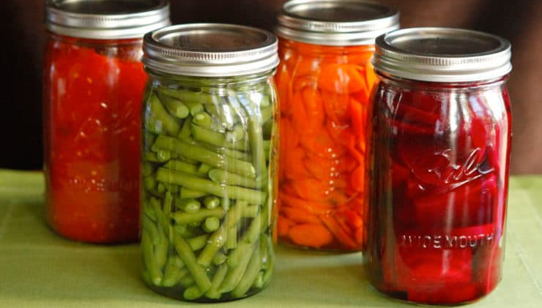
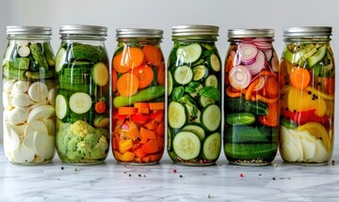
Food Preservation is a Science......
NOT a
Creative Art

Slide 5
Food Preservation requires
Attention to food safety
Controls growth of pathogen
Controls spoilage organisms
Following approved guidelines for specific foods
Using approved resources

Slide 6
Basics of Food Spoilage and
Preservation
Sandy Brown
WSU Faculty Emeritus
FOOD SAFETY & PRESERVATION

Slide 7
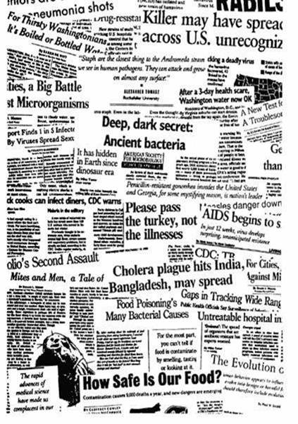
FOODBORNE ILLNESS
Definition: Any illness caused by eating contaminated food or water
Statistics:
Each year in the U.S…
– 76,000,000 become ill
– 325,000 are hospitalized
– 5000 die
Costs in U.S. $51 billion per year in medical care and lost productivity (2011)

Slide 8
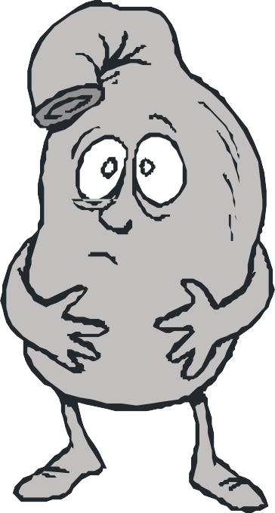
SYMPTOMS OF FOODBORNE ILLNESS
Nausea
Vomiting
Diarrhea
Fever
Abdominal cramping
Chills
What is incubation?
Incubation is the amount of time from eating a germ until you notice symptoms.
24-Hour Flu OR Foodborne Illness???

Slide 9
COMPLICATIONS FROM FOODBORNE ILLNESSES
Complications can range from non to fatal, including:
  Kidney Damage
  Blood Poisoning
  Arthritis
  Inflammatory Bowel Disease
  Birth Defects
  Neurological Damage

Slide 10
CASE vs. OUTBREAK
A case is a single person that has become ill from a confirmed FBI (Foodborne Illness).
An outbreak is 2 or more confirmed cases of the same illness.

Slide 11



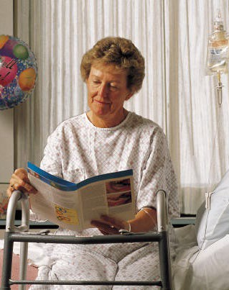
HIGHLY SUSEPTIBLE POPULATIONS
Certain people are at greater risk for complications due to foodborne illness:
  Young
  Old
  Pregnant
  Immune-compromised

Slide 12
FOOD TO AVOID IF PART OF AT-RISK POPULATION
Pregnant, immuno-compromised and the elderly should avoid the following foods:
  Soft cheeses
  Cold smoked fish
  Cold deli salads
  Unpasteurized dairy products
  Hot dogs or deli meats unless reheated to 165°F

Slide 13

Foodborne illnesses reports have
INCREASED….WHY?

Slide 14
Foodborne illnesses reports have INCREASED….WHY?
Increased awareness and surveillance
Increased susceptible individuals
People cook food less – raw or minimal cooking
Large food companies distribute to larger audiences.
Decreased food preparation skills.
  Food handling mistakes
  Food not reheated correctly
  More convenience foods
  Children cooking

Slide 15
Food Quality – Measurement of Excellence
Sensory characteristics
  Appearance
  Color
  Aroma
  Flavor
  Textures
Determined by:
  Looking at food
  Smelling it
  Tasting it
  Feeling it

Slide 16
Quality changes DON’T cause Foodborne Illness!
Organisms that cause FBI and spoilage are different
Cannot tell if food is safe by smell, taste, or flavor.
Loss of quality caused by:
  Microbial organisms
  Natural changes
  Physical changes
  Chemical changes
  External contaminants

Slide 17
Food poisoning microorganisms may give no obvious signs of being present!
– Can’t taste it, smell it or see it!
Most bacteria, viruses, and parasites are odorless, colorless and tasteless
Food is spoiled when the discriminating consumer is unwilling to eat it BUT could be safe while….
Unsafe food may look fine and make you sick.

Slide 18
Potentially Hazardous Foods:
In general, potentially hazardous foods include foods which are:
  High in protein
  Low in acid
  High in moisture

Slide 19
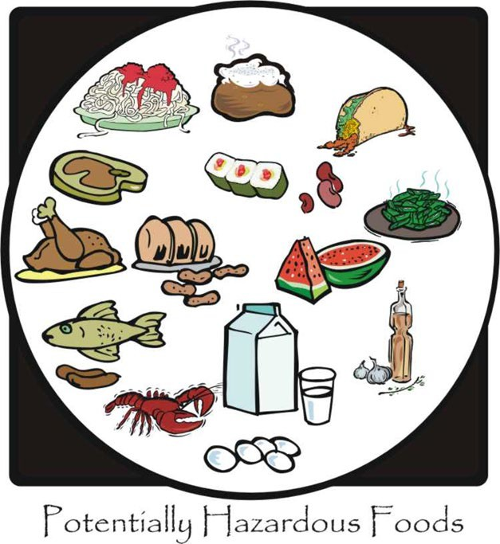
PoPotationally Hazaardous Foods
Animal Products
  All meats (red meat, poultry, fish, shellfish, crustaceans, etc.)
  Eggs, milk, dairy products
Cooked Starches
  Rice, potatoes, pasta, refried beans
Fruits and Vegetables
  Cooked vegetables, sliced melons

Slide 20
Identify the 4 food below that are NOT potentially hazardous foods:
Hamburger patties, raw
Bananas
Cut cantaloupe
Bread
Yogurt
Pizza
Can of soup, unopened
Dry pasta
Cooked pasta
Shell eggs
Baked potato
Alfalfa sprouts

Slide 21
Two causes of food deterioration
Microbial Spoilage
  Molds
  Yeasts
  Bacteria
Non-Microbial Spoilage
  Enzyme Action
  Oxygen
  Moisture Loss
  Insect contamination

Slide 22
Sources of Foodborne Illnesses
Primarily biological via
  Infections caused by viruses, parasites or bacteria
  Toxins produced by molds, bacteria, plants or animals

Slide 23
Microorganisms are distributed in the environment
Caused by:
  Bacteria
  Viruses
  Parasites
  Molds
Prefer to live in intestines of animals and humans
Contaminate food by:
  Soil and amendments
  Water
  Processing animal products
  Infected food handlers
  Poor personal hygiene

Slide 24
MOLDS
Consuming mold spores not a food safety risk
Desirable part of some foods
Mold Toxins can be harmful
Mycotoxins cause cancer in animals
Aflatoxin – liver toxin - most dangerous
– Found in: peanuts, corn, cottonseed

Slide 25
Microbial spoilage - MOLDS or MYCOTOXINS
Require air and water
Grows at room temperatures
Small plants with a stem and root system
Like acid foods
Also likes high sugar and salt concentrations.
Beneficial and Harmful

Slide 26
TO AVOID MOLD TOXINS
Wrap foods to exclude air
Vacuum packaging
Heat – 140° F to 190° F
Refrigerate cheese and fermented dairy products
Discard all moldy foods
What about cheese?

Slide 27
Microbial Spoilage - YEAST FERMENTATION
Like high and low acid foods
– Seen in fruit, juices and soft drinks
Grows well with or without air
Requires sugar, warmth and moisture.
Raises the pH and environment for bacterial growth.
Masses appear as slime, scum or murkiness
Also gas bubbles, froth or foam
Raises pH, and allows bacteria to grow

Slide 28
Control YEASTS by
Heating to 140° F to 180° F
At 0 ° F yeasts are inactivated by not killed

Slide 29
VIRUSES
67% of foodborne illness in U.S. (2011)
Transmitted via food
Originates in human intestines and shed in feces or vomit
Food contaminated by
  direct food mishandling
  direct through water sources and sewage

Slide 30
Control of Viruses
More resistant to heat than other pathogens
Heat food to 190° F in the center for 1 ½ minutes
Boil food in water for at least 3 minutes
Very strong disinfectants

Slide 31
NOROVIRUS (NORWALK) VIRUS
Norovirus is the leading cause of foodborne illness in the USA (per CDC)
9,200,000 cases/year
Most contagious due to low infectious dose (<10 particles) to make you ill.
CDC Scientists estimate the majority of Norovirus foodborne illnesses to be caused by:
– “BARE HAND CONTACT WITH READY TO EAT FOOD”

Slide 32
NOROVIRUS (NORWALK) VIRUS
Extremely common, Not often diagnosed
Nausea and Vomiting
Watery Diarrhea and Cramps
2 days – before, during, and after!
Not from animals but human intestinal tract.
Spread from on infected person to another
Anyone can contaminate food if they have virus on their hands

Slide 33
PARASITES – Depends on a living host for food
Intestinal Worms Protozoa
Giardia: fecal contaminated food, toys and water
Cryptosporidiosis: fecal contamination from water, food, person-to-person
Toxoplasmosis:
  Feces of infected cats
  Raw or undercooked meat, produce
  Unpasteurized dairy foods Control: safe water, personal hygiene, cooking foods well
Trichinosis: Roundworms
Cysticercosis: Beef tapeworms
Anisakiasis: fish roundworms
CONTROL
Heating or freezing
Pork – freeze for 5 days
Fish – freeze

Slide 34
BACTERIA - Intoxication vs Infection
Intoxication:
  Pathogens grow in food and produce toxins
  When eaten results in rapid illness
  Generally within a few hours
Infection:
  Bacteria infect body tissues or produce toxins in the intestinal tract
  Time from ingestion to illness is variable
  Usually a day or more.

Slide 35
Bacterial Pathogens – Animal Reservoirs
Salmonella and Campylobacter
  Leading cause of foodborne illness
  Live in intestinal tracts of wild and domestic animals
  Animal feces contaminate water and soil
  Foods involved include:
    Raw poultry, fish, milk,, shell eggs, custards, sauces, tofu, melons, sliced tomatoes, sprouts
  Control
    Cook animal products well
    Wash produce under running water

Slide 36
E. Coli Bacteria
Foods Involved:
  Raw or undercooked ground beef, unpasteurized milk& juices, soft cheese, fresh produce.
Control
  Cook meats to 160 degrees F
  Wash produce well
  Drink only pasteurized milk and juices
  Practice good hygiene
Microorganisms attach to gastrointestinal track and produce toxins
Causes bloody diarrhea, kidney failure or both
10 bacterial cells is enough to cause disease
Grow in temperatures above 40 degrees F.

Slide 37
Bacterial Pathogens – Soil Reservoirs
Two Pathogens –
  Clostridium perfringens
  Clostridium Botulinum
Commonly found in the soil
Grow and produce toxins in absence of Oxygen
Exist in vegetative cells and spores
Heat resistant form
Can survive in resting or hibernating state
  Often related to improperly cooled foods and low hot holding temperatures

Slide 38
Clostridium Perfringens
Grow quickly
Spores survive cooking temperatures
Grow and produce toxins in unrefrigerated foods
Foods involved:
  Cooked meat and poultry, stews, soups, gravies
  All kept at 60° to 125 ° F for several hours
Control:
  Cool foods rapidly and refrigerate within 2 hours
  Store in small quantities in shallow containers
  Reheat leftovers to 165 ° F to kill any pathogens that grow during cooling process.

Slide 39
Clostridium Botulinum
Most common in soils in Western US
Produces toxin in the absence of oxygen
Deadliest toxin know
Inactivated by heat

Slide 40
Clostridium Botulinum
Foods involved:
  Improperly canned low-acid foods, smoked fish, cooked, unrefrigerated low-acid foods, baked potatoes cooled and held at room temperature and garlic in oil at room temps.
Control:
  Preserve foods correctly
  Boil food for 10 minutes or heat in over to 185 ° F
  Refrigerate cooked low-acid foods quickly
  Store oil and garlic mixtures in refrigerator no longer than 4 days.

Slide 41
Listeria
Symptoms:
  Most serious to pregnant women, children and elderly
  Causes still birth, birth defects and brain damage.
Foods affected:
  Found in raw milk cheeses, deli meats, hot dogs and sausages
  Also found on knife holders and up near handles when knives are not cleaned properly.
Preventive Measures:
  Heat hot dogs, sausages and deli meats to 165° F & hold at 140° F
  Pregnant women should avoid raw milk cheeses, deli meats and un-cooked hot dogs

Slide 42
Bacterial Pathogens – Human Reservoir
Staphylococcus Aureus
  Found in nose, throat, hair and skin
  Transferred by bare hand contact with food
  Toxin not killed by cooking temps
  Symptoms intense vomiting
  Foods Involved:
    High-protein foods, salads mad with meat or eggs, puddings, custards and cream-filled pies
  Control:
    Good personal hygiene
    Keep foods below 40°F or above 140°F

Slide 43
How long does it take to show any symptoms of Foodborne illness after consuming a suspect food? a. 5 minutes b. 20 minutes c. 1 day d. 1 week e. 3 months

Slide 44
DETERMINING WHICH ILLNESS YOU HAVE
Symptoms depend on type of microbe swallowed.
Many symptoms similar.
Laboratory tests are usually necessary to identify.

Slide 45
Remember…SOURCES OF MICROORGANISMS
The food itself
Humans and animals in house
Air
Kitchen surfaces
Most any other place that isn’t a hermetically sealed, sterile environment

Slide 46

Questions ?
FOOD SAFETY & PRESERVATION

Slide 47
GROWTH OF MICROORGANISMS
The growth of microorganisms is controlled by: FAT TOM!
Food Acid Time
Temperature Oxygen Moisture

Slide 48
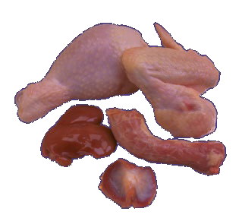
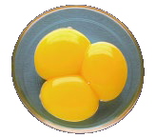
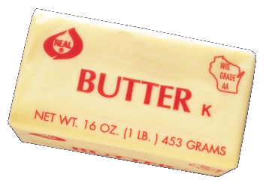
MICROORANISMS – CONDITIONS FOR GROWTH
Food
Microorganisms require nutrients to grow
  Proteins
  Carbohydrates
Raw Chicken pH 5.5–6.4
Egg Yolks pH 6.0–6.3
Acidity
– Pathogenic bacteria grow well at a pH of
4.6 to 7.5
Butter pH 6.0–6.8

Slide 49
Acid Important in Food Preservation
Most Bacteria won’t grow when pH is 4.6 or below.
Some like E.Coli and Salmonella can survive in an acid food.
pH in food
Low acid- pH above 4.6
  Meats, fish, poultry, vegetables
High acid – pH 4.6 and below
  Most fruits and tomatoes, and pickles

Slide 50

TEMPERATURE
Grow best between 90ºF and 110ºF The Temperature Danger Zone (TDZ)
Pathogens don’t grow:
  Below 40ºF
  Above 140ºF
The colder the food, the longer the shelf life

Slide 51
TIME
Bacteria can double every 10-20 minutes
Noticeable spoilage at 1-10 million organisms per gram of food
Under ideal conditions bacteria can spoil food when left in the TDZ in less than four hours

Slide 52
Activity: Calculate Bacterial Growth
Time | Number of Bacteria
0 | 5
30 min | 20
1 hour | 80
2 hours | 1,280
4 hours | 327,680

Slide 53
Oxygen
Microorganisms have different oxygen needs for growth
  Aerobic needs oxygen to grow
  Anaerobic grows only when oxygen is absent
  Facultative can grow with or without oxygen
Not the best way to control bacteria
  May encourage growth of some bacteria when discouraging others.
Is the best way to control mold and food deterioration .

Slide 54
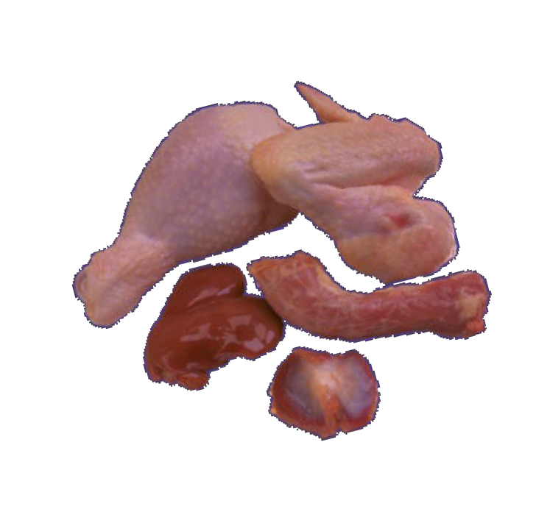
Moisture
Bacteria thrive on water
Water is absorbed in cell walls
Without water, bacteria die!
Water activity is amount of water available to bacteria
Most potentially hazardous foods have a water activity of .85 or above
Raw Chicken and Butter Water Activities of .95–1.0

Slide 55
Water Activity and Food Preservation
Bacteria, yeasts and molds need different amounts of water activity.
Sugar and salt binds with free water making it unavailable to bacteria to multiply.
Sugar in jams and jellies plays this role
Salt in brining binds free water

Slide 56
Non- Microbial Bacteria – Enzyme Action
-Enzymes responsible for changes in
appearance flavor
texture
vitamin content
When produce is cut enzymes interact with air and change color of product
Enzymes will reduce vitamin C content in harvested vegetables held at 68 degrees
Flavor changes can be bitter, hay-like, or just old due to enzyme changes.

Slide 57
Control of Enzymes
Heating food to 170º-190º F in boiling water, steam or microwave will inactivate enzymes.
This is the reason for blanching vegetables before freezing
Ascorbic acid will control enzymes when heating isn't a choice.
This best used on fruits for freezing or canning light colored fruits.

Slide 58
Oxygen
Air in products causes oxidation, which leads to color and flavor changes
  Rancidity in fat
  Off odors & off flavors
  Hastens enzyme activity leading to browning
To Control:
  Careful wrapping that includes airtight packaging, or vacuum packaging.

Slide 59
Moisture Content
Produce is alive
Gives off carbon dioxide, heat and water to continue life.
These processes soften food and cause loss of flavor and moisture.
This will occur quickly at room or warm temps
  Control:
  Refrigeration and good packaging

Slide 60
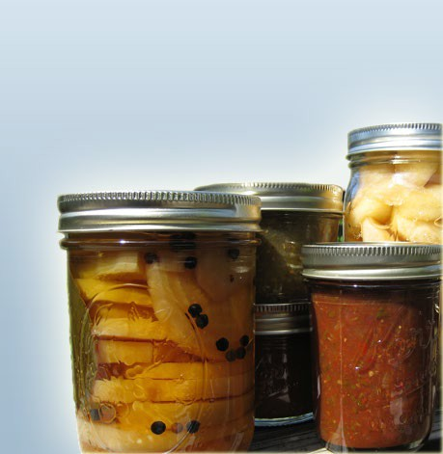
7 MAJOR METHODS OF FOOD PRESERVATION
Refrigeration
Freezing
Canning
Sweetening
Pickling
Drying
Salting

Slide 61
Group Discussion
Thinking about the 7 ways to preserve food, what control methods (FAT TOM) are in place that prevents food spoilage or growth of microorganisms.
HINT: there are more than one for each food preservation method.

Slide 62

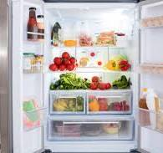
Preserving Methods and avoiding spoilage
Refrigeration
  Reduces temperatures
  Slows growth of microorganisms
  Slows action of enzymes
  Protects from moisture loss when wrapped well
l

Slide 63
Preserving Methods and avoiding spoilage
Freezing
  Reduces temperatures
  Increases temperatures – blanching
  Slows enzyme action unless blanched
  Requires 0º F for best quality
  Must combine with quality packaging
Clarence Birdseye discovered ‘quick freeze” process in the 1800’s!

Slide 64
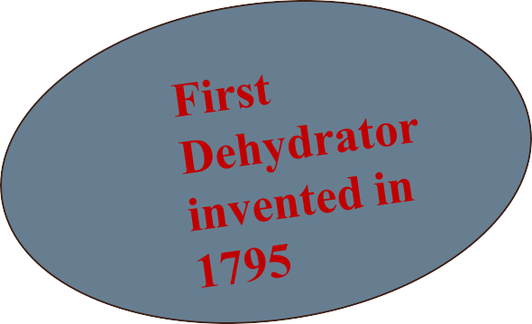
PRESERVING METHODS & AVOIDING SPOILAGE
Drying
  Reduces moisture
  Kills enzymes when heated
  Combine with good packaging
Salting
  Binds water to inhibit growth of some bacteria.

Slide 65
PRESERVING METHODS & AVOIDING SPOILAGE
Canning- Water Bath and Pressure
  Increases temperature
  Takes air out of jar forming a vacuum seal
  Absence of air prevents molds and some yeasts
  Absence of air can invite growth of anaerobic bacteria
  Pressure canning temps kill spore forming bacteria

Slide 66

PRESERVING METHODS & AVOIDING SPOILAGE
Pickling and Fermenting
  Acids prevents growth of microorganisms
  Increases acidity
    Fermenting creates lactic acid and lowers pH
    Pickling adds vinegar to lower the pH
  Heat processing
    takes away the air to create a vacuum
    Destroys spoilage organisms

Slide 67
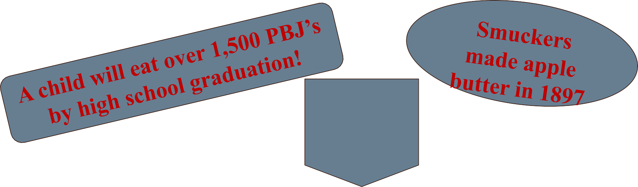
PRESERVING METHODS & AVOIDING SPOILAGE, cont.
Jams and Jellies
  Increases sugar content ties up water and lowers the pH
  Heat processing removes air creates a vacuum
  Freezing and refrigeration reduces temperature

Slide 68
Number One way food becomes contaminated?
FOOD SAFETY & PRESERVATION

Slide 69
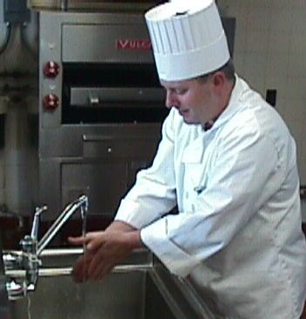
HANDS!
Hands are the number one way that food is contaminated.
Every Stage of Handwashing is Important:
  Scrubbing with soap
  Friction is the most important element in removing pathogens from hands
  Rinsing hands under high pressure & volume of running water - aids in removing transient viruses
  Drying hands

Slide 70
PROPER HANDWASHING
Handwash Time:
  20 seconds including a 10-15 second scrub
Soap:
  Removes grease, soil, and debris from the hands.
  Research recommends, if used properly, bland soap over antimicrobial.
Water Temp:
  Soap efficacy (100°F - 120°F)

Slide 71
Personal protection against disease:
  Avoid touching the mucous membraines of your eyes, nose, and mouth
  These routes are how the majority of diseases enter the body.

Slide 72
Hand Sanitizers – NOT as effective as soap and water
Designed to use without water
The killing agents are: ethanol, isopropanol or n- propanol in concentrations of 40-95%
A hand sanitizer should contain at least 60% to be effective to destroy most bacteria and viruses
Usually not effective on some bacteria
Norovirus is resistant to ethanol in concentrations as high as 90%.

Slide 73
WHEN TO WASH HANDS
BEFORE:
preparing or handling food
AFTER:
using the toilet
handling raw meat, poultry and seafood
handling garbage or dirty dishes
sneezing, coughing, using a tissue, etc
handling chemicals or animals

Slide 74
KEEPING THE KITCHEN CLEAN
Wipe off food preparation areas.
Clean cutting boards and counters.
Sanitize to kill pathogens.
– 1 teaspoon/quart cool water.
Use paper towels for cleaning.
Keep pests away by wiping up spills and covering food.

Slide 75
SPONGES – Most contaminated item in the Kitchen!!
Ideal location for bacterial growth
Thrive in the warm, moist and food rich environment
They dry slowly
Clean by soaping and rinsing and squeeze
Allow to air dry
Change at least monthly
Microwave to 170° F or until steaming
Be sure it is wet and won’t catch on FIRE!

Slide 76
DISHCLOTHS
Easier to keep clean than sponges
Use a clean one every day or after contaminated with meat juices
Launder in washing machine in hot water and dry in hot dryers
Paper towels are excellent for meat juices and such

Slide 77
CLEAN CUTTING BOARDS
Use smooth cutting boards free of cracks.
Wash with hot water, soap and scrub brush.
Sanitize with chlorine bleach & water.
1 Tablespoon/gallon cool water
Leave wet for 2 minutes, rinse, air dry.
Consider different cutting boards for different uses.

Slide 78
KITCHEN SINKS
Second most contaminated area in a home
Clean sinks regularly with warm water and soap and sanitize with a bleach solution

Slide 79
SANITIZING
Clean surfaces first - soap and water
Most sanitizing products cover the surface for 30 seconds to a few minutes to inactivate pathogens
Bleach solutions are the most cost effective
They can be premade
Let stand 5 minutes, rinse with water, air dry
Vinegar is less effective
Heat vinegar to 131° F increases its killing power.

Slide 80
CROSS-CONTAMINATION
When bacteria from raw foods gets on other foods.
Separate raw meat, poultry, seafood and eggs from other foods in your:
  Grocery cart and grocery bags
  Refrigerator
  During food preparation
Other tips:
  Wash hands, knives, cutting boards, and surfaces with soapy water

Slide 81
Insect Contamination
Insect eggs can be found in grains, seeds, herbs nuts and fruits
If they hatch they eat the foods
Preservation methods prevent hatching
Control:
  Good sanitation
  Clean up spilled foods
  Store dry good tightly covered
  Store in glass, food grade plastic and metal
  Buy appropriate amounts

Slide 82
RAW MEAT
Store raw protein foods on bottom shelf or on tray
Use refrigerator meat drawer for cooked ready-to- eat meats
Never place cooked food on a plate that held raw meat.

Slide 83
FOOD RINSING
Wash all fresh fruits under running cool water
Scrub melons and vegetables with firm rinds using a vegetable brush
Dry with a paper towel
Pay close attention those those that grown in or on the ground
Pre-washed produce – no need to!
PRODUCE WASHES – effective but not more so than washing and scrubbing

Slide 84
MEAT WASHING
Poultry and other meats should NOT be washed.
Any pathogens on the meat will be killed during the cooking process
Rinsing results in contamination of the skin, counters, hands and more
Check out ‘don’t wash your chicken’ campaign
www.drexel.edu/dontwashyourchicken

Slide 85
KEEP FOOD CLEAN
Wash veggies under cool running water
Scrub veggies and fruits with skins with a veggie brush under cool running water
Don’t store meat where it could drip on foods that will NOT be heated.
Use a clean plate to put freshly grilled meats on
Other tips?

Slide 86
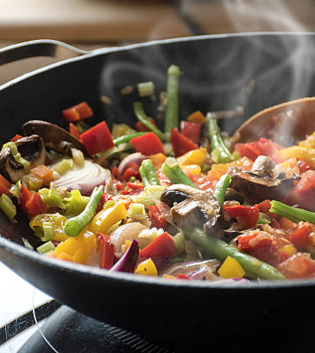
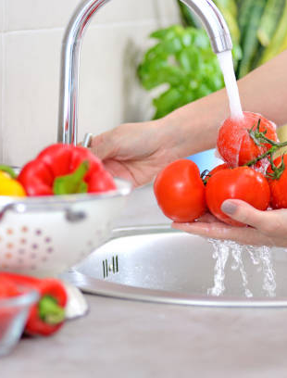
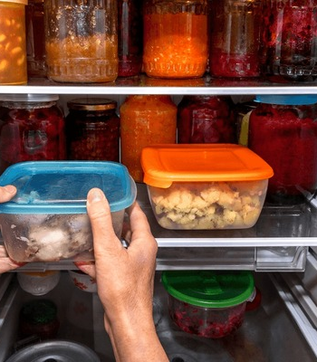
3 C's of Food Safety
Keep it CLEAN
COOK Well
Cool Quickly

Slide 87
Cool Food no thicker than 2 inches
Food needs to reach 40 degrees or below within 2 hours.
If deeper than 2 inches it will take:
...8 hours to cool 4 inches
….32 hours for 8 inches

Slide 88
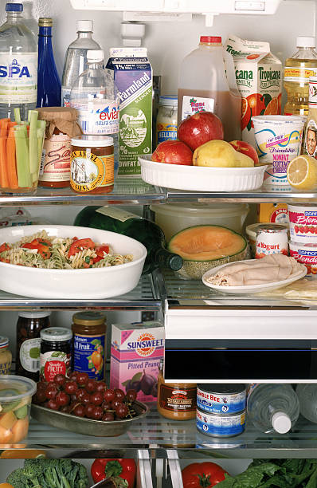
Group discussion!
Go to your refrigerator and select something that you think could be spoiled or suspect?

Slide 89

When in Doubt Throw it OUT!
This Photo by Unknown Author is licensed under CC BY-NC-ND
FOOD SAFETY & PRESERVATION

Slide 90

This Photo by Unknown Author is licensed under CC BY NC

Slide 91

Homework
Review Handbook chapters 1 and 2 and handouts
Answer quiz questions
Prepare a potential question about food safety
Read chapters 8 & 9 for next week's lesson

Slide 92



