Slide 1

Proclamations and Resolutions
Engaging Local Government with Messaging in Celebration of the 2026 IYRP
Mark Thorne, Retta Bruegger, Kalina Reini, Kaitlan Glover
IYRP Arts Education Webinar Series
May 5, 2025
www.iyrp.info
Notes:
The initiative to draft Proclamation and Resolution templates started with discussions within the Rangelands Partnership, a multi-state project involving 18 land-grant university Range Management specialists and Librarians, responsible for maintain the Rangelands Gateway web portal, and then developed in collaboration with members of International Affairs Committee of the Society for Range Management. My co-authors on this effort were Retta Bruegger, a Rangeland Management specialist for the Colorado State University cooperative extension and member of the Rangelands Partnership, Kalina Reini, who is the Washington DC Liaison for the Society for Range Management, and Kaitlan Glover, who is the Executive Director for the Public Lands Council and the NCBA Natural Resources. We presented the Proclamation and Resolution templates at the 2025 Society for Range Management Annual meeting earlier this year.
Proclamations and Resolutions are civic tools used bring ideas, issues, or events into the public realm for discussion, debate, and acceptance or rejection. They are commonly used in government settings, but in an open society, citizens can and often do bring proclamations and resolutions to their elected officials, especially those they want government action on. We feel that proclamations and resolutions are a great way to increase awareness and engagement with the IYRP across multiple target audiences at the local, regional, and national scales. All it takes are a few good range people. The Proclamation and Resolution templates and accompanying documents are intended to give them a jump start and make the process easier.

Slide 2
What are Proclamations and Resolutions?
A Proclamation is “an official statement or announcement made by a person in power or by a government” (Britannica Dictionary). Generally, given by executive officials (governor, mayor, president, etc.).
A Resolution is an official decision made after a group or organization has voted. It is a formal expression of opinion or intention passed by formal organizations, legislatures, clubs, or other groups. (Cambridge Dictionary). Generally, legislative bodies (town councils, state legislatures, etc.).
Notes:
Proclamation – an official announcement that directs individuals, organizations, agencies and others to take a described action surrounding a person, place, or thing – for example, the United Nations proclaimed 2026 as the International Year of Rangelands and Pastoralists. Similarly, we may ask mayors, governors, or others to recognized the significance of the 2026 IYRP by proclaiming recognition and events in celebration.
Resolution – an official decision by an organization to express its opinion or intentions to support specific actions. For example, we may draft resolutions to share with state legislators in support of the 2026 IYRP, or to support policies that will enhance rangelands or protect ranching or pastoralism.
While Proclamations and Resolutions are formal documents, often associated with government actions, individual citizens can draft proclamations and resolutions to support their ideas, and working with the appropriate government officials, have their ideas tested in the public domain.
Proclamations and Resolutions are organized and present information differently than what most people might be familiar with.

Slide 3
Proclamation and Resolution Structure
Three parts: Title, Reasoning (Whereas) statements, Conclusion (call to action)
Title: Descriptive and inclusive of relevant details. For example:
Any Town, USA, Proclamation
Proclaiming March 2026 a Month of celebration of Rangelands and Pastoralists in Solidarity with international communities in conjunction with the United Nations designation of 2026 the International Year of Rangelands and Pastoralists
Or
House Resolution
Urging the State to consider the importance of rangelands and pastoralists and adopt policies that further sustain rangeland health and pastoralist livelihoods
Notes:
Proclamations and Resolutions have three parts: 1) A Title; 2) Reasoning statements; and 3) Conclusions or Call to action.
The title of a proclamation or resolution are descriptive and inclusive of all relevant details. Generally speaking, the title includes the “Who, What, When, and Where” of the proclamation or resolution. Two examples, are provided on this slide, one for a proclamation and the other for a resolution.

Slide 4
Proclamation and Resolution Structure
Titles are followed be reasoning statements the “whereas” statements, for example:
Whereas, rangelands are natural ecosystems in which the indigenous vegetation is predominantly grasses, grass-like plants, forbs or shrubs and cover up to (8 billion hectares or 19.8 billion acres) of land globally (54% of the terrestrial surface); and,
Our template includes nine reasoning (whereas) statements leading to the concluding proclamation or resolution statement.
IYRP Proc_Reso Template v4 120424.docx
Notes:
The title is followed by the reasoning statements or arguments. The reasoning statements provide a series of logical arguments in support of your conclusion or call to action of your proclamation or resolution. They should be organized sequentially in a way that leads the reader or hearer to the conclusion or call to action you desire. The reasoning statements all begin with the word, “Whereas” with each “whereas” statement a single argument, punctuated with a semicolon, followed by an “and” to lead to the next “Whereas” argument, or at the end of your reasoning, your conclusion or call to action.
The proclamation and resolution templates that are available for anyone to use, contain 9 Whereas statements. The first three broadly defining the importance of rangelands. These are followed by four reasoning statements that defining pastoralism and its importance to the stewardship of rangelands. The final two whereas statements tie both rangelands and pastoralism together through the United Nations designation of 2026 as the International Year of Rangelands and Pastoralists and why local communities and governments will be engaged in celebrating the IYRP.

Slide 5
Proclamation and Resolution Structure
Conclusion statements of proclamations and resolutions are a call to action
Proclamations encourage others to respect, honor, engage with or celebrate something or someone important.
A Resolution express opinion or intent by the legislative body.
What your proclamation or resolution addresses is limited only by your imagination.
Notes:
Following your reasoning “Whereas” statements are your conclusions or call to action, which typically start off with a “Now, Therefore, Be It Resolved” phrase to signal the transition and focus attention to your call to action. The call to action is written to be specific as to the Who, What, When, Where, and How of your call to action. Multiple conclusions or calls to action can be added with successive “Be It Further Resolved” statements.
The difference between a proclamation and Resolution is largely in the conclusion or call to action. Proclamations encourage other to respect, honor, morn, or engage with or celebrate someone or something significant. Resolutions are used to express opinion or an intent to do something important by organized bodies, such as a town council, state legislature, or senate.
What a proclamation or resolution addresses is only limited by the imagination of the writer or writers.
Here are some examples proclamation requests:

Slide 6
Proclamation and Resolution Guidelines
Steps to Engage
Identify Targets (City, county, State Governor/legislature)
Set up meetings with Officials
Modify Proclamation and/or Resolution
Ask other local groups to sign on
Send letter to officials
Provide support and outreach as needed
Encourage adoption in early 2026
Guidance for Engaging in IYRP v3.docx
Notes:
Included with the Proclamation and Resolution template, we drafted a guidance document with the following 7 guiding steps developing and presenting our own proclamation or resolution to your local, regional, or state/provincial government.
Step:
Identify Targets (City council, mayor, state legislature, governor, etc.)
Set up meetings with appropriate officials – get them to buy-in to your ideas, gather information on procedures, wording, etc., and work with them to draft/introduce your proclamation or resolution
Modify you proclamation and/or resolution accordingly
Ask other local, like-minded groups to sign on (Nature conservancy, other land conservation organizations, livestock organizations, etc.).
Send letters to officials with draft proclamation/resolution details to encourage commitment/engagement
Provide support and outreach as needed – you may need to provide additional information on the importance of rangelands, stewardship and pastoralism, and the UN designation to officials and others.
Encourage adoption in early 2026 – many state legislatures meet at the beginning of each year, and you will need to have everything ready prior to that so that it will be considered.

Slide 7
Proclamation and Resolution Guidelines
Example Proclamation requests:
Designate a day/week for Rangeland Celebration
Rangeland Awareness/education Day(s) (Film festival, filed day, BBQ)
Pastoralist/ranch recognition events (parades, rodeos, festivals, etc.)
Example Resolution
Policy request
Funding support
Packet Materials
Cover Letter
Proclamation Draft
Resolution Draft
Guiding document
Worksheet
https://drive.google.com/drive/folders/1iZMNg44nGDsqt-_MghFsRkYna8QjLiyU?usp=sharing
Notes:
Here are some example Proclamations and Resolution requests;
For Proclamations – Request a mayor/town council to designate a day/week for Rangelands Celebrations, or Rangelands Awareness/educational day(s), which may include a film festival, field day event, and a BBQ, or maybe a pastoralist/rancher recognition events, such as parades, rodeos, festivals, BBQs and so on.
For resolutions, we may want to request the state legislature to adopt/support certain policies or generally agree to support the stewardship of rangelands through sustainable livestock production practices, or to support multiple uses, and so forth.
Proclamations and resolutions can be used together. For example, we might use a resolution to get local funding to support a Rangeland Awareness day proclaimed by the mayor.
To close, the Proclamation and Resolution packet contains
And introductory cover letter
A draft Proclamation that can be modified for your specific needs
A draft Resolution that can also be modified for your specific needs
A Guiding document that provides discreet steps in the process
A short worksheet to help you think through and organize your information
These documents are linked here in the chat and are available here https://drive.google.com/drive/folders/1iZMNg44nGDsqt-_MghFsRkYna8QjLiyU?usp=sharing

Slide 8

Thank you

Slide 10
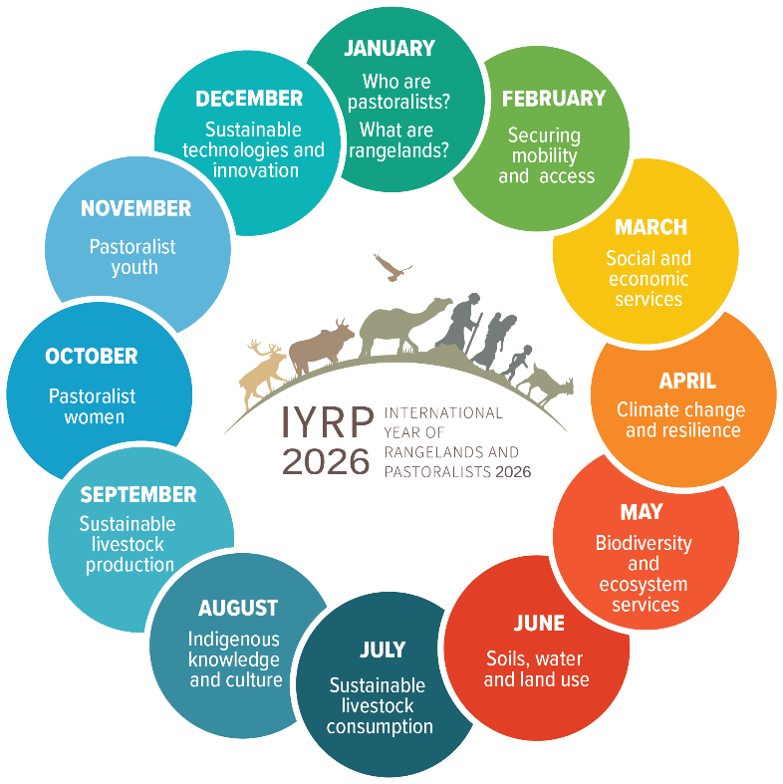

Slide 11
