Slide 1

IYRP Art-Based Education webinar: Contests!
Arts and Photography
www.iyrp.info

Slide 2
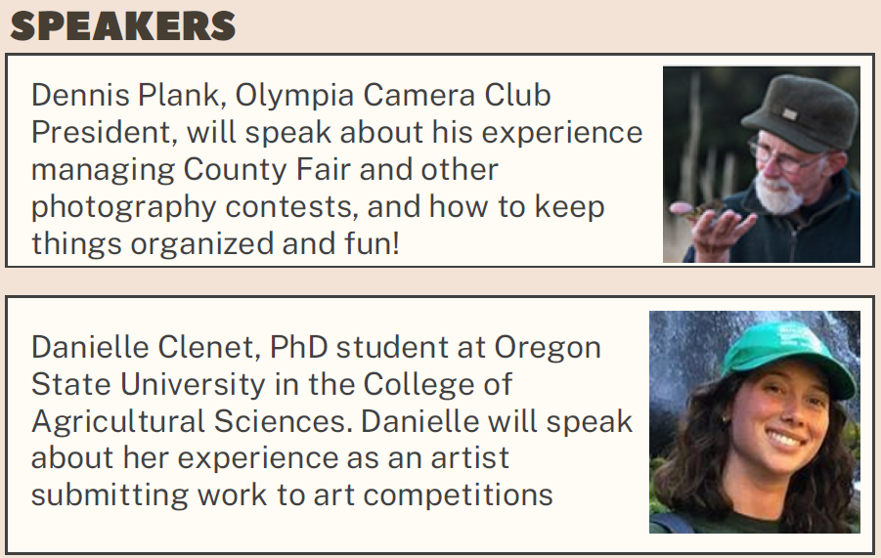
Program
12pm: Intro; IYRP-SARE any updates
12:10: Danielle Clenet, on art competitions
12:20: Dennis Plank, Photography Competitions
12:35/40: 10-15, Q&A discussion for attendees to ask questions

Slide 3
Organizing an Art Contest
What Needs to Be Considered Before Starting,
Danielle Clenet
www.iyrp.info

Slide 4
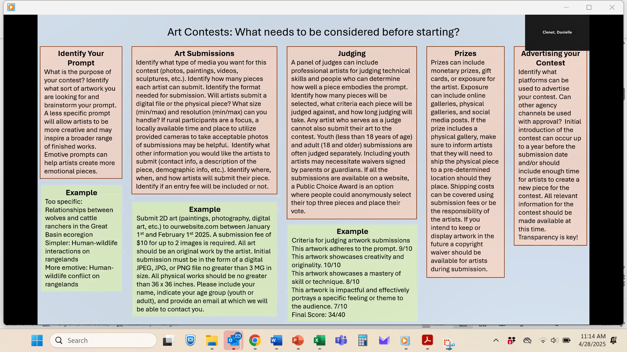
https://drive.google.com/file/d/1L_7Vige_BVe_iaRexha2rmuluTfJmZE1/view?usp=drive_linki

Slide 5
Developing a Photography Contest
Issues and Considerations,
Dennis Plank
www.iyrp.info

Slide 6
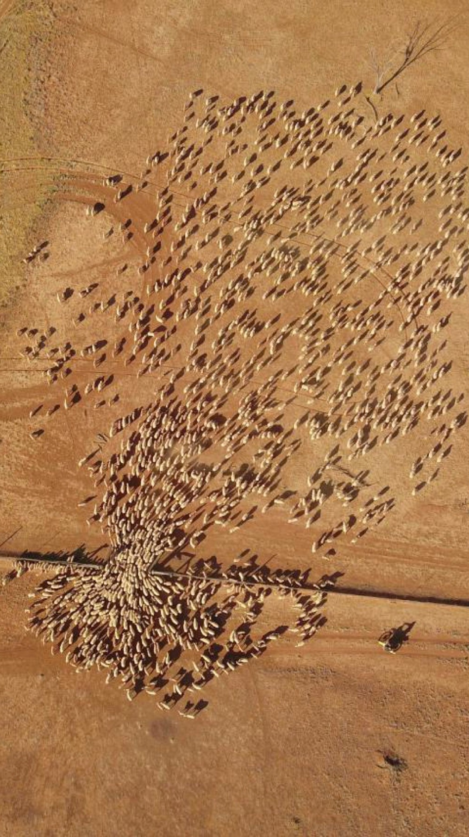
Decisions to Make
Digital or Print
Eligibility Rules
Number of entries per photographer
Rights of the contest in images entered
Categories of images
Judging
Timing
Physical venues?

Slide 7
Digital or Print
Pick one or the other. Combination is too complex.
Digital is easy for the photographer and logistics are simple. Judges can access them remotely. Not as easy for open judging (need projector and projectors are often uncalibrated and give false colors/brightness). It’s also not as easy to see what it would look like printed.
Prints are expensive for the entrant if they can’t do their own printing. Logistics are a bit more complicated (storage, handling, hanging for judging, etc.) They do give a good indication of what the final display would look like and in many ways work better if you want to use open judging.

Slide 8
Eligibility Rules
Age of photographer
Must be the entrant’s own work
Location taken?
Residence of photographer?
Size limitations of prints/digital files (also availability of high resolution file for printing display)

Slide 9
Number of Entries per Photographer
More entries per photographer can yield more high quality
Images from photographers that are particularly skilled at these kinds of images.
Less entries per person tends to create more diversity in styles.
Consider how big your pool of photographers is. We have approximately 150 people in our camera club of which less than 40 enter the county fair.
Somewhere between 3 and 10 images per photographer is probably reasonable.

Slide 10
Rights of the Contest to Use Images
This is a sore area with photographers. There are a lot of contests that are basically designed to steal images, giving the people running the contest total ownership of the entries.
To maintain good relations, the best thing is to limit your rights to using the images for the intended purose of creating displays to promote the “year of the pastoralists” and possibly on a promotional website associated with that effort.
To get this right, you need to consult an attorney. There are lots of posts on the web about what photographers should watch out for, but nothing I could find that provides the canned language.
As an aside, some people apparently use Facebook to run photography contests. I ran across a blog post on doing this and it appears that FB has a lot of restrictions on such activities.

Slide 11
Example from NOAA Marine Sanctuary Contest
By submitting a photo, you agree to all rules of the Get Into Your Sanctuary Photo Contest.
Photographers must be at least 13 years of age or older as of the first day of the contest (May 24, 2024).
We will assume that, in submitting a photo, you are the owner of the photo and have the right to publish it (including permission/model release for anyone identifiably pictured).
By submitting a photo, you are giving us permission to use the photo for other purposes, such as on our website, on social media, and in other NOAA and National Marine Sanctuary Foundation publications. We will provide credit to photographers whenever we use any of the photos. Organizations other than NOAA and the National Marine Sanctuary Foundation may use the photographs submitted in this contest to promote sustainable and responsible activities such as recreation within the National Marine Sanctuary System. These photos are not for sale and are not for commercial use unless prior permission is arranged.
Submitted photos without information on the photographer and a brief caption will not be considered.
No watermarks on submitted photos.
Photos should be a minimum of 1200 pixels wide (but the bigger, the better!).
Please limit the total number of your photo submissions to 10 entries. Additional photos will be disqualified if photographer submits more than 10 total images.

Slide 12
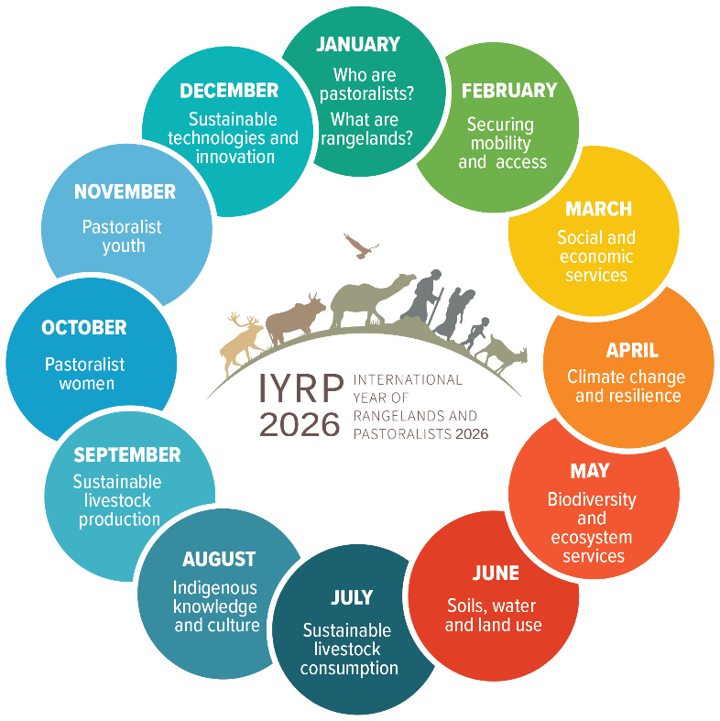
Categories of Images
Most photo contests divide images into categories.
  Makes judging easier
  Provides more winners
Categories are all over the place, so pick your own.
  You might consider the monthly themes as a starting point.
  Also, consider separating people, landscapes, animals,equipment, etc.

Slide 13
Prizes?
Ribbons?
  Silly as it seems, adults still like to get ribbons.
Certificates?
  Consider a certificate thanking photographers for participating and helping create your display.
Prizes?
  I don’t consider these necessary. There are cash rewards in our county fair, but a good year might net twenty bucks and no one really cares about them.

Slide 14
Judging
How many judges?
  Recommend an odd number. Three works well.
Judges’ backgrounds
  Recommend one photographer, one from the people working the display, and one from the local pastoralist community.
Live, online, etc.
  Strictly preference. Most contests do not have live judging with an audience. At our county fair we do and a lot of photographers attend because the judges are very good about explaining why they choose certain images over others. I think prints work better for live judging.

Slide 15
Miscellaneous Considerations
Entry form
Database/spreadsheet for tracking
Communications with contestants
Help with planning/organizing
  Most fairs have photography contests-check locally for who manages yours.
  Most photography clubs are “competition clubs” devoting one meeting/month to an internal competition. This makes a good source of judges. Also, it appears that many county fair photography competitions are run by a local photography club.

Slide 16

Thank you

