Slide 1
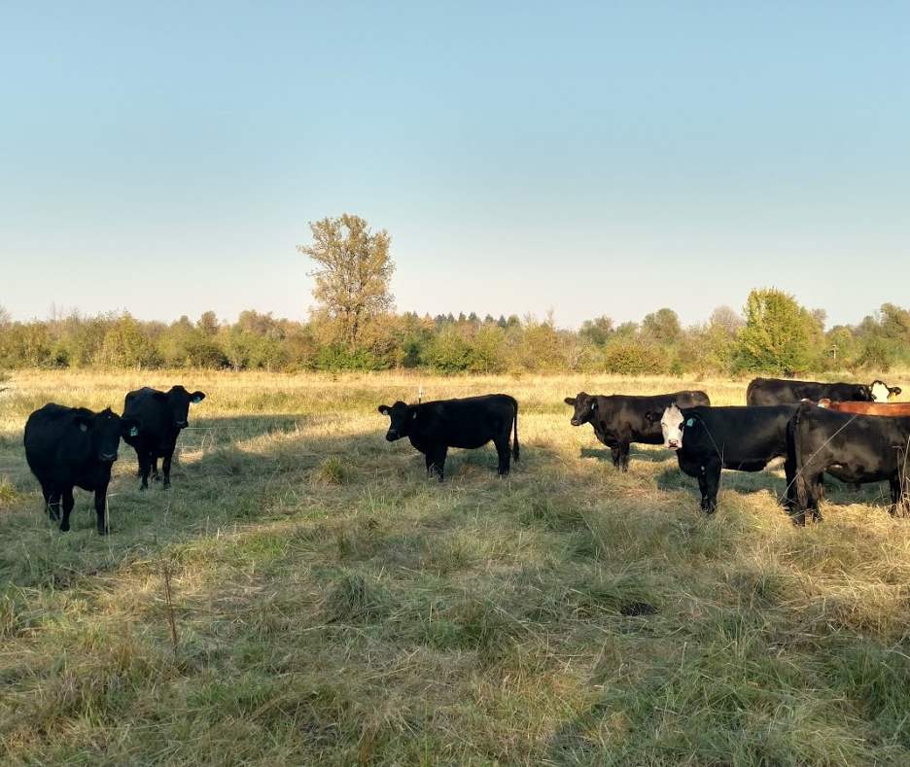
Tracking Y Ranch
“Grazing for Conservation: Ecological Opportunities for Ranchers at the Urban-Rural Frontier”
Focused on responsibly raising great Grass Fed beef; while improving properties for both owners and wildlife

Slide 2
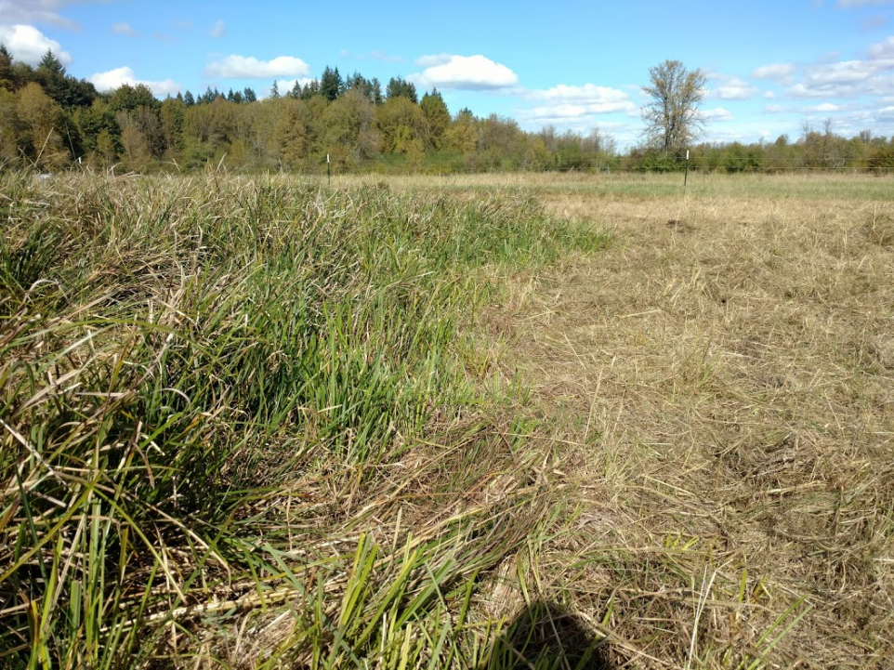

Business Goals
Improve pasture conditions
Improve wildlife habitat
Raise great beef for sale

Slide 3
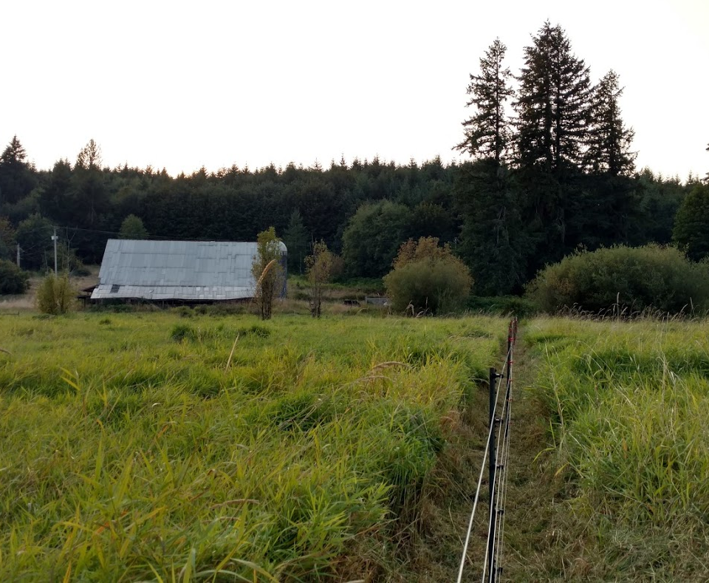
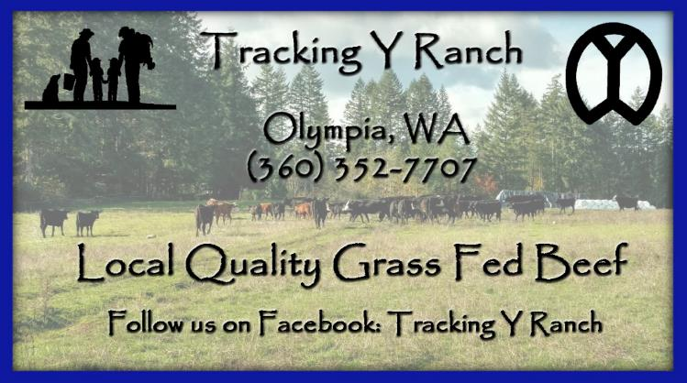
Tracking Y Ranch, 2015
Self, Family, and Business
Student WSU/ Walla Walla Community College
Grew up raising cattle, sheep and horses
Spent 5 years working/managing ranches
Last 17 years spent working full time in Public Safety
Married, Two young twin daughters
Live in the Tumwater area
Both work full times jobs on top of kids and Cattle
Active in 4-H and Grays Harbor Mounted Posse
Did not inherit livestock or property

Slide 4
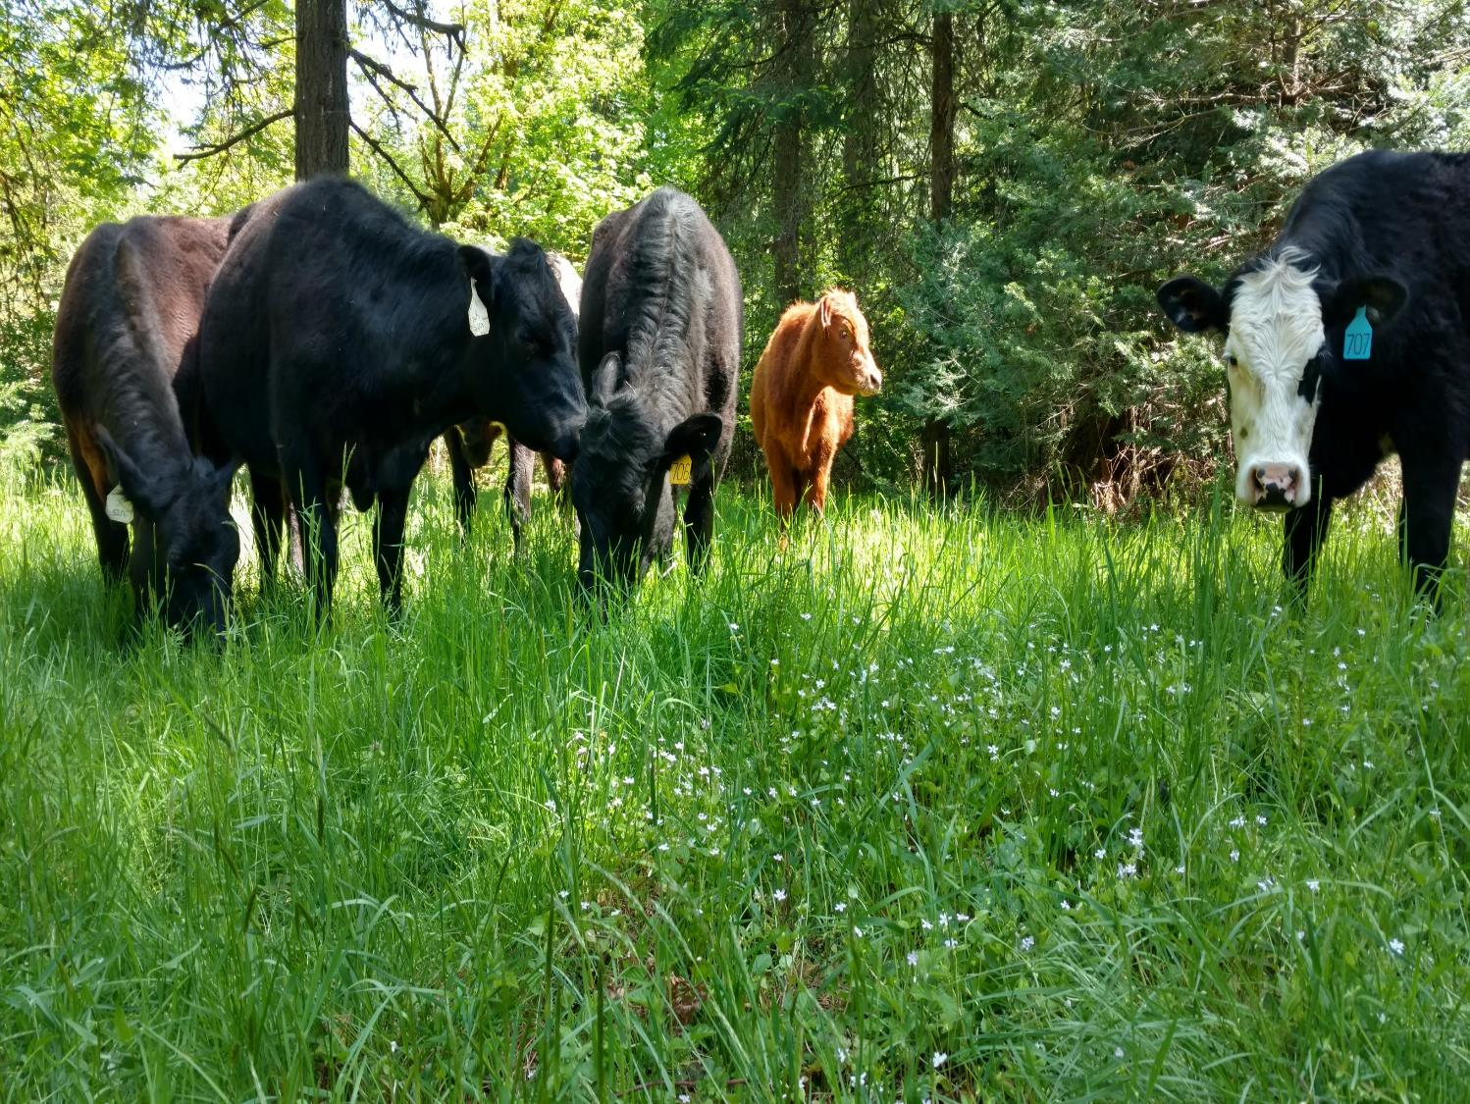
2015 Started Tracking Y Ranch with a partner and 6 pairs (Cow and Calf)
-First year acquired approximately 80 acres of leased ground
-Focus on care leases, versus rented/owned pasture
-Retaining heifers and cows that raise live calf to weaning
-Market steers and heifers as Grass Fed Beef with some custom finished stock finished on 30-90 days grain
2021 currently running approximately 80 pairs
-Currently manage about 325 acres of leased ground in a four county area
-Retain heifers and cows that raise a live calf to weaning
-Separate cow/calf and heifer/feeder herds
-Breed to Angus bulls
-Cull for temperament
-Market steers and breeding cull heifers as Grass Fed Beef

Slide 5
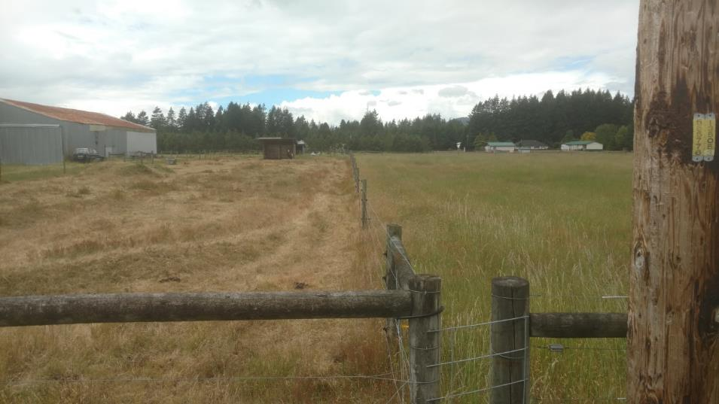
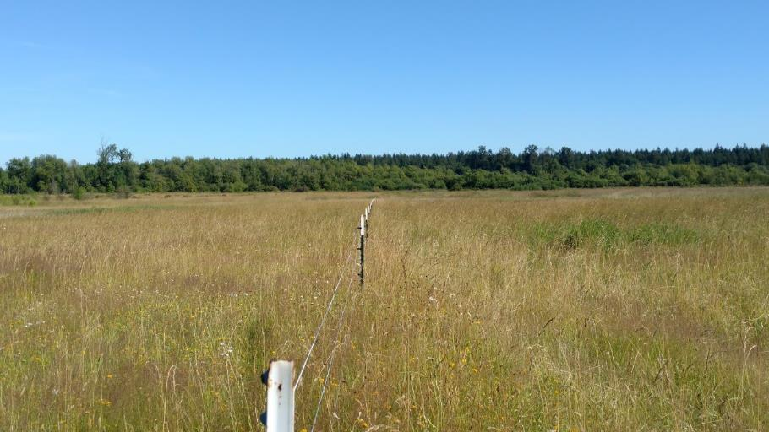
Improving Pasture Conditions

Slide 6
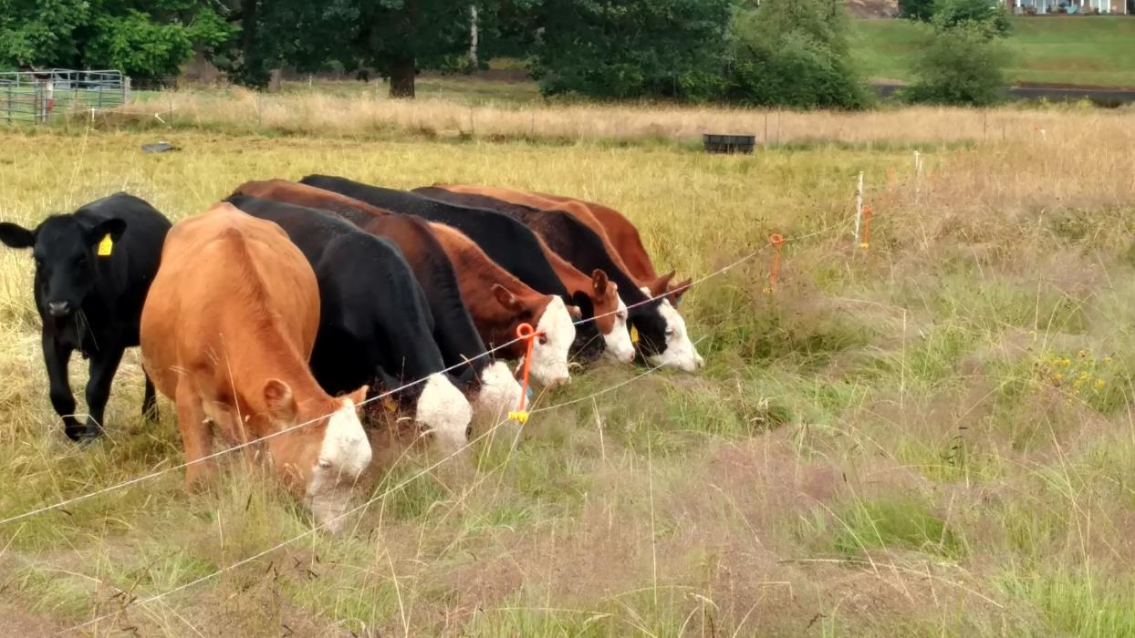
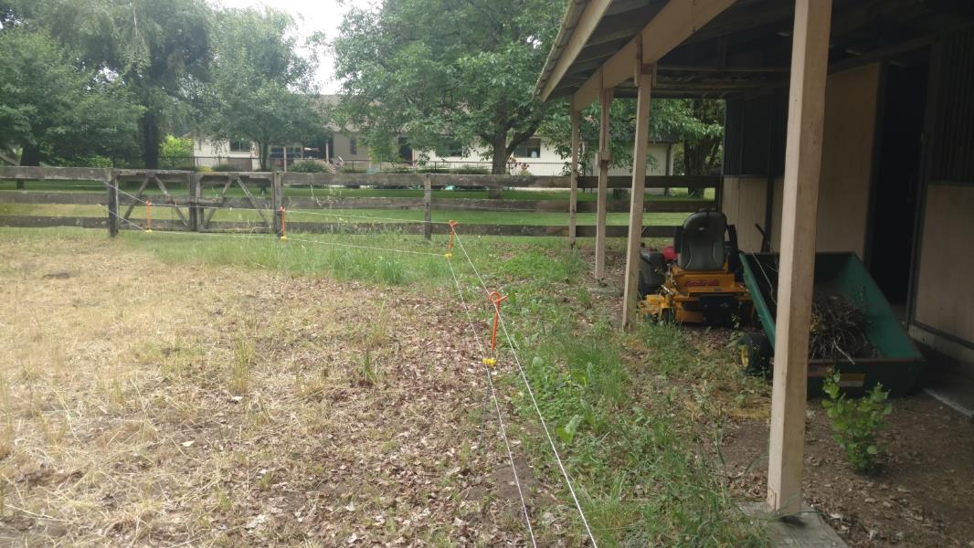


Slide 7
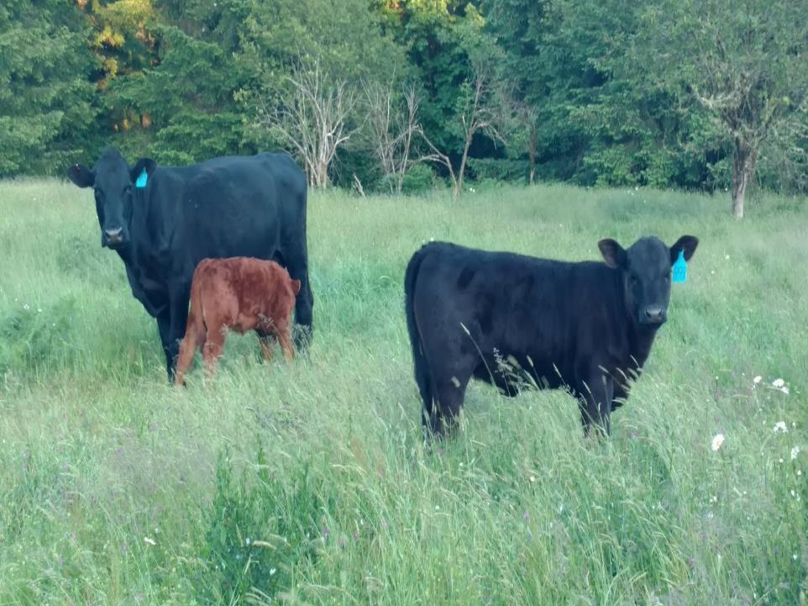
Secondary value added benefits of Livestock
Return nutrients to soil naturally
Control brush, increasing deer habitat and browse
Decrease fire risk
Supplies purchases for raising livestock are purchased locally, returning money to the local community
Produce Great Beef which is marketed locally
Employ seasonal employees, as needed, to assist with fence construction and livestock rearing
Decrease plant cover to provide habitat for geese and other waterfowl to land

Slide 8
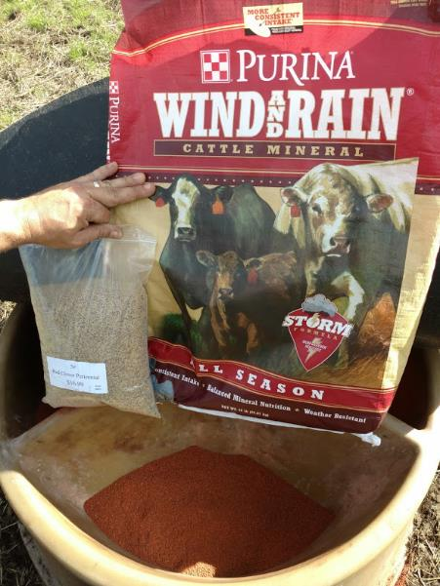
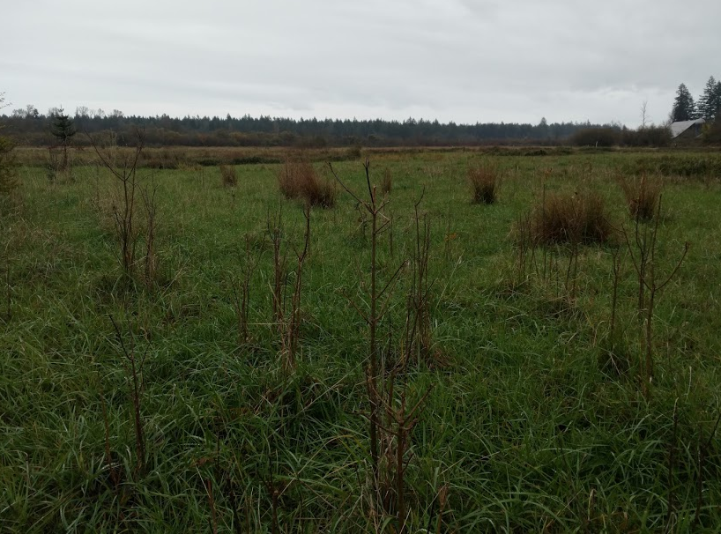
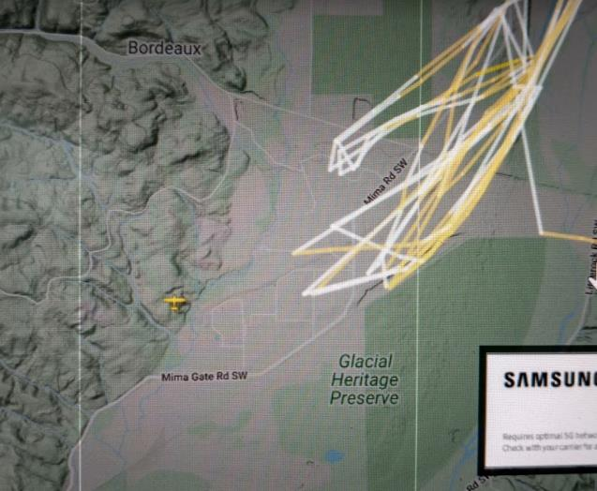

Slide 9
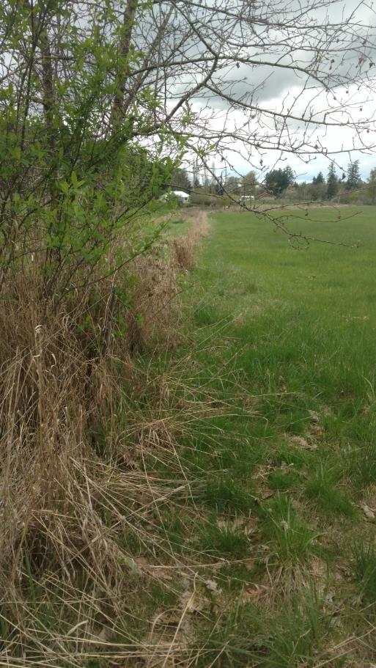
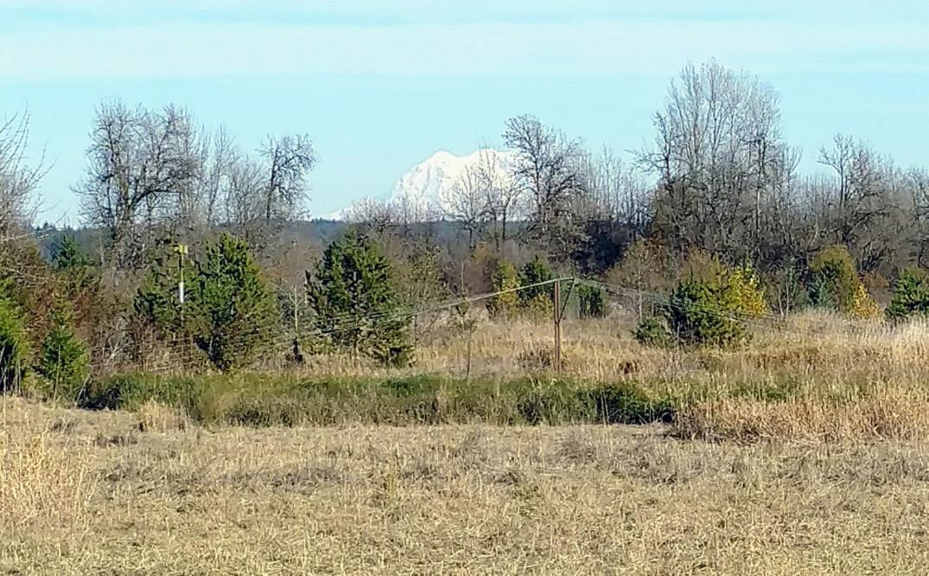
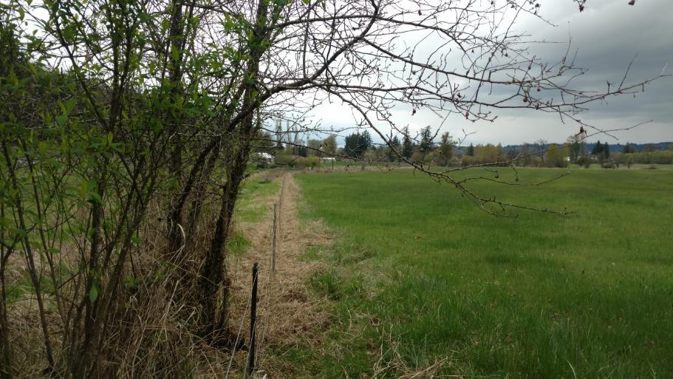
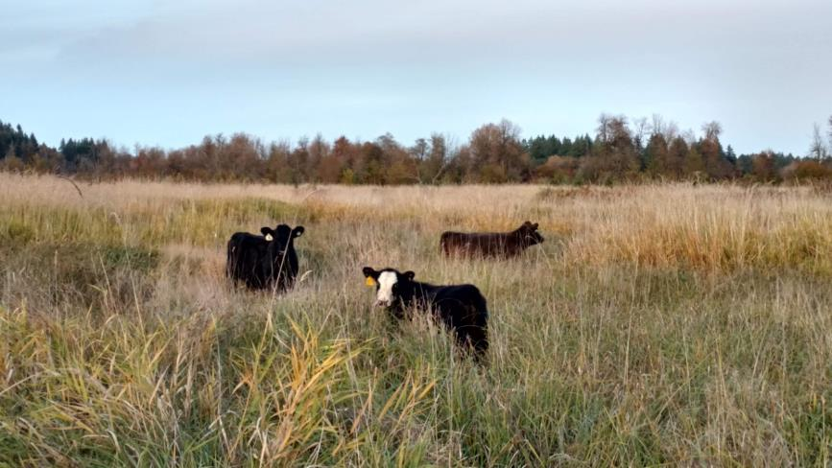
Fence line repairs and clearing, to restrict livestock access to fish bearing steams
Tilt-up wildlife bypass fence for Elk, Bear, and Deer

Slide 10
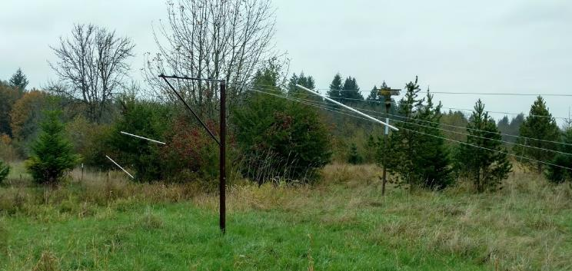
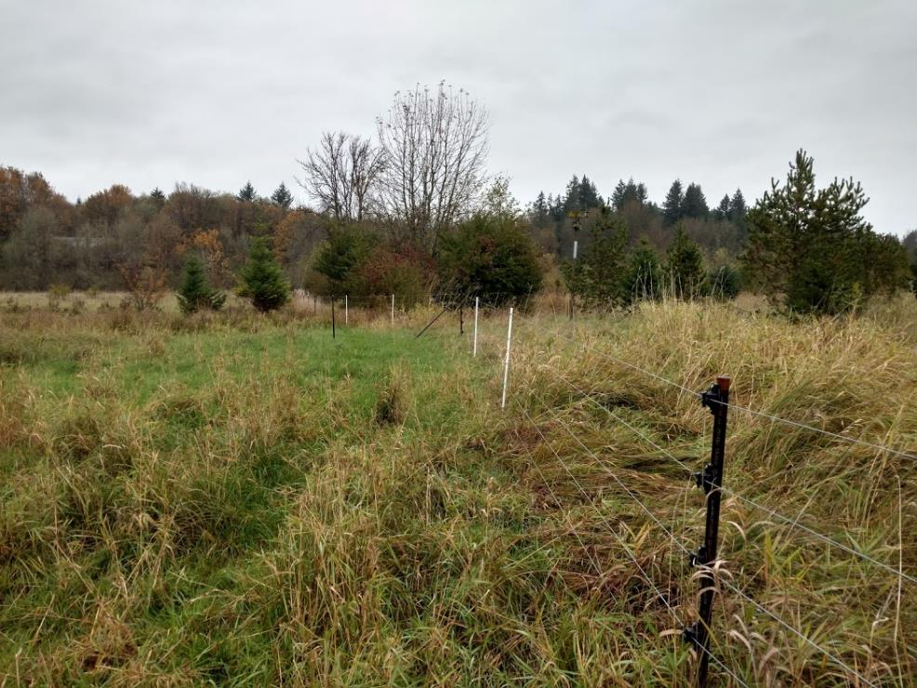
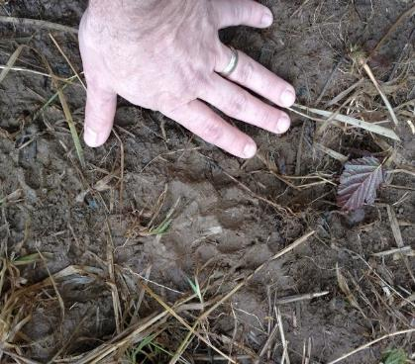
Check it out on Youtube @Tracking Y Ranch
https://youtu.be/uP7X8n9Zd04
Seasonal Wildlife Bypass;
Creates a 12’ high x100’
wide opening in the fenceline
Opened up when cattle are not actively grazing allowing deer, elk, and bear to cross
Constructed with high tensile wire, and Gallagher insulators

Slide 11
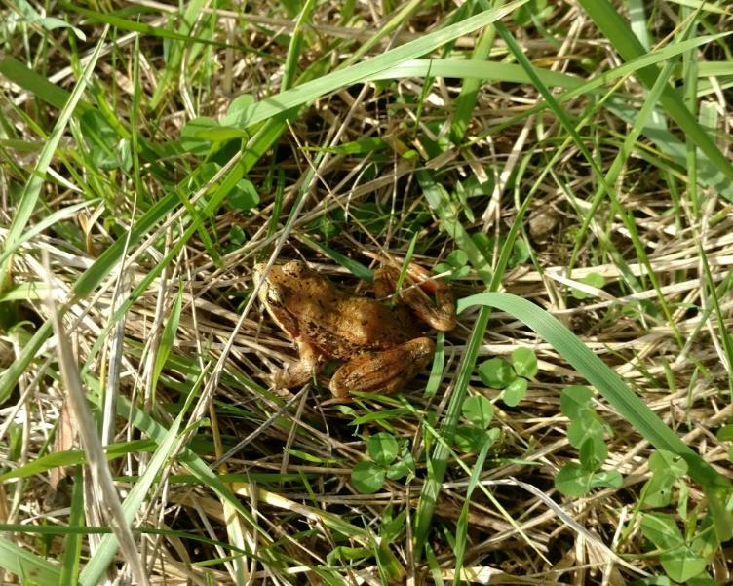
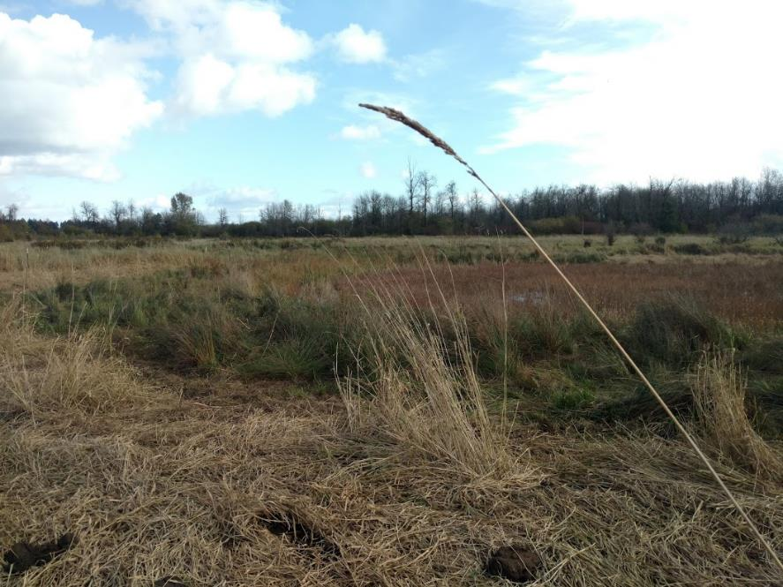
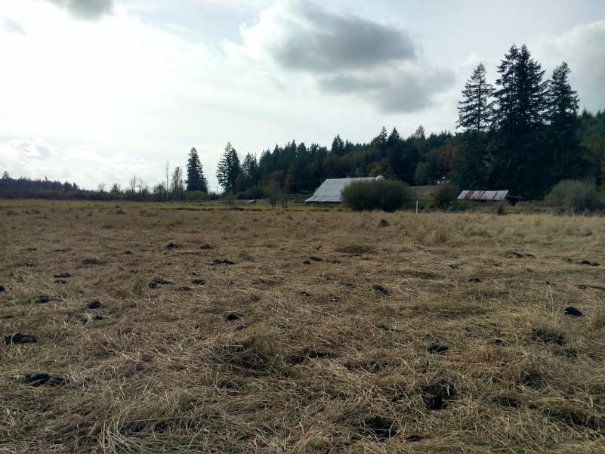
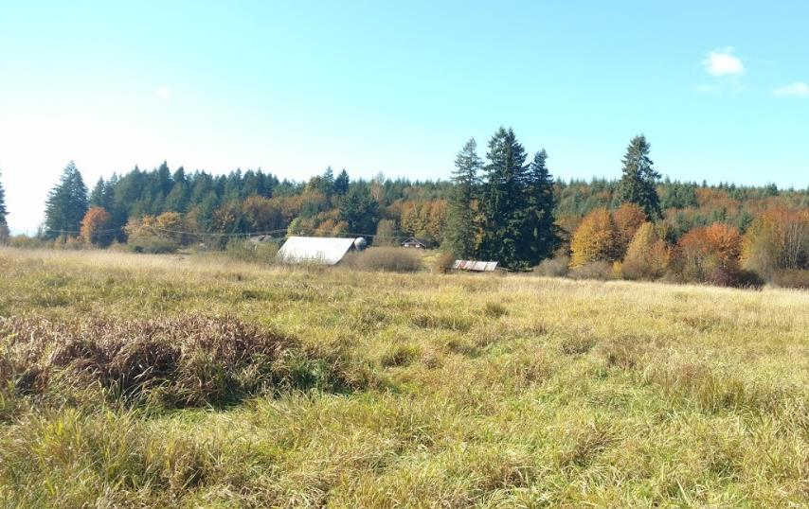

Slide 12
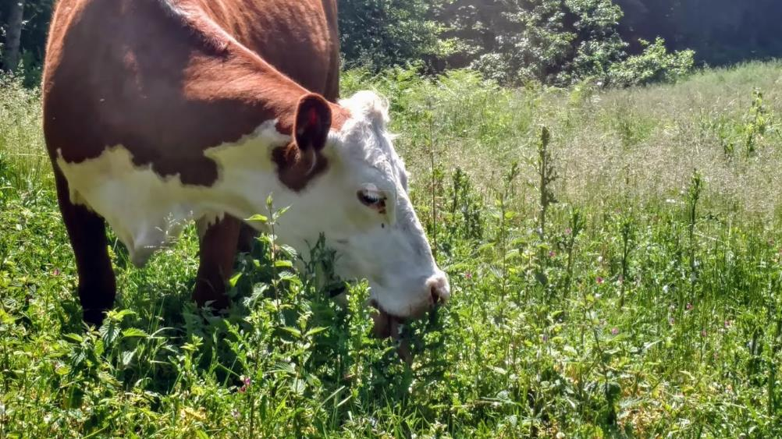
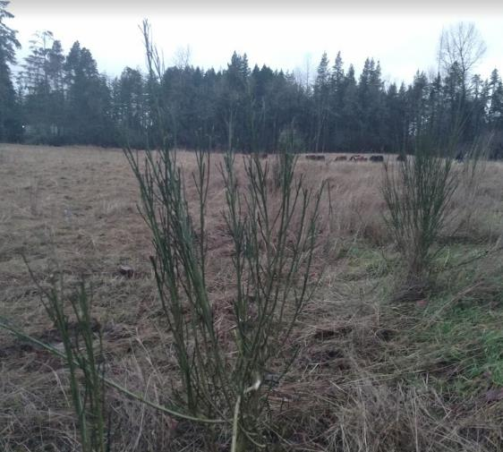
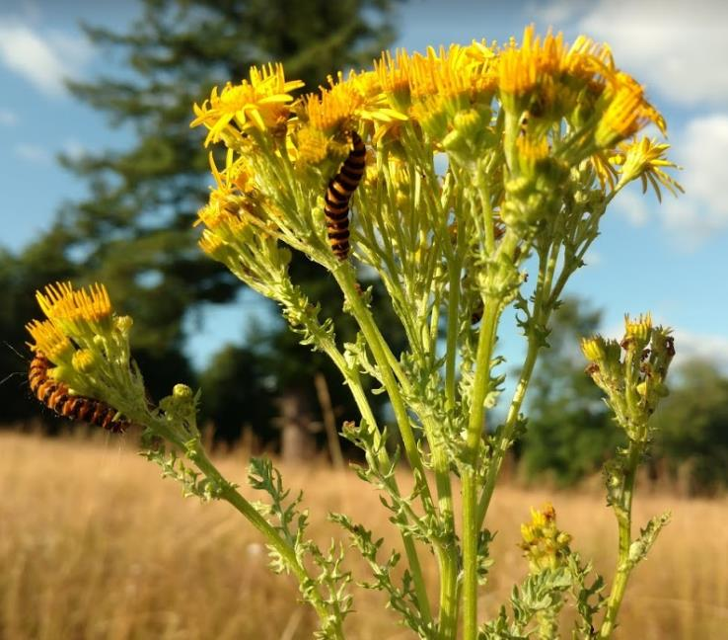
Grazing and nature working together to combat invasive species

Slide 13
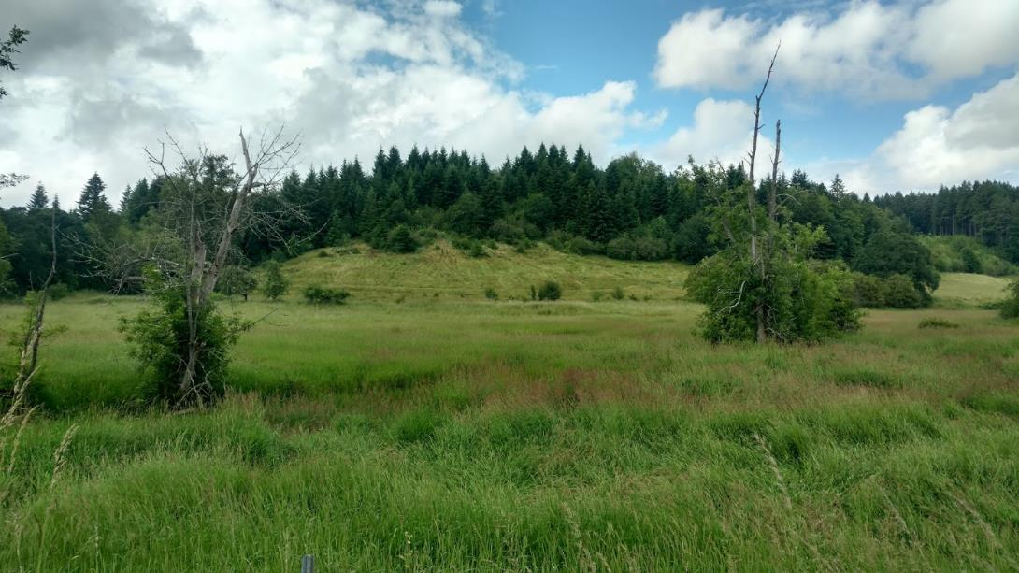
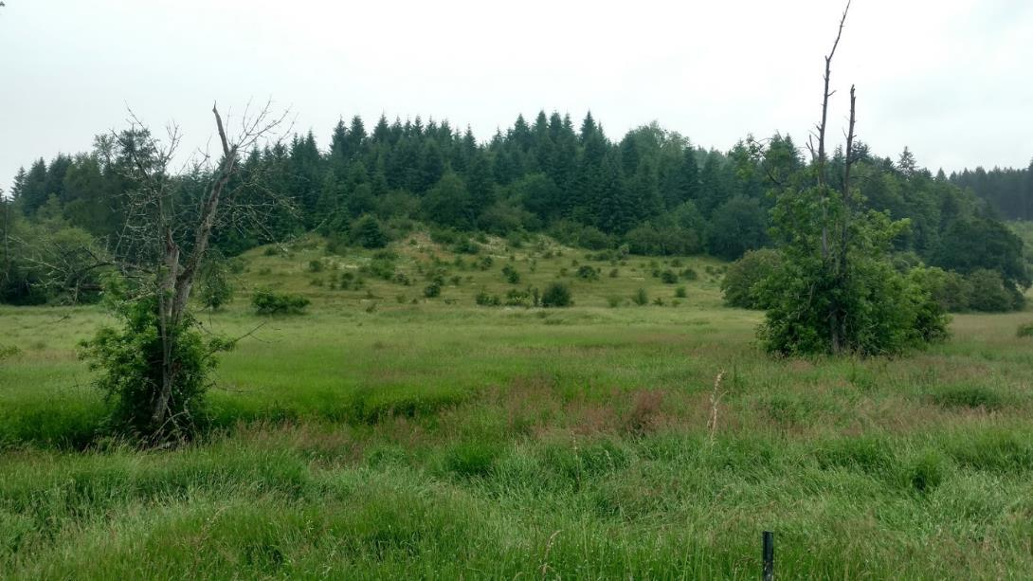

Slide 14
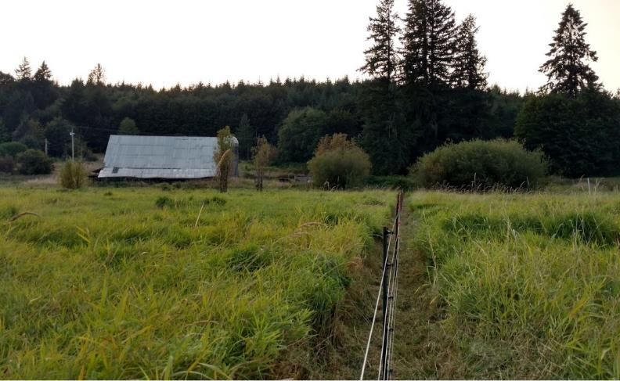
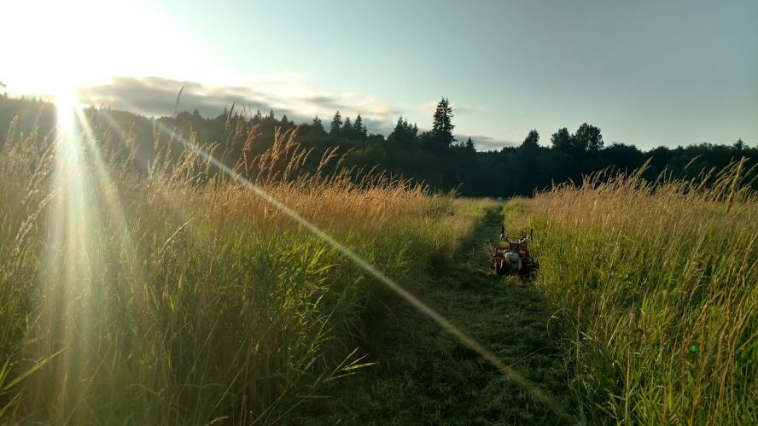

Slide 15
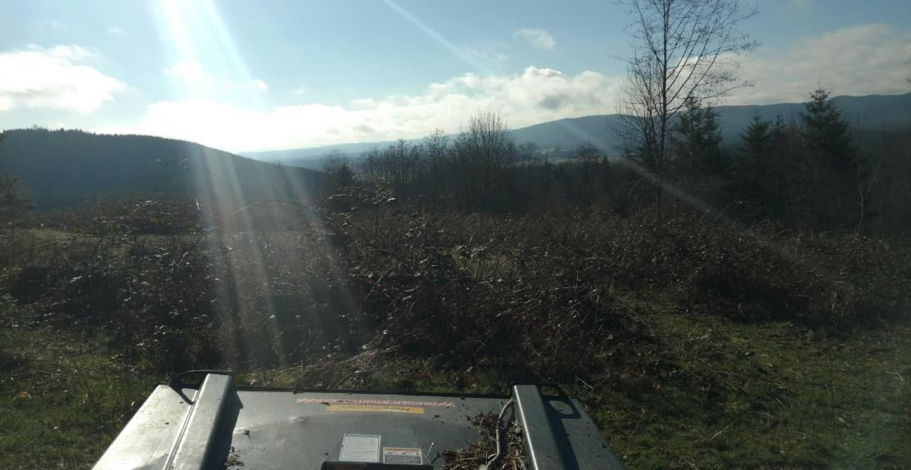
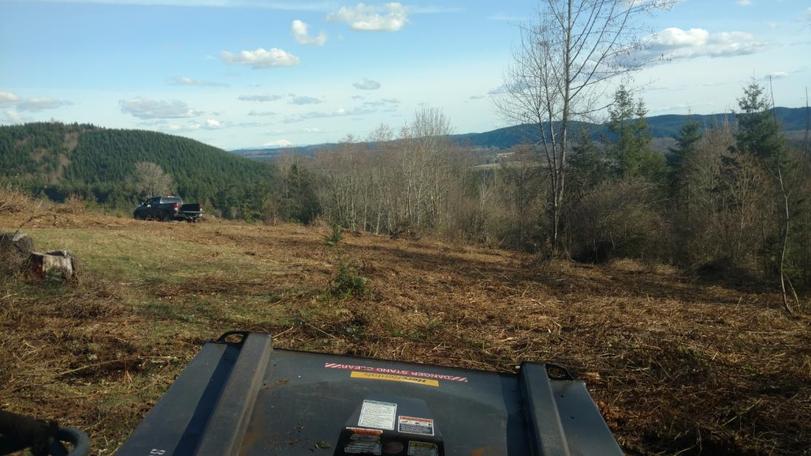
Blackberry briars and brush removal to improve grass growth, improve grazing ground, while increasing feed to local wildlife

Slide 16
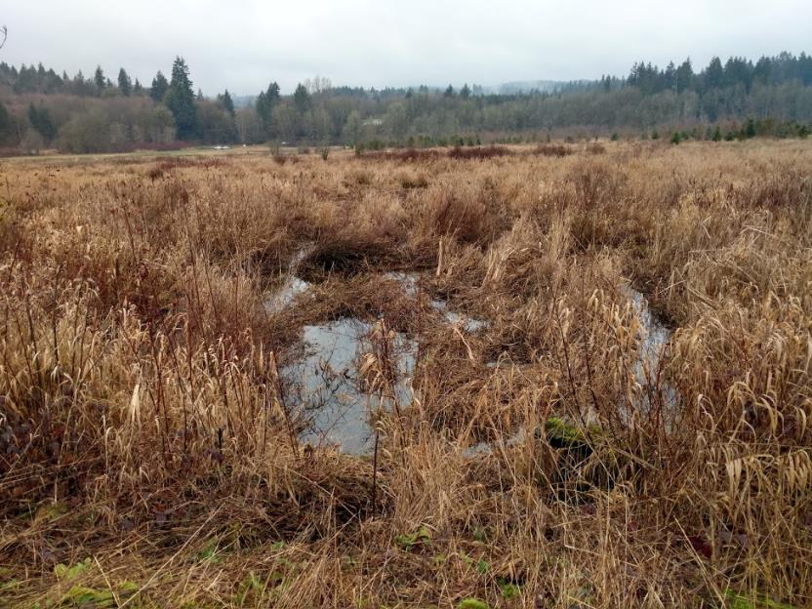
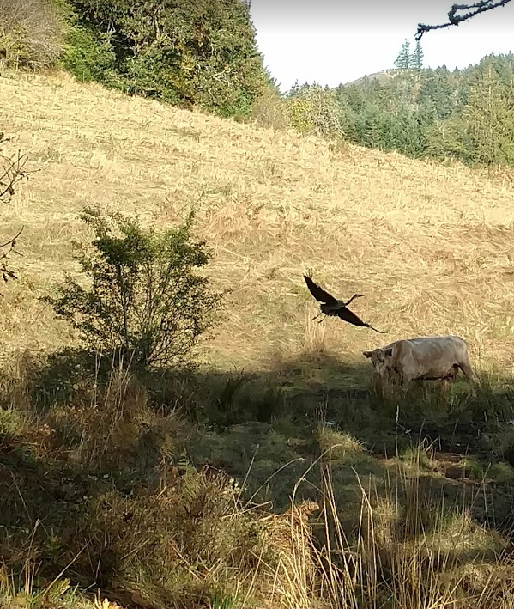
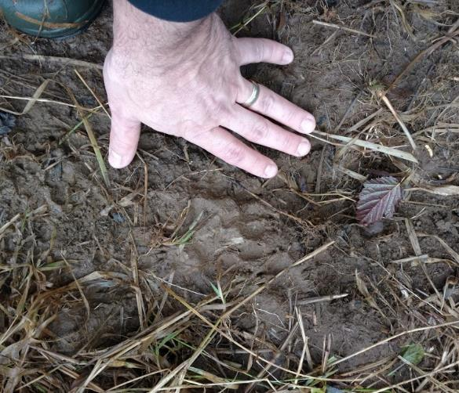

Slide 17
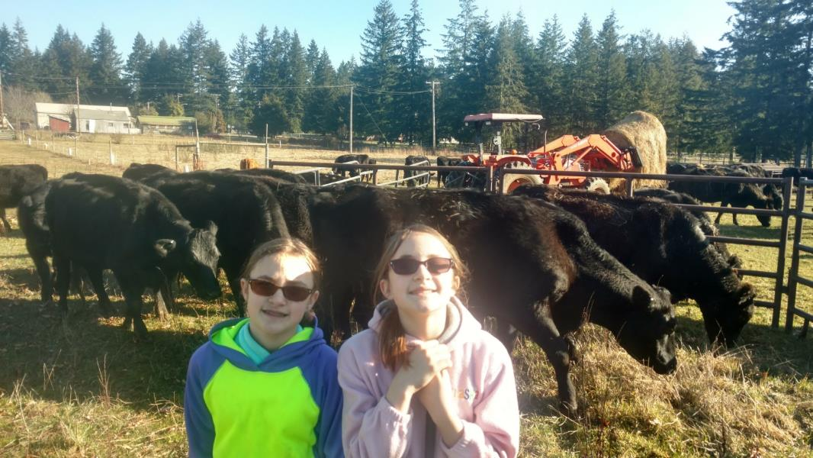
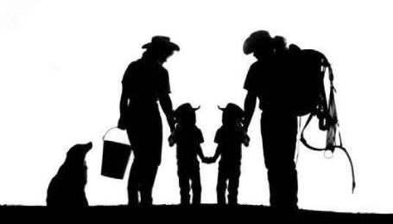

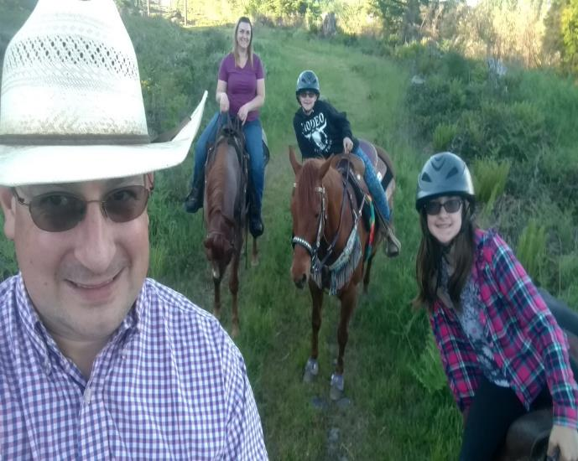
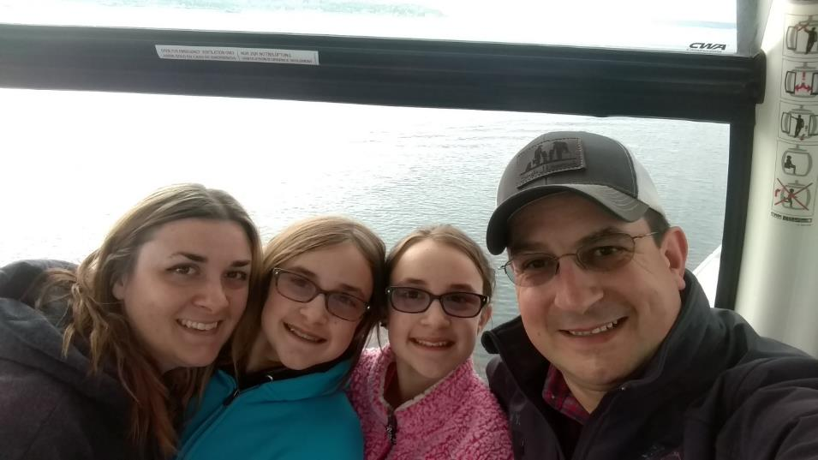

Slide 18
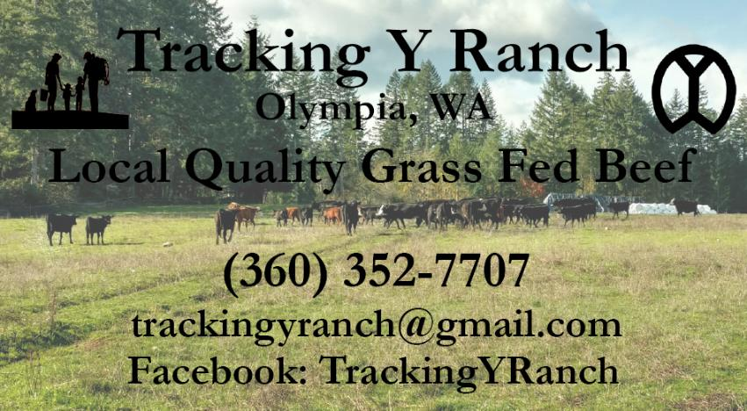
Youtube and Instagram@ Tracking Y Ranch
Gallagher products shown available at Gallagher Animal Management
Your welcome to use our discount code "TrackingY" on Gallagher purchases for a 10% discount. Makes purchasing Gallagher High Tensile Fence, Electric Fence chargers, or any other fence supplies, a little more affordable. Enjoy. https://bit.ly/3h8j7nH

