Slide 1

15 years of grazing for shrub-steppe conservation and risk reduction on a mixed-ownership landscape
Tipton D. Hudson
WSU Extension, Associate Professor of rangeland & livestock management

Slide 2
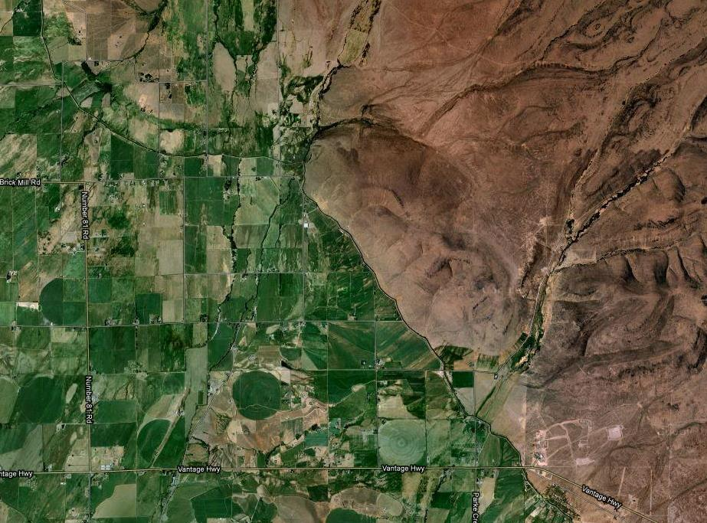
Notes:
Common problem in much of the semi-arid West lowlands
Contrast between irrigated valley and adjacent rangeland

Slide 3

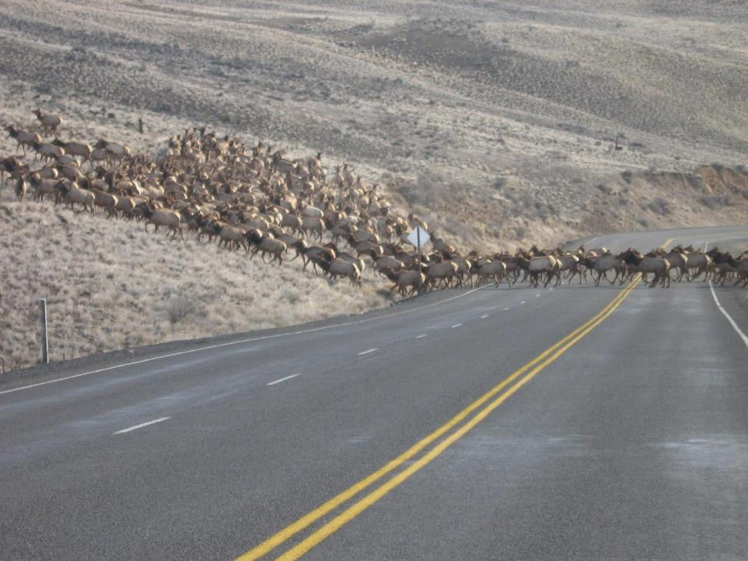
Elk herd is large and mobile
Notes:
Elk herd in this area is large and mobile. Mature females are 450-500 lbs. So a herd of 5-8,000 consumes a lot of forage.

Slide 4
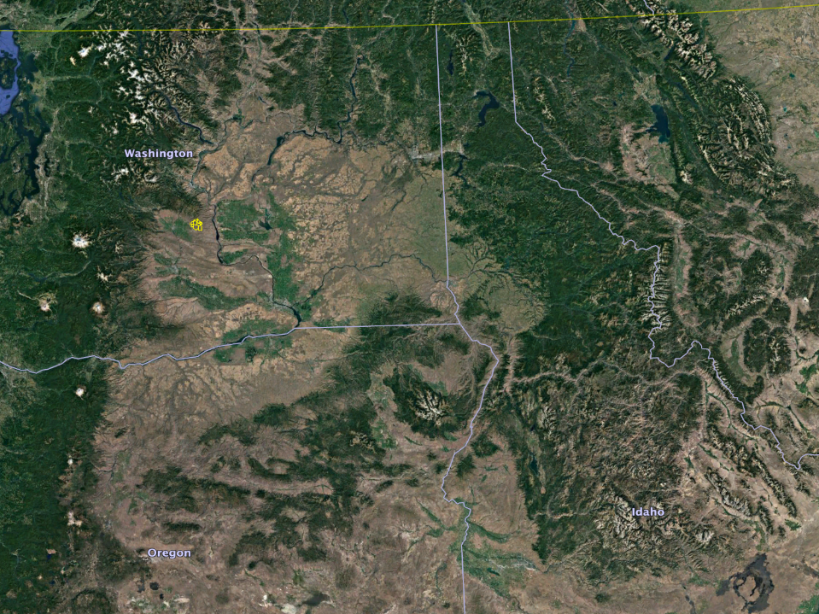

Slide 5
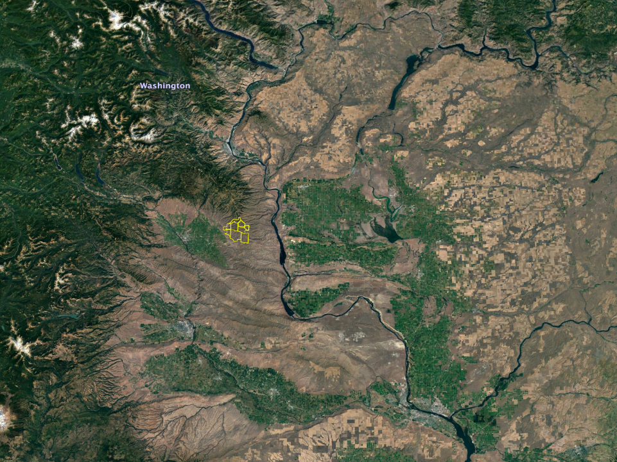

Slide 6
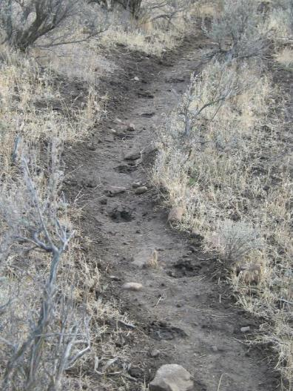
Big Game Management Roundtable
Est. 2003 to address community problem and find community solutions
Address root causes for long-term solutions
Provide short-term alleviation

Slide 7
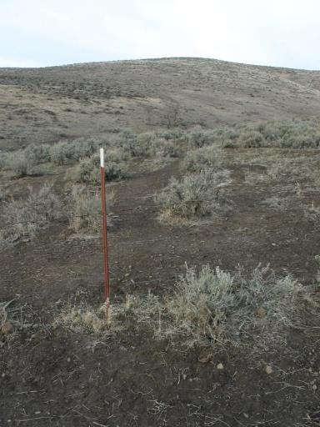
Suspected factors in re-distribution
Changing logging practices
Changing grazing practices
Loss of spring developments
Increased recreation & usage type
Loss of habitat connectivity
Elk feeding
Lack of natural disturbances
Attraction of valley forage

Slide 8
Wild Horse Coordinated Resource Mgmt.
Formed January 2006
Major land ownership changes
Purpose is collaboration among key stakeholders to develop an effective and successful grazing management plan for the Skookumchuck and Whiskey Dick Wildlife Areas in eastern Kittitas County

Slide 9
Historical grazing mistakes
High stocking rates
Inadequate recovery periods
Multi-season grazing
Annual grazing on the same site during internode elongation
Failure to allow seed production by native bunchgrasses
Notes:
Group set out to avoid some of the unsustainable grazing practices applied historically that led, in many places, to degraded rangeland.

Slide 10
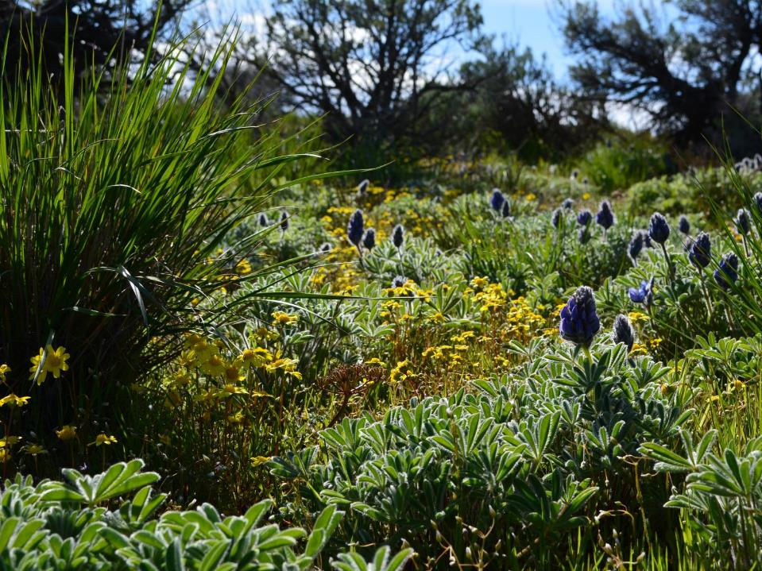
Aesthetic values

Slide 11
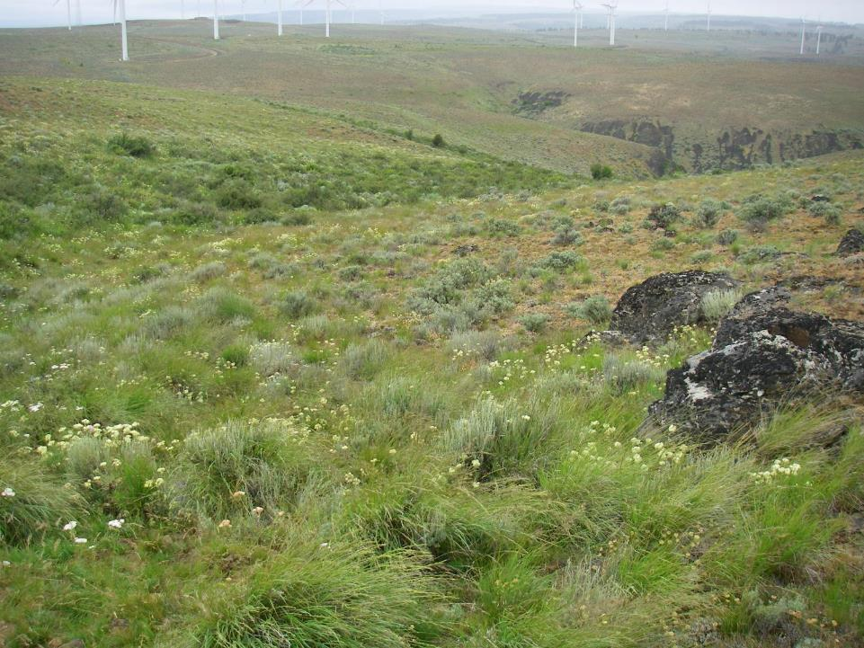
Economic values
Notes:
Wind energy facility built 2006-2008

Slide 12
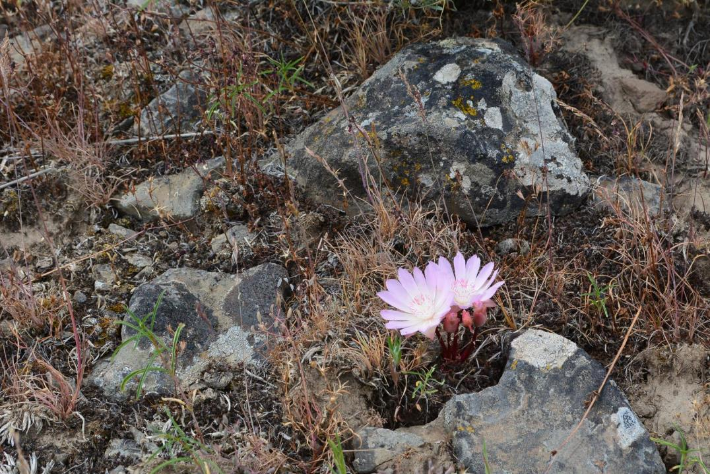
Cultural values
Notes:
Lewisia rediviva, bitterroot. Dug by indigenous peoples for food

Slide 13
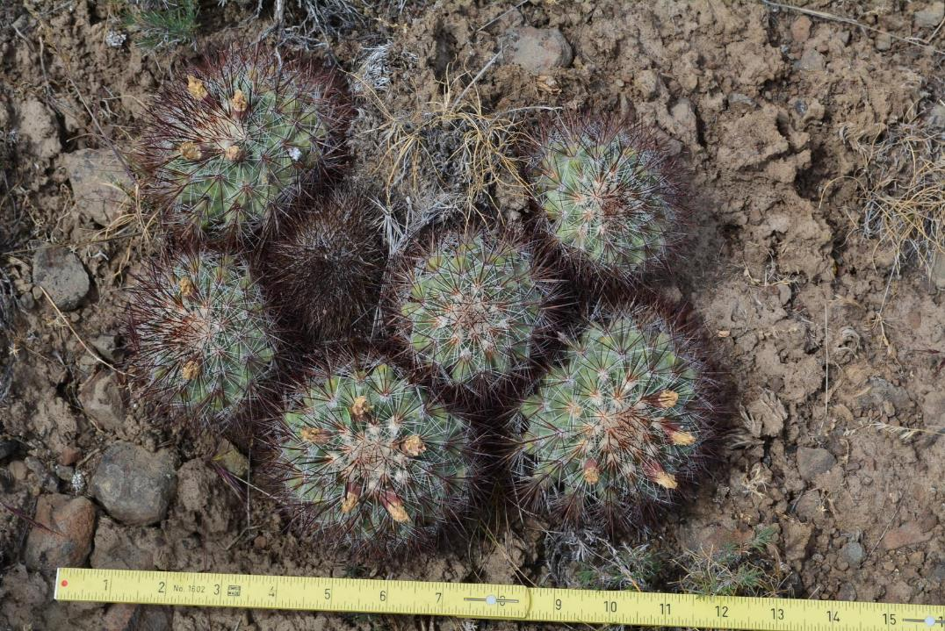
Biological values
Notes:
This area is one of the larger intact pieces of shrub-steppe in Washington State and it is in excellent condition. Botanical diversity is high and everyone wants it to stay that way.
Simpson’s hedgehog cactus (Pediocactus simpsonii)

Slide 14
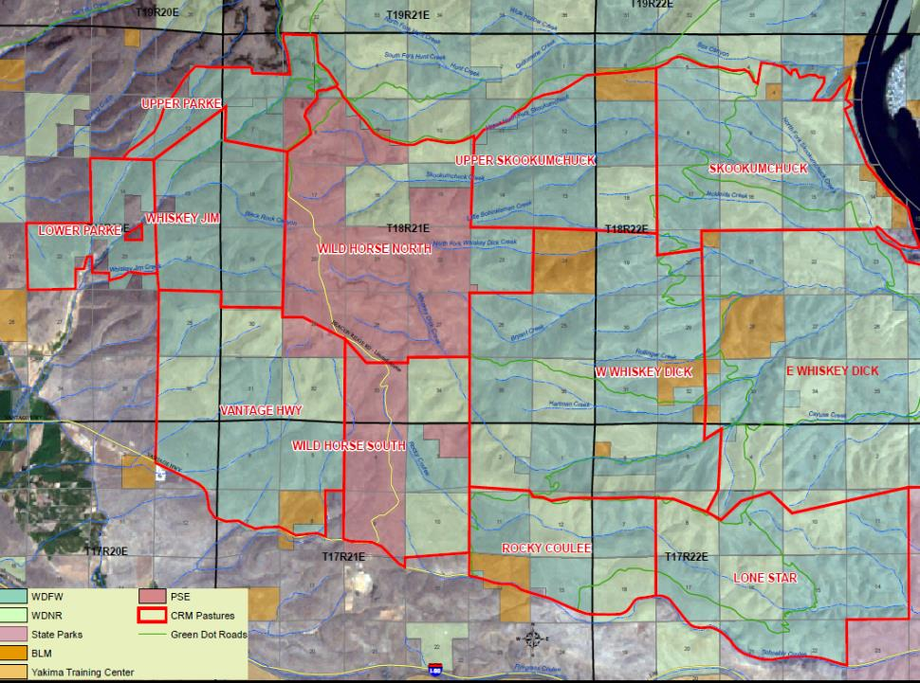

Slide 15
Wild Horse CRM grazing principles
Defer (avoid) grazing in each grazing unit during the growing season one year out of three;
Graze a management unit (pasture) during bunchgrass internode elongation only one out of three years;
Graze no more than half the growing season in a single pasture/management unit;
Plan for and implement within-grazing-period monitoring to achieve ~35% utilization on bluebunch wheatgrass within the zone of livestock accessibility;

Slide 16
Wild Horse CRM grazing principles
5. Maintain at least 15 cm grass/forb height for sage grouse breeding and brood-rearing habitat;
6. Use 60% utilization around water sources as a trigger for moving livestock before the planned move date if necessary;
7. Use 4 inch stubble height on key grasses as a trigger in riparian zones; and
8. Use 35% utilization of browse species (shrubs and trees) in riparian zones as a removal trigger

Slide 17
Public lands grazing makes headlines
Environmental group opposes E. Wash. cattle grazing plan
Whiskey Dick project plays small role in bigger picture
Grazing proposal runs into opposition
Grazing lawsuit could have more bite
Compromise is only way to solve grazing debate
Spar over cattle grazing issue
Group sues state over grazing on state wildlife land
Cattle battle
Kittitas grazing on the agenda
Sides air differences on grazing
Funding still in question for Kittitas County grazing plan
Range war in the West
Hypocrisy evident in conservationist’s jackpot with BLM

Slide 18
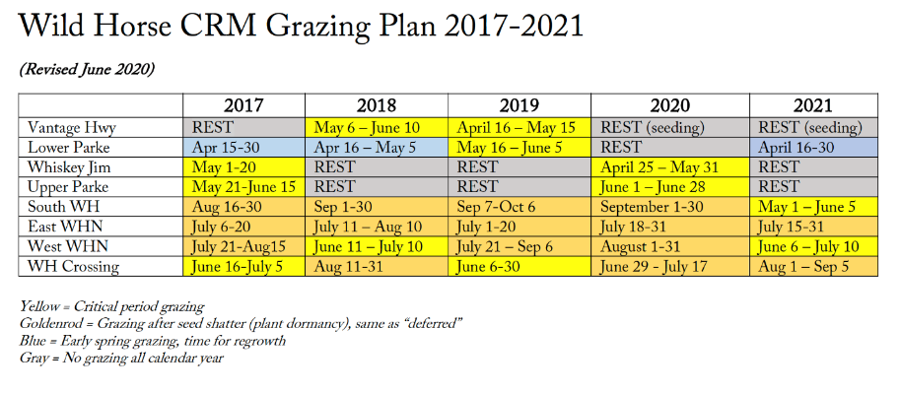
Example grazing schedule

Slide 19
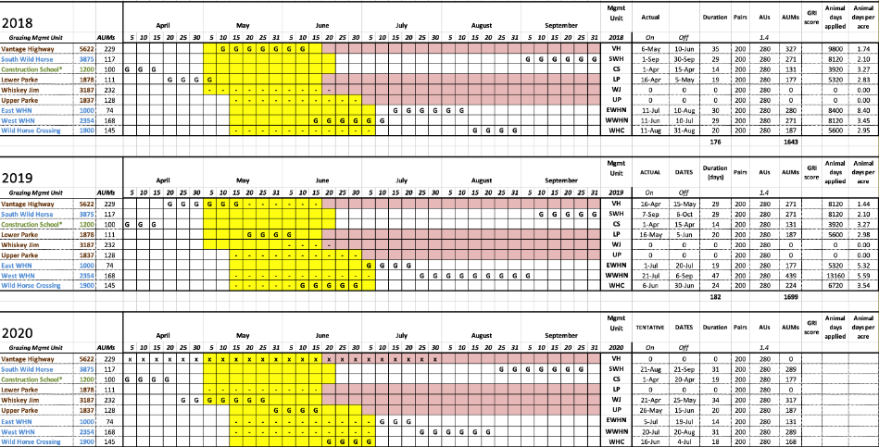
Detailed grazing schedule

Slide 20
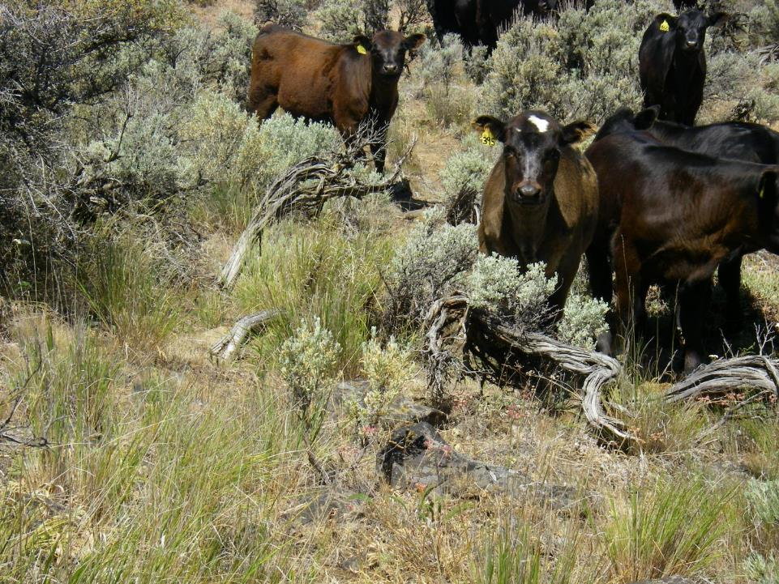
Notes:
Implementing this plan since 2007 with about 200 cow-calf pairs

Slide 21
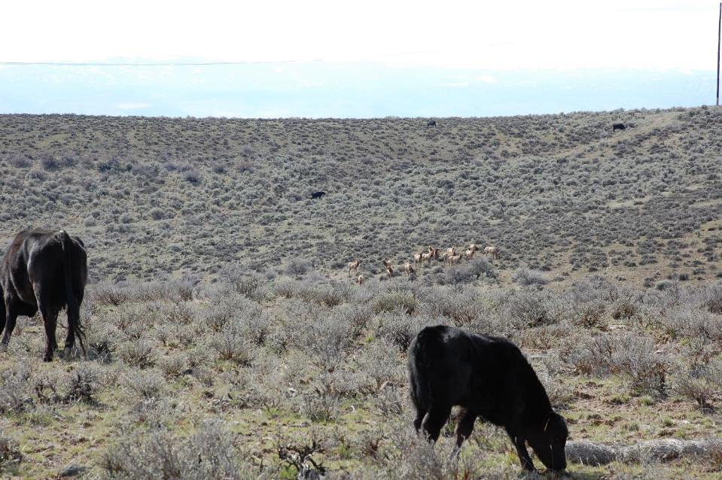
Elk and cattle commingle
Notes:
Late April photo.

Slide 22
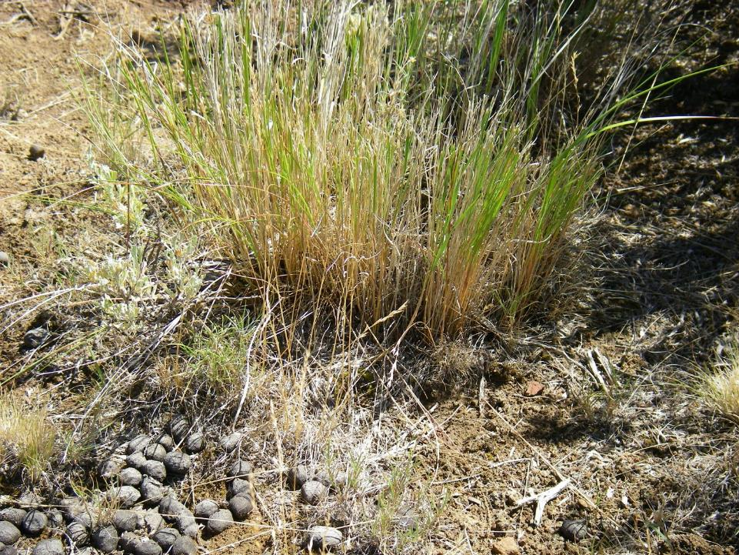
Post-grazing SWH
Notes:
At this relatively light stocking density combined with relatively short grazing periods, the severity of individual plant defoliation tends to be low.

Slide 23
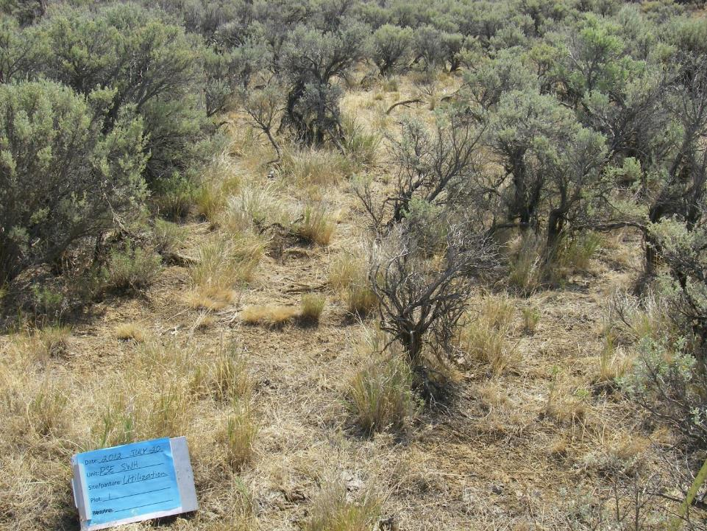
Post-grazing SWH

Slide 24
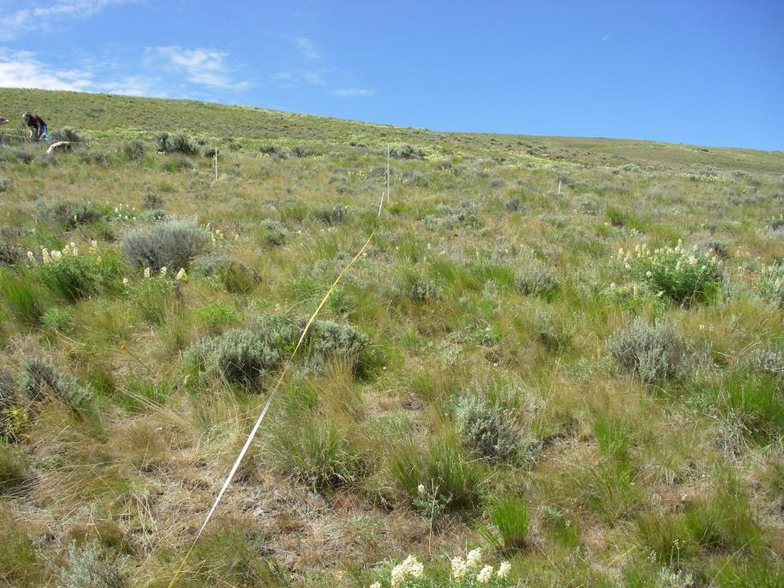

Slide 25
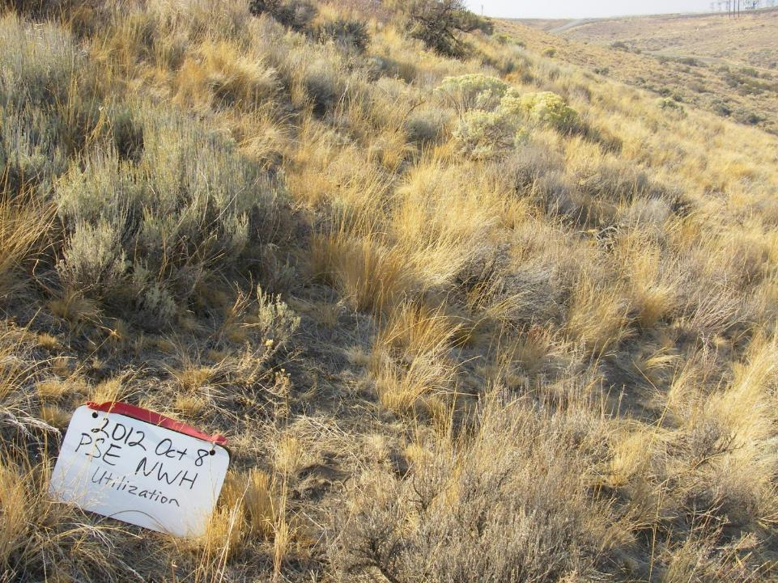
Post-graze North WH
Notes:
Large areas with light use.

Slide 26
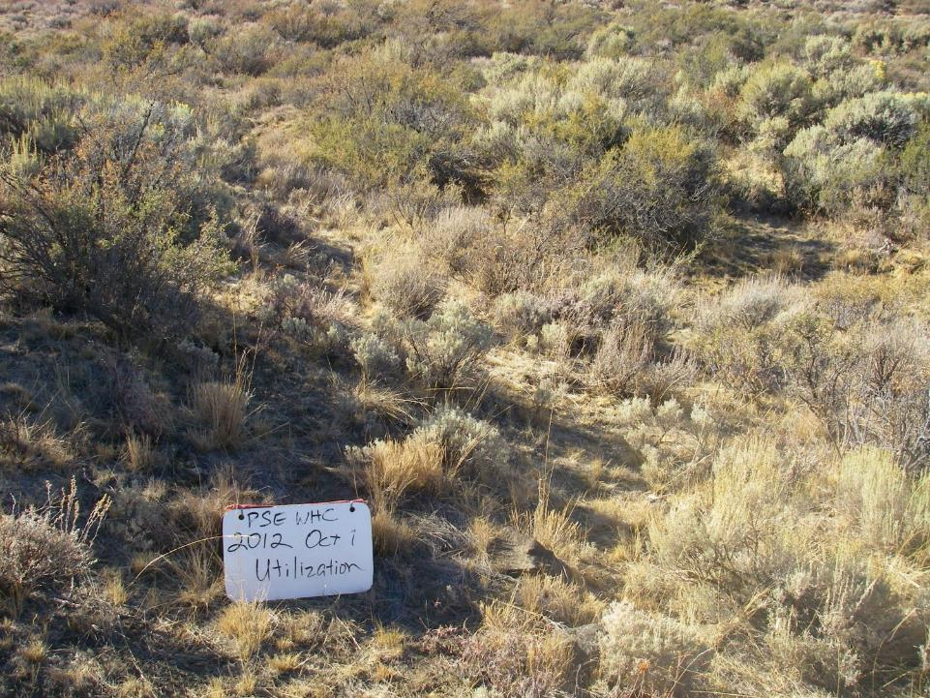
Post-graze WH Crossing (7/22)
Notes:
Large areas with moderate utilization.

Slide 27
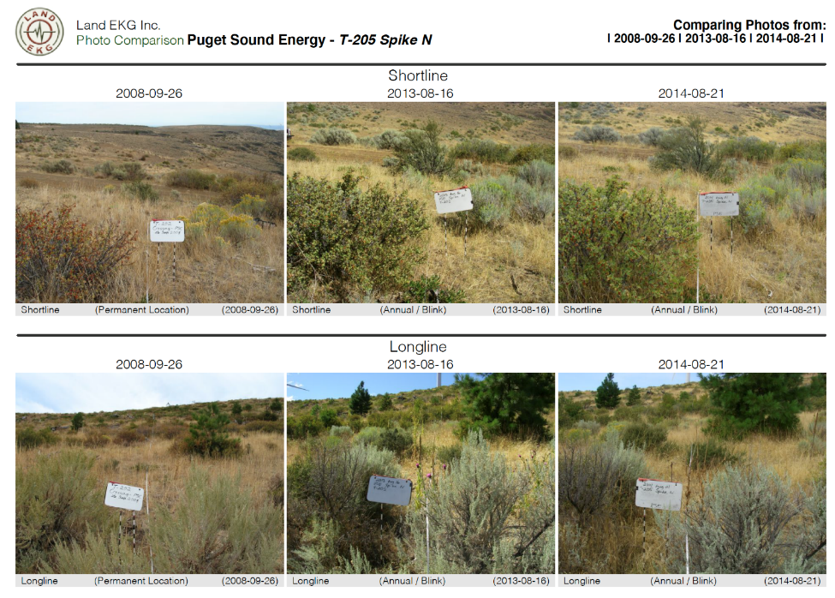
Notes:
Long-term repeat photo sites established in 2007 and later. These have provided useful information about intraannual variability of plant phenological development and production and reveal changes that various direct monitoring measurements don’t pick up.

Slide 28
Grazing utilization measurements (goal is <35%)
 | PSE rangeland grazing utilization (from local height:weight curve)
 | 2011 | 2012 | 2013 | 2014 | 2015 | 2016 | 2017 | 2018 | 2019 | 2020
SWH | 20 | 15 | -- | 9 | -- | 33 | 14 | 19 | 21 | 25
EWHN | -- | -- | -- | 12 | 21 | 20 | 17 | 27 | 24 | 22
WWHN | 21 | 28 | 22 | 13 | 12 | 6 | 19 | 29 | 17 | 24
WHC | 14 | 22 | 32 | 13 | 27 | 25 | 26 | 26 | 24 | 22
Average | 18.3 | 21.7 | 27.0 | 11.8 | 20.0 | 21.0 | 19.0 | 25.3 | 21.3 | 23.3
 |  |  |  |  |  | Stocking rate increase in 2016
Notes:
Utilization measured immediately after grazing period, regardless of when grazing period is within the year.

Slide 29
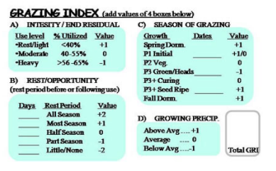
Grazing Response Index measurements
Comparison with historical range grazing practices in the same area
Factor |  |  | Description |  |  | Value
A, utilization |  |  | 50% utiliz. |  |  | 0
B, rest and opportunity |  |  | Part season |  |  | -1
C, season of grazing |  |  | Critical period |  |  | -1
D, precipitation |  |  | Variable |  |  | 0
 |  |  |  | GRI Score |  | -2
Grazing Response Index (Land EKG version)
 | 2007 | 2008 | 2009 | 2010 | 2011 | 2012 | 2013 | 2014 | 2015 | 2016 | 2017 | 2018 | 2019 | AVG
South WH | 4 | 4 |  | 0 | 2 | 3 | 5 | 1 | 3 | 2 | 5 | 4 | 4 | 3.1
West WHN | 4 | 2 | 4 | 2 | 4 | 2 | 4 | 2 | 1 | 5 | 3 | 1 | 3 | 2.8
East WHN | 4 | 2 | 4 | 2 | 4 | 4 | 4 | 4 | 2 | 4 | 4 | 2 | 3 | 3.3
WH Crossing |  |  |  | 4 | 3 | 3 | 1 | 3 | 3 | 3 | 1 | 2 | 0 | 2.3

Slide 30
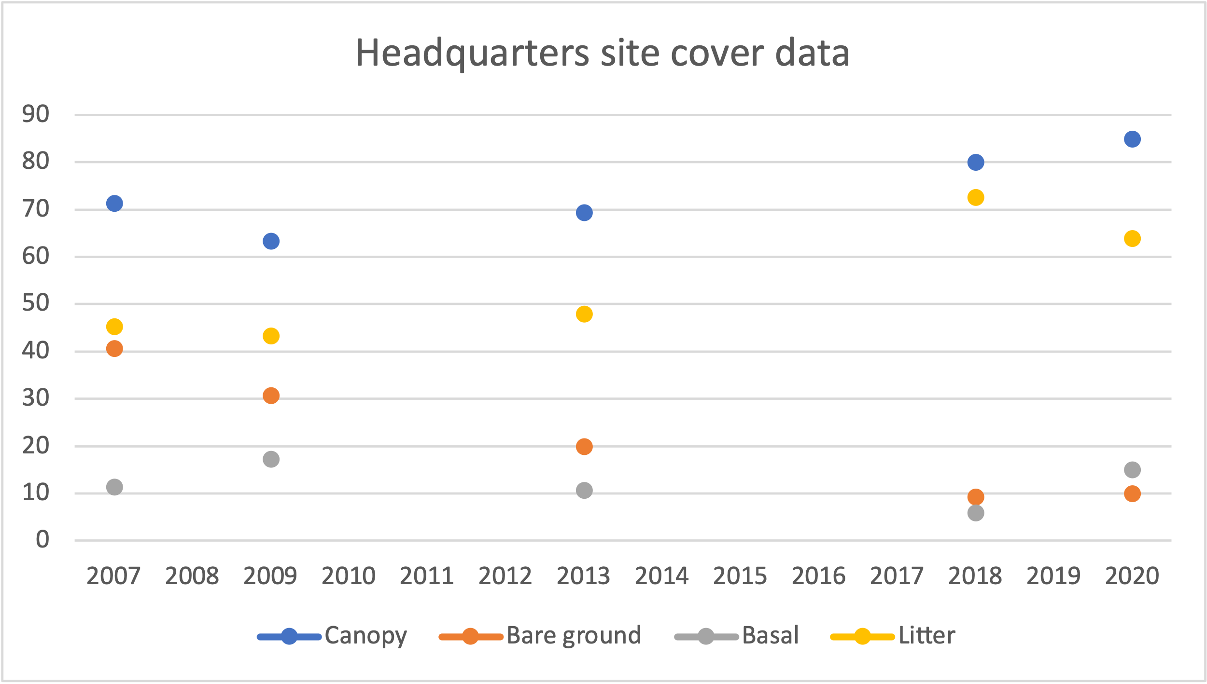
Plant community trend data
Notes:
This is the driest site on the CRM. Canopy cover up, litter up, bare ground down.

Slide 31
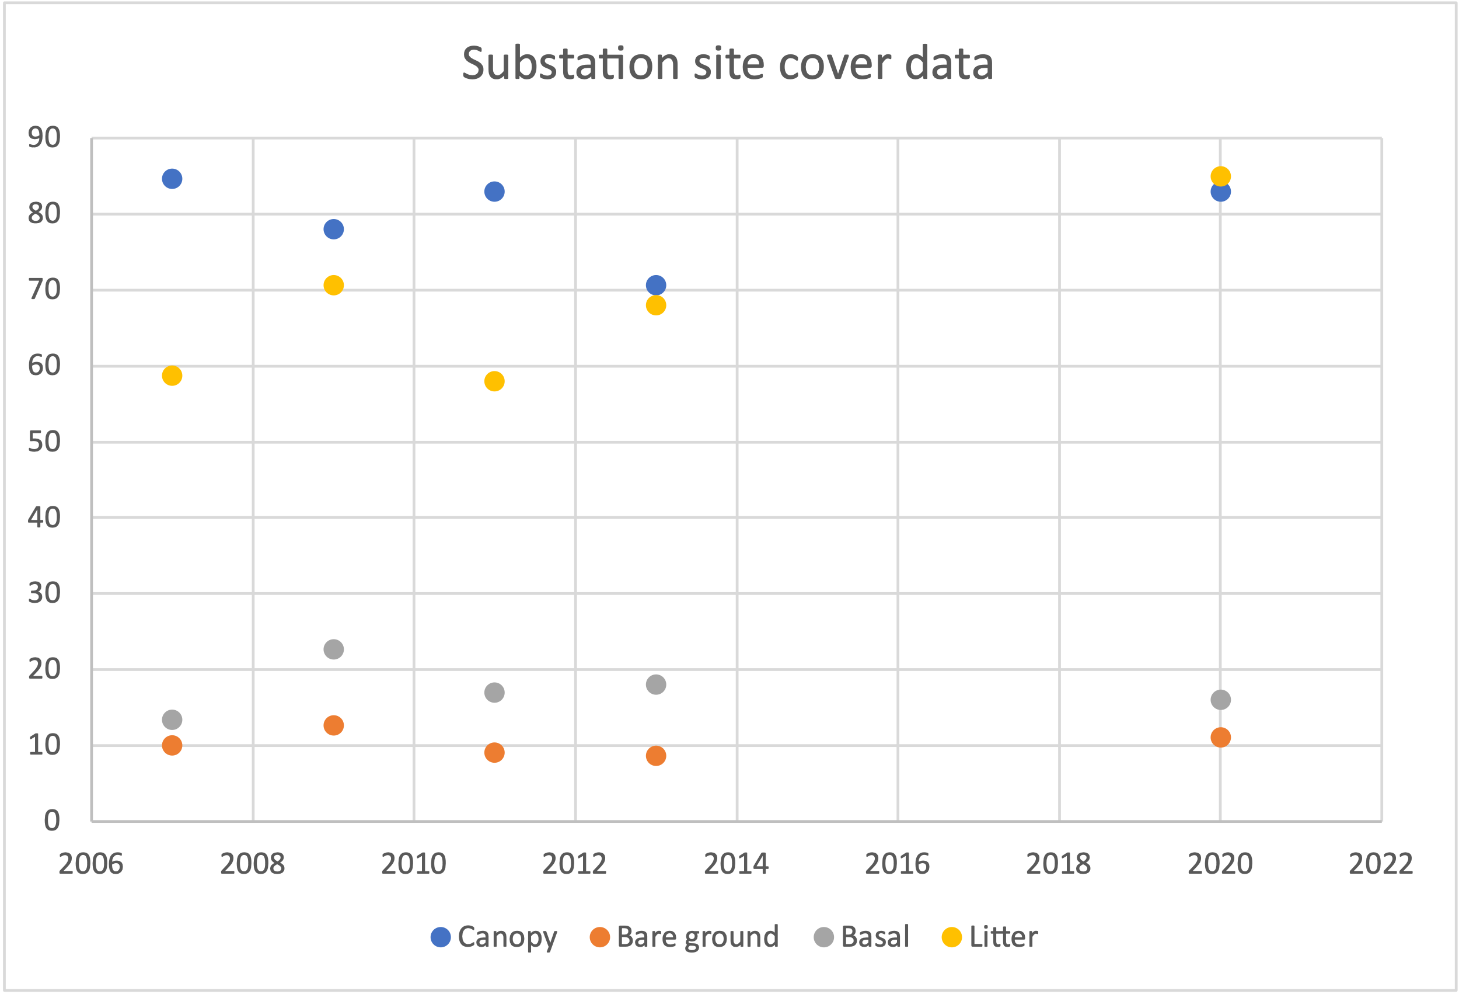
Plant community trend data
Notes:
Canopy cover stable, bare ground stable, litter stable to higer, basal cover stable.

Slide 32
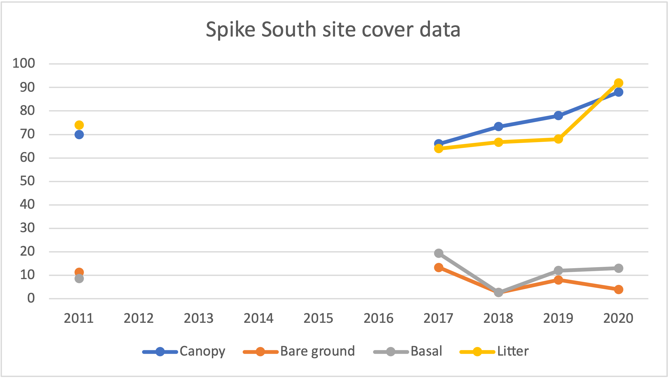
Plant community trend data
Notes:
Canopy cover stable to increasing. Measurement somewhat dependent on date of monitoring data capture. Both phenological development and date range of grazing relative to date of capture affect cover data.
Bare ground stable. Litter probably increasing due to repeated summer grazing.

Slide 33
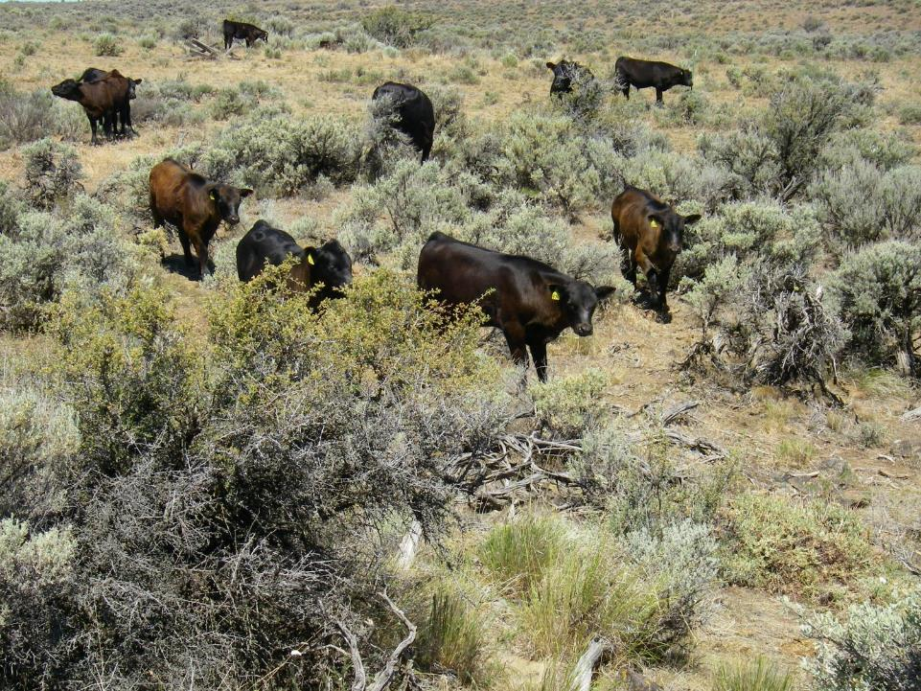
Ecological resilience promotes long-term profitability in several ways:
High forage yield is conserved with diverse, site-adapted plant populations
Duration of active plant growth is maximized with a diversity of plant species, increasing yield and reducing fire risk
Animal health is maintained where animals have access to a wide variety of plant species
Notes:
Even if your primary motivations for range management are economic, there is strong support for conservative stocking rates combined with livestock distribution effort.

Slide 34
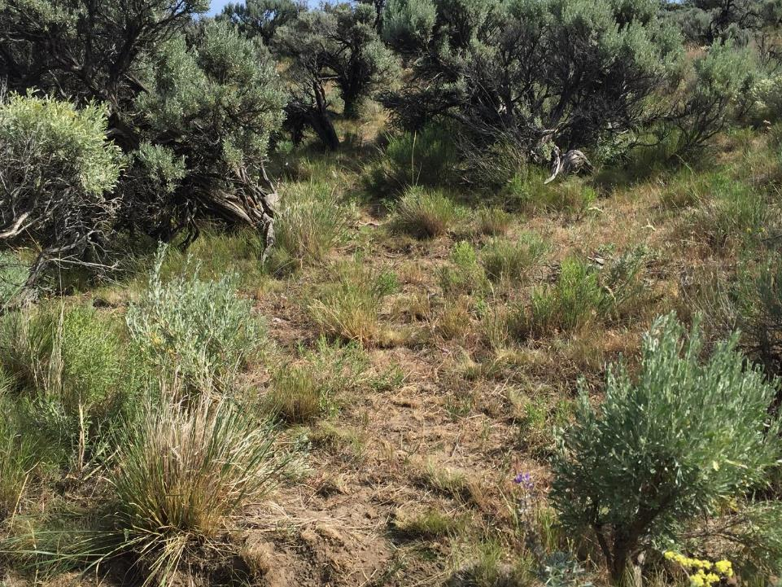
Factors in grazing success
Short grazing periods
Conservative stocking rate
Long periods of growing season recovery (no grazing pressure)
Reasonable pasture size to distribute animals
Water tank(s) available in each unit
Distribution effort (man-hours spent with cattle)
Different timing of use each year – grazing after seed shatter often
This results in:
Low per-plant defoliation
Relatively even grazing utilization
Seed production every year
Desirable species remain competitive
Low soil disturbance

Slide 35
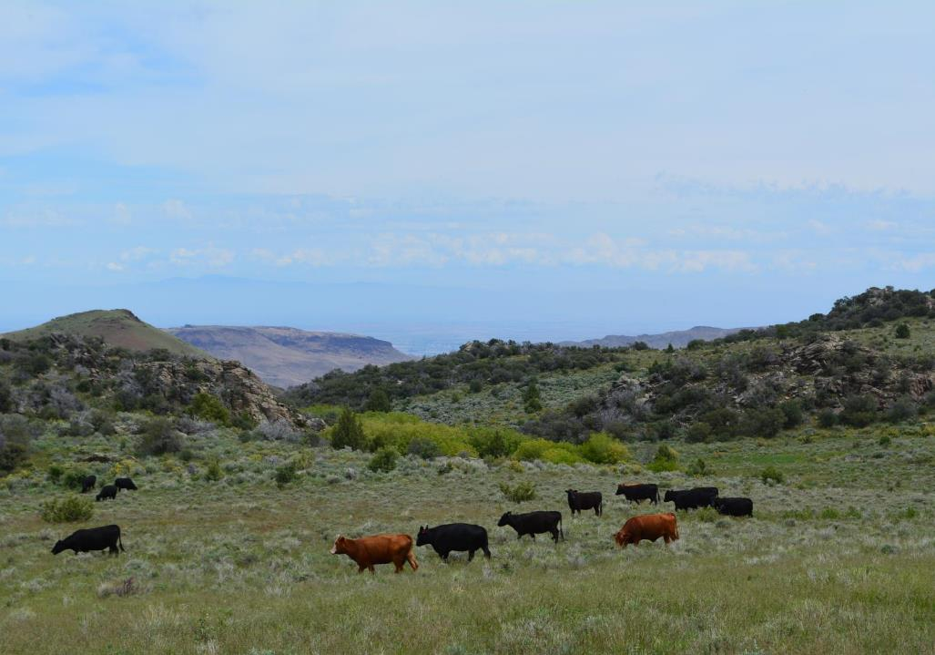
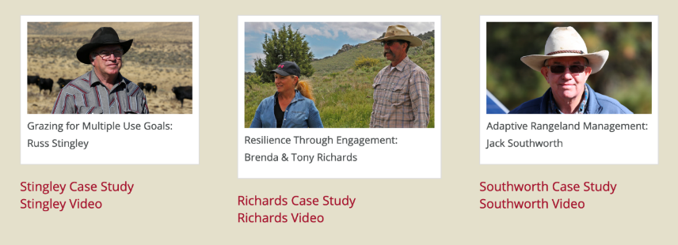
Case studies to increase resilience among farmers and ranchers in the Pacific Northwest
http://csanr.wsu.edu/case-studies/

Slide 36


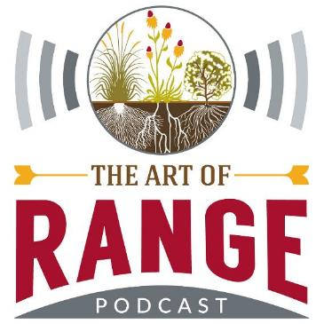
www.artofrange.com
Subscribe through iTunes, Stitcher, SoundCloud.
Send questions or comments to show@artofrange.com
Contact Tip directly at hudsont@wsu.edu or 509-962-7507.

