Slide 1
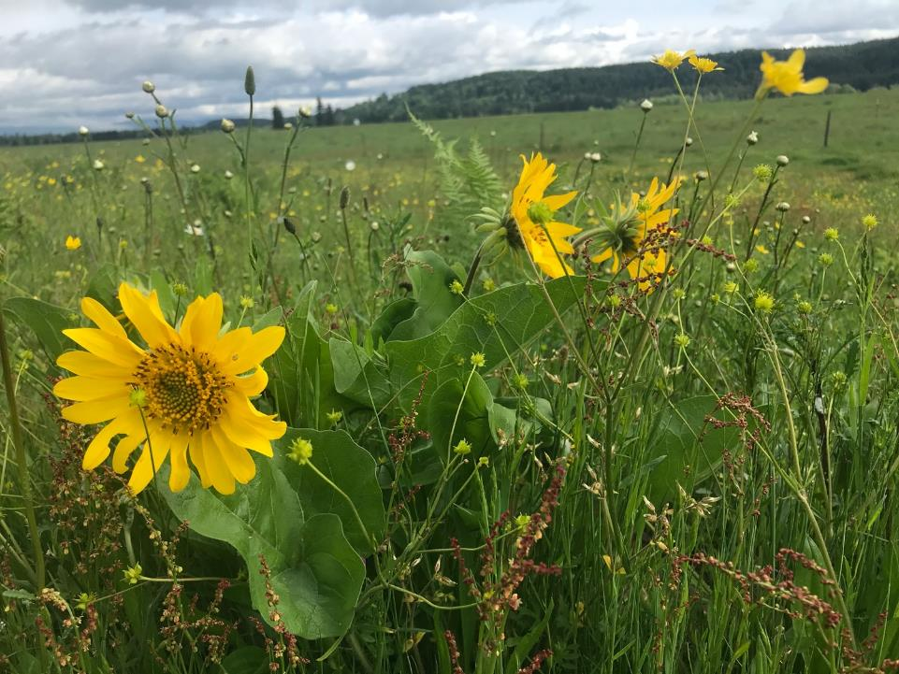
Maintaining rangeland productivity while protecting rare native prairies in western WA
Sarah Hamman, Ecostudies Institute
Stephen Bramwell, WSU-Extension
Melissa Habenicht, Ecostudies Institute
Talia Feinberg, WSU-Extension

Slide 2
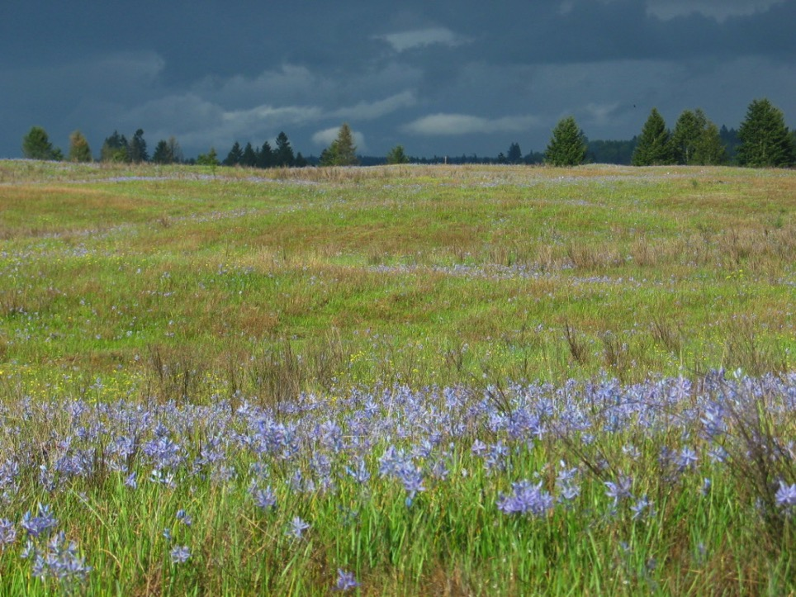
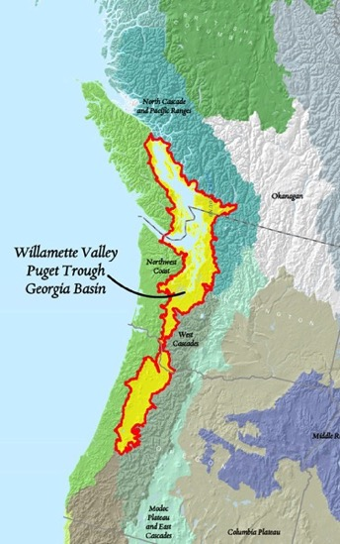
Pacific Northwest Prairies
History:
Formed by retreating glaciers
Maintained by indigenous burning and food harvests
Gravelly, well-drained, low nutrient soils
Host several rare, threatened and endangered species

Slide 3
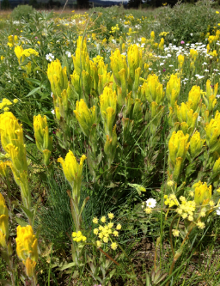
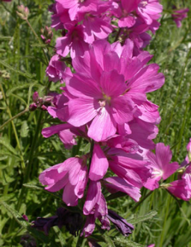
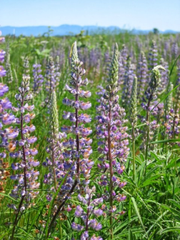
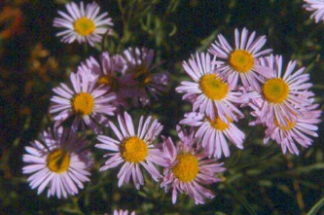
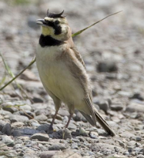
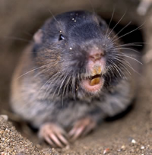
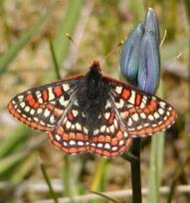
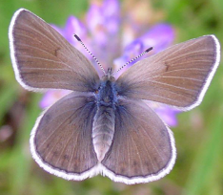
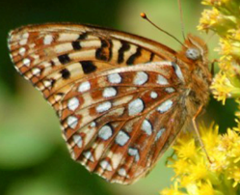
PNW Prairie Rare Species
Notes:
More background – rare species –
Fender’s blue butterfly.
Nelsons checkermallow- ?
Willamette Daisy – Tom Kaye
Kincaid’s lupine – IAE
TCB– Rod Gilbert
MPG – Ty Smedes
OSB – Mike Patterson

Slide 5
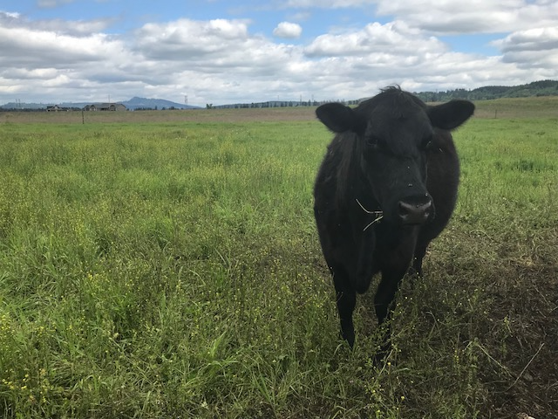
Research Questions
How does the plant community on grazed prairie differ from that on native, ungrazed prairie?
Can the native plant diversity on grazed prairies be enhanced?
How successfully can critical species occupy and utilize grazed prairie relative to ungrazed prairie?

Slide 6
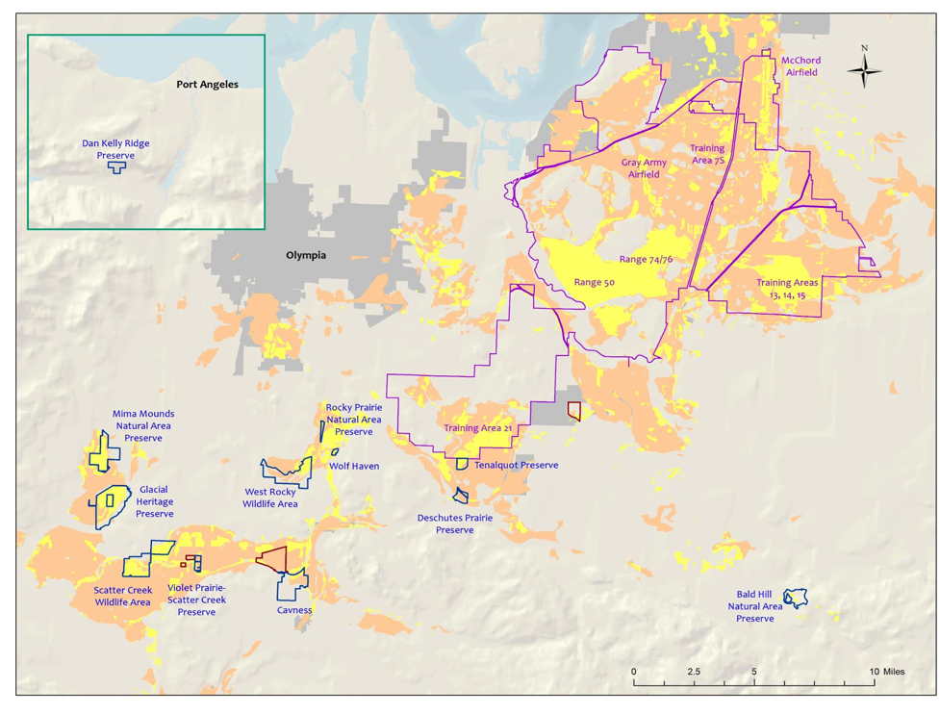
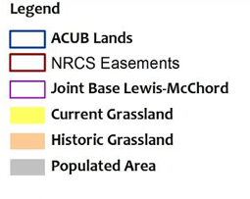

Protected Preserves
Photo: Ty Smedes

Slide 7
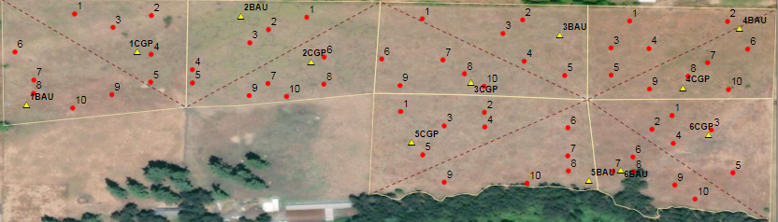
Study Design
Colvin Ranch Wolf Haven Prairie
Fisher Ranch West Rocky Prairie
Riverbend Ranch Johnson Prairie
On each farm, six paddocks were split into 1-acre Conservation Grazing Practice (CGP) & Business As Usual (BAU) treatments
Similar sized areas were established at Native Upland Prairies (NUPs)
Vegetation and gopher data collected from subplots

Slide 8
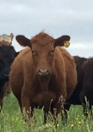
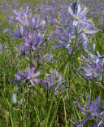
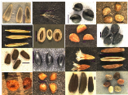

Conservation Grazing Practices (CGP)
J F M A M J J A S O N D
Sustainably graze, moving cattle every 1-2 days. Maintain stubble height ~3”
‘Rest’ pastures, completely removing cattle while native plants bloom and set seed
Sustainably graze, moving cattle every 1-2 days. Maintain stubble height ~3”
Seed native species
Notes:
Working with Stephen Bramwell (WSU Extension), Cheryl Schultz (WSU Vancouver), Marty Chaney (NRCS), three ranchers

Slide 9
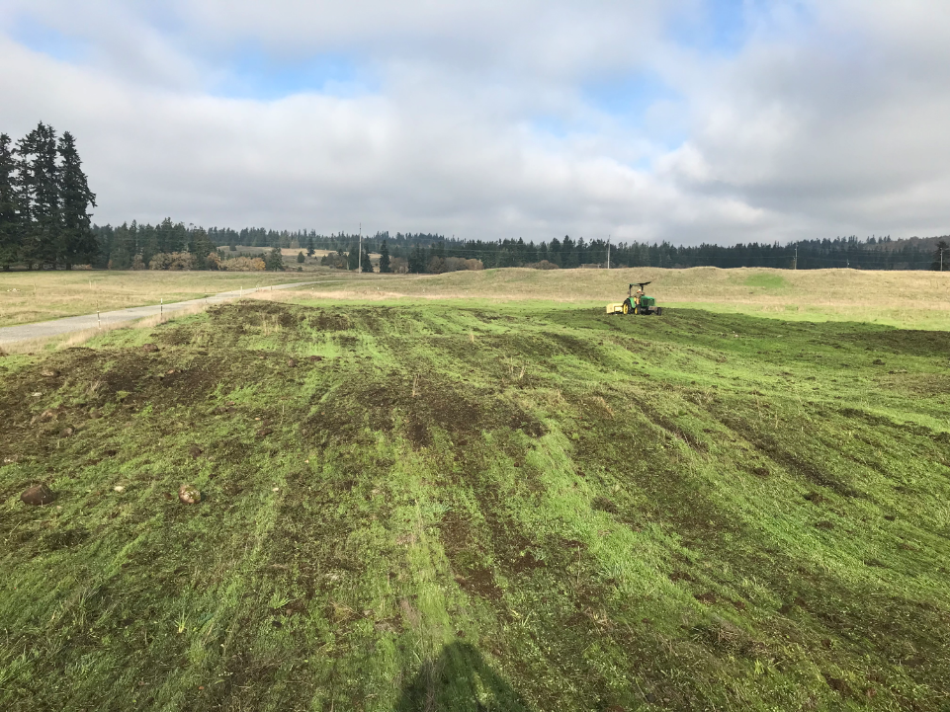


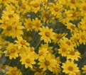
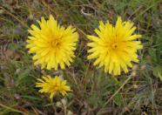






Notes:
Castilleja levisecta, Lupinus bicolor, Eriophyllum lanatum, Microseris laciniata, Cerastium arvense, Viola adunca, Collinsia parviflora, Lomatium triternatum, Ranunculus occidentalis, Plectritis congesta

Slide 10
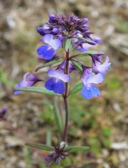
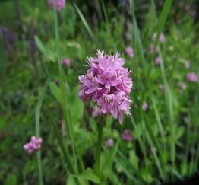
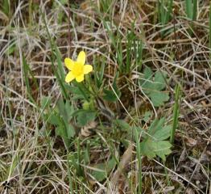
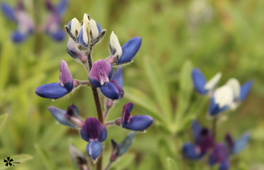
Native Seeding Success
Seeded 10 species with early season phenology, ability to establish in grazing systems, diverse life histories
Initial success in 4 out of the 10 species
Collinsia parviflora
(annual)
Plectritis
congesta
(annual)
Ranunculus occidentalis
(perennial)
Lupinus
bicolor
(annual)
Notes:
UPDATE FOR 2020

Slide 11


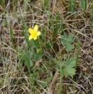
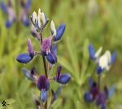

Slide 12
Golden paintbrush (Castilleja levisecta)
Federally threatened species

Slide 13
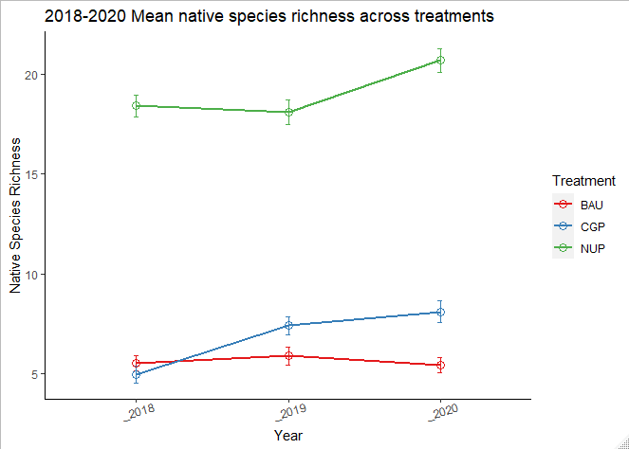
Native species richness
c
c
c
b
b
a
a
a
a

Slide 14
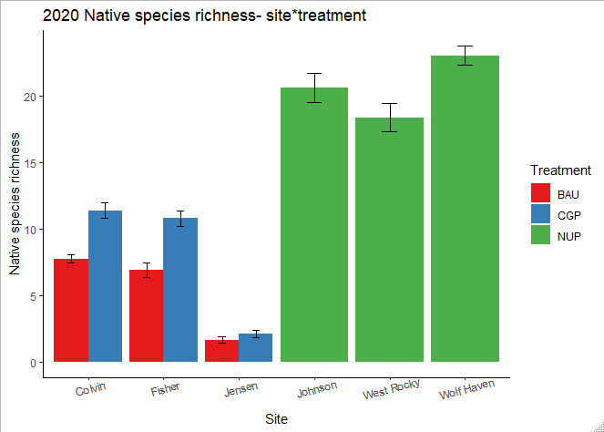
Native species richness

Slide 15
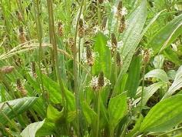
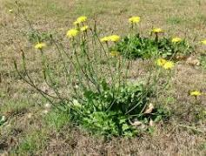
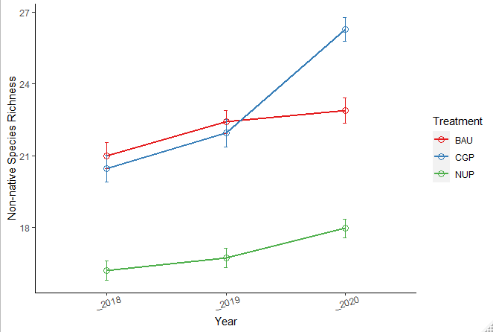
Non-native species richness
c
b
b
b
b
b
a
a
a
Notes:
Increase of 1.7 species on average in NUP and BAU treatments but average of 6.2 species in CGP

Slide 16

Gopher occupancy
CGP: occupancy increased from 55% to 80%
BAU: occupancy increased from 40% to 55%
NUP: occupancy increased from 65% to 75%

Slide 17
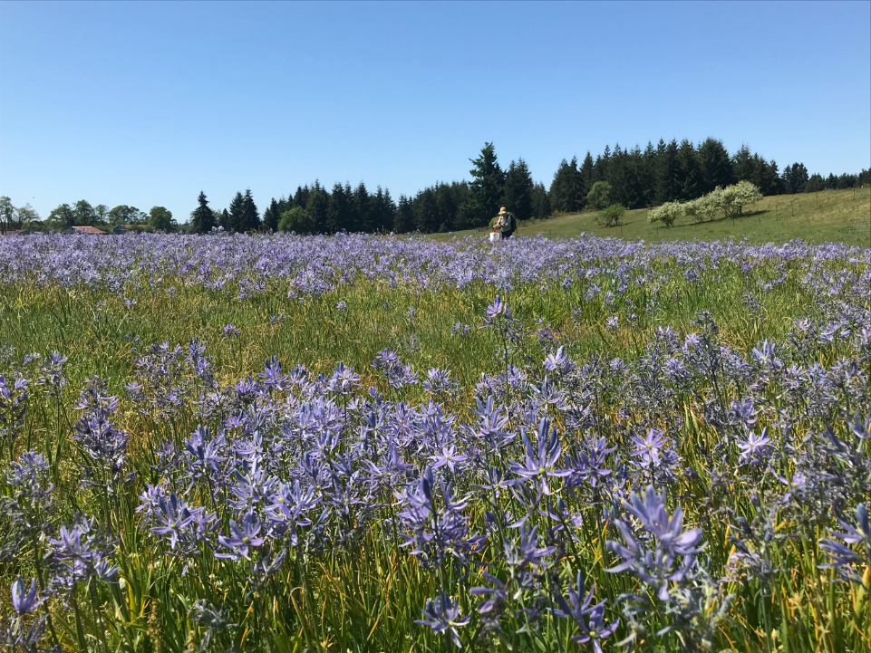
Conclusions
Conservation grazing practices increased native and overall species richness within three years
Native seeding into rotationally grazed paddocks was successful for some species – consider increasing sowing rates
Mazama pocket gopher occupancy in areas receiving conservation grazing practices is as high as in protected prairie preserves.

Slide 18
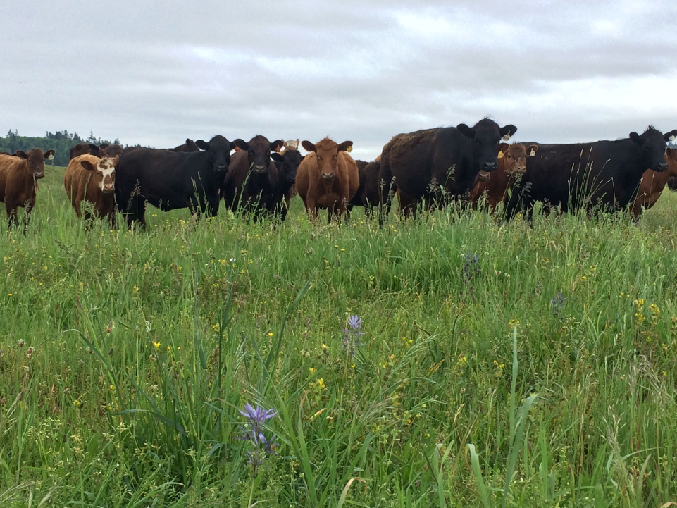







Thank you!
For more information:
shamman@ecoinst.org
www.ecoinst.org
www.cascadiaprairieoak.org

