Slide 1
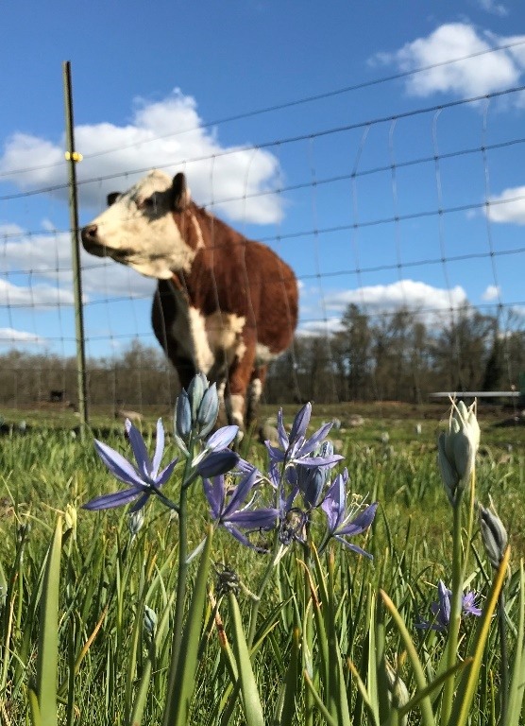




Maintaining Rangeland Productivity while Protecting Rare Native Prairies in Western WA
Stephen Bramwell, WSU Extension
Sarah Hamman, Ecostudies Institute
Melissa Habenicht, Ecostudies Institute
Talia Feinberg, WSU Extension

Slide 2
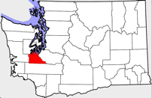
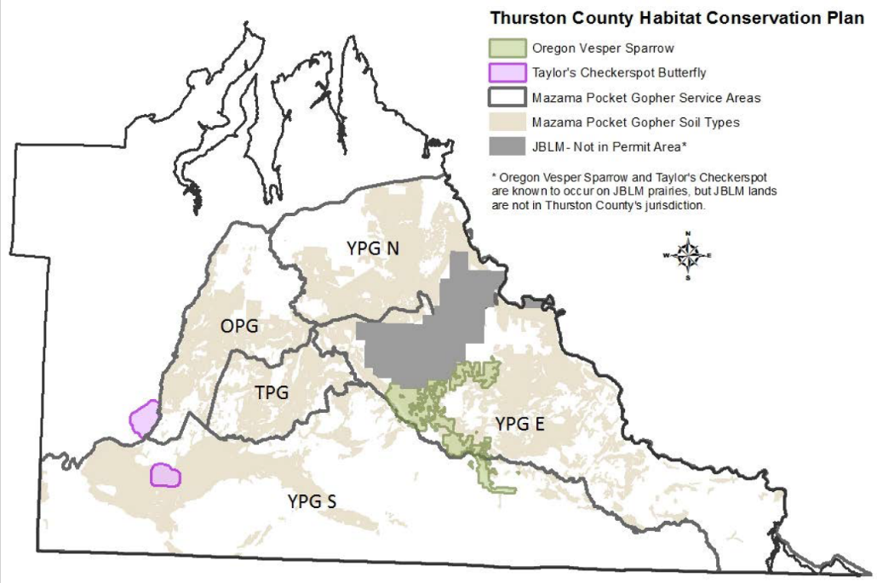
Intersection of Grazing Operations and Critical Species Habitat in Thurston County
26,843 acres of pastureland in Thurston County
6 threatened or endangered prairie and riparian species
Thurston County Habitat Conservation Plan
HCP Projected Conservation Acres: 3,469 acres

Slide 3
General Goals and Approach
Some seeded prairie species
Develop a network of 3 grazed prairie research sites and 3 ungrazed upland prairie sites to document and compare the effects of grazing on prairie habitat
Implement “Conservation Grazing Practices” or CGPs for habitat enhancement, including:
Evaluate the impacts of CGPs:
Golden paintbrush
Castilleja levisecta
Planned or rotational grazing
Exclusion (“deferment”) during flowering periods
Native seeding
Forage production and soil parameters
Native plant species richness, diversity, % cover
Gopher occupancy
Field chickweed (Cerastium arvense) and Rosy plectritis (Plectritis congesta)
Nineleaf biscuitroot (Lomatium triternatum)

Slide 4
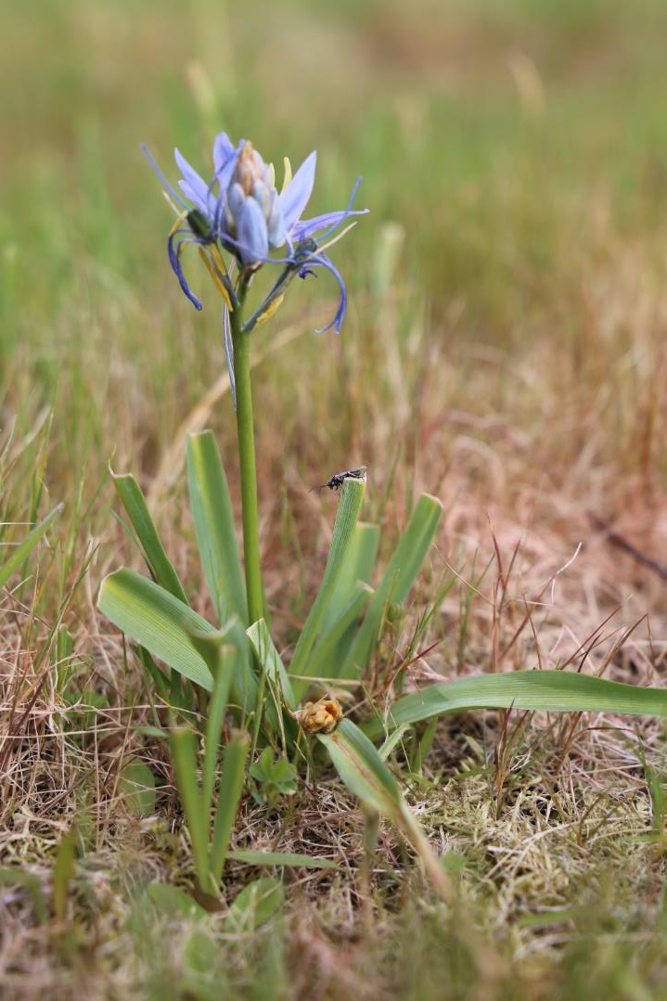


Basic Question
To what extent can conservation grazing contribute to prairie habitat and species protection?
Can CGPs be implemented without negatively affecting forage?
Do CGPs have forage production and soil quality benefits?
What is the potential native species richness and diversity of grazed prairie?
Can that diversity be enhanced?
How successfully can critical species occupy and utilize grazed prairie in relation to ungrazed prairie?

Slide 5
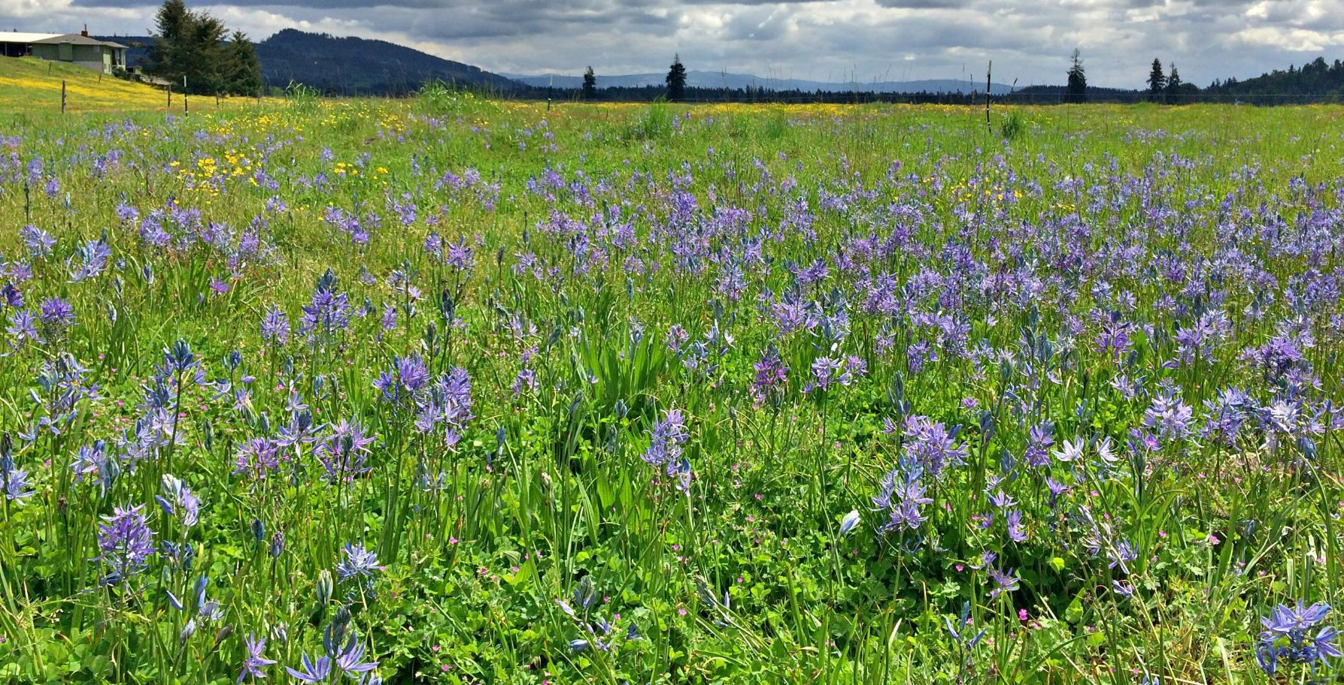
Rotational grazing
Long history of grazing deferment during spring
Established native prairie plants
More native seeding for study
Colvin Ranch

Slide 6
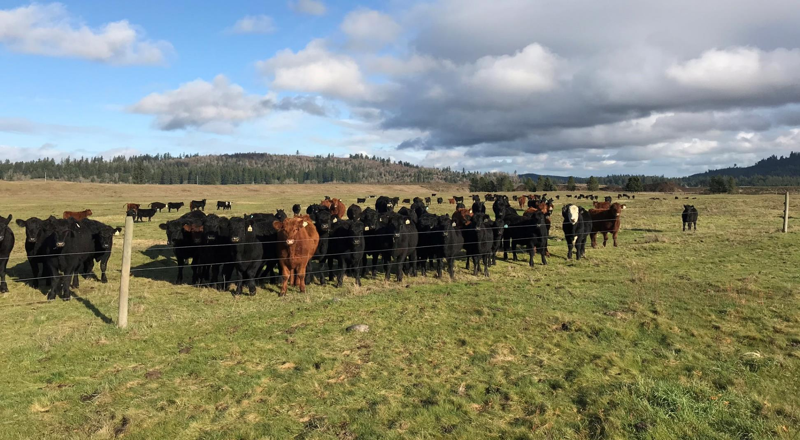
Colvin Ranch, December

Slide 7
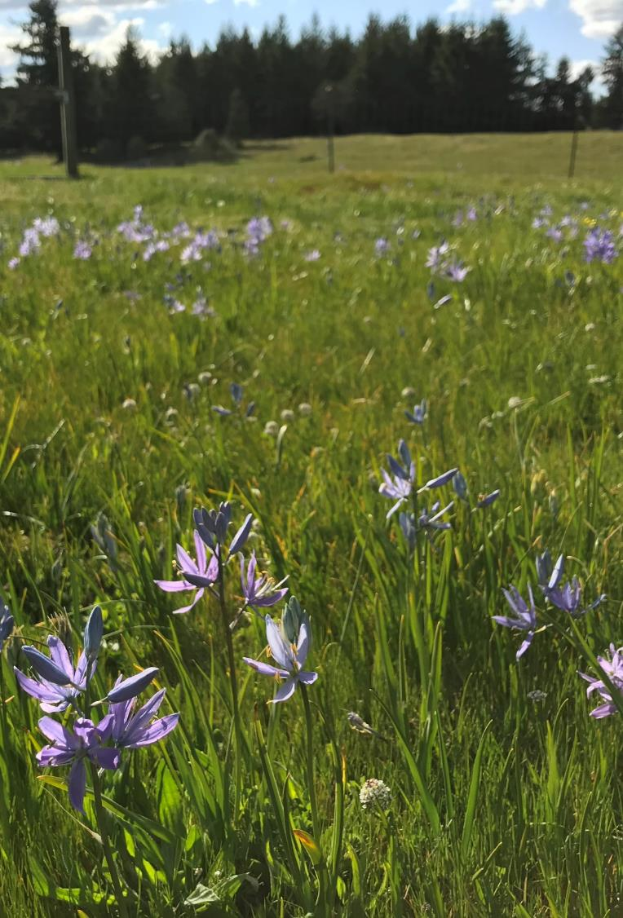
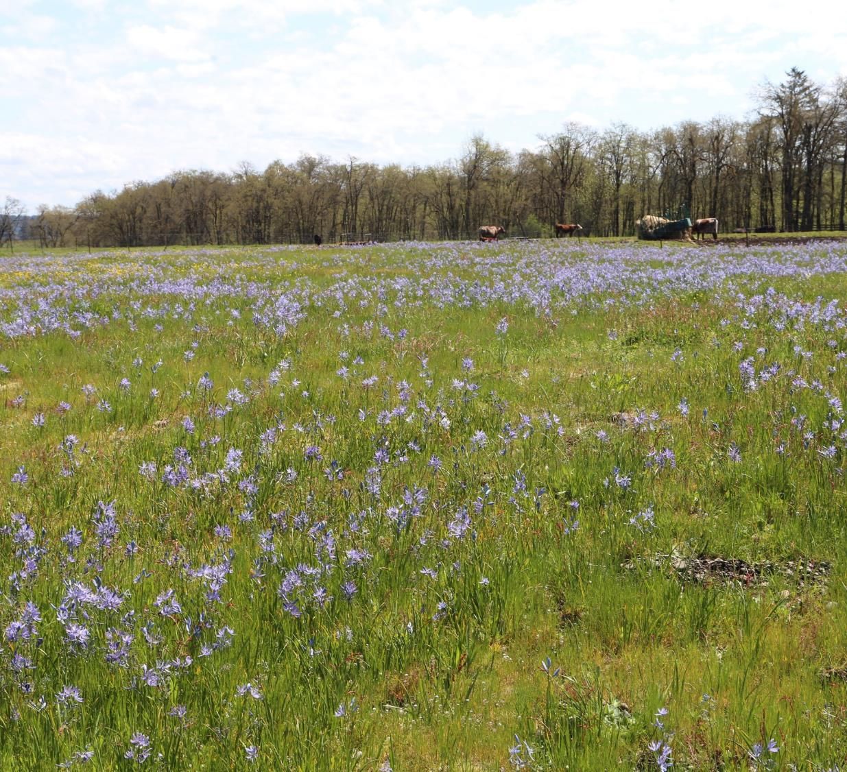
Moderate rotational grazing (less rest)
Shorter history of grazing deferment during spring
Established native prairie plants
More native seeding for study
Fisher Ranch (April)

Slide 8
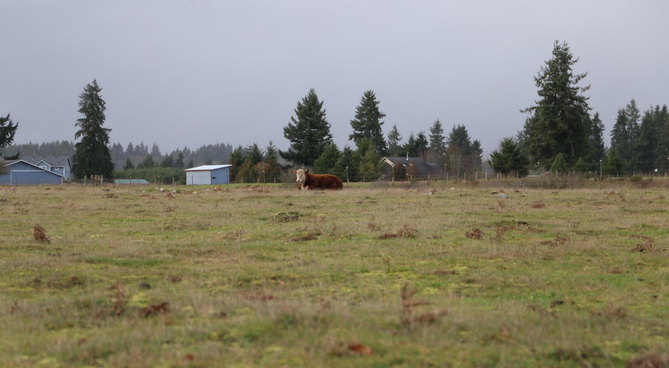
Fisher Ranch, December

Slide 9
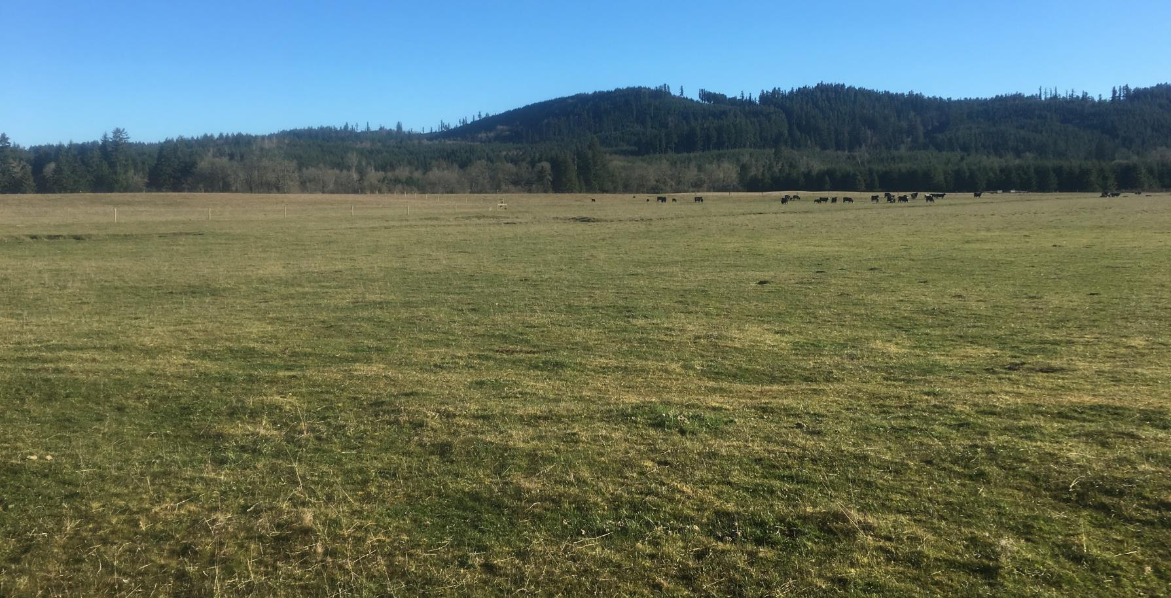
Continuous grazing
Implemented planned grazing paddocks
No history of grazing deferment during spring
Few established native prairie plants
Native plants seeded for study
Riverbend Ranch

Slide 10
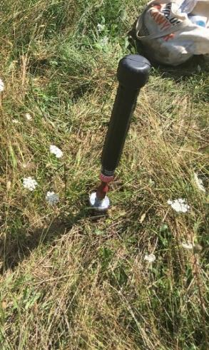
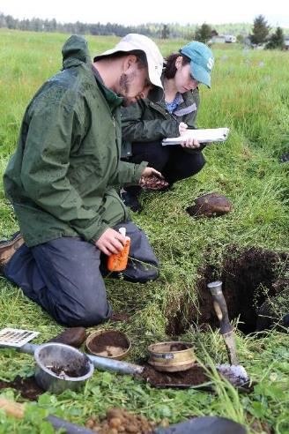
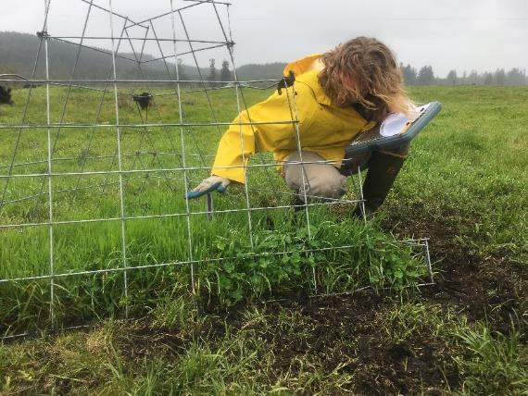
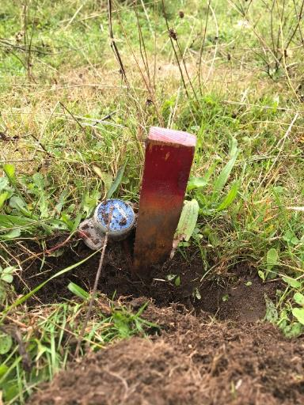
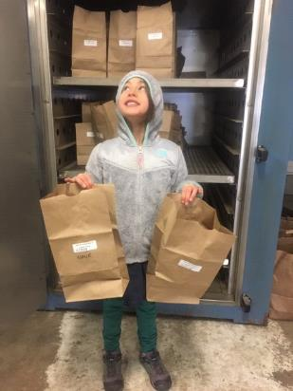
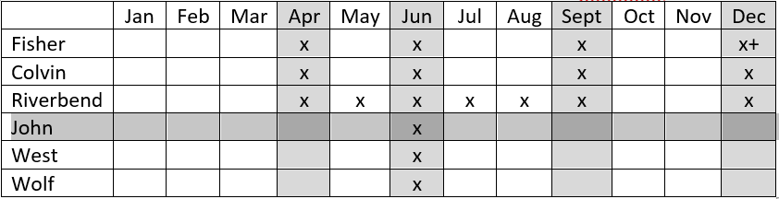
Forage and soil sampling
Can CGPs be implemented without negatively affecting forage?
Do CGPs have forage production and soil quality benefits?
Colvin, April 2019

Slide 11
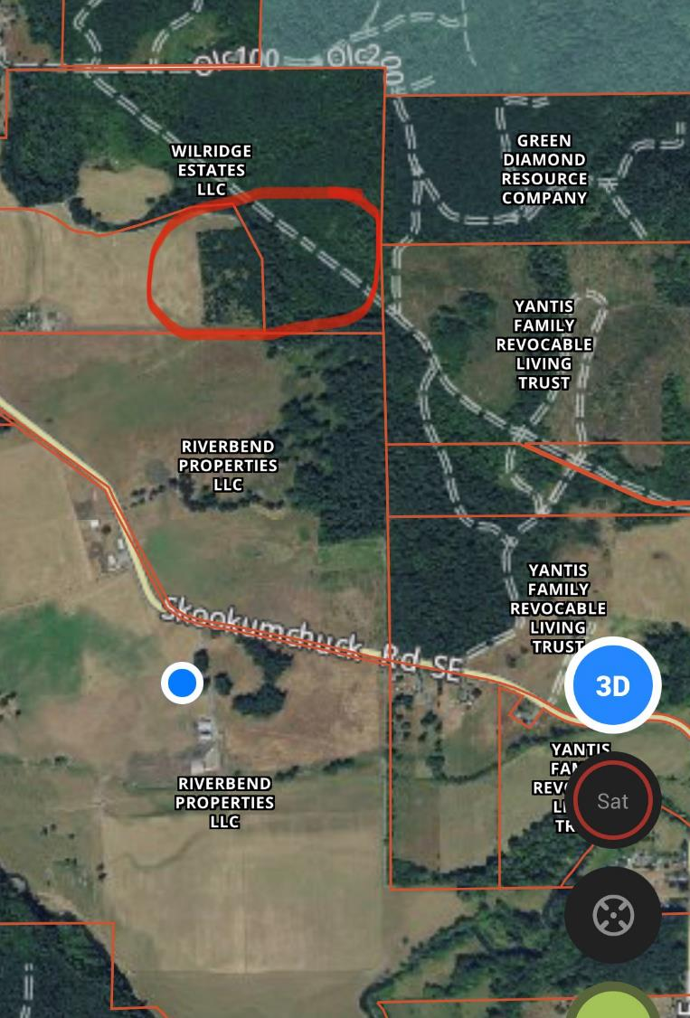
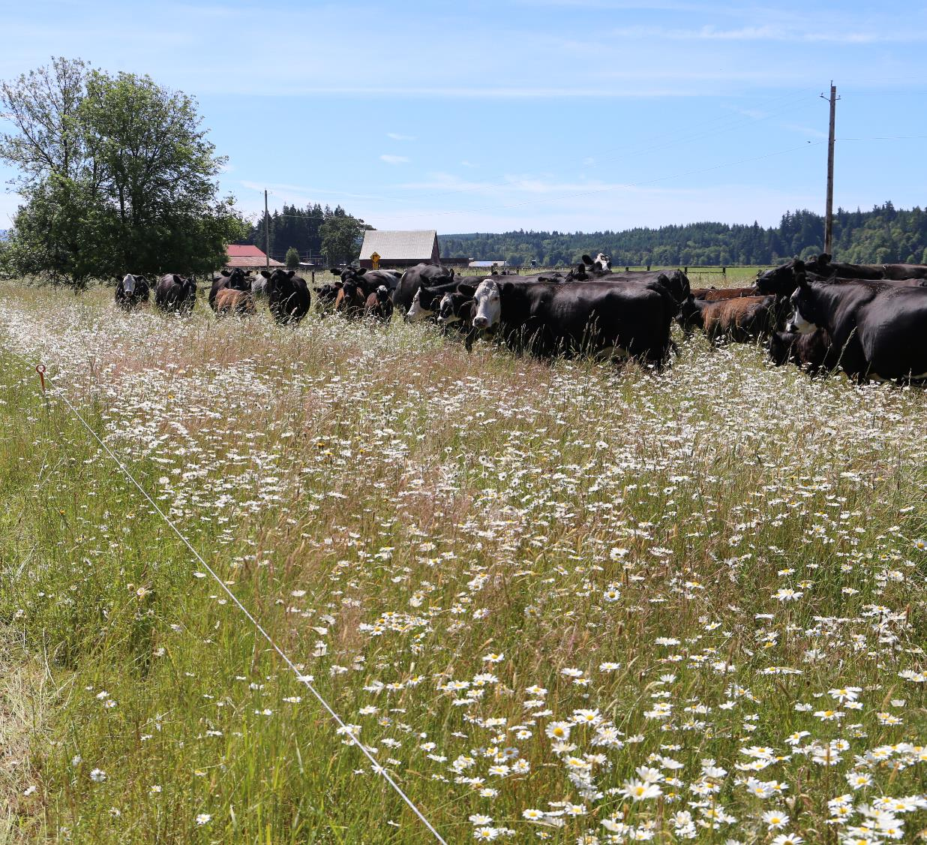
Riverbend Ranch

Slide 12
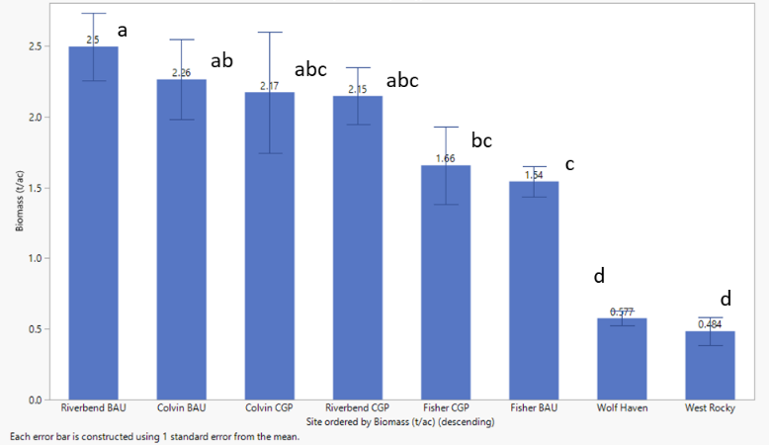
Total 2020 biomass production measured across sites and treatments.
Riverbend early spring graze: 0 t/ac
Colvin early spring graze: 39% utilization (0.26 t/ac)
BAU: Business as usual (continuous grazing)
CGP: Conservation Grazing Practices (rotation)
Comparison of means analyzed using Student’s t test. Levels not connected by same letter are significantly different.

Slide 13
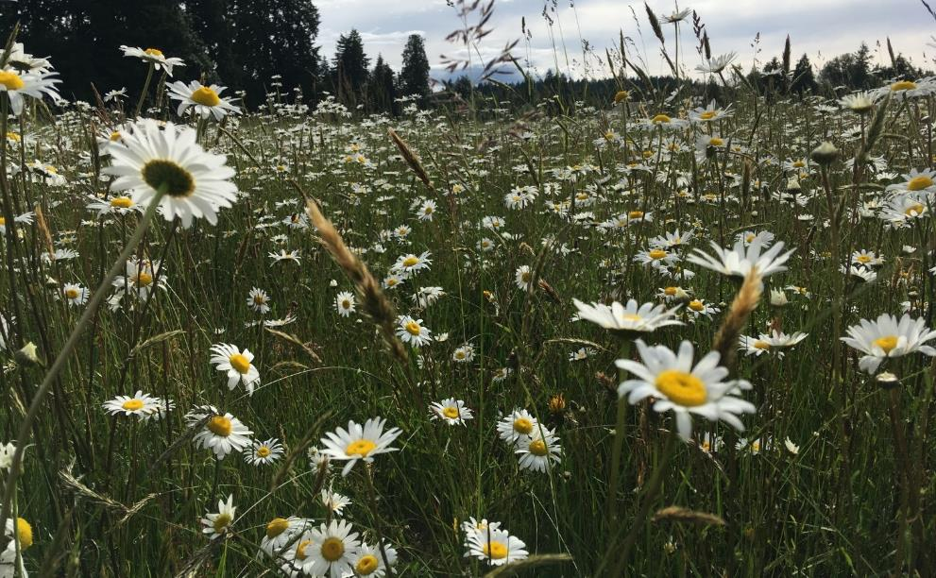
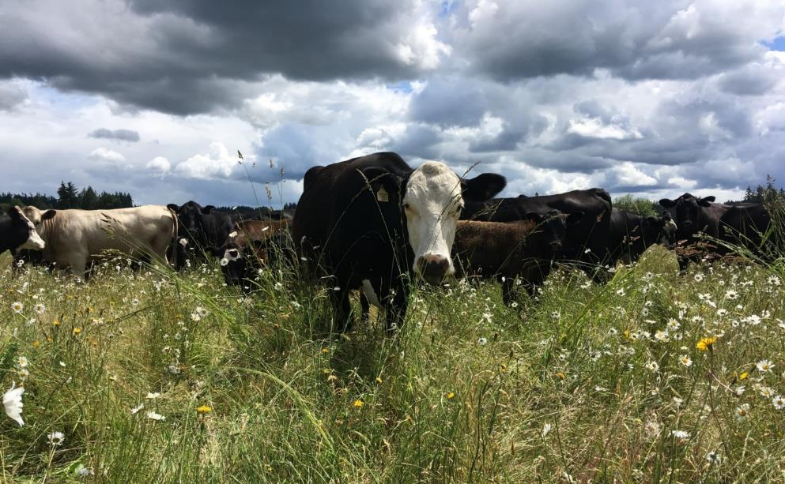
Riverbend CGP on June 10
-Oxeye daisy in full bloom and grass seedheads getting taller
-CGP will be grazed in about 1 week
BAU: Business as usual (continuous grazing); CGP: Conservation Grazing Practices (rotation)

Slide 14
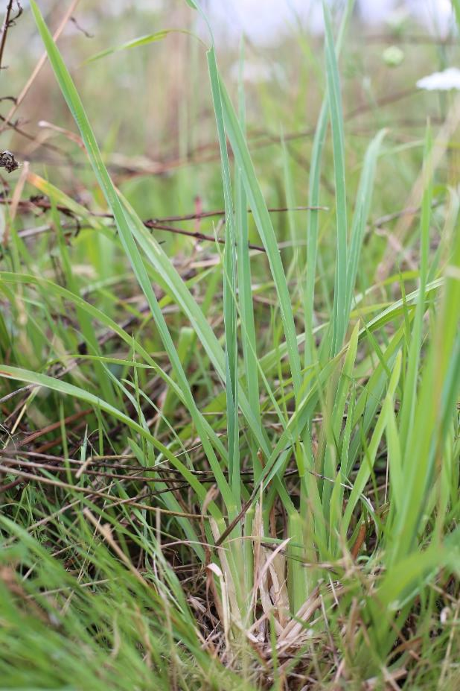
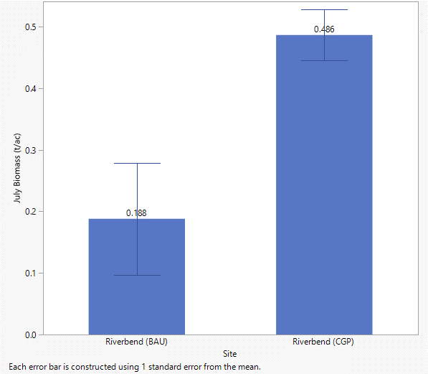
Average biomass production (t/ac) in July as measured under exclusion cages in CGP and BAU treatments at Riverbend Ranch – Year 3
0.46
0.19
BAU
CGP
Summer regrowth
Riverbend, July 2020
BAU: Business as usual (continuous grazing); CGP: Conservation Grazing Practices (rotation)

Slide 15
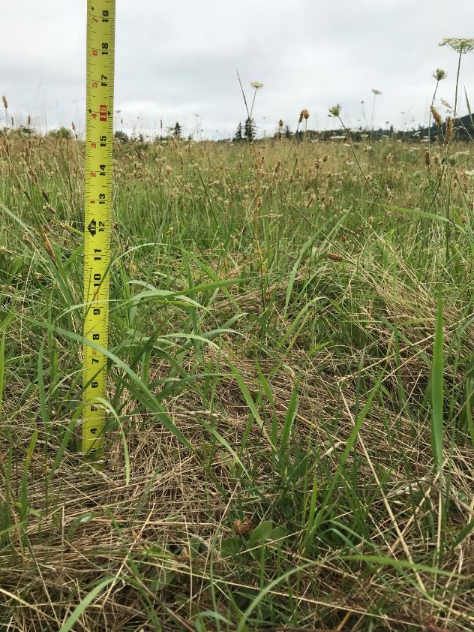
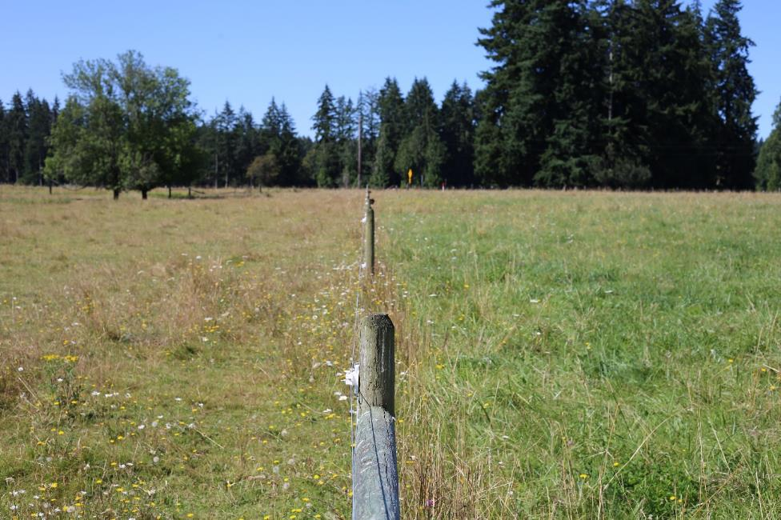
Summer regrowth Riverbend, July 2020
Why longer growth? How about shading possibly lowering soil temperatures?

Slide 16
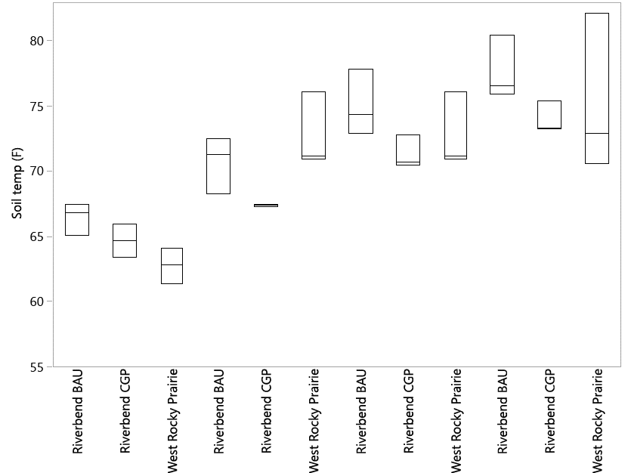
Grazing Effect on Daily Average High Soil Temperatures
May
June
a
a
Measured as mean highs averaged by month
May & June differences
Fades in summer
Variable prairie veg. structure
b
a
a
ab
a
a
a
a
ab
b
July
August

Slide 17
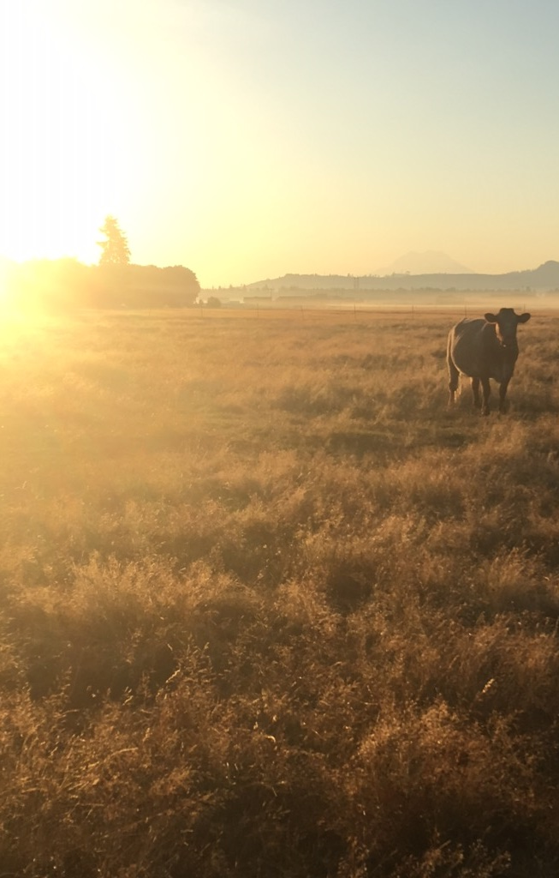
General findings
Forage productivity not great affected by CGP treatments generally
Careful utilization is needed to compensate for loss due to deferred grazing
Daily high soil temperature was significantly lower under CGPs
Bulk density was unchanged at 3-yr mark

Slide 18
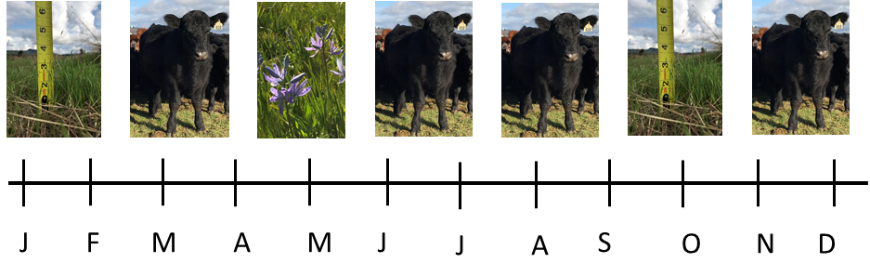
Conservation Grazing Approach
Can CGPs be implemented without negatively affecting forage?
Do CGPs have forage production and soil quality benefits?

