Slide 1
Costs & benefits for supporting habitat
A comparison of various habitat restoration scenarios and habitat protection on working lands

Slide 2
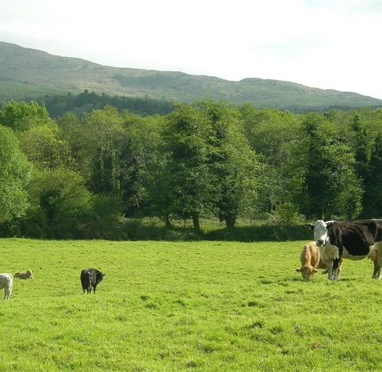
Overview:
Restoration on three types of non-working land in SW Washington
Habitat protection using deferred grazing on working lands
This Photo by Unknown Author is licensed under CC BY-SA

Slide 3

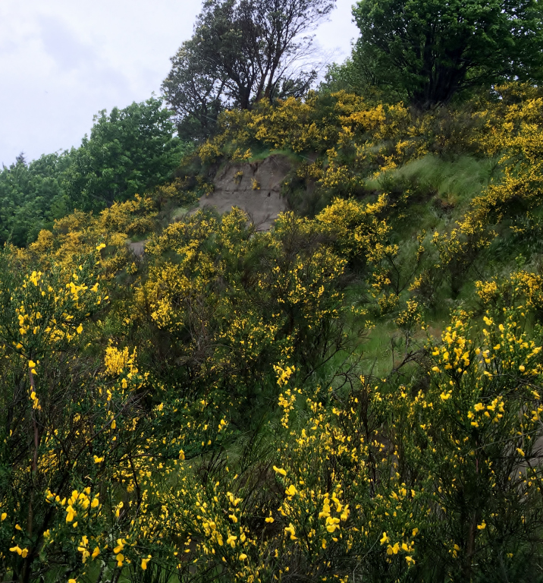
Habitat Restoration on Non-working Land
Scotch Broom infested ground
Abandoned rangeland
Abandoned cropland

Slide 5
Parcel Size (acres) 50

Slide 6
Scotch Broom Infested Land:

Slide 11
2020 Prairie Habitat Restoration Budgets: Abandoned Rangeland

Slide 15
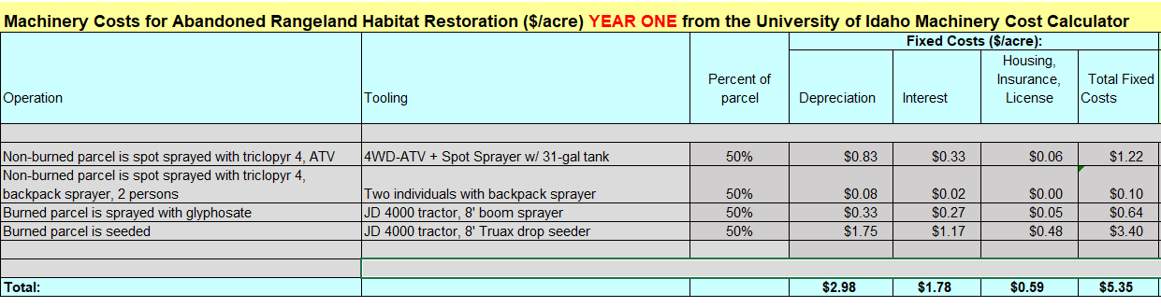

Slide 17
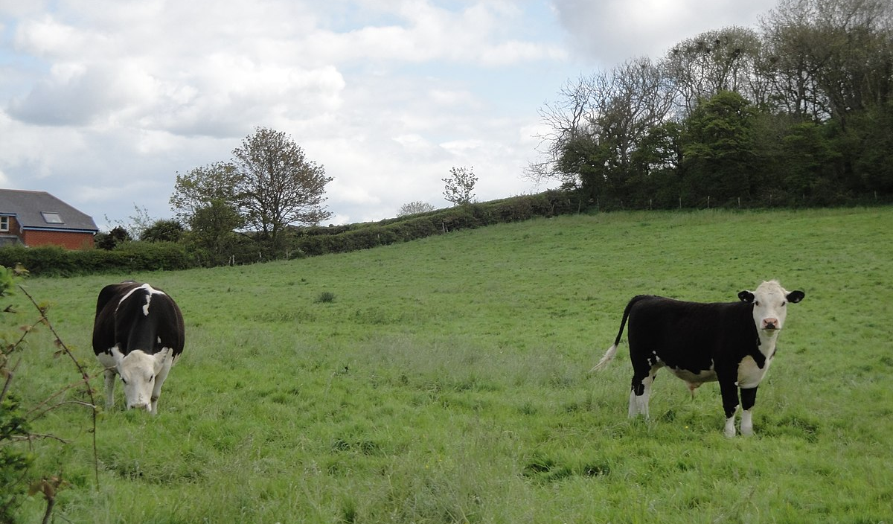
Working Lands Comparison
Cow-calf operation
Grassfed beef operation
This Photo by Unknown Author is licensed under CC BY-SA

Slide 18
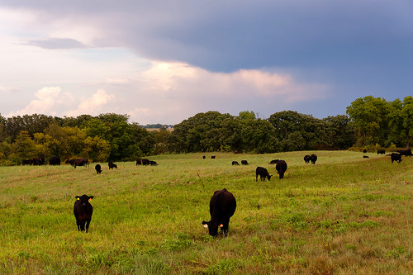
Pasture Rental on Working Lands
Example: 100 head on 50 acres
Cost: $20 per Animal Unit Month (AUM)
Deferment: 3 month period, April – June
$60 per AUM over 3 months for 100 animals = $6000
$6000 over 50 acres equals $120 per acre
NPV over 12 years = $1,064 per acre
This Photo by Unknown Author is licensed under CC BY

Slide 19
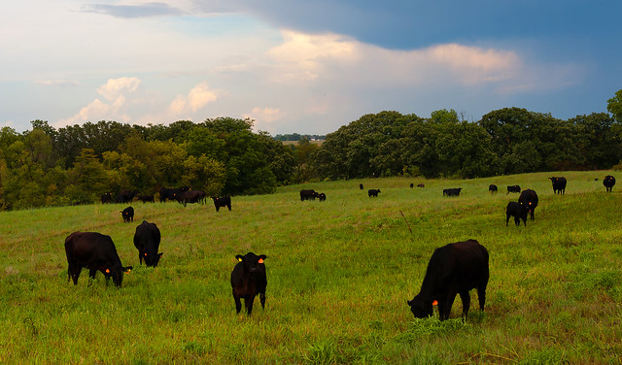
“Compensation but not motivation!”
Where would the cattle go?
Impact on field productivity for remainder of the year
Fencing, watering facilities
Transportation, labor
Risk: length of contract
This Photo by Unknown Author is licensed under CC BY

Slide 20
Benefits of Using Working Lands
Farm and ranch owners are already conducting noxious weed management on their lands
Cow-calf operations are productive, contributing to the food supply and the tax base
Local grassfed operations have a high value in terms of the local food system

Slide 21
Economic Analysis, Cattle Production

Slide 22
Fair market return, all factors of production
Owner labor, 730 hours at $25 = $18,250
Variable machinery costs = $5250
Capital recovery, buildings & improvements = $6537
Capital recovery, machinery & vehicles = $5530
Interest on retained livestock: $66,000 @ 5% = $3300

Slide 23
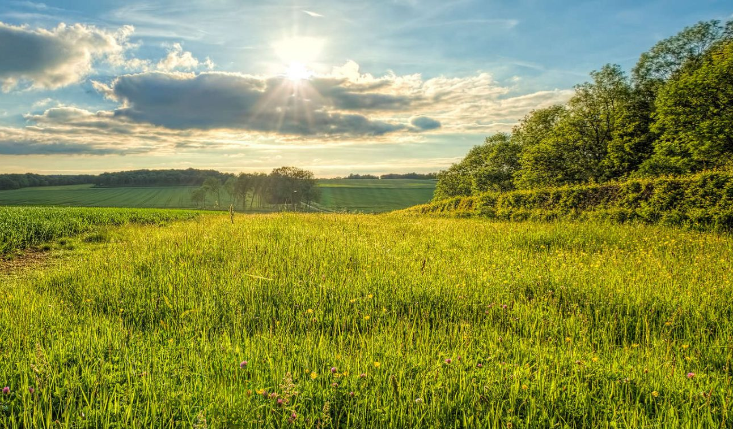
Discussion
Investment in working lands could support our ag sector
Investment in nonworking lands does not displace our ag sector
Much more costly to restore nonworking lands
Careful and complete cost:benefit analysis requires a great deal of input, analysis, and review
This Photo by Unknown Author is licensed under CC BY-SA

Slide 24
Email: kpainter@uidaho.edu
Office: (208) 267-3235
Cell: (509) 432-5755

