Slide 1

Record Books
Tackling the Beast
Level 2 Book

Slide 2
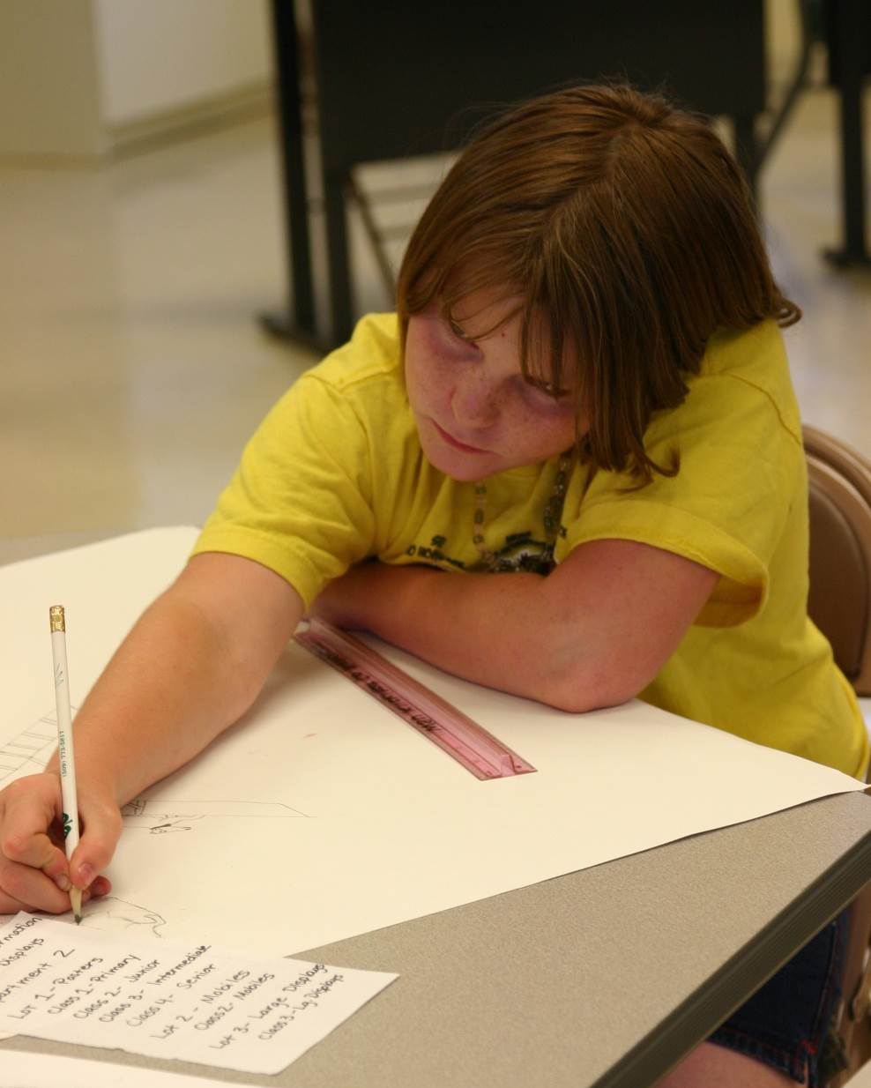
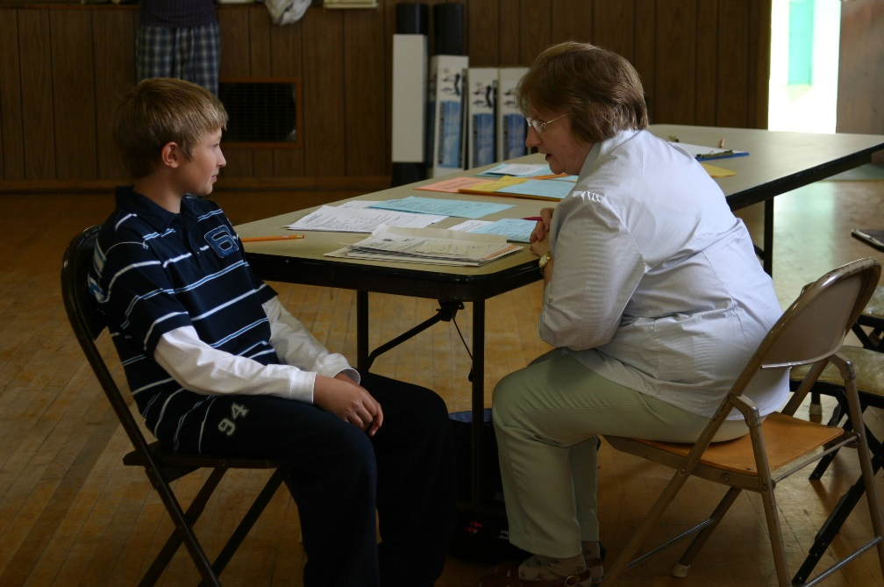
Supplies
Level 2 Record Book
Project Packets
Permanent Record
3 Ring Binder, 1-1.5” thick
Divider Tabs

Slide 3
Organizing Your Book
Cover
Planning Calendar
Project TAB #1
Project TAB #2
Ex. Breeding Beef
Project TAB #4
Permanent Record TAB
Permanent Record
4-H Story TAB
Planning Calendar TAB
Instructions
Ex. Market Rabbit
Ex. Photography
4-H Story
Supplemental Pages
Final Page
Club Agreements Page
Project TAB #3
Hosemanship

Slide 4
Fill Out Your Cover
Put this inside the front of your binder OR in the outside on the front cover.

Slide 5
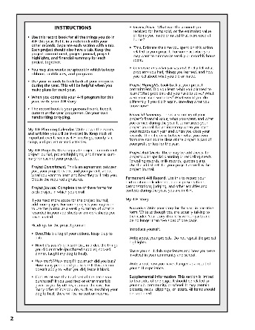
Instructions
READ ME
Print and Include in front of your Calendar TAB.

Slide 6
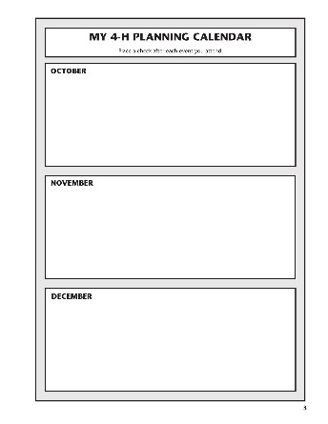
My 4-H Planning Calendar
Write using a consistent order i.e. date, time, then event name.
We understand that not all your events will be in chronological order.
Put down Project, Club, County, State 4-H events.
Hint Check the Clover Report & Club Minutes!
Your calendar could have lines or be open boxes.

Slide 7
Project Tabs
Every Project Should Have a Tab.
Especially if you are entering for an award in that area.
The only thing limiting you is your time!

Slide 8
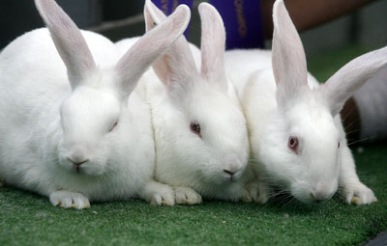
Sample Market Animal Project Tab

Slide 9
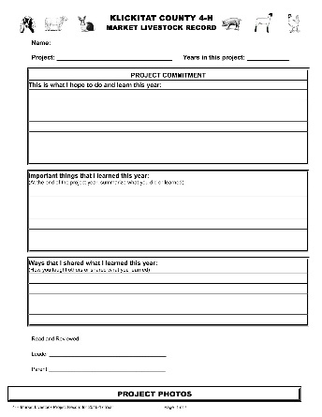
Market Project Commitment Page (Goals)
Try to avoid goals that are financially motivated (make $2,000 at the market) or competition goals (win Grand Champion).
Wanting to raise the best is great, but we encourage specific goals like “I want to buy an animal with good shoulders because last year my animal was faulted for a flat shoulder.
At the end of the year take some time to reflect!
More than one goal is recommended.
Write in complete sentences.

Slide 10

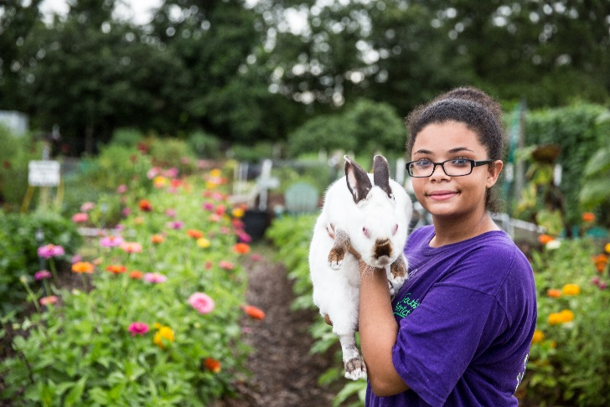
Project Photos
All the photos!
Your Animal
Animal’s housing.
You & Your animal at shows.
Learning about your project.
Etc.
One page only.

Slide 11
Add a copy of your Market Quality Assurance Form here.

Slide 12
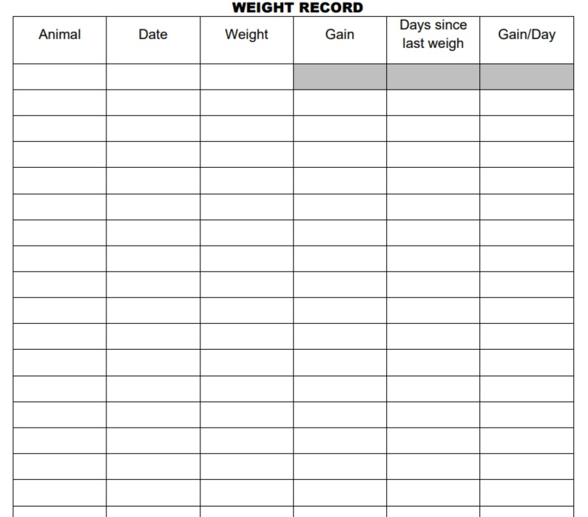
Weight Record
Use this to record your animal’s weight gain. You’ll need this information at Fair, consider making a copy of this page before you turn your Market Project In.

Slide 13
Monthly Project Journal
One per month you own your animal raised for Market. For rabbits this might be 3 months and include the time spent with the doe that kindles your rabbits or the time setting up your incubator for eggs etc.
Track your hours spent by week/days.
Use this to track income and expenses respectively by month.
The total from this page will be added with your other Project Journal Pages onto your Equipment Inventory Page under PROJECT SUMMARY.

Slide 14
Equipment Inventory
Track your MAJOR Equipment.
Remember to value the grazed pasture and hay even if it belongs to your family, that is an expense that goes into raising your project animal.
You only need one of these pages per project.

Slide 15
Project Essay
Write full complete sentences. Grammar and spelling count!
These should reflect on the goals you set at the beginning of the year.

Slide 16
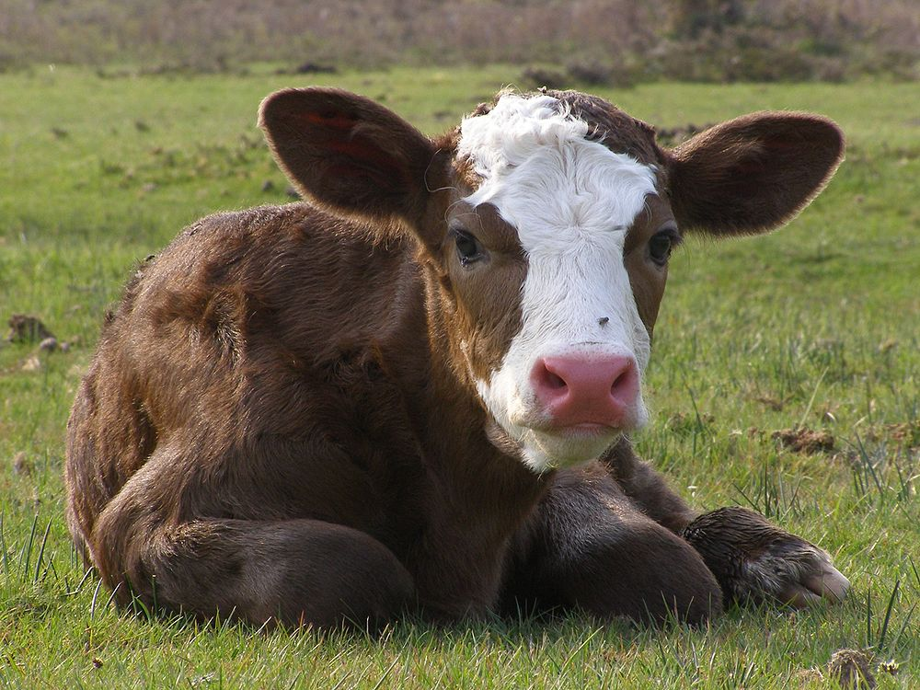
Animal Project Tab
For all non-market animals used for Breeding, Show, or Pet

Slide 17
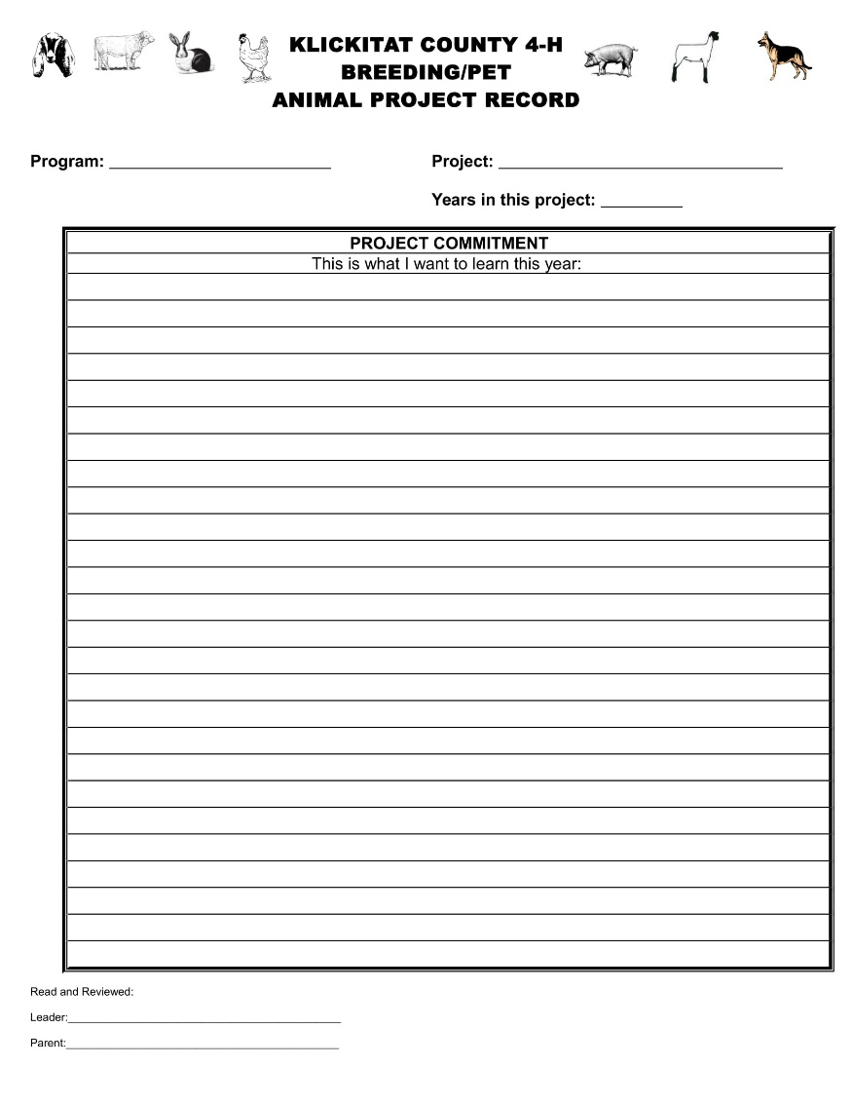
Project Commitment (Goals)
Write what you want to learn this year.
Make sure it is a clear obtainable goal.
A good goal is SMART:
  Specific
  Measurable
  Achievable
  Relevant
  Time Limited
Get your Leader’s Signature! This means your leader is aware of your goal will try to help you accomplish that.

Slide 18
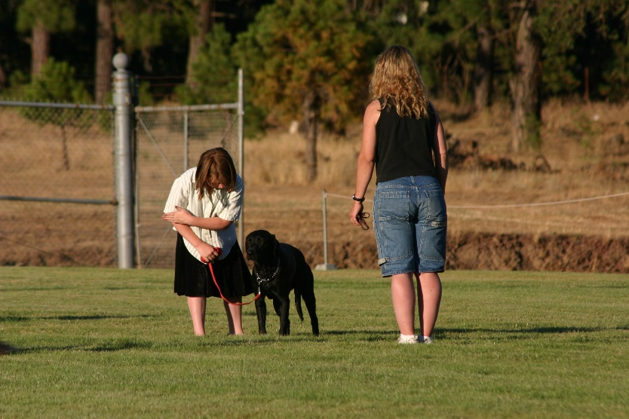
Project Photos
All the photos!
Your Animal
Animal’s housing.
You & Your animal at shows.
Learning about your project.
Etc.
One Page only
Date and explain the photo
This is me practicing “heel” with my dog. 4.30.20__

Slide 19
Project Journal
Add as many pages as you need!
Record
Date
Time Spent
What you Did
What you Learned
If you do this regularly it is easy!
Make it a habit to catch up your journal at least once a month.
PRO TIP: Use a calendar to record what you do as you do it and then transfer it onto this page once a month.

Slide 20
Project Inventory
Animals & Equipment are recorded separately.
Give yourself additional pages if need be.
Your Animals included could be All in that species you posses, not just the few you are taking to Fair.
Equipment might include grooming supplies, trailers, feed buckets, etc.

Slide 21
Animal Project Expenses
We all know you’ll need more pages!
Record things by category.
PRO TIP: Waiting till the end of the year with a stack of receipts is not fun, so save yourself!
Expenses Totals

Slide 22
Animal Project Income Sheet
If you sell a produced animal, win scholarships, or clean stalls to earn funds to pay for your project it can go here.
Do this regularly.
Many times you won’t have much income, don’t be discouraged!

Slide 23
Project Essay
Write full complete sentences. Grammar and spelling count!

Slide 24

Project Highlights
Fill out neatly.
Answer each section honestly.
You aren’t judged for failures!

Slide 25
Project Highlights
Fill out neatly.
Answer each section honestly.
You aren’t judged for failures!

Slide 26
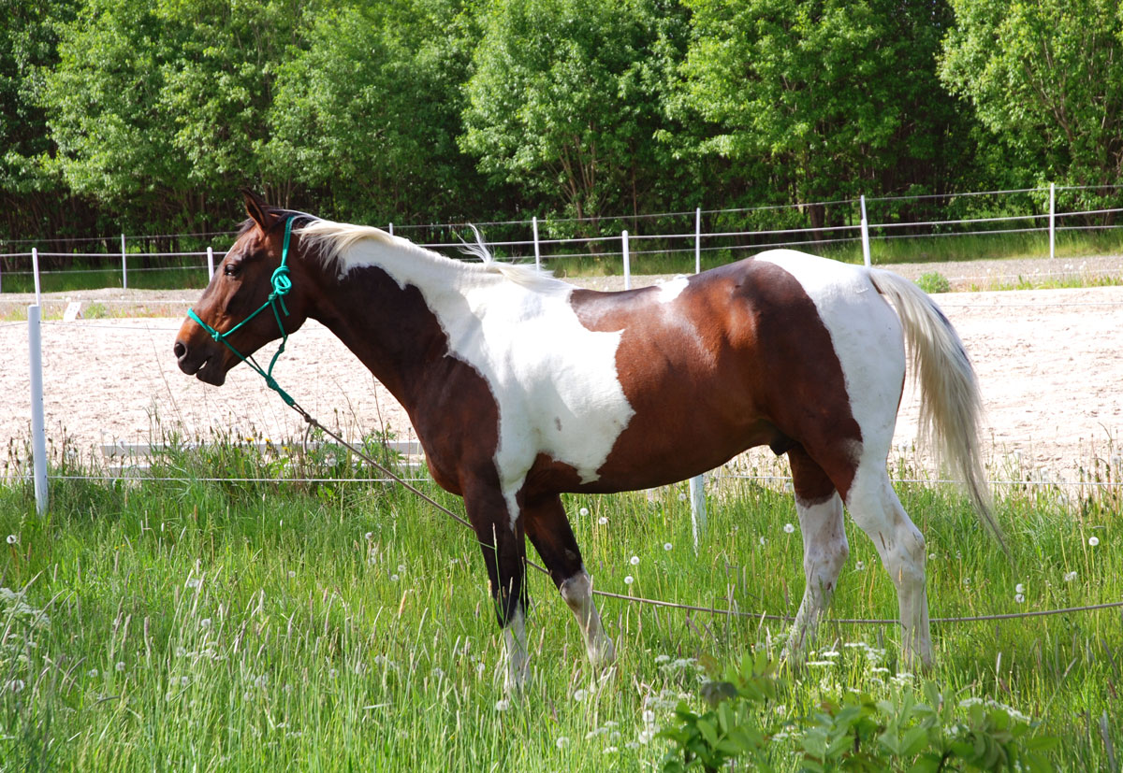
Sample Horse Project Tab
For Horsemanship, Horseless Horsemanship, and Mini’s
This Photo by Unknown Author is licensed under CC BY-SA

Slide 27
Project Commitment (Goals)
Write what you want to learn this year.
Make sure it is a clear obtainable goal.
A good goal is SMART:
  Specific
  Measurable
  Achievable
  Relevant
  Time Limited
Get your Leader’s Signature! This means your leader is aware of your goal will try to help you accomplish that.

Slide 28
Horse Certificates
Your horse certificates will go here.
You should have original certificates with new signatures from 4-H Staff each year.
Put one certificate for each horse that you are working with as a signed certificate is required to exhibit that horse in 4-H.

Slide 29
Activity & Training Journal
Track the date, hours per activity, and skills learned or what you were working on.

Slide 30
Horse Management Record
Equipment might include grooming supplies, trailers, feed buckets, ropes, halters, etc.

Slide 31
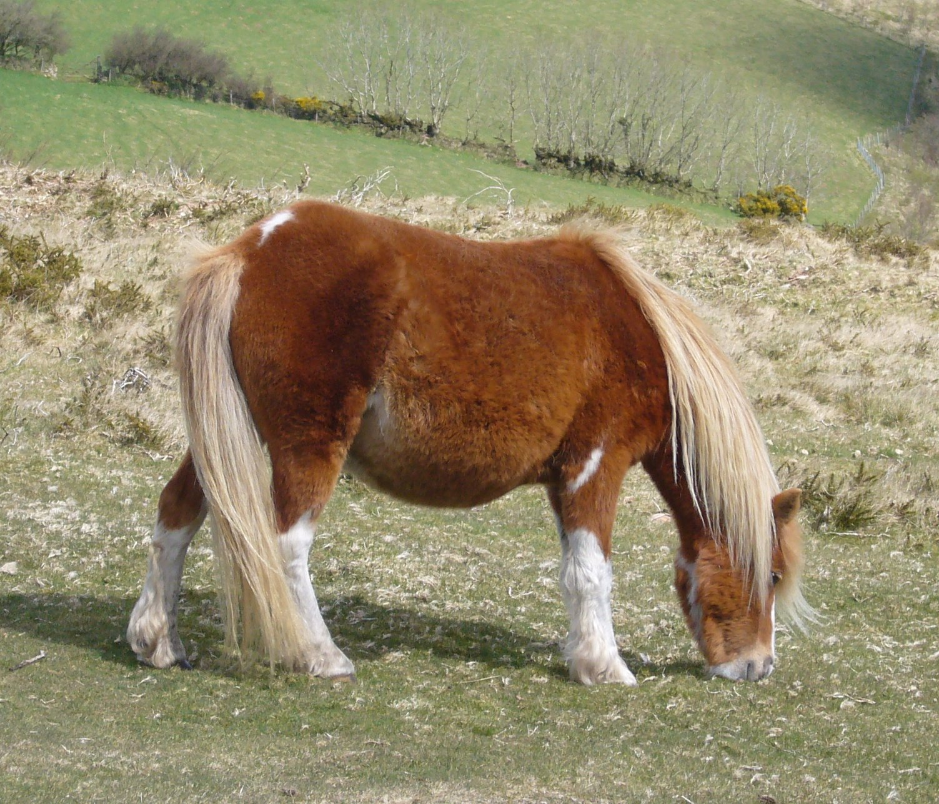
Project Photos
All the photos!
Your Animal
Animal’s housing.
You & Your animal at shows.
Learning about your project.
Etc.
One Page only
All the photos!
Your Animal
Animal’s housing.
You & Your animal at shows.
Learning about your project.
Etc.
One Page only
Date and explain the photo
This Photo by Unknown Author is licensed under CC BY-SA

Slide 32
Project Journal
Add as many pages as you need!
Record
Date
Time Spent
What you Did
What you Learned
If you do this regularly it is easy!
Make it a habit to catch up your journal at least once a month.
PRO TIP: Use a calendar to record what you do as you do it and then transfer it onto this page once a month.

Slide 33
Project Inventory
Animals & Equipment are recorded separately.
Give yourself additional pages if need be.
Your Animals included could be All in that species you posses, not just the few you are taking to Fair.
Equipment might include grooming supplies, trailers, feed buckets, etc.

Slide 34
Animal Project Expenses
We all know you’ll need more pages!
Record things by category.
PRO TIP: Waiting till the end of the year with a stack of receipts is not fun, so save yourself!
Expenses Totals

Slide 35
Animal Project Income Sheet
Do this regularly.
Many times you won’t have much income, don’t be discouraged!
Winnings from rodeos, shows, or scholarships can go here.

Slide 36
Project Essay
Write full complete sentences. Grammar and spelling count!

Slide 37

Photography Project Journal
(Non-Animal Projects)
Your Non-Animal Project Book might have more project specific prompts, but the general outline will be the same.

Slide 38

Project Goals
Write age appropriate goals.
Encourage non-competition driven goals.
How do you want to make yourself/your project better this year?
Get your Leader’s Signature! This means your leader is aware of your goal will try to help you accomplish that.

Slide 39


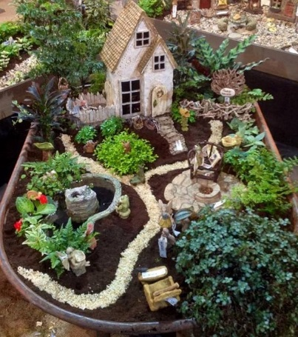
Project Photos
Photos from your field trips, club meetings etc.
Your best photos!
Your failed photos!
One Page only
Date and explain the photo

Slide 40
Photography Equipment Inventory
Track what you start & end the year with.
Items you include might be:
Camera
Lenses
Photography Bag
Mounting Supplies
Photos you have to sell $.

Slide 41
Photography Activities
What you did, where, and when!

Slide 42
Photography Expenses
Add your expenses together.
  Example Printing Photos for Fair
Add your income.
  Example Senior Photo Shoot for a Friend
Financial Summary is where you add it all together including your inventory value.
You will know how much your hobby is coasting and maybe get ideas for goals for the next 4-H Year!

Slide 43

Project Highlights
Fill out neatly.
Answer each section honestly.
You aren’t judged for failures!

Slide 44
Special Project Add Sheets Explained
Some projects have unique add sheets so we’ve included instructions for those here.

Slide 45



Horse Project- Activity & Training Journal
Foods and Nutrition Record – Value of Home Cooking
Include information on activities and lessons with your horse.
You can choose to include information on the riding conditions or weather on this page.
This page is an exercise in recording your costs of a meal. Juniors are required to fill this out for one meal they help prepare during the entire year.
Intermediates should fill out at least 2 time and Seniors 3 times.
This Photo by Unknown Author is licensed under CC BY-SA

Slide 46




Foods and Nutrition Record – Food Preservation Record
Sewing – Inventory of Tools, Equipment and Materials
Youth may only fill this out if they are enrolled in Food Preservation and are working with a Certified Project Leader.
Write NA if you are not in Food Preservation but are still doing a Food & Nutrition Project.
You can carryover your inventory from previous years.
This Photo by Unknown Author is licensed under CC BY-SA

Slide 47
Permanent Record
Forever and Ever and Ever

Slide 48
Tips to Start
Number each page if not automatically numbered.
Year: The 4- H year consists of three months of one calendar year and nine months of another. Therefore, whenever you write the year, indicate is as such: 2005-2006 or 05-06.
Blank Sections: If there are sections in which you have no entries for a year, write it down. For Example: "NONE" or "03-04-no offices held". This way anyone looking at your book will know that the blank is not just an oversight. You still earn points for sections where you have “NONE” written.
If you don’t think you have anything for a section, check again! Ask your leader for ideas.
Filled sections: When you fill a section in a Permanent Record, obtain a new Permanent Record. Do not split the current 4-H year between two Permanent Records. When you begin a new Permanent Record, label the front of your old one with the years it contains. On the front of the new Permanent Record fill in the date started and put it in front of the previous Permanent Record. You can also title each Permanent Record in the upper right corner "Book 1", "Book 2". Etc.

Slide 49
Permanent Record
Offices and Committee Assignments
Project and Exhibit Summary
Club Treasurer
Special Events Chair
County Awards Committee Teen Representative
Snack/Refreshment Chairmen
Telephone or Communications Committee
Decorating Committee
Herdsmanship Committee
Year | Project Title | Size | Exhibits | Where | Award
16-17 | Cavies | 3 | Type | State Fair | Blue, Red, Blue
16-17 | Gardening | 1 | Squash | County Fair | Blue, Gr. Champion, Judge’s Choice
When each project is broken out like this it is easier to judge your book.

Slide 50
Permanent Record
Judging
Public Presentations
Where did you practice your judging skills?
Examples:
Buying a new Sire for my Project
Judging Practice Night at Club
County Judging Clinic
County Fair Rabbit Judging Contest
County Fair Photography Judging Contest
Where and on what?
Speaking to your Club, to the Public, or at the County or State Fair.
4-H Fashion Review
Speaking on Radio or to Newspaper about your 4-H Activites

Slide 51
Permanent Record
4-H Contests Entered
Events Attended
Year | Contest Entered | Project | Where | Award
16-17 | Showmanship | Rabbit | Klickitat County Fair | Blue, Call Back
16-17 | Herdsmanship | Goat | Klickitat County Fair | Best Barn, Thursday & Sunday
4-H Non-competition Events
Club, County, Regional, State, or National Level Events
Achievement Night
Clinics
State Events like Teen Rally

Slide 52
Permanent Record
Community Service
4-H Promotion
4-H Club Gathered Bottles for Recycling
Packaged Food at a Food Pantry
Served Food at Soup Kitchen
Collected Food, Hygiene, and Clothing for homeless
Set out flags for Memorial Day
Wore my 4-H T-Shirt
Put up club event flyers at the grocery store
Attended KYG and spoke with the commissioners about the experience.
A picture of our club doing something was in the paper.
I invited a friend to come to my Club Meeting with me.

Slide 53
Permanent Record
School & Community Responsibilities
Leadership
Club Officer
County Role (Teen Superintendent)
State Ambassador
Committee Chair
Helped Another Member learn how to
School President
AWANA Group Leader
Track Contestant
Rainbow Girls Member
Math Club
School Play – Ensamble
Line Leader
Sports Team
ASB Club
Teacher Helper
Band

Slide 54
Permanent Record
Contests Other Than 4-H Entered (relevant to your projects)
4-H Meeting Attendance
ARBA (rabbit) Show
Spring Fairs
Photography Contests
We want to know how involved you are and what your other talents related to your project are.
Rodeo Event
16-17
12
10

Slide 55

Permanent Record
Most Important Recognition (To You)
Choose what accomplishment or award you are most proud of.
This should be something that made you feel successful.
You can update last year’s entry if it changed after you submitted your record book.

Slide 56

4-H Story Tab
Time to WRITE!

Slide 57

MY 4-H STORY
Narrative. Write your story for the year in narrative form. Write as though you are actually talking to the reader. Your story should have four parts and be no longer than two sides of one page.
Introduce yourself.
Write about each of your projects. Do not repeat the project highlights. Expand on what you’ve already said in your Project Tab.
Share your 4-H club experiences and how you were involved in your community and school.
Write about how you have changed as a result of your 4-H experience.
This story will have a large impact on awards and scholarships.
Make sure what you write here reflects the involvement in the 4-H Program you shared elsewhere in your book.
Talk about what IMPACT things had on you.
PRO TIP: Be honest. If it was a challenging year and you felt burnt out talk about it! If this was your best year ever talk about why!

Slide 58

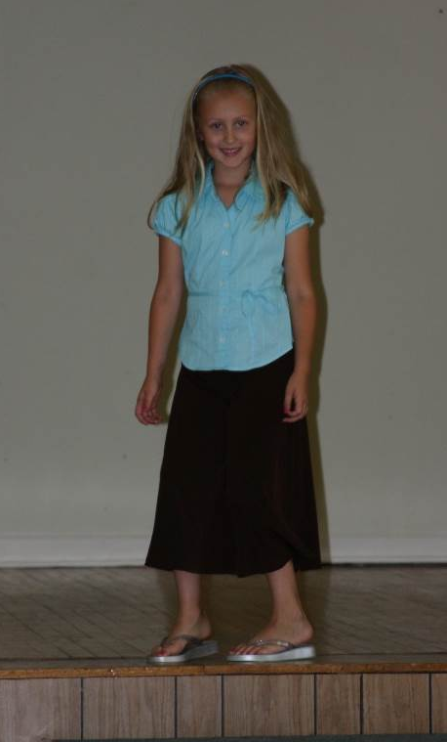
Supplemental Information
Place for FUN!
Limited to 2 pages.
Does not have to include only 4-H events. Can include things from other organizations, school, sports, family, hobbies etc.
Show that you are a well rounded 4-H Member.
Sharing what you are proud of during the past 4-H Year.
Include:
Newspaper Clippings
Photos
Letters
Caption everything. “This is a photo of me and my basketball team. We won 3rd at Districts on 5/1/19”. Include the date!
This is me showing my skirt in the Fashion Review Contest on August 14th

Slide 59

Back Page
Optional agreement for EACH club.
If your club does not have one ask your club leader to help you write one to present to your club.
Included this form as an END to your record book.

Slide 60
What the Judges Are Looking For

Slide 61
It isn’t hard to get 100%!

Slide 62

Questions?
Abby Brandt
4-H Program Manager
Klickitat County WSU Extension
Phone: 509-773-5817 ext. 7
Fax: 773-5707
Email: abbyb@klickitatcounty.org
228 W Main MS-CH 12 Goldendale, WA 98620
Extension programs and employment are available to all without discrimination. Evidence of noncompliance may be reported through your local Extension office.

