Slide 1
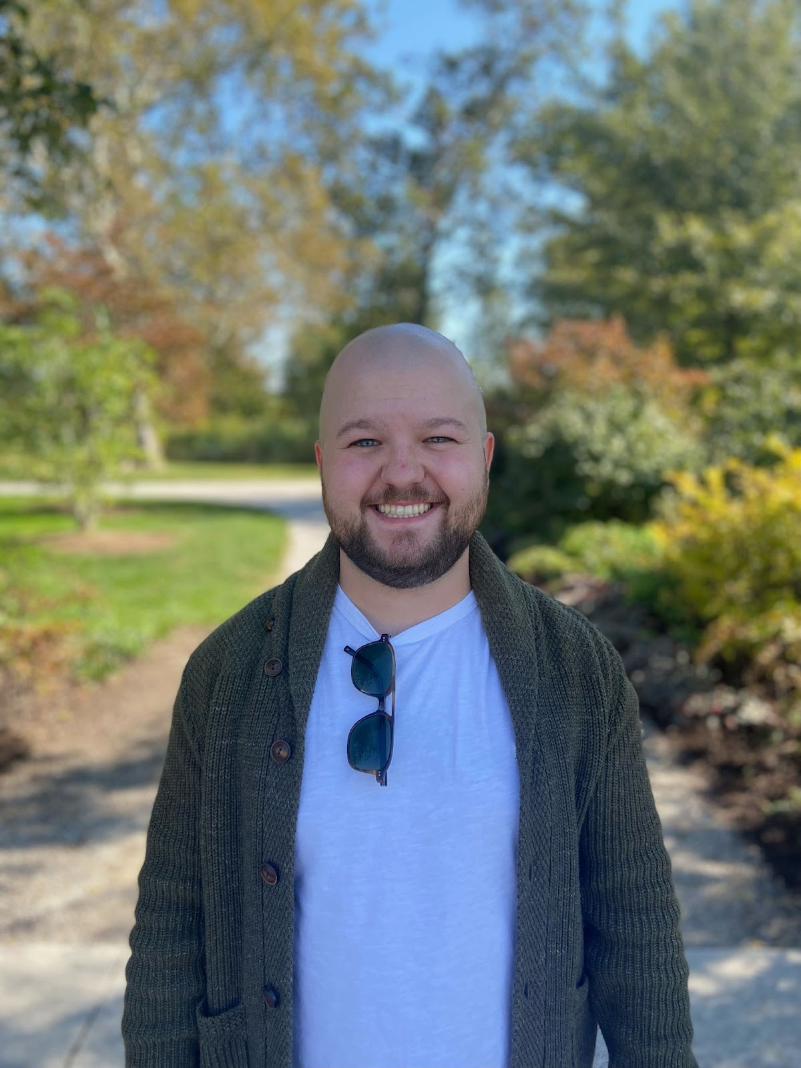
How to Write Code for a Billion People
A story of failures, risks, curiosities and the engineering side of the Internet.
Join us for industry speaker Kenneth Eversole, a 2019 Computer Science graduate from Washington State University. After graduation, he went to work for Boeing on their Apache Training Simulators but quickly went on to work as an early engineering employee for a startup called Balto. Today, he is a senior software engineer at Cloudflare working on their R2 storage platform.
An opportunity for lunch and conversation following the initial presentation.
    When: October 30
    Where: ETRL 101, Noon to 1pm
    Lunch Provided: ETRL 119, 1pm to 2pm

