Slide 1
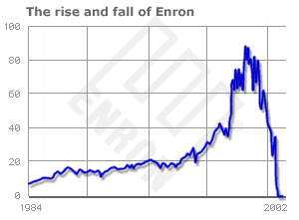

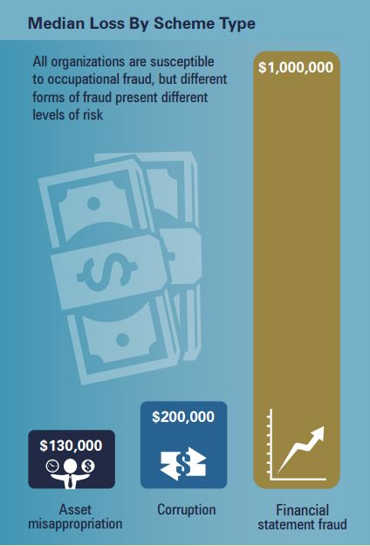
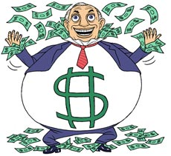



What Makes a CEO More Aggressive?:
A CEO’s Decision Horizon and Earning Manipulations
Motivation +
Means -

