Slide 1

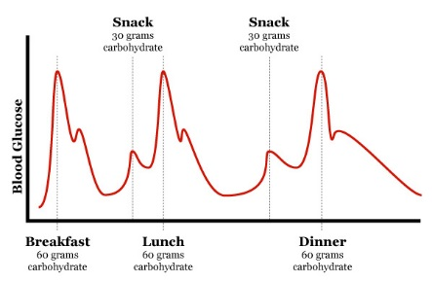
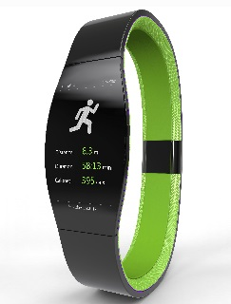
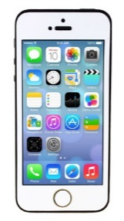
What is important to the patients (Value) when they use technologies to manage diabetes?
Patient
Values
Values
Accountability
Interpretation
Tasks
Symptom Management
Medication Management
Technologies
Participants
Information
Blood Sugar
Insulin
Calories
Food Carbs

