Slide 1
Goals, outcomes, Rubrics
UCORE + Writing Program
Lunch & Learn March 19, 2025
Lisa Johnson-Shull, Brooklyn Walter, Melanie Thongs

Slide 2
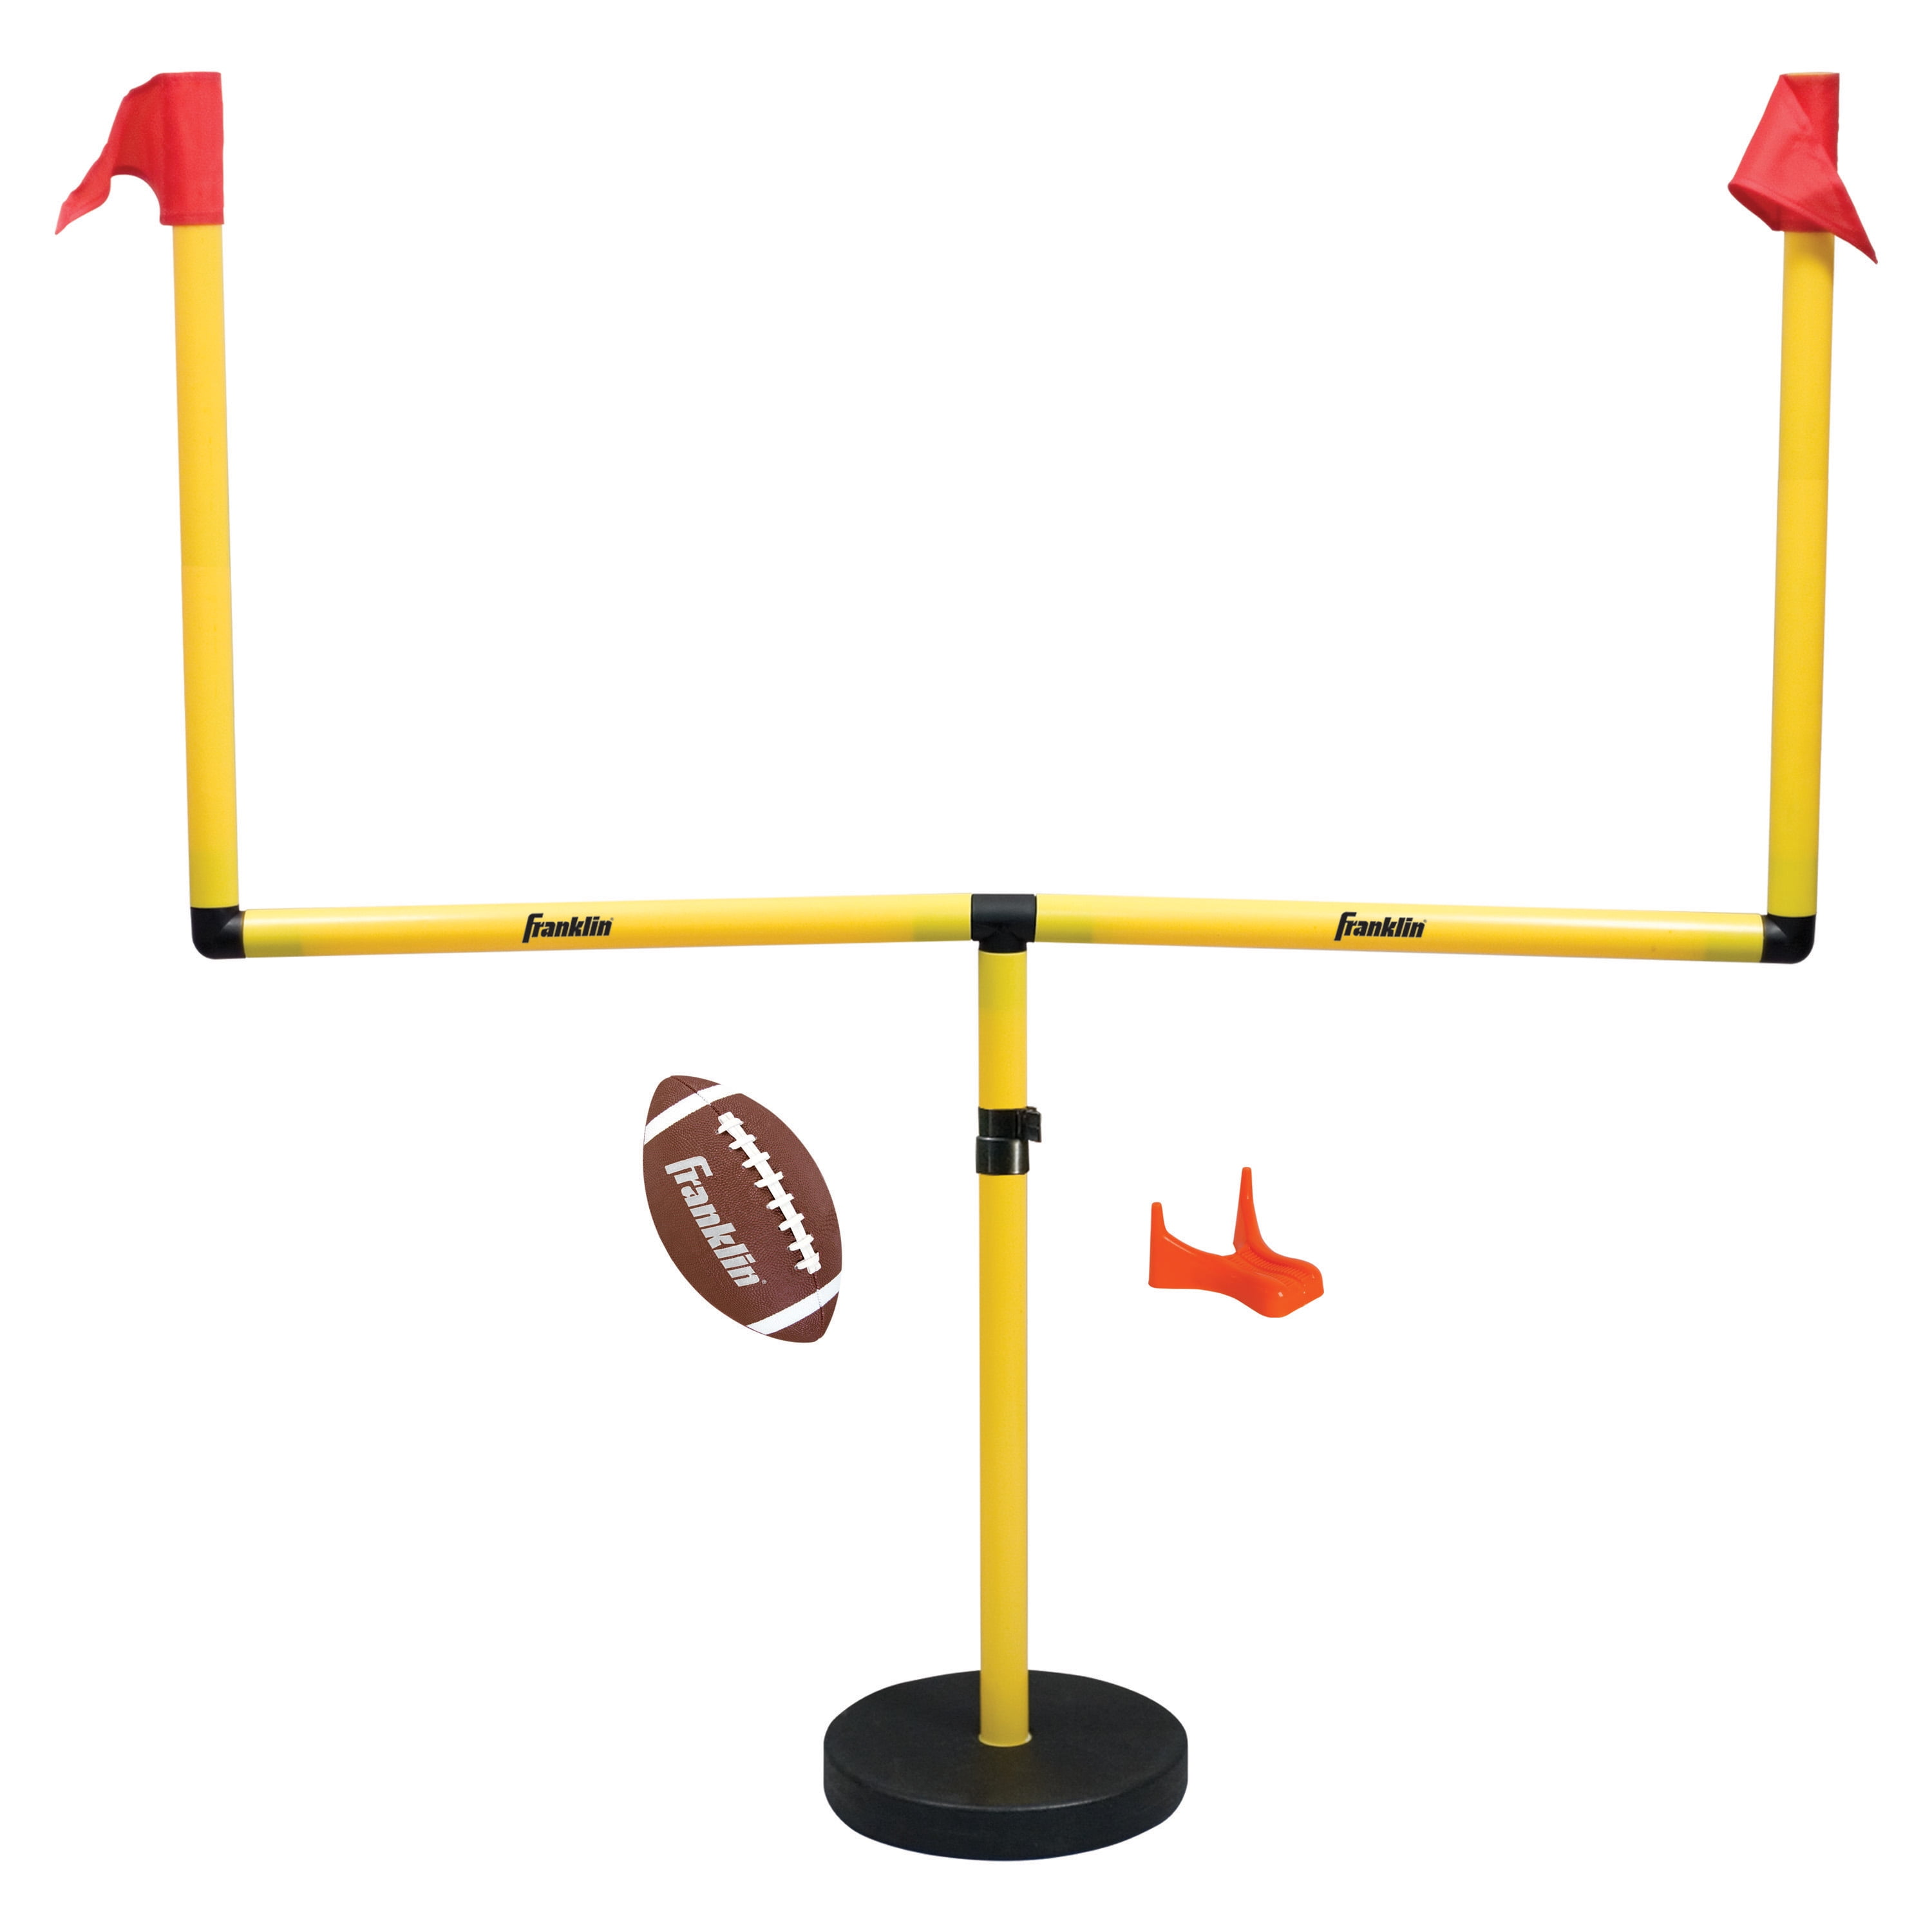
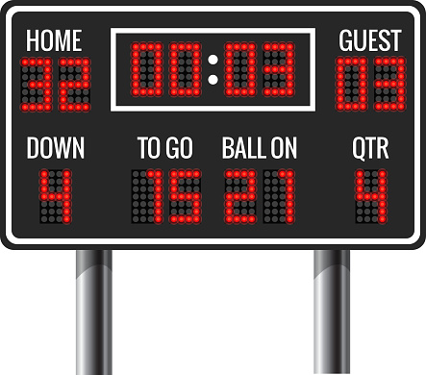
GOAL
OUTCOME

Slide 3
Rubrics in Day-to-day life
Credit Report
Home Inspection
Judging Animals at the Fair
APGAR Scores for Newborns
Results of a Health Physical
Car Checkup
Competitive Figure Skating
Wine and Apple Tasting

Slide 4
Rubrics
A rubric is an observable set of behaviors or qualities that is mapped to an evaluation scale.
It describes features in the product or process being evaluated.
The evaluation scale can range from “exceptional” to “inadequate” or “non-existent.”

Slide 5
Two types of rubrics
Analytic:
Grid format organized around specific criteria and a scale of evaluation
Criteria come directly from the assignment task and goals/outcomes
Scale might include numerical values for ease of grading (i.e., 1 – 5, increments of 3 or 5, or percentage values) or other words or symbols focused on feedback (i.e., “needs improvement > accomplished,” “D/F > A,” or “novice > mastery”)
Effective for both formative (in-progress) and summative (culminating) grading
Holistic:
Combine all criteria into one evaluative description in 1– 4 sentences
Criteria determined through the assignment task and goals/outcomes
Articulate levels of accomplishment or achievement (developing, proficient, sophisticated, etc.)
Quick, efficient, especially if used at the end of a project or paper that included opportunities for revision and utilized analytic grading or feedback that guided revision (summative grading)

Slide 6
Analytic rubric example
Criteria | Effective | Getting there | Needs a lot of work
Assignment | Writer met all requirements and exceeded expectations in the intellectual endeavor. | Writer met the minimum requirements and fulfilled the intellectual task. | Writer missed the point of the task or did not fulfill some aspect of it.
Focus | The thesis or central thread drives and connects everything. The scope is manageable so that the claim(s) or central goal of the paper is accomplished. | The thesis is present and functional, but the writer may stray from the point at times. The scope may be too big, or the writer may lose track of the paper’s goal at times. | The thesis is lacking, or the writer struggles to stay focused on the thesis throughout the paper. The reader may struggle to follow the point(s) or see connections in the paper.
Organization | The organization is easy to follow and achieves a purpose. Moving from one idea to the next makes sense to the reader. Ideas extend or build upon one another in ways that serve the paper’s goal(s). | The reader can generally follow the arrangement of ideas, but the paper lacks transitions or guidance regarding progression from one idea to the next. Some parts may feel out of order. | The reader struggles to follow or track the points made. Paragraphs seem disjointed, and points seem out of order. The paper seems to lack intentional arrangement.
Support | Claims are supported and explained thoroughly with relevant and interesting information. The types of evidence or support used are logical given the paper’s goal(s) and context. The evidence or support is connected to the goal(s) or thesis. | There are underdeveloped aspects in the paper. Some claims are under-supported or are supported with evidence that may not be relevant or appropriate for the context. | Many claims or points leave the reader wondering or hoping for more information. The paper lacks sufficient support throughout.
Proofreading | The paper has some typos or insignificant errors, but they do not compromise meaning or understanding. | There are mechanical and grammatical issues that are distracting; a few may compromise meaning or understanding. | There are mechanical and grammatical issues compromising meaning throughout the paper.

Slide 7
Holistic rubric example
6 = Essay demonstrates excellent composition skills including a clear and thought-provoking thesis, appropriate and effective organization, lively and convincing supporting materials, effective diction and sentence skills, and perfect or near perfect mechanics including spelling and punctuation. The writing perfectly accomplishes the objectives of the assignment.
5 = Essay contains strong composition skills including a clear and thought-provoking thesis, although development, diction, and sentence style may suffer minor flaws. Shows careful and acceptable use of mechanics. The writing effectively accomplishes the goals of the assignment.
4 = Essay contains above average composition skills, including a clear, insightful thesis, although development may be insufficient in one area and diction and style may not be consistently clear and effective. Shows competence in the use of mechanics. Accomplishes the goals of the assignment with an overall effective approach.
3 = Essay demonstrates competent composition skills including adequate development and organization, although the development of ideas may be trite, assumptions may be unsupported in more than one area, the thesis may not be original, and the diction and syntax may not be clear and effective. Minimally accomplishes the goals of the assignment.
2 = Composition skills may be flawed in either the clarity of the thesis, the development, or organization. Diction, syntax, and mechanics may seriously affect clarity. Minimally accomplishes the majority of the goals of the assignment.
1 = Composition skills may be flawed in two or more areas. Diction, syntax, and mechanics are excessively flawed. Fails to accomplish the goals of the assignment.

Slide 8
Ucore submissions + almost-rubrics
The use of clear rubrics or grading criteria are necessary for transparent and inclusive teaching.
Syllabuses and prompts should include your plan for evaluating student writing and projects.
Students need to know how they will be evaluated and what constitutes “success” in their efforts.
All too often, students do not know what professors are expecting or how they are grading. This leads to confusion, frustration, and ‘learned helplessness.’
We commonly see “almost-rubrics” in UCORE course proposals and renewals:
Syllabus lacking clear, accurate grading breakdown for the class.
Syllabus lacking writing/project prompts without rubric/grading that aligns with the assignment.
Syllabus with grading that does not clearly explain how a student would earn a grade/points.

Slide 9
Chicken worth 12 pts
Marinara worth 12 pts
Pasta worth 12 pts
Cheese worth 12 pts
Almost-rubric for chicken parmesan:
What does 12 points look like for chicken? How should a student-chef know constitutes a 12-point marinara?
Revised rubric for chicken parmesan:
Ingredients | Rating 12 – 10 Exemplary | Rating 9 – 7 Good | Rating 4 - 6 less than acceptable | Total pts.
Chicken | The chicken is moist and tender | The chicken is tender, but dry on the edges | The chicken is dry and tough
Marinara sauce | The sauce is evenly flavored with garlic, basil and Italian spices so each taste is obvious | The sauce is heavy on the garlic, and the flavor of the basil and Italian spices are lost | The sauce is unevenly flavored with too much or too little of the suggested spices
Pasta | The pasta is hand-prepared, holds together enough to be cut into even ribbons | The pasta is hand-prepared but is cut into uneven ribbons or chuncks. | The pasta is store-bought
Cheese | Parmesan is used from a block and hand-grated | Parmesan is used from a pre-grated package | Parmesan powder is used from a green can
Overall | Ingredients are in proper proportion | Ingredients are moderately balanced | Ingredients are entirely out of proportion.

Slide 10
Almost-Rubric Examples
Assignment:
Create an annotated bibliography w/ 8 sources using APA citations. The annotations should summarize the source, explain the source’s stance on the issue at hand, include details and/or direct quotes, and explain how the source might be used in the upcoming project.
Almost-Rubric:
8 sources = 8 pts for 8 sources
APA = 40 pts, 5 points per citation for important elements (author(s), date, title, publication, and correct formatting for those elements)
Annotations = 72 pts, 9 points per annotation (summary, relevance)
Total = 120 points
Students can imagine how 8 points for 8 sources might be evaluated, and even how 40 points for 8 citations could be evaluated. How will the annotation be evaluated? How can a student earn 9 points per annotation?

Slide 11
Revised Rubric:
8 sources @ 1 point each
Correct APA @ 5 points each (1 point each for name, date, title, publication, correct formatting)
Possible analytic rubric @ 9 points per annotation:
Criteria | Excellent (7-9 points) | Proficient (4 – 6) | Lacking (1 – 3) | (0)
Summary | The source is summarized in 3 – 4 sentences, including at least one sentence with the author’s name. Important info about the article, such as the use of a study, should be included. | The source is summarized in too many or too few sentences. The names of the author might be missing. The summary might not include important information. | The source is severely under-explained or over-explained. Important information is confusing or hard to find.
Source’s stance on issue | The source’s stance is clear. Verbs such as report, find, claim, critique, etc., are used to convey the author(s) stance and presentation of their ideas/research. | The source’s stance is somewhat clear. Precise verbs are sometimes used. | The source’s stance is not clear or is hard to identify. Precise verbs are rarely if ever used.
Use of details and/or direct quote | The annotation is detailed, particularly highlighting details unique to this source. Direct quotes are included if they are significant to the source somehow. The details and source would be useful to the project. | The annotation has some detail and/or quotes, but they may be lacking or they may not seem particularly significant. It is hard to imagine using the details or quotes in the project to any effect. | The annotation is lacking detail and/or quotes. The annotation does not provide much for the eventual project.
Source’s relevance to your project | The source’s relevance is explained in 1 – 2 sentences; explanation includes purpose, scope, and uniqueness or significance of the source. | Relevance explanation might not include purpose, scope, or uniqueness or significance. | Relevance is under- or over-explained. More than two aspects of relevance are not included.

Slide 12
Almost-Rubric Examples
Assignment:
Choose one of the following design challenges. Include a 300-word explanation of your choices and your process.
(challenge options…)
Almost-Rubric: Technique: Does the piece demonstrate understanding of fundamental elements and principles of graphic design such as color theory; proportion, alignment, and balance; typography, etc.? Concept: Is your design novel and creative while being relevant to the brand or company?
Explanation: Can you explain your decision-making? Can you describe your process?
What is the grading scheme? How much is the project worth? How are these three criteria evaluated? What does a student need to do in order to be successful in each of these categories?

Slide 13
Possible holistic rubric:
A = The designer demonstrates an exemplary understanding of graphic design elements through outstanding execution of color principles; excellent balance, proportion, and layout; and highly effective typography. Design elements strongly align with the context to achieve goals. The designer explains these decisions precisely and clearly. The designer includes several key steps in their design process using technical terminology.
B = The designer demonstrates strong understanding of graphic design elements through mostly-effective application of color principles, mostly-effective balance, proportion, and layout; and mostly-effective typography. Design elements generally align with the context. At least one of these elements, however, is lacking. The designer explains their decision-making and process but lacks precision, clarity, or technical terminology.
C = The designer demonstrates a proficient understanding of graphic design elements, but at least one element is distracting or ineffective. Some of the design elements do not obviously align with the context. The purpose is not obviously achieved. The designer’s explanations are lacking, ineffective, and/or inappropriate for the discipline.
D = continue revising adjectives and descriptors…
F =

Slide 14
Using the ucore learning outcomes grid to create a rubric
Sample UCORE SLO grid from a Spanish course (with approval from the instructor)
WSU/UCORE Learning goal | WRTG Learning Outcomes | Course-level Learning Outcomes
Written Communication | Students express ideas clearly, concisely and effectively in writing directed according to established standards of professional Spanish-language written work, taking into consideration students’ intermediate Spanish level. | Students will be able to write texts and orally transmit ideas about a variety of topics in a polished, grammatically standard fashion at a targeted ACTFL proficiency level between Intermediate Low and Intermediate High.
 | Students respond to prompts directed at diverse audiences in order to influence, persuade and expand intercultural understanding among these audiences, taking into consideration students’ intermediate Spanish level. | Students will be able to determine the appropriate audience for a piece of writing and express their ideas and analyses with an understanding of the cultural and intellectual characteristics of each audience.

Slide 15
Continued…
WSU/UCORE Learning | WRTG Learning Outcomes | Course-level Learning Outcomes
Information literacy | Use evidence to support and explain claims. | Students will be able to research the cultural and historical context of authors from various Spanish speaking countries and apply that research to their determination of audience and genre in written work. Students will be able to evaluate and use Spanish-language sources effectively and persuasively.
Critical Thinking | Recognize how and why conventions vary among disciplines and communities. | Students will become familiar with the grammar and orthography standards of Real Academica Española and produce sophisticated written work that conforms to these communicative standard. Students will compose written work directed at audiences of diverse national origins, historical contexts, gender identities and socio-economic statuses, using research and critical thinking at a targeted ACTFL proficiency level between Intermediate Low and Intermediate High.
Critical Thinking | Reflect on and apply feedback to increase the effectiveness of written communication. | Students will revise written work based on instructor feedback. Students will revise based on the grammatical and orthographic standards of the Real Academia Española as well as based on considerations of audience and genre evaluated by the instructor.
Critical Thinking | Reflect on and apply feedback to increase | Students will revise written work based on instructor feedback. Students will revise based on the grammatical and orthographic standards of the Real Academia Española as well as based on considerations of audience and genre evaluated by the instructor.

Slide 16
Use the course goals as starting point for a rubric:
Criteria | Outstanding | Proficient | Lacking
Written communication | Students express ideas clearly, concisely and effectively in writing directed according to established standards of professional Spanish-language written work, taking into consideration students’ intermediate Spanish level.
Written communication | Students will write texts and orally transmit ideas about a variety of topics in a polished, grammatically standard fashion at a targeted ACTFL proficiency level between Intermediate Low and Intermediate High.
Written communication | Students will write texts and orally transmit ideas about a variety of topics in a polished, grammatically standard fashion at a targeted ACTFL proficiency level between Intermediate Low and Intermediate High.

Slide 17
Use the course goals as starting point for a rubric:
Criteria | Outstanding | Proficient | Lacking
Information Literacy | Students will research the cultural and historical context of authors from various Spanish speaking countries and apply that research to their determination of audience and genre in written work.
Critical Thinking | Students will revise written work based on instructor feedback. Students will revise based on the grammatical and orthographic standards of the Real Academia Española as well as based on considerations of audience and genre evaluated by the instructor.

Slide 18
THE GOALS OF TEACHING AND LEARNING EMPATHY
Moving from Goals to Observable Outcomes (criteria) to a Rubric…
THE TEACHERS’ GOALS FOR THEMSELVES
Develop more sensitive practitioners
Promote better communication in the nursing field
Promote healthy nurse/patient relationships
THE TEACHERS’ GOALS FOR THEIR STUDENTS
To show themselves as more sensitive practitioners
To show themselves as better communicators in the workforce
To demonstrate the hallmarks of healthy nurse/patient relationships

Slide 19

Step #1: Define The Actions of Empathy
What does empathy entail? What is a person doing when they are being empathetic?
Listening actively
Personalizing communication
Offering to help
Considering different perspectives
Validating the feelings of others (show respect for different perspectives)
Asking questions

Slide 20
Step #2: expand actions into Observable criteria
Listen actively
Demonstrate focused attention with direct and prolonged eye contact
Not interrupting when someone else is speaking
Repeat back what was heard using “what I heard you say” statements
Personalize communication
Regulate vocabulary depending on audience
Know and use other languages (ASL, Spanish, etc.)
Learn and use people’s names
Offer to help
Understand your bandwidth and notice the bandwidth of others
Understand your skillset and the skillset of others
Share your skills where and when it is appropriate
Consider different perspectives
Know your own perspective
Know or be willing to learn the assumptions you make in your perspective
Understand how context influences perspective
Understand how culture influences perspective
Validate the feelings of others (show respect for different perspectives)
Use verbal expressions that acknowledge the observable reality
Play the “believing” and not the “doubting” game
Separate your feelings from the feelings of others
Ask questions
Collect data before reaching conclusions
Inquire about uncertainties

Slide 21
Step #3 Create a Rubric by listing the Actions and the observable criteria through the scale
 | Yay | Meh | Boo
Listens actively | Demonstrates focused attention with direct and prolonged eye contact; doesn’t interrupt when someone else is speaking; repeats back what was heard using “what I heard you say” statements. | Sometimes demonstrates focused attention with direct and prolonged eye contact; occasionally interrupts when someone else is speaking; sometimes repeats back what was heard using “what I heard you say” statements. | Rarely demonstrates focused attention with direct and prolonged eye contact; interrupts when someone else is speaking; rarely repeats back what was heard using “what I heard you say” statements.
Personalizes communication | Regulates vocabulary depending on audience; uses people’s names. | Attempts to regulate vocabulary depending on audience; sometimes uses people’s names. | Does not regulate vocabulary depending on audience; rarely uses people’s names.
Offers to help | Shares skills where and when it is appropriate…
Considers different perspectives | Willing to recognize own assumptions; understands how context and culture influence perspective.
Validates the feelings of others | Acknowledges observable reality; separates own feelings from the feelings of others…
Ask questions | Collects data before reaching conclusions; inquires about uncertainties.

Slide 22
A writing Example
Activities:
Use google scholar to find 5 appropriate primary sources
List evidence from each primary source that you think is useful to your point
Write paragraphs with topic sentences that make claims supported by the evidence
Use assigned style guide to make proper in-text citations.
Write a work cited for each primary source used.
Goal: Information Literacy
Smart goal: Uses evidence from 5 appropriate primary sources in support of a written argument.

Slide 23
Assignment Instructions:
Use google scholar to find 5 appropriate primary sources
List evidence from each primary source that you think is useful to your point
Write paragraphs with topic sentences that make claims supported by the evidence
Use assigned style guide to make proper in-text citations.
Write a work cited for each primary source used.
“Success” measurement in a rubric:
5 appropriate primary sources are used.
Evidence from each primary source is useful to your point.
Paragraphs start with topic sentence that make a claim; paragraph provides the evidence.
In-text citations are used properly according to the citation style.
A work cited contains each primary source used.

Slide 24
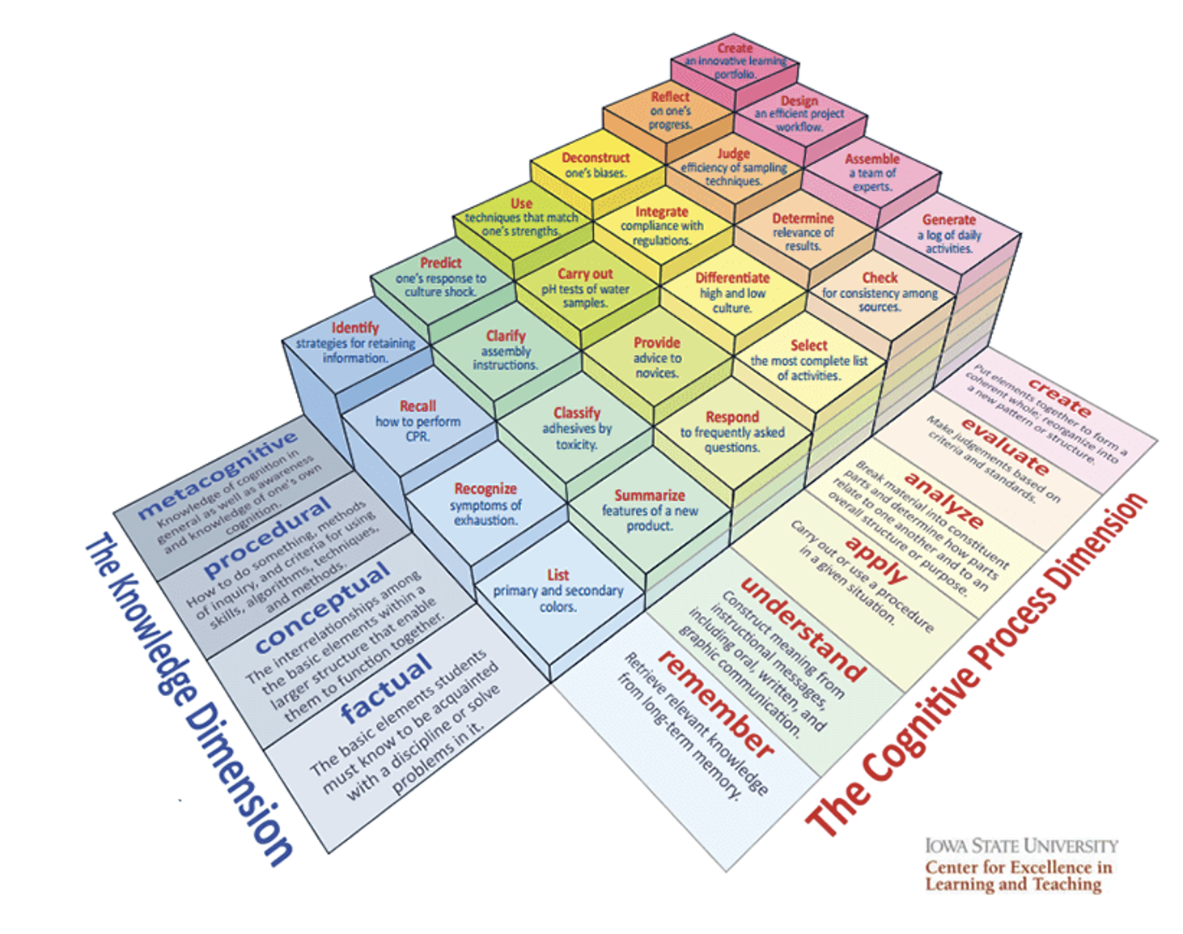
Importance of verbs in Rubrics

Slide 25
Example Assignment: Teachers in the Movies
Please select and watch a movie with a teacher theme and observe how the teacher is portrayed and reflect on how, at least in this film, the movie industry defines ‘good’ teachers.
Introduce the characters, describe encountered challenges/conflicts, and explain how teachers solve these problems. Please also connect this to educational theories and discuss how this movie affects your understanding of being a teacher.
Describe and introduce main topics/talking points to highlight the movie.
What inspires you the most from the movie? Explain and provide examples drawn from the movie. (I learn.)
Connect the content with readings from our text and your prior knowledge to reflect further. Be specific. No lengthy direct quotes. Instead, use your own words to capture the essences of the readings and theories to show understanding. Use APA style to cite. (I can connect my readings and prior knowledge to support.)
Ask relevant questions about the role of teacher and instructional practices you saw in this movie. Then, conduct additional research to provide additional information that would benefit your future teaching/career path. (I wonder)
Please provide your own opinions and make connections from readings and life experiences.
Write a one-paragraph conclusion.
Word limit: 800-1000 words, not counting reference, font 12, Times New Roman, Double space.)

Slide 26
Sample proficiency categories
Yay | Meh | Boo
Exceeds expectations | Meets expectations | Struggling
Good | Fair | Talk to me
Developed | Developing | Emerging | Struggling

Slide 27

Grading Rubric w/o Point Values
Assignment Component | YAY | MEH | BOO
Select a movie with a teacher theme | Given the goal and purpose of the assignment the movie selection gave ample opportunity to address the assignment components. | Given the goal and purpose of the assignment the movie selection gave moderate opportunity to address the assignment components. | Given the goal and purpose of the assignment the movie selection gave sparse opportunity to address the assignment components.
Reflect on how the movie industry defines ‘good’ teachers | Fully summarized how the teacher was portrayed and fully explained how the movie industry defines ‘good’ teachers | Partially summarized how the teacher was portrayed and partially explained how the movie industry defines ‘good’ teachers | Barely summarized how the teacher was portrayed and inadequately explained how the movie industry defines ‘good’ teachers
Introduce the characters | Each main character was introduced with enough detail to understand their role. | Each main character was introduced but in an abbreviated way. | Not all of main characters were introduced.
Describe encountered challenges/conflicts
Explain how teachers solve these problems.
Discuss how the movie affects an understanding of being a teacher
Connect educational theories to the discussion of how this movie affects the understanding of being a teacher.
Make connections to readings
Make connections to life experiences
Summarize the film

Slide 28
Peer Observation Checklist & Response
Assignment Component | Present | Absent | Explanation
Select a movie with a teacher theme |  |  | If Present, What was the movie selected?
Reflect on how the movie industry defines ‘good’ teachers |  |  | If Present, Does the reflection include a definition?
Introduce the characters |  |  | If Present, Who are the main characters?
Describe encountered challenges/conflicts |  |  | If Present, what challenges are described?
Explain how teachers solve these problems. |  |  | If Present, how were the problems solved?
Discuss how the movie affects an understanding of being a teacher |  |  | If Present, how did the movie affect that understanding?
Connect to educational theories the discussion of how this movie affects the understanding of being a teacher. |  |  | If Present, what theories did it connect to?
Make connections to readings |  |  | If Present, what readings did it connect to?
Make connections to life experiences |  |  | If Present, what life experiences did it connect to?
Summarize the film |  |  | What is the film about?
Use APA format
Refrain from excessive use of quotations
Meet the word and formatting limit: 800-1000 words, not counting reference, font 12, Times New Roman, Double space.)

Slide 29
Example: peer observation rubric, part 1
Name:
Name of student who’s paper you are reviewing:
Mark “present” or “absent” based on whether the writer of the paper included the following required components of the paper. Answer the questions under “Explanation” in the Peer Response column.
Assignment Components | Present | Absent | Explanation | Peer Response
P1-Described the extent and effects of the social problem using three scholarly sources |  |  | If Present, what is the extent and effects of the social problem? If Present, what scholarly sources are used?
P1-Described contributing factors of the social problem from two relevant sociological theoretical perspectives using lecture material |  |  | If Present, what relevant sociological theoretical perspectives were applied?
P2-Described the history and focus/aim/mission of the program or policy using information from the website |  |  | If Present, what is the focus/aim/mission of the program or policy?

Slide 30
Example: peer observation rubric, part 2
Assignment Components | Present | Absent | Explanation | Peer Response
P2-Described two events/situations contributing the creation of the program or policy using information from the website and one other relevant source |  |  | If Present, what two events/situations are described? If Present, what relevant source was used?
P3-Described three measurable quantitative or qualitative outcomes from the policy or program to date using information from the website and one other relevant source |  |  | If Present, what three measurable outcomes were used? If Present, what relevant source was used?
P4-Described two challenges, criticisms, unintended consequences, or missing pieces of the program or policy using information from the website and one other relevant source |  |  | If Present, what two challenges, criticisms, unintended consequences, or missing pieces were identified? If Present, what relevant source was used?
P5-Described two creative suggestions for improving, revising, or adding to the program or policy |  |  | If Present, what two creative suggestions were provided?

Slide 31
Grading rubric with point values
Grading Criteria | Points Awarded |  | Grading Criteria | Points Awarded
1. Writing is well-organized and clear, without distracting grammatical and spelling errors | 0 – Writing is difficult to follow, incomplete, and contains many grammatical errors 1 – Writing is missing some explanation, doesn’t flow well, or has grammatical errors 2 – Writing is easy to follow, gives complete explanations, and has few grammatical errors |  | 4. Origin and/or rationale of the USDA standard is fully explained and well-supported by sources | 0 – Minimal description with unreliable or no supporting sources 1 – Describes the origin or rationale but the description is not complete or well-supported 2 – Clearly describes the origin and the rationale in detail using effective sources
2. Reliable sources are used to support all aspects of the assignment and all sources are appropriately cited in the text and in a references list | 0 – Sources are not cited or incorrectly cited in the text and in the references list 0.5 – All resources used are correctly cited in the text and in a references list |  | 5. Critiques of the USDA standard from multiple perspectives (if applicable) are thoroughly discussed with support from relevant sources | 0 – Critique doesn’t use reliable sources, shows limited understanding, or is student’s opinion 1 – Critique focuses on a single perspective, has limited depth, or uses unreliable sources 2 – Critique of the standard is balanced, complete, and supported by reliable sources
3. The text of the chosen USDA standard is included with an appropriate in-text citation | 0 – The text of the standard is missing or not appropriately cited 0.5 – The text of the standard and an in-text citation are included |  | 6. Student supports their opinion using persuasive reasoning, logical arguments, and reliable sources | 0 – Student’s perspective is not sufficiently justified by their reasoning and arguments 1 – Student’s perspective is persuasive with well-supported arguments
 |  |  |  | Total points possible: 8

Slide 32
Grading Rubric with point values by percentages
Criterion | Effective (100%) | Getting there (80%) | Needs a lot of work (50%)
Scientific (biophysical) explanation; 2 pts (20% of total pts) | Demonstrates complete knowledge of the underlying science. Uses appropriate, relevant, and compelling content to convey that knowledge. 2 pts (100% of 2 pts) | Demonstrates knowledge of the underlying science. Uses appropriate and relevant content to explore that knowledge. 1.6 pts (80% of 2 pts) | Demonstrates some knowledge of the underlying science. Uses some appropriate and relevant content to convey that knowledge.1 pt (50% of 2 pts)
Context 2 pts (20% of total pts) | Thoroughly depicts where/when/who is affected by the identified issue. 2 pts (100% of 2 pts) | Conveys a general depiction of where/when/who is affected by the identified issue. 1.6 pts (80% of 2 pts) | Conveys a partial depiction of where/when/who is affected by the identified issue. 1 pt (50% of 2 pts)
Link between human actions and Problem 1.5 pts (15% of total pts) | Thoroughly links human actions and issue with appropriate, relevant, and compelling content. 1.5 pts (100% of 1.5 pts) | Links human actions and issue with appropriate and relevant content. 1 pt (50% of 2 pts) | Partially links human actions and issue with relevant content. 0.75 pts (50% of 1.5 pts)
Solutions 1.5 pts (15% of total pts) | Thoroughly describes potential solutions clearly, with all technical details correct. Balanced discussion of limitations included. 1.5 pts (100% of 1.5 pts) | Describes potential solutions clearly, with most technical details correct. Discussion of limitations included. 1.2 pts (80% of 1.5 pts) | Describes potential solutions but missing key details or some described incorrectly. Discussion of limitations is sparse. 0.75 pts (50% of 1.5 pts)
Sources and Evidence 1.5 pts (15% of total pts) | Demonstrates skillful use of peer-reviewed literature to develop ideas. All statements that are not common knowledge are cited in the text. 1.5 pts (100% of 1.5 pts) | Demonstrates consistent use of peer-reviewed literature to support ideas. A few missing citations and/or over-reliance on a few sources. 1.2 pts (80% of 1.5 pts) | Demonstrates an attempt to use peer- reviewed literature to support ideas. Many places missing citations. 0.75 pts (50% of 1.5 pts)
Organization 1.5 pts (15% of total pts) | Text is well-organized, with a logical order of ideas and coherent paragraphs. 1.5 pts (100% of 1.5 pts) | A few sentences out of place or a few missing topic sentences. Paragraph order. 1.2 pts (80% of 1.5 pts) | Paragraphs unorganized, information repeated in multiple places or paragraphs not in logical order. 0.75 pts (50% of 1.5 pts)

Slide 33
Neutral to negative rubric with points
Criteria | Neutral (no points removed) | -1 points | -2 points
Use proper grammar and consistent format in citations | Zero or occasional grammatical or citation errors | Noticeable grammatical and citation errors, but still able to read and find citations. | Full of errors, insufficient information to find citations, errors make paper hard to read.
5-8 pages, single- spaced (excluding references), 1”margins, 11-12 point Times New Roman or Calibri font | Meets all criteria | Paper 1-2 pages outside of length requirements once font size and margins are correct | Paper >2 pages outside of length requirements once font size and margins are correct

Slide 34
Tips for rubric best practices
Best Practices
Limit the rubric to a single page for reading and grading ease
Use parallel language. Use similar language and syntax/wording from column to column. Make sure that the rubric can be easily read from left to right or vice versa.
Use student-friendly language. Make sure the language is learning-level appropriate. If you use academic language or concepts, you will need to teach those concepts.
Share and discuss the rubric with your students. Students should understand that the rubric is there to help them learn, reflect, and self-assess. If students use a rubric, they will understand the expectations and their relevance to learning.
Consider scalability and reusability of rubrics. Create rubric templates that you can alter as needed for multiple assignments.
Maximize the descriptiveness of your language. Avoid words like “good” and “excellent.” For example, instead of saying, “uses excellent sources,” you might describe what makes a resource excellent so that students will know. You might also consider reducing the reliance on quantity, such as a number of allowable misspelled words. Focus instead, for example, on how distracting any spelling errors are.
https://teaching-resources.delta.ncsu.edu/rubric_best-practices-examples-templates/

Slide 35
Using genre in instruction and rubric/assessment
What genre is the best for practicing the skills needed to complete the assignment?
What are the conventions of the genre?
Will you incorporate all of the conventions of the genre, or a simplified subset of the conventions?
What components are necessary for your discipline’s version of this genre?
Does the genre use persuasion?
Does the genre expected to be entertaining?
Does the genre report information?
Include these genre components in your rubric with different weightings

Slide 36
What are the available and common genres in this discipline?
Case study
Lab report
Poem
Literary critique
Abstract
Business proposal
News article
Op-ed
Feasibility report
Technical manual
Clinical notes
Nurse’s notes
Care plan
Lesson plans
Social media posts
Advertising plan
Demographic analysis
Sermon
Literature review
Annotated bibliography
Research proposal
Biography
Songs
Blueprints & proposals
Pitches & presentations
Memos
Inspection reports
Novel or story
Quality assurance documents

Slide 37
The benefits of using a rubric
Well-designed rubrics can be beneficial for students by reducing aspects of the “hidden curriculum” that many students experience (especially first-generation students or students from historically marginalized groups) by making assessment expectations clearer to students (Allen and Tanner 2006, Wolf et al. 2008, Stevens and Levi 2013). Rubrics have been shown to increase student performance on assessments, however, increased scores were often only found if students were required to use the rubric prior to completing the assessment (Felder and Brent 2016, Francis 2018). For example, when researcher provided students in different class sections of the same course with different levels of engagement with a rubric (no rubric control group, rubric provided, rubric explained in class, rubric explained in class and students given access to additional resources), results showed no difference in student scores between the no rubric and rubric provided groups indicating that just giving students a rubric does not positively influence student grades on the assessment (Francis 2018). Yet, when the rubric was explicitly explained during a class session (regardless of availability of additional resources), significant improvements were seen in these student’s scores on the assessment (Francis 2018). In a separate study on self-assessment, researchers found that when a rubric was provided, students with access to the rubric (compared to the control group) reported higher levels of self-regulation, increased performance on the assessment, and higher self-accuracy (self-assessment scores better matched the earned grade) for the assessment (Panadero and Romero 2014). Thus, instructors must provide students with opportunities to meaningfully engage with the rubric for the rubric to be beneficial for student performance.

Slide 38
The benefits of using a rubric: Part 2
One method to achieve the level of engagement needed for rubrics to be helpful for students is to create assignments that require students to assess an example or conduct a peer-review using the rubric (Francis 2018). Alternatively, involving students in creating the rubric can also provide the level of engagement needed for rubrics to be beneficial for students (Panadero and Romero 2014, Francis 2018). In fact, student-instructor generated rubrics (usually created during a whole class activity) increased student engagement with the rubric while also reducing resistance to using the rubric for grading and promoted the development of skills including negotiation, self-regulation, and self-reflection in students (Zhao et al. 2021). It is also noteworthy that most peer-generated rubrics for grading of group dynamics or group projects often are highly aligned to what an instructor would have created for students to use (Zhao et al. 2021).

Slide 39
The benefits of using a rubric: Part 3
Students are not the only ones to benefit from rubrics. Rubrics can assist instructors by reducing the time required to grade assignments, providing timely feedback to students, and allowing for more consistency in grading (Allen and Tanner 2006, Stevens and Levi 2013, Felder and Brent 2016, Francis 2018). Designing a rubric can help instructors develop a better assessment and provides a framework for grading when multiple instructors are teaching different sections of a course (Allen and Tanner 2006, Brookhart 2013). Thus, rubrics can benefit instructors once they are constructed and aligned to the learning objectives and assessment.

Slide 40
Challenges when using rubrics: Part 1
Not all educators find rubrics to be useful for their courses. Many find the time and effort needed to develop a well-designed rubric does not result in higher performance from students or that the rubric does not accurately reflect the students actual understanding of the topic being assessed (Wormeli 2006, Felder and Brent 2016). Although some pre-made rubrics are available, most analytic rubrics (those that best assist students) require either substantial adaptation of these pre-existing rubrics or construction of new rubrics (Allen and Tanner 2006). These rubrics also require updating and re-evaluation to determine if the criteria and descriptions for each level of performance are accurately reflecting student learning (Allen and Tanner 2006, Wormeli 2006). Thus, rubrics can require a large investment of time from instructors and may not result in increased learning by students.

Slide 41
Challenges when using rubrics: part 2
Others find using rubrics (and grades in general) in courses causes unintended negative consequences that undermine learning (Kohn 2006). When students are graded (especially using a rubric), they are less inclined to learn the material deeply (instead just doing the minimum to meet the requirements), to take risks (including creativity and innovation), and often develop a loss of interest in learning and take on a more fixed mindset (Kohn 2006). Grading in general impedes critical thinking (Nieminen 2020), reduces student motivation (Schinske and Tanner 2014, Chamberlin et al. 2018, Schwab et al. 2018), and widens inequalities (Feldman 2019, Link and Guskey 2019). By trying to make something subjective (assessment) and make it more quantitative (using rubrics, standardized tests, and similar approaches), instructors rationalize and legitimize the grades they give students over any real understanding of what students are learning (Kohn 2006). Additionally, the underlying reasoning for student improvement when rubrics are provided may not reflect increased “pedagogical value” in the rubric but instead relate to reductions in student anxiety and stress (due to having a better idea of assessment requirements) allowing them to focus and create better assignments (Francis 2018). If this is the case, then any method that allows students to gain a better understanding of the assessment requirements will improve learning and rubrics may not be the best method. Thus, it is up to the instructor to determine the best method to explicitly convey assessment criteria and expectations while also providing students with timely feedback on assessments.

