Slide 1
Goals, outcomes, and the creation of effective Rubrics

Slide 2
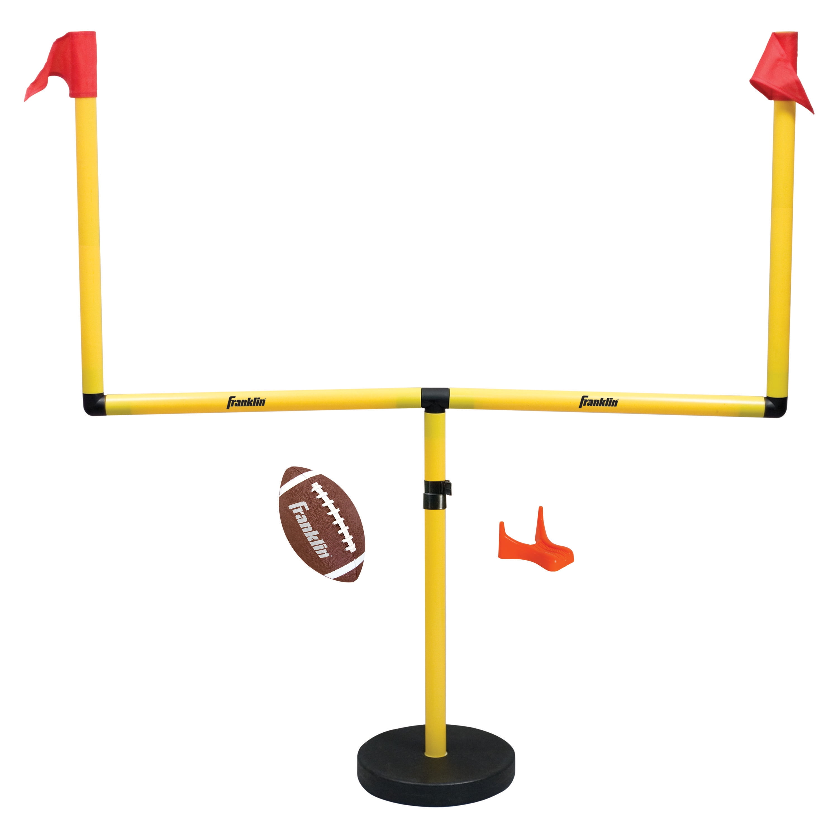
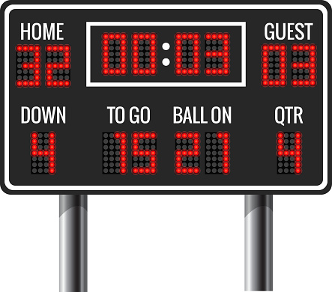
GOAL
OUTCOME

Slide 3

Course Goals
Broad general statements about what you want your students to learn during the course
Larger, overarching descriptions of outcomes for the course in which verbs like “appreciate” and “understand” are appropriate.
Example: A sample course goal might be:
“Students will understand the effect of immigration on American culture after the Civil War.”

Slide 4
Assignment Goals
Assignment goals form the foundation of the class.
Assignment goals are written from a student’s point of view and describe what the student will be able to do as a result of completing the assignment.
Specifies a behavior, skill, or action that a student can demonstrate in some way
Many specific task-based assignment goals need to be written in such a way that show they are measurable by some sort of assessment.
An effective assignment will explain expectations for student performance of the assignment goal.

Slide 5
Assignment Goal COnsiderations
To ensure that learning goals are student-centered, the goals might appropriately complete the statement “The student will…”.
The choice of an effective action verb is of utmost importance.
The level of knowledge or skill desired as described in Bloom’s taxonomy will inform the choice of verb.
Higher order/Lower Order: “identify” is a low level of understanding, while “synthesize and analyze” represent a deeper level of learning.

Slide 6
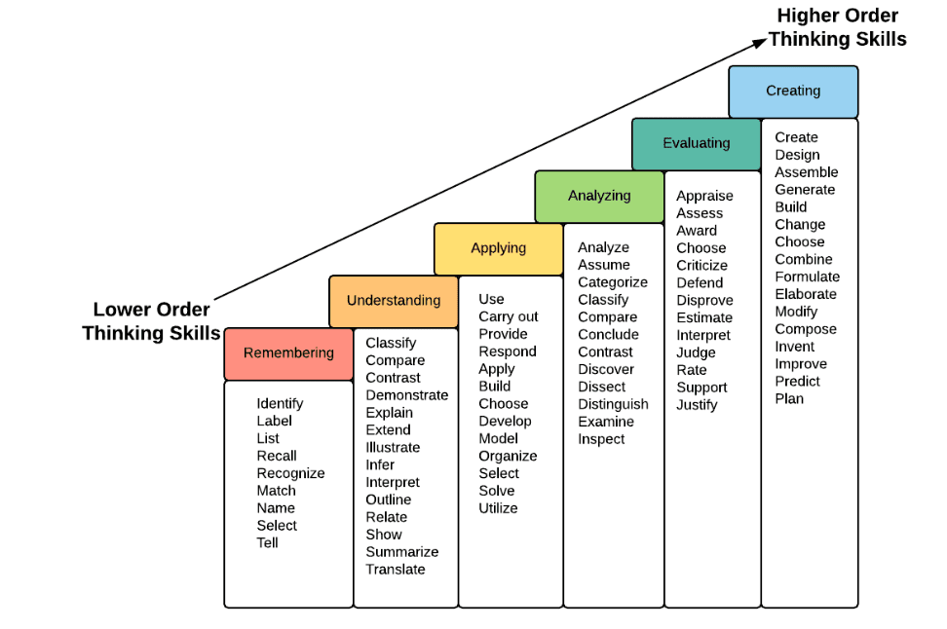
Bloom’s Taxonomy

Slide 7
Creating Goals To outcomes
Not all assignment goals have to be quantifiably measurable, such as understanding, appreciating, empathizing. Moving goals to outcomes can be challenging—but it is worth it because that how you determine what you are looking for in the student submission. Once you know what you want to assess, you can create assignment outcomes.
Outcomes are observable actions/verbs. Here’s a good formula for writing assignment outcomes: Start your assignment/learning goals by writing. . .
By the end of the course, students will be able to:
Choose an action verb that corresponds to the specific action you wish students to demonstrate
Explain the knowledge students are expected to acquire or construct
Explain the criterion or level students are expected to reach to show mastery

Slide 8
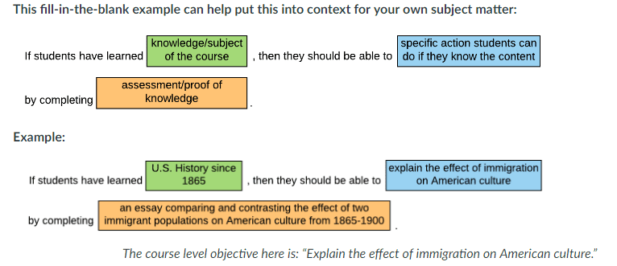
Template for Assignment Goals
If you cannot logically fill in the last blank of this example (assessment), then the goal may not be measurable.

Slide 9
Questions for Working Backwards
Why should your students write? What kind of assignment reflects the course goals? Do you want them to demonstrate content knowledge or learn genre conventions, primarily? What do you want final products to look like? State goals for meeting final product clearly and concretely. What is the purpose of the assignment? What writing project aligns with how you teach? How can you be explicit about the Rhetorical Situation they are writing in: Purpose, Audience, Context, Genre, etc.
How can you scaffold actions/tasks? (research, note-taking, drafting, revising, editing) Do you need to further break down the process and make each task clearly identified with relevant steps?

Slide 10
The Actions of Empathy
Listen actively
Demonstrate focused attention with direct and prolonged eye contact
Not interrupting when someone else is speaking
Repeat back what was heard using “what I heard you say” statements
Personalize communication
Regulate vocabulary depending on audience
Know and use other languages (ASL, Spanish, etc.)
Learn and use people’s names
Offer to help
Understand your bandwidth and notice the bandwidth of others
Understand your skillset and the skillset of others
Share your skills where and when it is appropriate
Consider different perspectives
Know your own perspective
Know or be willing to learn the assumptions you make in your perspective
Understand how context influences perspective
Understand how culture influences perspective
Validate the feelings of others (show respect for different perspectives)
Use verbal expressions that acknowledge the observable reality
Play the “believing” and not the “doubting” game
Separate your feelings from the feelings of others
Ask questions
Collect data before reaching conclusions
Inquire about uncertainties

Slide 11
grading the actions of empathy
 | Yay | Meh | Boo
Listens Actively | Demonstrates focused attention with direct and prolonged eye contact; doesn’t interrupt when someone else is speaking; repeats back what was heard using “what I heard you say” statements. | Sometimes demonstrates focused attention with direct and prolonged eye contact; occasionally interrupts when someone else is speaking; sometimes repeats back what was heard using “what I heard you say” statements. | Rarely demonstrates focused attention with direct and prolonged eye contact; interrupts when someone else is speaking; rarely repeats back what was heard using “what I heard you say” statements.
Personalize Communication | Regulates vocabulary depending on audience; uses people’s names. | Attempts to regulate vocabulary depending on audience; sometimes uses people’s names. | Does not regulate vocabulary depending on audience; rarely uses people’s names.
Offers to help | Shares skills where and when it is appropriate
Considers different perspectives | Willing to recognize own assumptions; understands how context and culture influence perspective.
Validates the feelings of others | Acknowledges observable reality; separates own feelings from the feelings of others
Ask questions | Collects data before reaching conclusions; inquires about uncertainties.

Slide 12
The ATTRIBUTES OF GOOD WRITTEN COMMUNICATION
Clarity
Main points are present and easy to understand
Minimal to no ambiguity
Conciseness
Information is straightforward and succinct
Word choice is precise
Extra words that don’t add meaning have been removed
Relevance
Content is pertinent to the audience and the issue
Content delivery is crafted with an understanding of the audience
Unity
All paragraphs discuss aspects of the main topic
All sentences within a paragraph support the Topic Sentence
Coherence
Logical flow of information
The sentences and paragraphs are logically connected
e
Engagement
Has an interesting “hook”
Incorporates appropriate “rhetorical appeals” (ethos, pathos, logos)
Tells a relevant story
Genre
The content is consistent with the type and purpose of the writing writing
The format is consistent with the type and purpose of the writing writing
The style is appropriate with the type and purpose of the writing
Correctness
Minimal errors in grammar and punctuation
Appropriate citations

Slide 13
grading the Attributes of Good Written Communication
 | Yay | Meh | Boo
Clarity | Main points are present and easy to identify. | Some parts of the document have easily identifiable main points, while other parts have no identifiable point. | Difficult to identify main points.
Conciseness | Information is straightforward and succinct; word choice is precise. | Information is occasionally straightforward and succinct; word choice is sometimes precise. | Information is not straightforward and succinct; word choice is imprecise.
Relevance | Content is pertinent to the audience | Content is sometimes pertinent to the audience | Content is rarely pertinent to the audience
Unity | All paragraphs discuss aspects of the main topic; all sentences within a paragraph support the topic sentence. | Some paragraphs discuss aspects of the main topic; some sentences within a paragraph support the topic sentence. | Few paragraphs discuss aspects of the main topic; few sentences within a paragraph support the topic sentence.
Coherence | Demonstrates logical flow of information by having sentences and paragraphs logically connected. | Sometimes demonstrates logical flow of information by having sentences and paragraphs logically connected. | Rarely demonstrates logical flow of information by having sentences and paragraphs logically connected.
Engagement | Includes and interesting “hook,” appropriate appeals, and a relevant story. | Includes only two of the following: an interesting “hook,” appropriate appeals, and a relevant story. | Includes one or none of the following: an interesting “hook,” appropriate appeals, and a relevant story.
Genre | The content, format, and style are appropriate for the type of writing. | The content, format, and style are somewhat appropriate for the type of writing. | The content, format, and style are not appropriate for the type of writing.
Correctness | The writing contains few to no errors in grammar and punctuation. | The writing contains a moderate number of errors in grammar and punctuation. | The writing contains so many errors in grammar and punctuation that meaning is impeded.

Slide 14
Abstract goals
Open Mindedness | Creativity
Critical Thought | Information Literacy

Slide 15
KEY COMPONENTS of CREATIVITY
What Kind of Creativity?
Scientific
Artistic
Everyday
Novelty
Usefulness
Divergent Thinking
Convergent Thinking
Imagination
Flexibility

Slide 16
KEY COMPONENTS of Critical thinking
Identifies the issue
Identifies one’s own perspective
Recognizes other perspectives
Questions or recognizes assumptions
Considers the influence of context
Gathers, evaluates and marshals evidence
Draws conclusions and predicts implications

Slide 17
KEY COMPONENTS of OPEN-MINDEDNESS
Listens actively
Asks questions
Demonstrates flexibility and willingness to change
Seeks out diverse perspectives
Responds to new ideas without immediate judgment
Gathers evidence and weighs it fairly
Explores beyond one’s comfort zone

Slide 18
key COMPONENTS of Information literacy
Determines the extent and type of information needed
Implements well-designed research strategies
Accesses information effectively and efficiently from multiple sources
Assesses credibility and applicability of information sources
Use information to accomplish a specific purpose
Accesses and uses information ethically and legally
Understands what counts as evidence within the disciplinary context
Understands what evidence is appropriate in the disciplinary context

Slide 19
GETTING MORE CONCRETE ABOUT CREATIVITY
What are the observable features of “novelty”?
What is created is different or distinct from things that already exist
What is created show a break in the established pattern or norm
What is created offers a new function or feature that did not exist before
Perhaps it is faster, cheaper, or more effective
It may include new colors, shapes, or patterns
… or new sounds, textures, tastes, or visual experiences
It provokes new thoughts or creates new trends
It might disrupt existing paradigms
It offers new ways to interact with technology

Slide 20
GETTING MORE CONCRETE ABOUT open-mindedness
What are the actions of getting students out their comfort zone so that you can SEE it and EVALUATE it?
Trying new activities, hobbies, or tasks
Taking calculated risks (for example, public speaking)
Provide students with the opportunity to do in-class presentations (but not necessarily requiring them to do that).
Showing anxiety
Putting in additional effort
Provide extra credit opportunities
Seeking constructive feedback
Handling criticism well
Provide constructive criticism and measure the degree to which students respond to it by following your suggestions or directions.
Being willing fail
Provide challenging assignments that are graded based on trying something new, not on quality.
Breaking routine
Showing emotional vulnerability

Slide 21
GETTING MORE CONCRETE ABOUT open-mindedness
What are the observable features of “getting out of your comfort zone”?
Trying new activities, hobbies, or tasks
Taking calculated risks (for example, public speaking)
Showing anxiety
Putting in additional effort
Seeking constructive feedback
Handling criticism well
Being willing fail
Breaking routine
Showing emotional vulnerability

