Slide 1
Navigation Overview
By Monica Spicker
2010

Slide 2
Movement and Route Selection (1)
Plan the route
  Mission
  Distance, Terain, Conditions
  Fitness and experience of personnel
  Careful evaluation of maps and photos
  Check points
    Linear features that cross route are best.
  Decision Points
    Places where there is a change in direction
  Catching features
    Know when you have gone too far
  Multiple or alternate routes
  Time

Slide 3
Movement and Route Selection (2)
2. Always Know Your Location
  Directional orientation
  Distance and direction to objective
  Other landmarks or features
  Hazards
  Need good map reading skills!
  Check with GPS: need to know how to determine and how to plot coordinates

Slide 4
Movement and Route Selection (3)
3. Stay on route
  Offsets may be necessary to get around obstacles.
  People tend to drift to one side or the other as well as downhill.
4. Recognize Objective
  Select easily recognized checkpoint close to target.
  Determine distance and direction to target from the checkpoint.
  Determine features that indicate target was missed.

Slide 5
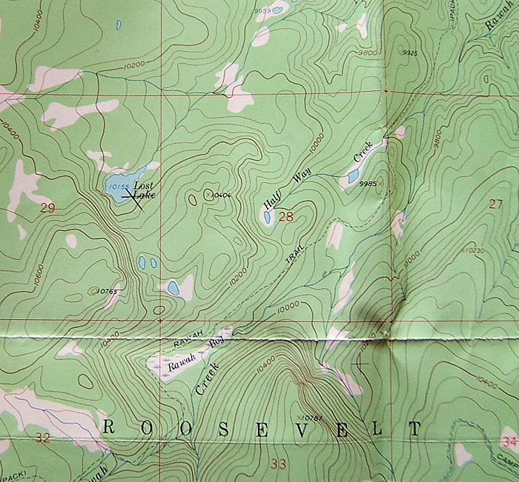
Example
Route goes from Lost Lake to the trail.
Use hilltop as intermediate goal
Use ridge line for safer travel and as a handrail to the trail.
Creek beyond the trail would indicate you missed.
Half Way pond would indicate you veered too far SE. The steep hillside would be another clue.

Slide 6
Offsets
Used to get around obstacles.
  Easiest by turning 90 degree angles
  Turning 60 degree angles and going equal distances on both legs also works.
Accurate compass work and pace needed.

Slide 7
Navigation Techniques: Dead Reckoning
Distance and direction to checkpoints determined from map and followed in the field.
  Map reading, scale, pacing and compass skills!
  Some can be determined before going out.
  Rest are done in the field.
A series of steering marks followed in field.
  At night or poor visibility, this can be someone in front who is directed into the line of travel.
A series of lines from checkpoint to checkpoint (route legs).
  Can readjust at each checkpoint to correct for pace and compass errors.
  Checkpoints can be stored as waypoints, so one can fine tune or find in poor visibility with GPS.
  Do not rely only on GPS!

Slide 8
Navigation Techniques: Terrain Association
Identify and locate selected features on map and on the ground.
  Orient map to terrain
  Slope aspect (which way it faces), shape and steepness.
  Elevation.
  Relative position of landmarks and features (creeks, roads, outcrops, peaks)
Handrail: Parallel to course
  Creeks, ridges, elevation
  Identify and use roads as handrails, even if you cannot travel on them!
Catching feature: perpendicular to course
  When to turn
  When you have gone too far
  When you are close to objective.
Usually use a combination of dead reckoning and terrain association

Slide 9
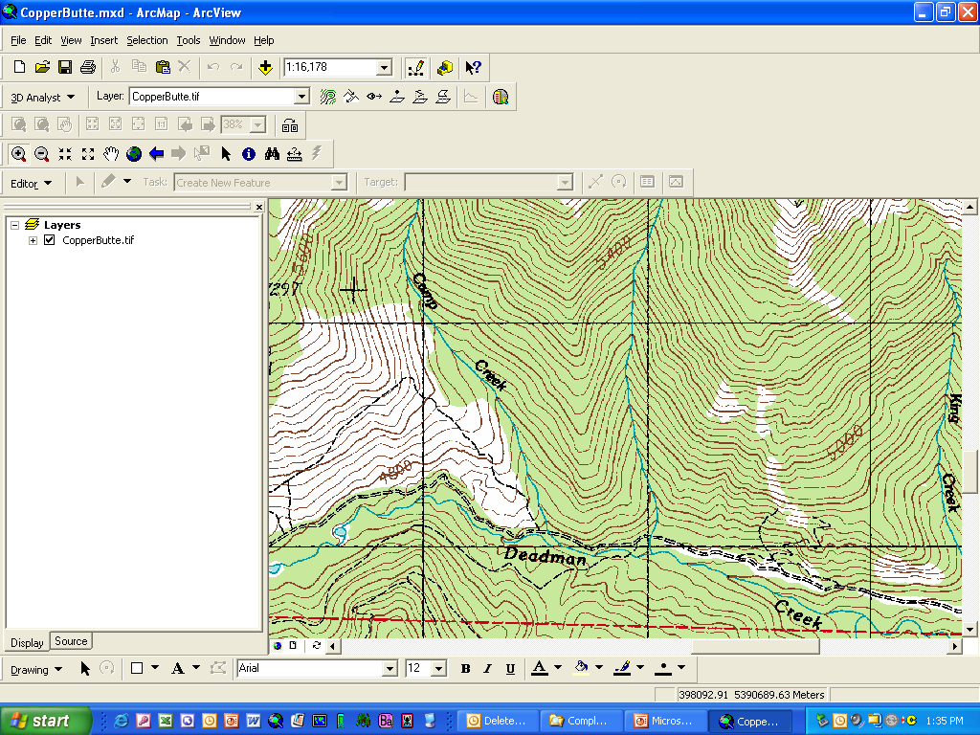
Example of Handrail & Catching Features
Objective
2 Handrails: west of creek but east of ridge (can’t be seen)
5400 ft elevation: catching feature
Turn west.
Use pace and compass &/or GPS waypoint to zero in on target.
planned travel route
Creek = catching feature.
(You missed the pt.)
Deliberate offset: turn at elevation higher than target, so you know you would have to come downhill in all cases.

Slide 10
Other Considerations
Planning:
  Check and decision points
    Pre-identified and marked on a map.
    Set up a table with the coordinates of the points as well as the distance and bearing between the points
    Be prepared to adjust this in the field!
Rally point: Place to gather if separated.
  Identified during planning and in field.
  Regularly designated during mission.
  Can be a checkpoint
Safety direction (“Panic azimuth”)
  Direction that gets everyone to a known feature from anywhere.
Everyone knows their position at all times!
  Get separated from group
  Navigator out of commission
Do not rely on only one instrument or technique.

Slide 11
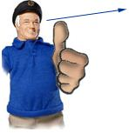
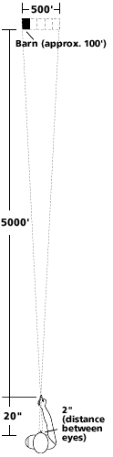
DETERMINING DISTANCE
Rule-of-Thumb Method
YOUR ARM IS ten times longer than the distance between your eyes.
Example, you're standing on the side of a hill, trying to decide how far it is to the top of a low hill on the other side of the valley. Just below the hilltop is a barn, about 100 feet wide on the side facing you.
Hold one arm straight out in front of you, elbow straight, thumb pointing up.
Close one eye, and align one edge of your thumb with one edge of the barn.
Without moving your head or arm, switch eyes, now sighting with the eye that was closed and closing the other.
Your thumb will appear to jump sideways as a result of the change in perspective.
How far did it move? (Sight the same edge of your thumb when you switch eyes).
  Let's say it jumped about five times the width of the barn, or about 500 feet.
  Now multiply that figure by the handy constant 10 (the ratio of the length of your arm to the distance between your eyes), and you get the distance between you and the barn -- 5,000 feet, or about one mile.

Slide 12
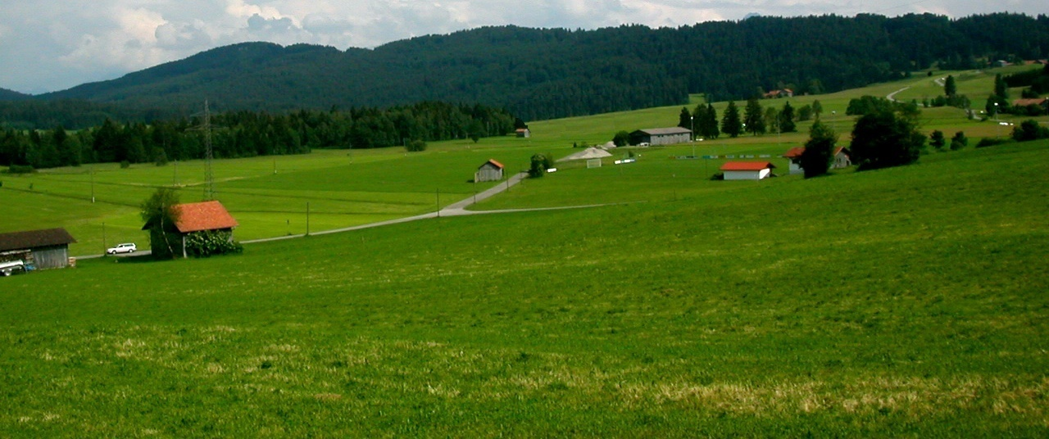


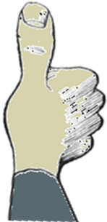
Rule-of-Thumb Method (example)
You estimate that the small barn is 60 feet wide.
You stretch your arm out, put your thumb up and close one eye.
You switch closed eye with open eye.
And find that your thumb moved the distance of two barn widths.
60 x 2 x 10 = 1200 ft
60 ft
1200 ft

Slide 13
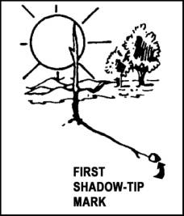
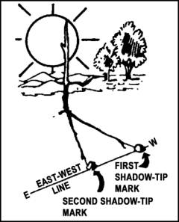
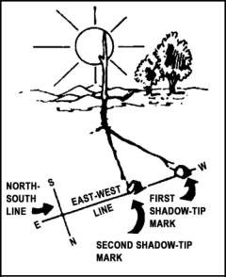
Determining Direction w/o a Compass
Shadow-stick method
Wait 10 to 15 minutes between first and second marks

Slide 14
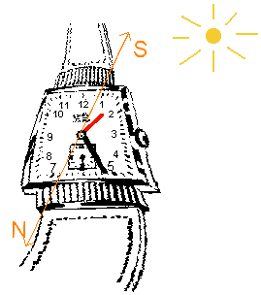
Determining Direction w/o a Compass (Watch method)
The split is NOONWARDS if before 6am or after 6pm.
During daylight savings time, use the 1 instead of the 12!

Slide 15
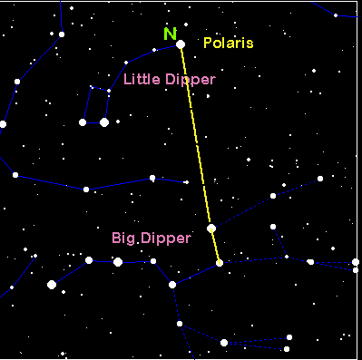
Determining Direction w/o a Compass (at night)

Slide 16
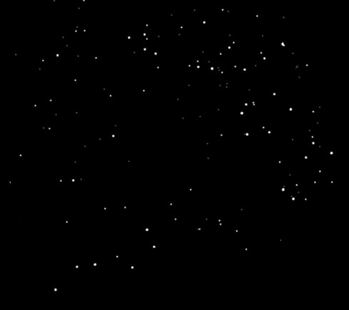
Where is Polaris?

Slide 17
Where is Polaris? (solution)

Slide 18
Using the Mission Planning Worksheet

