Slide 1
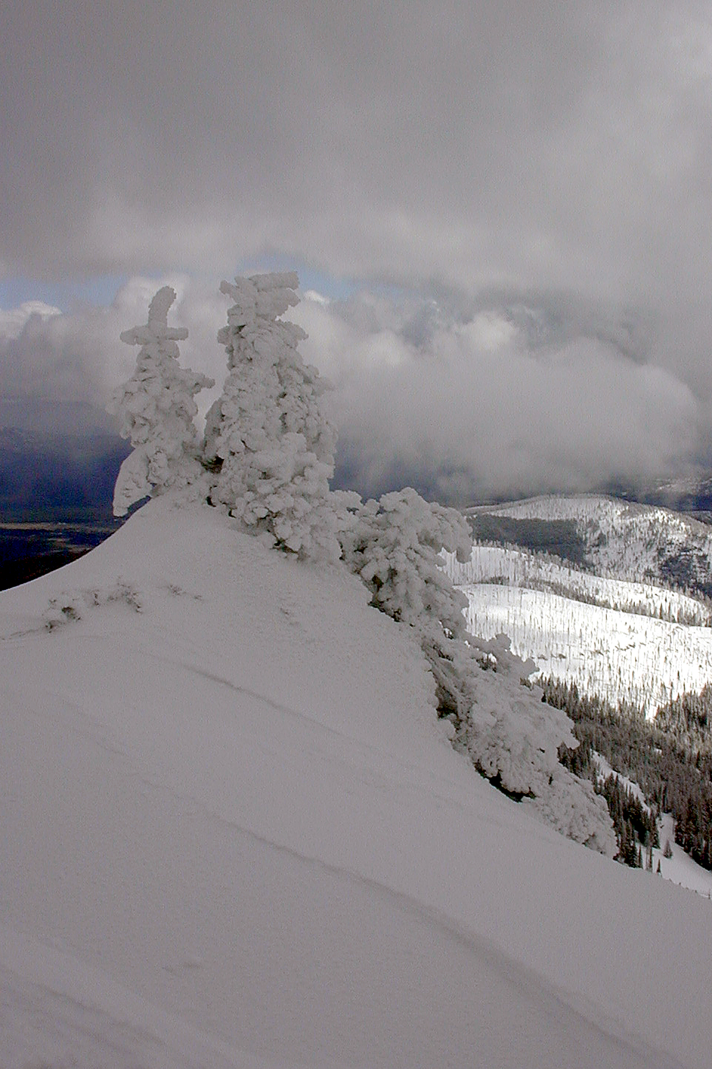
MOUNTAIN WEATHER
Monica Spicker
2008

Slide 2
Objectives
Explain basic causes of weather.
Identify incoming bad weather on the basis of clouds and altimeter readings.
Explain what to do if caught in a lightning storm.
Appropriately take weather into consideration in mission planning.

Slide 3
Causes of Weather
Energy flow along gradient
Temperature differences
Pressure differences
Moisture differences
The bigger the difference, the stronger the wind and other weather effects.

Slide 4
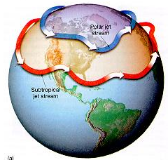
Large Scale Influences
Prevailing Wind: SW.
Jet Stream.
Mountain Ranges.
Ocean and Lakes.
Season.
http://www.crystalinks.com/jetstream.html

Slide 5
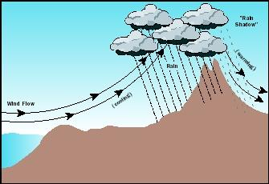
Small Scale Influences
Local topography
Orographic Lifting
Elevation
“Rain Shadow”
“Chinook”
Time of day
Up slope winds in morning.
Afternoon thunderstorms build above ridges.
Down slope winds at night.
Quiet times at sunrise and sunset
Season

Slide 6
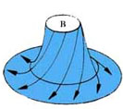
Good Weather
Sinking, stable air
Cool
Dry
High pressure
Counterclockwise air flow (anticyclone)
http://library.thinkquest.org/03oct/01054/Cyclone/cyclone.html

Slide 7
Bad Weather
Rising unstable air
Warm
Wet
Low pressure
Clockwise flow in northern hemisphere (Cyclone)

Slide 8
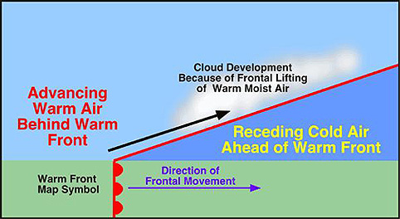
Fronts: Warm Front
Warm air over cool air
Comes slowly
Brings much precipitation
Warms up after passage
http://rst.gsfc.nasa.gov/Sect14/Sect14_1c.html

Slide 9
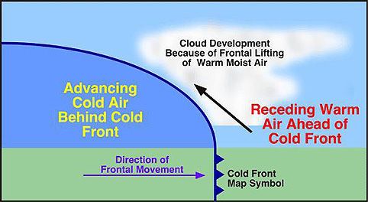
Fronts: Cold Front
Cold air overtaking and coming up underneath warm air
Comes quickly, often violently
Thunderstorms
http://rst.gsfc.nasa.gov/Sect14/Sect14_1c.html

Slide 10
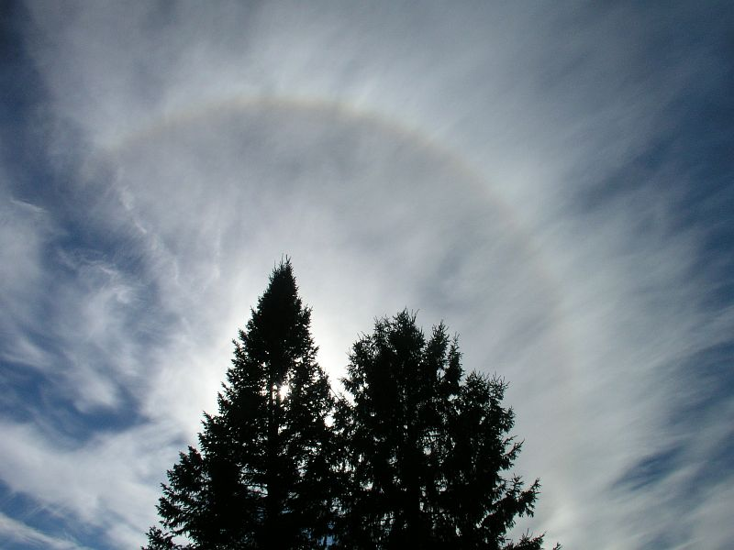
Warm Front Clouds
High clouds
24 to 48 hours
Sun Halo
http://k43.pbase.com/v3/17/317917/1/51687992.PA290515_sunhalo.jpg

Slide 11
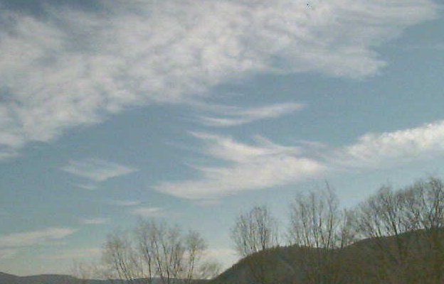
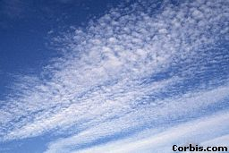
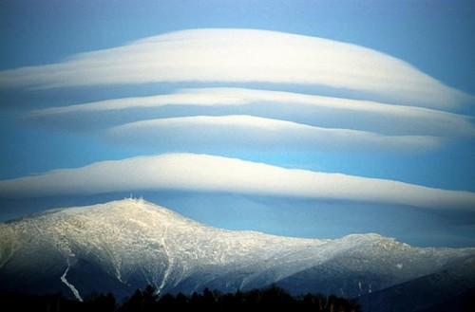
Warm Front Clouds (2)
24 hours
Cirrus & Mare’s Tails
Cirrostratus
Lenticular clouds
http://www.weatherwizkids.com/cloud.htm

Slide 12
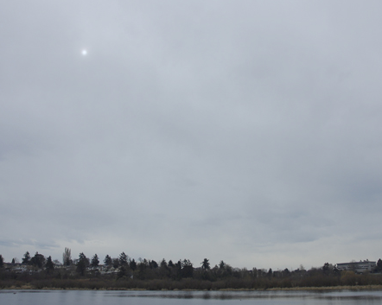
Warm Front Clouds (3)
Middle clouds
12 to 24 hours away!
Altostratus
http://www.weatherwizkids.com/cloud.htm

Slide 13
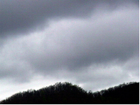
Warm Front Clouds (4)
Low clouds
Warm front is here!
Nimbostratus and nimbocumulus
Rain or snow
http://www.weatherwizkids.com/cloud.htm

Slide 14
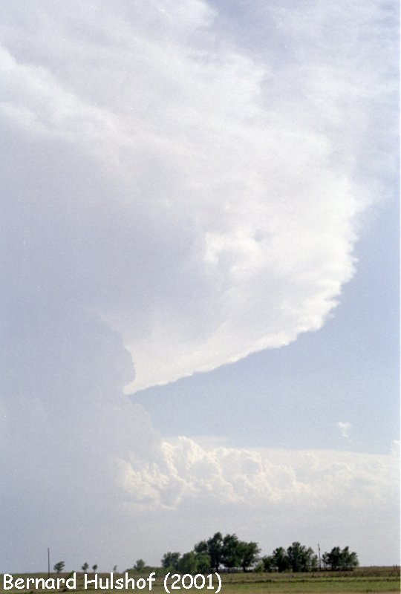
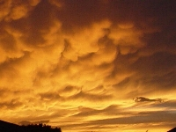
Cold Front Clouds
Cumulonimbus
Sudden uplift – very unstable
Reaches to stratosphere – anvil shape
Irregular, direction changing winds
Rain, hail, sleet, lightning
Mammutus clouds are associated with severe winds and tornadoes.
http://www.weatherwizkids.com/cloud.htm

Slide 15
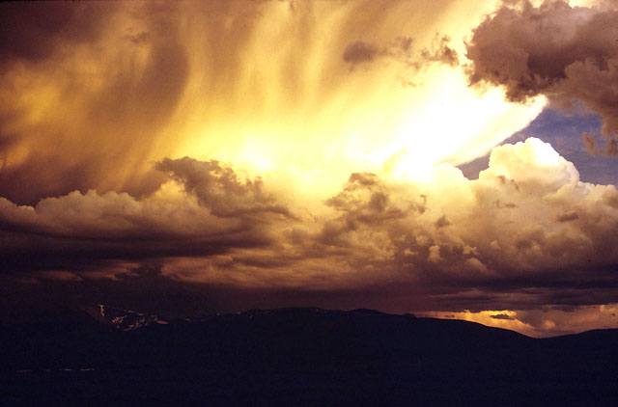
Clouds Tell the Tale!
Photo by Fred Spicker, 1973
Cumulonimbus buildup from orographic lifting

Slide 16
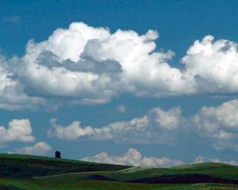
Other Clouds
Cumulus = “Fair weather clouds”
Actually indicate high humidity and unstable air
Can develop into local storms.
http://www.erin.utoronto.ca/~w3gibo/How%20to%20do%20field%20studies/weather_data1.0.htm

Slide 17
Lightning Safety
Stay alert for signs of thunderstorm development.
Bolt can go up to 10 miles!
Don’t stand near tall objects, hilltop or terrace edges.
Go down hillside
Stay away from vertical rock walls and caves.

Slide 18
Lightning Safety (2)
Go to lowest point
Remove metal objects.
Stay away from others.
Minimize ground contact.
Make yourself small & compact.

Slide 19
Other Signs of Approaching Bad Weather
Altimeter reading rises in a given place means low pressure system approaching.
Changing direction and strength of winds.
Low = shift from N, NE to SE; increasing speed.
Cold front = shift from SE to SW
High = shift from SW to N

Slide 20
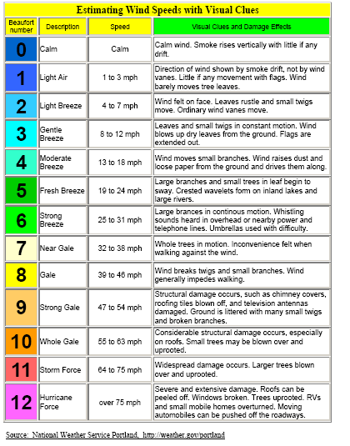
Estimating Wind Speed

Slide 21
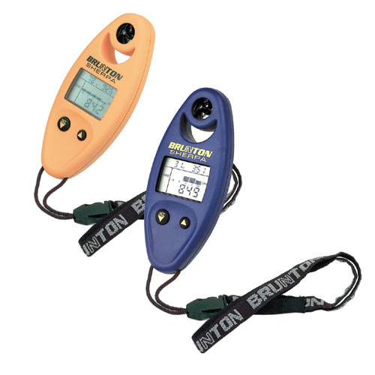
Other Considerations
Weather patterns prior to trip
Current forecast
Use altimeter
Monitor clouds and temperature changes.

Slide 22
Where to Get Forecasts
NOAA National Weather Service (http://www.nws.noaa.gov/)
Meteorological Service of Canada (http://www.weatheroffice.ec.gc.ca/)
State and Province DOT
Weather Underground – worldwide (http://www.wunderground.com/)
Forest Service Fire Weather
Local news or newspaper

