Slide 1
Maps: An Overview
By Monica Spicker
2012

Slide 2
Objectives
Identify different types of maps
Identify elements of maps
Use scale ratio and scale bar to determine distance
Identify terrain features from contours
Determine elevation
Match map features to real features in the field.
Identify hazardous slopes via contours by aspect, shape and steepness.

Slide 3
Types of Maps
Planimetric
Flat surface – no geographic features
Road maps, ownership maps, tourist maps.
Topographic
Terrain represented via contour lines
Other geographic features such as rivers, seasonal creeks, permanent snowfields, vegetation, etc.

Slide 4
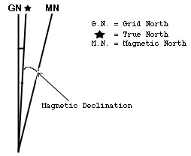
Elements of Maps
North
True
Magnetic
Grid
Scale
Scale bar
Scale ratio
1 ruler unit on map = RF ruler units on the ground
1: 24000 means 1 map inch = 24000 ground inches
or 1 map cm = 24000 ground cm.
Need to convert ratio ruler units to ground units or ground units to map inches to use correctly!

Slide 5
Elements of Maps (part 1)
Legend
Not all symbols mean the same thing
Certain cultural biases
Grid systems
Alphanumeric
Public Land Survey System (PLSS or “legals”)
Geographic (Latitude/Longitude)
Universal Transverse Mercator (UTM)

Slide 6
Elements of Maps (part 2)
Date
A map is a snapshot in time.
Datum
Essential for GPS use – will discuss later
Contour Interval
Needed to determine elevations on a topographic map and to assess steepness.
General area of map
The bigger picture

Slide 7
Finding Distances

Slide 8
Using the Scale Bar
Use a string (careful not to stretch), paper edge, chain or special wheel to determine total length of trail, road, feature, etc.
Lay down against the scale bar to determine total distance.
Be careful of where 0 is on the scale bar!
About 750 meters

Slide 9
Using the Scale Ratio
Decide map units (ruler units) you will be using: inches or cm
Convert the RF to the desired ground units (usually feet, miles, meters or kilometers) based on the ruler units to be used.
Measure the distance on the map and multiply by the converted RF for total distance.
Example: Scale ratio = 1:10000. Will measure in cm and want the distance in meters.
10000/100 cm per meter = 100 m.
Measure a road that is 5.3 cm long.
5.3 * 100 = 530 m of road.

Slide 10
Measuring Distance in the Field
Time – hard to estimate unless well practiced
Pacing – also takes practice.
1 pace = 2 steps
Changes with conditions, terrain and footwear
Know pace in terms of meters or feet
Pace out intervals not entire distance
Use pacing beads to keep track.
On team maneuvers, common to use one person as pacer and another to run compass.
Should be able to do both compass and pace work.
Example: Want to go 970 meters.
Pace is 60 paces per 100 meters.
Pace out 100 meters 9 times, keeping track with pacing beads each time complete 100 meters.
Pace final 70 meters to objective.

Slide 11
Some map and scale exercises!

Slide 12
Understanding contour maps.

Slide 13
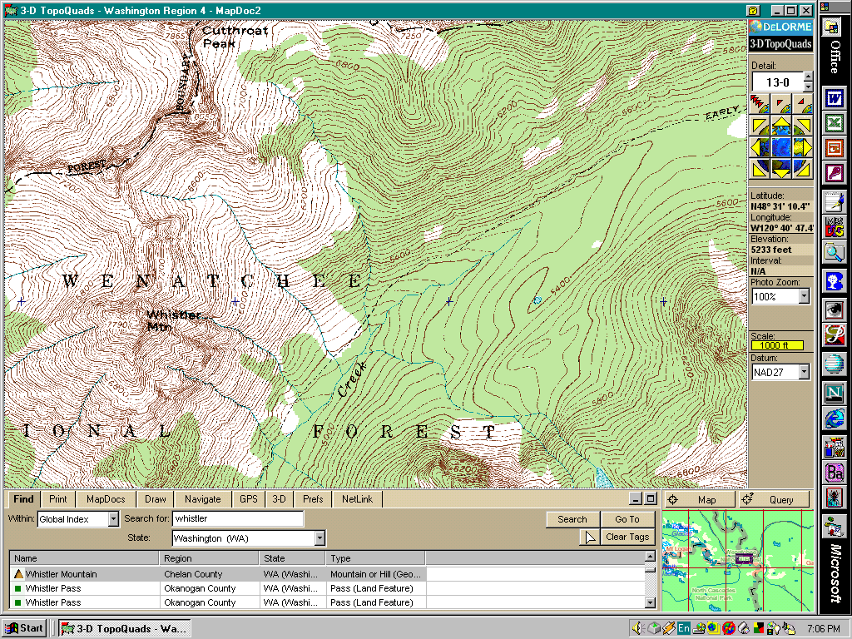
A portion of a contour map
Viewpt

Slide 14
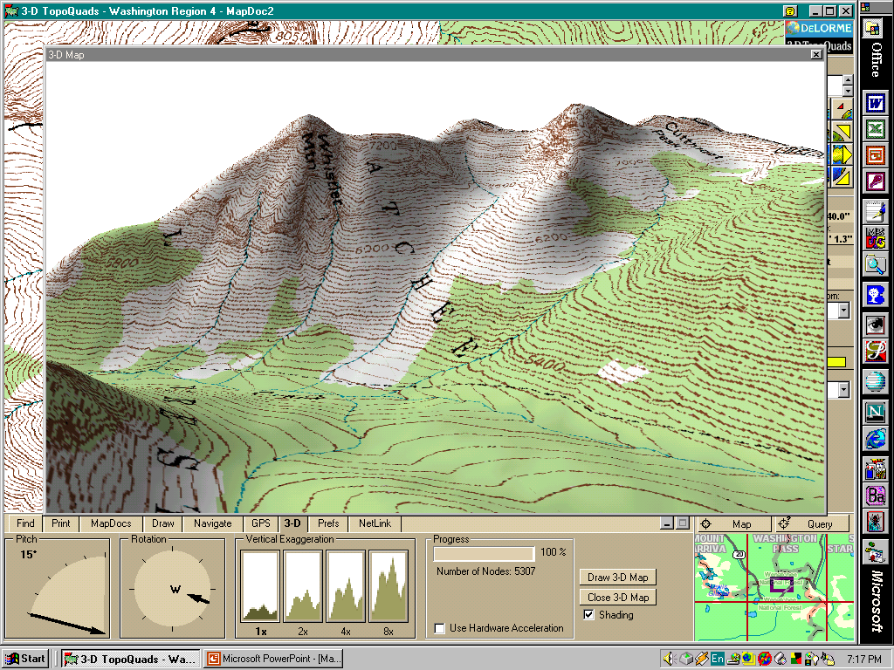
3-D Version of the same map

Slide 15
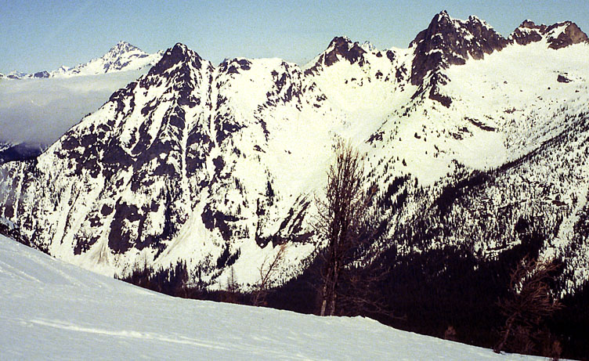
The Real Thing

Slide 16
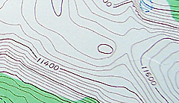
What are contour lines?
Lines of equal elevation.
Brown on land, blue on glaciers and snow fields.
Every fifth line darker, many are labeled.
primary contour.
Four lighter lines between
Change in elevation between any two lines: contour interval (elevation change).
Difference in elevation between 2 primaries divided by 5 = contour interval.
39 foot cliffs can hide between 40 ft intervals!
“Flat” trails can rise and fall.
What is the contour interval?

Slide 17
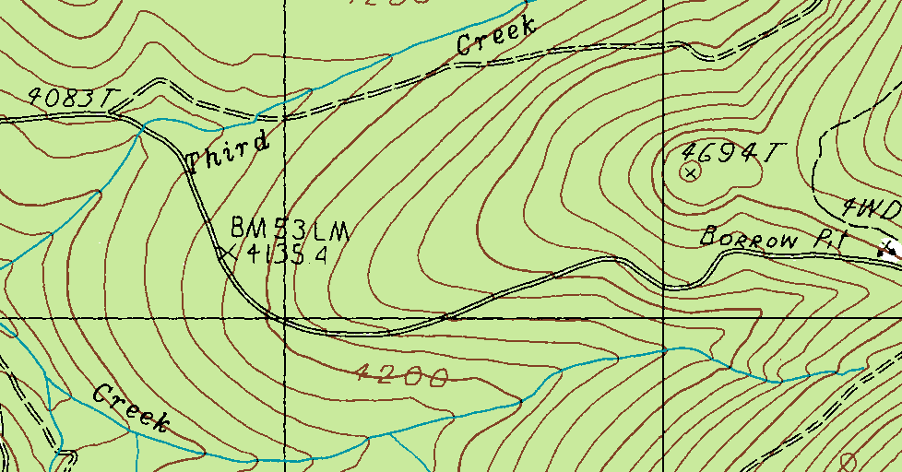
Determining elevations
Benchmark
Surveyed point; temporary
Spot elevation
Some points have labeled elevations
Points between contour lines are interpolated (usual to estimate at ½ interval)

Slide 18
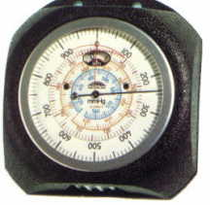
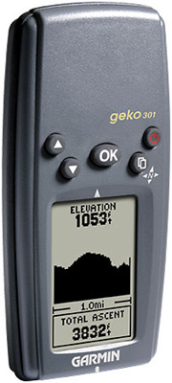
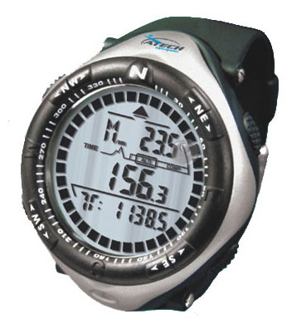
Determining elevations in the field
Barometric altimeter
Analog
Digital
Must be reset often
Sensitive to weather
GPS
Computed elevation can be off because of the Earth model used.
Some GPS also have barometric altimeters.

Slide 19
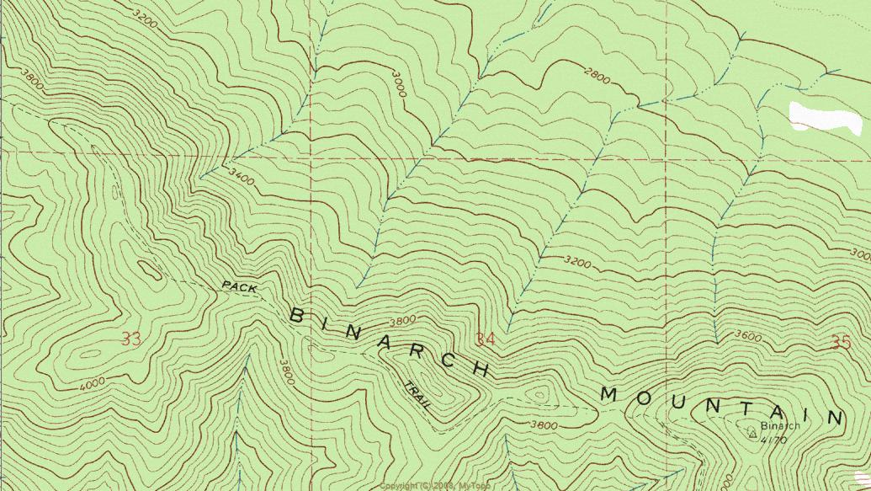
Features Shown by Contours – Example 1
Viewpt
Steep
No trees
Flat
Forested
Trail

Slide 20
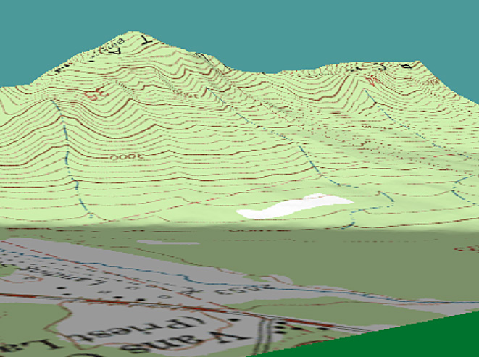
3-D Version of the same map – Example 1
Forested
Trail
Steep
No trees
Flat

Slide 21
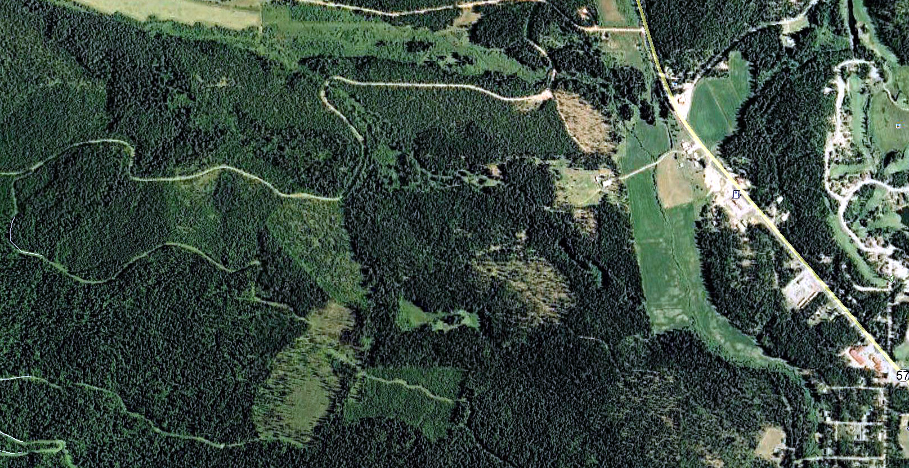
Google Earth image
Are all the places indicated on the map as forested still forested?
This is why map date is important!

Slide 22
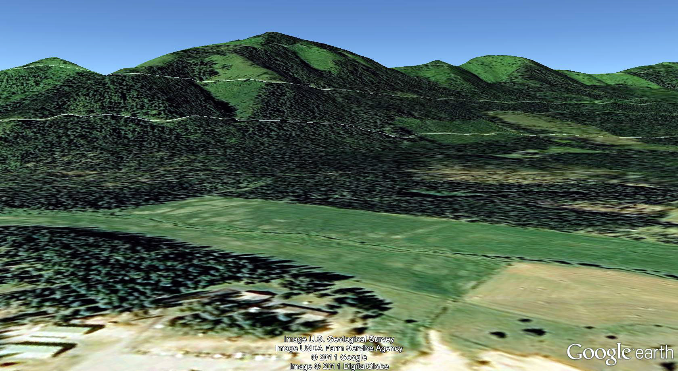
Google Earth 3-D image

Slide 23
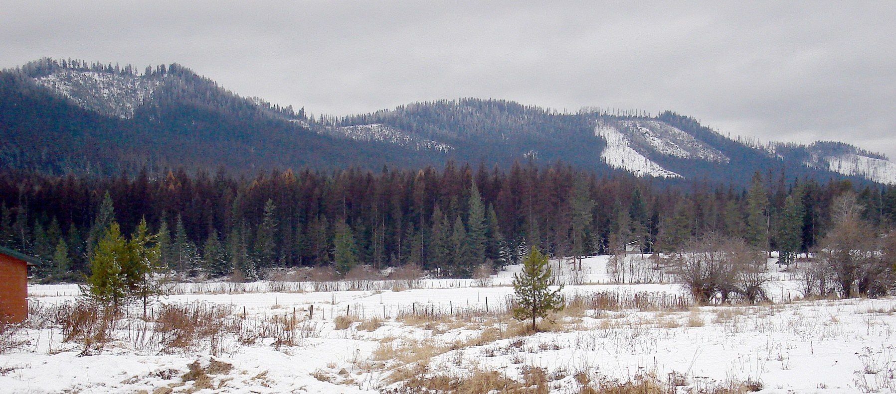
Photo taken Dec 2011

Slide 24
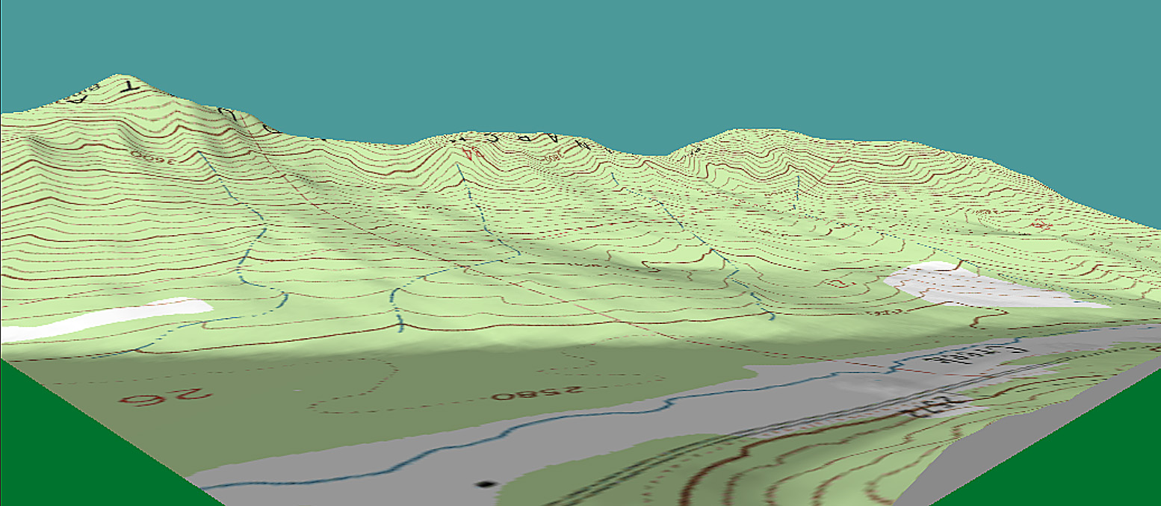

A comparison between a topographic map and a picture of the same location

Slide 25

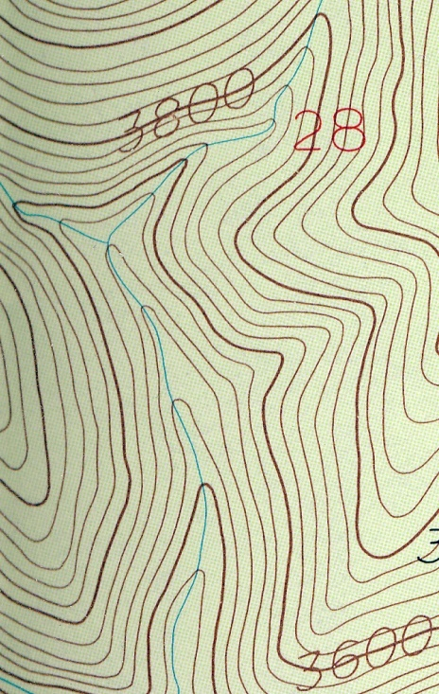


Slope features
Hilltop – full circle
Saddle
2 contours bend away
Ridge:
“point” downhill, usually rounded.
Draws & Creeks:
Point uphill,
usually sharp.

Slide 26
Features Shown by Contours – Example 2
Seasonal Creek
Ridge
Draw or gully
Viewpt
Saddle
Hilltop

Slide 27
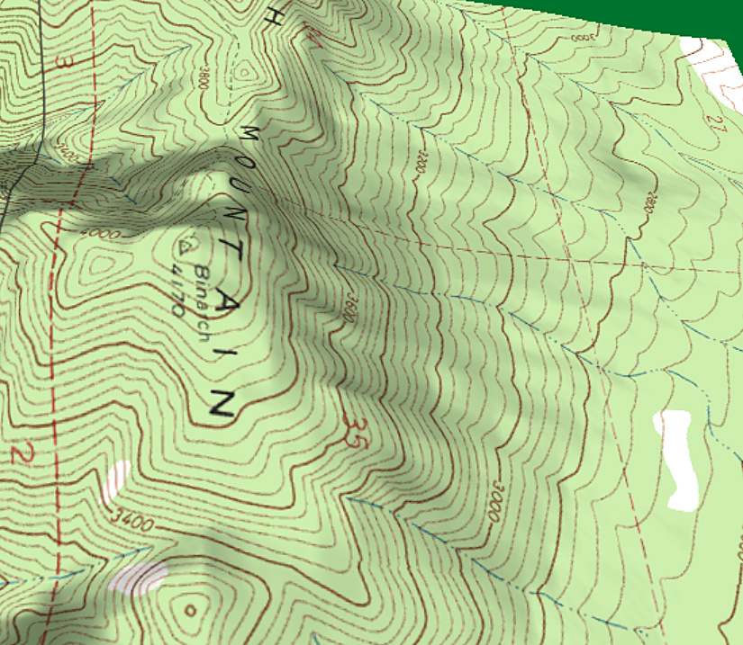
3-D Version of the same map – Example 2
Saddle
Seasonal Creek
Hilltop
Ridge
Draw or gully
Notes:
View is different from the pictures because when you look at the contours backwards, i.e., from the south, the ridges and gullies invert!

Slide 28

Match the contours to the features! Vegetation can obscure features.

Slide 29
Contours matched to features

Slide 30
Practice with contours

Slide 31
Slope Aspect: which direction a slope faces
Draw arrow perpendicular to contours and down hill (Fall Line).
That direction is the aspect!
E
S
W
N

Slide 32
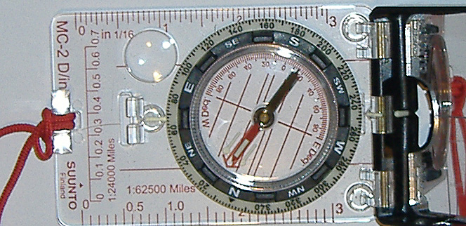
Using compass to measure aspect in the field
Face away from the hill (back to the hill)
Hold compass in front of you and rotate dial until “Red Fred” (the needle) in in the “Shed” (red outline arrow in base plate).
Reading at hinge is the aspect. (in this case W, SW)

Slide 33
Slope Shape
Convex slope: flat on top, steeper towards the bottom.
Concave slope: Steeper at top, flatter towards the bottom.
These patterns are typical of avalanche paths!

Slide 34
Slope Shape (3-d)
Convex
Concave
Possible avalanche paths

Slide 35
Dangerous Slopes
Most avalanches occur on 25 to 45 degree slopes.
N and NE aspects are more avalanche prone in midwinter; S and SW slopes in spring.
Prevailing winds are from the SW: NE slopes are leeward and loading areas.
Convex slopes more dangerous than concave.

Slide 36
Slope angle
Fall Line: line perpendicular to the contours.
Depends on contour interval and map scale:
1:24000, 40 foot contour
20º: 19 contours per inch
30º: 29 contours per inch
40º: 42 contours per inch
Use grid

Slide 37
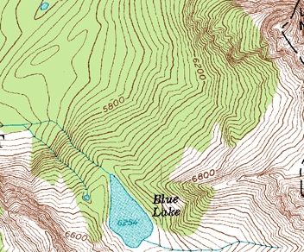
Slope angle: Using the Grid

Slide 38
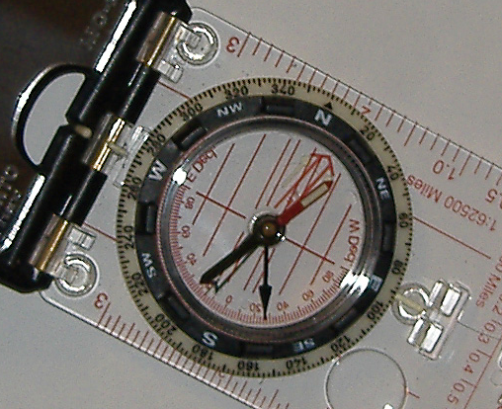
Using compass to measure slope in the field
Dial compass to west at the hinge.
Hold compass at same angle as the slope, with the declination scale at the bottom.
Where the black swinging needle points is your slope angle in degrees.
(in this case 27º)

Slide 39
More contour and elevation exercises.

