Slide 1

GPS Basics
by Monica Spicker
2010
Some figures are copyrighted and used with the kind permission of Dr. Peter H. Dana.

Slide 2
Objectives
Student will
Understand how GPS basically works
Understand the limitations of GPS
Describe common error sources
Correctly setup a receiver
Input waypoints in the classroom and in the field
Navigate to points in the field using a variety of techniques.

Slide 3
Rule To Remember!
A GPS receiver is an accessory, NOT A REPLACEMENT for a map, compass altimeter and good, basic navigation skills!

Slide 4
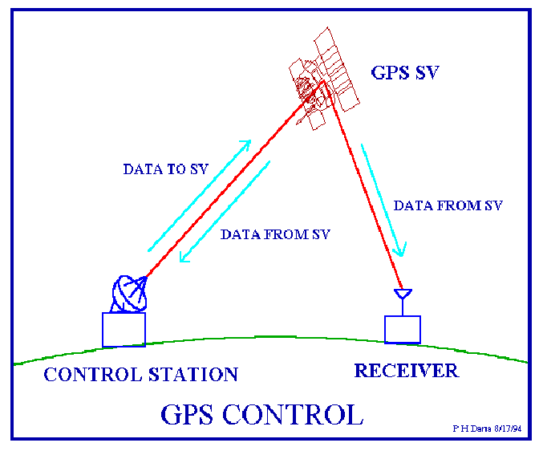
Parts of a GPS System

Slide 5
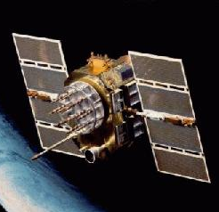
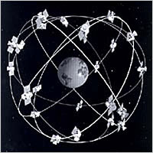
Satellites
About 31 satellites
Very high orbits
Several replaced every year.
6 orbital planes ensure at least 4 or more satellites available at almost all times.
There is a large gap to the north.

Slide 6

Receiver
100 – 500$
10+ meter accuracy
Computer cable
Download and upload maps, routes and waypoint.
Upgrade over the internet
Computer Mapping Software
Can map out tracks and waypoints
Can plan and upload routes, tracks and waypoints
Receivers may also have
Digital compasses
Barometric Altimeters
FRS Radio
Other features.

Slide 7
Hints
Check batteries and settings before setting out.
Use lithium batteries when available.
Practice with and know all needed screens on your receiver.
Have all your screens set the way you want them
If possible, set up trip screen to include both UTM and latitude/longitude fields.
Clear out old tracks, unneeded waypoints.
Organize waypoints by name and symbol for easier management.
Calibrate the compass and altimeter, if you have them.
Have all navigation equipment together and readily available.
Tie your navigation equipment onto yourself.

Slide 8
Three okay, four or more better
3 satellites are needed to acquire a position fix. (2D mode)
4 satellites are needed for an accurate position and to get elevation. (3D mode)
More satellites are really needed because of errors that arise from a variety of sources.
Satellite positions (geometry)
Weather
Multipath
Timing errors
Typical error is 10+ meters.
All GPS are 12 channel: can receive up to 12 satellites

Slide 9
Ideal Satellite Geometry
N
W
E
S

Slide 10
Poor Satellite Geometry
N
W
E
S

Slide 11
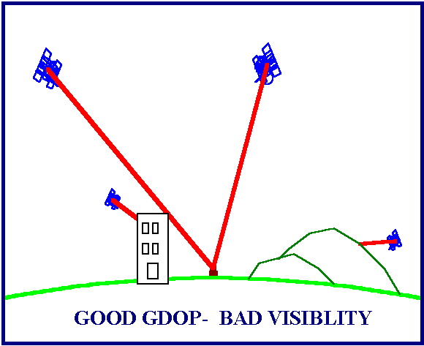
GPS cannot “see” through objects!
Some of the newer satellites and receivers can receive through thinner solid objects like cars, building walls and forest canopy.
Terrain and larger buildings are still too big.

Slide 12
Multipath Error
A signal that bounces of a smooth object and hits the receiver antenna.
Increases the length of time for a signal to reach the receiver.
A big position error results.
Gravel roads
Open water
Snow fields
Rock walls
Buidlings

Slide 13
Initializing the receiver
Setup : *CRITICAL!
Map Datum*
Grid System*
It is possible to create your own grid and or datum!
Distance units
Other features or options
If you have a digital compass, set it to kick in at under 2 mph speed
Calibrate compass and altimeter, if receiver has them.

Slide 14
Map Datums
Earth model to reference and compute coordinates
GPS based on World Geodetic System 1984
(WGS 84)
USGS quad maps based on North American Datum 1927 (NAD27)
Some US maps are based on NAD83 (=WGS84)
Canadian maps are based on NAD83
Other countries have their own datums
GPS Receiver set up must match map.

Slide 15
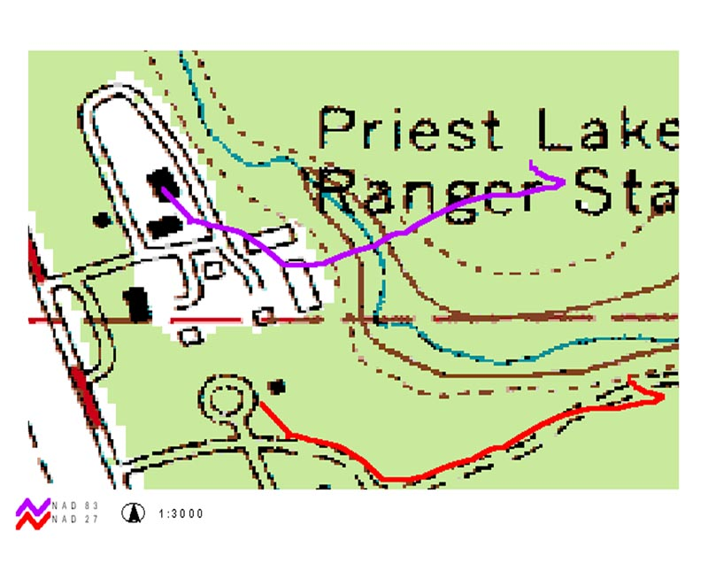
What happens when datum is not set correctly!

Slide 16
Elevations
GPS uses Height Above Ellipsoid (HAE)
Elevations on a map are based on mean sea level shape (HAG)
Can be very different and you won’t know where or when it’s different and by how much.
Satellite geometry error increases elevation error.
DO NOT USE GPS ELEVATIONS FOR CRITICAL NAVIGATION DECISIONS.
GPS receivers with barometric altimeter use both methods.
Set to fixed,
Barometric altimeters still need to be regularly calibrated at a known elevation.

Slide 17
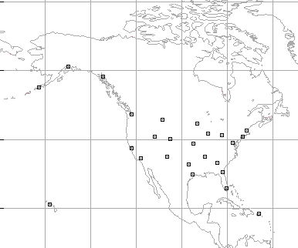
WAAS
Wide Area Augmentation System
25 ground reference stations in US monitor GPS satellite data and calculate corrections.
The correction is broadcast through one of two geostationary satellites.
Currently, WAAS coverage is only in US and parts of southern Canada.
Any receiver with a WAAS antenna can receive the signal.
Must enabled through setup.
Uses up batteries
Doesn’t always give best results.
Uses up to 4 regular satellite channels.

Slide 18
What Receivers Record
Track Logs
Collected any time receiver is on.
Should be cleared before each mission
Overwrites previous positions, if track memory is full
Tracks
Track logs can be saved for reuse
Not as much detail as log
Can be drawn on computer map and uploaded
Waypoints
Stored or entered locations
Routes
Set series of waypoints
Less detail than a track

Slide 19
Navigating
Need to have stored waypoints.
Travel is in a straight line from waypoint to waypoint (route). Can also be a track you uploaded and follow.
Feedback is distance and direction – compass and pace may be more efficient.
Can use to check progress and whether you are still on track.
Can save waypoints along the way and follow back (reverse route).
Straight line may not be safest - use a map when planning or to double check!

Slide 20
Planning a Navigation Route
= Waypoint
Start

Slide 21
GPS Navigation Strategies
Receiver downloads new position every 5 to 30 seconds.
“Compass” may jump
Best to follow hand compass or electronic compass rather than GPS compass.
If receiver has electronic compass, set it so it will kick in at under 2 mph.
As long as distance is decreasing, you are going the right direction.
Can select easier terrain to increase travel speed.

Slide 22
Use Basic Navigation Techniques!
Target
Better:
Follow road (or handrail it) until distance starts to increase. Now follow GPS the shorter distance into the target.
If curve is easy to identify, can use GPS to navigate road to this checkpoint and then use compass and pace into target from here.
Okay:
GPS “track” if just following it in nav mode
Start

Slide 23
Garmin Basics
There are differences between models as well as between brands.
Basics are the same.
Should sit down with instruction booklet and learn all the functions.

Slide 24
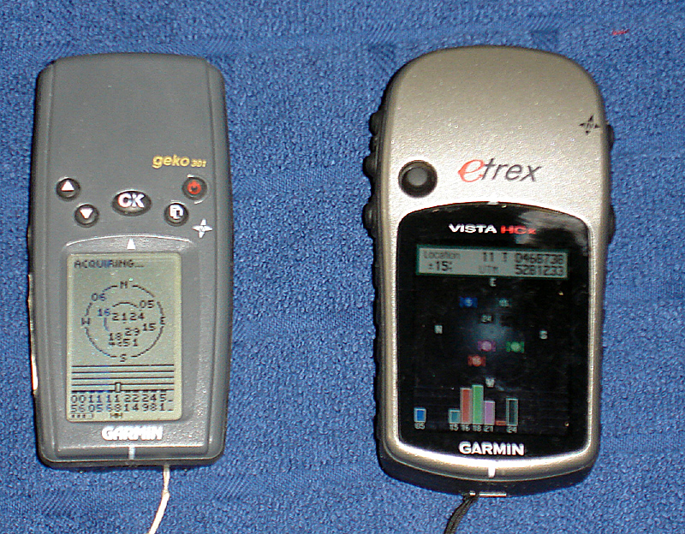
The Parts
On/Off
Turn Backlight on off
Page key to switch screens
Toggle between fields.
Left side of etrex: up down keys and find or zoom key.
Depends in which screen you are.
Enter. Push straight down on etrex. Holding enter will create a waypoint.

Slide 25
Backlight
Needed at night
Turn on and off by pushing power switch.
On some, only one level, on others settable. Should set at lowest level to see.
Some will go to full brightness if power is pushed again – be careful!

Slide 26
The Screens
Other makes will have similar screens and functions
Basic screens:
Sky View
Map View
Trip Log
Main Menu
Other screens
Compass view – always on some, only during navigation on others.
Elevation screen – only if unit has an altimeter
Most screens have sub screens to allow you to pick what will be displayed.
Use page key to move between screens.

Slide 27
Sky View
First screen to come up after turning on.
Shows sky plot, which satellites should be up and onto which you have locked.
Center of circle is zenith, outer edge is horizon.
Ready to navigate or similar after lock onto 4 achieved.
Gives estimate of precision based on geometry

Slide 28
Sky View Picture

Slide 29
Map View
Shows map of current location.
If navigating, some will show purple line to follow.
Can zoom and pan on some models.

Slide 30
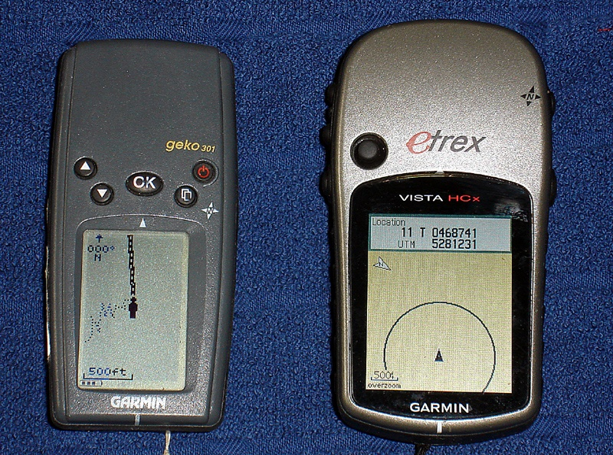
Map View Picture

Slide 31
Trip View
Gives overview of current trip stats.
Can set up what you see
This may have multiple sub screens.
Clear out old data from this view.
Keeps a track log. Stores position every 5 to 30 seconds. Can be saved. Can be downloaded and mapped
Should at least clear track log before every trip.

Slide 32
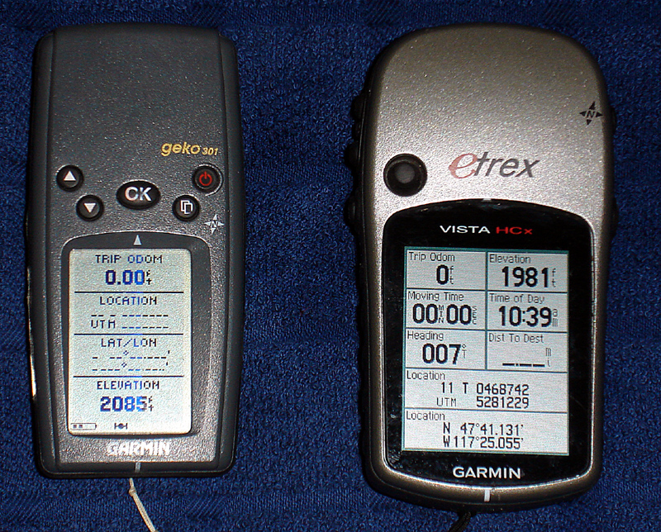
Trip View Picture

Slide 33
Main Menu
Most functions found here
Setup
Waypoints
Create, Edit, Delete
Tracks
Setup, Clear, Save, Turn on and off.
Calibration
Other

Slide 34
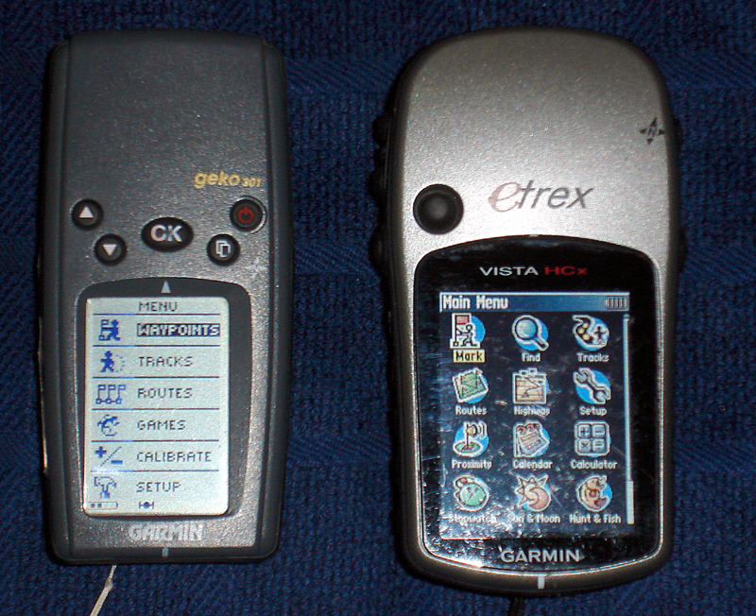
Main Menu Picture

Slide 35
Main Menu – Setup
System: basic look and feel, turn WAAS on and off.
Set compass to kick in when speed = 2mph.
Display: set backlight.
Set backlight to stay on.
Set for lowest level to do night work.
Units: Coordinate system, Datum, Units for distance and elevation, etc.

Slide 36
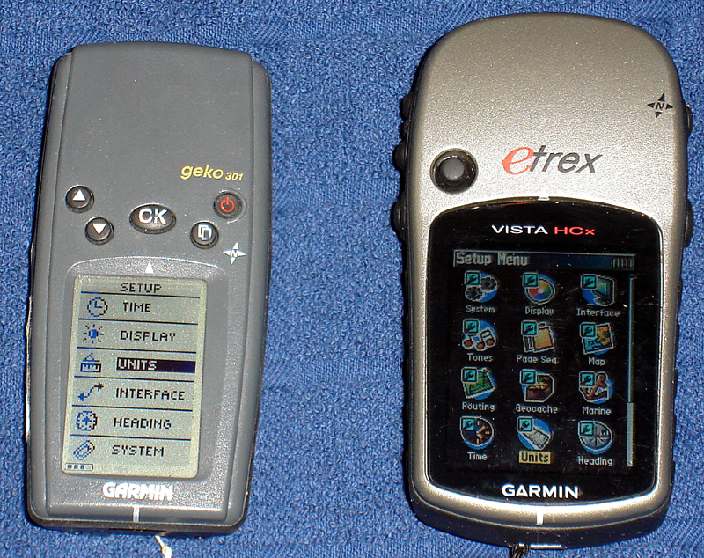
Setup

Slide 37
Waypoints
On most Garmins, hold enter key to mark a waypoint or go to main Menu to mark.
Can then edit Name, Symbol, Location.
Have a naming convention so waypoints show up in the list together.
Group important points with the same symbol. like a folder – can bulk delete everything with the same symbol and not others.
Select named waypoint, then GOTO to start navigation.

Slide 38
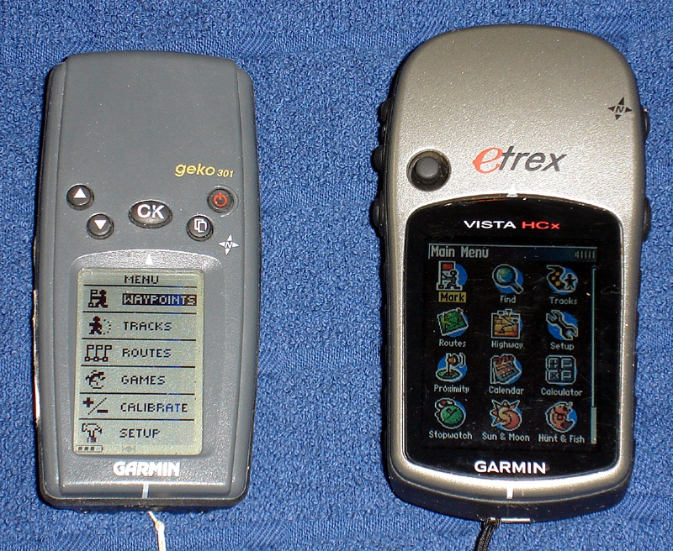
Waypoints Picture

Slide 39
Waypoints – Marking

Slide 40
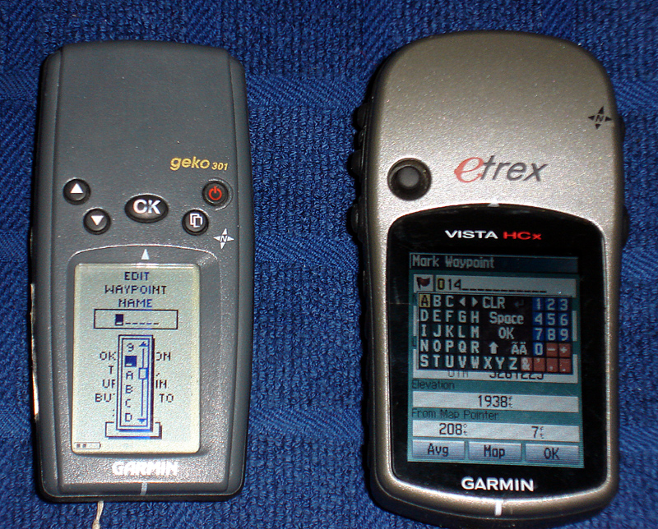
Waypoints – Editing

Slide 41
Navigation
Main Menu – Waypoints or Find
Select desired waypoint
Go To
Map screen or compass screen comes up

Slide 42
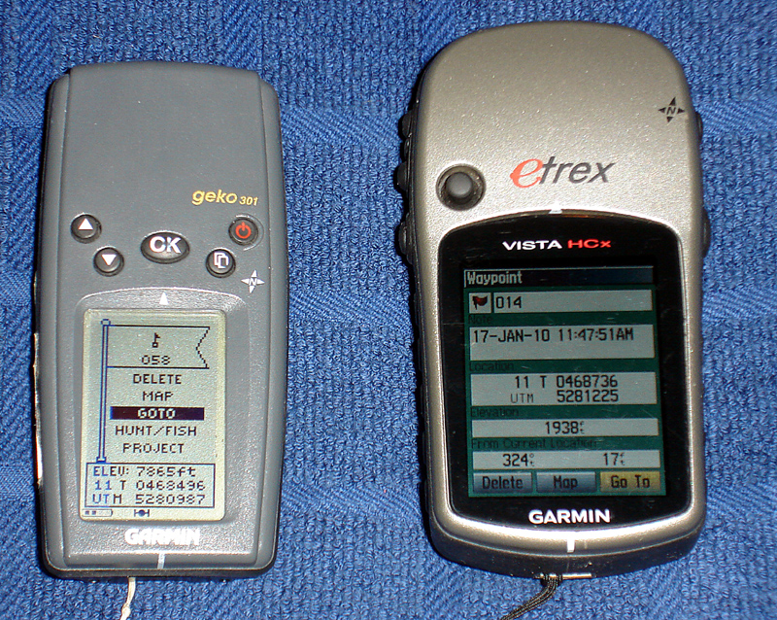
Waypoints – Find

Slide 43
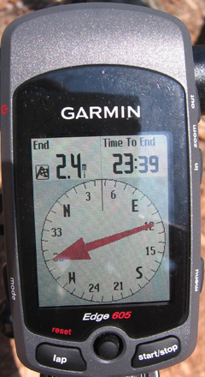
GPS Navigation
Once map or compass screen comes up:
Start walking
You must be moving for navigation mode to work.
Turn so compass points to top of unit or the arrow points down the map track.
When you get close
Switch to coordinate screen to find final coordinates.
GPS usually has a 5 to 10 meter error, more in poor conditions.
Mark where the GPS takes you and search a 10 meter full circle around the point

Slide 44
Calibrate
Only if your GPS has an altimeter and/or compass.
Calibrate will not show in menu, if you do not have it.
Calibrate, altimeter, known elevation.
Must be at that actual elevation to calibrate.
Should recalibrate daily or when weather has changed.
Calibrate, compass
Hold GPS level and slowly turn 2 rotations – receiver will tell you when it is complete.
Must recalibrate after changing datum and coordinates.
Navigation will not work right if compass not calibrated.

Slide 45
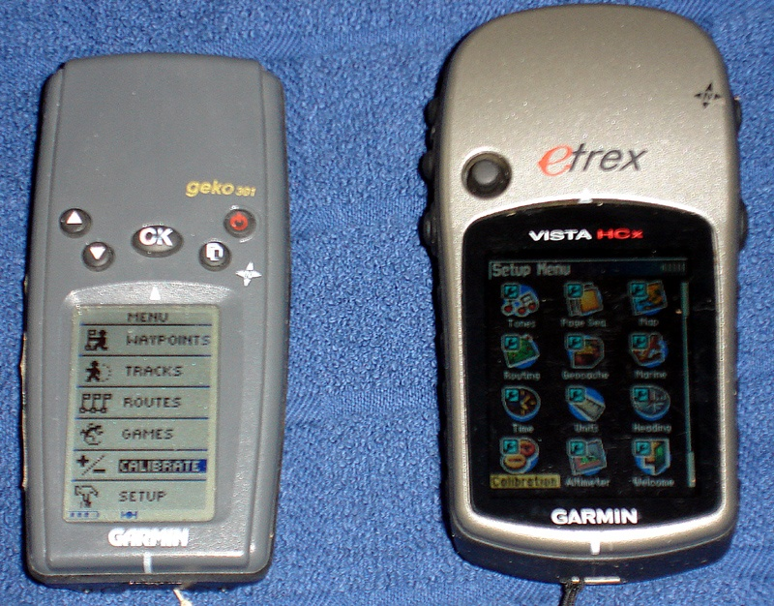
Calibrate Picture

