Slide 1
Using an Orienteering Compass
By Monica Spicker
2008

Slide 2
Objectives
Identify types and parts of a compass
Determine a direction from a map.
Transfer a reading onto a map
Follow a reading in the field
Take a reading in the field
Determine position by resectioning in the field.

Slide 3
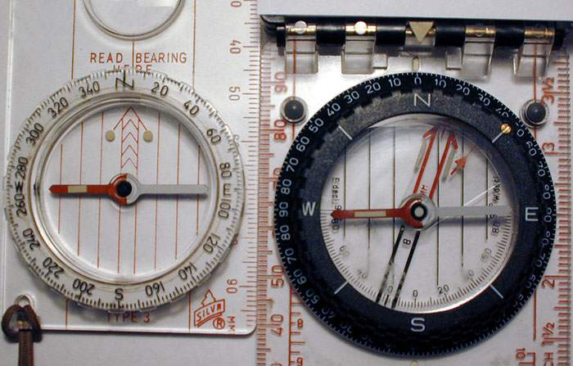
Compass styles Azimuth Bearing

Slide 4
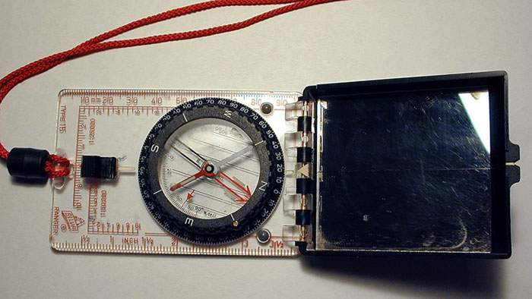
Compass parts
Reading taken or set here
Base lines
To
From
Needle “Red Fred”
Orienting arrow. The “Shed”
Screw to set declination: No further calculations needed!

Slide 5
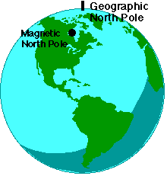
Magnetic vs True North

Slide 6
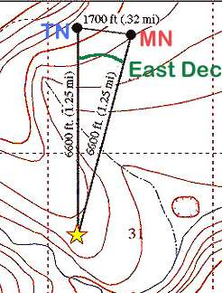
Magnetic Declination
Compass needle points to magnetic north
Maps oriented to true north
Difference must be calculated or preset on the compass itself.
True reading (map) = magnetic (needle) + dec
By convention east is always + and west is –
MEAT: Magnetic East Add True

Slide 7
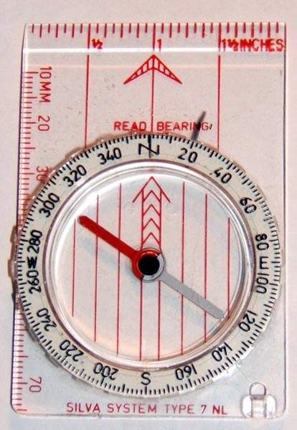
My compass cannot be set for declination!
Make plans to buy one.
OR Can draw lines of magnetic north onto your map to align your compass, rather than using true north (must change every so often or buy a new map)
OR Can draw a line at the magnetic north position on your compass.
If true (map reading) is on the dial, rotate that reading to the declination mark, and you have set magnetic to follow in the field.
If magnetic is on the dial (field reading), then the reading at the declination mark is the true reading. Rotate that reading to the dial to plot lines on your map.
Needs to be changed regularly, but easier than on the map.

Slide 8
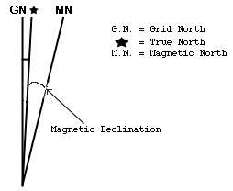
Grid North
The angle at which the UTM grid is oriented.
UTM grid lines may be too far off for orienting the compass!

Slide 9
Determining Direction
Need a map
Best if there are grid lines that run north-south on it
Compass
The objective is to determine the setting needed to travel from Point A to Point B in the field.

Slide 10
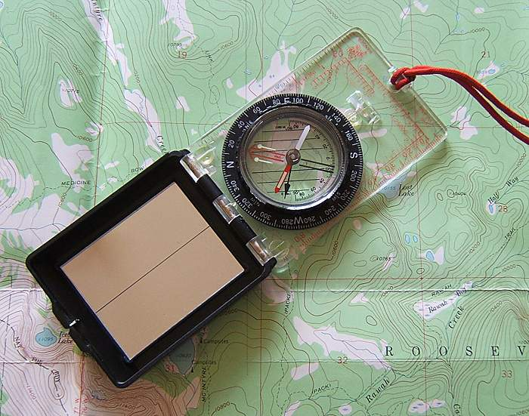
Determining Direction: Step 1
Compass edge is used like a ruler
From
From Lost Lake
To
To this campground

Slide 11
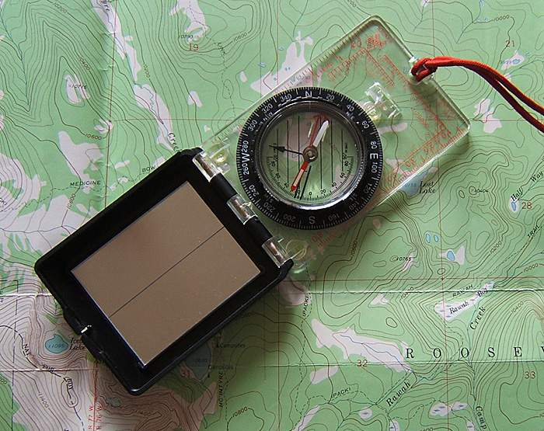
Step 2
Turn dial so BASE lines are parallel to true north. N of dial must point north.
(Red orienting arrow is skewed, because declination is set. )
IGNORE THE NEEDLE!
Read direction here. No further calculations needed! Leave this reading set, if you want to travel this route.

Slide 12
Practice

Slide 13
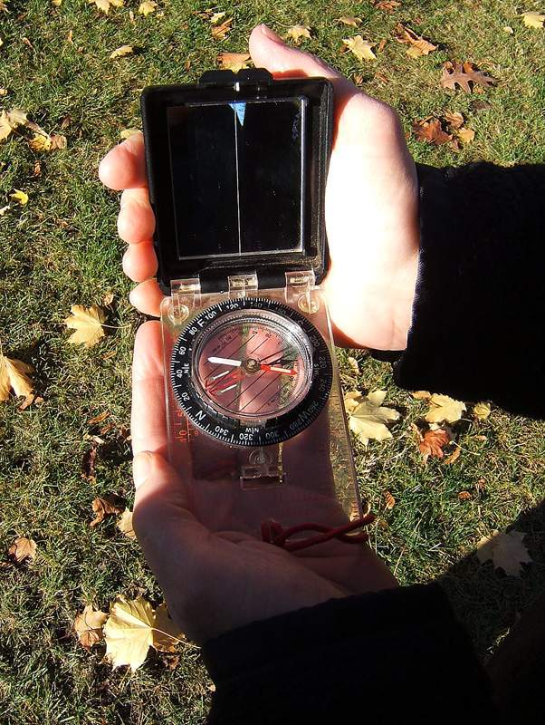
Following a Set Direction: Step 1
Set the desired reading here

Slide 14
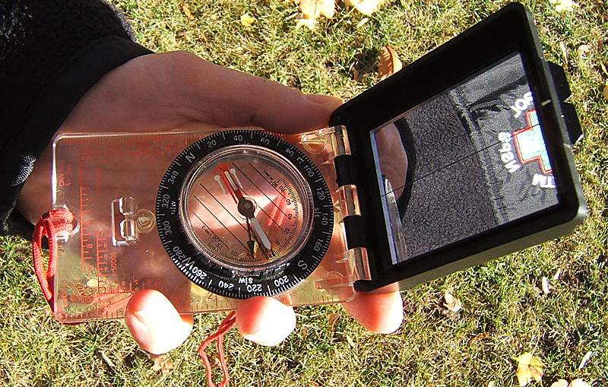
Following a Set Direction: Step 2
Turn yourself until “Red Fred is in the Shed” (The red needle is inside the outline arrow in the base plate.)

Slide 15
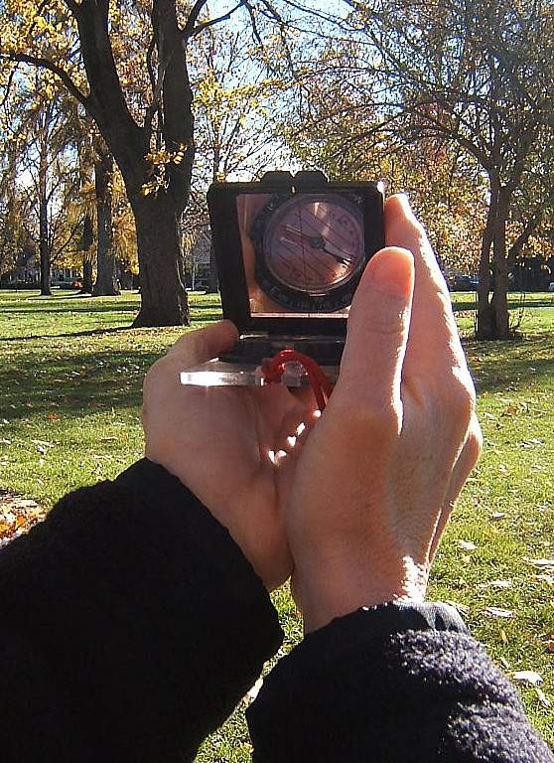
Step 3: Following a Set Direction
Hold the compass LEVEL in front of you.
Flip the mirror down so you see the dial in it.
The black line in the mirror should appear to go through the reading.
Make sure Red Fred is still in the shed!
The sighting notch in the black cover points to your target.
Repeat when you reach your first target until you reach your target. Count paces as needed.

Slide 16
Resectioning
Intersection of two line features to determine position.
Road and elevation
Creek and road
One or more directions drawn on map and another line feature.

Slide 17
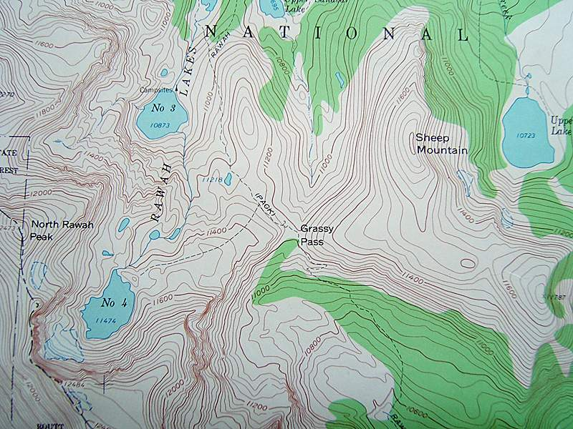
Resectioning Examples
Intersection of trail and stream
Intersection of stream and elevation 11400
Intersection of 2 trails

Slide 18
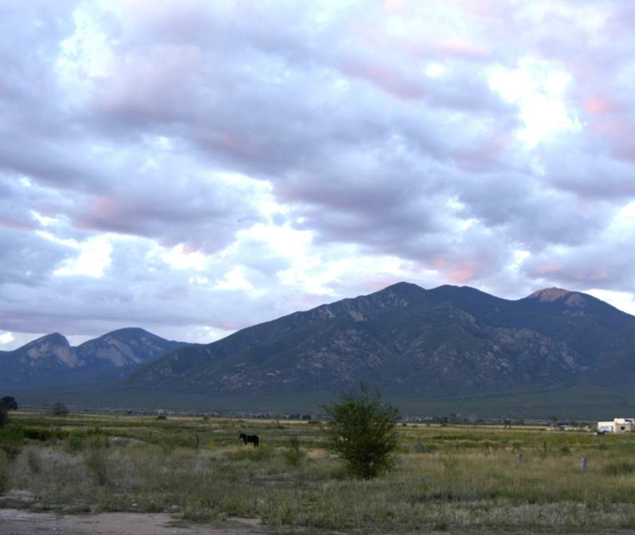
Resectioning with compass directions
Take compass readings on two prominent landmarks (A and B) that you can identify on a map.
Plot these on the map. Intersection is your position.
B
A
Your Location in Field
X

Slide 19
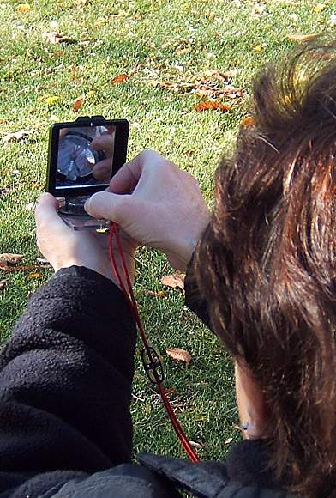
Taking a Reading
Look at target
Hold compass level in front of you
Flip down the mirror until you can see the dial.
Aim the sighting notch in the compass at the target
Turn the dial until Red Fred is in the Shed
The direction is read at the hinge end of the dial.

Slide 20
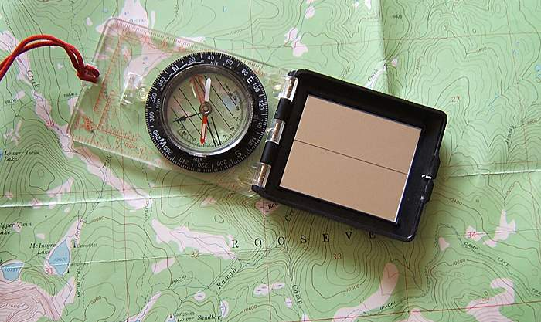
Plotting a Direction: Step 1
Set heading on compass
FROM: If you shot from a known point, then lay this end over the point on the map
TO: If you shot to a known point, lay this end over that point on the map
Compass edge acts like a ruler

Slide 21
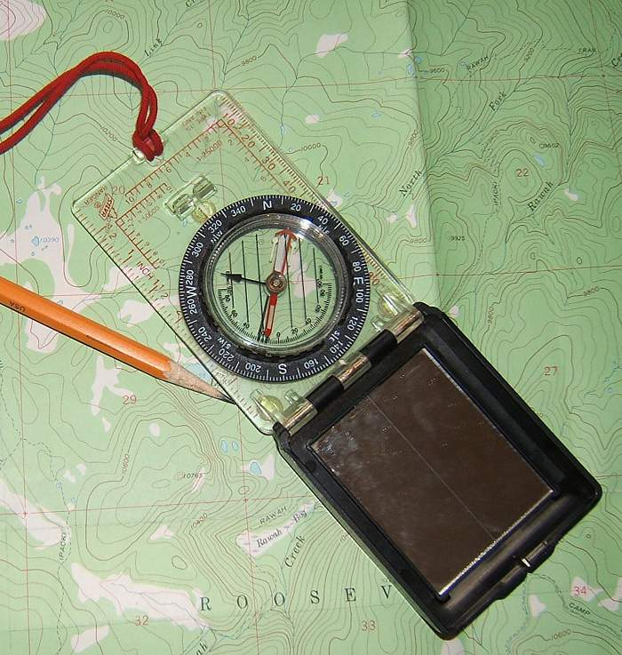
Plotting a Direction: Step 2
1) Turn entire compass until base lines are parallel with true north on map and the N on the dial is north
2) Draw line along compass edge

Slide 22
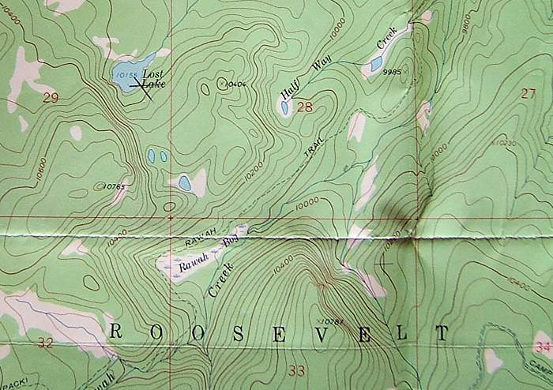
Step 3
For resectioning, repeat with a second line feature or second compass reading
Intersection is your location.
Lost Lake is now found!
If plotting a distance from a known point, mark off the distance to see the objective.

Slide 23
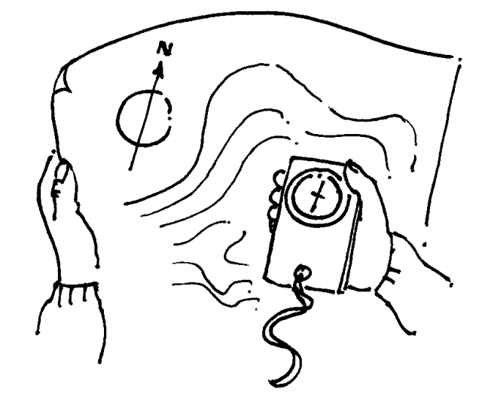
Plotting Practice

Slide 24
Field Practice

