Slide 1
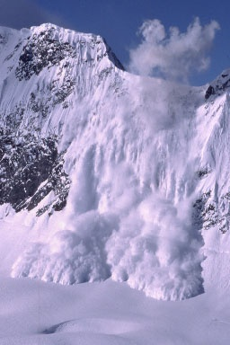
Avalanche Awareness
Many slides taken from various PowerPoint files by Mike Laney, posted at the National Ski Patrol website.
Some photographs copied from www.avalanche.org and from the USFS Snow Avalanches brochure
Monica Spicker
2012

Slide 2
Objectives
Describe the four factors that create avalanche danger
Describe the basic conditions of each factor that create avalanche danger
Correctly use several field indicators and tests to identify and avoid hazards.
Correctly conduct self searches/rescues.

Slide 3
Caveat
The more you travel in avalanche terrain, the higher the likelihood you will be caught in one.
Show clips
Take all the training you can get and stay up to date.
AAA Level 1 or NSP Level 1 or similar is recommended.
On line training: http://access.jibc.bc.ca/avalancheFirstResponse/index.htm
At least read Snow Sense!
Movie (Know Before You go – Available on YouTube.com)

Slide 4
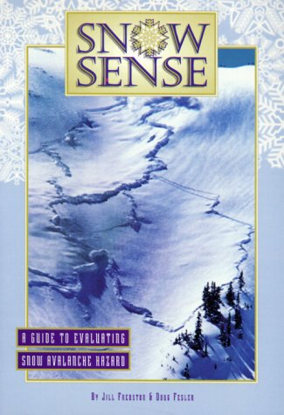
Avalanche Resources
www.avalanche.org
www.nwac.us
www.nsp.org
www.americanavalancheassociation.org

Slide 5
Types of Avalanches
Loose Snow Avalanches
Start at one point on the snow cover and grow into the shape of an inverted “V”
Wet Loose Snow Avalanches
Occur in spring and summer, lubricated by meltwater and rain
Slab Avalanches
Lee slopes, heavy storms, high winds
20 to 150+ mph!

Slide 6
Four Factors Leading to Snow Avalanches
Terrain
Weather
Humans
Snow pack
Avalanche Triangle

Slide 7
Dangerous Terrain Elements
Angle: 35 – 45 deg
Profile (Shape): Convex
Aspect: N & E
Leeward of wind
Length: any!
Terrain Traps: gullies, chutes, cornices, runouts, cliff bands.
Texture: smooth (after vegetation is covered)

Slide 8
Analyzing Terrain
Plan before you go!
Contour maps show
Angle
Aspect
Shape
Vegetation patterns
In the field
Pay attention to aspect and angle: use your compass to measure!
Look for past activity and other signs.
Learn to dig pits and do stability tests.

Slide 9
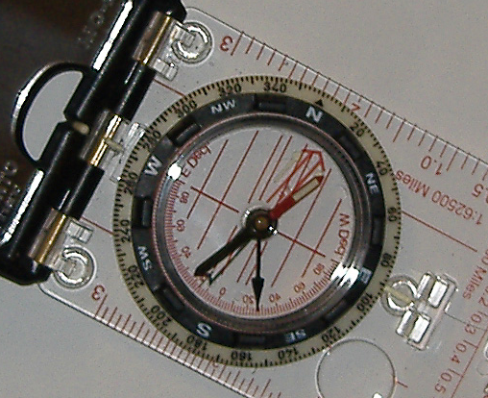
Using compass to measure slope in the field
Dial compass to west at the hinge.
Hold compass at same angle as the slope, with the declination scale at the bottom.
Where the black swinging needle points is your slope angle in degrees.
(in this case 27º)

Slide 10
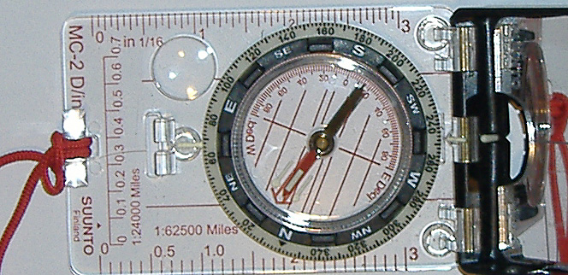
Using compass to measure aspect in the field
Face away from the hill (back to the hill)
Hold compass in front of you and rotate dial until “Red Fred” (the needle) in in the “Shed” (red outline arrow in base plate).
Reading at hinge is the aspect. (in this case W, SW)

Slide 11
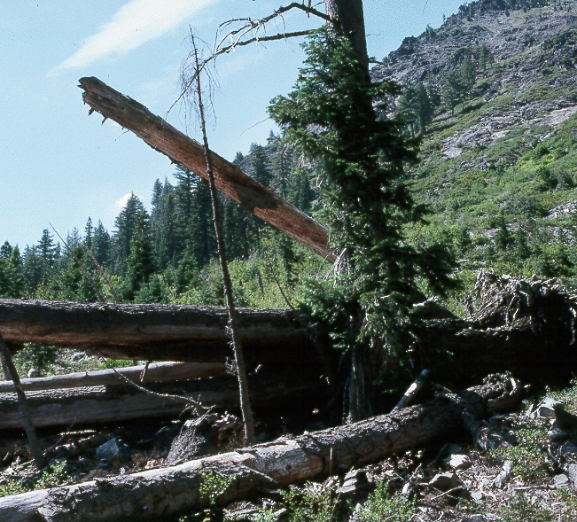
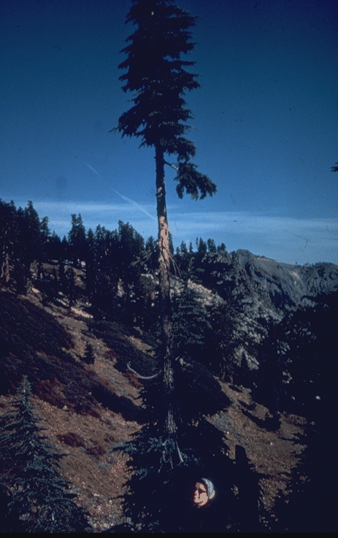
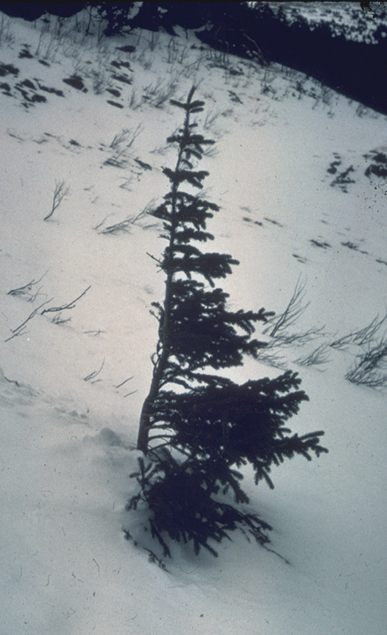
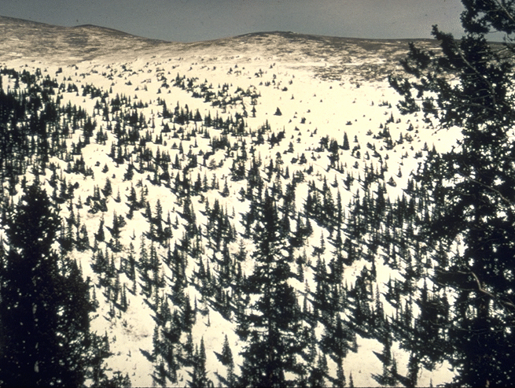
Vegetation Clues
Downed trees
Younger growth
Flagging
Sparse or no vegetation.
Open chutes in vegetation

Slide 12
Weather
Precipitation
more than 1”/hr, 12”/24hrs
Rain on snow
Temperature
Cold stays unstable longer
Wind
Stay away from leeward side
Past – Current – Forecast
Most avalanches within 24 – 48 hrs of storm
Most after midday
Understand & monitor weather patterns

Slide 13
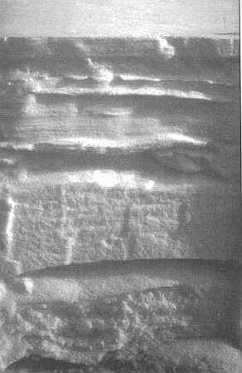
Snowpack
Each event shows in the snow pack as a layer.
Properties change over time (metamorphism)
Snowpits are used to measure and assess the stability of each layer.

Slide 14
Factors in Snowpack Stability
Depth and Type of Snow
Density : how compact
Metamorphism
Progressive change in snow crystals
Bonding strength
Stress within snow pack.

Slide 15
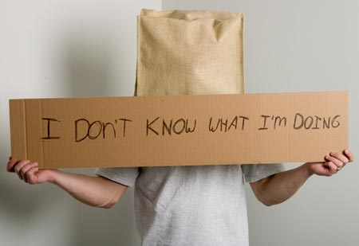
The Human Factor: Most people trigger their own avalanche
Attitude,Experience, Fitness, Equipment, Training.
Herding instinct
Rush for first tracks
The rush home
Bad weather breeds conservatism
Sunny weather gives false confidence
Get your money’s worth.
http://www.backcountry.com/images/newsletter/806.jpg

Slide 16
Putting it all together
Plan
Study maps and aerial photos to identify dangerous slopes, aspects and traps. Plan escape and alternate routes.
Monitor weather.
Get Avalanche Rating
During Trip
Regularly re-assess conditions.
Change route and plan as needed.
Be ready to turn around or hunker down.

Slide 17
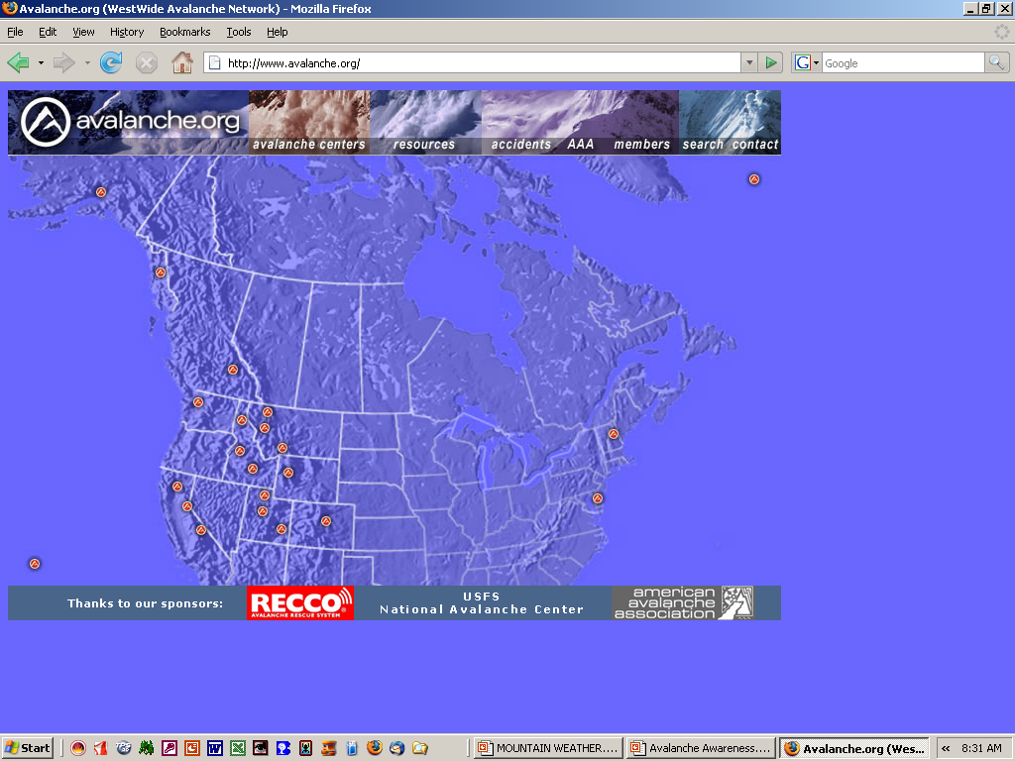
Avalanche Reports
www.avalanche.org
Local agencies

Slide 18
North American Public Avalanche Danger Scale
Danger Level | Travel Advice | Likelihood | Size and Distribution
5 – Extreme | Extraordinarily dangerous avalanche conditions. Avoid all avalanche terrain. | Natural and human-triggered avalanches certain. | Very large avalanches in many areas.
4 – High | Very dangerous avalanche conditions. Travel in avalanche terrain not recommended. | Natural avalanches likely; human-triggered avalanches very likely. | Large avalanches in many areas; or very large avalanches in specific areas.
3 – Considerable | Dangerous avalanche conditions. Careful snowpack evaluation, cautious route-finding, and conservative decision-making essential. | Natural avalanches possible; human-triggered avalanches likely. | Small avalanches in many areas; or large avalanches in specific areas; or very large avalanches in isolated areas.
2 – Moderate | Heightened avalanche conditions on specific terrain features. Evaluate snow and terrain carefully; identify features of concern. | Natural avalanches unlikely; human-triggered avalanches possible. | Small avalanches in specific areas; or large avalanches in isolated areas.
1 - Low | Generally safe avalanche conditions. Watch for unstable snow on isolated terrain features. | Natural and human-triggered avalanches unlikely. | Small avalanches in isolated areas or extreme terrain.

Slide 19
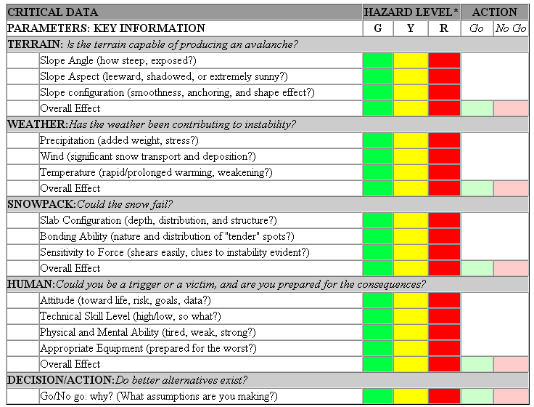
Red-Yellow-Green

Slide 20
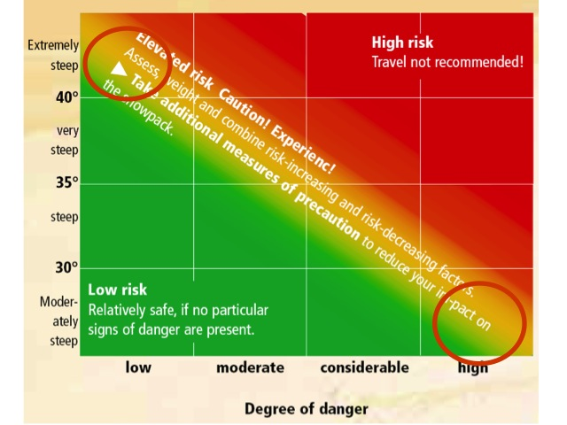
Avalanche risk in Unfavorable Aspects

Slide 21
3 Clues or More = Don’t Go
Rating: Considerable or higher hazard on the current avalanche bulletin
Loading: By snow, wind, or rain in the last 48 hrs.
Avalanches: In the area in the past 48 hrs.
Thaw instability: Recent warming of the snow surface due to sun, rain, or warm air
Unstable snow: Collapsing, cracking, hollow snow, or other clear evidence on instability.
Path: Easily identifiable.
Terrain traps: Gullies, trees, cliffs, or other features.

Slide 22
“Nature’s Billboards”
Evidence of past avalanches
Other avalanches
Fracture lines
Hollow Sounds or “Whumping”
Snow settling under feet
Recent wind loading

Slide 23
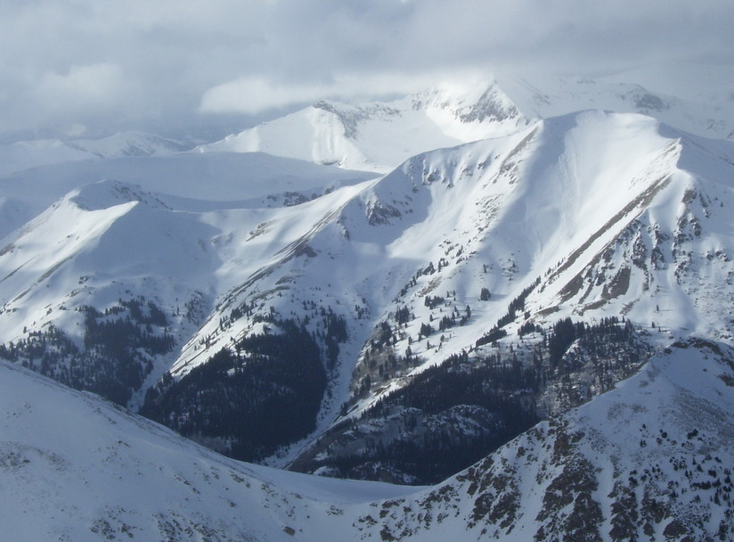
Assess this terrain and conditions!
Photo by Scott Patterson

Slide 24
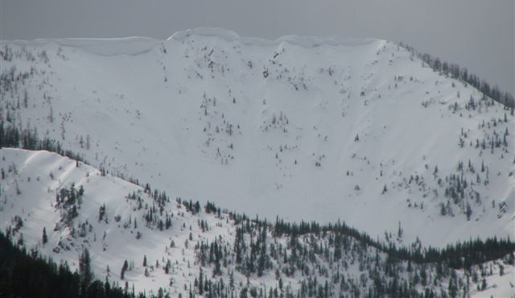
8 people killed near here 2008 Why?

Slide 25
Grim Statistics
25% are killed by trauma during the avalanche.
65% die of suffocation.
Most are buried < 2 ½ feet; few survive.
Best survival if found within 15-18 minutes of burial.
The victim must do what he/she can to be found.
All should regularly practice rescue techniques.

Slide 26
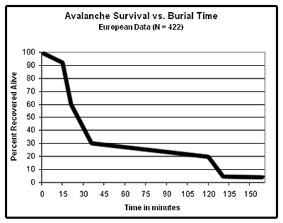
Avalanche Survival vs. Burial Time
Best chance of survival if found within 15 – 18 minutes!

Slide 27
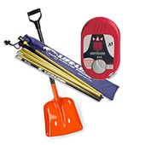
Personal/Group Safety
Prepare for the Worst!!!
Research route
Equipment/Training.
Know the capabilities of your group!
Practice search techniques EACH TIME before setting out.
Wear beacon at all times, carry probe & avalanche approved shovel.
Check beacon & batteries before leaving & regularly during trip.
Keep radios and other magnetic sources at least 6”away from transceiver!
Be prepared to turn around or to dig in.

Slide 28
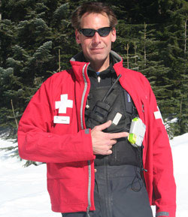
Wearing a Transceiver
Under outer layer of clothing but accessible.
Use and adjust harness to fit snugly.
In the field, wear at ALL times, including while sleeping.
Set to transmit.
Rescuers reset to receive during search.

Slide 29
Route Selection
Use R-Y-G, 3 Clues or other assessment tool.
Avoid midday and 24 - 48 hrs after storm.
Seek routes that limit exposure.
Take advantage of ridges but avoid cornices.
Avoid gullies and chutes.
Identify run out zones &avoid
Stay in dense timber.
Be suspicious of convex slopes.
Be cautious of shaded slopes.
Stay on windward side.
Conduct slope stability tests

Slide 30
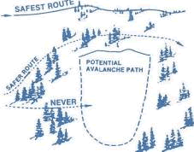
Crossing Questionable Slopes (Minimize Exposure)
Dress up.
Undo ski pole straps.
Undo any straps
Follow the same path, high on the slope.
One person at a time.
Never travel above your partner.
Plan ahead. Always look for escape paths.
Don’t Fall!
http://www.fs.fed.us/r1/kootenai/recreation/activitiesx/snowmobile/images/crossing.gif

Slide 31
Survival
Discard Equipment
Yell
Swim to reach the surface
Make your self big
Create breathing space (air pocket)
Relax

Slide 32
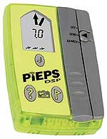
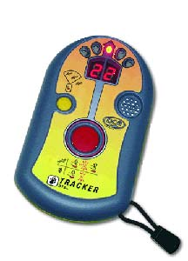
Transceivers
Transmitter sends electromagnetic pulses
Receiver detects electromagnetic pulses
Processor displays received signal as sounds, lights, images, etc.
Both digital and analog
All on the same frequency

Slide 33
Basic Rescue steps
Signal Acquisition
Coarse search
Fine Search
Pinpoint Search (probing)
Shovel
Care for victim
Show video

Slide 34
Caring for Victim
Get torso free at once & establish breathing.
Assess for injuries & treat accordingly.
Assess for hypothermia & treat accordingly.
Quickly extricate to safe place & arrange for transport.

Slide 35
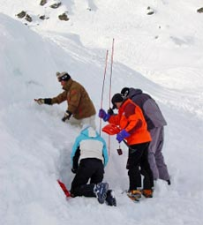
Field Practice
Slope assessment
Snow pit demo
Single burial, shallow
Single burial, at depth
Multiple burials
Probing, shoveling

