Slide 1


Welcome
to the
Social Sciences and Humanities Program

Slide 2
This program is housed under the
School of Languages, Cultures, and Race.
It offers two degree options:
Bachelor of Arts in Social Sciences
and
Bachelor of Arts in Humanities

Slide 3
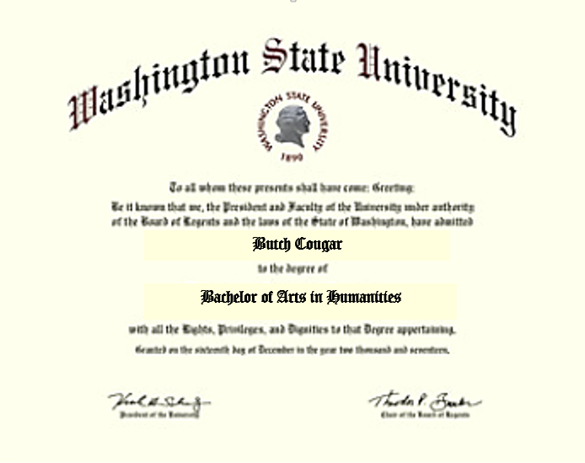
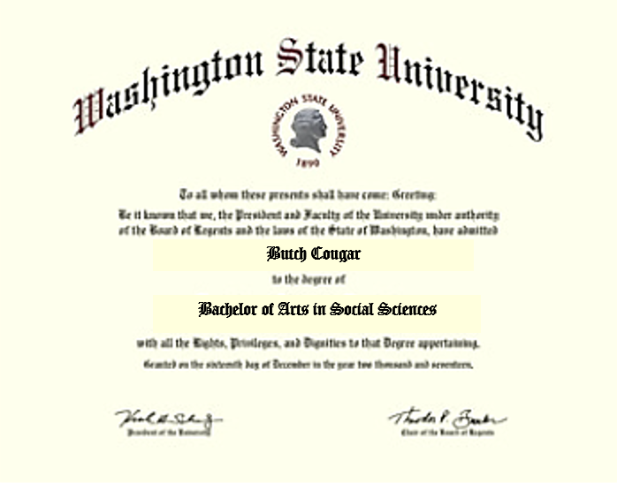
Bachelor of Arts in Humanities or Social Sciences is the title printed on your diploma.

Slide 4
Bachelor of Arts in Social Sciences
and
Bachelor of Arts in Humanities
These two interdisciplinary degrees allow students the flexibility
to create a degree plan that:
has more than one interest area
can potentially make use of credits completed in other departments
can potentially make use of transfer credits

Slide 5
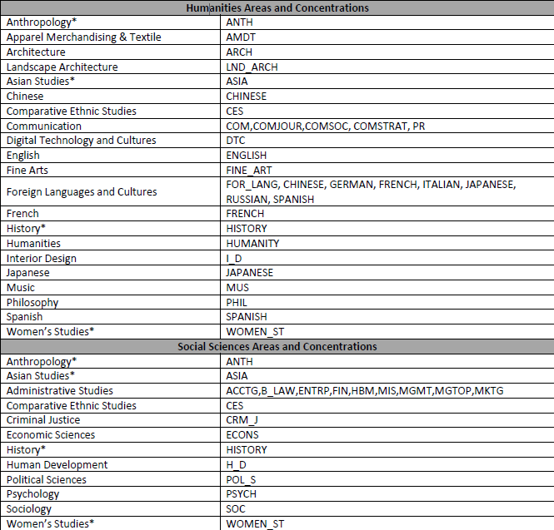
You can select from this list of concentration areas to create a plan that incorporates your interests and any applicable credits you have already completed.
You can combine concentrations from both Social Sciences and Humanities.
The category from which the majority of the credits for the major come from determines the degree.

Slide 6
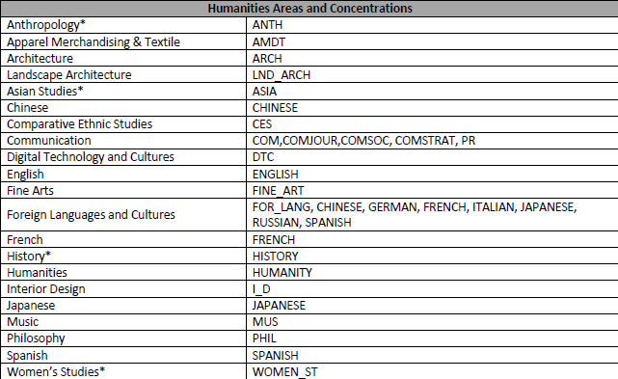

Slide 7
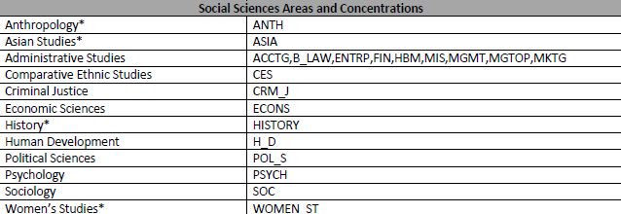

Slide 8
Your Social Sciences and Humanities advisor can work with you to determine which combination of areas will work best for your plans.

Slide 9
Special note: Administrative Studies (business) cannot be used as a primary concentration under plan A.
It can be used as a secondary concentration or as one of the areas in plan B.

Slide 10
Having concentrations areas in any of these subjects does not open up classes that are restricted to certain majors only.

Slide 11
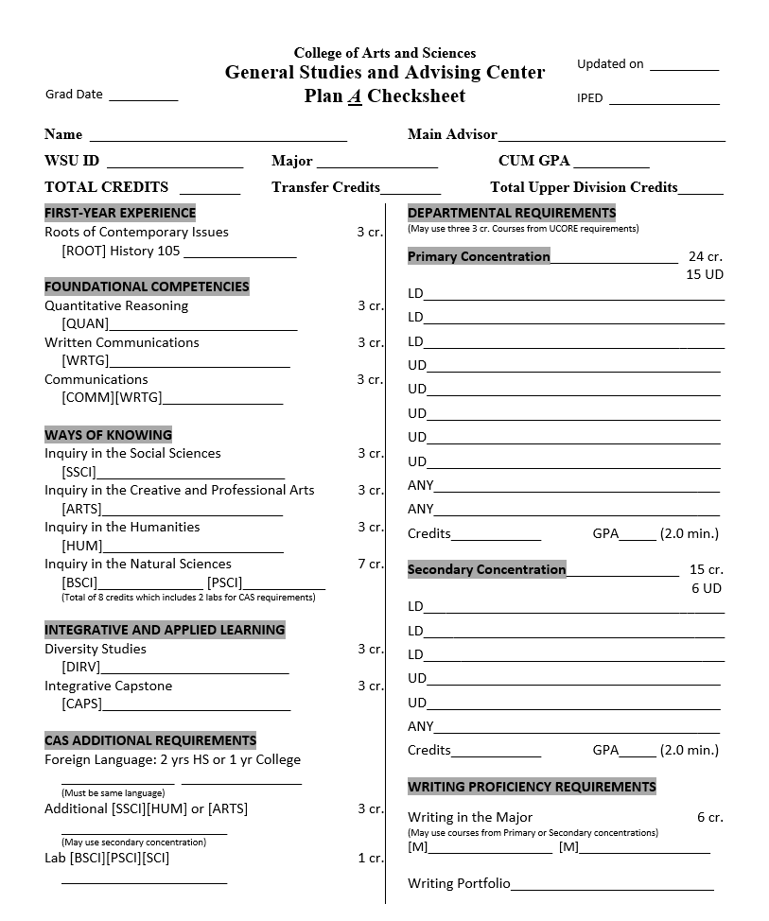
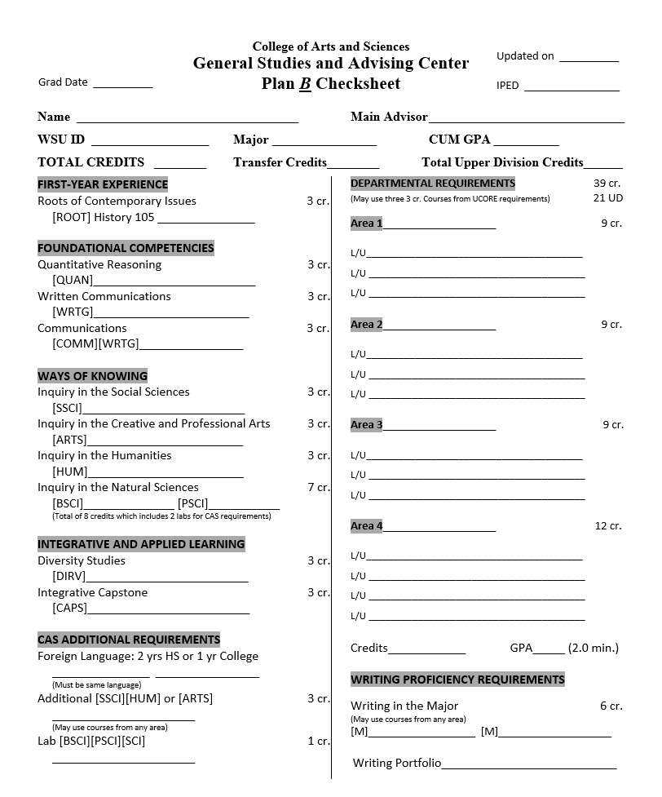
Both the Social Sciences and Humanities degrees have 2 plans from which you can choose to complete the major requirements.

Slide 12
Both of these plans have the same University Common Requirement (UCORE) areas that must be fulfilled.

Slide 13
Specific requirements set by the College of Arts and Sciences include:
8 Science credits that must include 2 labs
Completion of a foreign language
An additional class from the [SSCI], [HUM], or [ARTS] categories

Slide 14
The difference between the 2 plans is in the number of concentration areas required for each.

Slide 15
Plan A consists of two concentration areas:
Primary
Secondary
Both of these areas combined total 39 credits.

Slide 16
The primary concentration consists of 24 overall credits from a single subject.
15 of these credits need to be upper division, which is 300-400 level coursework.

Slide 17
The secondary concentration under plan A requires 15 overall credits from a single subject.
6 of these credits need to be upper division (300-400 level).

Slide 18
Plan B consists of 3 or 4 concentration areas totaling 39 credits.
Each area requires a minimum of 9 (or 12) credits from a single subject.

Slide 19
Like plan A, this plan also requires the completion of 21 upper division (300-400 level) credits within its concentration areas.
This plan, however, is more flexible in that the upper division coursework can be dispersed throughout all areas depending on your choice of classes.

Slide 20
A 2.00 GPA is also required for the concentration areas.

Slide 21
Certification into a Bachelor of Arts in Humanities or Bachelor of Arts in Social Sciences degree
requires the following:
            A minimum of 24 completed credits
            A minimum of 2.00 cumulative GPA
            Selection of a plan and specific concentration areas

Slide 22
Just as with any other degree offered through WSU, all university graduation requirements must also be completed.
This include, but are not limited to:
Completion of at least 120 overall credits (40 of which must be upper division)
Completion of the Writing Portfolio
All University Common Requirement (UCORE) areas
2 Writing in the major [M] classes
All additional College of Arts and Sciences requirements

Slide 23
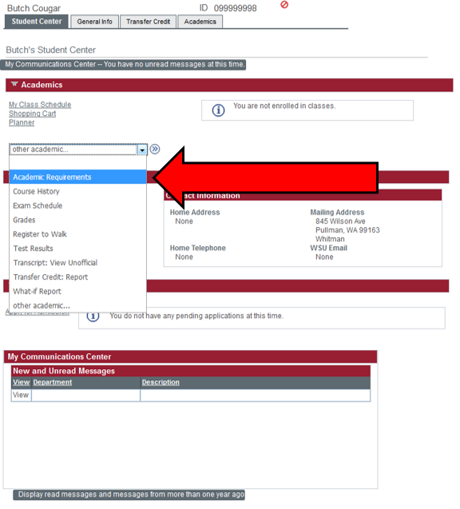
It is your responsibility (regardless of major) to become familiar with your degree audit report and make sure that all requirements are being fulfilled in a timely matter.
Your advisor can help you navigate this report, which you can find in your myWSU student center.

Slide 24
Students interested in certifying into Social Sciences or Humanities can begin by setting up an initial appointment with one of our advisors.
Set up your appointment through our front desk by:
Calling 509-335-8731
Emailing Bonnie Quick at quick@wsu.edu
Visiting Daggy Hall room 201
This initial meeting is required and is expected to last 1 hour.
Appointments are scheduled first-come-first-serve so be sure to contact us as soon as possible if certifying into our major is particularly urgent!

Slide 25
Thank you
and
GO COUGS!

