Slide 1
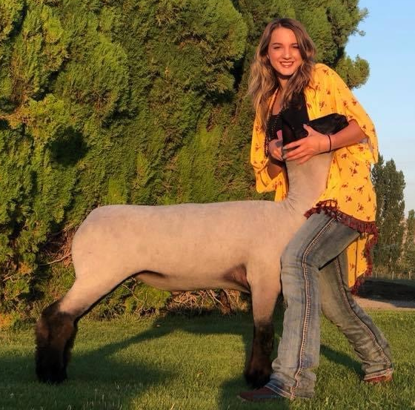
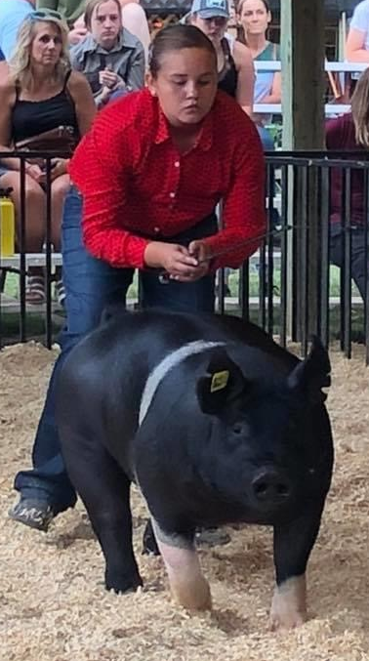
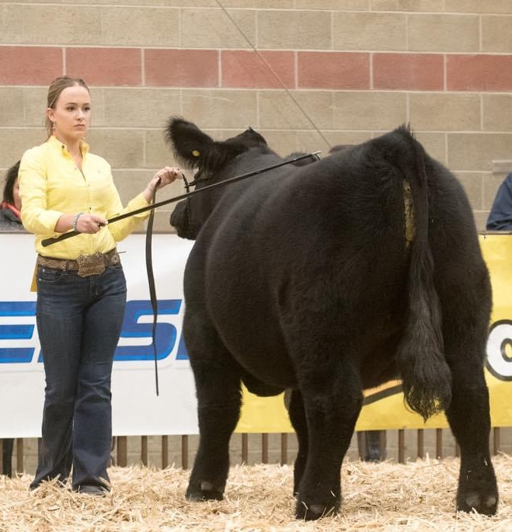
Virtual Photo and Video Staging Examples and Patterns
Version.5.26.2020

Slide 2
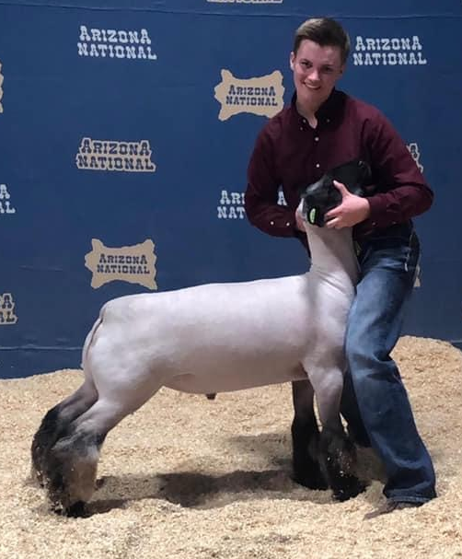

Virtual Show You Say?
When something happens and a fair or exhibition shuts down or has to limit its offerings, where does one turn for options?
Virtual shows have begun to emerge as a possible option. Small fairs, exhibitions and/or livestock shows may not be able to afford the price of a commercially available virtual show. Navigating “what to do” or “how to prepare for” an impending shutdown will help possibly ease some concerns for educators, volunteers, fairs, expositions, and livestock shows.
The following are guidelines to offering a livestock show virtually. Using these tools will help guide an exhibitor’s success in photography and videography. These slides have been created to share with youth exhibitors, volunteers, leaders, advisors, etc.
Version.5.26.2020

Slide 3
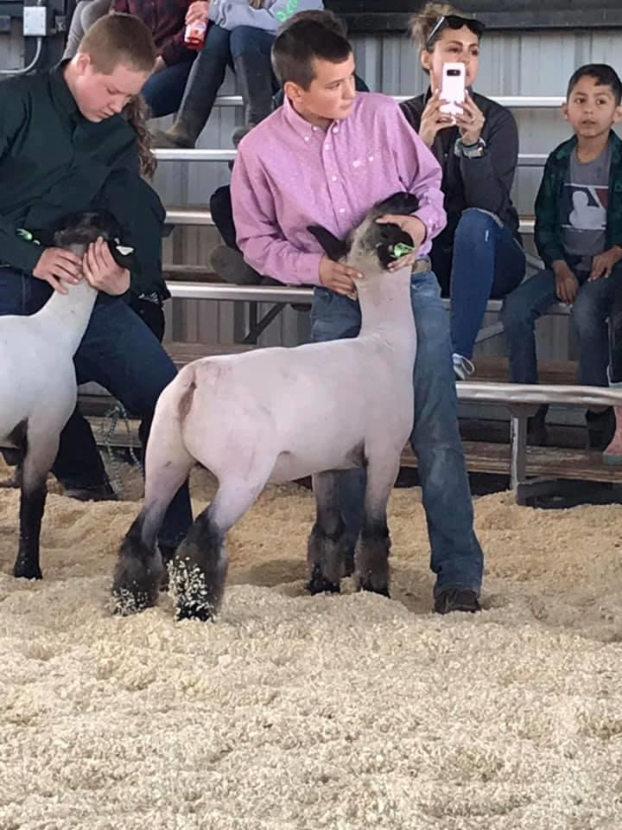
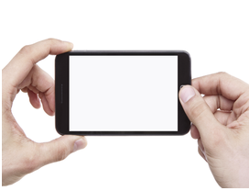
Figure 1 - Still Photo and Video: Angle and Elevation
Turn your phone to the horizontal position when shooting a photo or video. Both photo and video should be taken from eye level or below eye level position with animal. Try not to take photo above the animal in a downward position. The downward angle offers a skewed perspective in the actual size of the animal. Assure that lighting is appropriate. Avoid taking photos in low light, or where shadows or intensely bright light (such as directly into sun) may impact the quality of the photo.
10 – 14 feet distance
Version.5.26.2020

Slide 4
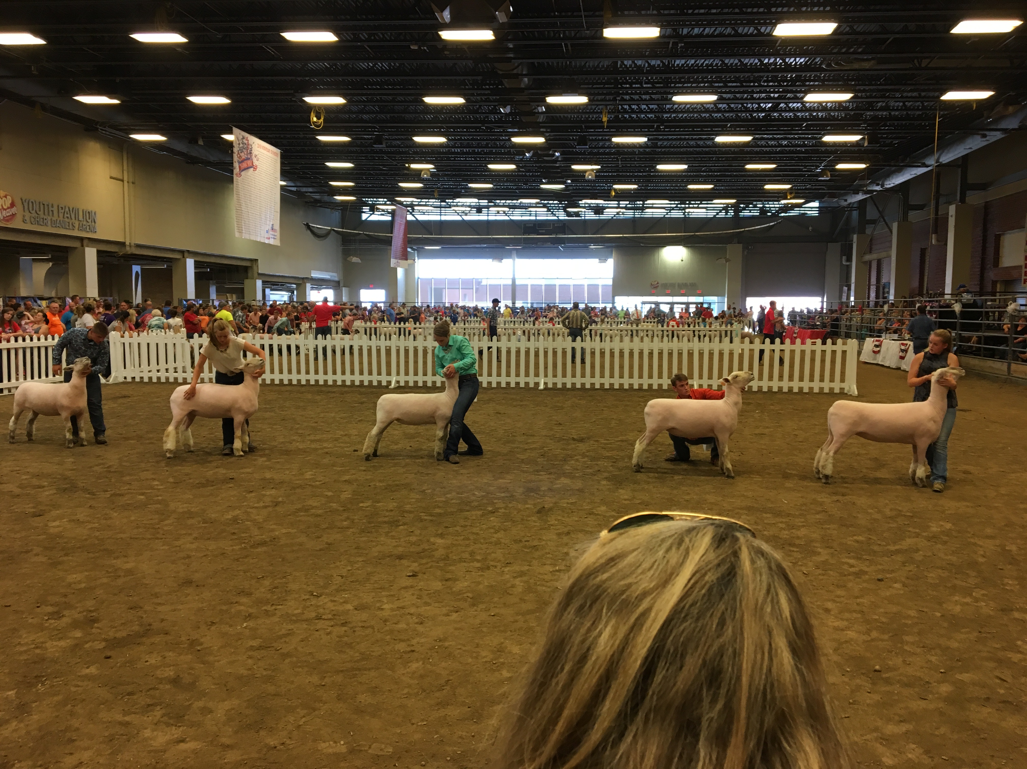
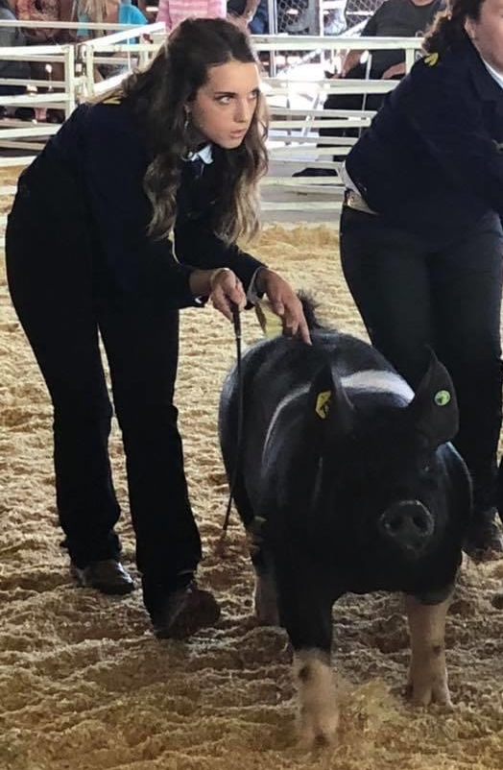
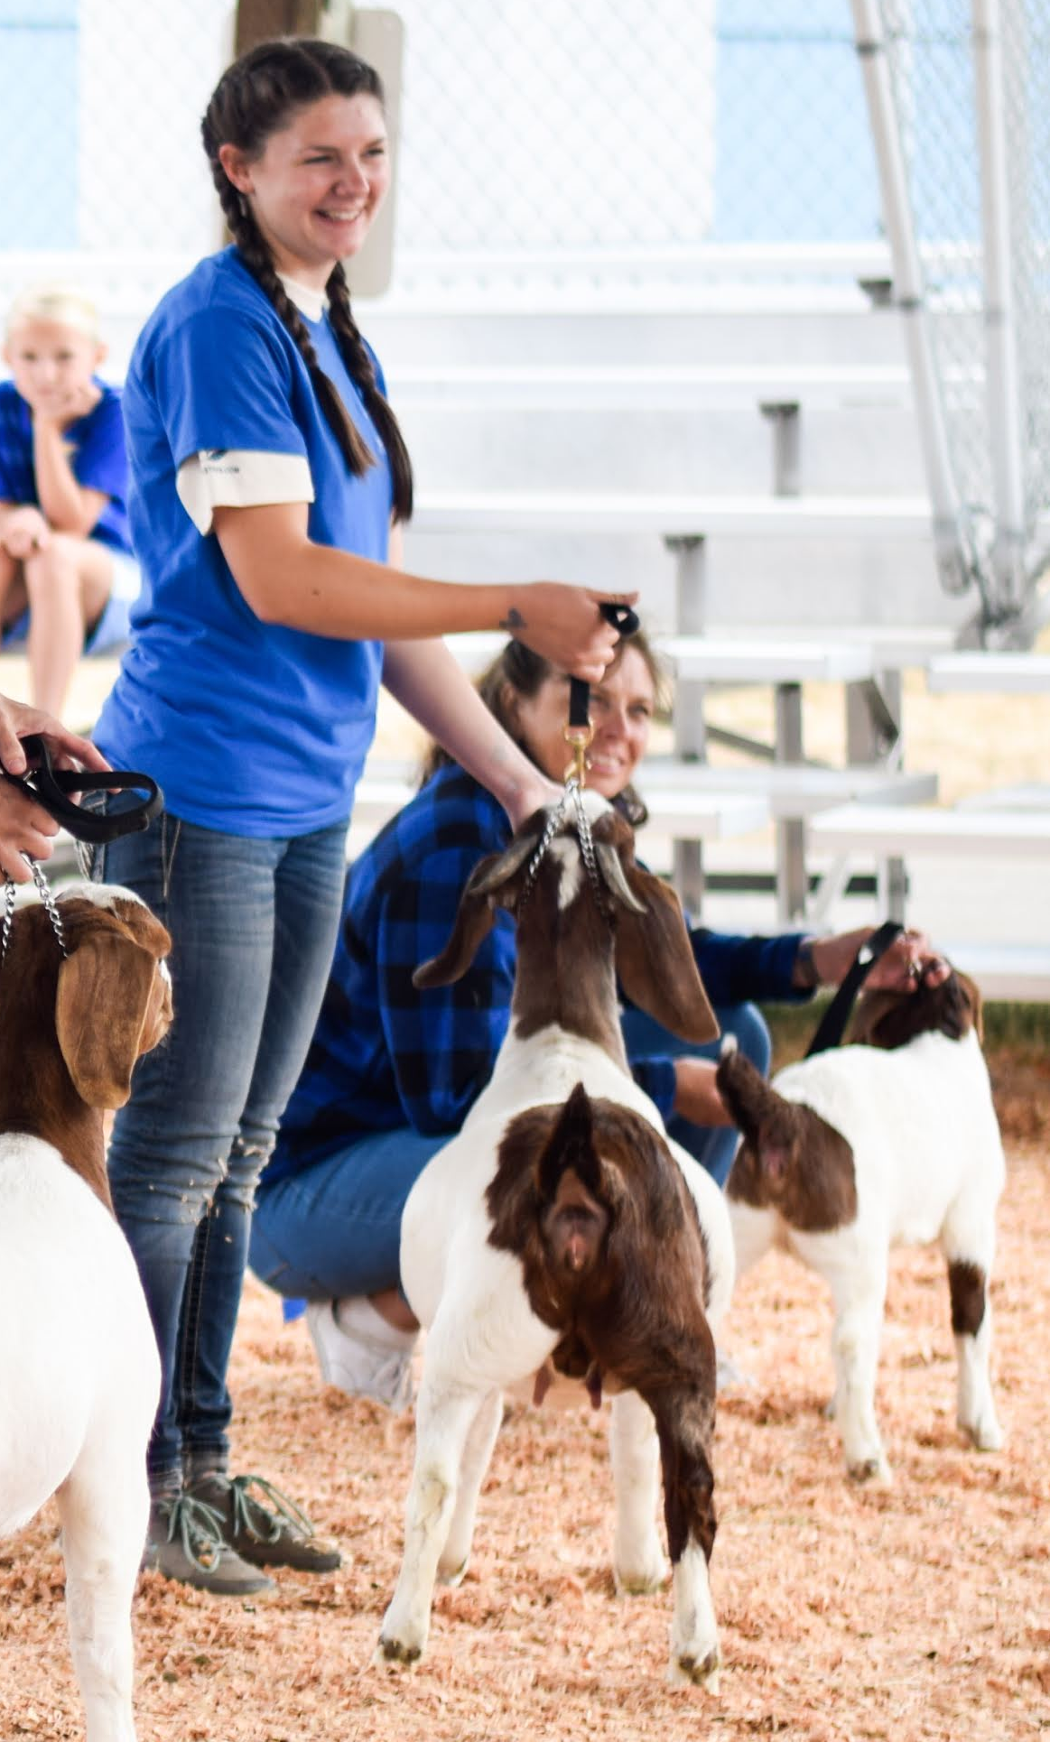
Figure 2 - Still Photo and Video: Handler in Full View with Front, Side and Rear Positioning
10 – 14 feet distance
These are images with the exhibitor in full view and in control, through contact. Capture a front view, side view and a rear view. Judges can evaluate three dimensionally with the views provided.
Version.5.26.2020

Slide 5
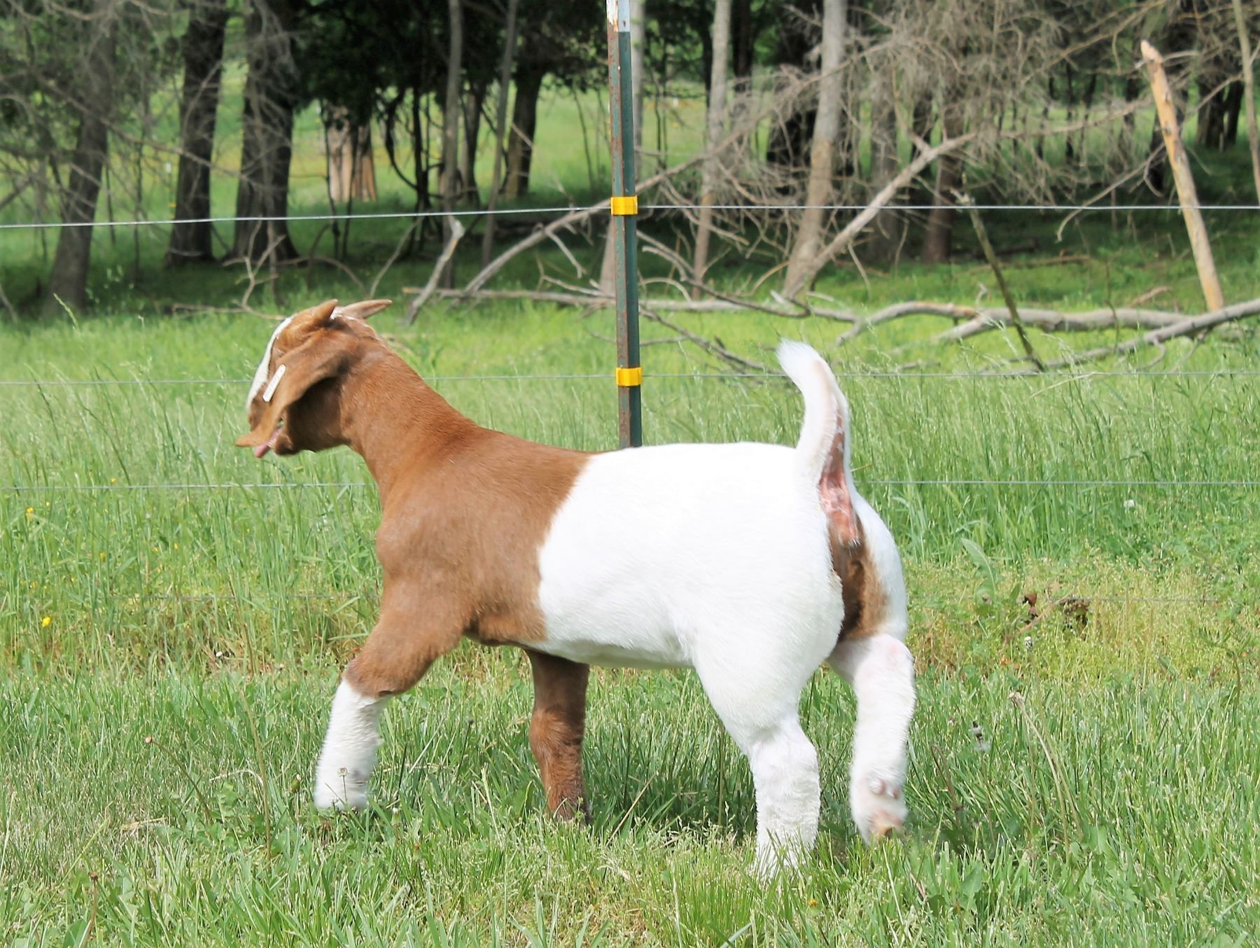
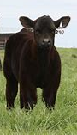
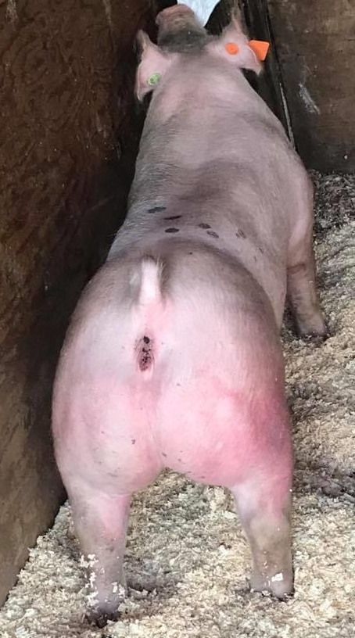
Figure 3 - Still Photo and Video: Handler Not Present/In Control for True Quality and Anonymity
10 – 14 feet distance
Animals on the loose, captured with a front view, side view
and a rear view. These may not be as direct (front, side or rear) of a view, as you read animal movement. Judges can evaluate three dimensionally with the views provided.
Version.5.26.2020

Slide 6
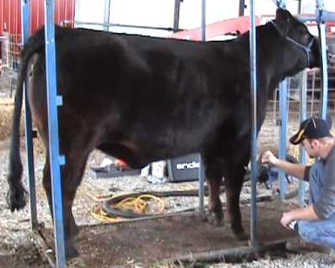
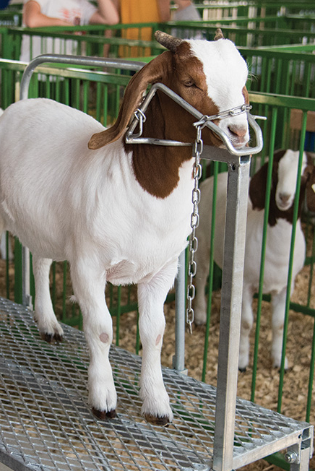
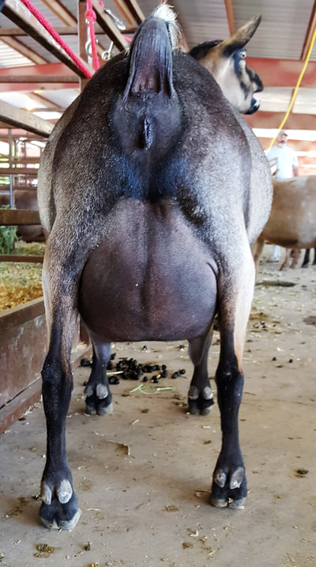
Figure 4 - Still Photo and Video: Handler Not Present, Animals Restrained for True Quality
10 – 14 feet distance
Animals restrained (trimming stand, blocking chute, neck collar, etc.) with a front view, side view and a rear view. Animals may be positioned (set-up) but handler is not in control or in photo. Judges can evaluate three dimensionally with the views provided.
Version.5.26.2020

Slide 7
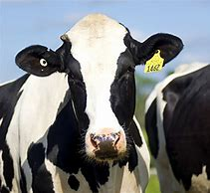
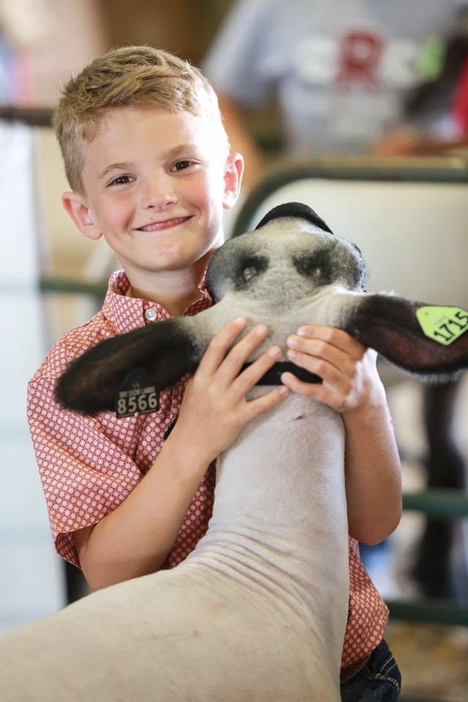
Figure 10 - Still Photo and Video: Identification of Animal and Exhibitor for Show Management
Verify Ownership and ID:
Capture a clear photo of the animal’s identification. If the animal has more than one form of identification, record both.
Pictures of tattoos as identification require a clean ear or web and a close-up shot for reading the numbers. You may have to request an additional photo with a tattooed animal that shows the animal with the exhibitor for verification of ownership.
Version.5.26.2020

Slide 8
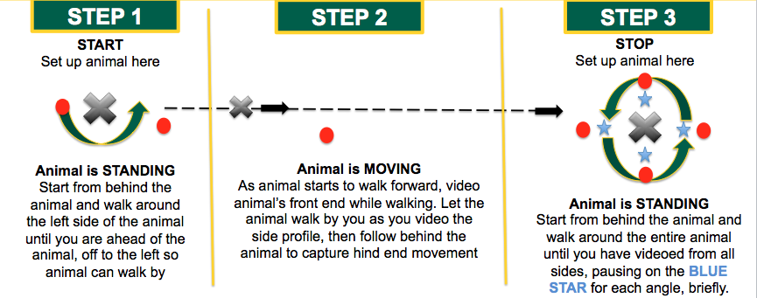

Figure 5 - For: Beef Cattle and Dairy Cattle
All Breeding and Market Animals
Adapted from: North Dakota 4-H
2020 Virtual Livestock Show
Video Instruction Guide,
NDSU Extension
Version.5.26.2020

Slide 9
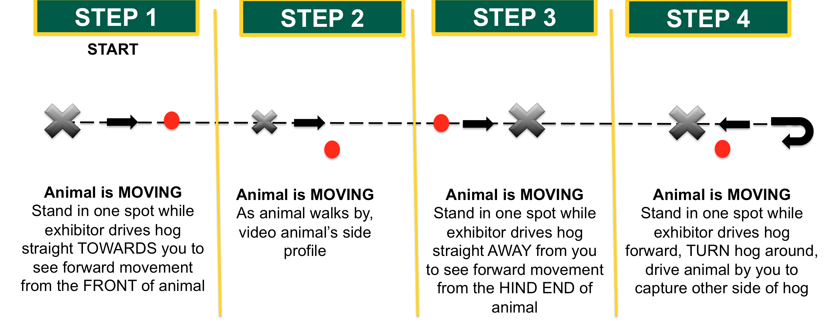
Figure 6 - For: Hogs
All Breeding and Market Animals
Adapted from: North Dakota 4-H
2020 Virtual Livestock Show
Video Instruction Guide,
NDSU Extension
Version.5.26.2020

Slide 10
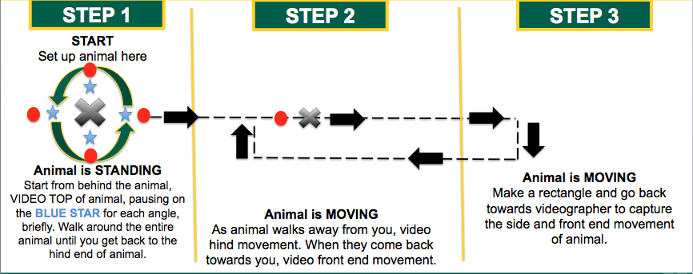
Figure 7 - For: Sheep and Goats
All Breeding and Market Animals
Adapted from: North Dakota 4-H
2020 Virtual Livestock Show
Video Instruction Guide,
NDSU Extension
Version.5.26.2020

Slide 11
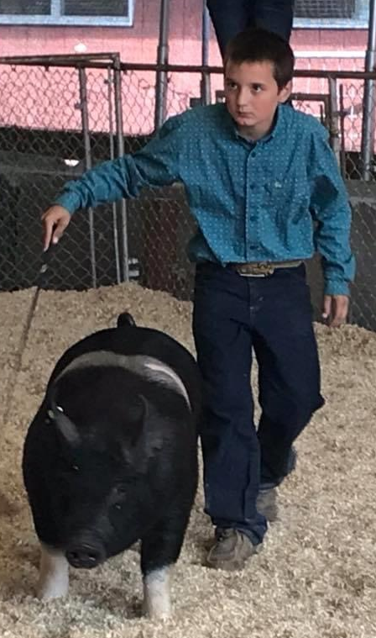
Video Platforms
YouTube - The following link will direct you to a general YouTube “How to upload your video to YouTube”:
How to load a Video on YouTube
Record the video and save,
Upload video using the create button,
Provide them with a “title” format so you can track videos when you receive with entry,
Instruct exhibitors and families to set their visibility setting to unlisted (so only people with the link will see)
After uploading, choose to “Copy Video URL.” This is the link that you’ll use to enter.
Videos MUST be submitted in the follow YouTube URL format: https://youtu.be/nJu78GZ_VBk
Version.5.26.2020

Slide 12
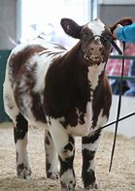
Video Platforms
Vimeo – Another option and for ease of uploading is straightforward. The following link will direct you to an instructional YouTube video on “How to Upload a Video to Vimeo”: How to Upload Video on Vimeo
After uploading:
Click share and then copy the link,
Advise the exhibitors to paste link into the entry,
Videos MUST be submitted in the follow Vimeo URL format https://vimeo.com/403839309
This program does require that videos be seen by anyone upon saving. So if you prefer that videos are not seen by the public, this may not be the go to video upload.
Version.5.26.2020

Slide 13
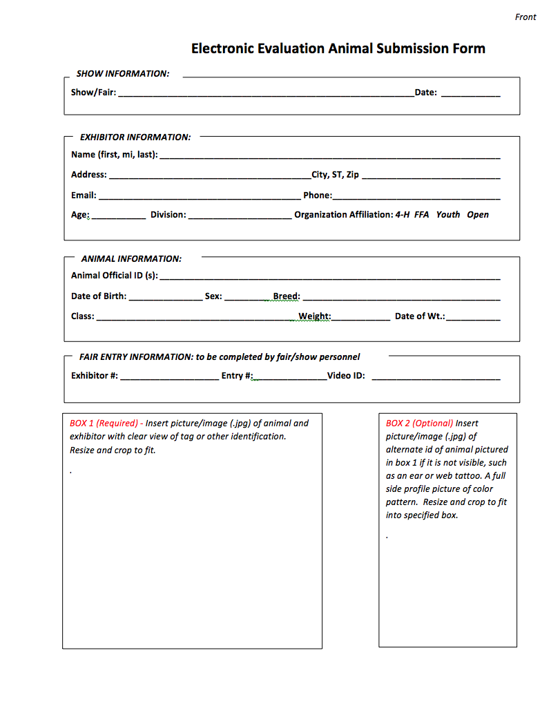
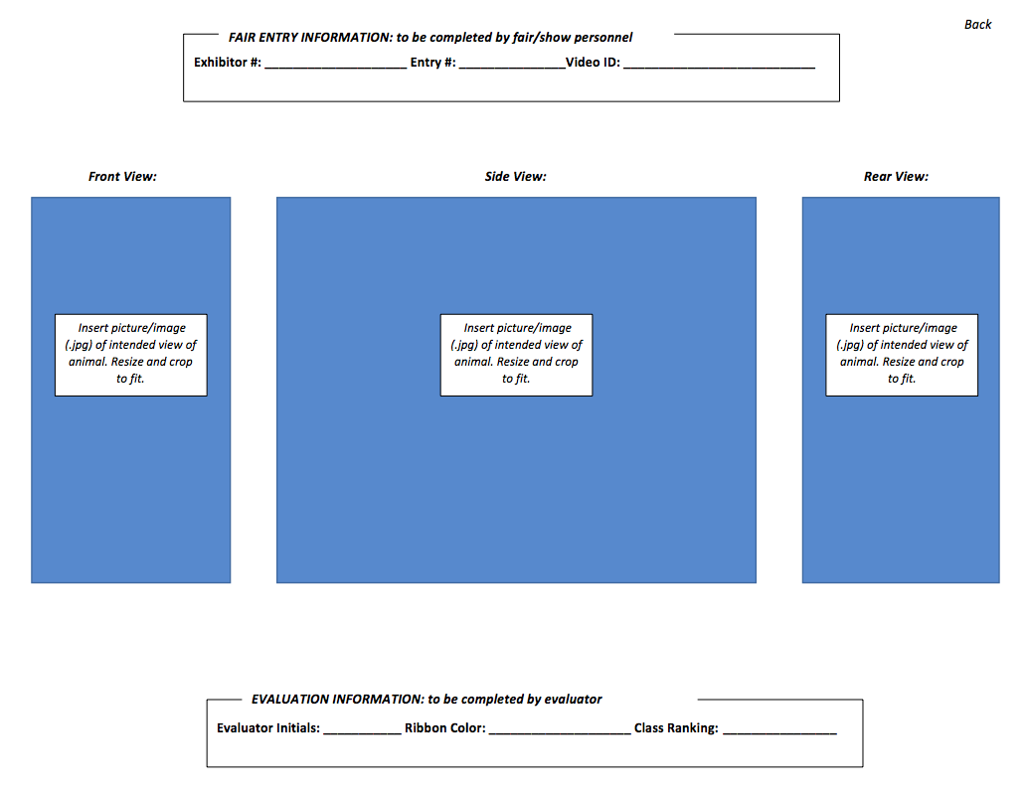
Example Entry Form
This form could be used as a template to upload into a digital format for entry submission.
Version.5.26.2020

