Slide 1
Copyright
Are you following the rules?
Jim Kropf June 17, 2020

Slide 3
Copyright
Text, tables, illustrations, photos, graphics, video, and audio segments from the works of others, regardless of the source except for federal entities, are protected by copyright and may not be reproduced by employees of Washington State University Extension without explicit written permission from the copyright owner or entity. Production of materials that contain copyrighted materials, except for brief sections of text treated as a quotation, must have written permission to protect Washington State University against copyright infringement claims. If you are unsure of what is considered copyrighted, please go to https://printing.wsu.edu/copyright/.

Slide 5
Copyright
Is the title or are any text, charts, or tables copied directly from another source?
Yes Is the copied material longer than 2 paragraphs?
Yes Complete the Copyright Permission Request form.
Then go to question 2.
No Place the material in quotes and acknowledge the source with a standard reference citation.
No Go to question 2.

Slide 7
Copyright
Are any graphs (photos, drawings, or illustrations), video or audio segments, or any other elements of content used wholly or in part from another source?
Yes
Complete the Copyright Permission Request form. Then go to question 3.
Yes
Stock or purchased photo? Source: Then go to question 3.
No
No permission is required. Go to question 3.

Slide 8
Copyright Permission Request Form
l)alc
^{To,} From:
I am ttquttUog l)()Clt'XCtuih' ris:hlslOtJ,e1Ulll('tial:JUslt.'<lbdow 10USC'°'a pubUc.-.liOll beiQg prod"'ed by
W.a.s.blnglotlSl:.ltc Unlvc-rslly.(1/tt,-Nrult,Mmq 6t dl.l -ldtdIn t«/1lfl'lfd,.,,,,lbtdt.i.'tlhl,..jbrll'Mltl.)
Publlcullon name:
l)alcof PubllcalIon·
Articlellll (IJ"fl(1Jkll1Kt>
ncms btlog req,aested fa, 1i.se:
(lk .. ,p«1JK,u pMSJllft"Y P'tftllWIJWN.J)ill'»i''Pfi '
JOIIC fJ/pt,o{O,S.jfllpftta.lllbi\!$,J d(.J
Plea$e lDdlcate your approvalbyStgu.lr1Qand returolOg Ollicopy.Jn$JgrJ.tn(t. you represenl that liretbe$Olt ow1)C1of lbc rightsgr.1.11ll'<L If you are110l Uw.-oopyrighl boldt.'f or If.addllloua.l 1x•mi.issl0Jl Is JK'cc;kd fromanolh• er,sourcl\ please lndkaLC andlet meknow towhom I should apply.
Thank you(or yourGoodder.iUon. Please do not heslt.11.e torontacl me If youhaveanyqueslloos.
Agtla1ld Approved by(s l'l:&lurc):
Date
P nln;am -------------

Slide 9
Fair Use of Copyright
‘Fair use’ is not the same as ‘free use’
In place for the ‘greater good’, to allow copyrighted works to be used without permission for the benefit of the public.
However, there are limits and multiple factors must be taken into account.
Photos are a problem because we use all of a photo unlike a written paragraph where we can use a portion.

Slide 10
Copyright
There are free online sources of images.
Examples include:
  Bugwood.org
  Flickr
  Wikimedia commons
  Pexels
  Pixabay
You must give credit for images you use.
Be sure and follow the rules.

Slide 11
Copyright
Bugwood.org

Slide 12
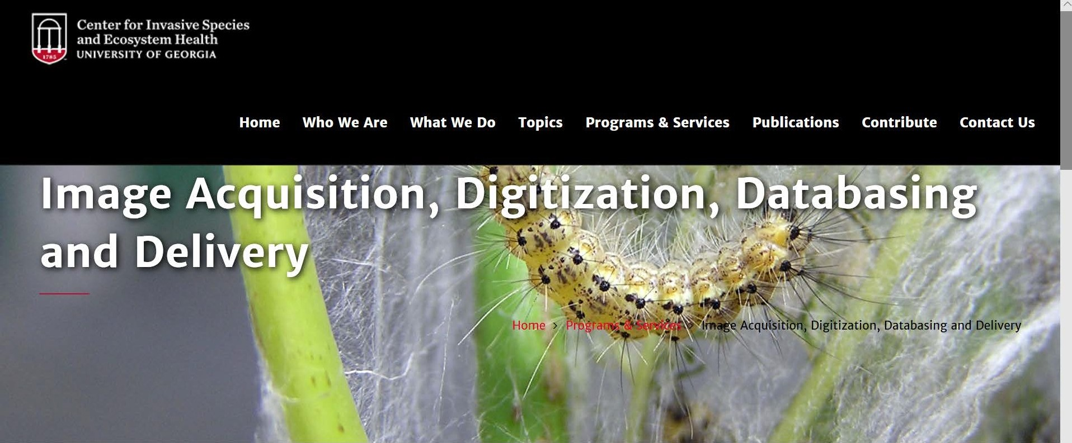
The Image Database
The University of Georgia Center for Invasive Species and Ecosystem Health operates a set of educational web sites in
Database Statistics
V

Slide 13
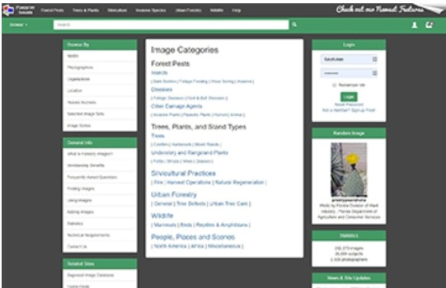
fil
Center for Invasive Species and Ecosystem Health
UNIVERSITY OF GEORGIA
'11111'-
Home
Who We Are
What We Do
Topics
Programs & Services
Publications
Contribute
Contact Us
The Image Database
The University of Georgia Center for Invasive Species and Ecosystem Health operates a set of educational web sites in cooperation with a wide array of federal, state, and private agencies, as well as with many individuals, colleges and universities. Images available through The Bugwood Network image sites (Forestry Images, lnvasive.org, 1PM Images, and Insect Images) can be used for educational and noncommercial purposes with no royalties and fees contingent upon credit being given to the photographer, the photographer's affiliation (if appropriate) and to appropriate image site thereby ensuring that full descriptive and photographer credit information is available for every image. All commercial usage rights are retained by the photographer or designated image rights' holder.
Database Statistics
292,000+ Images
26,700+ Subjects
2,500+ Photographers
Forestry Images
Forestry Images is provides an accessible and easily used archive of high quality images related to forest health and silviculture.
950,000+ average page views per year
280,000+ average users per year
I
V

Slide 14
Copywright
If you are unsure about using anything that you have not created, don’t use it.

