Slide 1
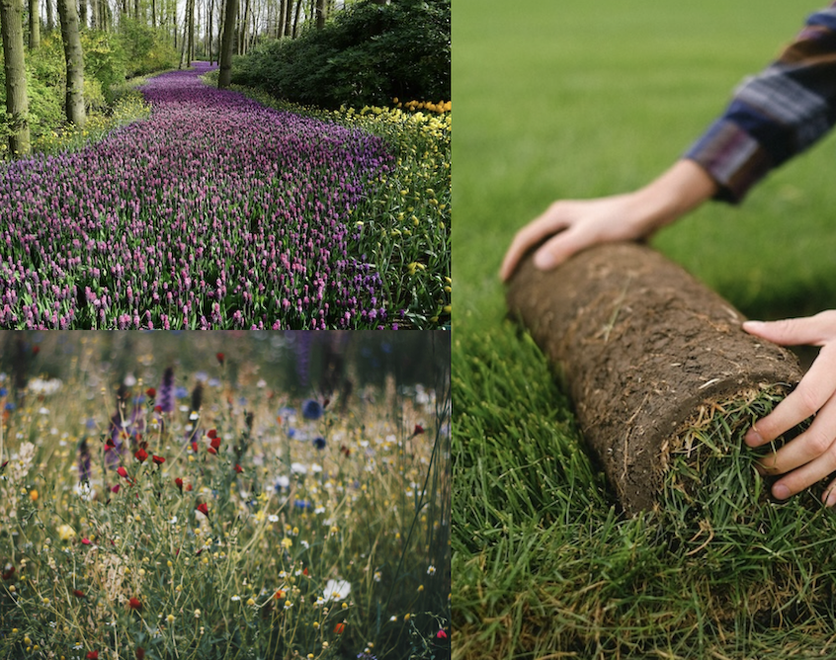




Reimagining Your Lawn
Mike Peronto
Pierce County
Master Gardener
Credit: pexels.com
CC-006
Notes:
This presentation stands on its own, but it is an outgrowth of another presentation titled “The Resilient Yard”. That presentation covered the impact that your yard has on climate change and changes you can make to turn your yard from an emitter of green house gasses to one that captures and stores CO2 into the plants and soil in your yard. In that presentation, we looked at the lawn from a perspective of changing the way we maintain it to be more climate friendly.
In this presentation, we’re going a step further: we will take a more critical look at the lawn and its impact on the climate and then survey some of the alternatives to the traditional lawn that are available to you.

Slide 2



Extension is for everyone!
Washington State University is an affirmative-action, equal-opportunity employer. Washington State University Extension programs and materials are open to all without regard to race, color, national origin, sex, gender, gender identity, religion, age, height, weight, disability, political beliefs, sexual orientation, marital status, family status, or veteran status.
Welcome!
We are glad
you are here.
Notes:
WSU Extension programs and policies are consistent with federal and state laws and regulations on nondiscrimination. Extension is for everyone, so we are glad you could join us today.

Slide 3






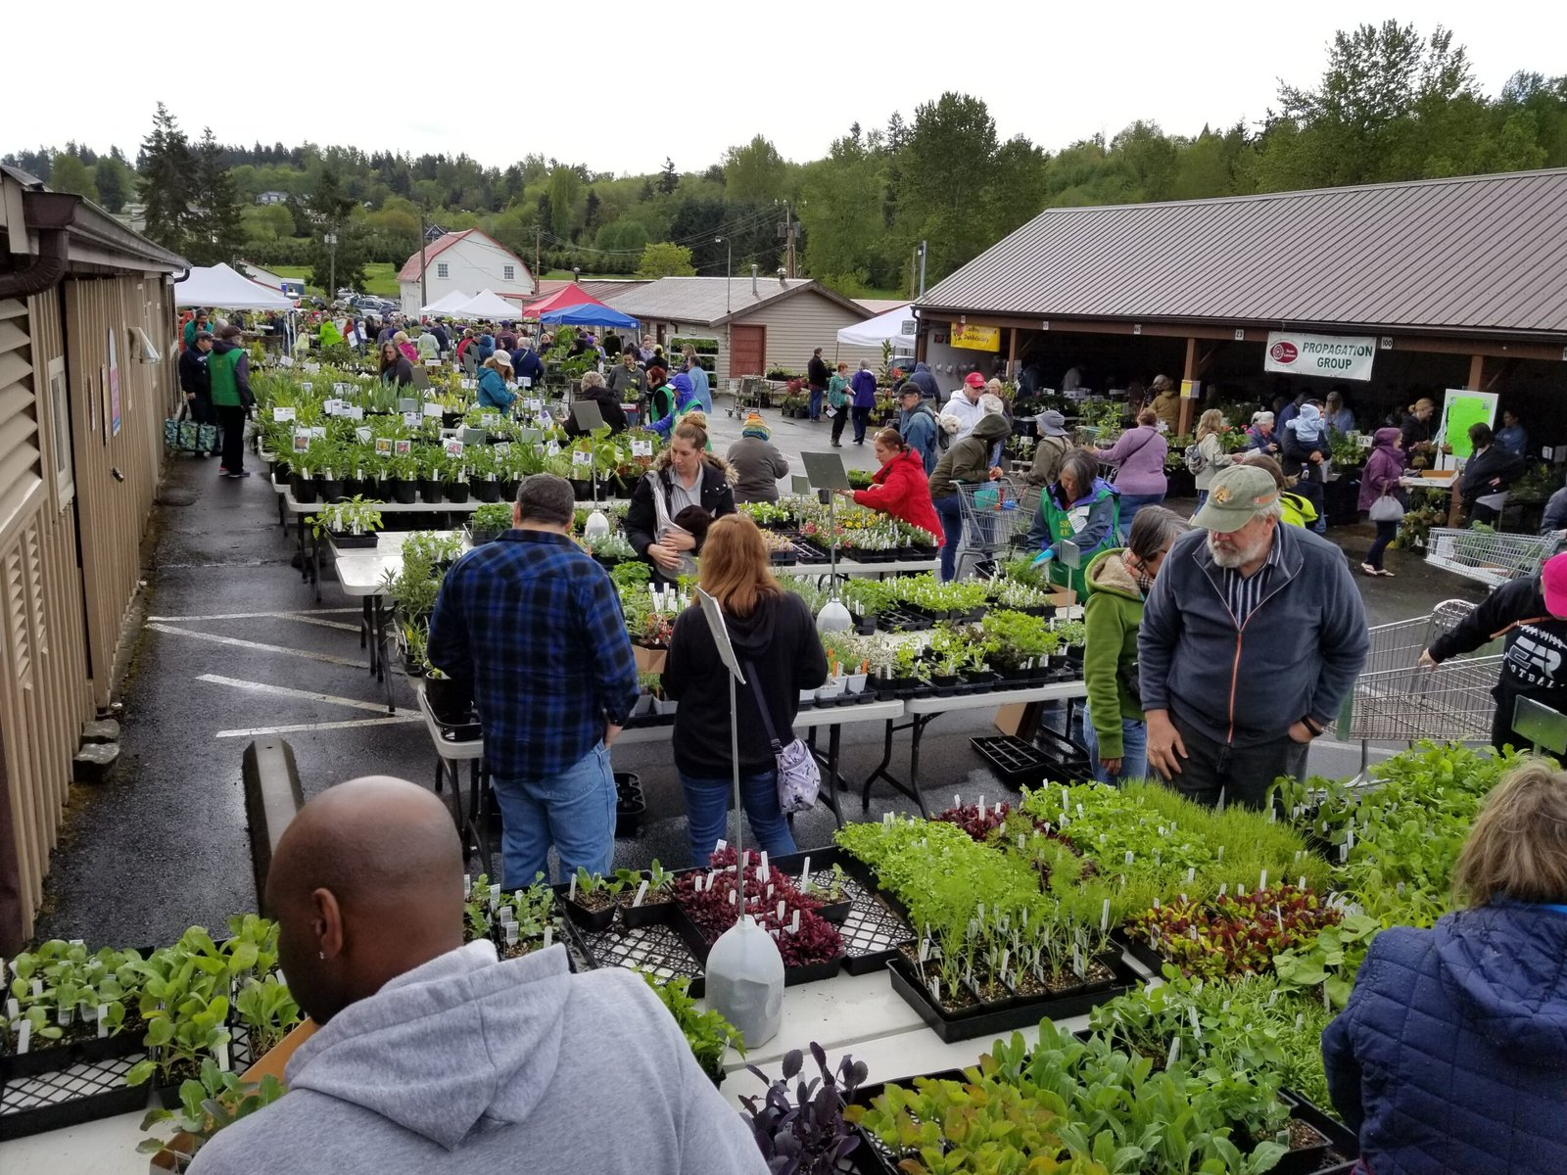


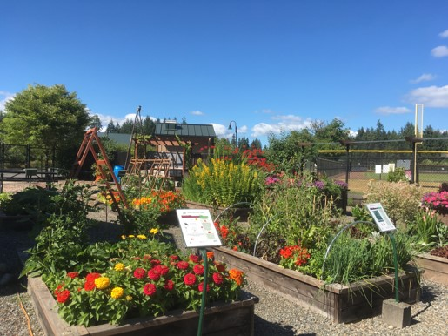
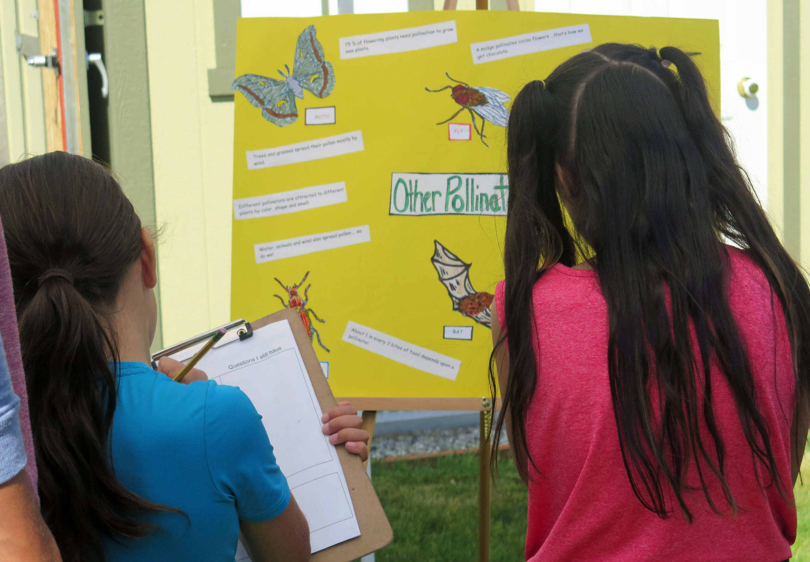
Cultivating plants, people, and communities since 1973
Speakers Bureau
Ask a MG
Mission
Educational Outreach:
Horticulture &
Environmental Stewardship
Annual Plant Sale
Demo Gardens
Youth Education
All images credit: WSU EMG
Notes:
I ask if attendees are familiar with the Master Gardener Program, if not: time for a quick commercial:
If you aren’t familiar with the Master Gardener Program…..the program was founded in 1973 by WSU Extension Agents in Pierce & King County and has since spread to all 50 states and some foreign countries. We are a volunteer program dedicated to providing education on Horticulture and Environmental Stewardship, free of charge, to gardeners in every county in the state of Washington.
We are trained by Washington State University, but powered by volunteers.
We deliver much of our educational outreach via programs like this one, called ‘Speakers Bureau’ as well as offering ‘Ask a Master Gardener’ answer clinics via email and in person in clinics at Nurseries, Farmers Markets, and other locations throughout the county. We also have demonstration gardens where provide hands on gardening education including Youth Gardening Workshops for the next generation of home gardeners.
While our charter is to offer this education free of charge, many of these programs require funding which is not provided by WSU and so we have a Foundation dedicated to generating the revenues to cover the costs of delivering education to the public which spans a number of funding events, the most important of which is our Annual Plant Sale - you might have heard of that! - which covers much of the funding of our programs.

Slide 4

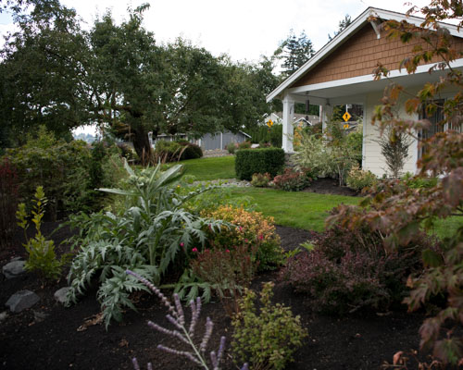

Contents:
Sections:
Why lawns are ‘bad’
History of lawns
Nature’s Best Hope
Survey of choices you can make
Credit: WSU_EMG Casson
Notes:
In the first section of the presentation, we’ll review why lawns are ‘bad’ from the perspective of the environment and climate change. We will look at the history of lawns to see how we got where we are today.
Then we will talk about different ways to look at the lawn that is more in line with the way we live today and see if we can turn an environmental liability into an asset, while also saving ourselves time, effort and money.
In discussing changing our approach to lawns, we will sort through changes which are progressive modifications to the current set-up on the way towards more extreme measures like taking out your lawn entirely. So: changes at the margin first, moving towards more extreme measures.
Because there are so many lawn alternatives and so little time today, the back end of the presentation will be a survey of the various approaches, weighing the pros and cons of each. The goal here is not to recommend any one solution but rather to make you aware of your choices so that you can take the approach best suited to your needs.
And the best news: you don’t have to take any notes. We’ve set up the presentation so that we can send you a PDF of the presentation and we’ve linked to many of the sources we used to create it. This way you have a handy short-cut to taking a deeper dive from your home computer: we’ve done the research for you and made it easier for you to dive into greater detail in just the areas that interest you the most.

Slide 5

Why Lawns are ‘bad’
“I’m a little fuzzy on that good - bad thing” Peter Venkman, GhostBusters
~ 40 million acres:
Over watered
Chemical stew
Emits greenhouse gasses
Damages soil &
surrounding ecosystem
High maintenance costs
Labor intensive
Credit: Pexels-7290259
Notes:
Let’s start with why lawns are bad from the perspective of climate change and the environment:
Over just the last 75 years, we’ve been told that the ideal lawn is a mono-culture: a ‘putting green’ of perfectly shaped, short blades of grass that we have to keep green all year long. Before 1950, lawns had a mixture of plants that could be walked upon. The ‘putting green’ lawn is a recent invention.
In order to get this, we over-water our lawns; we apply large amounts of fertilizer and herbicides creating a chemical stew in our lawns. Because we put more nitrogen on the lawns than the grass can handle, the excess washes into our waterways causing environmental damage, and also some of the excess nitrogen becomes a gas, Nitrous Oxide, that contributes to global warming. Synthetic fertilizers that advertise ‘quick greening’ of the lawn are most susceptible to emitting Nitrous Oxide
But wait, there’s more! The herbicides and pesticides wash into the soil and wreak havoc with the organisms in the soil as well as the pollinators above ground. So, this is what we mean by the word ‘bad’.
And… beyond all that: maintaining lawns are a lot of work! And if you choose to hire it done, it is expensive. The lawn has become a losing proposition on almost every front.
You want more?…. Let’s take you through a few numbers: (next slide)

Slide 6
By the numbers: ~40million acres….
Over-watered:
30-50% of your water bill
Chemical stew:
1 lb Synthetic Fertilizer =
4-6 lbs CO2 in manufacture
On average, we put 10X the amount of fertilizer as food crops
+ Herbicides & Pesticides
damages soil underneath
Emits greenhouse gasses:
Over-fertilization = Nitrous Oxide
Gas powered lawn equipment:
180,000,000 lbs CO2 in Pierce
Maintenance Costs:
DIY: Mowers + Edgers + Blowers
Gas + Tune-ups, etc. etc.
Lawn Service: $3,000/year(?)
So…. How did we get here?
Notes:
Not convinced that lawns are such a bad deal? Let’s do it by the numbers….
Over-Watering: source: US EPA WaterSense program
Chemical Stew: Fertilizer source: David Wolfe, Plant & Soil Ecology, Cornell University
- Over fertilizing source: U.S. Fish & Wildlife Service
Greenhouse Gasses: Source for emissions due to lawn equipment, for top 100 counties: Lawn Care Goes Electric
Maintenance Costs: I tend to ask the audience if they have a lawn service, is $250/mo about right? If so, that totals $3,000 per year.
In today’s presentation, we’re trying to get you to at least consider that maybe there is a better way than the status quo. Whether you are motivated by environmental concerns or you just want to save time & money is less important than taking the time to take a step back and consider what you really want out of the square footage that is currently allotted to your lawn.
Quick note on why this is such a big deal: As an individual, there are 3 areas where you can take personal action to impact climate change, the areas are what the analysts term: Transportation; Built Environment & Land Use. Transportation & Built Environment come down to how much greenhouse gasses you generate moving yourself and your stuff around…. Lots of solutions here, the big one being buying an Electric Vehicle. Built Environment looks at the greenhouse gasses emitted from operating your home. Lots of solutions here, too and the big one being adding solar panels. In general, as a society, we’re making significant progress on the Transportation front. A little less on the Built Environment front, but the ‘big solution’ is there awaiting larger adoption.
It is the third area, Land Use, that is the focus of this presentation. And while there are not any ready-made big dollar solutions like an EV or Solar Panels, this area is perhaps strategically more significant because our lawn dominated yards comprise more that 40 million acres when added up across the US. And finding a way to ‘move the needle’ on some of these 40 million acres is strategically significant because other sectors, like agriculture, are struggling in their quest to grow more food while generating less greenhouse gasses and, importantly, not cutting down more forests. Our yards comprise a lot of land where the forest has already been cleared and if we can make these chunks better at absorbing greenhouse gasses we can make an important difference in the battle against climate change.
So, let’s start back at the beginning: where did the current model of a house with a lawn come from?

Slide 7
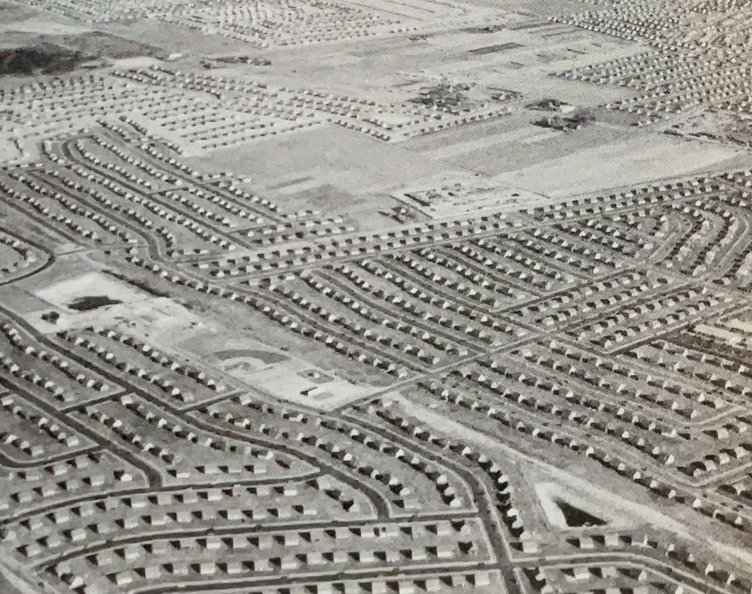
Lawns - history
‘Lande’ to Lawn
Levittown, NY circa 1948
1500’s in Europe - protection
1700’s England - grass & ‘ha-ha’
1868 first patented lawn mower
1950’s: the ‘modern’ American lawn:
- GI’s needing affordable housing
- The tract home with yard
- Power mowers & edgers & blowers
First push toward ‘mono-culture’ with
- New seeds
- Synthetic Fertilizers & Herbicides
- Marketing: American Dream
Credit: American Green (Resources)
Notes:
First mentions of the ‘lande’ in the 1500’s were for a clearing around the home so you could see approaching invaders. This was probably what we think of as a grassy meadow today and was grazed by livestock.
In the 1700’s in England, you had large expanses of grass that linked areas of the garden around the home and gave a view out to lager grassy areas and the surrounding landscape. But, because the blades of grass had to be cut by hand, the lawn near the home was small with a ditch called a ‘ha-ha’ that separated it from the larger grassy meadow that was again maintained by grazing livestock. Because of the high maintenance cost, the lawn was the purview of the English aristocracy and was brought to America by colonists wanting to emulate the English, like George Washington.
The invention of the lawn mower, patented in 1868 led to a significant reduction in the maintenance effort and started to ‘democratize’ the ownership of lawns. But it wasn’t until about 1950 and the return of GI’s from WWII that our current suburban lawn model took hold. The formula for the tract home was perfected with the yard featuring the lawn and garden beds and they were built by the millions. The father of the modern was William Levitt and the location was in Levittown, NY in 1948. He pioneered the model of the modern tract home… thousands of homes built to the suburb ‘spec’ of the tract home with matching yards with the perfectly green lawn.
Coupled with this in short order was the development of power tools to maintain the lawn: mowers, blowers & edgers. At the start of WWII, 140k mowers were sold per year. That figure jumped to one million in 1950 and four million per year by 1962. A multi-billion dollar industry was born.
To this point, a lawn was still a mix of various plants interwoven in the yard. But at the same time, synthetic fertilizers and herbicides were developed and the lawn care industry began to market that the ideal lawn was something that looked like a putting green: a mono culture, that must be weed free and kept green year-round. This marketing was linked to home ownership and the American Dream. This is where things stand for about the last 75 years.
(Primary source: “American Green” in the Reference Section)

Slide 8
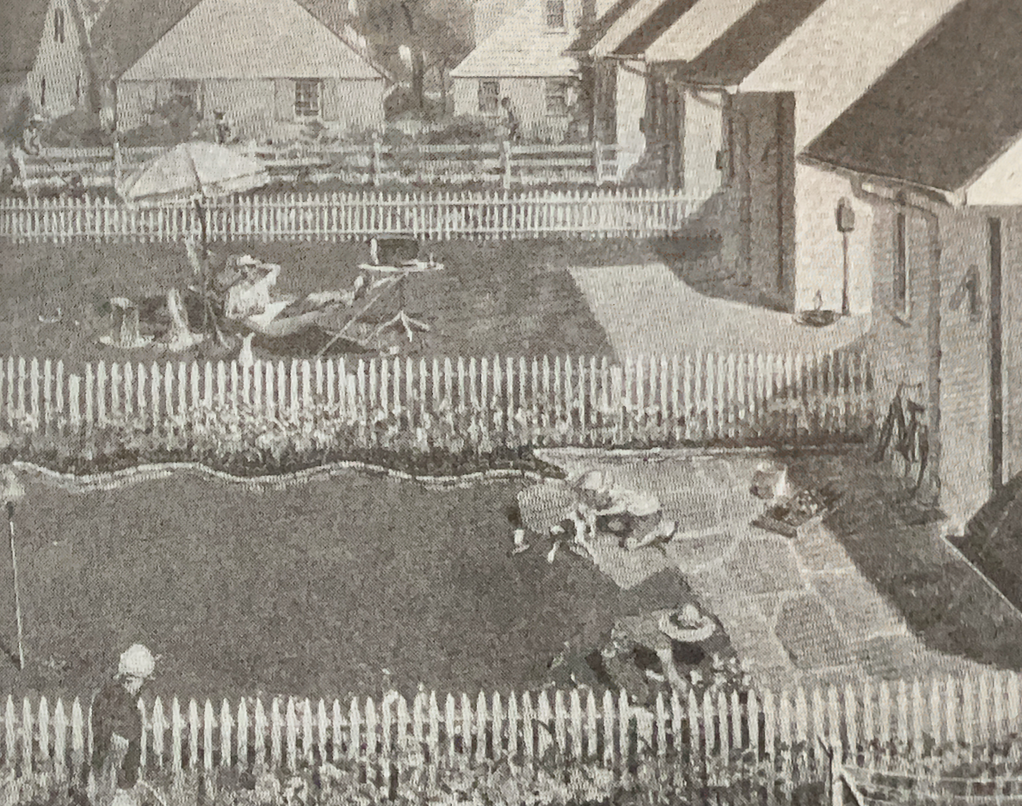
‘American Dream’= Home Ownership
‘American Dream’= Putting Green Lawn
At the 75-80 year mark…
… time for a change?
Lawn’s role today:
Weekend Lawn Warriors
- maintenance vs. relaxing
- ‘experiences’ vs. ‘stuff’
Family Sports
- go to public fields
Environment
- remember that ‘good/bad’ thing
- 40 million acres put to better use
Credit: American Green (NY Post)
Notes:
This notion of linking the lawn to the home to the American Dream is a powerful idea that is extremely hard to break.
But, over the last 75 years, times have changed. If we were to stop and really think about what we want from our lawns we would realize that we’re getting a bad deal and we would like something better suited to the way we live today. A few examples:
Maintenance Time & Costs: In the 1950’s, we were sold on the idea of maintaining our own lawn but somewhere over the last 30 years we’ve transformed from a society where you maintained your own lawn and hired out your travel planning to just the opposite. Today, we use the internet to plan our own travels and increasingly we hire people to maintain the lawn….. all part of a societal change that increasingly values ‘experiences’… and the chore of lawn maintenance gets in the way.
Family Sports: The notion of playing ball in the yard has largely disappeared over the last 75 years. As kids get into sports, their parents pack them into the car and drive them to sports fields to play. Really, the only remaining activity for kids where they use the lawn is for smaller children as a play area and even that is disappearing in favor of heading out to the park. So, really….
Environment: “When enough people get to that ‘ah-ha’ moment where you realize that instead of accelerating climate change, smart & simple changes to the way we maintain the square footage dedicated to the lawn can actually slow climate change while saving us both time and money. That is when we will see a ‘sea-change’ and the link between the lawn and the American Dream will be broken.”
There are some leading thinkers that are putting up visions for how the lawn needs to evolve. One of the biggest: Douglas Tallamy…. Nature’s Best Hope + Homegrown National Park…

Slide 9


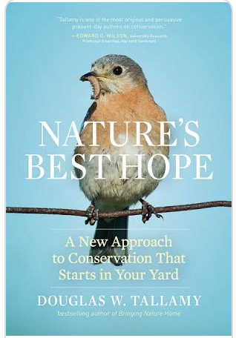
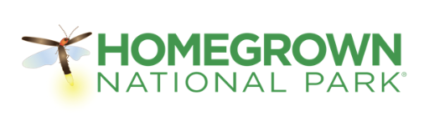
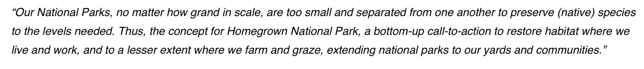
Nature’s Best Hope
Douglas W.
Tallamy
Conservation Problems:
#1: Idea that we must live in competition with nature
#2: Leaving the conservation
to the conservationists.
What you can do:
Shrink the lawn
Remove invasives
Plant Keystone Plants
Add more stuff!
Specialist pollinators
Do not spray or fertilize
Notes:
Douglas Tallamy is a Professor in the Department of Entomology and Wildlife Ecology at the University of Delaware.
His target is much bigger than our lawns. His group is trying to restore some diversity of wildlife across the U.S. (& World) because as species disappear at an alarming rate, it affects us all in things like food production. In his best selling book “Nature’s Best Hope” he points out all the issues associated with the modern yard against the backdrop of our National Park system because, in his experience, a lot of people think that we are preserving our native species within our national parks.
He points out that National Parks cannot do the job because many species must migrate to survive. The only way we can save all those who migrate is to reimagine our yards as the highway system that enables birds, butterflies and other species with the ecological pathways to move in order to survive.
This concept powered the organization he founded: Homegrown National Park, which we’ve linked to in this slide. His concept of reimagining your yard as a place for nature to thrive and use as it migrates with the seasons is the kind of grand scale thinking we need to help battle the impacts of climate change.
Will this be ‘THE’ new model for the next 75-80 years? I don’t know. Tallamy & crew face a huge battle trying to change the status quo. But it will be something like this which needs to catch on and significantly change the current model of the suburban yard for us to make significant headway in that ‘Land Use’ category in dealing with climate change.
What is the Homegrown National Park model? Shrink the lawn (because, well… you now know why); replace invasive plants with Keystone Plants… then add more plants; when doing that, remember to include plants that help pollinators in your area; and never spray or fertilize. Again… you know why.
So… what are ‘Keystone Plants’?

Slide 10
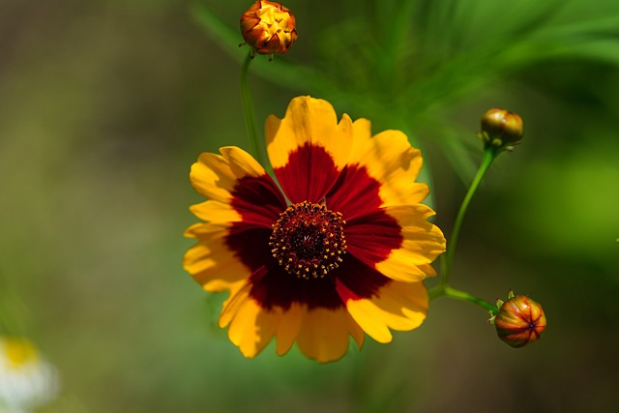
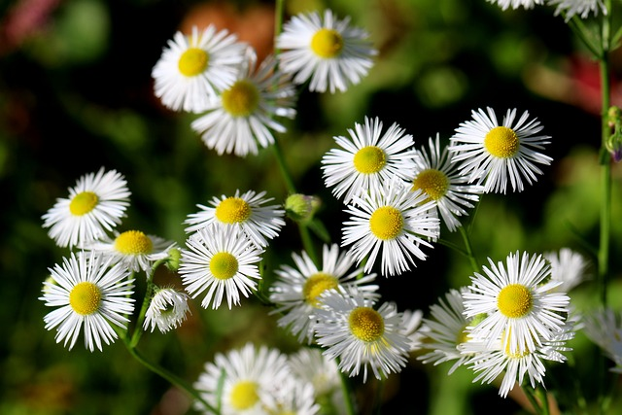
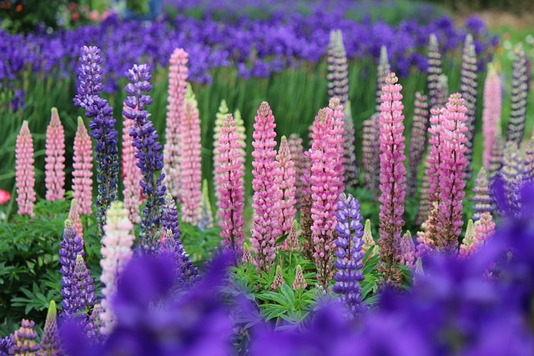
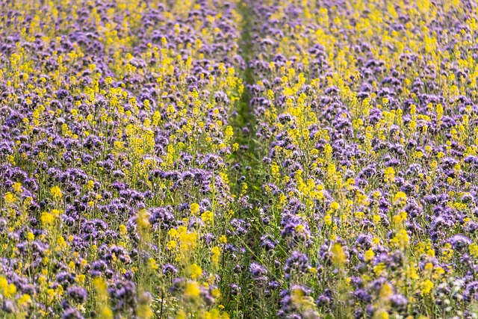
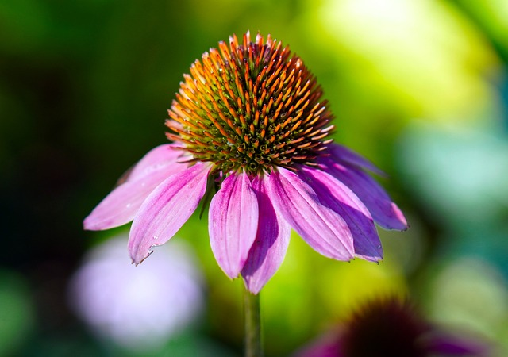
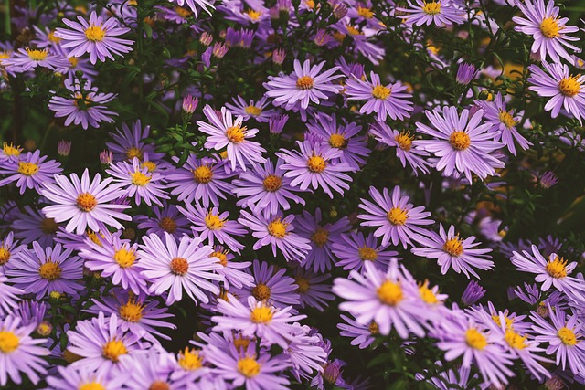
Keystone natives in our zone:
Tickseed Coreopsis tinctoria
Credit: Pixabay id:7703165
Fleabane Daisy Erigeron speciosus
Credit: Pixabay id:1005494
Silvery Lupine Lupinus argenteus
Credit: Pixabay id:715918
Phacelia (Phacelia californica)
Credit: Pixabay id:153208
Coneflower Ridbeckia occidentalis
Credit: Pixabay id:3930681
Aster Symphyotrichum chilense
Credit: Pixabay id:8968314
Notes:
The Homegrown National Park website covers the entire USA and pulls together lists of both Flowers&Shrubs as well as trees that are native to your area. Since I focus on a typical suburban yard, I’ve pulled out the list of Flowers&Shrubs for our area. I left off the trees because most of them are huge. But you can look them up on the site.
These are called ‘Keystone’ plants because they provide something like 80% of the nutrients that pollinators and other critters native to our area need to survive. So, if you just include these 6 plants in your yard, you will be taking a significant step towards making your yard a healthy zone for native species.
If you take a look, these are some beautiful plants. My point being that you don’t have to be making any kind of great sacrifice to adopt a model for your yard that better reflects the era we are living in.

Slide 11
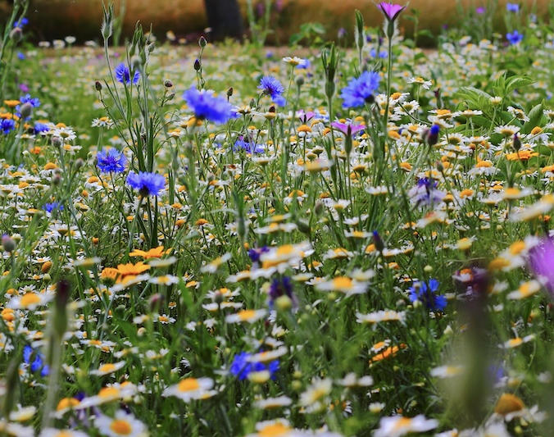
If you build it, they will come!
Flower Meadows Study:
Urban vs. Natural
# & Species richness of
Bees, Butterflies
& Hover flies
No difference for bees
& hover flies
Butterflies: quantity increases with size of meadow
Credit: Pexels-6839-51548
Notes:
And, if you are wondering wether simply adding plants will ‘work’ in your area of if there is some special additional magic that needs to happen…. I’m pleased to report that the old Field of Dreams slogan “if you build it, they will come” does in fact work in this case! When you offer living things food, water & shelter…. They seem to figure out where you are.
In my readings, it has been pointed out time and again (anecdotally) the ‘before and after’ difference from a simple planting strategy. But, as Master Gardeners we seek out scientific studies to go beyond anecdotes, and happily, there was a study published in November of 2024 by the Royal Entomological Society where a group in Poland looked at this question. They structured a study to determine if adding small fields of wildflowers to urban areas would attract similar pollinator populations as would large meadows in the countryside.
They went about the painstaking task of counting the number and variety of bees, butterflies & hover flies per square yard in the urban fields that had been sown from flower & grasses mix versus naturally grown rural fields. They found by years 2&3, little difference between the urban and rural fields. The only significant difference was that the larger the field the greater quantity of butterflies. But you still got the same variety of butterflies, just fewer per square yard.
So… can you make a difference, even in your little yard?! Yes, you can!
Reference: Sown wildflower meadows: Can they replace natural meadows in urban spaces for bees, butterflies and hover flies?
https://doi.org/10.1111/een.13396

Slide 12
Summary of first section
Historical Reasons for Lawns:
Protection from attack
Mastery of nature
Class affirmation
Class emulation
American Dream
…. ?
Climate Change: reimagine
Good news:
- less work,
- save money
- better for the environment!
Win, win,WIN!
Notes:
Transition: we’re going to move from the theoretical to the practical. From ideas to actions. You don’t have to embrace ideas like Tallamy’s “Homegrown National Park” to want to change your lawn into something that better suits the way you live today…….
Historically:
- Lawns were the original ‘moat’… an open space so you could see approaching invaders
- Then, in England & France came the adoption of cultivated gardens with intermixed lawns which demonstrated mans conquest of nature. This was exclusively an upper class phenomenon
- And… it spread as what the upper classes do, then
- It was increasingly ‘democratized’ as working classes emulated the upper crust to show they had ‘made it’
- And finally, with machinery and chemicals we moved to a world where lawns were available to all & linked to the American Dream of home ownership.
Today:
- Climate Change has put the microscope on the lawn & for all our good, it is time for a change
- The good news: lawns have become more trouble than they are worth, labor wise
- And expensive to pay to have someone else do it for you
- So, there is a better path where you can save both time and money, while also re-purposing that lawn in a way that is better for the environment. A Win-Win proposition.
The Next Part of this Presentation:
We will survey several alternatives to the ‘putting green lawn’. We won’t tell you which approach you should adopt: that is up to you. The purpose of this section is to expand your knowledge of the various options open to you AND to provide you with the information so you can research further to determine which option is best for you and your current situation in life.

Slide 13
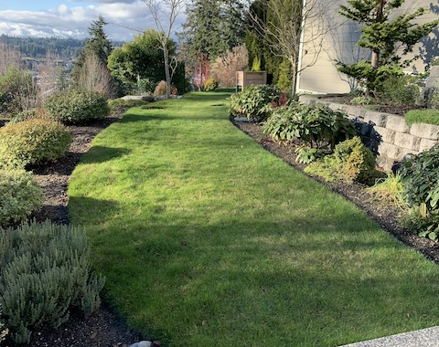
When you take action…
Evolution vs. Revolution:
Baby steps…
Over time…
Can lead to…
A fundamentally different lawn
But, feel free…
To rip it all out at once
Credit: WSU EMG
Notes:
Take this picture as an example of the choices you face in dealing with your lawn. This patch of lawn serves two purposes:
1. It is a high traffic area leading from one area of the yard to another
2. It frames a lower bed down to the sidewalk and also frames the beds that are next to the house
Both ‘high traffic’ path and ‘framing beds’ are legitimate purposes for having a lawn.
But you could yank the lawn out entirely and replace with stepping stones, expanded beds and ground covers. That is the ‘rip it all out at once’ approach.
Alternatively, please notice the shrubs on the border of the lawn. Closer up, the shrubs are overlapping the grass. Further away, there’s about 6-9” gap between the two.
This is my yard and, in thinking about this presentation I realized that for the last 50 years, whenever there was competition at the border between lawn and shrub growth, I always treated the lawn as sacred and clipped back the shrubs. Sometimes into some pretty awful shapes. Recently, I asked myself “why does the lawn always have to win”? So in just the last year, I’ve started the opposite approach: I’ve been cutting back the edge of the grass 4-6” on each side every spring and fall. To date, I’ve shrunken the lawn in this section by about 12-18”. This does two things: allows the shrubs to grow in a more balanced way and opens up spaces between shrubs, gradually, for the addition of more shrubs, flowers or ground covers.

Slide 14
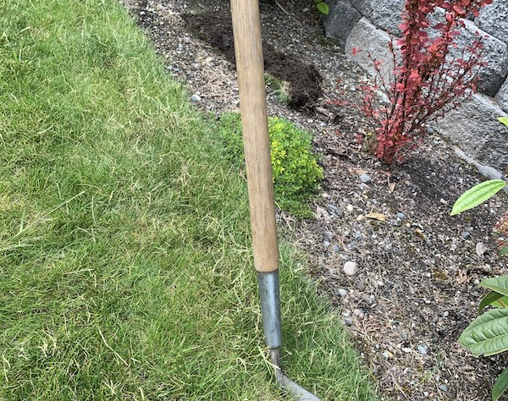
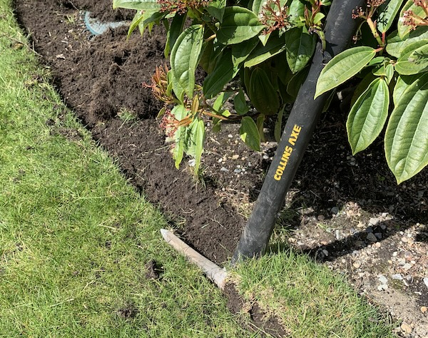
Small changes, over time…
‘Half Moon’ Tool
Pick Axe
Credit: WSU EMG
Credit: WSU EMG
Notes:
Presenter: this slide may be too much information. If so, just take it out.
What is the most efficient way to do this? I experimented and found that using a bladed edging tool (left picture) to make the new boundary cut, followed by swinging a pick axe, instead of a shovel, gave me the easiest way to remove the sod. I then flipped it over to dry out, shook out as much dirt as I could and then included it in my weekly yard waste bin for disposal (which is OK in Pierce county, is some counties this is prohibited)

Slide 15
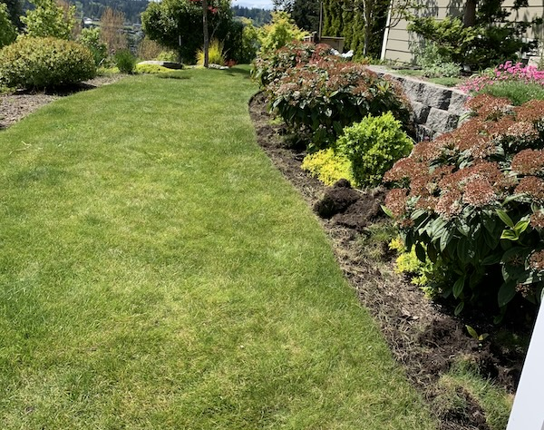
Barely noticeable, but in 3 years…
Fall 2024
Spring 2025
Credit: WSU EMG
Credit: WSU EMG
Credit: WSU EMG
Notes:
This is the same stretch of lawn before and after removal of 4-6”… left slide in the fall, right side the following spring. I challenge you to spot the difference.
This is the ‘baby steps’ approach. And note that starting with baby steps doesn’t preclude me from deciding to take out the lawn entirely… I just get there by taking smaller bites.
Whichever way you choose to proceed, we should discuss the best ways to remove lawn sod because it is really heavy and so results in a disposal challenge. Using the ‘baby steps’ approach, I take the removed sod, flip it grass side down to let it dry out for a few days. Then I shake out as much soil as I can to lighten the weight. Doing this, I can simply recycle this into my yard waste bin.
But, baby steps or ‘rip it all out’, at some point you are probably going to take out more lawn that will fit into your yard waste. So, let’s talk about the best way to do that…..

Slide 16
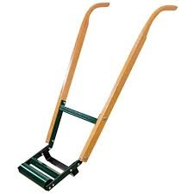
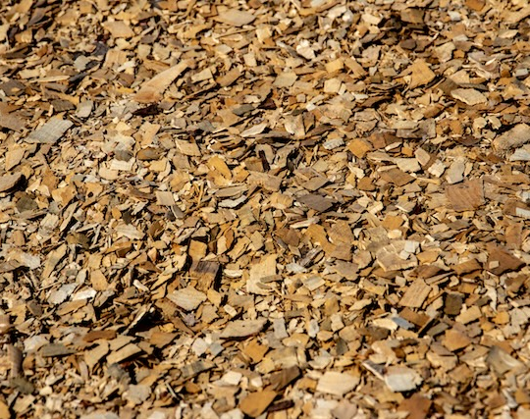
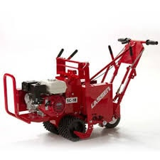
The Best Way to Remove Lawn
Also happens to be easiest!
1. Mow lawn close (scalp it)
best time is mid-summer
2. Cover with 8-12” Arborist Wood Chips
When they chop up the trimmings
3. Wait 2-6 weeks
Then pull back and check
4. Plant
Credit: Pexels 7509234
Notes:
Good news! The proven best way to remove lawn is also the cheapest and easiest.
First, you mow your lawn as close to the ground as you can. Scalp it.
Next, you cover it with 8-12” of Arborist Chips… that’s the chopped up mulch that comes from an arborist trimming up someone’s yard. If you’re lucky, you can get those chips for cheap/free on ChipDrop.com Do not skimp on the depth: 8-12” is required. Some will ‘cook down’ and you need enough to completely block the sunlight.
Wait… 2 to 6 weeks. You can check by pulling back the chips and see if the grass is dead. Once it is, …
Plant by pulling back the chips in the place where you want to add the plant, then cover it back up.
This approach is the least expensive, it requires the least work and entails no hauling off of the heavy sod. It is also the best for the soil and results in the healthiest new plants.
How do we know this? Scientific studies! (Next slide)

Slide 17


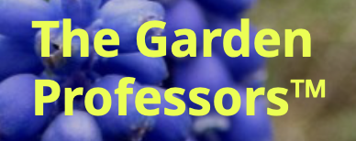
Two Studies:
Linda
Chalker-Scott
WSU
Glyphosate*:
Study:
- Used to kill weeds
- Turned soil
- Planted Natives
following spring
Compared to wood chips:
- More weeds!
- Lower plant survival
rate
Wood Chips*:
Kills the lawn
Supreses weeds
Oxygen & water can still reach the soil
Cardboard:
Do NOT use cardboard in your yard!
- Contains
‘Forever Chemicals’(!)
- Deprives soil of oxygen
* Wood Chip mulch improves plant survival and establishment at no-maintenance restoration site Ecological Restoration, October 2005 (Linda Chalker-Scott)
Notes:
This is a summary of two separate studies:
Linda Chalker-Scott is a Professor of Horticulture at WSU and is a ‘rock-star’ to Master Gardeners. Our Mission is to provide Science-backed information to you. Sometimes finding the appropriate studies is a challenge because most studies are funded for commercial, not home applications. Professor Chalker-Scott, however has always kept the homeowner in mind in her pursuits and is adept at either providing the appropriate studies or in reading commercial studies and sifting out the importance for home owners.
In 2005, she was part of a study on the UW grounds, where they were replacing grass with native plants, so they constructed a side-by-side comparison: they killed the lawn in the fall and planted natives in the following spring. In one plot, they used arborist chips and in the adjacent plot they used the chemical glyphosate (formerly the active agent in Roundup, but it has been reformulated). Both killed the lawn in the fall, but in the ensuing spring planting the glyphosate side was rife with weeds(!) Not so for the side with arborist chips. Also, the native plantings had a higher survival rate and grew larger on the Arborist chips side. Clear winner.
The second study I want to highlight relates to cardboard. In many of the books I read, they recommend placing cardboard down to ‘smother’ the lawn then cover it with compost or mulch and plant into that. Do not do this! In 2023, there was a study for commercial purposes of using shredded cardboard for chicken bedding. In measuring the results, they learned that the chemicals they treat corrugated cardboard with to make it smooth and waterproof contain ‘Forever Chemicals’ (PFAS and many others). These chemicals entered into the food chain through the eggs, and meat of the chicken. So, if you are using cardboard in your yard (like I have) … stop it! Further, using full sheets of cardboard to ‘smother’ the grass also ‘smothers’ the soil and likely kills the critters in the soil. Many people, when lifting up the cardboard see a bunch of worms and think they are attracted by the cardboard. Much more likely is that they are ‘coming up for air’.
https://gardenprofessors.com/cardboard-does-not-belong-on-your-soil-period/

Slide 18
Survey of approaches:
- No Mow May
- Micro-clover
- Pearl’s Deep Rooted
- No Mow Lawn
Artificial Turf
Ground Covers
Gravel Gardens
Moss
- Grassy Meadows
Notes:
So far, we’ve talked about why lawns are ‘bad’, presented an alternate way to view your yard: as a Homegrown National Park & talked about the mechanics for removing the lawn from your yard. That just leaves us with the key question: what do we replace it with?!
In the following section, we will survey the various ways you can alter or remove your lawn. The purpose of this section is to make you aware of the various alternatives so that you can choose your own path. We will not do that for you.
But, we have tried to provide resources: relevant books and links to websites to make it easier for you to take that deeper dive in order to create an action plan that is your own.
Remember: we’ll send you the PDF of this presentation with all the links intact: all you have to do is click to find the book or website to further your research.

Slide 19
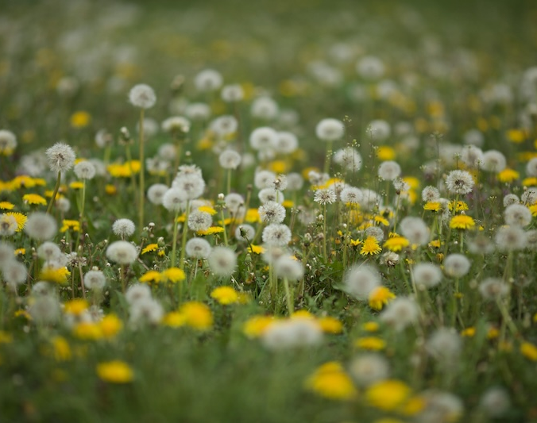

No Mow May vs. Mixed Grasslands
No Mow May:
Lots of articles
- Neighbor & HOA conflicts
Mixed Grasslands/Meadows:
Easy as 1 - 2 - 3
1. Stop watering/fertilizing/mowing in July
2. Add: mixed flower seeds in fall
3. Add: perennial starts in fall
Credit: Pexels-6205197
Notes:
If you are already sold on getting your lawn and you just want to know the quickest, cheapest, easiest way to move on then you might be a candidate for what several articles in popular publications call the “No Mow May Movement”. You will see these articles because, I believe, they get clicks on-line. They follow a similar structure: concern about the environment; example of neighbor who stops mowing their lawn to promote pollinators quickly followed by neighbor complaints and HOA intervention.
I confess that I was skeptical of the whole ‘movement’ (as you can tell by my description above). If your goal is to promote pollinators, you can be much more ‘intentional’ with your plans than simply no longer mowing the lawn: you can convert one or more of your beds to pollinator gardens and select specific plants to encourage the right kind of pollinators (note the Keystone natives on earlier slide). So, I was going to come down hard on the ‘No Mow May Movement’ until I read a section titled “Mixed Grasslands” in the book Planting Design for Dry Gardens.
So, let me try to explain without the ‘hype’:
If you have thought it through and you want, in one pass, to move away from the ‘putting green lawn’ to something that requires less water, fertilizer, herbicides, pesticides and labor to maintain then the easiest way to accomplish this might be moving to “Mixed Grasslands”. To do this, the work starts in July (not May) to set things up for the following spring. The first thing you do is stop watering/fertilizing your lawn as you enter the hot months. Your lawn will go brown. While I have called the ‘putting green’ lawn a monoculture, it is actually a mixture of grasses. By stressing out that lawn in the heat of summer, those strains of lawn that need the most water and fertilizer will be the ones to be most weakened.
Then, in the fall when the rains return, the grass that ‘comes back’ best will be the stronger strains. You will also have dead patches in your lawn. This opens up ‘space’ for more diversity in your lawn. If you do nothing more then whatever ‘weeds’ come up is what you will have. And, if you have used a lot of herbicides in the past, the most likely viable seeds in your soil are those that have recently ‘blown in’. Often dandelions and daisies. Couple these with the ever present clover patches and that is what your lawn will look like the following spring. To avoid the complaints of neighbors, most people will want to give nature a ‘guiding hand’ in this process so as to not be left with a field of dandelions. To do this, use a rake to ‘scratch’ those areas that are most dead, then buy your favorite wildflower mix and add to the lawn. Now you have a more diverse lawn with some more attractive pollinators (and you can tell your neighbors what you’re doing).
The third step in this process is recommended because in casting a wildflower mix, you don’t know what you’re going to get: the germination rate can be low and inconsistent. So, you give nature a further ‘nudge’ by adding a few of your chosen perennial flower starts sprinkled lightly throughout the lawn. You want flowers that reproduce both via seed and via ‘runners’ (stolons) to ensure that you’ve got some diversity of flowering plants the ensuing spring…… THEN you can say you are joining the “No Mow May Movement” if you want.
This ‘all at once’ approach is great because you aren’t replacing your lawn, you are converting it. But many people will not want to be this aggressive initially for some of the reasons listed above: neighbor and HOA revolt; risky end result and many lawns aren’t shaped to be suited to an all at once approach. It is more likely that you will do section by section, over time to get to the design you want. So, let’s look at some other alternatives. But first:

Slide 20

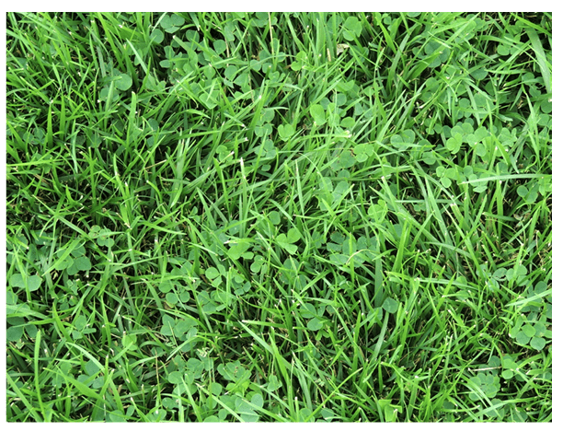
Micro-clover
What is it?
Specially bred clover that grows lower and has fewer flowers.
Part of the lawn mix before 1950
Pros & Cons:
Legume family: ‘nitrogen fixers’!
Winter die-back & poor in shade
Herbicides will kill it
Notes:
Micro-clover is a Marketing Term applied to White Clover or Dutch white clover which has been bred to have smaller leaves, grow lower to the ground, grow more uniformly (less clumping) and have fewer flowers than the Clovers we have been trained to regard as weeds. But before the 1950s and the introduction of herbicides and the start of the ‘putting green’ marketing; clover was a regular, desired part of what was considered the typical lawn mix.
Why? Because clovers are part of the legume family which have the magical property that they can pull nitrogen directly from the atmosphere, convert it from a gas to a solid and place little nitrogen nodules in their root structure. So, they fertilize & make more green all the blades of grass that can access that nitrogen. Adding clover to your lawn reduces the need to fertilize your lawn.
Micro-clovers are not intended to replace your turf grass. They are intended to blend with it, reduce the need for fertilizer and provide an increased food source for pollinators.
If you want to mix clover into your lawn, you can search on the term Micro-clover and there are a multitude of organizations willing to sell you their seed.

Slide 21
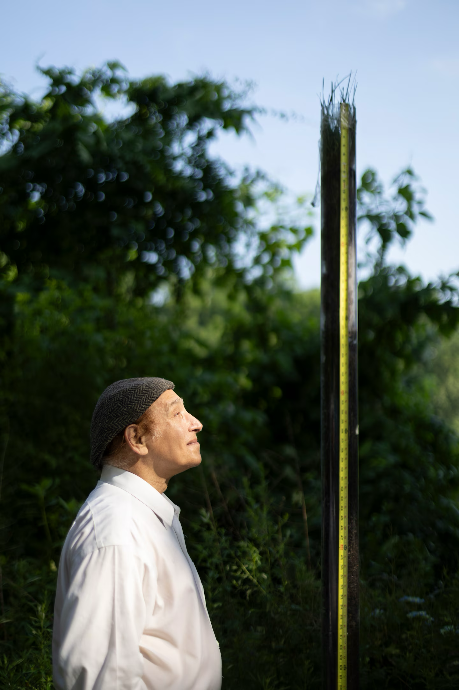

Pearl’s Deep Rooted Grass
What is it?:
Mix of 7 types of Fescue
Blended to produce
“greater ecosystem function”
Reported Benefits:
Watering: little to none
(after year one)
Fertilizing: none
Mowing: occasional
(or none if you want grassland)
Notes:
Before I tell you about “Pearl’s Deep Rooted Grass” we need to review the Master Gardener charter: we can only make recommendations to you on things that are backed by science. It is much easier to find scientific studies on commercial / farming scale products than it is for something like the suburban lawn.
When talking about something without the backing of science, it is a little like in Medicine. Most people realize the difference between ‘Drugs’ that have been backed by FDA testing versus ‘Supplements’ which have not. The supplements might or might not meet up with the manufacturers claims: they are not backed by independent science.
So, Pearl’s Deep Rooted Grass is like the vitamin supplement situation: an interesting concept that seems to have merit, but the only scientific backing I can find for it is provided by the manufacturer. I’m drawing your attention to it because, like I said: it is interesting. But if you are interested in following up, you need to verify the manufacturers claims or just be aware of the risk. Another thing: Pearl’s approach is altering the blends of grasses to achieve the desired results of no watering or fertilizer and limited mowing. This is selective blending of various strains of grasses is the same approach the commercial grass industry uses. Only they are optimizing for the putting green without regard for amount of fertilizer or water. So… there is nothing ‘whacky’ about Pearl’s….
Interesting story behind Pearl’s: In 1999 a Multimedia Show Designer (like Concerts & Theme Parks) moved to a home next to a golf course and soon after, his outdoor cat died of cancer. The Vet treating the cat thought it was due to the chemicals they poured onto the course. So, this designer with no scientific training has spent the next quarter of a century trying to breed a grass that requires little water and no chemicals. His idea, after extensive library reading and consulting with some turf scientists, was to focus on adjusting the blend of 7 types of fescue and bluegrass ( including red, tall & Kentucky blue) and growing them in containers on his back patio. After 7,000 trials over several years he finally hit on a blend that worked. Then he tuned that blend another 3,000 times until you have the product pictured here.
The picture is of Jackson Madnick looking up at a section of grass growing in a tube on his deck that is 8 feet long: the roots grow to nearly the bottom of the tube.
With roots this deep, he claims that after year one, the lawn needs little to no watering as the roots tap into ground water. The lawn is also slow growing so you do not have to mow it often. If you don’t mow it at all it just ‘flops over’ and becomes a grassland. And it doesn’t need any chemicals. The key lies in the mix: “When you have more species growing together, you get greater ecosystem function”
He’s been selling it since at least 2010 and has won several awards on the east coast (where he is from). So, if you want a traditional looking lawn that promises lower maintenance costs in terms of water, fertilizer and mowing effort. This might be worth checking out.

Slide 22
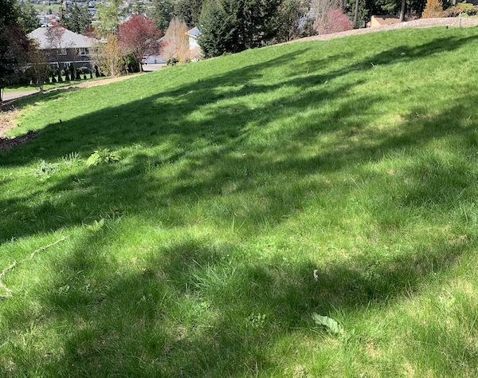

‘No-Mow’ Lawn
April
What is it?
Seed ‘blend’ designed for grassy meadow type lawn
Water only in late summer
(deeply & infrequently)
Mow just twice a year
(spring & fall)
Issues:
Yard Service Providers!
Credit: WSU EMG
Notes:
Not to be confused with No Mow May Movement, there are a number of seed blends that are marketed as: “No Mow Lawns”
These products, like Pearl’s, are the result of a blend of grasses optimized for low water and ‘No’ mowing. By ‘No’ they actually mean 2 times a year, to a height of greater than 4”: First time is in late spring when the grasses have a lot of seed heads…. String trim them off. Second time is in late fall to ensure “quicker greening” the following spring. Just let the grass clippings fall.
I have personal experience with a No Mow Lawn: our HOA planted No Mow over a septic drain field two years ago. It was the cheapest solution for a large area with poor soil conditions. During the first year, the lawn struggled (even with watering) in the hottest part of late summer. By year two, it held up pretty well.
The biggest issue we’ve had is not the No Mow itself, it is the Yard Service hired to maintain it. They have no clue what to do with it. They are geared to mow weekly and pour chemicals at the first sight of weeds. Though we’ve told them to back off… we’re at an uneasy ‘truce’ with them. So, it is hard to tell what the lawn could look like with proper maintenance.

Slide 23

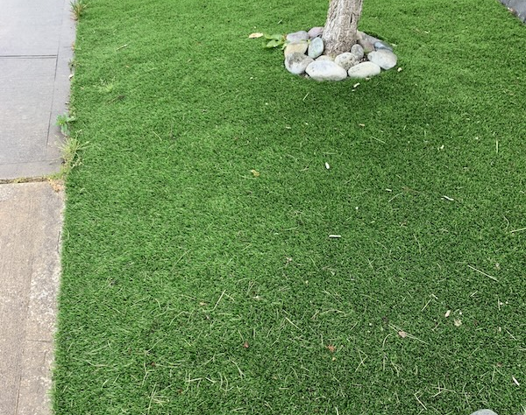
Artificial Turf
Pros & Cons:
Saves water & fertilizer
Expensive to install, but
cheaper to maintain
Lasts 8-25 years - then dispose
Hot on hot days
Bacteria & pathogen issues
with pets… special maintenance
Reduces pests / biodiversity
Credit: WSU EMG
Notes:
Sources:
When researching artificial turf, you have a repeat of the ‘Scientific Studies’ issue: when talking ‘Home use’ there is virtually no information other than that provided by those who have a commercial interest in you buying their product. There ARE studies on the health effects of artificial surfaces on Sports Fields. Here is what seems agreed upon by all parties in relation to homeowners, with just a few sports field comments blended in where I thought it was relevant:
Pros & Cons:
- Saves water & fertilizer costs.
- Financial. High installation cost, but lower ongoing maintenance cost. (Leaves don’t pick themselves up! & There is concern that they may harbor bacteria & pathogens if not properly maintained. Especially if there are pets around.)
- Durability: Lawn life is 8-10 years if sports field 20-25 reported for home use.
- Environmental#1: made of petroleum products and must be disposed of after useful life.
- Environmental#2: may contain PFAS which can leak out of the product.
- Environmental#3: Fewer pests in yard vs. Destroys environmental diversity is the two sides of the same coin: you are replacing nature with something that is trying to be sterile.
- Health Risks: see bacteria & pathogen comments above + ‘gassing off’ of the chemicals can trigger asthma in sensitive individuals
- Artificial surfaces are hotter than grass in the hot summer months.
There is a lot of discussion on the health effects of the crumbled used tires added to sports fields to reduce injuries. Much concern regarding the chemical composition of these old tires and their effect on children. But, again, that is mostly in sports fields.

Slide 24
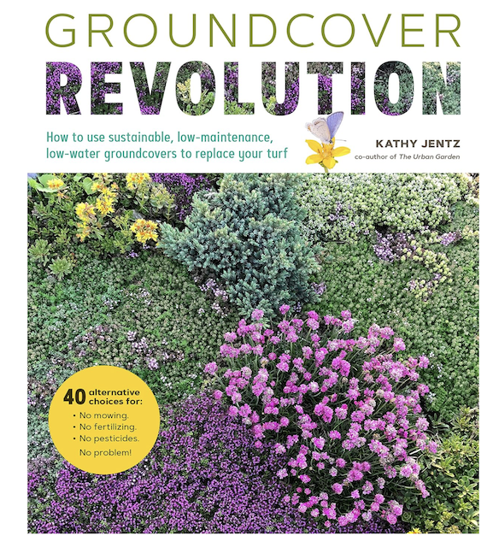
Ground Covers
Pros & Cons:
Wide range of choices
Design the solution you want
Full lawn replacement -or-
Shrink-it-down strategy
Optimize for:
- dry or wet
- sunny or shady
- pollinators
- soil erosion, etc, etc,
Notes:
Ground Cover Revolution by Kathy Jentz was used for a lot of source material for this section. Jentz adopts a broad definition of ground covers:
Any plant that covers soil in a fairly dense manner, and focuses on those that are viable substitutes for turf grass lawns. Low maintenance, moderately fast spreaders and don’t require a lot of chemical applications.
The advantage of this book is the extensive descriptions of a large number of ground covers, from ‘A-to-Z’ with their key attributes (Deer Resistant, Full Sun to Full Shade, etc.). So, if you are seriously considering replacing your lawn with a series of ground covers, this book may be a good place to start.
… and this leads to a key difference to this approach: With ‘No Mow’ or ‘Micro-Clover’ or ‘Artificial Turf’ you are just replacing the lawn in full with something else, or blending in another seed with your current lawn in the case of Micro-clover. Going to ground covers adds a ‘design’ element, where you need to do additional research to create the right blend of plantings to achieve the look and functionality you want. For some people, this is a lot of fun. For others, it is a lot of work!
But here, I want to emphasize that in practice most times you will be taking a more gradual approach and shrinking your lawn rather than outright replacing it. And it is in this approach where ground covers excel. Because you can pick off the part of the lawn that is failing because it is too shady or because it is too wet and select ground covers that are best suited for exactly that sub-area of your struggling lawn.
With ground covers, you can optimize for pollinators, weed control, preventing soil erosion, growing in wet areas, etc, etc. You are only limited by your ability to identify the best plant to meet your needs …. And so, finding resources that identify a wide range of plants with their key attributes will be important.

Slide 25
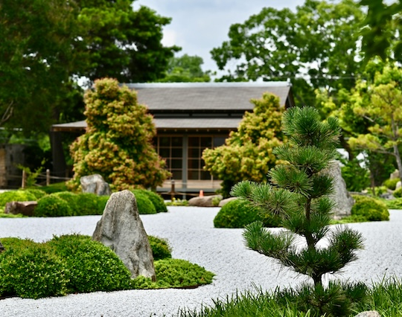
Gravel Gardens
Pros & Cons:
No watering / chemicals
Few weeds (install properly!)
Substitute for grass’ role in “setting off” areas of the yard
Expense of installing
Credit: Pexels 210146366-11742670
Source: Filippi, Olivier Planting Design for Dry Gardens
Notes:
I adopted the term ‘Gravel Gardens’ from the Planting Design for Dry Gardens book by Olivier Filippi. He applied the term to what I would view as pretty high-end gardens that were conceived by landscape designers. That’s beyond the scope of this presentation, which focuses on what you and I can do with our lawns. However, I included the category because the strategy is a way to reduce watering and when properly installed, block weeds. But, as shown in this picture, you still need some design work to plant the areas that you choose to set-off with gravel.
So, depending on how you view it, you can choose to use gravel as a lawn substitute in those areas where the grass has been ‘setting off’ or ‘highlighting’ a bed or area of the yard. In areas where your HOA might not be happy with all the grass disappearing…. Achieving the manicured look with gravel might be a win-win. Something to consider.
If you are going this route, you want to level properly before applying the gravel and apply enough gravel to mitigate weed growth. So, it’s installation cost like that of artificial turf is relatively high.

Slide 26
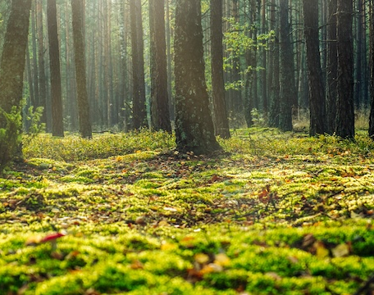
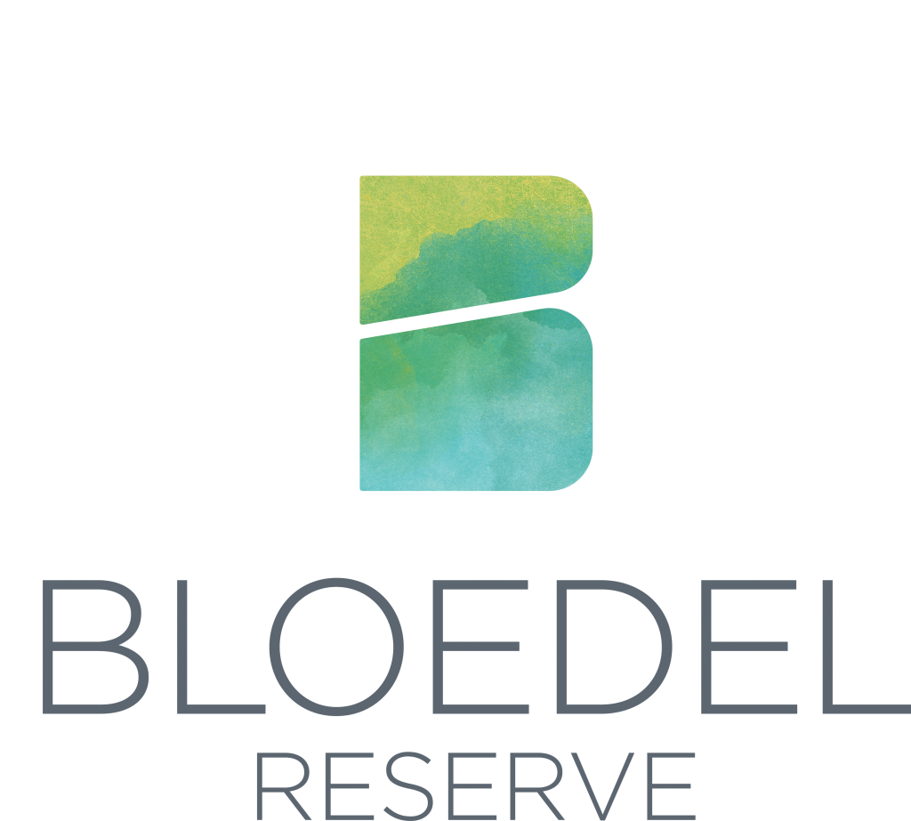

Moss
Pros & Cons:
Damp/shady areas of yard
Low maintenance, low water
No fertilizer
More expensive than lawn seed
Clackamas, OR
Conservation District
Credit: Pexels-1260324
Notes:
Source to read: Bloedel Reserve, The Moss Garden
Best in damp shady environments & soil with low pH (6 or below). If you have difficulty growing grass because your yard is too shady, might want to look at moss. Also does well on steep sloping areas. Moss is low maintenance, doesn’t require much care or fertilizer and remains green year round. Moss can withstand light foot traffic.
You can buy flats (plugs) of moss from online retailers…. It will be more expensive than grass seed.
Since moss has no roots, you ‘plant’ the plugs by setting on top of the soil, soaking it and using landscaping pins to ensure it maintains contact with the soil. Keep moist for 4-6 weeks then remove the pins.

Slide 27
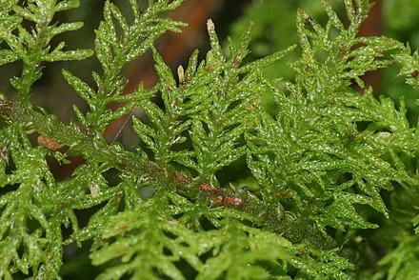
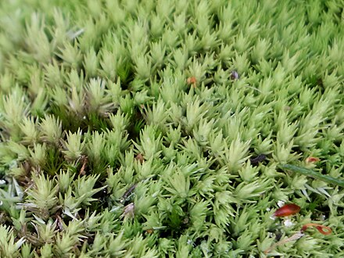
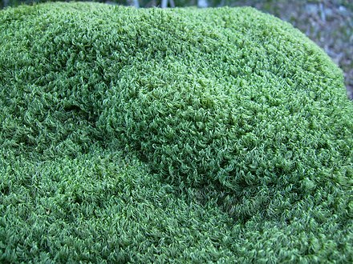
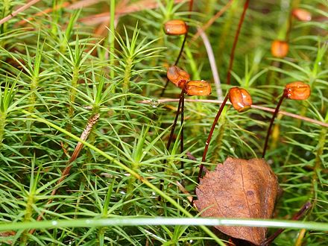
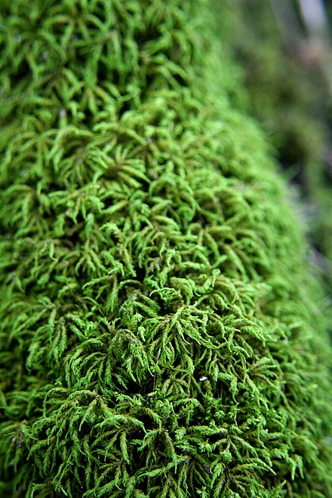
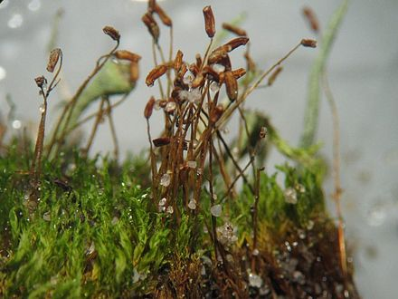
Types of moss:
Feather Thuidium delicatulum
Cushion Leucobryum albidum
Mood Dicranum scoparium
Haircap Polytrichum commune
Shiny Seductive
Entodon seductrix
Sidewalk Ceratodon purpureus
Credit: Wikipedia
Notes:
… and here are a few pictures of the various types of moss you can use in your yard.

Slide 28
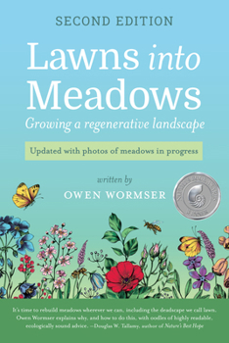

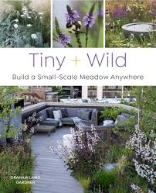
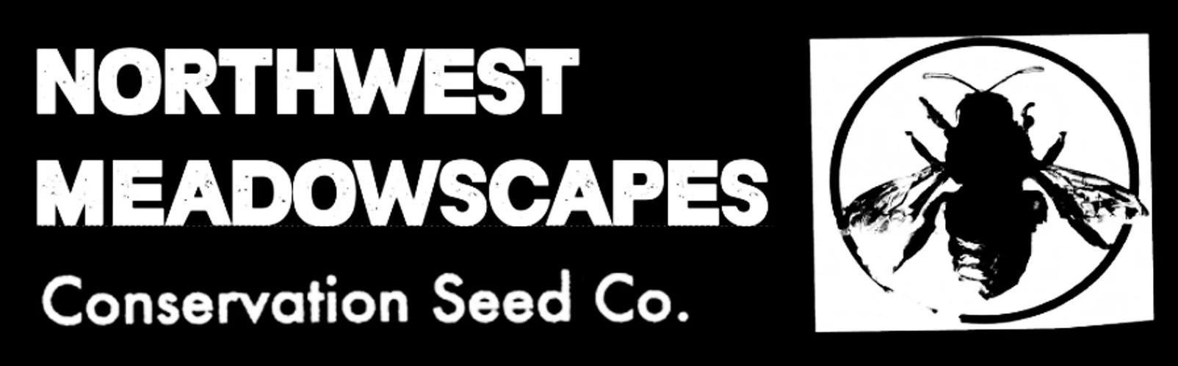
Creating a Meadow
Two Types
Meadow Garden (small)
Traditional Meadow
Anchored by selected grasses
(via plugs - 35 to 75%)
Supplemented by native flowers
(via seeds - cost savings)
Grasses provide the permanent
framework
Natural selection on the flowers
… and can change over time.
Notes:
Source: Wormser, Owen Lawns into Meadows 2020 Stone Pier Press ISBN:978 0998862378
Another Source: Graham Laird Gardner Tiny + Wild, Build a small-scale meadow anywhere 2023. Cool Springs Press ISBN:978 0760376232
I started this section of the presentation with the assertion that the “No Mow May Movement” was really a poor execution of converting your lawn to a meadow or ‘mixed grassland’ and then outlined an approach of converting your existing lawn to a less chaotic ‘mixed grassland’. I want to circle back and finish off this section highlighting two books that are explicitly about designing your lawn area as a meadow. These books assume a more structured approach of converting over. They assume that you have removed your lawn (instead of just not watering it during the summer) and they lay out design considerations for meadows.
They are a good source of information in that they detail what types of plants you should select for your meadow as well as giving appropriate proportions of grasses (35 to 75%) and how to establish various height layers to optimize the attractiveness of your meadow.
In addition, I confess that before researching for this presentation, I only considered a meadow option for large yards. The Tiny + Wild book points out that, depending on plant selection you can have a meadow in any sized yard or in just sections of your yard.
So, if you want to go the meadow route, these might be good books to reference. And they are available at your local library!

Slide 29
Presentation Summary:
With changing climate and changing lifestyles….
The traditional lawn has outlived its usefulness
It is time to reimagine the area dedicated to grass
And repurpose it into something that is better for the environment
… and matches your lifestyle/needs
Save time, save money, save the planet
CC-006
Notes:
Summary:
You have a wide range of options in moving your lawn towards something that can better withstand, and can help to mitigate some of the effects of our warming planet. You just need to figure out what you want to emphasize:
Maintain lawn ‘look but: Minimize maintenance: No-Mow … add in less watering: Pearl’s….minimize fertilizer: add in Micro-clover
Re-design your lawn: ground covers or grassy meadows… will save water, reduce maintenance as well as provide an area where pollinators can thrive.
Or, you can just say ‘to hell with it’ and replace everything with artificial turf!
It’s up to you…. But my hope would be that if you are going to the trouble of changing what you have, that you move (at whatever pace you are comfortable with) in a direction where you put some of the 40 million acres of yard to the service of our pollinators…. They need the help and we will all benefit when they thrive.

Slide 30


Questions?
Mike Peronto
WSU Extension Master Gardener Volunteer
robert.Peronto@WSU.edu
http://mastergardener.wsu.edu/
https://www.facebook.com/WSUMGProgram

Slide 31

Resources:
Print Publications
Author; Title; Publication Date; Publisher; ISBN
Wormser, Owen Lawns into Meadows
2020 Stone Pier Press; ISBN:9780998862378
Graham Laird Gardner Tiny + Wild
2023 by Cool Springs Press; ISBN: 978 0 7603 7623 2
Filippi, Olivier Planting Design for Dry Gardens
2016 by Filbert Press; ISBN: 978 0 99338 920 7
Jentz, Kathy Ground Cover Revolution
2023 by Cool Springs Press; ISBN: 978 0 7603 7815 1
Tallamy, Douglas W. Nature’s Best Hope
2019 by Timber Press; ISBN: 978 1 60469 900 5
Steinberg, Ted. American Green
W.W. Norton & Company; ISBN 0-393-06084-5
Online Sources
Publishing Site; Title; Author; Date Accessed; url (where information is available)
Homegrown National Park
Lawns & Microclover, University of Maryland Extension
Did this Citizen Scientist invent the perfect lawn? (WaPo)
Sown Wildflower Meadows, Royal Entomological Society
Lawn Care Goes Electric, Environment America
Slide Credits:
Credit: WSU & WSU-EMG. Permission to use has been granted by WSU and/or the Extension Master Gardener Program.
Notes:
For the “If you build it, they will come” slide:
Sown wildflower meadows: Can they replace natural meadows in urban spaces for bees, butterflies and hoverflies? Barbara Zajdel, Łukasz Dylewski, Agata Jojczyk, Weronika Banaszak-Cibicka, Kornelia Kucharska, Mikołaj Borański, Jakub Gąbka; First published: 20 November 2024; https://resjournals.onlinelibrary.wiley.com/doi/10.1111/een.13396

Slide 32
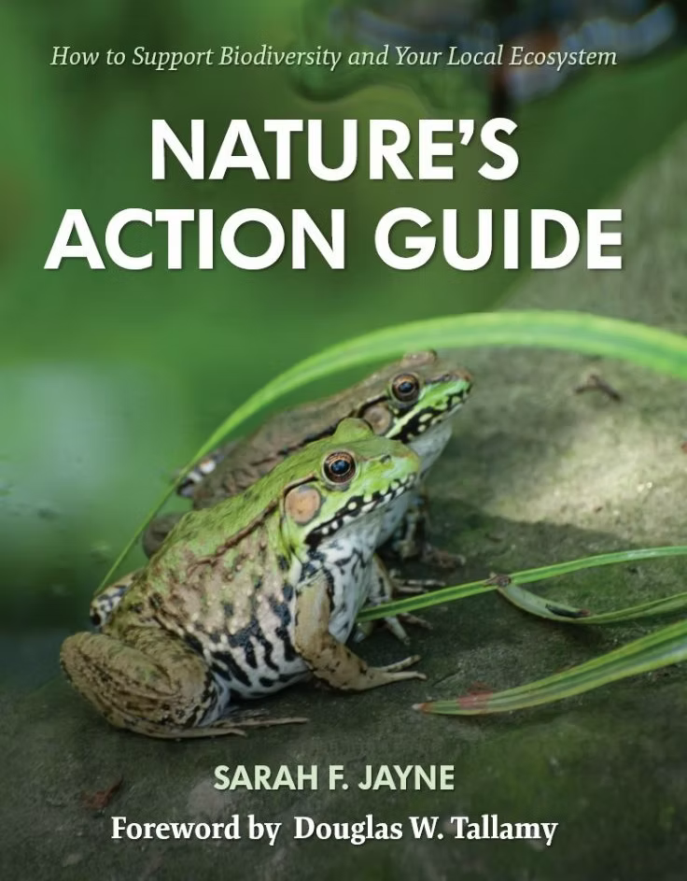
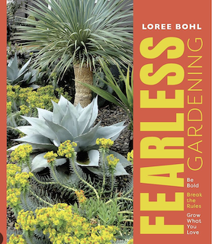
Additional Resources:
Make a lasting impact on the environment and create a healthier, more biodiverse ecosystem with Nature's Action Guide: How to Support Biodiversity and Your Local Ecosystem. This comprehensive guide offers practical, cost-conscious, toward zero-waste solutions to help protect wildlife and preserve our planet.
Nature's Action Guide features fifteen urgently needed actions to create healthy, functioning ecosystems where you live, work, and play. Each action includes an action checklist, step-by-step instructions, recommended resources, and informative tips.
Fearless Gardening, by Loree Bohl
Portland based author. Additional reading with sections which discuss the benefits of gardening with gravel.

