Slide 1



WSU Extension Pierce County Master Gardener Program
Informational Session
WSU Extension programs and employment are available to all without discrimination. Evidence of noncompliance may be reported through your local Extension office.

Slide 2



Extension is for everyone!
Washington State University is an affirmative-action, equal-opportunity employer. Washington State University Extension programs and materials are open to all without regard to race, color, national origin, sex, gender, gender identity, religion, age, height, weight, disability, political beliefs, sexual orientation, marital status, family status, or veteran status.
Welcome!
We are glad
you are here.
Read more on the WSU Extension website:
https://extension.wsu.edu/about-extension/extension-is-for-everyone/
Notes:
WSU Extension programs and policies are consistent with federal and state laws and regulations on nondiscrimination. Extension is for everyone, so we are glad you could join us today.

Slide 3

Today’s Session
What is the WSU Extension Master Gardener (EMG) program?
What does training to become an EMG volunteer look like?
What is the Washington Gardener certificate?
Goals:
Determine if the Extension Master Gardner Program is right for you.
Determine if the Washington Gardener program is a better fit.
Learn about next steps for getting involved.

Slide 4



Washington State University
A top research university dedicated to solving problems and improving lives.
College of Agricultural, Human, and Natural Resource Sciences
Leads Washington State University’s land grant mission to serve all people through education, research, and service.
Extends non-credit education to people throughout the state. Translating world-class research into hands-on practice to help create thriving communities, families, and individuals.
WSU Extension
WSU Extension
Master Gardener Program
One of the community education programs that Extension offers. Others include 4-H Youth Development, Snap Ed, Nutrition Education, Agriculture, and Forestry.
Notes:
To start: a quick overview of where Master Gardeners is situated within the WSU structure.

Slide 5





Resilient Washington
Our Mission: Building a Resilient Washington Together
Washington State University’s College of Agricultural, Human, and Natural Resource Sciences works to create a more resilient Washington. Our scientists, educators, students, and volunteers foster discovery and innovation across many disciplines that improve our state’s productiveness, sustainability, health, and wellbeing. Our mission embraces four pillars of endeavor:
Create an adaptable workforce
Providing a secure food supply system
Helping to maintain sustainable natural resources
Supporting thriving, healthy communities, families, and individuals
Notes:
WSU Extension is the front door to the University. It extends non-credit education to people throughout the state.
WSU Extension empowers people, organizations, businesses, and communities to find solutions for local issues.
WSU Extension is recognized for its science-based educational programs and collaboration with community partners to create a culture of life-long learning.
Such programs include 4H, Agriculture, Community and Economic Development, Youth and Families, Nutrition, Gardening and natural resources.

Slide 6



WSU Extension Master Gardener Mission
Engaging university-trained volunteers to empower and sustain diverse communities with relevant, unbiased, research-based horticulture and environmental stewardship education.
Notes:
‘Must Use’ slide:
We want to ensure that you properly ‘place’ Master Gardeners as part of the WSU Extension program, touch on our mission and point out that we have 9 guiding Priorities, of which your presentation is one.
Suggest you cover this while handing out your questions/evaluation form.
Throughout this presentation there are links to documents of various file types. Please contact our Statewide Program Leader if you require this information in a different format.

Slide 7
WSU Ext Master Gardener Program
What exactly does “Engaging university-trained volunteers to empower and sustain diverse communities with relevant, unbiased, research-based horticulture and environmental stewardship education” mean?
Individuals go through a year-long training process with WSU faculty & staff, WSU curriculum, and hands-on experiences. This training teaches them the most current and researched-based gardening knowledge in order to become certified Extension Master Gardener Volunteers. These volunteers use their training to conduct various educational outreach programs throughout their community – extending that gardening knowledge to the community.
Let’s look at some of these educational outreach programs…

Slide 8
Educational Outreach
Our Programs
“Ask A Master Gardener” Clinics
Demonstration Gardens
Youth Gardening Workshops
Speaker’s Bureau
Community Garden Mentorship
Propagation Group

Slide 9
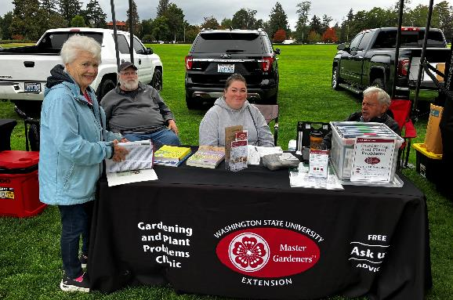
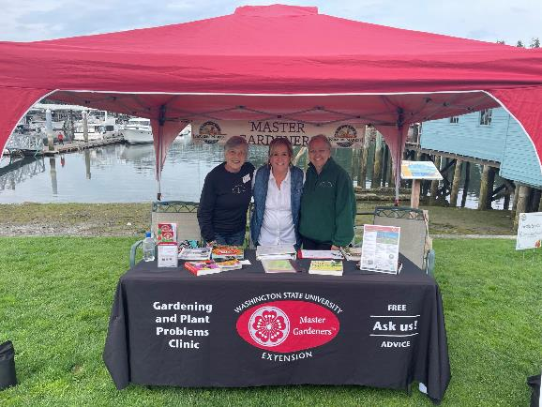
Educational Outreach
Our Programs
“Ask A Master Gardener” Clinics
Demonstration Gardens
Youth Gardening Workshops
Speaker’s Bureau
Community Garden Mentorship
Propagation Group
Clinics
Our volunteers provide free plant and insect diagnostic guidance at our ‘Ask a Master Gardener’ clinics.
Clinics are located at farmers markets, hardware stores, nurseries, demonstration gardens and Extension offices throughout the state of Washington.
Pierce 2024
246 clinics
7,500 answered questions

Slide 10
Educational Outreach
Our Programs
“Ask A Master Gardener” Clinics
Demonstration Gardens
Youth Gardening Workshops
Speaker’s Bureau
Community Garden Mentorship
Propagation Group
Demo Gardens
Volunteers learn and demonstrate:
Composting
Urban Edibles
Container Gardening
Propagation
Native Plants
Shade Garden
Pollinator Garden
Accessible Garden Beds
Hügelkultur
and more…
Demonstration Gardens are free outdoor classrooms, open to the public. They are built to teach gardening, conservation and sustainability techniques for all ages.
Each garden showcases something unique and is inspired by volunteer interest, research, and community need.

Slide 11
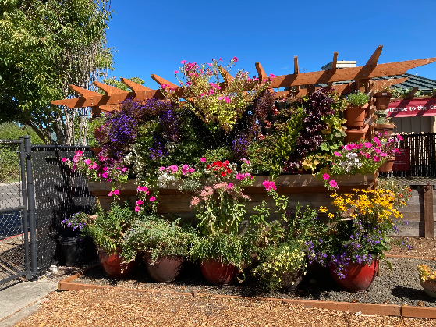
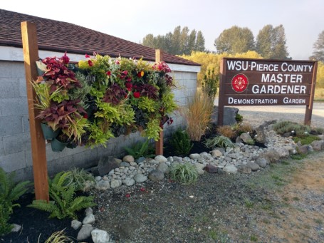
Educational Outreach
Gig Harbor
Our Programs
“Ask A Master Gardener” Clinics
Demonstration Gardens
Youth Gardening Workshops
Speaker’s Bureau
Community Garden Mentorship
Propagation Group
Demo Gardens
Two locations in Pierce County:
Gig Harbor Demonstration Garden
(located within Sehmel Homestead Parks)
Puyallup Demonstration Garden
(located at WSU Research and Extension Center)
Puyallup

Slide 12
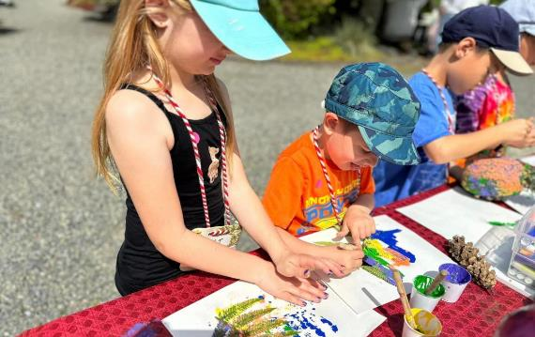
Educational Outreach
Our Programs
“Ask A Master Gardener” Clinics
Demonstration Gardens
Youth Gardening
Speaker’s Bureau
Community Garden Mentorship
Propagation Group
Demo Gardens
Youth Gardening
We offer youth gardening programs that allow kids to experience the wonders of gardening firsthand.
Youth Programs are offered at both of our Demo Gardens through weekend workshops, tours, and volunteers who make school visits.
Pierce 2024
33 School Visits/Tours/
Garden Workshops
2,300 youth
While building essential knowledge, these programs primarily aim to cultivate a lifelong love for the art of gardening. Nurturing the gardeners of tomorrow!

Slide 13
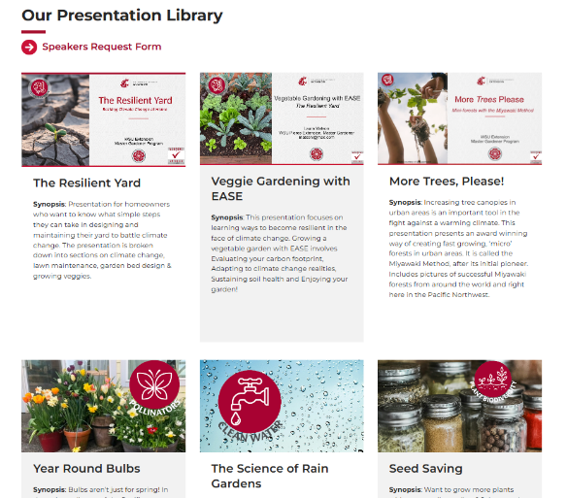
Educational Outreach
Our Programs
“Ask A Master Gardener” Clinics
Demonstration Gardens
Youth Gardening
Speaker’s Bureau
Community Garden Mentorship
Propagation Group
Speaker’s Bureau
Need a speaker for a gardening topic? Our Speaker’s Bureau fulfills speaker requests from various community groups by organizing Master Gardener presentations.
They also organize the “Saturday Garden Talks” during the summer at the two demonstration gardens.
Pierce 2024:
50 public presentations
We speak at local libraries, garden club events, HOA meetings, and much more.

Slide 14
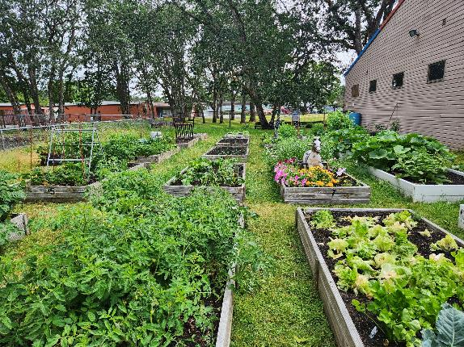
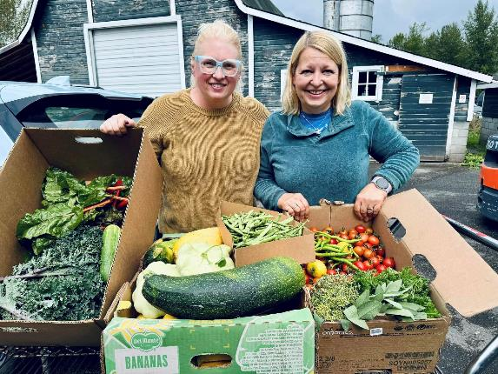
Educational Outreach
Our Programs
“Ask A Master Gardener” Clinics
Demonstration Gardens
Youth Gardening
Speaker’s Bureau
Community Garden Mentorship
Propagation Group
Community Gardens
Master Gardener Volunteers will provide mentorship within community gardens around Pierce County. Mentors provide education, support, and demonstrations to community gardeners during all phases of the growing season.
Pierce 2024:
1,826 pounds of produce donated to local food banks

Slide 15
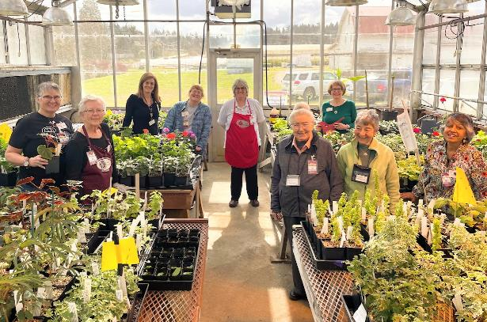
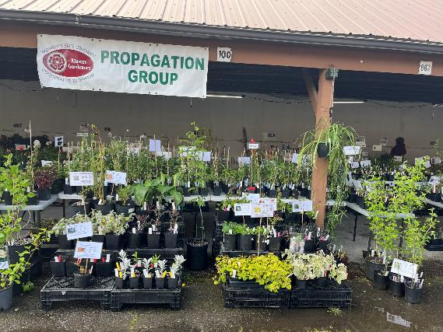
Educational Outreach
Our Programs
“Ask A Master Gardener” Clinics
Demonstration Gardens
Youth Gardening Workshops
Speaker’s Bureau
Community Garden Mentorship
Propagation Group
Propagation
The Propagation Group teaches and practices propagation techniques for hundreds of plant varieties.
Every year, they propagate and care for thousands of plant starts that are donated to our Plant Sale.

Slide 16
Additional Program Support
Volunteers also engage in a wide variety of activities that support our ability to provide these educational outreach programs:
Program leadership & coordination
Plan and execute an Annual Plant Sale
Marketing & communications
Diversity, equity, inclusion, and access work
Mentorship
Coordination of continuing education opportunities
And more!

Slide 17
Check-in
As you can see, Master Gardeners are all about voluntarily extending education.
After learning what an Extension Master Gardener Volunteer does & the various educational outreach programs they run, I invite you to take a moment to reflect: does this sound like the right fit for me?
Yes!
Great – the next few slides will cover:
What the training process looks like.
How to apply.
Not exactly.
Great – we will cover an alternative option that might be a better fit for what you are looking for.

Slide 18
Volunteer Training
Training to become an Extension Master Gardener Volunteer has 3 main components:
WA Green School Course
Local Volunteer Training
Volunteer Internship Hours

Slide 19

Volunteer Training
Training to become an Extension Master Gardener Volunteer has 3 main components:
WA Green School Course
Local Volunteer Training
Volunteer Internship Hours
WA Green School Course
The online course will take place over a 20-week period between October 5, 2025, and February 21, 2026.
Green School offers flexible, remote and hybrid training options.
This includes self-paced online classes and online review sessions with subject matter experts from WSU.
Courses are specific to the PNW’s climate, soil, environment, insects, wildlife, and plants.
Training is a big commitment and includes reading (online, no text required), homework, quizzes, in-class activities, lectures, and a final exam.

Slide 20
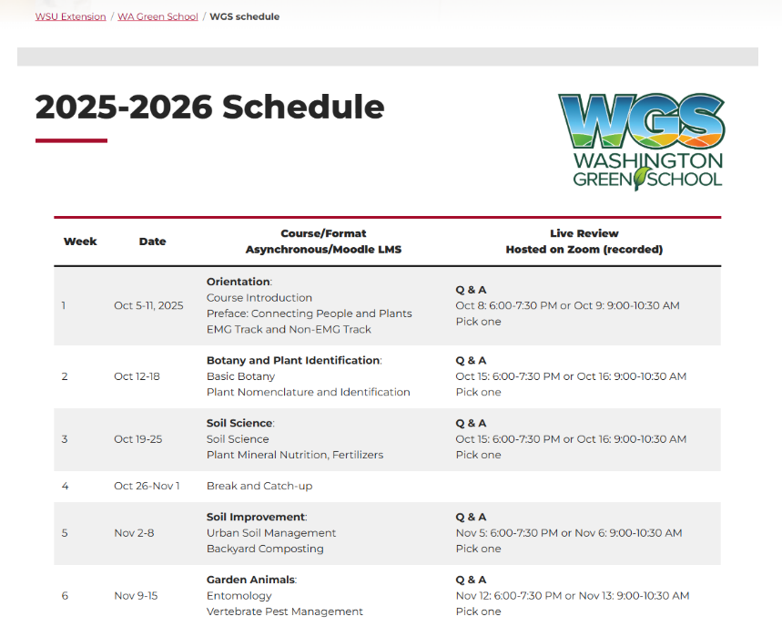
Volunteer Training
Training to become an Extension Master Gardener Volunteer has 3 main components:
WA Green School Course
Local Volunteer Training
Volunteer Internship Hours
WA Green School Course
Sample – full schedule listed online.

Slide 21
Volunteer Training
Training to become an Extension Master Gardener Volunteer has 3 main components:
WA Green School Course
Local Volunteer Training
Volunteer Internship Hours
Local Volunteer Training
Hands-on, in-person experiential learning that takes place within Pierce County.
Pruning workshop
Plant pathology & diagnostic lab
Inset identification lab
Garden design workshop

Slide 22
Volunteer Training
Training to become an Extension Master Gardener Volunteer has 3 main components:
WA Green School Course
Local Volunteer Training
Volunteer Internship Hours
Volunteer Internship Hours
Upon completing their training, trainees transition into their internship.
As interns, they volunteer alongside certified WSU Extension Master Gardeners, enhancing their knowledge and skills while gaining comfort in community education and program participation.
Interns are expected to complete 40 hours of volunteer service their first year.
Volunteer service include answering garden questions at our answer clinic, helping to maintain one of our demonstration gardens, giving presentations, or helping with our children’s education team – to name just a few of the many opportunities.

Slide 23
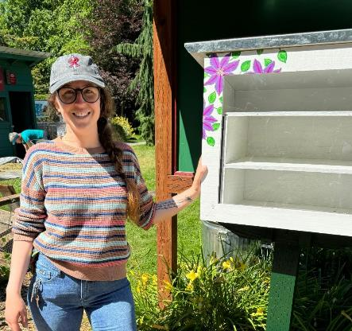
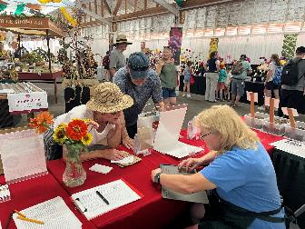
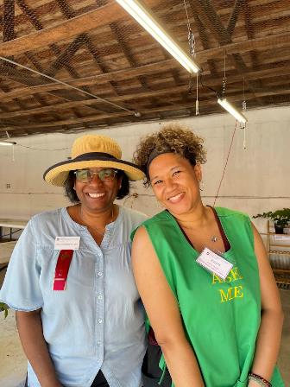
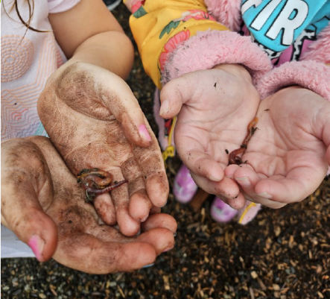
Volunteer Commitment
Upon successful completion of the year-long training, interns become certified Extension Master Gardener volunteers.
As a certified EMG volunteer, you are making an annual commitment to:
25 hours of Volunteer Service
10 hours of Continuing Education
Record all hours served in online database

Slide 24
Apply to volunteer training
Be sure to review volunteer expectations.
Application period: July 1st, 2025 - July 31st, 2025
Application will be found on our website.
Accepted applicants will be notified mid to late August.
Accepted applicants will complete a mandatory background check ($15).
Enrollment into online systems will begin in September.

Slide 25

Washington Gardener Certificate
If becoming a volunteer is not exactly what you are looking for, but you do have an interest in learning relevant & researched-based gardening and horticultural knowledge, consider the Washington Gardener certificate track.

Slide 26

Washington Gardener Certificate
The Washington Gardener certificate program has one component:
WA Green School Course
Certificates can be used to:
Grow your gardening knowledge
Supplement a resume
Promote a business
The online course will take place over a 20-week period between October 5, 2025, and February 21, 2026.
Green School offers flexible, remote and hybrid training options.
This includes self-paced online classes and online review sessions with subject matter experts from WSU.
Courses are specific to the PNW’s climate, soil, environment, insects, wildlife, and plants.
Training is a big commitment and includes reading (online, no text required), homework, quizzes, in-class activities, lectures, and a final exam.

Slide 27
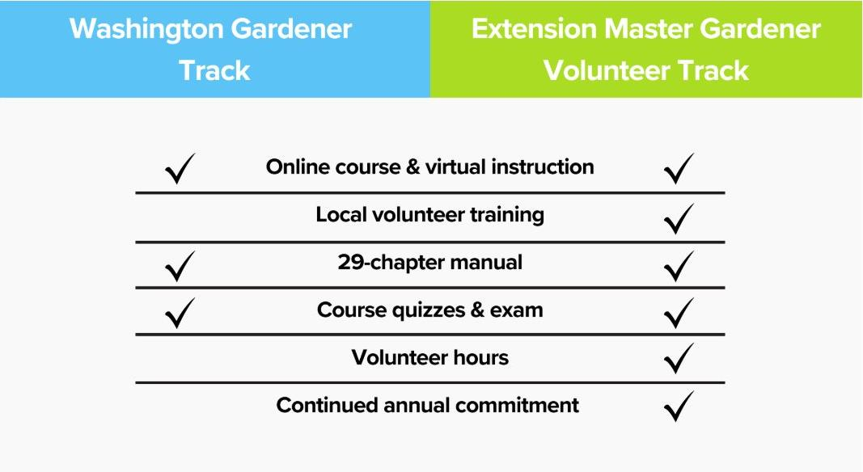
Comparison

Slide 28
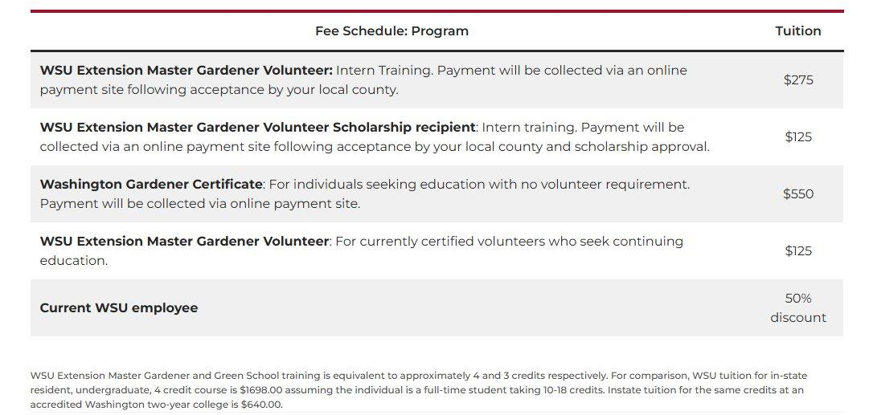
2025-2026 Green School fees

Slide 29
Next steps
Determine which program is right for you.
If EMG volunteer, apply on Pierce County website between July 1st – July 31st
If WA Gardener, enroll on state website between August 15th – September 30th

Slide 30
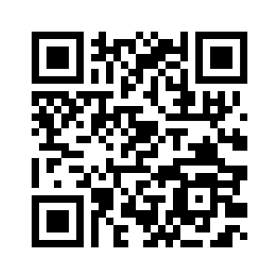
Questions?
Caitlin May
(she/her)
WSU Extension Pierce County Master Gardener Program Coordinator
caitlin.may1@wsu.edu
Learn more at:
Pierce County Extension: https://extension.wsu.edu/pierce/mg-home/
WA Green School: https://greenschool.extension.wsu.edu/

