Slide 1


Title
WSU [insert county] Extension
Master Gardener Program
WSU Extension programs and employment are available to all without discrimination. Evidence of noncompliance may be reported through your local Extension office.

Slide 2



Extension is for everyone!
Washington State University is an affirmative-action, equal-opportunity employer. Washington State University Extension programs and materials are open to all without regard to race, color, national origin, sex, gender, gender identity, religion, age, height, weight, disability, political beliefs, sexual orientation, marital status, family status, or veteran status.
Welcome!
We are glad
you are here.
Read more on the WSU Extension website:
https://extension.wsu.edu/about-extension/extension-is-for-everyone/
Notes:
WSU Extension programs and policies are consistent with federal and state laws and regulations on nondiscrimination. Extension is for everyone, so we are glad you could join us today.

Slide 3







Resilient Washington
Our Mission: Building a Resilient Washington Together
Washington State University’s College of Agricultural, Human, and Natural Resource Sciences works to create a more resilient Washington. Our scientists, educators, students, and volunteers foster discovery and innovation across many disciplines that improve our state’s productiveness, sustainability, health, and wellbeing. Our mission embraces four pillars of endeavor:
Create an adaptable workforce
Providing a secure food supply system
Helping to maintain sustainable natural resources
Supporting thriving, healthy communities, families, and individuals
Notes:
WSU Extension is the front door to the University. It extends non-credit education to people throughout the state.
WSU Extension empowers people, organizations, businesses, and communities to find solutions for local issues.
WSU Extension is recognized for its science-based educational programs and collaboration with community partners to create a culture of life-long learning.
Such programs include 4H, Agriculture, Community and Economic Development, Youth and Families, Nutrition, Gardening and natural resources.

Slide 4



WSU Extension Master Gardener Mission
Engaging university-trained volunteers to empower and sustain diverse communities with relevant, unbiased, research-based horticulture and environmental stewardship education.
Notes:
‘Must Use’ slide:
We want to ensure that you properly ‘place’ Master Gardeners as part of the WSU Extension program, touch on our mission and point out that we have 9 guiding Priorities, of which your presentation is one.
Suggest you cover this while handing out your questions/evaluation form.
Throughout this presentation there are links to documents of various file types. Please contact our Statewide Program Leader if you require this information in a different format.

Slide 5

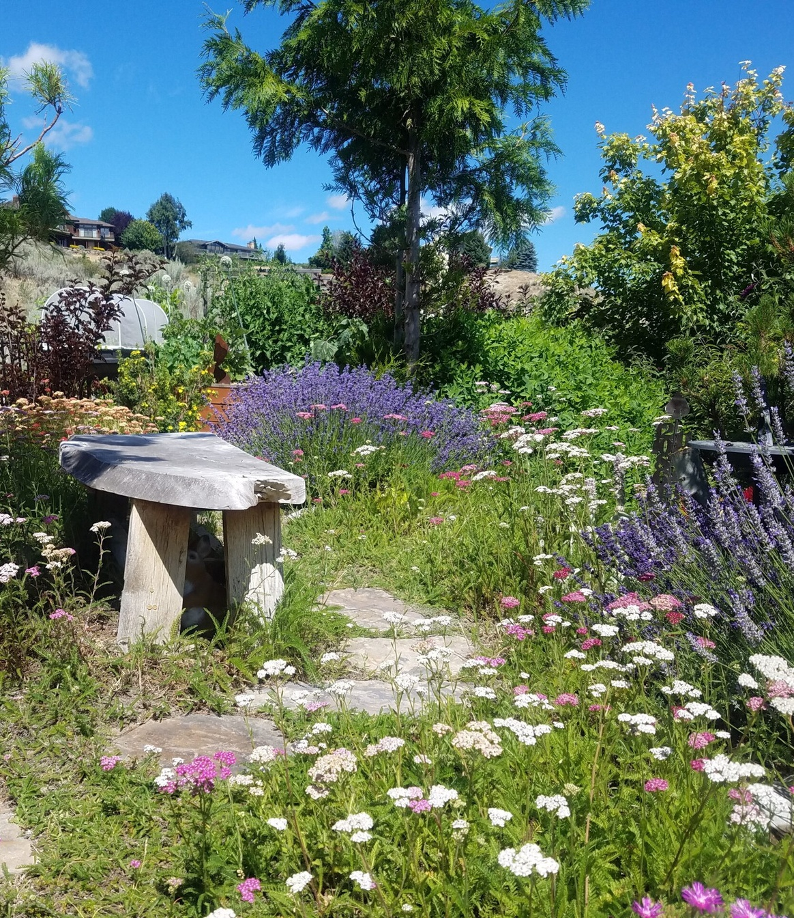

ANNUAL
REPORT
2024
Washington State University
Extension Master Gardener Program
WSU Extension programs and employment are available to all without discrimination. Evidence of noncompliance may be reported through your local Extension office.

Slide 6

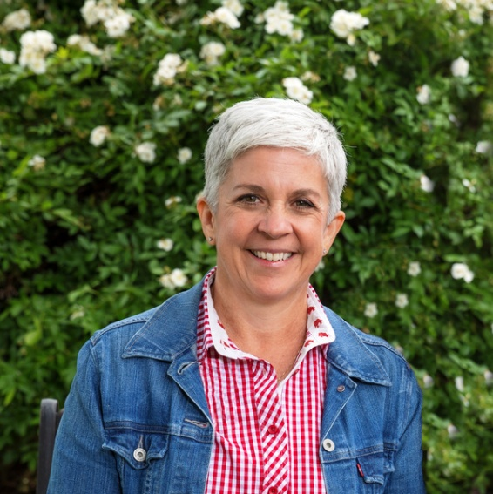

Rooted in Community
2024 WSU Extension
Master Gardener Program Impacts
The WSU Extension Master Gardener Program plays a vital role in building a resilient Washington by educating communities on sustainable gardening, climate adaptation, and ecosystem stewardship. As part of Washington State University’s College of Agricultural, Human, and Natural Resource Sciences (CAHNRS), the program empowers individuals to make environmentally sound choices that strengthen landscapes and communities. In 2024, we continue evolving to meet community needs, ensuring accessible, science-based education for all.
Volunteers are at the heart of this mission, addressing critical issues such as pollinator health, climate resilience, and food security while strengthening natural resource conservation efforts. As we look ahead, we embrace technical innovation and collaborative learning to adapt to a changing world. With strong leadership, volunteer dedication, and the support of our communities, we are poised to grow and thrive—continuing to make a lasting impact for future generations.
Jennifer Marquis
Statewide Program Leader
Office: (509) 335-1723
Email: jgmarquis@wsu.edu
mastergardener.wsu.edu

Slide 7


Cultivating plants, people, and communities since 1973
BY THE
NUMBERS
3,079
Certified volunteers.
570
New volunteers trained.
As a Land Grant University, Washington State University (WSU) has responsibilities to teach, research, and extend knowledge to all people. The Extension Master Gardener Program, launched in 1973 by WSU, is one way that land-grant universities fulfill those purposes. The success of the WSU Extension Master Gardener Program has led to the replication of the program across the United States and internationally with over 100,000 master gardeners serving their communities.
318,134
Hours were dedicated by volunteers to WSU and the communities they serve.
43,223
Continuing education hours earned by volunteers.
3,163
Ask a Master Gardener PLANT CLINICS offered across the state.
49,453
Research-based answers provided on various topics aligned with our nine program priorities.

Slide 8
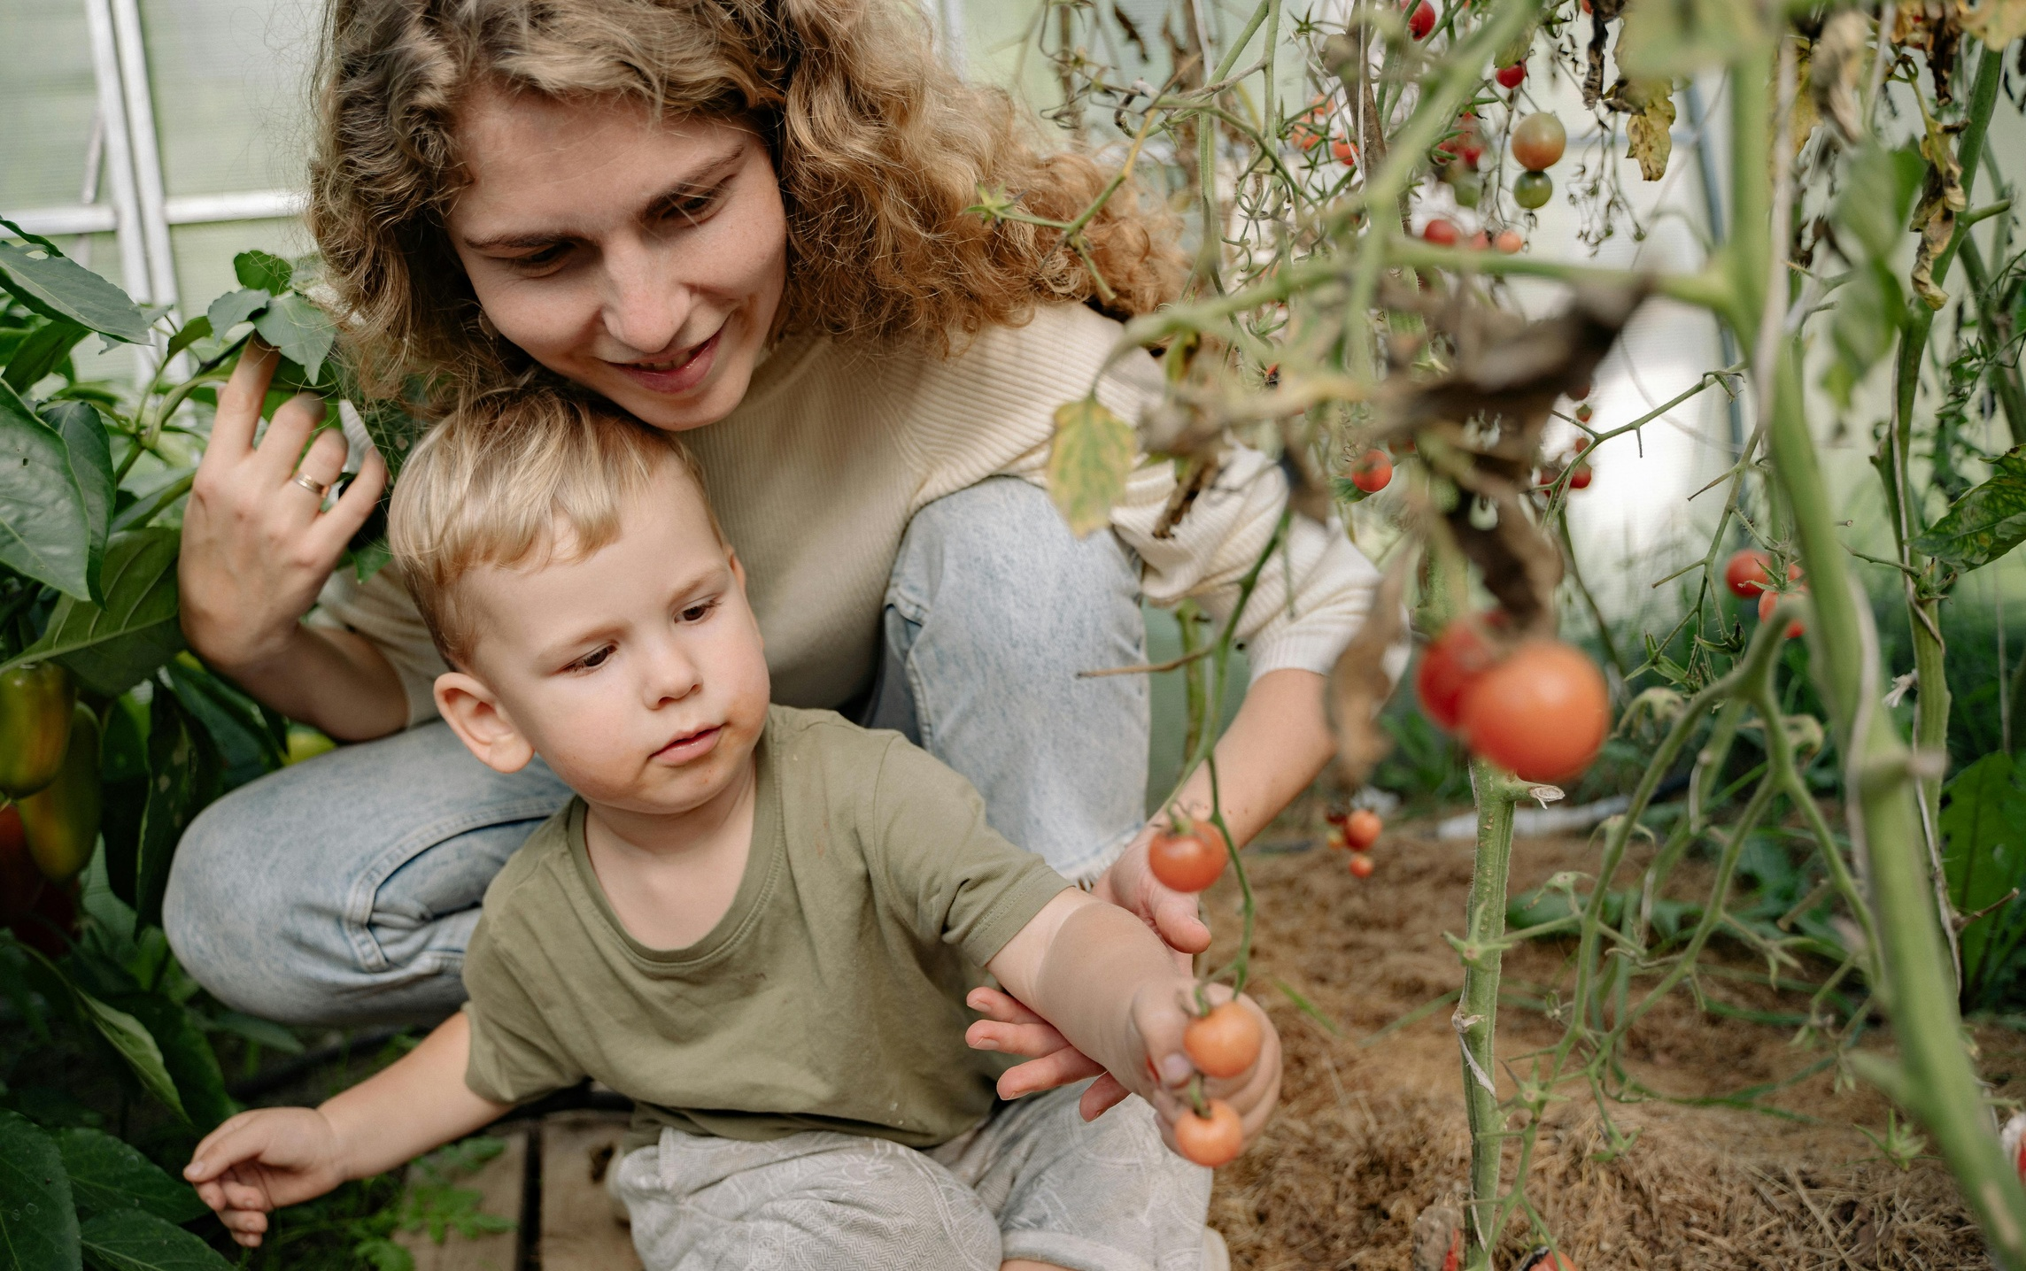
Local Food
BY THE NUMBERS
1,718
ADULT CLASSES, WORKSHOPS, DEMONSTRATIONS, and FIELD DAYS to share knowledge and promote sustainable practices.
The Extension Master Gardener Program in Washington State directly impacted food growing and security practices among 17,769 individuals. This led to increased engagement of community members in growing food and donating produce to local food banks and pantries. The program donated 167,229 pounds of produce, valued at $361,215. This made nutrient-dense foods easily accessible locally, feeding 429 households for a year.
623
YOUTH CLASSES, WORKSHOPS, DEMONSTRATIONS, and FIELD DAYS, where volunteers provided research-based gardening education, fostering healthy eating habits, environmental stewardship, and vital life skills.
17,769
Youth and adult ATTENDEES gained valuable insights into gardening practices grounded in research.
11,515
QUESTIONS answered at plant clinics on growing food, providing valuable guidance to gardeners and growers.
26%
Improvement in understanding how to SELECT suitable plant varieties for cultivation in my area.
23%
Boost in knowledge about GROWING fruits and vegetables their family likes to eat.
14%
Increase in understanding of the connection between access to local food and individual and community HEALTH and WELLNESS.
11%
Increased recognition that ACCESS to nutrient-rich fruits and vegetables enhances both individual and community health.
20%
Enhancement in understanding ways to promote and support FOOD SECURITY in their communities.

Slide 9
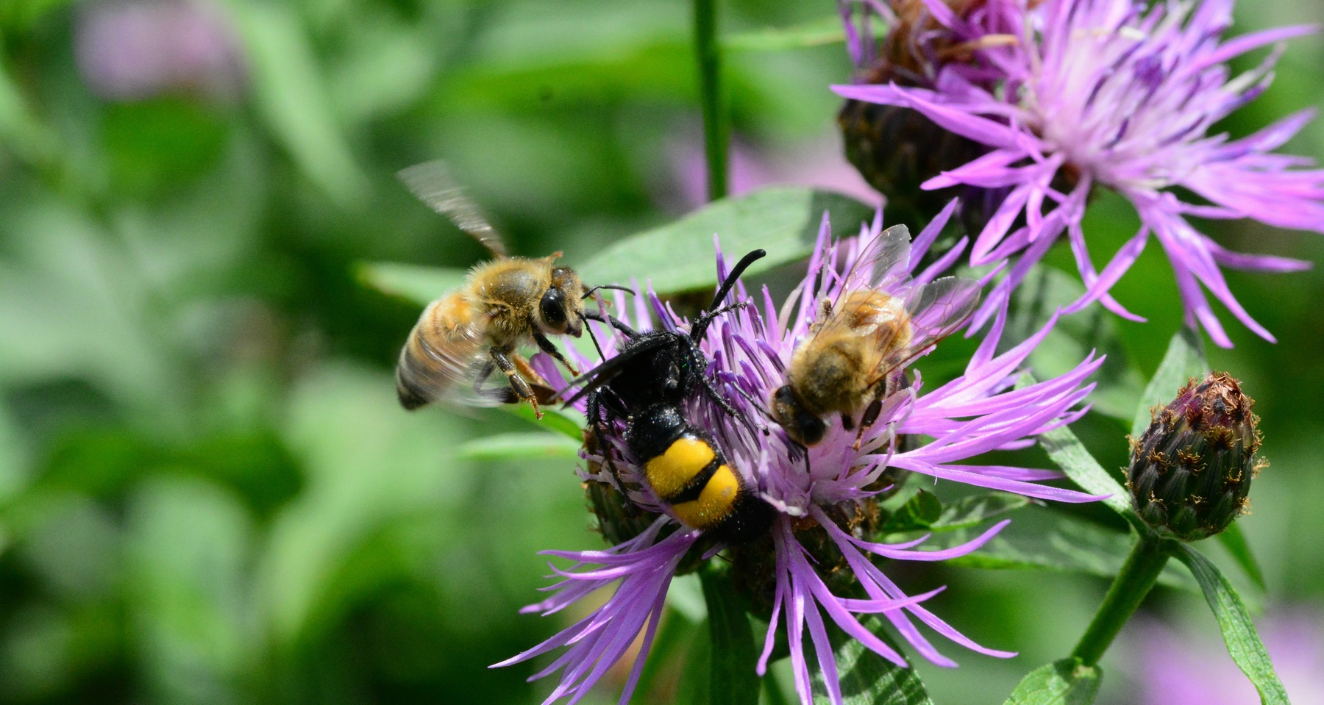
Pollinator Health
BY THE NUMBERS
1,627
ADULT CLASSES, WORKSHOPS, DEMONSTRATIONS, and FIELD DAYS focused on pollinator diversity, examining the impact of human activities like pesticide use, habitat destruction, air and light pollution, and invasive species on pollinator well-being.
The WSU Extension Master Gardener Program directly impacts pollinator health and conservation by teaching sustainable gardening practices that protect and restore vital habitats. Through science-based education and hands-on community engagement, the program empowers individuals to create pollinator-friendly landscapes, ensuring stable food production and biodiversity preservation. By supporting native plant growth, advocating for pesticide alternatives, and reducing environmental stressors, Master Gardeners actively strengthen pollinator populations, safeguard essential ecosystem services, and drive long-term environmental resilience.
459
YOUTH CLASSES, WORKSHOPS, DEMONSTRATIONS, and FIELD DAYS, where participants learned pollinator health and habitat conservation practices.
11,454
Youth and adult ATTENDEES gained a deeper understanding of pollinators’ roles in ecosystems and their significance in food production.
3,205
QUESTIONS answered on pollinator health and habitat at Ask a Master Gardener plant clinics.
21%
Developed a deeper understanding of pollinators’ role in NATURAL ECOSYSTEMS and FOOD PRODUCTION.
22%
Increased awareness of pollinator diversity and the importance of plant-animal relationships for RESILIENCE.
14%
Improved knowledge of selecting ALTERNATIVES to chemical pesticides to protect pollinators.
13%
Gained an understanding of the benefits of replacing traditional lawns with pollinator-friendly LANDSCAPING.
32%
Gained confidence in providing essential HABITAT for local pollinators.

Slide 10
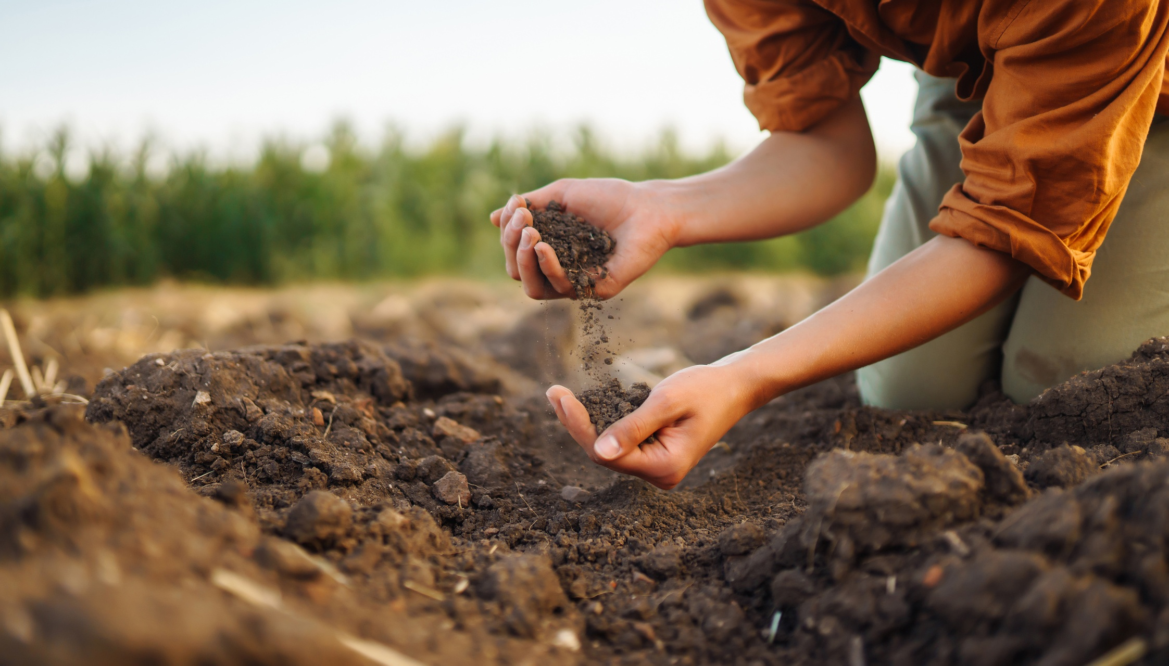
Soil Health
BY THE NUMBERS
1,033
ADULT CLASSES, WORKSHOPS, DEMONSTRATIONS, and FIELD DAYS educating participants on soil properties and their influence on home landscapes and environmental sustainability.
The WSU Extension Master Gardener Program directly impacts communities by providing science-based education that improves soil health, strengthens ecosystems, and promotes sustainable gardening practices. Through hands-on workshops, field demonstrations, and personalized guidance, Master Gardeners empower individuals to adopt techniques that prevent erosion, enhance soil fertility, and sustain long-term productivity. Their outreach has led to measurable improvements—such as increased knowledge of soil conservation, better land stewardship, and stronger local food systems. By actively engaging with residents, Master Gardeners ensure that communities have the tools and knowledge to create healthier landscapes, resilient ecosystems, and sustainable gardens for future generations.
499
YOUTH CLASSES, WORKSHOPS, DEMONSTRATIONS, and FIELD DAYS, engaging youth in learning experiences equipping them with the knowledge to make informed, sustainable choices for the future.
8,700
Youth and adult ATTENDEES developed greater awareness of soil threats, such as pollution, erosion, and overuse, and the importance of conservation efforts.
6,114
QUESTIONS answered at plant clinics on soil health and sustainability.
33%
Gained awareness of basic SOIL PROPERTIES—physical, chemical, and biological—and their impact on the home landscape.
30%
Developed an understanding of why FERTILIZER application should be based on soil test results.
28%
Learned why NO-TILL techniques are a best practice for home gardening.
31%
Recognized how home COMPOSTING helps reduce methane emissions from landfills.
35%
Improved knowledge of appropriate organic MULCHING techniques.
32%
Strengthened understanding of proper composting METHODS for yard and kitchen waste.

Slide 11
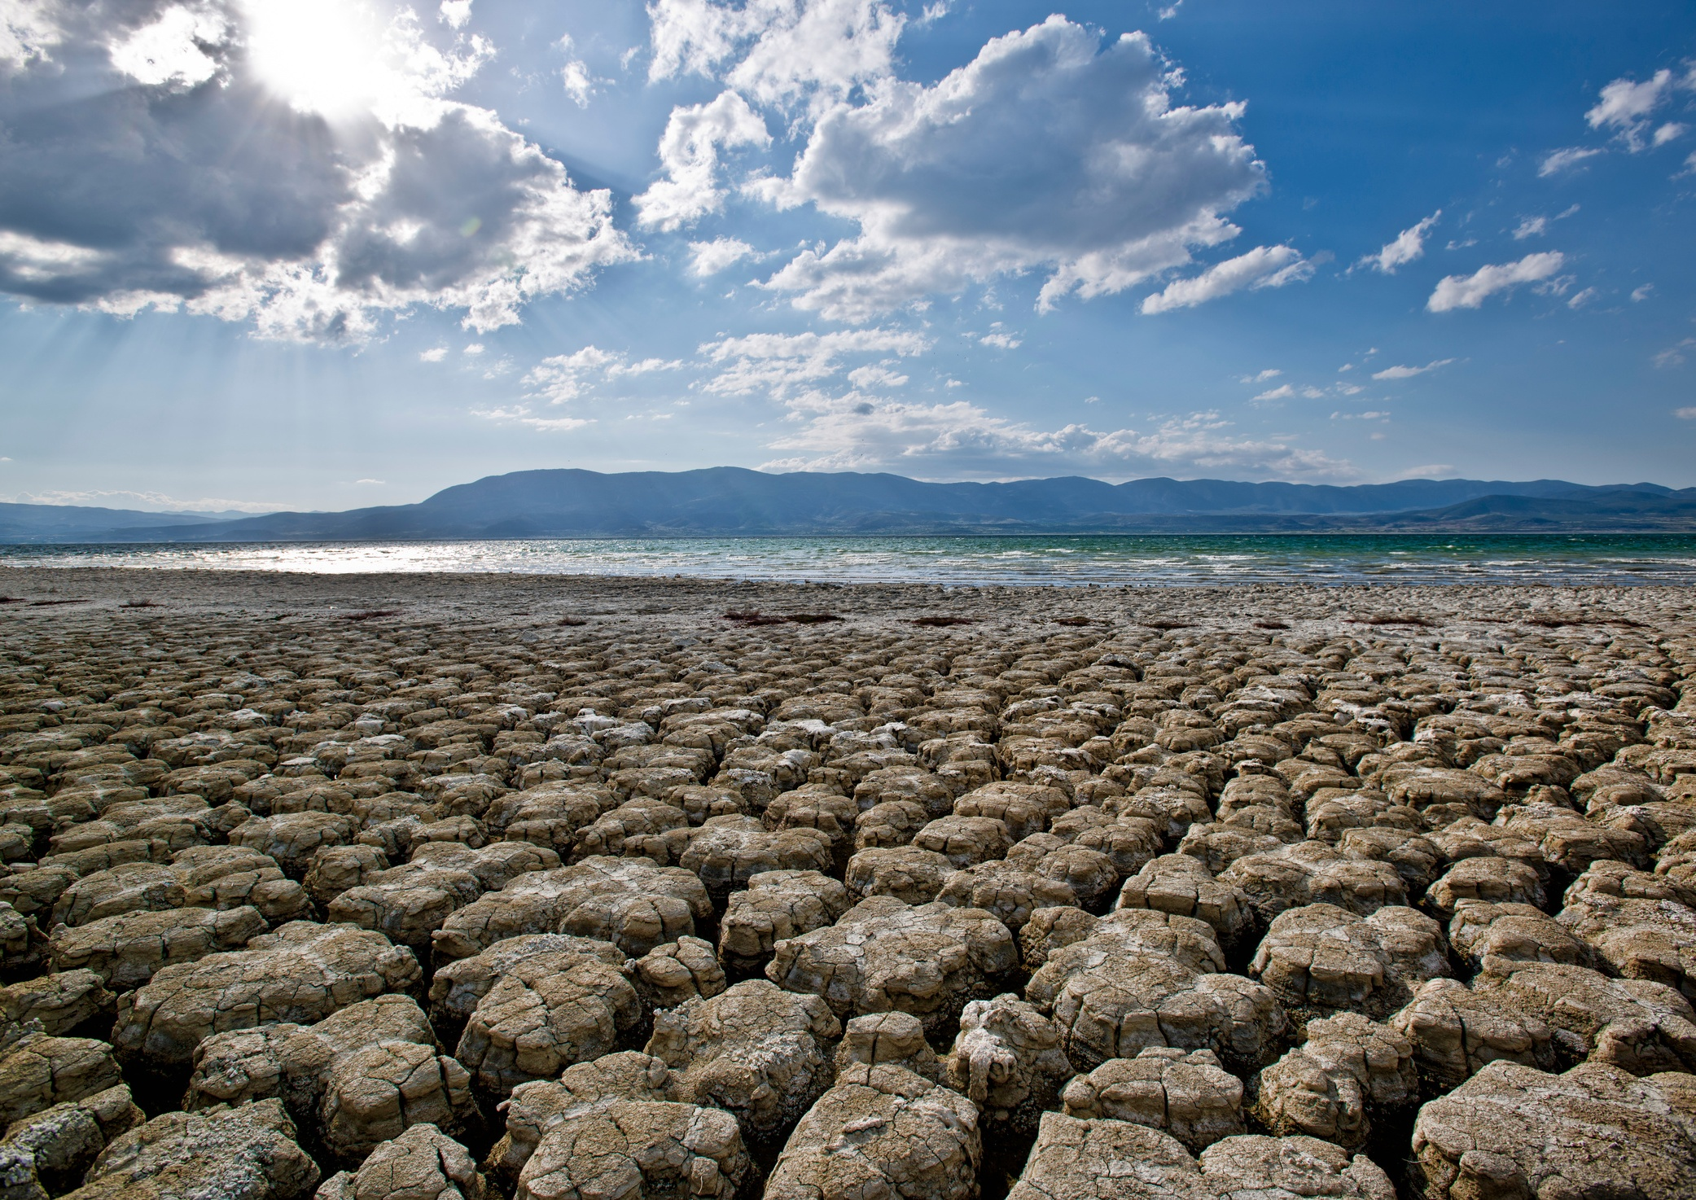
Climate Change
BY THE NUMBERS
566
ADULT CLASSES, WORKSHOPS, DEMONSTRATIONS, and FIELD DAYS teaching research-backed techniques empowering gardeners to build sustainable, climate-resilient landscapes.
The WSU Extension Master Gardener Program directly impacts communities’ efforts to combat climate change by teaching sustainable landscaping practices. Volunteers educate residents on strategies that reduce carbon footprints, minimize pollution, and lower greenhouse gas emissions. By conserving water, improving soil health, and supporting biodiversity, these practices create resilient landscapes that act as carbon sinks, absorbing and storing carbon dioxide. Through hands-on education, the program empowers communities to contribute to a cleaner environment and a more sustainable future.
282
YOUTH CLASSES, WORKSHOPS, DEMONSTRATIONS, and FIELD DAYS, provided hands-on science-based gardening education, empowering young learners to understand climate resilience and sustainability.
3,962
Youth and adult ATTENDEES expanded their knowledge of sustainable gardening practices and the impact of climate change on home landscapes, gaining insight into conservation strategies that support resilient gardens.
2,830
QUESTIONS answered at plant clinics on actionable climate solutions.
22%
Gained a deeper understanding of how climate change AFFECTS the environment, ecosystem functioning, and human health.
27%
Increased awareness of strategies to enhance landscape RESILIENCE in response to climate change.
23%
Developed knowledge of the significant IMPACT urbanization has on climate change.
22%
Recognized how climate change disproportionately AFFECTS marginalized and underrepresented communities.
22%
Learned effective STRATEGIES for offsetting carbon emissions and reducing greenhouse gas pollution.

Slide 12

Clean Water
BY THE NUMBERS
759
ADULT AND YOUTH CLASSES, WORKSHOPS, DEMONSTRATIONS, and FIELD DAYS focusing on pesticide safety, proper use, and IPM principles.
The WSU Extension Master Gardener Program directly improves public health and environmental sustainability by educating communities on clean water practices that safeguard local ecosystems. Through science-based outreach and hands-on demonstrations, volunteers empower individuals to reduce harmful chemicals, enhance water quality, and protect vital waterways. Their efforts seek to lower municipal costs for water treatment and healthcare while fostering environmental stewardship and a deeper connection to local water systems. By promoting sustainable water management, Master Gardeners help ensure clean, accessible water for future generations.
3,227
Youth and adult ATTENDEES expanded their knowledge ofthe importance of clean water and how gardening decisions impact water quality.
3,650
QUESTIONS answered on the least toxic pest control methods at Ask a Master Gardener plant and insect clinics.
20%
Gained a deeper understanding of how clean water directly IMPACTS human health, local wildlife, and natural ecosystems.
17%
Increased understanding of how human activity intensifies THREATS to water resources.
7%
Participants gained a clearer understanding of their personal RESPONSIBILITY in preventing pollutants from entering waterways.
27%
Gained a deeper understanding of gardening TECHNIQUES that enhance water quality.
73%
COMMITTED to practicing Integrated Pest Management (IPM) and employing sustainable gardening techniques to minimize chemical inputs.

Slide 13
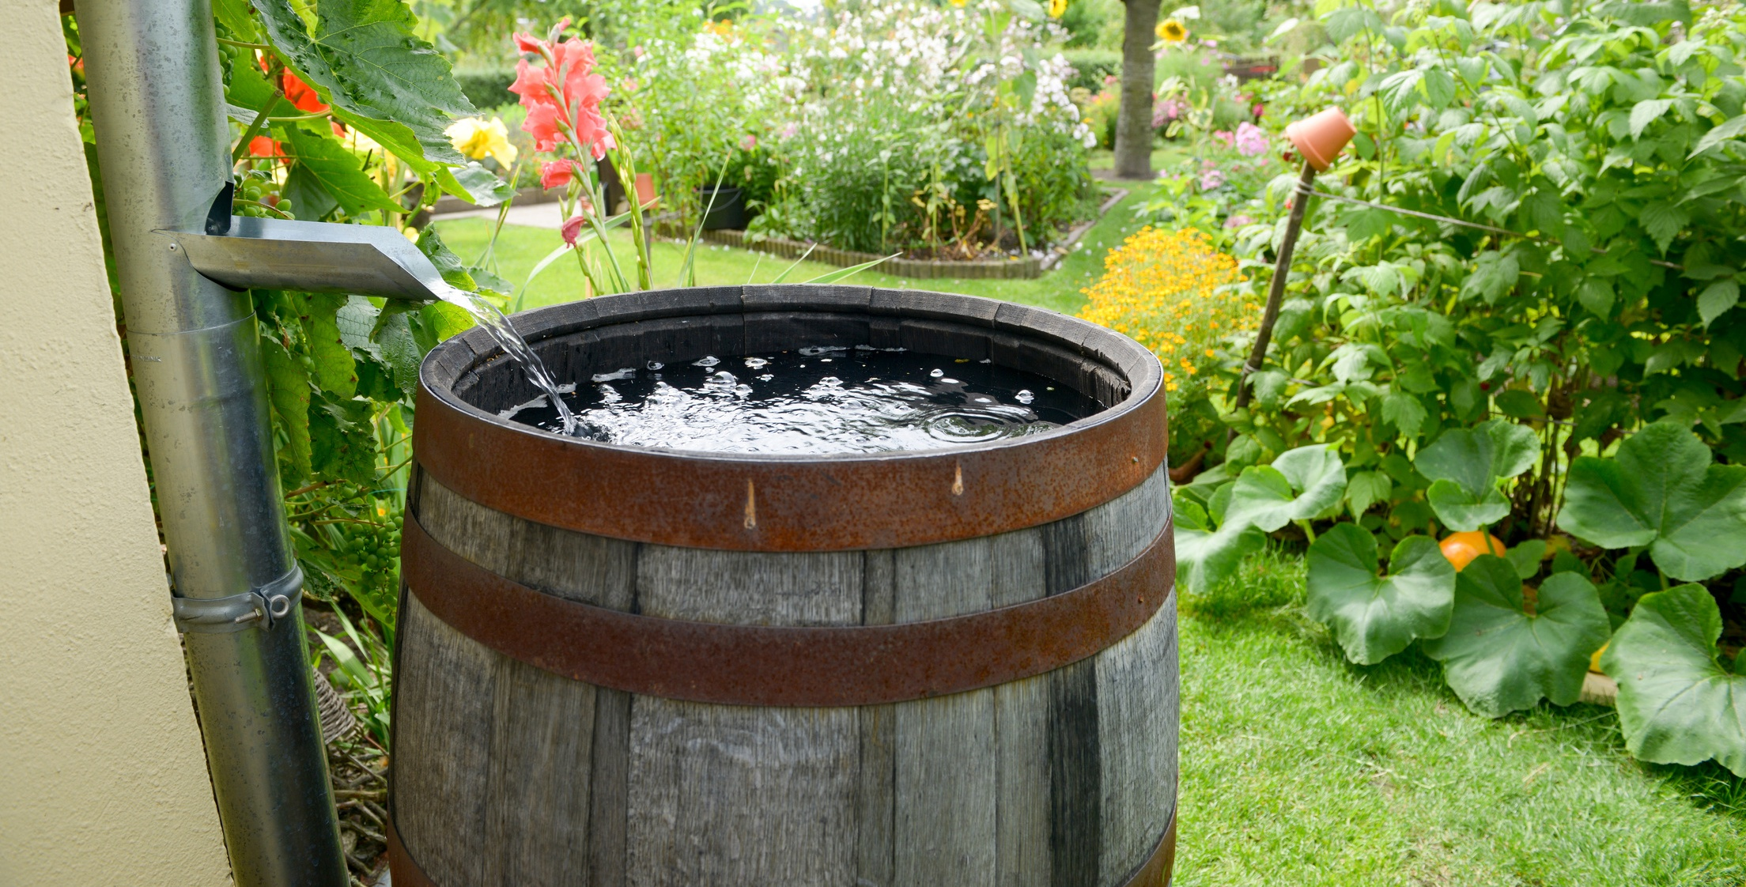
Water Conservation
BY THE NUMBERS
621
ADULT AND YOUTH CLASSES, WORKSHOPS, DEMONSTRATIONS, and FIELD DAYS focusing on water-saving strategies for home landscapes.
The WSU Extension Master Gardener Program drives lasting environmental stewardship by equipping communities with science-based water conservation practices that safeguard public health, protect ecosystems, and ensure the sustainability of local water resources.
Through education, outreach, and hands-on demonstrations, volunteers provide individuals with the knowledge and tools to reduce pollution, improve water quality, and strengthen resilience against environmental challenges. Their efforts seek to lower municipal costs, enhance local water systems, and foster a culture of sustainability, ensuring that clean, accessible water remains available for future generations.
3,362
Youth and adult ATTENDEES learned the importance of conserving water and its role in supporting people, agriculture, and ecosystems.
3,650
QUESTIONS answered on water conservation at Ask a Master Gardener plant clinics, helping gardeners adopt efficient practices.
26%
Improved understanding of how water conservation BENIFITS people, agriculture, and the environment.
31%
Gained understanding of how home landscapes IMPACT the local watershed and water quality.
31%
Improved understanding of how individual landscapes INFLUENCE water availability and conservation.
27%
Improved understanding of key water conservation PRINCIPLES and their impact on sustainability.
28%
Learned ways to CONSERVE water through specific, sustainable techniques.
75%
COMMITTED to adapting their home landscape to local conditions to conserve water.

Slide 14
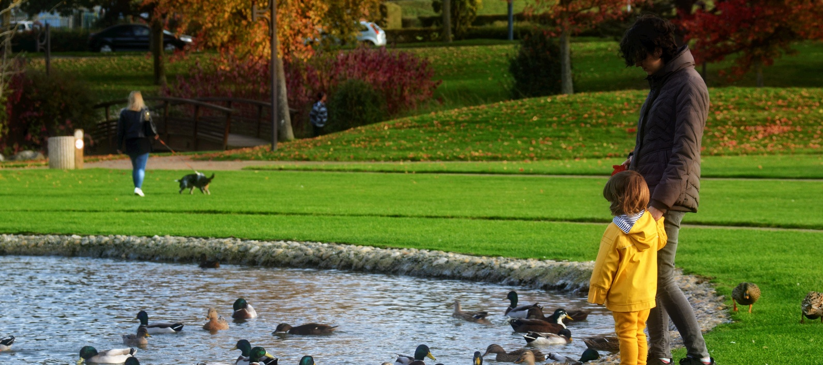
Nearby Nature
BY THE NUMBERS
1,037
ADULT AND YOUTH CLASSES, WORKSHOPS, DEMONSTRATIONS, and FIELD DAYS centered on exploring and understanding nearby nature.
The WSU Extension Master Gardener Program directly impacts community health by equipping individuals and families with science-based education that fosters physical and mental well-being, strengthens social connections, and builds resilient landscapes. Research shows that being in nature reduces stress, lowers the risk of cardiovascular disease, and improves cognitive function.
Through hands-on workshops and outreach, Master Gardeners empower individuals to create pollinator-friendly landscapes, urban gardens, and sustainable green spaces that reduce pollution, manage stormwater, and mitigate the urban heat island effect. These efforts improve air and water quality, and provide essential spaces for recreation and relaxation, ensuring that communities continue to benefit from nature’s health advantages for generations to come.
13,154
Youth and adult ATTENDEES developed essential knowledge and skills in sustainable horticulture to support and enrich nearby nature.
10,592
QUESTIONS answered at Ask a Master Gardener plant clinics about nearby nature, helping communities better understand and appreciate their local environment.
30%
Enhanced understanding of the benefits of ENGAGING with nature at both individual landscape and broader community levels.
26%
Greater recognition of the role a home landscape plays in SUPPORTING the local ecosystem.
25%
Increased awareness of shared green spaces and green infrastructure as valuable community resources, along with the RESPONSIBILITY of individuals in safeguarding their benefits.
29%
Improved knowledge of how to OPTIMIZE the advantages of nature in the home landscape through thoughtful design, plant selection, and maintenance.
30%
Strengthened ability to SELECT the right plant for the right location to promote sustainability and resilience.
59%
COMMITTED to spending more time outdoors.

Slide 15
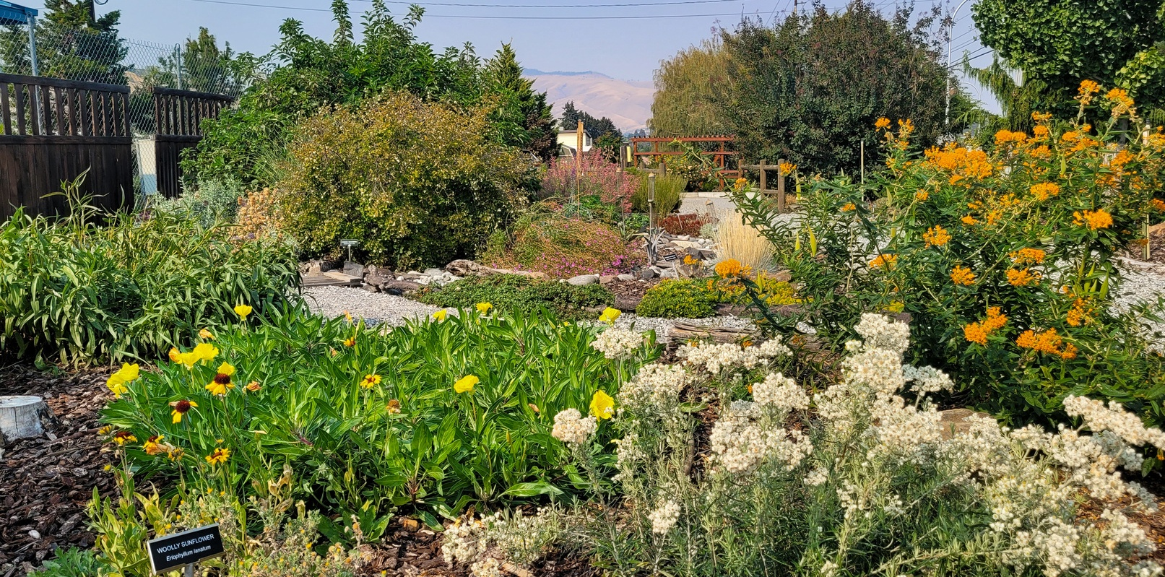
Plant Biodiversity
BY THE NUMBERS
2,560
ADULT AND YOUTH CLASSES, WORKSHOPS, DEMONSTRATIONS, and FIELD DAYS educating about the significance of biodiversity and invasive species management..
The WSU Extension Master Gardener Program drives lasting environmental impact by equipping communities with science-based knowledge and practical strategies to cultivate plant biodiversity and invasive species management. Through volunteer-led education, the program empowers individuals to restore native habitats, support pollinators, and enhance soil health, ensuring resilient ecosystems that sustain local food production and public health.
These efforts may lead to measurable behavior change, with participants adopting sustainable gardening practices that reduce chemical inputs, improve water conservation, and strengthen biodiversity.
9,082
Youth and adult ATTENDEES gained a comprehensive understanding of biodiversity and invasive species management, equipping them with practical strategies to support ecosystem health in their communities.
8,527
QUESTIONS answered at Ask a Master Gardener plant clinics provided valuable insights into plant biodiversity.
21%
Improved understanding of the VITAL ROLE plant biodiversity plays in human health and well-being.
22%
Greater awareness of the actions individuals can take to PROTECT plant biodiversity, including reporting and removing invasive species, replacing lawns, and supporting native plant growth.
19%
Enhanced knowledge of how invasive species negatively IMPACT ecosystems, agriculture, and infrastructure.
19%
Deeper recognition of human INFLUENCE on species biodiversity and the ways individuals can contribute to conservation efforts.
84%
COMMITTED to removing invasive plants in their home landscapes.

Slide 16
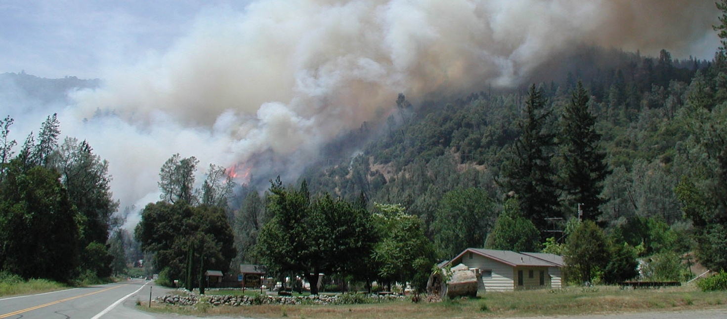
Wildfire Preparedness
BY THE NUMBERS
382
ADULT AND YOUTH CLASSES, WORKSHOPS, DEMONSTRATIONS, and FIELD DAYS educating about the significance of biodiversity and invasive species management..
The WSU Extension Master Gardener Program improves wildfire resilience by equipping communities with science-based education on defensible space creation and vegetation management. Volunteers empower individuals to implement fire-resistant landscaping practices that protect homes, reduce wildfire risks, and safeguard local ecosystems.
These efforts drive behavior change, with residents adopting strategies that minimize fuel loads, enhance emergency preparedness, and mitigate environmental and economic risks. By fostering a culture of proactive wildfire prevention, the Extension Master Gardener Program creates safer, more sustainable communities, ensuring long-term resilience against increasing wildfire threats.
1,144
Youth and adult ATTENDEES gained a comprehensive understanding of biodiversity and invasive species management, equipping them with practical strategies to support ecosystem health in their communities.
672
QUESTIONS answered at Ask a Master Gardener plant clinics helped community members understand how to establish defensible space around their homes.
30%
Improved understanding of wildland fires in Washington state, including their role in native ecosystems, the heightened risks in the Wildland-Urban Interface (WUI), and the broader community costs and IMPACTS of wildfire.
27%
Greater awareness of individual RESPONSIBILITY in fire risk reduction and prevention within home and community landscapes.
41%
Increased ability to IDENTIFY 'defensible space' and distinguish between different zones of fire defense.
35%
Learned how to CREATE a fire-defensible landscape, including assessing ignition risks of materials and understanding zones of risk and defense.
75%
COMMITTED to develop a landscape plan, incorporating fire risk.

Slide 17
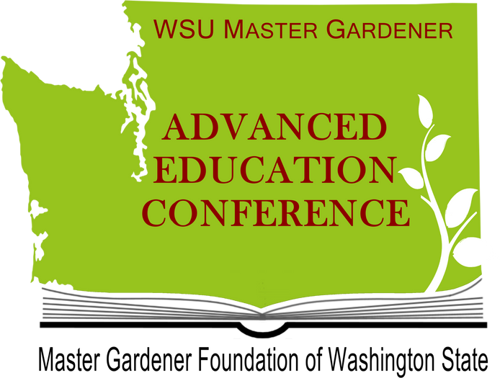

Advanced Education Rooted in Research
BY THE NUMBERS
A survey was conducted among conference attendees following the 2024 virtual advanced education conference to evaluate the percentage of knowledge gained across the nine program priorities of the WSU Extension Master Gardener Program.
Pollinators: Attendees reported a 45% increase in understanding of the essential role pollinators play in ecosystems and strategies to protect their habitats.
Nearby Nature: Knowledge grew by 35%, improving awareness of the benefits of accessible green spaces and methods to enhance local biodiversity.
Wildfire Preparedness: Attendees gained 31% more knowledge on creating fire-defensible landscapes and implementing fire-resistant gardening techniques.
Plant Biodiversity: Insights into conserving diverse plant species and integrating native plants into sustainable gardens improved by 28%.
Water Conservation: Understanding of water-saving techniques, such as efficient irrigation and drought-resistant plants, expanded by 33%.
Local Food: Attendees improved comprehension of sustainable food-growing practices and the value of local food systems by 25%.
Climate Change: Knowledge of climate-smart gardening practices to reduce environmental impact increased by 26%.
Soil Health: Attendees expanded their expertise by 36% in soil testing, fertilization, and methods to improve soil structure and fertility.
Clean Water: Understanding of practices to prevent water pollution, including responsible gardening and pest management, grew by 35%.
Master Gardener Skills: Confidence in leadership and the ability to educate communities in sustainable, research-based gardening practices increased by 35%.
The WSU Extension Master Gardener Program’s advanced education equips volunteers with the expertise to deliver accurate guidance, champion sustainable horticulture, and educate communities on diverse gardening practices.
The WSU Extension Master Gardener Advanced Education Conference underscores the program’s commitment to continuous learning, providing volunteers with the latest science-based gardening knowledge. By fostering leadership skills, the program expands its outreach and impact, strengthening its ability to cultivate a knowledgeable, engaged, and environmentally responsible gardening community that supports long-term sustainability.
mglearns.org

Slide 18


A Year of Growth and Impact
BY THE NUMBERS
7,461
Podcast DOWNLOADS and LISTENS
440
Extension Master Gardener Program Volunteer HOURS contributed to podcast production.
9
Extension Master Gardener Program Volunteers from 6 Washington counties, alongside other gardening experts, collaborated to DEVELOP content.
Top 5 Episodes
Protecting Our Pollinators (Episode 16)
Spring Vegetable Gardening (Episode 18)
Tomato Tips for Washington (Episode 27)
Soil Carbon Sequestration (Episode 14)
Seed Saving Secrets (Episode 31)
Launched in July 2023, The Evergreen Thumb Podcast connects communities with expert gardening and environmental stewardship insights. Produced by WSU Extension Master Gardener volunteers and supported by the Master Gardener Foundation of Washington State, the podcast empowers listeners with science-based knowledge to promote sustainable practices, enhance biodiversity, and build resilient landscapes. By fostering informed decision-making, it strengthens environmental awareness and cultivates a more sustainable future for individuals and communities alike.
Average Listens by
Program Priorities
Pollinators: 358
Nearby Nature: 285
Wildfire Preparedness: 270
Plant Biodiversity: 316
Water Conservation: 293
Local Food: 353
Climate Change: 316
Soil Health: 332
Clean Water: 297
evergreenthumb.mastergardenerfoundation.org

Slide 19
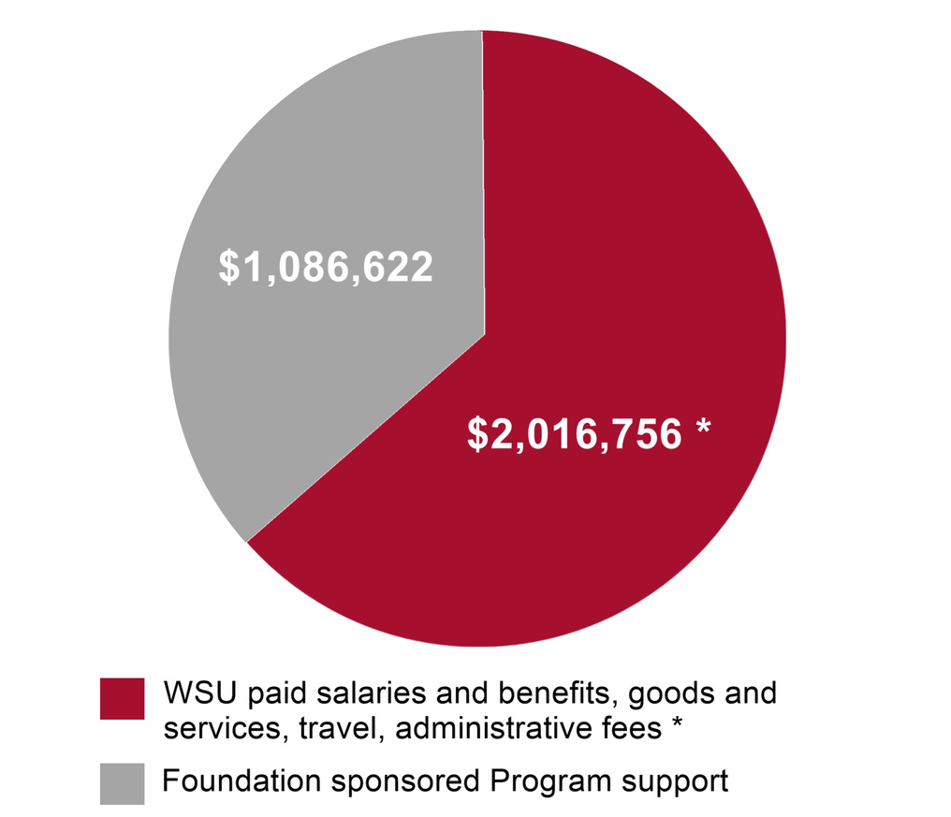
Financial support for the WSU Extension Master Gardener Program (estimated)
SUPPORTING LASTING IMPACTS
The WSU Extension Master Gardener Program receives funding from multiple sources, including USDA-NIFA, Washington State University, county governments, grants, service fees, donor contributions, and the generosity of Master Gardener Foundations. This financial support enables the program to maintain faculty and staff positions, covering salaries, benefits, goods and services, travel, and administrative costs. WSU alone provides over $2 million annually to sustain the program, supporting 13 full-time equivalent positions, 11 half-time roles, and 41 partial appointments.
Beyond direct funding, the program benefits from additional resources such as office space, equipment, and land for demonstration gardens provided by WSU. Ancillary support also comes from CAHNRS IT, CAHNRS Marketing and Communications, the Pesticide Resource and Education Program (PREP), and the WSU Integrated Pest Management Team, which contribute to essential training and education efforts. The Master Gardener Foundations further bolster the program by funding educational outreach, volunteer recognition, and general operations, ensuring continued impact in communities across Washington.
*This amount excludes support from various WSU programs, facilities, and resources, including CAHNRS IT, CAHNRS Marketing, PREP, the Integrated Pest Management Team, AOI, and the value of office space, equipment, and land for demonstration gardens.

Slide 20


Questions?
Insert Name
WSU Extension Master Gardener Volunteer
Contact info
http://mastergardener.wsu.edu/
https://www.facebook.com/WSUMGProgram

