Slide 1
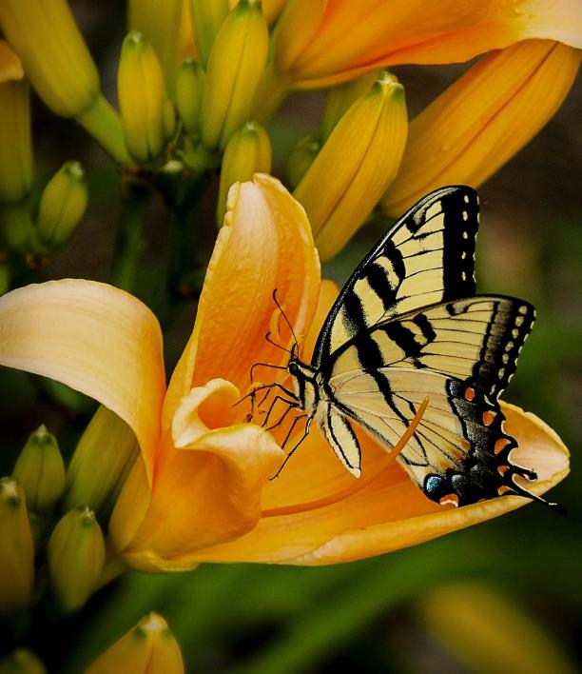






Climate Ready Plants
Natives, Cultivars & Perennials
Molly van der Burch
King County
Master Gardener Program
WSU Extension programs and employment are available to all without discrimination. Evidence of noncompliance may be reported through your local Extension office.
Photo credit: by James DeMers via Pixabay
CC-005
Notes:
SLIDE 1 TITLE
My name is ________. Today we are going to look at some exciting new research to see which plants are adapting best to our changing PNW climate.
_____ Throughout this presentation there are links to documents of various file types. Please contact our Statewide Program Leader if you require this information in a different format.

Slide 2



Extension is for everyone!
Washington State University is an affirmative-action, equal-opportunity employer. Washington State University Extension programs and materials are open to all without regard to race, color, national origin, sex, gender, gender identity, religion, age, height, weight, disability, political beliefs, sexual orientation, marital status, family status, or veteran status.
Welcome!
We are glad
you are here.
Read more on the WSU Extension website:
https://extension.wsu.edu/about-extension/extension-is-for-everyone/
Notes:
WSU Extension programs and policies are consistent with federal and state laws and regulations on nondiscrimination. Extension is for everyone, so we are glad you could join us today.

Slide 3






Resilient Washington
Our Mission: Building a Resilient Washington Together
Washington State University’s College of Agricultural, Human, and Natural Resource Sciences works to create a more resilient Washington. Our scientists, educators, students, and volunteers foster discovery and innovation across many disciplines that improve our state’s productiveness, sustainability, health, and wellbeing. Our mission embraces four pillars of endeavor:
Create an adaptable workforce
Providing a secure food supply system
Helping to maintain sustainable natural resources
Supporting thriving, healthy communities, families, and individuals
Notes:
WSU Extension is the front door to the University. It extends non-credit education to people throughout the state.
WSU Extension empowers people, organizations, businesses, and communities to find solutions for local issues.
WSU Extension is recognized for its science-based educational programs and collaboration with community partners to create a culture of life-long learning.
Such programs include 4H, Agriculture, Community and Economic Development, Youth and Families, Nutrition, Gardening and natural resources.

Slide 4



WSU Extension Master Gardener Mission
Engaging university-trained volunteers to empower and sustain diverse communities with relevant, unbiased, research-based horticulture and environmental stewardship education.
Notes:
I am speaking today in my role as a Master Gardener. We are all volunteers trained in the science of gardening by WSU to give garden advice to the public. We offer plant clinics, online gardening classes, and have demonstration gardens where you can see different techniques in action.

Slide 5
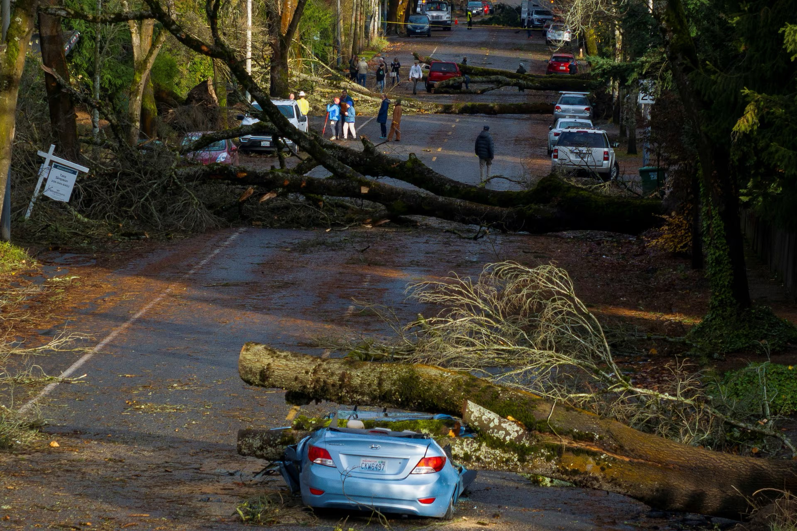
More Extreme Winter Storms
Hotter & Drier Summers
Photo Credit: Nick Wagner from Seattle Times November 20, 2024
Notes:
SLIDE 5
Why worry about finding plants that adapt? Climate change isn’t going away. Who can forget the extreme wind and damage from the November bomb cyclone or the flooding and mudslides from the atmospheric river in fall 2021 that closed I5? With our summers getting hotter and drier with longer periods of drought, choosing plants that are going to survive and thrive is increasingly important. In the latest USDA planting zone map, the Puget Sound region shifted from hardiness zone 8b to zone 9 as a response to our changing climate. Have you already noticed plants in your garden that are struggling to adapt or perhaps never recovered from our June 2021 heat dome?
_____ Throughout this presentation there are links to documents of various file types. Please contact our Statewide Program Leader if you require this information in a different format.

Slide 6
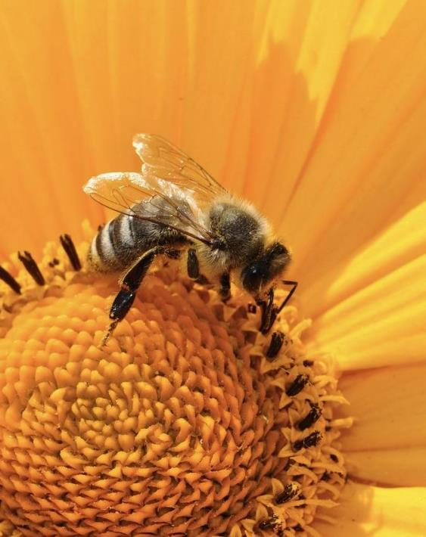
Today’s Topics
Criteria for Climate Resilient Plants
UW Botanic Gardens Climate-Ready Plants Study
Comparing Climate Resilience of Natives, Cultivars, and Nativars
Studies on Attractiveness to Pollinators
Photo credit: by Katja via Pixabay
Notes:
SLIDE 6 TODAY’S TOPICS
With our changing climate in mind, here’s what we are going to look at today. (Read from slide)
_____ Throughout this presentation there are links to documents of various file types. Please contact our Statewide Program Leader if you require this information in a different format.

Slide 7
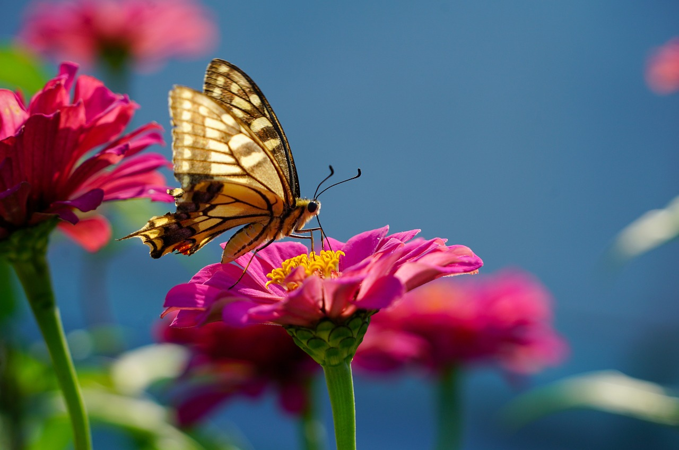
What is a climate resilient plant?
Can survive in a variety of conditions
Can tolerate pests and diseases
Can attract pollinators
Photo Credit: by Hans via Pixabay
Notes:
SLIDE 7 WHAT IS CLIMATE RESILIENT PLANT
Important to understand what we mean by climate resilience in plants
3 main factors – tolerate and thrive in different situations – heat, drought, cold, wet
Resist pests and diseases including new invasive pests
Attract pollinators – essential for plant survival
_____ Throughout this presentation there are links to documents of various file types. Please contact our Statewide Program Leader if you require this information in a different format.

Slide 8
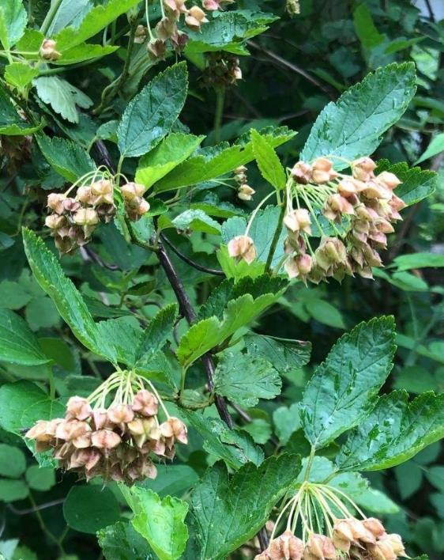
Criteria for Choosing Climate Resilient Plants
Adaptable to PNW ecosystem
Use less water
Resistant to pests and diseases
Improve genetic diversity
Beneficial to pollinators
Photo Credit: Ninebark Carol Davit29 June 2021.jpg
Notes:
SLIDE 8 CRITERIA FOR CHOOSING CLIMATE RESILIENT PLANTS
We need some criteria so that we can compare how different plants are adapting to climate change in the PNW. Keeping in mind the definition of climate resilience, we can compare… (read from slide)
_____ Throughout this presentation there are links to documents of various file types. Please contact our Statewide Program Leader if you require this information in a different format.

Slide 9

University of Washington
Climate-Ready Plants Study
Notes:
SLIDE 9 UW CLIMATE-READY PLANTS STUDY
Let’s start with an exciting local plant trial right here at UW that is evaluating one piece of our criteria --which landscape plants can take the lowest water conditions.
_____ Throughout this presentation there are links to documents of various file types. Please contact our Statewide Program Leader if you require this information in a different format.

Slide 10
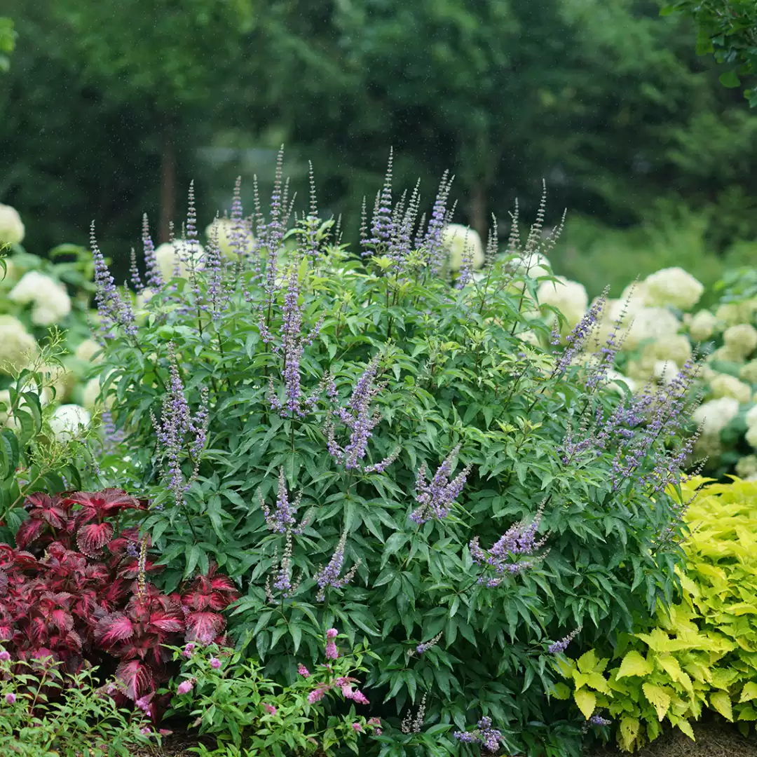
University of Washington
Climate-Ready Plants Study
Six field sites
Testing 15 taxa at each site
Evaluating drought resistance
Involves local retail nursery and landscape professionals
Photo Credit: UW Botanic Garden Climate Ready Plant Study
Notes:
SLIDE 10 UW CLIMATE READY PLANTS STUDY
The study is called Climate-Ready Plants and includes six field sites -- University of Washington, University of California-Davis, University of Arizona, Utah State University and Oregon State University. With funding from a USDA grant, each site has 15 types of plants – 6 are the same plants at all 6 sites and the other 9 are chosen by the different sites to reflect the tastes and climate of the region. One unique aspect of this study is that Seattle area retail nursery and landscape professionals and even Great Plant Picks were involved in choosing the 9 UW plants to be added to the study. All are sun-loving landscape plants.
_____ Throughout this presentation there are links to documents of various file types. Please contact our Statewide Program Leader if you require this information in a different format.

Slide 11
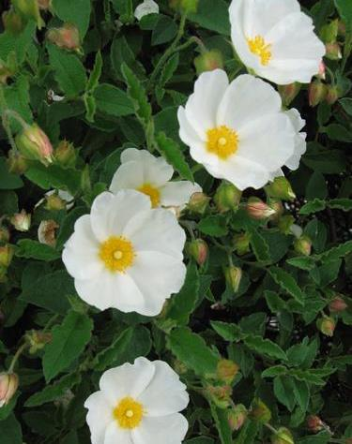
How the Study Works
Year One - All plants watered the same amount
Year Two - Plants randomly assigned one of three different irrigation treatments — high 80%, medium 50%, or low 20% water use
Open House held at end of Year Two to evaluate foliage, flowering, pest tolerance/disease resistance, vigor and overall appearance (AKA, the “WOW factor)
Two years of Irrigation Deficit Trials - 2022 and 2023
Next phase will be testing shading and cooling effects of vines
Cistus
Photo credit: c Rick Peterson courtesy Great Plant Picks
Notes:
SLIDE 11 HOW THE STUDY WORKS
Year one all plants receive the same amount of water irrigation in the summer to get established. Irrigation (of the non-rainfall variety) is suspended during the winter.
Year two plants are randomly assigned one of three different irrigation levels (low, moderate, and high)
At the end of the second year, all the plants are evaluated by graduate students and rated in the following categories: foliage, flowering, pest tolerance/disease resistance, vigor and overall appearance (AKA, the “WOW factor”). Those which thrive best with the lowest amount of irrigation were the “winners”, so to speak. There have been two field trials in 2022 and 2023. The next phase of the study will evaluate the shading and cooling effects of vines.
_____ Throughout this presentation there are links to documents of various file types. Please contact our Statewide Program Leader if you require this information in a different format.

Slide 12
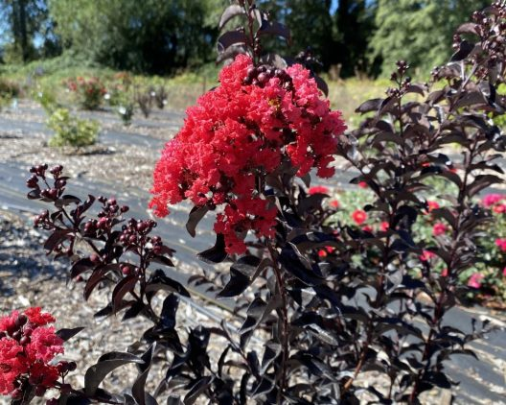
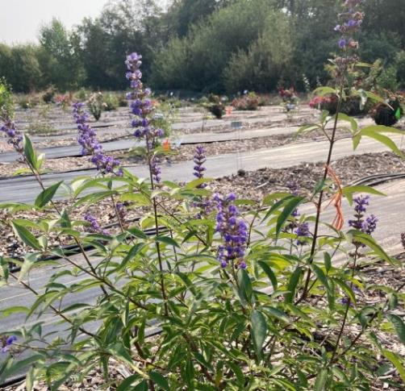
2022 Open House Favorites
Lagerstroemia ‘Center Stage Red’
Vitex ‘Blue Diddley’
Photo Credit: UW Botanic Garden Climate Ready Plant Study
Photo Credit: UW Botanic Garden Climate Ready Plant Study
Notes:
SLIDE 12
OPEN HOUSE FAVORITES
Let’s look at a few of the winners.
Lagerstroemia ‘Center Stage Red’ crape myrtle
Vitex ‘Blue Diddley’ — dwarf of the chaste tree gets 3-5’ — ball of lavender/blue spikes in summer
_____ Throughout this presentation there are links to documents of various file types. Please contact our Statewide Program Leader if you require this information in a different format.

Slide 13
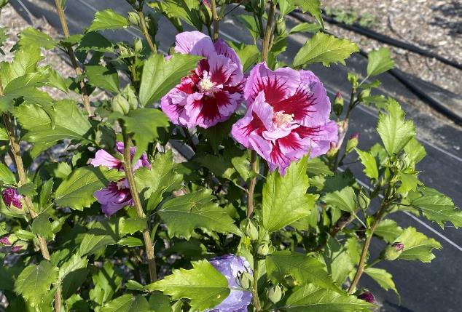
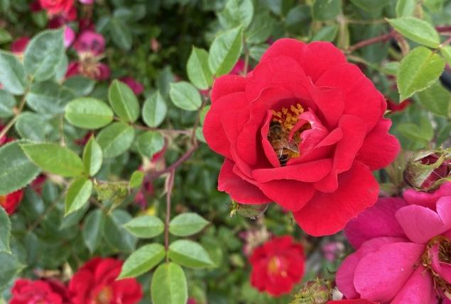
“This trial is significant as it really does put data to the observations–not just qualitatively, but quantitatively–about how plants are performing,” explains Ray Larson, Curator of Living Collections at UWBotanicGarden
Photo Credit: UW Botanic Garden Climate Ready Plant Study
Photo Credit: UW Botanic Garden Climate Ready Plant Study
Hibiscus ‘Purple Pillar’
Rosa ‘Oso Easy Urban Legend’
Notes:
SLIDE 13 HIBISCUS AND ROSA
Hibiscus “Purple Pillar” and Rosa ‘Oso Easy Urban Legend’
One of the real surprises was how well the roses did with very little water!
_____ Throughout this presentation there are links to documents of various file types. Please contact our Statewide Program Leader if you require this information in a different format.

Slide 14
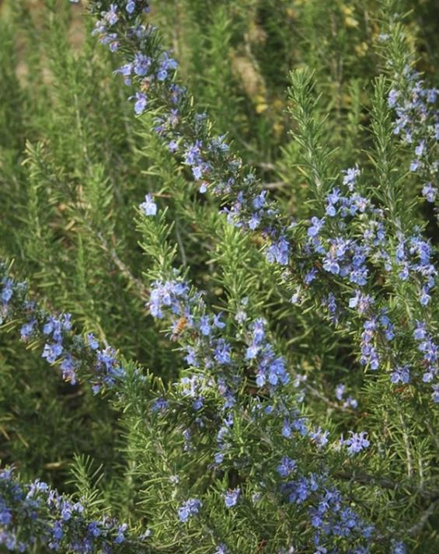
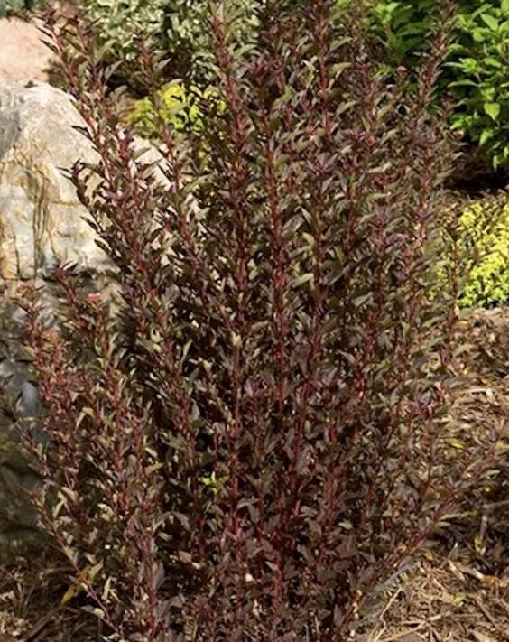
And a few more…
Rosemary officinalis ‘Arp’
Physocarpus ‘Little Devil’
Photo Credit: UW Botanic Garden Climate Ready Plant Study
Photo credit: UW botanic Garden Climate Ready Plant Study
Notes:
SLIDE 14 AND A FEW MORE
Rosemary ‘Arp’ and Physocarpus ‘Little Devil’ Ninebark
_____ Throughout this presentation there are links to documents of various file types. Please contact our Statewide Program Leader if you require this information in a different format.

Slide 15
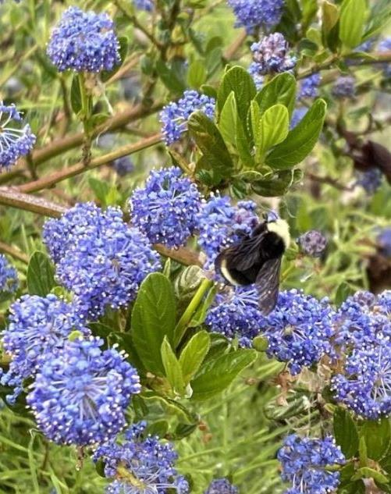
Complete list at botanicgardens.uw.edu/science-conservation/climate-ready-plants/
Ligustrum ‘sunshine’
Rosa ‘Petite Knockout’
Ceanothus ‘Victoria’
Hydrangea quercifolia ‘Pee Wee’
Mahonia aquifolium
Osmanthus ‘Variegatus’
Ceanothus ‘Victoria’
Photo credit: UW Botanic GardenClimate Ready Plant Study
Notes:
SLIDE 15
You can access all of the plants tested in 2022 and 2023 at this website to give you some specific future favorite plants to look for. And there is a new project at the site to research how effectively vines create shade.
_____ Throughout this presentation there are links to documents of various file types. Please contact our Statewide Program Leader if you require this information in a different format.

Slide 16
How Do Natives and Cultivars Handle Our Changing Climate?
Notes:
SLIDE 16 HOW DO NATIVES HANDLE OUR CHANGING CLIMATE?
The UW study deals primarily with landscape plants, many of which are non-natives. Because so many of us have natives and cultivars in our home gardens, let’s explore how these plants are adapting to our climate.
_____ Throughout this presentation there are links to documents of various file types. Please contact our Statewide Program Leader if you require this information in a different format.

Slide 17
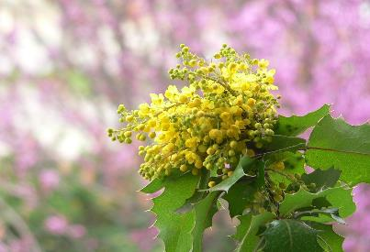
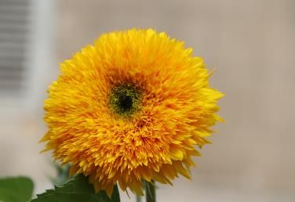
Let’s Define
Natives
Cultivars
Not introduced through human activity
Present before European colonization
Integral to native plant community
Combination of two words - cultivated and variety
Selected for certain traits by intentional breeding
Derived from native or non-native plants
May not produce nectar or seeds
Native Mahonia
Sunflower with double flowers
Photo Credit: by Hans via Pixabay
Photo Credit: by Gaimard via Pixabay
Notes:
SLIDE 17 LET’S DEFINE
First, let’s do some basic definitions.
Natives – Found in regions without human intervention, In North America, that means they were present before European colonization.
Cultivars – Two words combined “cultivated” and “variety”, Intentional breeding for certain traits (color, shape, size, bloom time), can come from native or non-native plants, cultivars are not grown from seed, they are clones of the original plant and reproduced thru cuttings, grafting, or tissue cultures. You can identify them in the nursery as it will have a name enclosed in single quotations ‘Sunset Hydrangea’. They may or may not produce nectar or seeds
_____ Throughout this presentation there are links to documents of various file types. Please contact our Statewide Program Leader if you require this information in a different format.

Slide 18
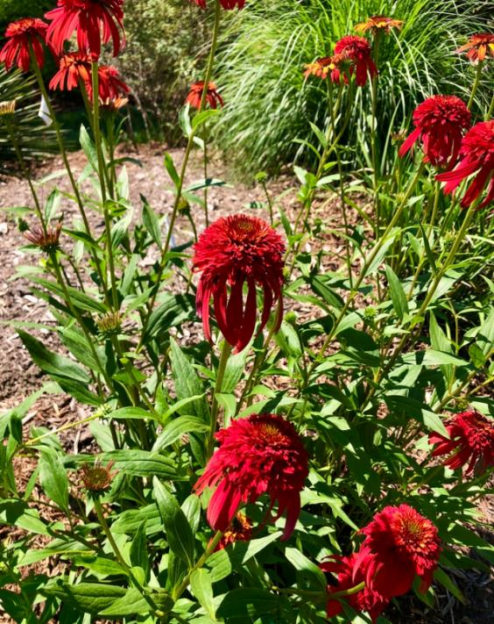
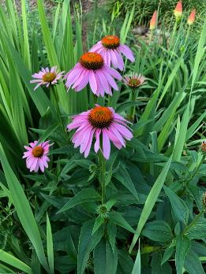
Nativar
Derived from a native plant
Human selection for specific plant traits
Some have no nectar or pollen
Native Echinacaea purpurea Photo Credit: Cathy Dwitt
Echinacaea ‘Hot Papaya” Photo Credit: Cathy DeWitt
Notes:
SLIDE 18 NATIVAR
Another definition you may run into – Nativar.
This is the popular name for cultivars of native plants. Like the cultivar, there is human selection for specific plant traits, they are not grown from seed, and they may or may not have nectar or pollen.
_____ Throughout this presentation there are links to documents of various file types. Please contact our Statewide Program Leader if you require this information in a different format.

Slide 19
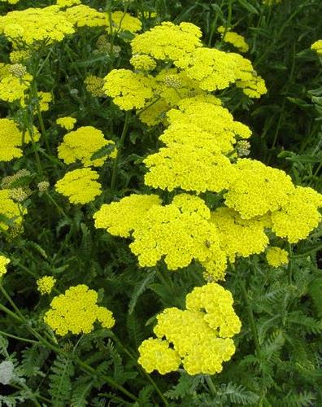
Perennials
Live more than 2 years
Die back in winter and re-emerges in spring
Can be divided and moved around the garden
Invasives
Non-native species
Establish, reproduce rapidly, and spread
Cause harm to the environment, economy, or human health
Achillea ‘Moonshine’
Photo credit: c Blooming Nursery courtesy Great Plant Picks
Notes:
SLIDE 19 PERENNIALS and INVASIVES
A perennial is a plant that lives more than two years and regrows each spring. While the blooms and leaves of perennials die back during winter, new growth arises the following spring with minimal work on your part. Can be divided and moved around the garden.
Invasive plants are non-native species that, once introduced to an environment, establish, reproduce rapidly, and spread, causing harm to the environment, economy, or human health. Examples would be Himalayan blackberry, Scotch broom, English holly, spurge-laurel, butterfly bush, giant hogweed
_____ Throughout this presentation there are links to documents of various file types. Please contact our Statewide Program Leader if you require this information in a different format.

Slide 20

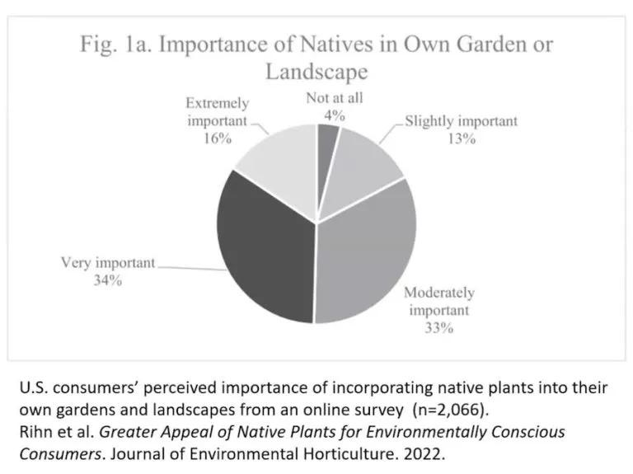
Importance of Natives in Own Garden or Landscape
Notes:
SLIDE 20 GRAPH OF NATIVE POPULARITY
How popular are natives in our gardens? In a survey from Journal of Environmental Horticulture, about 1/3 of people consider native plants very important in their gardens and another 1/3 consider them moderately important. A National Wildlife Federation study found an increase of almost 20% in the number of native plants that consumers are purchasing since 2020. So safe to say, that native plants are continuing to grow in popularity for home gardeners.
_____ Throughout this presentation there are links to documents of various file types. Please contact our Statewide Program Leader if you require this information in a different format.

Slide 21
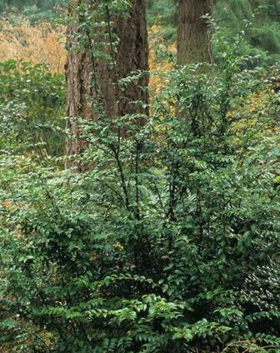
Natives vs. Non-Natives the Climate Controversy
Vaccinium ovatum
Photo Credit: c Richie Steffan courtesy Great Plant Picks
Notes:
SLIDE 21 NATIVES VS NON-NATIVES: THE CONTROVERSY
Every discipline has to have its controversies, and gardening is no exception. For the past decade, the big debate in gardening has been which is better – natives or non-natives. Non-natives in this case would be any plant that arrived after colonization and was introduced by direct or indirect human activity. So non-natives would include many of the perennials and shrubs currently in our home gardens. This debate has carried over to which plants are adapting better to climate change so let’s explore some of these assumptions.
_____ Throughout this presentation there are links to documents of various file types. Please contact our Statewide Program Leader if you require this information in a different format.

Slide 22
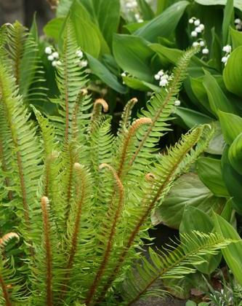
Natives are best adapted to PNW Climate – Myth or Reality
Natives do best in natural environment (forest floor, marsh, meadow)
Struggle in some home gardens with different conditions
Invasives are adapting faster than some natives to climate changes
Some slow to adapt to heat and drought
Native Sword Fern
Photo Credit: c Richie Steffan courtesy Great Plant Picks
Notes:
SLIDE 22 NATIVES ARE BEST ADAPTED TO PNW CLIMATE: MYTH OR REALITY
Scientists know that native plants do better in certain types of environments where they grow naturally like the forest floor, marshes, or meadows. There are still many environments where natives are thriving. Unfortunately, those environments can be hard to duplicate in the home garden. If a native is meant to grow in marshy conditions and is put in compacted, dry soil next to a concrete driveway it is not going to thrive. Many home gardens may have poor soil, little irrigation, and garden beds next to streets or driveways. Invasives are tolerant to a wider range of conditions than non-invasive species. Some invasives are changing their flowering schedule like purple loosestrife that has been blooming almost a month earlier in Whatcom County in the last few years. Natives have been slower to adapt and are losing ground to the highly competitive invasives. Some of our local native conifers are struggling to adapt to the hotter, drier conditions. The scientific consensus is that our alpine, freshwater aquatic, and some forest habitats are most at risk which puts our native plants that prefer those habitats at risk.
_____ Throughout this presentation there are links to documents of various file types. Please contact our Statewide Program Leader if you require this information in a different format.

Slide 23
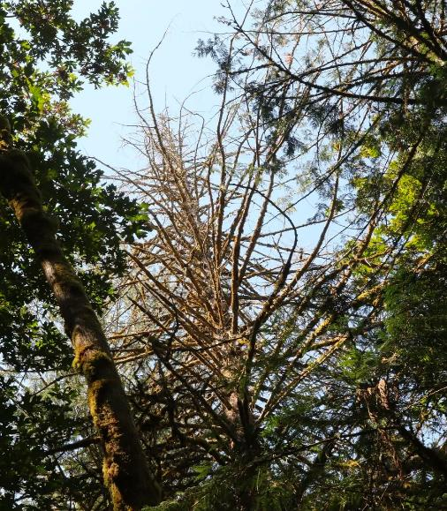
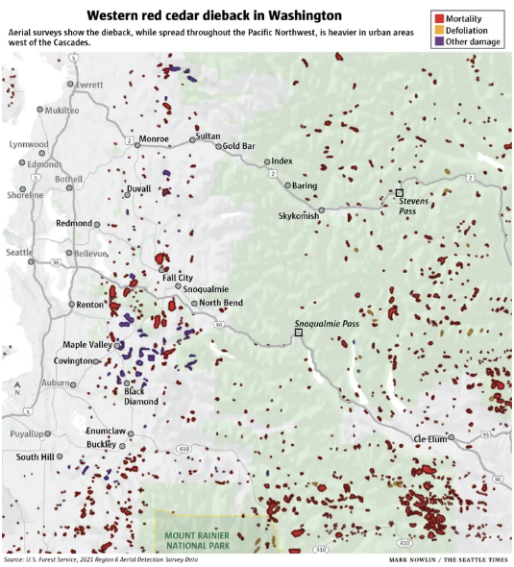
Western Red Cedar Die-Off
Photo Credit: US Forest Service from Seattle Times October 30, 2022
Notes:
SLIDE 23 WESTERN RED CEDAR DIE-OFF
On the left is a dead Western Red Cedar in Seattle. On the right are dead or dying Western Red Cedars in Washington identified by aerial survey. A recent WSU study found that a warming climate and more frequent and severe summer droughts, especially in consecutive years, are increasing the vulnerability of our Western Red Cedars.
_____ Throughout this presentation there are links to documents of various file types. Please contact our Statewide Program Leader if you require this information in a different format.

Slide 24

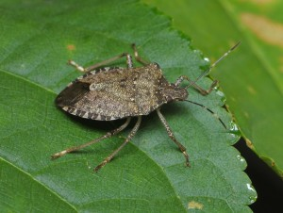
Natives are better at resisting pests and diseases – Myth or Reality?
Best adapted to native pests and predators
Threatened by migrating invasive pests and diseases
Brown Marmorated Stink Bug
Photo credit: E. Beers, treefruit.wsu.edu
Notes:
SLIDE 24 NATIVES ARE BETTER AT RESISTING PESTS AND DISEASES – MYTH OR REALITY
Natives are best adapted to native pests and native predators. Unfortunately, our higher temperatures and wetter conditions translate to a warm and humid environment that is ideal for the population growth of insect and plant pathogens. We are seeing more invasive pests and they are able to produce more generations in a shorter period of time. Pests are migrating from more tropical and temperate climates to the PNW. In the past few years we have seen new priority invasive species like Northern giant hornet, brown marmorated stink bug, scarlet lily beetle, and emerald ash borer enter our region and affect many of our native plants. Many natives are vulnerable to these new invasive pests and diseases.
_____ Throughout this presentation there are links to documents of various file types. Please contact our Statewide Program Leader if you require this information in a different format.

Slide 25
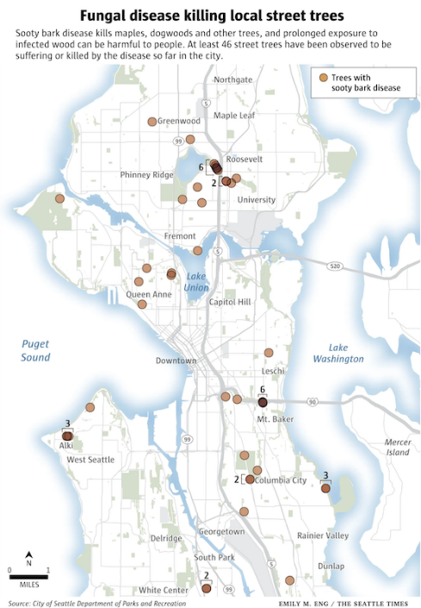
SOOTY BARK DISEASE OF MAPLES
Caused by fungus cryptostroma
First found in Seattle in 2020
Linked to changes in climate
Notes:
SLIDE 25 SOOTY BARK DISEASE OF MAPLES
An example is the Sooty bark disease of maples caused by the fungus Cryptostroma was first found in Seattle in 2020; This disease is associated with heat & drought, likely aggravated by climate change.
_____ Throughout this presentation there are links to documents of various file types. Please contact our Statewide Program Leader if you require this information in a different format.

Slide 26
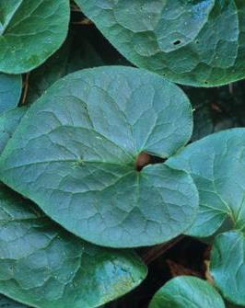
Natives use less water, fertilizer, and pesticides – Myth or Reality?
Generally rely on groundwater
Less chemicals needed against native pests
Need less maintenance if can adapt to urban gardens
Asarum Caudatum – Native Wild Ginger Photo credit: c Richie Steffan courtesy Great Plant Picks
Notes:
SLIDE 26 NATIVES USE LESS WATER, FERTILIZER, AND PESTICIDES – MYTH OR REALITY
Native plants depend on an underground source of water or a dormant seed bank in the ground. Some depend on fire to start germinating. In areas where the water table is increasingly low due to extended drought conditions, native plants will need to depend on irrigated water. If a home garden has a good irrigation system, natives can thrive even if the water table is very low. Under good local conditions, most natives do not need extra fertilizer. As for pesticides, native plants are well adapted to deal with specific local pests and predators and when isolated from non-natives, will not usually need pesticides. The problem comes in when pests from neighbor’s gardens or invasive pests arrive that native plants are not ready for. When natives can adapt to urban garden environments, they are low maintenance and attract native pollinators and birds.
_____ Throughout this presentation there are links to documents of various file types. Please contact our Statewide Program Leader if you require this information in a different format.

Slide 27
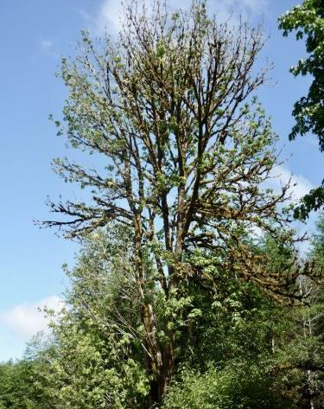
Big Leaf Maple Decline
UW study attributed decline to increasing and prolonged summer drought
Weakens immune system of native trees
More likely to decline near roads and other urban development
Photo credit: Jacob Betzen University of Washington
Notes:
SLIDE 27 BIG LEAF MAPLE DECLINE
Since 2011, scientists, concerned hikers and residents have observed more stressed and dying bigleaf maple across urban and suburban neighborhoods as well as in forested areas. Often the leaves are the first to shrivel and die, eventually leaving some trees completely bare. While forest pathologists have ruled out several specific diseases, the overall cause of the tree’s decline has stumped experts for years.
A new study led by the University of Washington, in collaboration with Washington Department of Natural Resources, has found that bigleaf maple die-off in Washington is linked to hotter, drier summers that predispose this species to decline. These conditions essentially weaken the tree’s immune system, making it easier to succumb to other stressors and diseases. In addition to warmer, drier weather, the researchers found that bigleaf maple are more likely to decline near roads and other development — especially in hotter urban areas.
_____ Throughout this presentation there are links to documents of various file types. Please contact our Statewide Program Leader if you require this information in a different format.

Slide 28
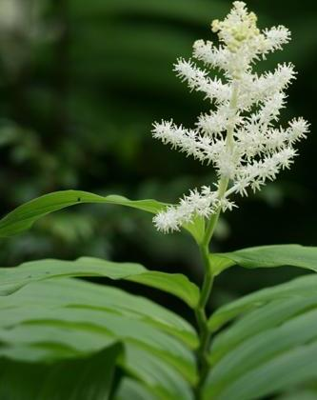
Bottom line on Natives Adapting to Changing Climate
Do best in their native environments and can struggle in urban gardens
Seem to be losing ground to invasives
Still provide biodiversity
Can use less fertilizer and fewer pesticides
False Solomon’s Seal
Photo credit: c Richie Steffen courtesy Great Plant Picks
Notes:
SLIDE 28 BOTTOM LINE ON NATIVES
Do best in their native environments and can struggle in urban gardens
Seem to be losing ground to invasives
Still provide biodiversity
Generally use less fertilizer and fewer pesticides
_____ Throughout this presentation there are links to documents of various file types. Please contact our Statewide Program Leader if you require this information in a different format.

Slide 29
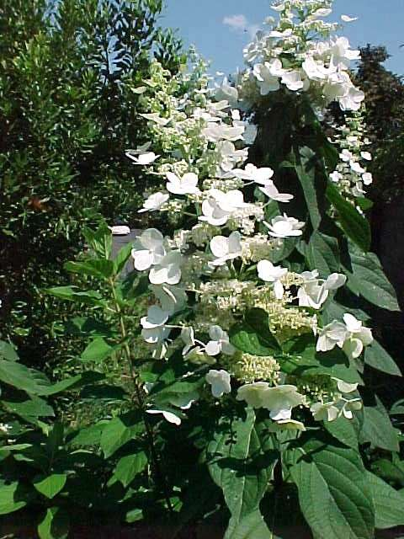
And what about Cultivars and Nativars?
Provide wide variety of colors, forms
Some can be bred to be more hardy and disease resistant
Clones of the original plant so often sterile; do not produce seeds
Reduce genetic diversity
Ongoing research on water and fertilizer use
Hydrangea paniculata ‘Tardiva’
Photo credit: c Missouri Botanical Garden Kemper Center PlantFinder/www.mobot.org courtesy Great Plant Picks
Notes:
SLIDE 29 AND WHAT ABOUT CULTIVARS AND NATIVARS?
Cultivars and nativars are favorites in many of our gardens because they come in such a wide variety of colors and forms. Many of them are specifically bred to be more disease and pest resistant than native varieties. like the cultivar to resist Dutch Elm Disease. Unlike plants grown from seed or plants grown in the wild, which could produce different characteristics and more genetic diversity, cultivars actually reduce genetic diversity which is a real drawback. There is ongoing research on water and fertilizer use in cultivars.
_____ Throughout this presentation there are links to documents of various file types. Please contact our Statewide Program Leader if you require this information in a different format.

Slide 30
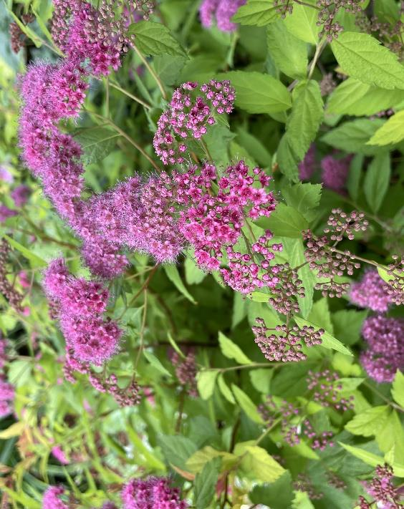
What about Perennials?
Have longer root systems to hold moisture and store carbon
Reduce erosion and enrich soil
Abundance of colors, shapes, and sizes that appeal to variety of pollinators
Bloom over multiple seasons and good food source for pollinators
Can add biodiversity combined with natives and cultivars
Photo credit: Molly van der Burch KCMG
Notes:
SLIDE 30
Perennials have some advantages compared to natives and cultivars. Gardeners have to choose from an abundance of colors, shapes, and sizes. So much variety attracts numerous different pollinators.
With careful planning, a garden can have perennials in bloom all year and over multiple seasons providing a good food source for pollinators and wildlife.
Perennials have longer root systems so they can better hold moisture and are a good source for storing carbon in soils. The longer roots and aerated soil reduce erosion and improve the soil. Combined with natives and cultivars, perennials increase biodiversity in home gardens.
_____ Throughout this presentation there are links to documents of various file types. Please contact our Statewide Program Leader if you require this information in a different format.

Slide 31
Ability to Attract Pollinators
Notes:
SLIDE 31 ABILITY TO ATTRACT POLLINATORS
One of our important criteria for adapting to changes in our local climate is the continuing ability to attract pollinators. There have been quite a few studies on the varied attractiveness of natives and cultivars to pollinators. We are going to take a look at two of them.
_____ Throughout this presentation there are links to documents of various file types. Please contact our Statewide Program Leader if you require this information in a different format.

Slide 32





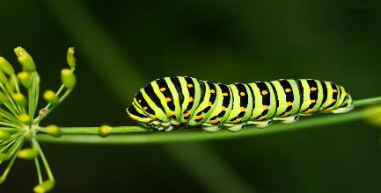
Research Study by Entomologist Dr. Douglas Tallamy
Plant Habit -- No difference to wildlife
Disease Resistance – No difference to wildlife
Leaf color – Nativars with purple or dark brown leaves not as attractive as green leaves
Looked at these 4 characteristics of cultivars and natives:
Plant habit
Disease-resistance
Leaf color variation
Increased berry size
Leaf variation – The more variegation, the less nutritious the leaves but some preferred variegated leaves
Increased berry size – Nativars have larger, more abundant, and more appealing fruit for caterpillars
Photo credit: By mivey2222 via Pixabay
Notes:
SLIDE 32 RESEARCH STUDY BY DR DOUGLAS TALLAMY
The first study is by Dr Douglas Tallamy. Many of you will be familiar with Dr Tallamy, a noted entomologist and professor at the University of Delaware and his book Bringing Nature Home. In this study, he compares native woody plants and their matching cultivars to see which are more effective in supporting native insects, particularly caterpillars. Caterpillars are a key food for many birds. He looks at these 4 characteristics: plant habit, disease resistance, leaf color variation and increased berry size.
Plant habit – changing height or form had no effect
Disease resistance – Cultivars bred for disease resistance made no difference
Leaf color – this is one area where there was a difference. Cultivars with purple leaves were not as attractive as those with green leaves.
Leaf variation – the more the variation, the less nutritious the leaves
Berry size – Larger berried blueberry cultivars were more appealing
_____ Throughout this presentation there are links to documents of various file types. Please contact our Statewide Program Leader if you require this information in a different format.

Slide 33
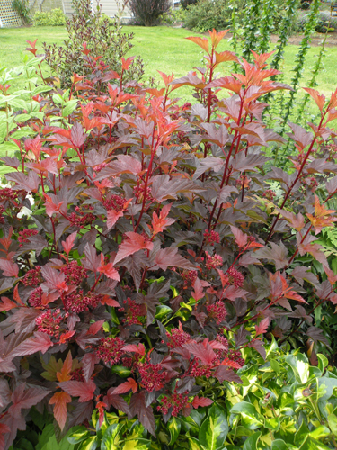
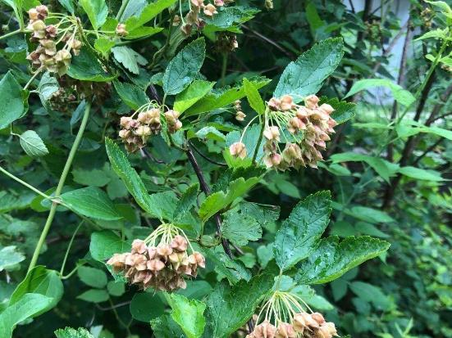
Cultivars versus Native plants
Center Glow Ninebark
Cultivar
Physocarpus opulifolius Ninebark
Native
Photo credit: c Richie Steffan courtesy Great Plant Picks
Photo credit: Carol Davit 29 June 2021
Notes:
SLIDE 33 SUMMER WINE CULTIVAR AND NATIVE NINEBARK
You can see the Summer Wine cultivar with the purple leaves that are less appealing than the native ninebark with green leaves. Tallamy explains that red leaves remove chlorophyll from the leaf and load it with anthocyanins. Choosing plants that are more attractive to wildlife improves the biodiversity and climate resiliency of your garden.
_____ Throughout this presentation there are links to documents of various file types. Please contact our Statewide Program Leader if you require this information in a different format.

Slide 34
Which are better for pollinators – native or cultivar flowering plants?
Research study by Dr. Annie White, University of Vermont
Compact Form Cultivar
Fewer Flowers
Less Desirable to Pollinators
Double-flowered Cultivar
More sterile
Less Desirable to Pollinators
Quantity/
Quality of Nectar
Varied
Mixed Results
Notes:
SLIDE 34 WHICH ARE BETTER FOR POLLINATORS – NATIVE OR CULTIVAR FLOWERING PLANTS?
The second study we are going to look at is by Dr Annie White of the University of Vermont. She is comparing flowering plants and their attractiveness to pollinators rather than woody plants like Dr Tallamy. The field trial included 500 plants, 14 native species with native cultivar pairings. Read from slide
_____ Throughout this presentation there are links to documents of various file types. Please contact our Statewide Program Leader if you require this information in a different format.

Slide 35
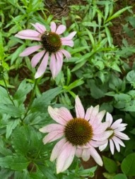
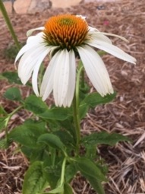
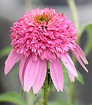
Cultivars versus native plants 2
Echinacea purpurea (Native)
Echinacea ‘White Swan’
Echinacea ‘Double Pink Surprise’
Photo credit: Ltshears CC BY-SA 3.0 via Wikimedia Commons https://commons.wikimedia.org/wiki/File:Pink_Double_Delight_Coneflower_001.jpg
Photo Credit: Sarah Bingham
Photo credit: Susan Martin
Notes:
SLIDE 35 PHOTO OF 3 CONEFLOWERS
The flowering plant that has some of the most cultivars in the coneflower or echinacea. These are 3 coneflowers from White’s study. The native was the most appealing to pollinators, the “White Swan” cultivar which is a shorter variety was next and the least appealing was the “Double Pink Surprise”. The double flowered coneflower has modified the stamens and carpels to make additional petals. This makes it harder for pollinators to reach the pollen and nectar and often these flowers are sterile.
_____ Throughout this presentation there are links to documents of various file types. Please contact our Statewide Program Leader if you require this information in a different format.

Slide 36
“Choosing a cultivar that’s as close to the native species as possible—in morphology, bloom time, and color—is going to increase the likelihood that it’s a comparable substitution.” Dr. Annie White
Bottom line – The more manipulated the cultivar, the less attractive to pollinators
Notes:
SLIDE 36 CHOOSING A CULTIVAR QUOTATION
Read the slide
_____ Throughout this presentation there are links to documents of various file types. Please contact our Statewide Program Leader if you require this information in a different format.

Slide 37
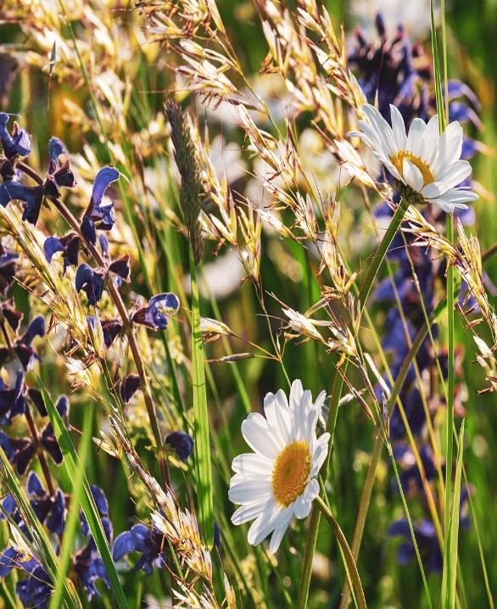
Ideas to Increase Climate Resiliency
Reduced monitor invasive plant species
Plant both natives and non-natives to increase biodiversity
Consider pollinator value
Read plant labels for cold tolerance and planting zone
Use research to find drought tolerant plants
Think “right plant, right place”
Photo credit: By Couleur via Pixabay
Photo credit: AdobeStock-530890492-15
Notes:
SLIDE 37 IDEAS TO INCREASE CLIMATE RESILIENCY
We have compared how natives, cultivars, and perennials are adapting to climate change. To sum up, here are some ways to add climate resiliency in our home gardens:
—Reduce invasive plant species -- early detection, eradication, and management of invasives
—Consider planting both natives and non-natives – that would include perennials and cultivars. Improves the biodiversity in our gardens and provides a greater variety of plants for pollinators
—Think about the pollinator value of the plant — can pollinators easily access the nectar and pollen?
—Pay attention to plant labels for cold tolerance and planting zone for heat tolerance
—Take advantage of the research studies to find drought tolerant plants
—Remember right plant, right place – for natives, try and match the native habitat as closely as possible; consider type and quantity of irrigation; group plants with similar water and light needs together
____ Throughout this presentation there are links to documents of various file types. Please contact our Statewide Program Leader if you require this information in a different format.

Slide 38
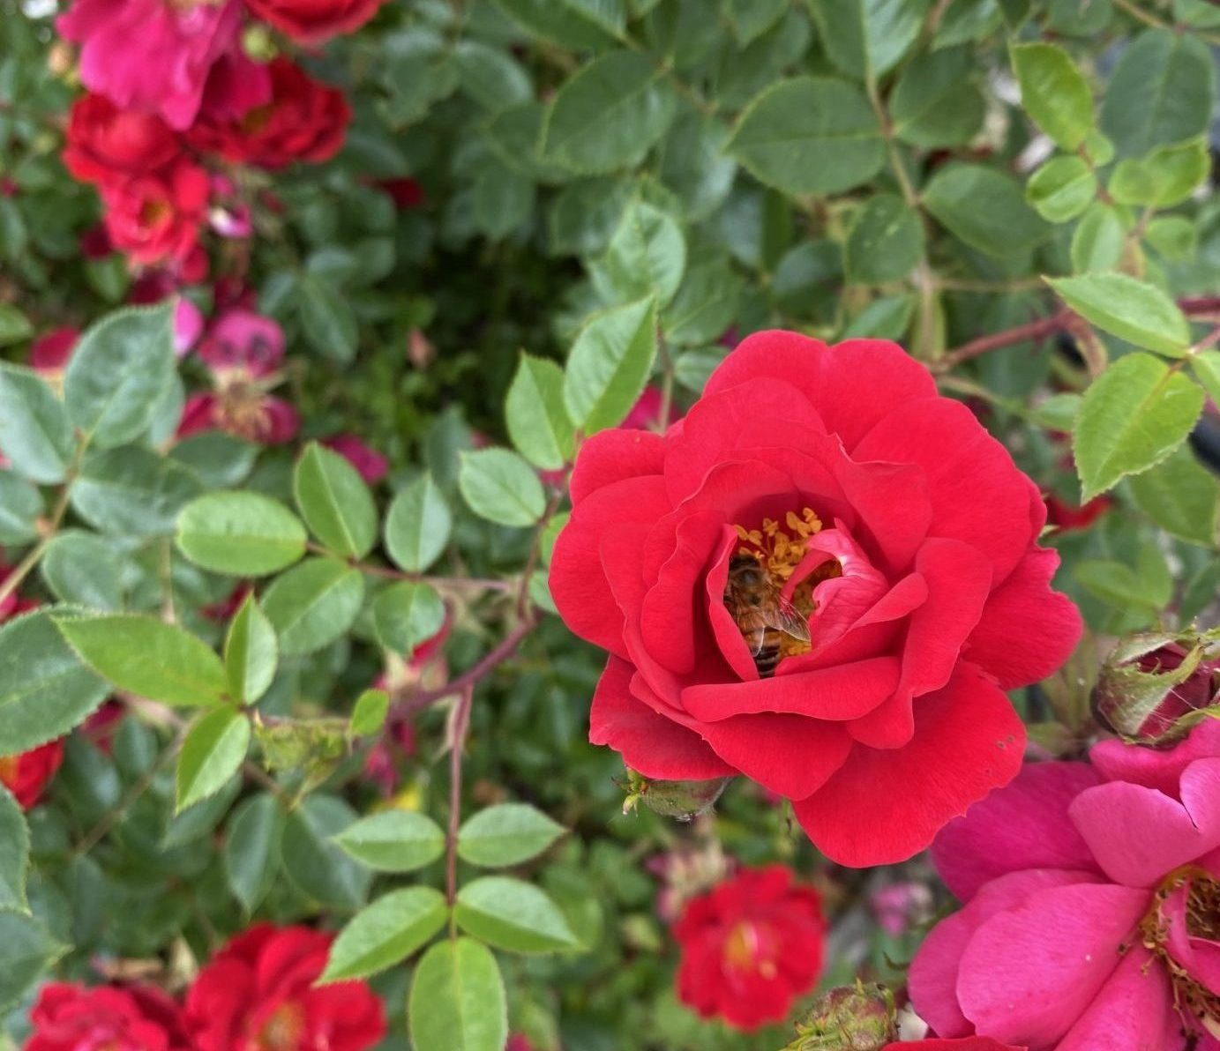
Vanish, Adapt, or Migrate
“To plant a garden is to believe in tomorrow.”
Audrey Hepburn
Photo Credit: UW Botanic Garden Climate Ready Plant Study
CC-005
Notes:
SLIDE 38 VANISH, ADAPT, OR MIGRATE
We hope ongoing and future studies will prevent our favorite plants from Vanishing – Facing extinction, loss of habitat, being overrun by invasives, or becoming susceptible to new diseases and pests
The fate of our Future Favorite plants will depend on their ability to
Adapt to our changing PNW climate -- by altering their metabolism and growth,, flowering cycle, reproduction, or appeal to pollinators
Migrate -- Toward areas with more favorable climatic conditions either by seed dispersal or by human action
In the end, as gardeners, we can follow Audrey Hepburn’s advice –
“To plant a garden is to believe in tomorrow.”
_____ Throughout this presentation there are links to documents of various file types. Please contact our Statewide Program Leader if you require this information in a different format.

Slide 39


Questions?
Molly van der Burch
Extension Master Gardener Program
King County
Program Questions: king-mg@wsu.edu
Gardening Questions:
ask-a-mastergardener@live.com
WSU Extension programs and employment are available to all without discrimination. Evidence of noncompliance may be reported through your local Extension office.
Notes:
‘Must Use’ slide: Standard way to end your presentation….
_____ Throughout this presentation there are links to documents of various file types. Please contact our Statewide Program Leader if you require this information in a different format.

Slide 40
Resources: online documents
Claire McLean University of Washington Botanic Gardens, Climate Ready Plant Trials Underway at UW Botanic Gardens
Accessed February 2024, https://botanicgardens.uw.edu/about/blog/2021/09/06/climate-ready-plant-trials-underway-at-uwbg/
Ben Alexander, LeAnn Locher, Apollo Stone, Brian Matson, Climate Resiliency: The Future of Native Planting A Conversation with Botanists, Landscape Designers, Restoration Technicians in the Pacific Northwest
Accessed June 2024, https://bpb-us-e1.wpmucdn.com/sites.uw.edu/dist/4/16698/files/2023/02/Falls-Indv-Project-4.pdf
Bruce Bennet, Climate Ready Landscape Plants, Jefferson County Master Gardener Foundation
Accessed February 2024, file:///Users/mollyvdb/Desktop/Natives:Perennials/Bruce%20Bennett%20article.html
Linda Chalker-Scott, Are Native Trees and Shrubs Better Choices for Wildlife in Home Landscapes?
Accessed February 2024, https://pubs.extension.wsu.edu/are-native-trees-and-shrubs-better-choices-for-wildlife-in-home-landscapes
Bert Cragg, Are Natives the Answer?
Accessed February 2024, https://gardenprofessors.com/are-natives-the-answer-revisited/
Linda Chalker-Scott, Want more bird visitors? Non-native plants may be the answer
Accessed February 2024, https://gardenprofessors.com/want-more-bird-visitors-nonnative-plants-may-be-the-answer/
Grow Native Missouri Prairie Foundation, Natives, Cultivars, and Nativars
Accessed February 2024, https://grownative.org/learn/natives-cultivars-and-nativars/#goodbad
Janet Marinelli National Wildlife Federation, Native or Not So Much?
Accessed February 2024, https://www.nwf.org/Magazines/National-Wildlife/2016/JuneJuly/Gardening/Cultivars
Alicia Rihn, Greater Appeal of Native Plants for Environmentally Conscious Consumers,
Journal of Environmental Horticulture March 2023
Accessed February 2024, https://meridian.allenpress.com/jeh/article/41/1/7/491283/Greater-Appeal-of-Native-Plants-for
King County Native Plant Guide, Native Plants
Accessed February 2024, https://green2.kingcounty.gov/gonative/
Jerry Faulring, Fact Check: Native Plants vs Cultivated Natives
Waverly Farm 2021, Accessed February 2024, https://www.waverlyfarm.com/blog/the-fine-points-of-native-plants-vs-cultivated-natives
Notes:
_____ Throughout this presentation there are links to documents of various file types. Please contact our Statewide Program Leader if you require this information in a different format.

Slide 41
More Resources
Susan Martin, Piedmont Master Gardener, Native Species or Cultivars of Native Plants – Does it Matter?
Piedmont Master Gardeners, Accessed February 2024, https://piedmontmastergardeners.org/article/native-species-or-cultivars-of-native-plants-does-it-matter/
Rebecca McMackin, State of the Native Plant Movement: A Way To Garden, Accessed June 2024, https://awaytogarden.com/state-of-the-native-plant-movement-with-rebecca-mcmackin/
Doug Tallamy, Creating Living Landscapes: The Importance of Native Plants
High Country Gardens, Accessed February 2024, https://www.highcountrygardens.com/content/gardening/creating-living-landscapes-the-importance-of-native-plants
Caitlyn Fallon, Consumer Gardening Report Finds one in Three People Turning to Native Plants, Gardening for Wildlife
National Wildlife Federation Accessed June 2024, https://www.nwf.org/Latest-News/Press-Releases/2022/5-02-22-Consumer-Gardening-Report
The Real Dirt Blog, Native vs. Non-Native Plants
UC Master Gardeners of Butte County, CA Accessed June 2024, https://ucanr.edu/blogs/blogcore/postdetail.cfm?postnum=50407#:~:text=With%20non%2Dnative%20plants%2C%20make,and%20their%20diminishing%20natural%20habitat
Kristen, What’s the Deal with Cultivars?
Blue Stem Natives, Accessed June, 2024, https://www.bluestemnatives.com/post/what-s-the-deal-with-cultivars
Deborah Pilkington EMGV, Native, Nativar, Cultivar: What’s in a Name?
Extension Master Gardener Volunteers of Durham Co., Accessed June 2024, https://durhammastergardeners.com/2022/01/19/native-nativar-cultivar-whats-in-a-name/
Green America, Annuals and Perennials
Accessed June 2024, https://greenamerica.org/faq/annuals-and-perennials
Nathan Giles, As tree species face decline, ‘assisted migration’ gains popularity in Pacific Northwest, Seattle Times Dec 30, 2023, Accessed June 2024, https://www.seattletimes.com/seattle-news/environment/as-northwest-tree-species-decline-assisted-migration-gains-popularity/
Michelle Ma, Bigleaf Maple Decline Tied to Hotter, Drier, summers in Washington, Washington Educational News September 30, 2021, Accessed June 2024, https://www.washington.edu/news/2021/09/30/bigleaf-maple-decline-tied-to-hotter-drier-summers-in-washington/#
Notes:
_____ Throughout this presentation there are links to documents of various file types. Please contact our Statewide Program Leader if you require this information in a different format.

