Slide 1
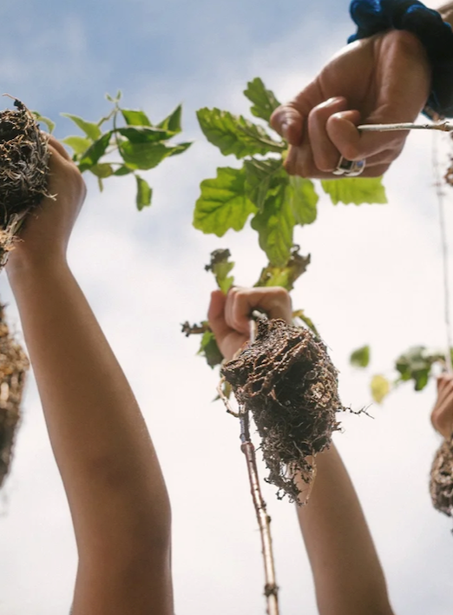






More Trees Please
Mini-forests with the Miyawaki Method
WSU Extension
Master Gardener Program
Photo courtesy of @sugiproject
CC-004
Notes:
Welcome to More Trees Please. This presentation was a Master Gardener’s intern project in 2022.
The MG program in Washington is an extension program of Washington State University. GO COUGS!. If you aren’t a MG, you might find it interesting that the MG program started 50 years ago(1973) in Washington State and the first cohort to complete the training was in Pierce County. Master Gardener volunteers are now serving their communities in all 50 states.
The presentation is available to the local community as a face-to-face presentation, as are other really great talks through request of the Pierce County MG website. This presentation is also recorded for those who are not able to attend F2F and is available via the Pierce County MG YouTube channel

Slide 2



Extension is for everyone!
Washington State University is an affirmative-action, equal-opportunity employer. Washington State University Extension programs and materials are open to all without regard to race, color, national origin, sex, gender, gender identity, religion, age, height, weight, disability, political beliefs, sexual orientation, marital status, family status, or veteran status.
Welcome!
We are glad
you are here.
Read more on the WSU Extension website:
https://extension.wsu.edu/about-extension/extension-is-for-everyone/
Notes:
WSU Extension programs and policies are consistent with federal and state laws and regulations on nondiscrimination. Extension is for everyone, so we are glad you could join us today.

Slide 3
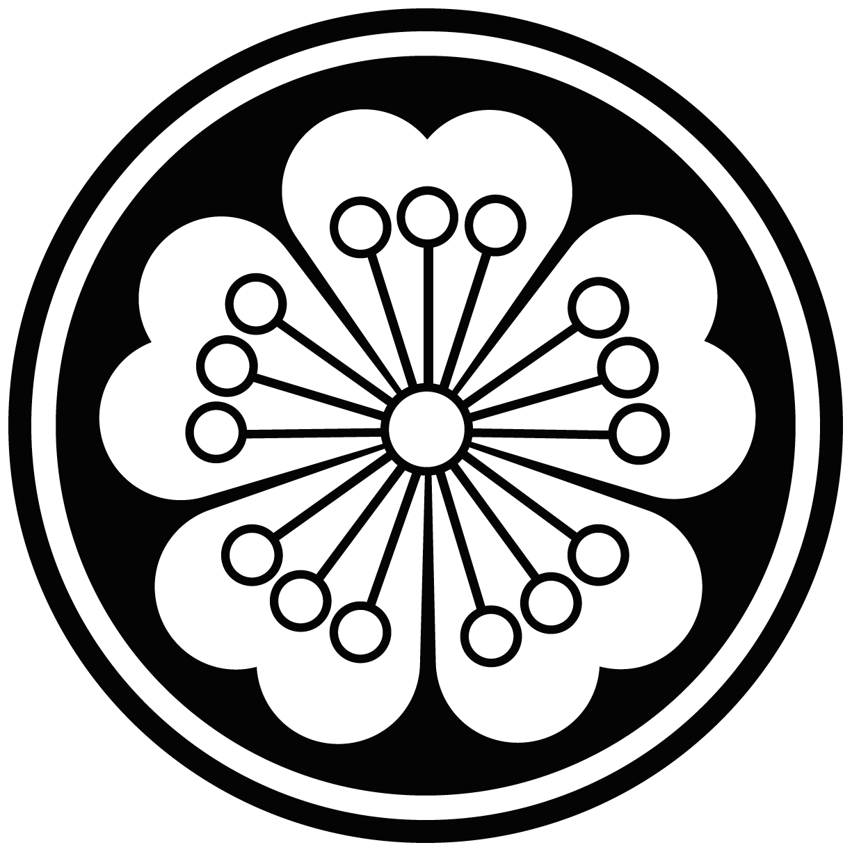





Resilient Washington
Our Mission: Building a Resilient Washington Together
Washington State University’s College of Agricultural, Human, and Natural Resource Sciences works to create a more resilient Washington. Our scientists, educators, students, and volunteers foster discovery and innovation across many disciplines that improve our state’s productiveness, sustainability, health, and wellbeing. Our mission embraces four pillars of endeavor:
Create an adaptable workforce
Providing a secure food supply system
Helping to maintain sustainable natural resources
Supporting thriving, healthy communities, families, and individuals
Notes:
WSU Extension is the front door to the University. It extends non-credit education to people throughout the state.
WSU Extension empowers people, organizations, businesses, and communities to find solutions for local issues.
WSU Extension is recognized for its science-based educational programs and collaboration with community partners to create a culture of life-long learning.
Such programs include 4H, Agriculture, Community and Economic Development, Youth and Families, Nutrition, Gardening and natural resources.

Slide 4


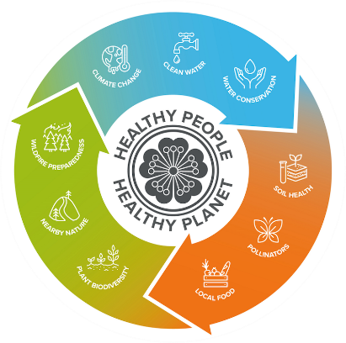
WSU Extension Master Gardener Mission
Engaging university-trained volunteers to empower and sustain diverse communities with relevant, unbiased, research-based horticulture and environmental stewardship education.
Notes:
‘Must Use’ slide:
We want to ensure that you properly ‘place’ Master Gardeners as part of the WSU Extension program, touch on our mission and point out that we have 9 guiding Priorities, of which your presentation is one.
Suggest you cover this while handing out your questions/evaluation form.
Throughout this presentation there are links to documents of various file types.
Please contact our Statewide Program Leader if you require this information in a different format.

Slide 5
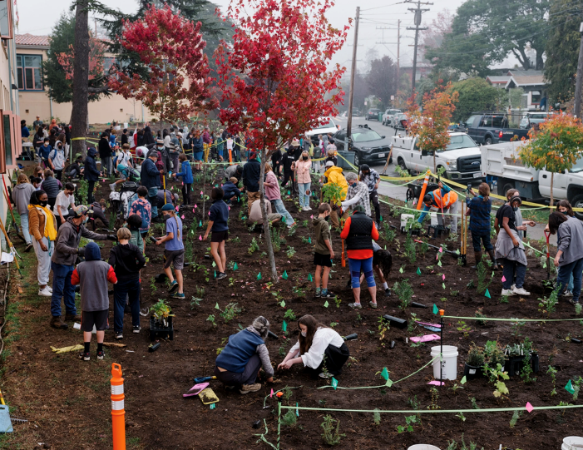
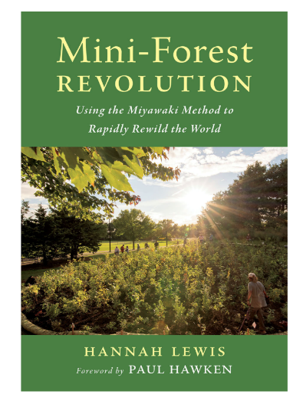

2 Acknowledgements:
https://www.sugiproject.com
Notes:
There were several resources used to prepare this presentation; I want to acknowledge 2 of them up front. One is the SUGi Project Website; SUGi is a 501c(3) organization whose mission is to empower individuals to invest in nature and restore biodiversity by planting forests; this organization fundraises to support the establishment of community foresting projects around the globe.
SUGi gave permission to use their pictures to tell the story of a few of their projects and to advocate for the use of the Miyawaki Method which SUGi promotes in their work.
In addition to SUGi, the other primary inspiration for this talk was a book published in 2022 Called Mini-Forest Revolutions: Using the Miyawaki method to Rapidly Rewild the World. Written by Author Hannah Lewis and published by Chelsea Green.
INTRODUCE HANDOUT. With this presentation you will find a handout which provides links to resources recommended for some homework to get you better informed.

Slide 6
Close Your Eyes
Notes:
Close Your Eyes
I want to take you back to an past experience when you were surrounded by nature. You are cocooned by the natural world. Think about the smell of that experience—the fresh air, the sounds or absence of sound, perhaps there is birdsong or insect noise. Remember the feeling of cool, damp air on your face. Maybe there is a wild animal near by, maybe several animals.
Do you feel Peaceful?
Are you in a Forest?

Slide 7
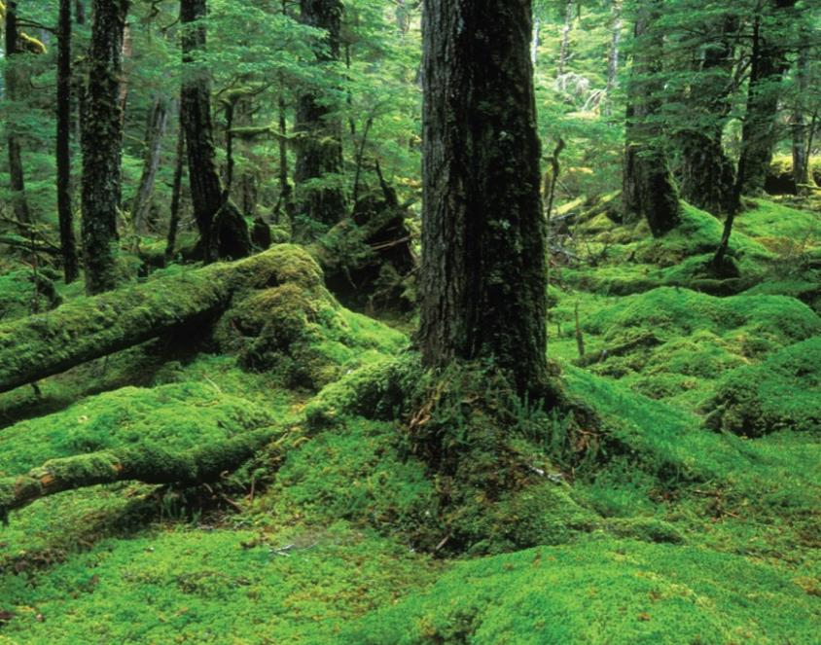
The Miyawaki Method to Mini-Forests
Photo Courtesy of Alaska Magazine
Notes:
Open your eyes. Maybe you were in the middle of an old growth forest like this? This is the Tongass National Forest, Old Growth; Virgin Forest in Coastal Alaska. A truly special beautiful place that you should visit with an indigenous guide when you are in the area.
Spending time in a forest has real wellness benefits. Forests have much cleaner healthier air thanks to the vast amount of photosynthesis. In a forest it is likely that you feel noticeably better—and experience a sense of ease; You may achieve optimal blood pressure. Dr. Quing Li, a medical doctor and researcher has studied the phenomenon and found that spending time in a forest can reduce stress, anxiety, depression, and anger; strengthen the immune system; improve cardiovascular and metabolic health; and boost overall well-being.
In Japan there is a practice of ”Forest Bathing” that dates back to 1980. Shinrin-yoku, also known as forest bathing, is a practice or process of therapeutic relaxation where one spends time in a forest or natural atmosphere, focusing on sensory engagement to connect with nature.
Having reminded you of the serenity and benefits of forests, the goal with this presentation is to advocate for “mini-Forests” which this presentation will demonstrate are being grown on degraded and derelict parcels of urban land.
A secondary goal: Advocating for conservation of our existing urban forests and urban tree canopy.

Slide 8



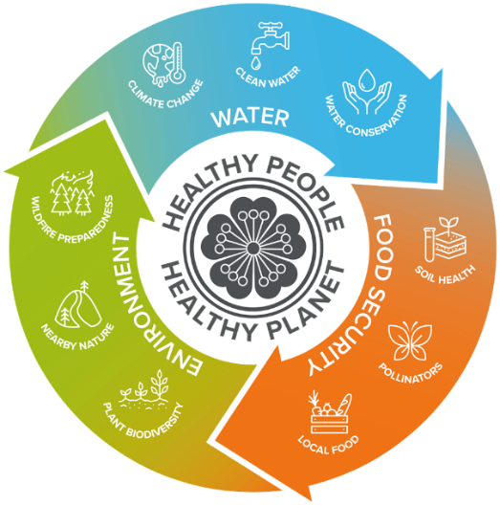

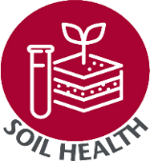

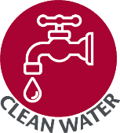


Healthy people , healthy planet
Notes:
A little background; In Washington state the MG program seeks to address, by providing un-biased research-based education, 9 priority issues that face Washington residents. These program priorities describe what we MGs do and why we do it. These priorities help connect the dots from the horticulture skills we learn in the classroom to the natural resources we volunteers are trained to protect.
This presentation about mini-forest efforts will touch on 6 of these priorities. They are: …
So, Now, let’s talk about this Miyawaki Method to create a forest.

Slide 9
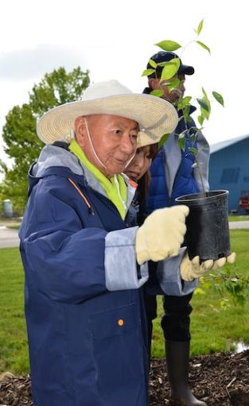
Dr. Akira Miyawaki 宮脇 昭 (1928-2021)
Japanese botanist and expert in plant ecology; Was the recipient of the 2006 Blue Planet Prize
Outspoken advocate for restoration of natural forests using the concept of potential natural vegetation
Established the Miyawaki Method for rapidly growing forests with projects in over 1,700 areas worldwide
Promoted use of the Miyawaki Method to establish “tiny forests” in urban environments
Contributed to vegetational surveys and seed banks for tree species throughout Southeast Asia
Photo of Dr. Akira Miyawaki holding up a seedling during Arvin Sango’s first planting day in Madison, Indiana.
https://www.inverse.com/science/mini-forests
Notes:
I want to introduce you to Dr. Akira Miyawaki.
Blue Planet Prize recognizes outstanding efforts in scientific research or applications of science that contribute to solving global environmental problems. It is an international recognition for work in the field of environmental and climate change studies.
One of Dr. Miyawaki’s earliest academic pursuits was the study of weeds. I thought It ironic that an expert on WEEDS would inspire the world to plant forests on degraded urban land.
Advance Slide
The concept of potential natural vegetation asks the question “what would grow in a area if there was no human management or climatic disturbance?” Think native plants suited to the particular microclimate that complements the plant and animal biodiversity of the area.
Advance Slide
The forests projects Dr. Miyawaki planted and consulted on were often on very degraded land and in a variety of microclimates and harsh conditions.
For example, Dr. Miyawaki was involved in planting forests along the coast of Japan after the earthquake and tsunami that devastated that area in 2011. The natural coastal areas suffered far less impact than the areas with built structures that had been erected to protect the inland. It is my understanding that after the tsunami, Japan has determined to replace the man made build structures with forests. IT IS thought that the forests will provide better protection than the man made structures and concrete barriers that failed in 2011.
Some areas are using Miyawaki designs, some are using non-Miyawaki style plantings and others have rebuilt the concrete walls.
Quote from the Oxford Climate Reveiw: "The Great Forest Wall has not failed, but neither has it grown and evolved in quite the ways that Dr Miyawaki expected. The competing interests of local and national actors problematised the Great Forest Wall as a one-size-fits-all solution for Tōhoku. Although the project fostered creativity and collaboration between some parties, it met with competition and opposition from others. While the Great Forest Wall — like other green walls the world over — may not have lived up to its initial lofty aspirations, it still provided and continues to provide a strong impetus for community reconstruction in an area which suffered massive environmental degradation."
https://www.anthroposphere.co.uk/post/taking-root-failure-and-success-for-the-great-forest-wall-of-t%C5%8Dhoku
Advance Slide
Since Dr. Miyawaki’s initial work to establish a method for rapid reforestation, the use of his methodology has been applied to MINI urban sites.
Advance Slide
Another important academic pursuit of Dr. Miyawaki’s was surveying and saving seeds for tree species that were disappearing from nature. This effort was critical in some of the projects undertaken.
This picture of Dr. Miyawaki was taken at a “planting festival” day in Madison, Indiana at an Arvin Sango Manufacturing facility in 2014. Japanese auto-companies like Subaru and Toyota have a practice of planting forests at there industrial manufacturing facilities around the globe. This effort of auto companies has been a factor in spreading use of the Miyawaki Method globally. AND leads me to the next person I want to introduce Shebendhu Sharma…

Slide 10
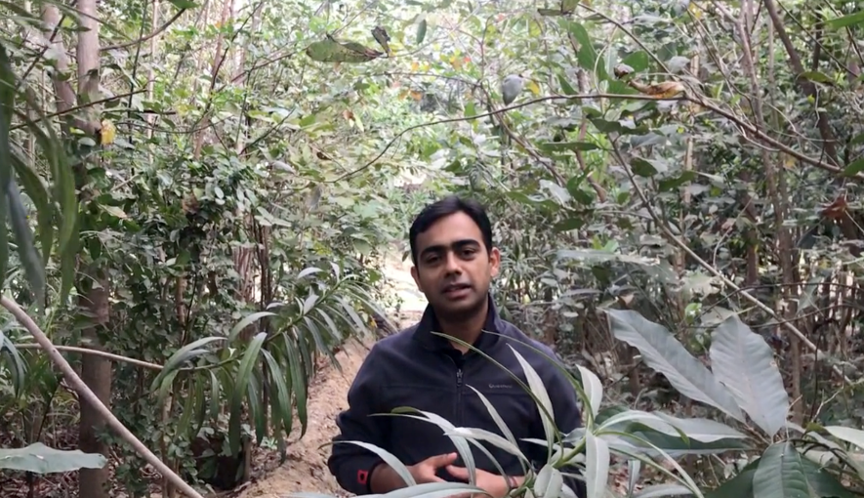

Shubhendu Sharma
Notes:
Second only to Japan, India has the most experience creating mini-forests using the MM.
WHAT IS AFFORESTT. The efforts of automotive companies to plant forests at Toyota introduced the MM to one industrial engineer Shebendu Sharma from India. Mr. Sharma used his industrial engineering training to start a company that consults on planting these mini-forest. AFFORESTT now has a professional staff that consults on MM forest projects throughout INDIA and internationally.
The related handout gives you links to two of Sharma’s TED TALKS which have spread the word on the Miyawaki Method. He has a variety of other Youtube videos explaining the concepts behind the Miyawaki Method.
This picture is a screen capture from one of his videos and was included here because it demonstrates the Miyawaki method dictate to plant very densely.

Slide 11

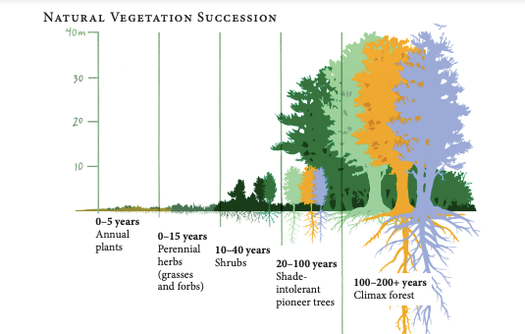
What are Pioneer species of plants?
What are Climactic species of plants?
Illustration Courtesy of Elara Tanguy
Notes:
SOME VOCABULARY:
The term pioneer is used to describe the species that first colonize new habitats created by disturbance (think logging, development, forest fire, tsunami, volcano). EXP: The pioneer species that first arrived at Mt. Saint Helen after the eruption was lichen.
Once pioneer species colonize the area and start to build soil, other species like grasses begin to move in. The complexity of the new community increases as more new species, including small shrubs and eventually shade intolerant trees, arrive.
BUT a Forest is not a sunny place. A forest thrives in shade. It is after the sun-loving species are established that the shade loving trees arrive and a forest can finally thrive.
AS time progresses, the soil becomes richer as leaves and vegetation decay and eventually the area will support climax species. If you’ve ever visited a old growth forest, you will recall that the soil feels spongy—you wind up walking on beautiful fragrant humus.
If Mother Nature is left to reestablish vegetation through NATURAL VEGETATION SUCCESSION with no HUMAN help or management it takes 100-200 years to produce a Climax forest.
Based on Prior Questioning: It is important to point out that the forests growing in tropical environments grow faster and will establish quicker than those grown in temperate climates. Thus the 100 to 200 year time frame. LATITUDE OF the particular SITE, DEGREE DAYS, AMOUNT OF SUNLIGHT --difference between Borneo and Western Washington.
The amount of rainfall would be another local factor in determining how long it takes to establish a forest.
HOW IS THE MM DIFFERENT??

Slide 12
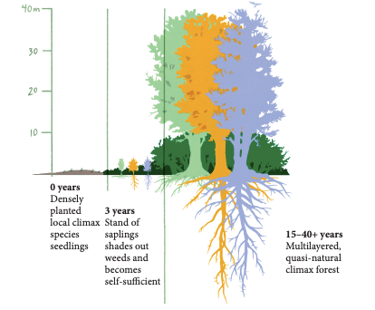
Miyawaki Time Line
How is the Miyawaki Method used to establish a forest different from Natural Succession?
Illustration Courtesy of Elara Tanguy
Notes:
The Miyawaki Method establishes the Climactic forest much quicker (15-40 years) by fixing the soil through human manipulation and planting climax species plants on day 1.
Human management is necessary for no more than 3 years.
THE NEXT SLIDES ARE RATHER TECHNICAL. Afterwards WE WILL GET TO INSPIRATIONAL EXAMPLES AND STORIES

Slide 13
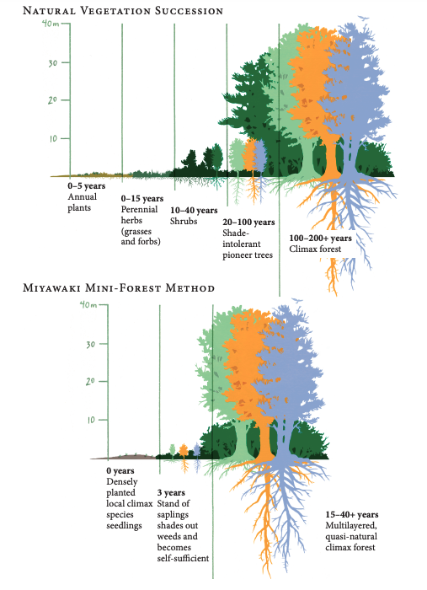
Planning What and How to plant a Miyawaki Forest?
Principles:
Select Native plants ideal to the growing conditions of the microclimate
Plant with maximum biodiversity
Plant densely
Consider the potential for the return of native wildlife & pollinators
Illustration Courtesy of Elara Tanguy
Notes:
SELECT PLANTS-Think Natives: the first question is what is the potential natural vegetation for the area or site? In many projects the ideal climax species may not be obvious. In degraded areas, the ideal climax plants may have been removed centuries before. This is where Dr. Miyawaki’s efforts to identify, collect and catalogue ancient seeds was so necessary and valuable.
In Japan, the land had often been manipulated by humans for so long that ancient art and texts provided clues to which native climax species are most suitable to the site; another resource used to identify the appropriate and often rare species was the nearest Shinto Shrine which are traditionally left undisturbed through the years.
Many Japanese would be surprised that the conifer forests common in Japan are not native. They were introduced to generate timber resources. Through his research Dr. Miyawaki determined that deciduous trees which were quite often very rare in an area were usually the best climax species to plant in the Japanese sites. For many early Miyawaki projects in Japan and India the need for nursery space to propagate unavailable species was a necessary step in the Miyawaki process.
In selecting plants, it is important to consider slope, wind, rain, drainage, proximity to roads or buildings. You wouldn’t plant a species that thrives on a mountainous slope by a lowland river, even if these areas are side by side. Plantings beside roadways should not impede visibility.
DIVERSITY: Rule of thumb: 70-80% of saplings should be canopy and subcanopy species, 10% shrubs and the remaining 10-20% midsized plants. The KEY species should be the climax species.
There should be as many different species as possible. Experience has shown that the more species the better. This is not a tree plantation with a mono-forest of one species planted in row upon row.
Considering the impact of Climate Change over the next 15-40 years, you may want to include some plants that thrive to your south in a warmer climatic zone.
PLANT DENSELY: Rule of thumb: 3 trees per square meter (~3 trees per square yard). By densely planting a very biodiverse array of native species, such forests encourage collaboration between the plants, fungal and microbial life in the soil, resulting in fast-growing forests with high survival rates. They create self-sustaining ecosystems after the initial few years following planting.
The dense planting is 30X denser than a typical garden or park area which provide 30 times the photosynthesis of carbon dioxide into carbon and oxygen.
HABITAT: The older of Miyawaki forests (examples in Japan and India which started using the method earlier) have shown that animal life returns to the healthy forested site often quicker and in more biodiversity of species than expected. The MM Method has been used to create animal corridors for species of animals, promoting their genetic diversity and resulting in healthier animal populations. Examples in India are thought to have contributed to the healther population of Tigers that has been documented. Tigers are able to mingle.
Ask: What is the potential to encourage pollinators to return?

Slide 14

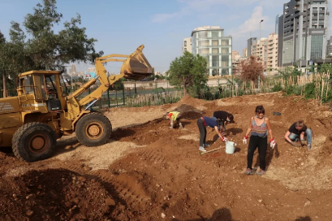
Selecting, Preparing and Maintaining the Site
Site Selection is often a community decision
Site Preparation typically requires mechanical and professional assistance
Soil Analysis is prescribed
Amend Soil as necessary to promote drainage AND Compost!!!
Readily available local mulch is recommended
Depending on local requirements human-managed irrigation and maintenance is necessary for no more than 3 years
Photo courtesy of @sugiproject
Notes:
SITE SELECTION” The Site selected is a community decision. Hannah Lewis’s book shares some of the back and forth with municipal decision makers. It could be a school or park or abutting a particularly unpleasant roadway. In many instances Miyawaki Mini-forests have been established for the purpose of creating a buffer between noisy dirty transport links or industrial sites and residential and community gathering areas. (think train tracks, highways, factories or a port) on the one side and residential, schools and parks on the other. These buffer forests reduce noise and ALSO lower particulate pollution, making the air healthier to breath.
Miyawaki projects in Paris for example are replacing pavement in an effort to address the heat island effect the city is experiencing due to Climate Change. Paris has established an objective that no resident should be more than a 7 minute walk from a cooling island and are using Miyawaki mini-forests to to meet that goal.
Selected sites often provides degraded conditions with compacted soil
SITE PREPARATION: Unless if it a very tiny site, preparation usually involves the use of a backhoe; the backhoe can also be used to address particular drainage issues; for example, the site may be built/bermed up to improve drainage or taken down to promote water retention in the forest with swails.
SOIL ANALYSIS AND AMENDMENT: The question of whether the soil is clay, loam or sandy must be answered and addressed; The MM prescribes use of the The ribbon method to analyze the soil. May need to amend for good drainage. AND
HEAVY compost is recommended. The Miyawaki Method instructs you to use the readily available compost—Tagro a biosolid from our waste treatment system would be a good option. Free and readily available
AND MULCH IS IMPORTANT: Readily available and traditional local mulch is applied after planting.
THE BEAUTY OF THE METHODOLOGY: Once the forest is planted, weeding and irrigation is necessary for no more that 3 years. Planting, weeding and irrigation are often volunteer activities that bring the community together in shared efforts. For some projects municipalities or local parks departments take on the responsibility for irrigation because they have water trucks and can make quick work.

Slide 15
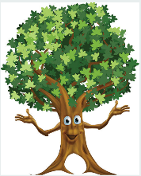
Take Aways
The Miyawaki Method of afforestation allows for the rapid creation of pockets of forest—even on degraded urban land.
It is quick to establish and practically maintenance free once established.
It utilizes 100% natural and organic methods.
It is 30 times denser than other planting methods.
Older projects result in many times more biodiversity than nearby areas.
It is proven in Japan and around the globe with a 97% success rate for forest survival.
Notes:
IN SUMMARY. FACTOIDS!!!
Emphasize that this methodology has been around since the early 1970’s with proven success of more than 1700 projects undertaken by Akira Miyawaki alone. AND more as forest projects are taking off through India and beyond.

Slide 16

Cost?
Use of a Backhoe and Operator is likely the most significant cost.
Selected Plants may be available at little or no charge from local municipal organizations; any need to propagate in a nursery would add cost.
Young saplings are more affordable than larger plants; planting at the best time of year for the microclimate will promote survivability.
Use of readily available compost and mulch will be low cost.
Use of volunteer labor for planting and minimal maintenance will be free; there will be a need to weed only noxious and invasive plants; we will want other native volunteer-type “weeds” to establish naturally.
Once established, the Miyawaki Forest will thrive practically maintenance and cost free.
Benefits with the potential to save costs long term include *cleaner air for better community health, *urban noise reduction, *water restoration, *food production, *wildlife and pollinator habitat restoration and *community building.
Notes:
Criticism of the Miyawaki Method seems to center on the cost. Costs can vary depending on such things as the use of consultants and the use of paid labor;
the goal is to re-forest areas where tree canopy has been wiped out by urbanization. We’re trying to quickly grow tree canopy, not re-create the forest that was there before civilization”…
SO A PICTURE IS WORTH 1000 WORDS AND I HAVE SEVERAL INSPIRING EXAMPLES OF MM FORESTS TO SHARE
AND NOW ON TO THE BEAUTIFUL PHOTO EXAMPLES

Slide 17


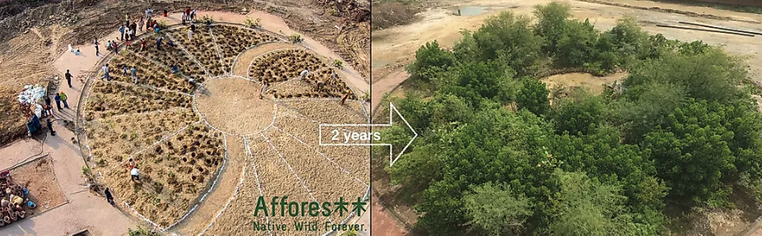
Clifton Park, Karachi, Pakistan
Photo of Clifton Park Miyawaki Forest. Afforestt.
https://www.worldatlas.com/news/the-budding-industry-of-growing-personal-forests.html
Notes:
Afforestt Project. Before and After 2 Years--Contrast. Planting day
This mini-forest project was planted in 2015 to address the heat island effect in this very crowded area of this big urban city. If you google maps this today, you can see that the entire park has been “greened”.
Let’s talk a little about the UHI --Urban Heat Island. Our urban areas are noticeably much warmer due to human activities. Think Pavement, big buildings and industrial activities. They can also be dryer due to human manipulation of water drainage.
Through study and data collection it has been determined that these UHIs are as much as 10^F warmer in air temp and 20-45^F warmer in surface temperatures than nearby green space with tree canopy such as parks. UHIs heat up faster and cool down slower than nearby green space.
A primary solution to make these areas liveable is to plant trees. Or Better a little forest

Slide 18

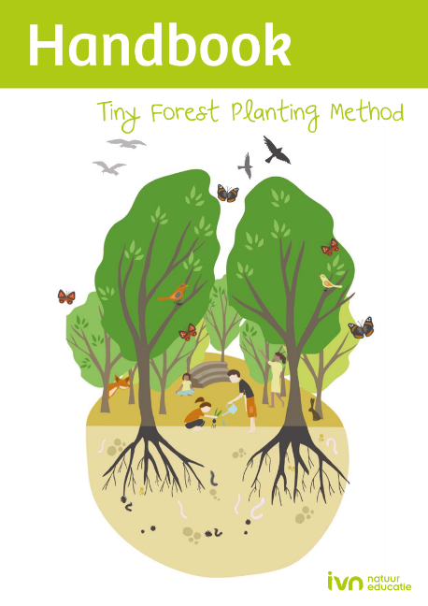
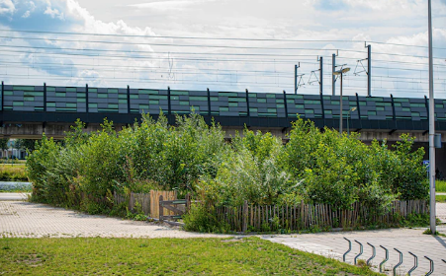

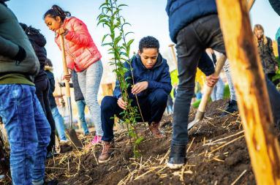
The Netherlands
Photos of IVN Mini-forest Handbook.
https://www.ivn.nl/tinyforest/handbook-tiny-forest-english-version
Notes:
The Netherlands is another leader in promoting the MM and Mini Forests throughout the country. Forest Makers in the Netherlands struggled to get the go-ahead for the first Miyawaki forests, but once the initial project was completed, other communities have jumped in. Hannah Lewis shares stories of neighboring communities competing for bragging rights on who can complete a better project.
In 6 years the Dutch organization IVN planted 111 mini-forests and has written the handbook which is available to download in multiple languages and free of charge. This is the Cover of the English version.
While Shubhendu Sharma was an early MM consultant in the Netherlands, this organization “ivn” is now consulting on Miyawaki forest projects across Europe
2 primary Motivations in the Netherlands: 1) In addition to the UHI issue, the Dutch efforts have been motivated in part to address the ever present flood risk which is only increasing with Climate Change; planting the right mini forest can reduce flooding with plants suited to take up and store water. AND 2) effort is largely directed to give school children the opportunity to experience nature in a very densely populated country with few places to experience nature.
The middle picture illustrates the density of planting and cooling opportunity at a transit station. It is also an example of how you can start small and expand.
MY NEXT EXAMPLE IS A WATER RESTORATION STORY

Slide 19

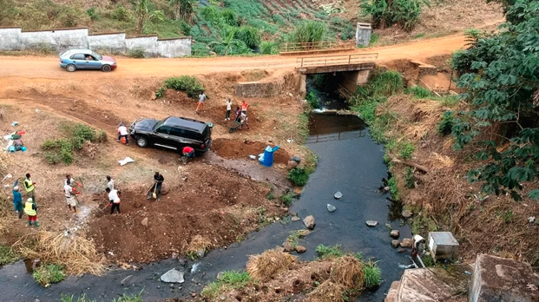
Buea, Cameroon
Planting Day
March 2020
Photo courtesy of @sugiproject
Notes:
This picture is one of 5 MM mini-forests patches (they call them pocket forests) planted as a coordinated project in Buea, Cameroon . A great influx of population in the 1980’s resulted in cutting down the local forests to provide timber for housing. Although this area of Cameroon gets a lot of rain and mountain runoff within the Congo River Basin, the loss of forest caused the water catchment to dry up.
Though the area is blessed with abundant water resources, local inhabitants had faced a serious water crisis for a generation. They had to haul in water for human use.
LOOK AT THE BRIDGE AND FIXED STRUCTURES.

Slide 20
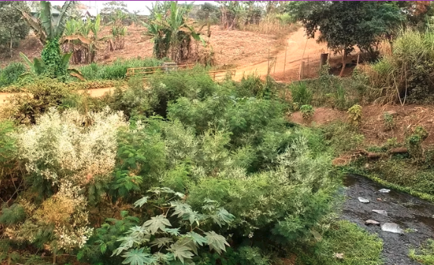
Buea, Cameroon
One Year later
Photos courtesy of @sugiproject
Notes:
ONE YEAR LATER –Note the same bridge and Structure
As you can see in this picture, the natural springs are coming back and are storing water. While the effort is ongoing, the desired results are happening much quicker than anticipated. This community did not have the resources for a engineering hydrology study which might be a first step; however, their hopes paid off and the water crisis was averted.
The Buea forest is the brainchild of one determined leader, Limbi Blessing Tata, who attended an 8 month leadership institute in India where her primary goal was to explore the development of educational opportunities for girls and women in her community. This is where she learned about the MM and realized the potential it offered at home.
The Buea forest patches were planted with the additional goal of restoring fruits, nuts, mushrooms, spices, firewood and traditional medicinal resources that had been lost with the deforestation. It is hoped that opportunity for traditional work associate with gleaning will return.
You can find a yearly update on the SUGi website which lists the a variety of insect and other animal species that have retured the the Camaroonian MM sites including birds frogs and crabs.
2023 SUGi Update: They have recently installed solar panels to pump water to nearby villages. The water table is in much better shape.
2023 SUGi Update: the survival rate for the trees dipped to 62.66% when villagers cut down some of the forest. It is expected that renewed education and awareness efforts will bring the community together to protect these pocket forests.
AND THAT BRINGS ME TO the NEXT EXAMPLE TODAY—MUCH CLOSER TO HOME AND WITH A MASTER GARDENER CONNECTION

Slide 21
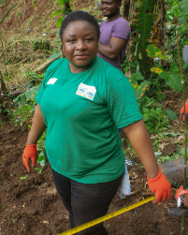
Buea, Camero - One Year later
Photos courtesy of @sugiproject
Notes:
ONE YEAR LATER
As you can see in this picture, the natural springs are coming back and are storing water. While the effort is ongoing, the desired results are happening much quicker than anticipated. This community did not have the resources for a engineering hydrology study which might be a first step; however, their hopes paid off and the water crisis was averted.
ADVANCE SLIDE
The Buea forest is the brainchild of one determined leader, Limbi Blessing Tata, who attended an 8 month leadership institute in India where her primary goal was to explore the development of educational opportunities for girls and women in her community. This is where she learned about the MM and realized the potential it offered at home.
The Buea forest patches were planted with the additional goal of restoring fruits, nuts, mushrooms, spices, firewood and traditional medicinal resources that had been lost with the deforestation. It is hoped that opportunity for traditional work associate with gleaning will return.
You can find a yearly update on the SUGi website which lists the a variety of insect and other animal species that have retured the the Camaroonian MM sites including birds frogs and crabs.
2023 SUGi Update: They have recently installed solar panels to pump water to nearby villages. The water table is in much better shape.
2023 SUGi Update: the survival rate for the trees dipped to 62.66% when villagers cut down some of the forest. It is expected that renewed education and awareness efforts will bring the community together to protect these pocket forests.
AND THAT BRINGS ME TO the NEXT EXAMPLE TODAY—MUCH CLOSER TO HOME AND WITH A MASTER GARDENER CONNECTION. The next story is just outside of Toppenish, Washington

Slide 22

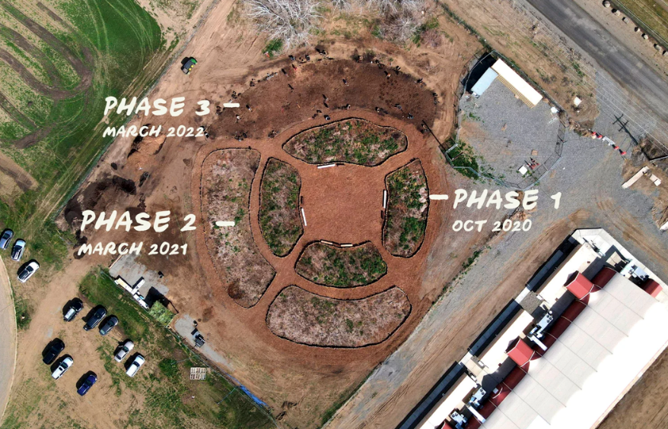
Healing forest
Healing Forest: 2020
Yakama Nation Correctional and Rehabilitation Facility
Photo courtesy of @sugiproject
Notes:
This Miyawaki Forest is planted in the shape of a medicine wheel, a traditional native American design associated with health and healing. It is a human rehabilitative project as many of the Mini-Forests are at heart. Residents of the correctional facility provided much of the labor to establish the forest.
This forest serves as an outdoor classroom, where tribal elders can teach traditional skills and about native plants and their Yakama names and traditional tribal uses for the plants.
The impetus to establish the MM Healing Garden at the Correctional facility came at the recommendation of Debra Byrd, a tribal member and Master Gardener who is a dietician for the Yakama Tribe. Debra Byrd has also planted a mini-forest in her own backyard and in both of these forests they have planted along the outer edges the sacred roots disappearing with the nearby forests; she will use the sacred native roots in her work with specifically diabetes. She also plans to use the forests to teach youth in her community about the native tribal and food traditions.
Note that this Miyawaki project is planted in phases. Also, a more northerly dryer site, it is slower to establish.

Slide 23
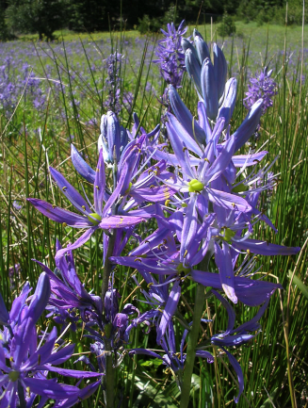
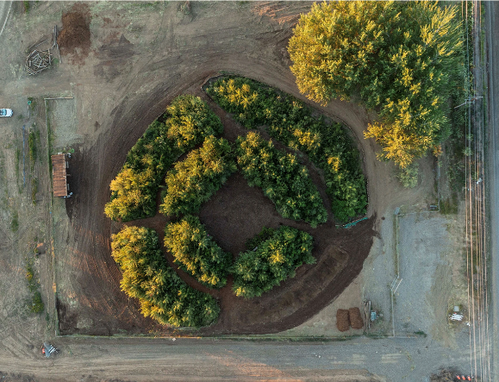
Healing Forest: 2024
Yakama Nation Correctional and Rehabilitation Facility
May 2024
Photo of Common Camas.
https://www.fs.usda.gov/wildflowers/plant-of-the-week/camassia_quamash.shtml
Photo courtesy of @sugiproject
Notes:
Since this example if closer to home, the question of what to plant is really interesting to us MGs. PLANT SELECTION. This Forest matrix selected initially 36 total species in 4 ascending layers (shrub, subtree, tree, and canopy). Some examples include once common trees and shrubs know for indigenous uses and suited to the habitat zone for the selected site; the mix of plants includes Black Cottonwood, Scouler Willow, Trembling Aspen, Wild Rose, Buffalo Berry, Native Blackberries, Camas and Huckleberry.
Camas is an amazing plant that among other benefits is low in the glycemic index. Indigenous people traditionally harvest the camas bulbs to produce flour.
Picture of Camas

Slide 24
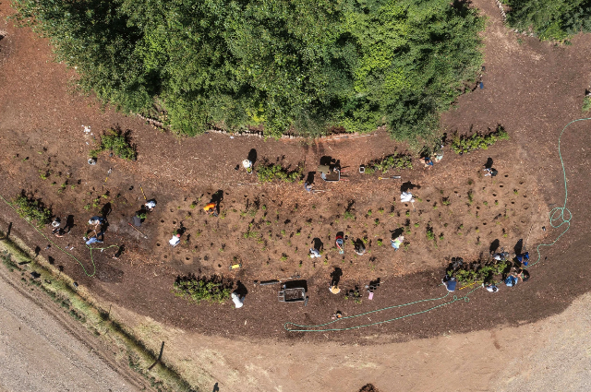
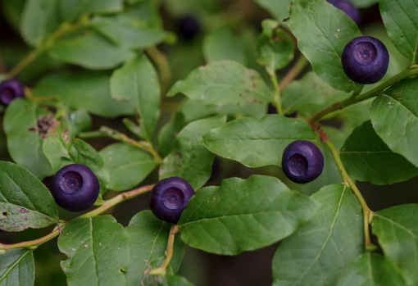
Healing Forest
Yakama Nation Correctional and Rehabilitation Facility
PP
Photo of Mountain Huckleberry
May 2024 Planting of Phase 4
Photos courtesy of @sugiproject
Notes:
Medicinal herbs planted on the outer area of the forest include stinging nettles for pain relief; tree moss for overall health; huckleberry leaves to settle the stomach; pine needle tea for digestive health; and yarrow for wound-healing. Camas is an amazing plant that among other benefits is low in the glycemic index. Indigenous people traditionally harvest the camas bulbs to produce flour.
Note that this Miyawaki project is planted in phases. Also, a more northerly dryer site, it is slower to establish.
Picture of Evergreen Huckleberry

Slide 25
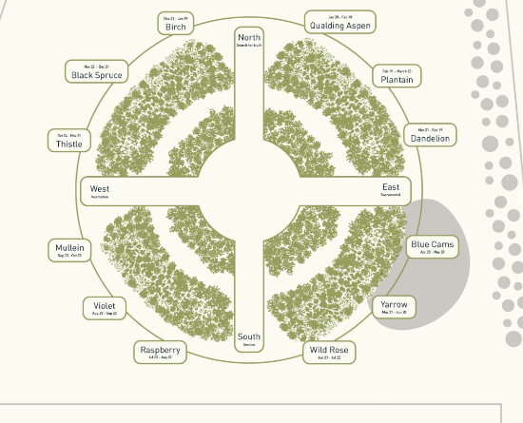
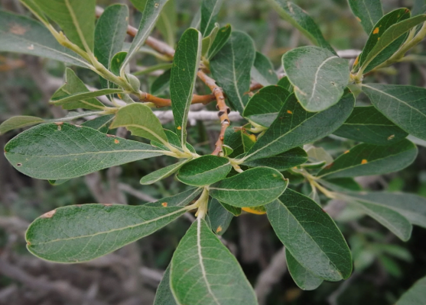
Healing Forest
Yakama Nation Correctional and Rehabilitation Facility
Scouler Willow
Photo and Illustration courtesy of @sugiproject
Notes:
Medicinal herbs planted on the outer area of the forest include stinging nettles for pain relief; tree moss for overall health; huckleberry leaves to settle the stomach; pine needle tea for digestive health; and yarrow for wound-healing. Camas is an amazing plant that among other benefits is low in the glycemic index. Indigenous people traditionally harvest the camas bulbs to produce flour.
Picture of Scouler Willow

Slide 26
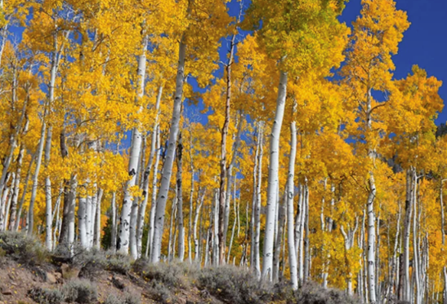
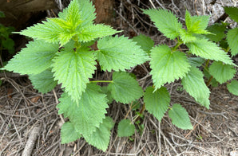
Healing Forest: Plants
Yakama Nation Correctional and Rehabilitation Facility
Photo of Trembling Aspen: https://www.atlasobscura.com/places/pando-the-trembling-giant
Photo of Stinging Nettle: https://www.quora.com/Is-stinging-nettle-plant-soup-dangerous-to-consume-What-if-its-not-cooked-right
Notes:
Picture of Trembling Aspen. Picture is from Utah. Basicallly one plant all sharing the same root structure.
Stinging Nettle planted for medicinal uses

Slide 27
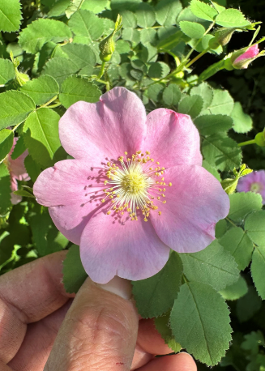
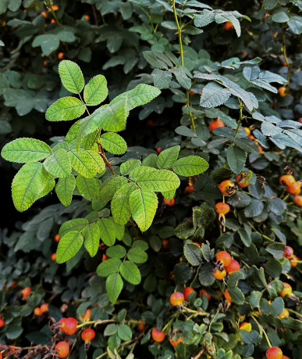
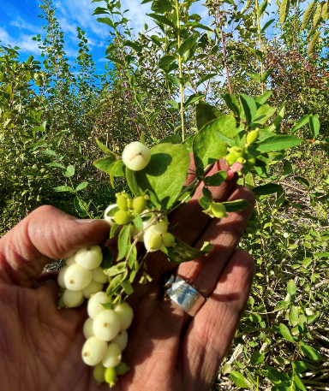
Healing Forest:
Yakama Nation Correctional and Rehabilitation Facility
Wild Rose
Wild Rose Hips
Snowberry
Photos courtesy of @sugiproject
Notes:
Photos of Wild Rose
Photo of Snowberry

Slide 28
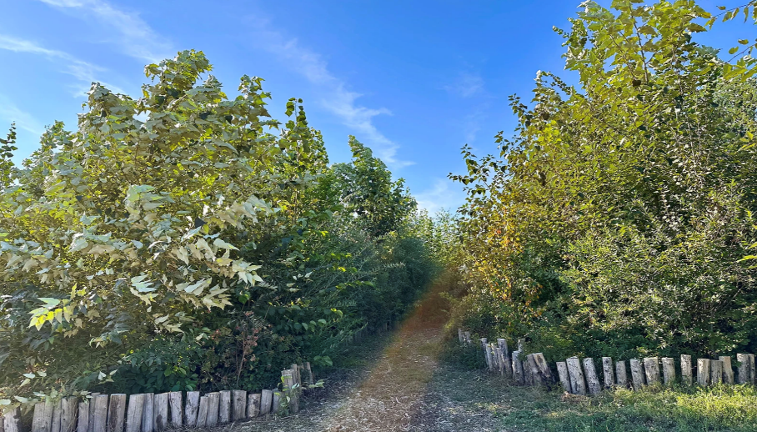
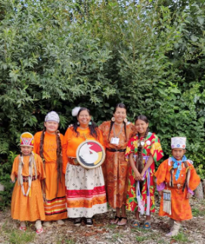
Yakima Nation Healing Forest in 2023
Photos courtesy of @suqiproject
Notes:
2023 Update from the Yakima Healing Forest:
“Today, there are 28 different foods to be foraged from the pocket forest to nurture our people. That has not happened for probably at least 100 years.”
Marylee Jones, Gatherer and Member of the Yakama Nation

Slide 29

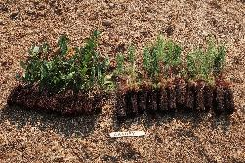
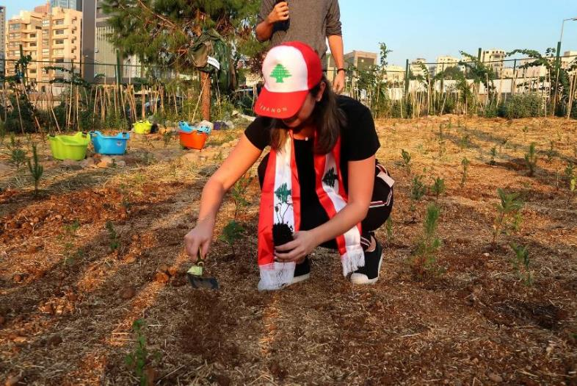

Beirut, Lebanon
Photos courtesy of @sugiproject
Notes:
ONE LAST EXAMPLE—ANOTHER HEALING PROJECT: SUGi Projects in Beirut. These projects have addressed water purification and OVERALL HEALING for these Forest Makers dealing with a lot of loss and hardship.
These SUGi pictures illustrate two questions you may gave. How small are the saplings to be planted and how small can the mini-forest be.
The forest pictured here-lower left is a small strip along a busy roadway in front of an urban power station referred to as the “power plant of death” because of the air pollution emitting from the chimneys. For this reason, this forest is considered an air filter. It is also an example of a forest where irrigation was a challenge and some replanting was necessary.
No updates for the Air Filter Power Plant Forest since 2021. when it reported only 55% survival rate

Slide 30
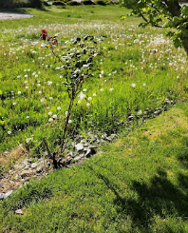

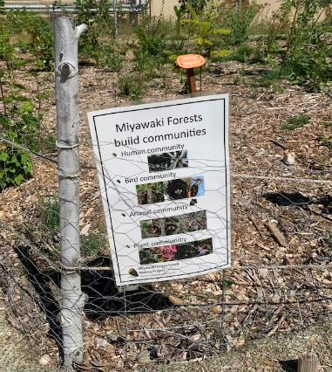
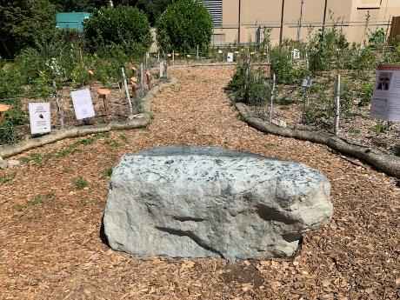
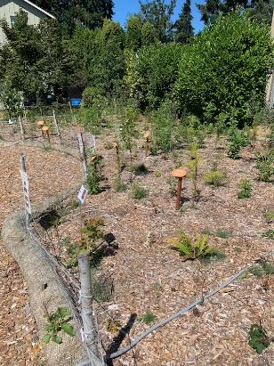
Miyawaki Urban Forest
Shoreline Historical Museum-planted Oct. 2023
July 2024 Photos courtesy of Mike Peronto
Notes:
Miyawaki Project in Western Washington

Slide 31
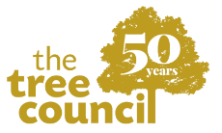
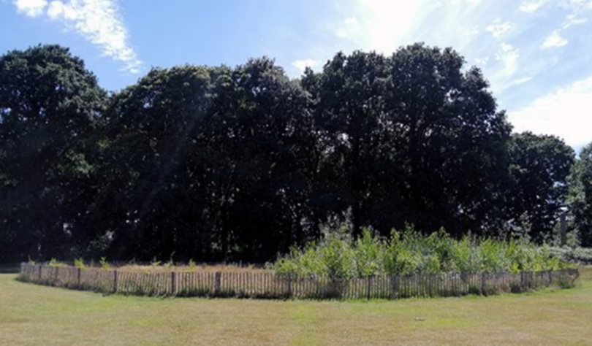
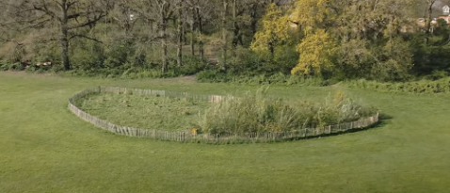
Trees Outside Woodland Project in the UK
https://treecouncil.org.uk/trees-outside-woodland-project-secures-additional-2m-funding/ https://www.youtube.com/watch?v=0VizWfEIW1U
Notes:
This picture is one of several plots established by this organization which is experimenting with the Miyawaki Method in the UK.
There is a 10 minute YouTube video that I recommend watching—link is in the handout.
In the video the team of researchers shares the approach to the project and results they are seeing.
The particular plot in this picture shows a Miyawaki planting on a piece of land that was used as the staging area for a residential development. Think compact awful soil.
The area on the right utilizes Miyawaki Principles (exp. fixing soil and planting densely)
In the area on the left, the same species of plants were planted at the same time into existing soil conditions.
While the visual contrast after one growing season is evident, this team has observed other differences--such as the leaves stay on trees longer, leaves get bigger and critters are returning to the MM side. Interestingly, they made note that the Miyawaki area has not be vandalized like the other side of the plot. They are measuring ambient and soil temperatures and proving out the UHI benefits on the MM side. Regarding biodiversity returning to the MM planting, an ancient forest fungi has returned to the MM.

Slide 32
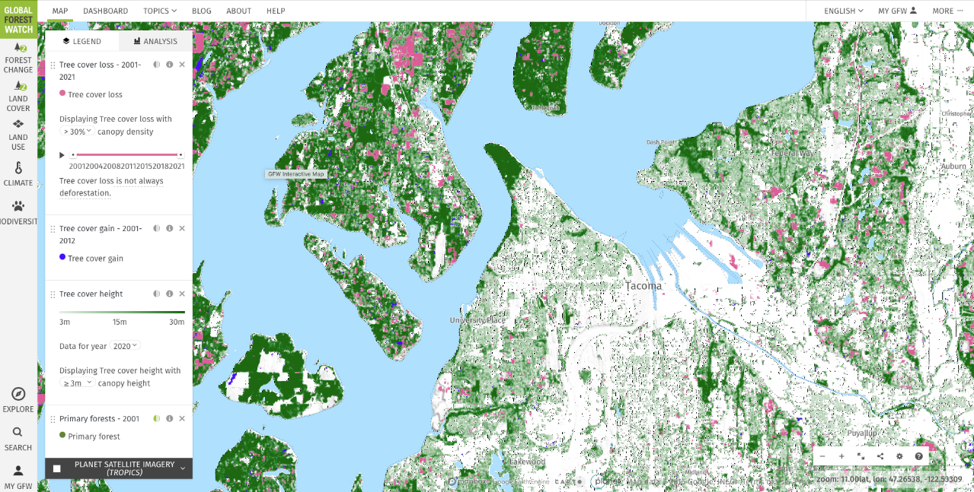
Forest change in Tacoma
https://www.globalforestwatch.org/map
Notes:
Presenters may want to exchange this slide for one discussing local Tree projects in their area.
BRING THIS TOPIC HOME: this topic was selected to share the MM forests and these inspiring projects that span the globe with Pierce County Master Gardeners and our larger community; BUT learning about mini-forest begs us to find out what is happening locally and here are some activities in Pierce County:
Our local Tacoma tree canopy goal is 30% by 2030 and we are currently below 20%-- which is low relative to our peer cities in Washington State(Seattle is at 28%). Paris is 10% Tokyo is just under 34%. One of the things I learned is that Tacoma has a tree staff of 3 and comparable cities with similar size and goals have an average of 11 staff.
Another comparable example is Washington DC. DC has 37% tree canopy with a goal of 40% by 2032. In the last 5 years with a staff of 24 urban foresters DC was able to improve its canopy by a little more than 2%.
4) In Pierce County: There are no measurable goals established for tree canopy specifically. However Pierce County, in line with WA State goals, has adopted the goal of reducing green house gas emissions by 45% by 2030 in its Sustainability Plan 2030. The plan focuses on 5 areas to meet this goal. Carbon Sequestration and Educational Outreach are two areas of focus listed in the plan and interestingly the WSU Puyallup Extension is listed as a partner on many of the action items proposed in these areas of the plan. Conservation is an action item recognized in the plan. The Handout has a link to the PC Sustainability Plan 2030.
5) The handout also provides a link to the Pierce Conservation Futures Program. This is a process to identify and acquire land that should be conserved. There is an established application process which is designed according to a two year cycle. there is a matching requirement that 10% is independently funded with the County contributing the other 90% and an obligation that the land be held in trust by an agency such as a municipal parks organization or an established land trust. There is an emergency process to facilitate the protection of land when there is more urgency to acquiring the land.

Slide 33
So, What can you do?
Become Better Informed
Share your knowledge with friends and neighbors
Contact your city, county and tribal council members to advocate for Miyawaki projects in your community
Explore local opportunities to connect with urban foresting
Plant a Forest! If you have the space
Encourage conservation of existing forests and tree canopy!!
Notes:
Share the Handout. There are suggestions for more exploration you can undertake on your own.
We in Tacoma and other communities in PC are on the ancestral lands of the Puyalllup people. I personally would like to make a connection with the Puyallup tribe to share the MM.

Slide 34
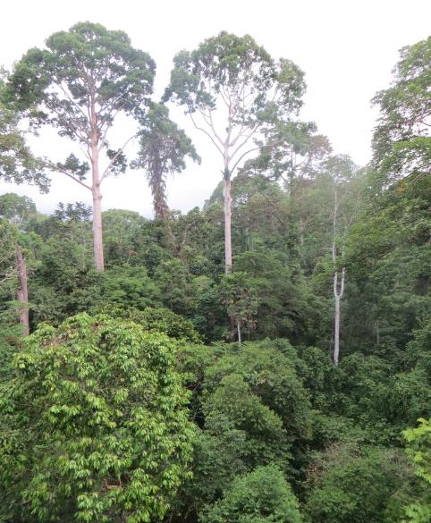
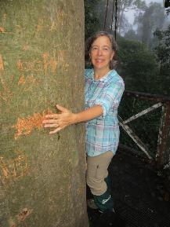



Questions?
Gail Hecmanczuk
WSU Extension Master Gardener Volunteer
https://extension.wsu.edu/pierce/mg/
https://www.facebook.com/WSUMGProgram
CC-004
Notes:
Picture of me at 25 meters/75 feet in the tree canopy of a Dipterocarp forest in Borneo.
These are links to connect with the Master Gardener group in Pierce County, WA.
With the dire climate crisis news we hear almost every day, there are hopeful positive actions being taken around the globe to heal nature.
As one reviewer of Hannah Lewis’s book stated. “Imagine a world where every modest scrap of worn-out dirt or asphalt- think tennis-court-size- can become a cooling, moisture-circulating, air-cleansing, wildlife-nurturing forest within a few years. Mini-Forest Revolutions shows how ordinary citizens can embrace this trowel-ready solution, and are doing so.”
I hope this presentation has given you some food for thought and that you will share your thoughts with others to promote various efforts to plant and keep our established trees. THANKS FOR YOUR ATTENTION.

Slide 35

Event feedback

Slide 36
More Trees Please Resources
Presentation inspired by Mini-Forest Revolution: Using the Miyawaki Method to Rapidly Rewild the World, by Hannah Lewis. (Lewis, Hannah. Mini-Forest Revolution. White River Junction, Vermont, Chelsea Green Publishing, May 2022.)
Photo of The Tongass National Forest. Alaska Magazine. https://alaskamagazine.com/travel/southeast-alaska/the-tongass-national-forest/
Photo of Dr. Akira Miyawaki holding up a seedling during Arvin Sango’s first planting day in Madison, Indiana. https://www.inverse.com/science/mini-forests
"Mini-Forest Revolution"; Illustration Courtesy of Elara Tanguy.
Photo of Clifton Park Miyawaki Forest. Afforestt. https://www.worldatlas.com/news/the-budding-industry-of-growing-personal-forests.html
Photos of IVN Mini-forest Handbook. https://www.ivn.nl/tinyforest/handbook-tiny-forest-english-version
Photos of Buea, Cameroon Miyawaki Pocket Forest. SUGi. https://www.sugiproject.com/projects/bulu
Photos of the Yakama Healing Mini-Forest. SUGi. https://www.sugiproject.com/projects/healing-forest
Li Q. Effects of forest environment (Shinrin-yoku/Forest bathing) on health promotion and disease prevention -the Establishment of "Forest Medicine". Environ Health Prev Med. 2022;27:43. doi: 10.1265/ehpm.22-00160.
Photos from 75 feet high in the Forest Canopy of the Danum Valley, Malaysian Borneo. Photos Courtesy of Dick Hecmanczuk.

Slide 37

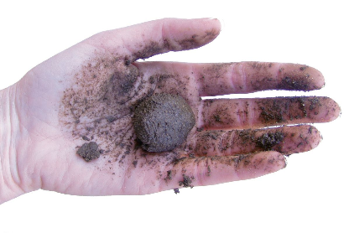


Ribbon Test to Analyze Soil Texture
75 mm is about 3 inches
https://www.agric.wa.gov.au/soil-constraints/soil-texture-estimating-hand
Notes:
75 mm is about 3 inches

