Slide 1

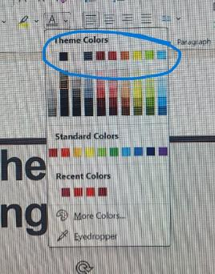


















RESOURCES FOR YOUR SLIDE SHOW
Delete the first two resource slides when your document is finished.
Typography
To create a consistent look for a wide variety of communications, there are two main typefaces for print (Proxima Nova and Freight Big Pro) and one for web (Montserrat).
If these are not available there are substitutes: Sans Serif: Corbel and Arial. Serif substitute is Baskerville Old Face.
For the purpose of consistency between MAC and PC software, this PowerPoint uses Arial throughout the slides.
Please go to Typography – Washington State University for more information.
Colors
WSU theme colors can be found at the top of the color picker.
For WSU color information and formulas go to Colors – Washington State University
Priority icons for light backgrounds.
Priority icons for dark backgrounds
Find Program Priority icons at For Master Gardeners | Master Gardener Program | Washington State University
Delete this resource slide when your document is finished.

Slide 2
Reduce the file size of your PowerPoint presentations
To reduce the file size of your PowerPoint presentations, you can follow these tips:
Compress Pictures:
Select a picture in your presentation.
Go to the Picture Format tab.
In the Adjust group, choose Compress Pictures.
Under Compression options, consider:
Deselecting Apply only to this picture to apply changes to all pictures in the document.
Selecting Delete cropped areas of pictures (note that this is irreversible).
Choosing Use default resolution.
Delete Image Editing Data and Lower Default Resolution:
Go to File > Options > Advanced.
Under Image Size and Quality, do the following:
Select Discard editing data (irreversible but reduces file size).
Ensure Do not compress images in file is not selected.
Choose a default resolution of 150ppi or lower.
Reduce the Character Set of Embedded Fonts:
To make your presentation more shareable with others who lack the same fonts, embed only characters used in the presentation.
Go to File > Options > Save.
Under Preserve fidelity when sharing this presentation, select Embed fonts in the file, and then Embed only the characters used in the presentation.
Delete this resource slide when your document is finished.

Slide 3
Step-by-Step Guide to Checking Accessibility in PowerPoint
Open Your Presentation:
Launch PowerPoint and open the presentation you want to check.
Access the Review Tab:
In the PowerPoint ribbon at the top of the window, click on the Review tab.
Start the Accessibility Checker:
In the Review tab, look for the Check Accessibility button. It’s typically located in the Accessibility group.
View the Accessibility Checker Pane:
Clicking Check Accessibility will open the Accessibility Checker pane on the right side of the PowerPoint window. This pane will list all issues found in the presentation.
Review Inspection Results:
The Accessibility Checker will categorize issues into three sections:
Errors: These are issues that make it difficult or impossible for people with disabilities to understand your content.
Warnings: These are issues that might cause problems for some users.
Tips: These are suggestions for improving the accessibility of your content.
Understand and Fix the Issues:
Click on each issue in the Accessibility Checker pane to see more information about why it might be a problem and how to fix it. PowerPoint often provides specific instructions for addressing each issue.
Common Accessibility Issues and Solutions
Missing Alt Text: Ensure all images, shapes, and other non-text content have descriptive alternative text.
Slide Titles: Each slide should have a unique title to help with navigation.
Reading Order: Ensure that the reading order of slide content is logical for screen readers.
Contrast Ratios: Make sure there is sufficient color contrast between text and background.
Tips for Improving Accessibility
Use Built-in Slide Layouts: These are designed to be accessible.
Use Simple Language: Make content clear and easy to understand.
Check for Appropriate Fonts and Sizes: Use readable fonts and sizes.
Add Captions to Multimedia: Provide captions for videos and audio.
Delete this resource slide when your document is finished.

Slide 4


Title
WSU [insert county] Extension
Master Gardener Program
WSU Extension programs and employment are available to all without discrimination. Evidence of noncompliance may be reported through your local Extension office.
Photo: canva.com

Slide 5



Extension is for everyone!
Washington State University is an affirmative-action, equal-opportunity employer. Washington State University Extension programs and materials are open to all without regard to race, color, national origin, sex, gender, gender identity, religion, age, height, weight, disability, political beliefs, sexual orientation, marital status, family status, or veteran status.
Welcome!
We are glad
you are here.
Read more on the WSU Extension website:
https://extension.wsu.edu/about-extension/extension-is-for-everyone/
Notes:
WSU Extension programs and policies are consistent with federal and state laws and regulations on nondiscrimination. Extension is for everyone, so we are glad you could join us today.

Slide 6







Resilient Washington
Our Mission: Building a Resilient Washington Together
Washington State University’s College of Agricultural, Human, and Natural Resource Sciences works to create a more resilient Washington. Our scientists, educators, students, and volunteers foster discovery and innovation across many disciplines that improve our state’s productiveness, sustainability, health, and wellbeing. Our mission embraces four pillars of endeavor:
Create an adaptable workforce
Providing a secure food supply system
Helping to maintain sustainable natural resources
Supporting thriving, healthy communities, families, and individuals
Notes:
WSU Extension is the front door to the University. It extends non-credit education to people throughout the state.
WSU Extension empowers people, organizations, businesses, and communities to find solutions for local issues.
WSU Extension is recognized for its science-based educational programs and collaboration with community partners to create a culture of life-long learning.
Such programs include 4H, Agriculture, Community and Economic Development, Youth and Families, Nutrition, Gardening and natural resources.

Slide 7



WSU Extension Master Gardener Mission
Engaging university-trained volunteers to empower and sustain diverse communities with relevant, unbiased, research-based horticulture and environmental stewardship education.
Notes:
‘Must Use’ slide:
We want to ensure that you properly ‘place’ Master Gardeners as part of the WSU Extension program, touch on our mission and point out that we have 9 guiding Priorities, of which your presentation is one.
Suggest you cover this while handing out your questions/evaluation form.
Throughout this presentation there are links to documents of various file types. Please contact our Statewide Program Leader if you require this information in a different format.

Slide 8
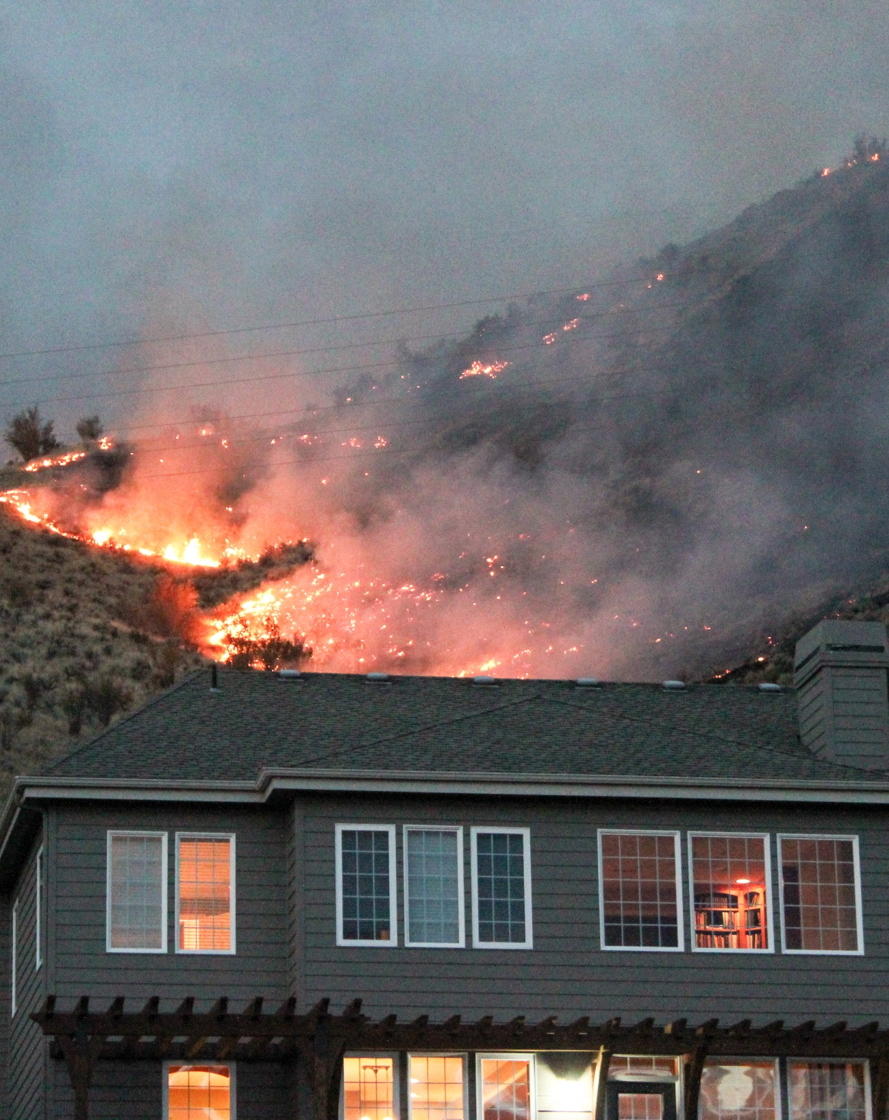
Wildfire Preparedness
Teaches landscaping principles to reduce the risk of loss due to wildfire.
Impact of wildland fires on the ecosystem, in the WUI, and on our communities
We all have a role to play
Work together with neighbors, create a plan
Photo credit: Debra Benbow
Notes:
Each year, wildland fires destroy homes and property in the wildland-urban interface – defined as areas where homes are built near or among lands prone to wildland fire. Studies show that as many as 80 percent of homes lost to wildland fire may have been saved if brush around the homes were cleared and defensible space created around structures. Proper planning landscape practices can reduce the risk of wildland fire damaging or destroying property.
This talk on [insert title] will give you a better understanding of the impact that wildfires have on communities, help you recognize that we all have a role to play in protecting ourselves from the risk of loss and will provide you with specific techniques for creating defensible space around your home.

Slide 9


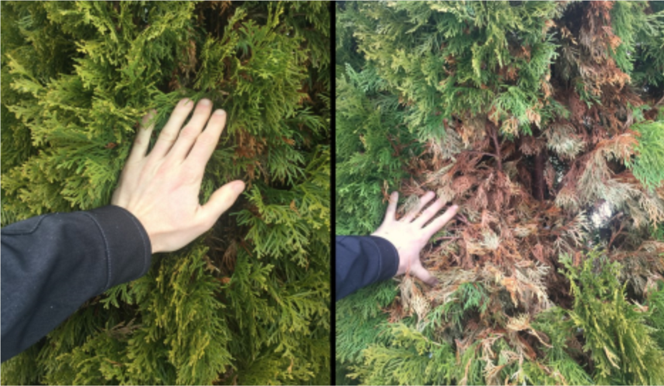
Your slide title here
Photo credit: Al Murphy

Slide 10
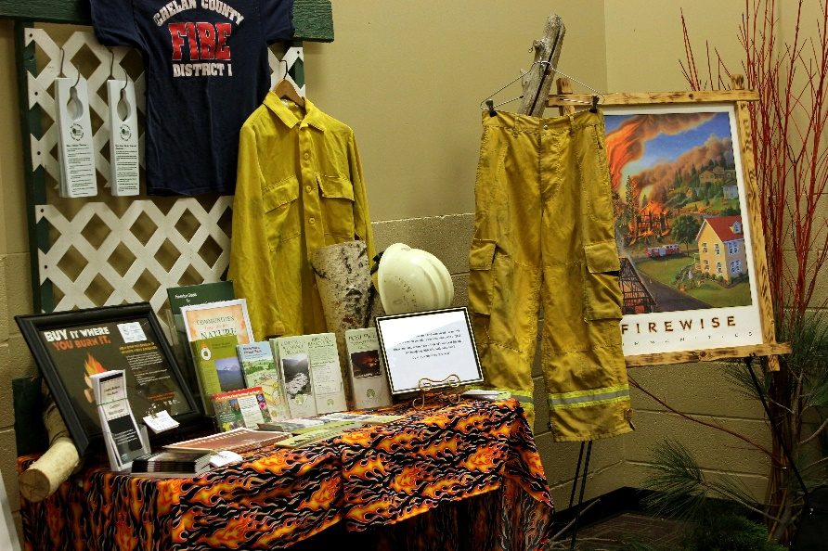
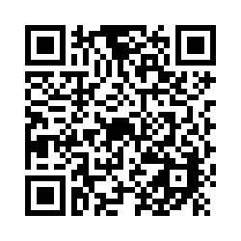
Thank you for attending today’s educational event!
Help us better serve your needs. Please tell us how we did by taking this short survey.
https://bit.ly/EMGwildfire
Photo: Extension Chelan/Douglas Master Gardener Program

Slide 11


Questions?
Insert Name
WSU Extension Master Gardener Volunteer
Contact info
http://mastergardener.wsu.edu/
https://www.facebook.com/WSUMGProgram

