Slide 1
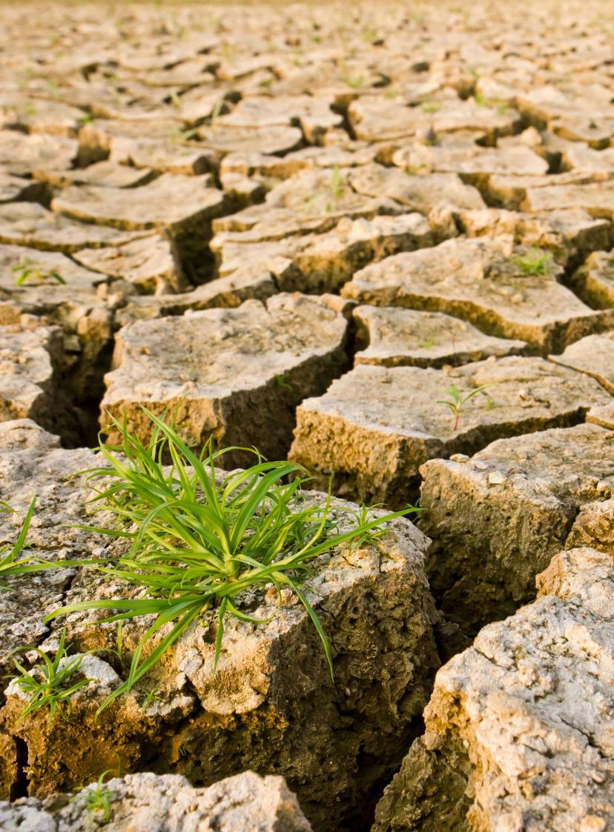





The Resilient Yard
Battling Climate Change at Home
WSU Extension
Master Gardener Program
Photo by Deposit Photos
CC-001
Notes:
Editor’s Notes are in green. Presenters notes are in black.
I use this slide to introduce myself, the Master Gardener program and the title of the presentation.

Slide 2



Extension is for everyone!
Washington State University is an affirmative-action, equal-opportunity employer. Washington State University Extension programs and materials are open to all without regard to race, color, national origin, sex, gender, gender identity, religion, age, height, weight, disability, political beliefs, sexual orientation, marital status, family status, or veteran status.
Welcome!
We are glad
you are here.
Read more on the WSU Extension website:
https://extension.wsu.edu/about-extension/extension-is-for-everyone/
Notes:
WSU Extension programs and policies are consistent with federal and state laws and regulations on nondiscrimination. Extension is for everyone, so we are glad you could join us today.

Slide 3






Resilient Washington
Our Mission: Building a Resilient Washington Together
Washington State University’s College of Agricultural, Human, and Natural Resource Sciences works to create a more resilient Washington. Our scientists, educators, students, and volunteers foster discovery and innovation across many disciplines that improve our state’s productiveness, sustainability, health, and wellbeing. Our mission embraces four pillars of endeavor:
Create an adaptable workforce
Providing a secure food supply system
Helping to maintain sustainable natural resources
Supporting thriving, healthy communities, families, and individuals
Notes:
WSU Extension is the front door to the University. It extends non-credit education to people throughout the state.
WSU Extension empowers people, organizations, businesses, and communities to find solutions for local issues.
WSU Extension is recognized for its science-based educational programs and collaboration with community partners to create a culture of life-long learning.
Such programs include 4H, Agriculture, Community and Economic Development, Youth and Families, Nutrition, Gardening and natural resources.

Slide 4


WSU Extension Master Gardener Mission:
Engaging university-trained volunteers to empower and sustain diverse communities with relevant, unbiased, research-based horticulture and environmental stewardship education.
Notes:
This is ‘Must Use’ slide #2
We want to ensure that you properly ‘place’ Master Gardeners as part of the WSU Extension program, touch on our mission and point out that we have 9 guiding Priorities, of which your presentation is one.
Suggest you cover this while handing out your questions/evaluation form.
Throughout this presentation there are links to documents of various file types.
Please contact our Statewide Program Leader if you require this information in a different format.

Slide 5

Climate
Change
Teaches ways to create resilient landscapes that are adapted to our changing climate.
Impact of climate change on people, wildlife and ecosystems
We all have a role to play
Techniques for home landscapes
Notes:
This is ‘Must Use’ slide #3. Program provided wording to ‘frame’ the Climate Change issue.
Warmer winters, hotter summers, flooding and droughts affect plant growth and impact the many organisms that interact with plants (insects, pollinators, diseases and microbes). Home gardeners have an important role to play in combating climate change. Choosing human-powered tools like push mowers, rakes and hand clippers over gas-powered tools such as lawn mowers and leaf blowers can reduce greenhouse gas emissions. Choosing resilient plants that are well adapted to your soil and climate and using research-based horticulture practices to manage soil will help keep your landscape resilient. Composting on-site closes the loop on waste and yields valuable nutrients and helps to reduce methane emissions from landfills.
This talk on [insert title] will give you a better understanding of the importance of creating resilient landscapes that can thrive in a changing climate, help you recognize that we all have a role to play in reducing the impact of climate change on our society and will provide you with specific techniques that you can use to build and maintain resilient landscapes in your own spaces.
Throughout this presentation there are links to documents of various file types.
Please contact our Statewide Program Leader if you require this information in a different format.

Slide 6

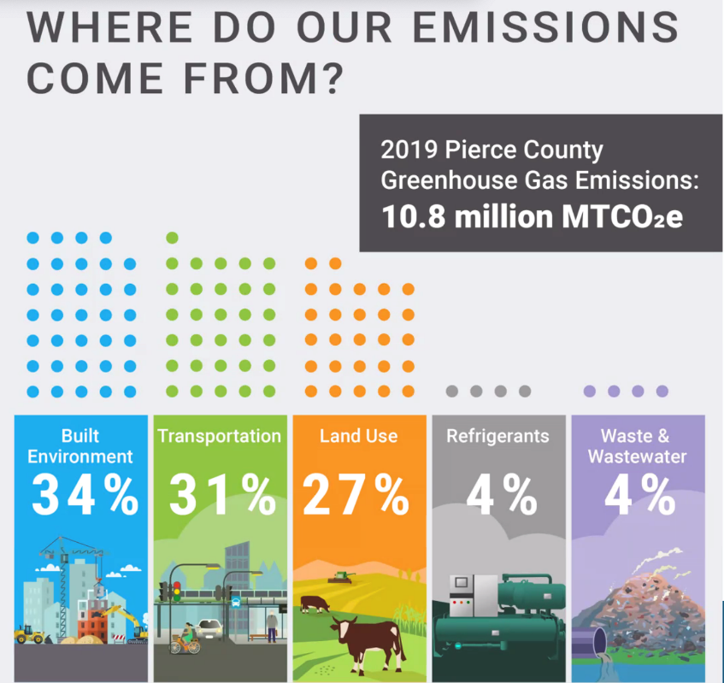
What can I do about Climate Change?
There are three major areas where individuals can impact climate change.
Built Environment (your home)
Transportation
Land Use (your yard)
Source: Pierce County Conservation District, 2023
Notes:
Editor’s Note: there is an alternate US-wide graphic at the back of this presentation that you can use. It has a different category sort (includes ‘industry’) so I don’t like it as well, but if you cannot find local statistics, you can choose to use this. There is also a website containing Greenhouse Gas graphs for WA. You can search it for something you like here: https://ecology.wa.gov/Air-Climate/Reducing-Greenhouse-Gas-Emissions/Tracking-greenhouse-gases/GHG-inventories
Presenter’s Notes: Set the parameters of the presentation: This is a presentation about doing what you can, as an individual home owner, to make a difference. We are presenting you with actionable information that you can take home and implement.
Big Picture: individuals can act in three areas: Home - how they heat and cool their homes; Transportation - how they move themselves and their things around; Yard - how they manage their yards to capture and store carbon. We’re Master Gardeners, so we’re going to talk about this third option.
Pierce County Stat (replace with stats from your county, if you can find them): Home + Transportation + Land Use = more than 90% of our emissions when you look at both commercial and private use. So, you are acting in an area that can make a difference.

Slide 7
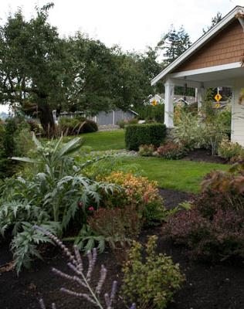
Contents:
Introduction & Overview
  ‘Climate Change 101’
The Suburban Yard
  The Lawn
  Garden Beds
  Veggie Garden
Photo credit: Teresa Casson (EMG) 2023
Notes:
Presenter’s Notes: This presentation is broken down into 4 sections of roughly equal time:
Climate Change 101: Climate Change is a huge topic, we’re only going to cover what you need to know to understand our recommendations in the rest of the presentation
Then we’re going to break down the typical suburban yard into it’s components: the lawn and the garden beds, plus we’re going to make an argument that adding a veggie garden to your yard is an important step in helping our agricultural industry deal with our changing climate.

Slide 8
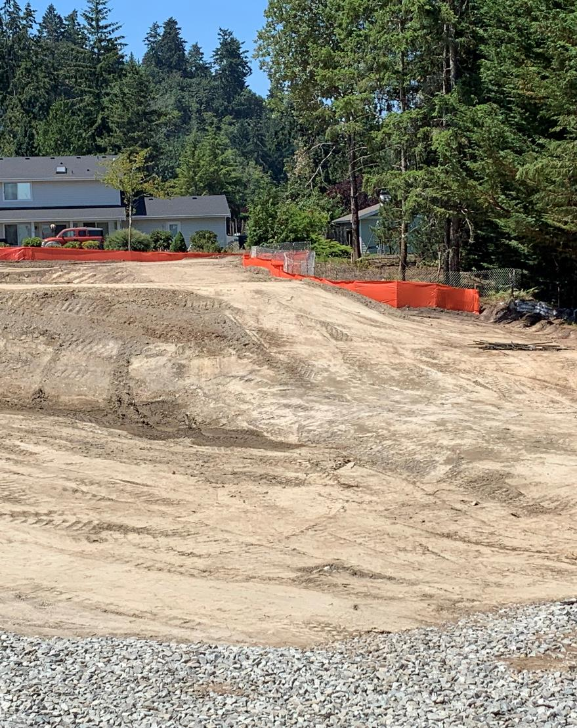
New Homes
Everything is dug up and carted off. Down to the ‘hard pan’
Above ground:
  Trees storing decades of carbon
Below ground:
  All the rich humus
Hundreds of years of stored carbon
  Gone
You can rebuild this capability!
Photo credit: Mike Peronto (EMG) 2022
Notes:
Presenter’s Notes: Let’s start where virtually all of our homes started from: this is a picture of a new development going in. You can see from the picture, that this used to be a forested area with a mature set of trees that were capturing and storing carbon in their leaves, branches and trunks… and in the soil. But for houses to go in, trees must come out. That isn’t surprising. What might be more surprising is that if you look closely at the dirt in the foreground, all the dark rich humus-y soil is gone! The builder has stripped it down to the ‘hard pan’. Why? Because we want foundations, roads and sidewalks that do not crack. And rich soil expands and contracts with changes in the seasons… so it’s got to go.
So, a mini-ecosystem, often hundreds of years in the making is ripped out in order to build our homes. Then we all know what happens next: after the house is built, they truck back 1-2” of topsoil, roll out turf grass, pop some plants into the small beds, cover that with bark mulch and irrigate. Then they sell the home.
But, life finds a way… and this yard starts to grow. But, as an environment its ability to store carbon is never optimized. It is never even considered. In this presentaton, we’re going to show you how you can do that. It isn’t difficult. It just requires a little thought and planning (and not much expense!). But before we do that, we’ve started to throw Climate terms around like “storing carbon”… we first need to explain what we mean by that.

Slide 9
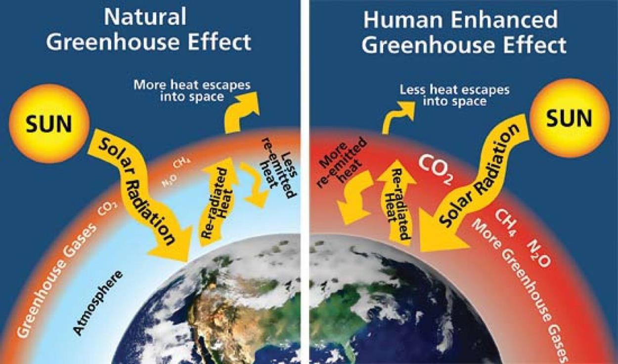
Climate Change ‘101’
Greenhouse gasses act like a blanket & trap the heat from the sun.
Carbon Dioxide (CO2) ~80%
Methane (CH4) ~12%
Nitrous Oxide (N2O) ~6%
Note:
Earth’s carbon doesn’t change
Solid/liquid to gas is the issue
https://www.colorado.edu/ecenter/sites/default/files/styles/large/public/page/greenhouse-effect.jpeg?itok=4X5-u6Iz
https://www.epa.gov/ghgemissions/overview-greenhouse-gases
Notes:
Presenter’s Notes: Explain the graphic. Note that in the comparison nature also emits greenhouse gasses and we need some of them to keep the planet from getting too cold issue. But the “Human Enhanced” side of the graphic show that we’re adding too much, and heating the planet.
Key point: BUT… just as we turned solids (coal & wood) & liquids (oil) into a gas, we can do the opposite: turn those gasses in our atmosphere back into a form where carbon can be stored, where they actually help the planet instead of warm it. That is called carbon capture…
There are lots of entrepreneurs out trying to find a cost-effective way to capture and store carbon on a world-wide scale, but so far there is only one economically feasible way to do this at scale….(next slide)

Slide 10
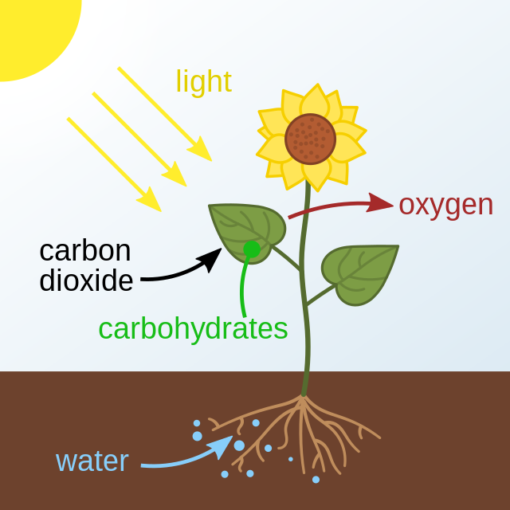
Photosynthesis!
Changes CO2 from gas into carbon that can be stored:
Plants convert CO2 to carbohydrates
~ 70%* to feed above ground trunk, branches, leaves
~ 30% ‘exudates’ from roots to accelerate….
*What Your Food Ate by David Montgomery & Anne Bickle
Illustration credit: https://en.wikipedia.org/wiki/Photosynthesis
Notes:
…. the Technology to convert CO2 into stored carbon is called Photosynthesis, and the ‘machines’ that do it are called plants(!)
So, back to school: photosynthesis is the process where the leaves in plants, when watered and exposed to sunlight grab CO2 from the air and turn it into the oxygen we breathe and they create a substance (e.g. plant sugars, carbohydrates, ‘exudates’) that they use to both feed themselves (~70%) and also to ‘exude’ these carbs into the soil through their roots (~30%) as a food source for the microorganisms in the soil.
So, that’s step one: the plants through their growth store carbon in solid form in their leaves, branches and trunks.
Step two is….(next slide)

Slide 11
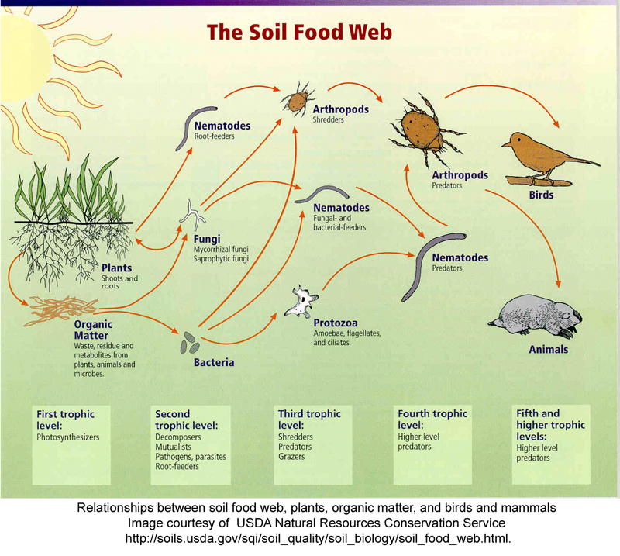
The Soil Food Web:
Organisms in/on the soil comprise ~59%* of all life on earth:
Insects, earthworms, nematodes, springtails
Bacteria
Fungi
Once fed, these organisms
‘Do what living things do’
*Growing a Revolution by David Montgomery
Notes:
… The Soil Food Web….
Those root ‘exudates’ deposited by plants are an important food source for soil organisms. And there are billions upon billions of them. Almost 60% of all life on earth is either in or just on top of our soils (another UW Prof David Montgomery reference. This one from an earlier book “Growing a Revolution”). And once fed, these organisms do what living things do, they poop, multiply, attract predators and die…. All these activities return carbon to the soil where it can stay for hundreds of years.

Slide 12
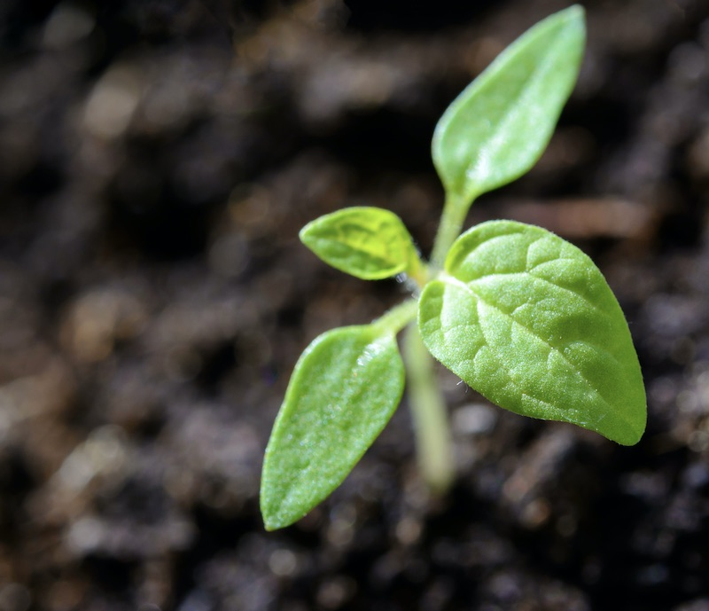
Adding plants & compost:
Builds & stores carbon in your soil and plants.
Above ground (~40%)
In the ground (~60%)
Strategy: accelerate & maximize these processes to the extent your yard will allow.
Photo credit: pexels-photomix-company-1002703
*Growing a Revolution by David Montgomery
Notes:
… so, the key learnings from our foray into ‘Climate Change 101’ is that there are two actions you can take to capture CO2 and store it in your yard:
One: plant stuff
Two: add compost to your soil. It is important to add organic matter to the soil because, beyond just adding plants, you are trying to accelerate the growth of those billions of organisms in the soil and the more food you give them, the more they do “what living things do”.

Slide 13


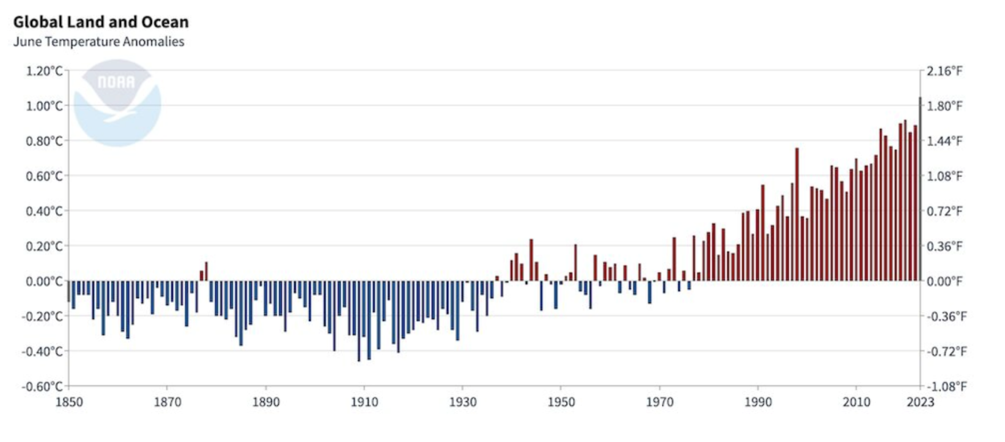
173 Year Global Average Temps
National Centers for Environmental Information
Notes:
Editor’s Note: In general this presentation, rather than trying to convince the audience, just assumes that Climate Change exists. The emphasis is: here’s what you can do about it. I have found that to be more successful/less controversial than trying to prove to someone that Climate Change exists. This is the one slide that I include for any doubters to give evidence that we’ve been heating up the planet.
Presenter’s Note: This slide is included to give you a feel for the trends we are trying to counteract by capturing carbon in our yards. Just as a frame of reference.
Here’s how to read the slide:
We have been capturing daily temperatures around the globe since 1850.
This slide takes the average of those temperatures for each June for the last 173 years.
The straight line at “0.00C/F” is the 173 year average
Then, each year in sequence has been graphed against that average
You can see that for about 90 years (1850-1940) we were consistently BELOW average; then for about 40 years we hovered around average, but in the last 43 years, we’ve sky-rocketed above the average… to about 1.5-1.75 degrees above…. With no reduction in sight.
Ed Note: The Seattle Times graphic can be deleted if you don’t want to use it. I use it as an anecdote to point out that Climate Change needs to alter our thinking about everything. Here’s how I do that….(note that you can also go less extreme than looking to N. Calif as done here. Can also just say ‘look south’… Oregon, etc)
And so, we need to fundamentally re-think the way we handle our yards. As just one example, I know of several sources whose ‘go to’ recommendation to battle Climate Change is to “plant Natives” . BUT… natives became native in a much colder climate. We need to start looking at the native plants from warmer climates to blend into our yards to maximize the chances of survival. And, anecdotally, if you look, the evidence is growing all around us. For example is this article in the 2023 Seattle Times - native trees like the Western Red Cedar are dying off at an alarming rate. And what is the parks department replacing them with? Northern California Sequoias! So, there are no simple pat answers. Instead, we need to rethink how we approach our yards. (But not to worry…. There are relatively steps you can take)

Slide 14
Designing & Maintaining your lawn
Primary Strategy: expend less CO2
Notes:
Ask for questions on the first section. You should be at about the 15 minute mark in the presentation…. Check your time to make sure you don’t have to rush at the end.
Transition: We are now going to discuss lawn care. And while lawns DO capture and store carbon (yep, photosynthesis) the big win for the environment is to start maintaining our lawns in a more climate friendly way.

Slide 15
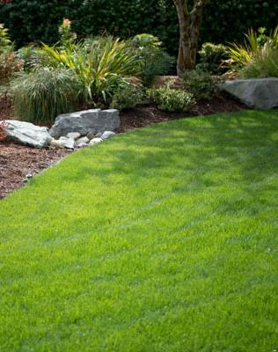
“Get rid of your lawn”
Why?
  ~ 40 million acres
  Monoculture
  Over-watered
  Too many chemicals
But
  ‘American Dream’
  It does store carbon
  Can be maintained responsibly
Photo credit: Teresa Casson (EMG) 2023
Notes:
Most climate change articles / presentations argue that you should just get rid of your lawn. We are not going to do that here. But, what drives that line of thought?
From a big picture perspective, when you add together all the lawns, nationwide, we have something like 40 million acres of lawn. That is more acreage dedicated to growing grass than any commercial crop. More than corn. And grass is grown for decorative and leisure purposes, not to provide food. Further, grass is a “mono-crop” and nature prefers diversity. The only way for our mono-crop lawns to look the way we intend is to put increasing amounts - of fertilizer - of herb&pesticides - of water on it to keep it green, lush and weed free the way we want it to look. But doing that creates a toxic stew that is damaging to the environment…. Hence the “get rid of it” argument.
However, lawns are not going away any time soon. The single family home with lawn is too tightly linked with the American Dream. AND lawns do store carbon. So, let’s figure out a more environmentally friendly way to care for our lawns.

Slide 16
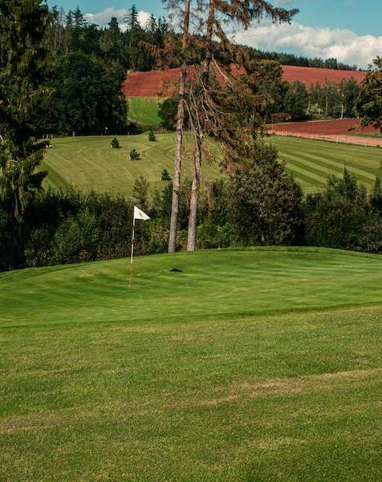
If it stays:
Minimize ‘carbon inputs’
Reduce synthetic fertilizers
Optimize watering
If you want it to look like a golf course, think the rough, not the putting green
Mow it long: 2” to 3”
Pho credit: pexels-lucie-liz-5384083
Notes:
If you are going to keep your lawn, you need to maintain it in a way that minimizes the ‘carbon inputs’ (which we’ll explain), reduce the application of synthetic fertilizers and optimize the amount of water you apply to your lawn.
And as a starting point, we need to learn to let our lawns grow longer. So, if your goal is to “maintain it like a golf course” you need to start thinking “the rough”… not “the putting green”.
(Note: guideline is 2-3” but as lawns age, the blades of grass ‘bend over’, so more than a specific measurement I encourage people to let it grow as long as it can while still ‘standing up’ so that it can be mown.)

Slide 17
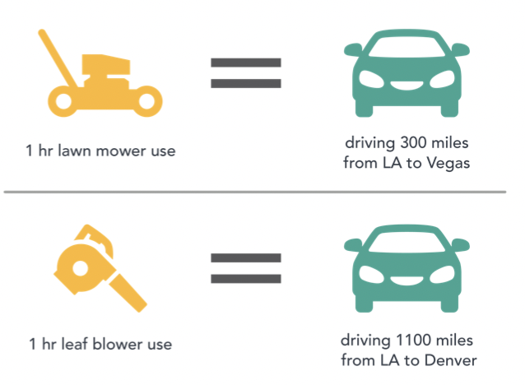
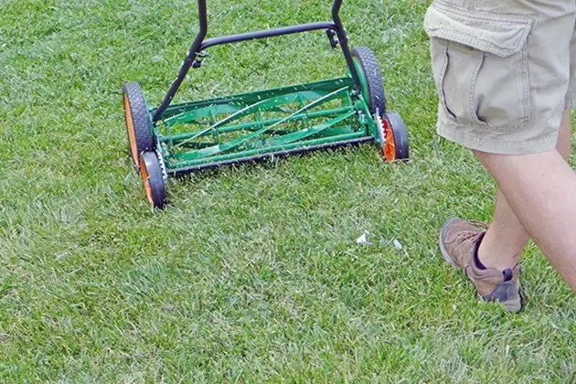
Ditch the gas powered tools
Trimmers, edgers & blowers: electric
Mowers: electric or reel
CARB California Air Resources Board
If you employ a Yard Service…
It’s time to have “The Talk”
… switch to electric
https://www.nytimes.com/wirecutter/reviews/best-reel-mower/
Notes:
First step: ditch the gas powered tools.
In 2020, the California Air Resources Board did a study: they measured the CO2e produced by the top selling brand of lawn mower and measured it against the top selling auto brand. They found that one hour of lawn mower use produced the same amount of CO2e as driving the car for 300 miles(!). And leaf blowers are worse… 1,100 miles (!!).
Why is this the case? Because lawn equipment is powered mostly by ‘2 stroke’ (and sometimes ‘4 stroke’) engines which are light and powerful, but they are also terribly inefficient in burning their fuel, generating lots of CO2e.
You can also note that gas powered tools, especially leaf blowers are NOISY… they emit low frequency sound which goes through walls and windows and disturbs the neighborhood… as well as damages the hearing of the user.
The good news: electric trimmers, edgers & blowers are all cost effective and powerful enough to do the job. Even electric mowers are now powerful enough to handle all but the largest lawns. And you might want to go a step further and use the old-fashioned reel (push) mower and get a little exercise while you’re at it.
AND… for those of you who think this doesn’t apply to you because you have a lawn service…. It is time to have “the talk” with your provider: ask them to switch to electric….. Do I think they are going to immediately change? No. But they have 20-40 customers and if enough of them ask, the smart ones will start going electric… even if it is for just the ones who ask for it. It is all about accelerating the change from gas to electric.

Slide 18
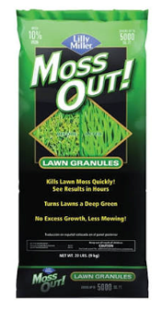

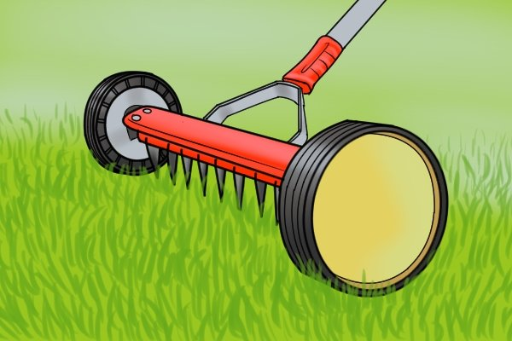
Reduce chemical inputs
Fertilizer*: from 4 to 2 times/year
  Let nitrogen rich clippings drop (25-40%)
  Add Compost
Moss Killers & “Weed &” products
  Stop (add lime instead)
  Thatch & pull
  Major issues: Master Gardeners!
Thatching Rake
* Synthetic fertilizer: 4-6 lbs CO2e for every 1 lb used
David Wolfe, professor of plant and soil ecology, Cornell University
Notes:
Once you’ve gone electric, the next step is to cut back on the chemicals applied to your lawn. This, too, is pretty simple to accomplish.
Fertilizer. It is important to cut back on the use of synthetic fertilizers from a climate perspective because so much energy is used up in the manufacturing process to create these nitrogen based fertilizers. To manufacturing temperatures of 750 degrees and atmospheric pressures of 100 times sea-level are required to extract the nitrogen and turn it into fertilizer. Cornell University studied this and determined that 4-6 pounds of CO2 is expended for each pound of synthetic fertilizer you apply to your lawn. So, think about those bags of fertilizer…. They weigh about 25 pounds. The commercial websites encourage you to apply 4 times/per year. By avoiding 2 of those applications, you can save 100-200 pounds of CO2 per year in fertilizer not manufactured. How do you do that?
Going from 4 to 2 times per year is not difficult. Just do two things. First, when you mow your lawn, let the clippings drop. They are rich in nitrogen and provide food for the microbes in the soil. If you mow regularly, the clippings are short enough that they fall between the blades of grass and onto the soil. You cannot see them. Second, replace one fertilizer application (preferably the spring, when the soil microbe activity is picking up) with a screened compost. The screening gives you a fine enough compost that it can just be ‘top-dressed’ and raked in, again providing food for the soil microbes to boost their population and improve the soil underneath your lawn, making it more able to absorb and store water for the dry summer months ahead. And finally, when you do apply commercial fertilizer, please look for fertilizers labelled organic. Less energy went into the creation of those fertilizers.
We also encourage you to reduce / stop using other lawn chemicals. Moss Killers just kill the moss, you still have to rake it out. BUT, moss has small root system and can just be raked out without applying the chemical. It isn’t needed. Recommend a thatching rake (pictured) to make the job easier. And, by the way, moss thrives in a low PH environment and the moss killers lower the PH of your soil (!). Better way is to apply slow release lime in the fall to raise the PH of your soil, tilting the balance in favor of growing grass and away from aiding moss growth. All the “Weed and…” products should be avoided. They are a broadcast herbicide that is applied to 100% of your lawn. But lawns rarely if ever are covered with 100% weeds. So it is overkill (literally) with harmful impacts on the critters in and around your lawn. If you have a small problem, just weed by hand. For more significant issues…. That’s why you have Master Gardeners! They can tell you what you need to do to solve your issue in an environmentally friendly/ier way. Look us up at a Clinic near you.

Slide 19
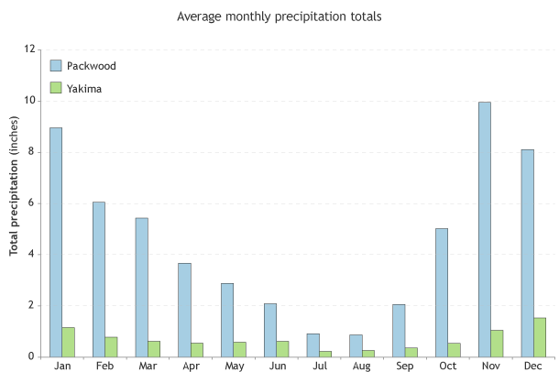
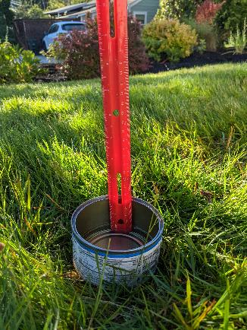
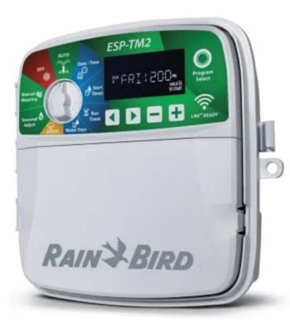
Water: Deep & infrequently
Photographer: Teresa Casson
By Hand:
Irrigation:
1 time & 1” week
Tuna can test
Good soil: sponge
Water savers, IF
Adjusted frequently
Check your service provider
https://www.climate.gov/news-features/blogs/beyond-data/highs-and-lows-climate
Notes:
Presenter’s Notes: OK, so we’ve rid ourselves of the gas powered tools, and reduced the chemicals we apply to the lawn. It’s time to look at watering.
This graph shows the difference in precipitation between Eastern & Western WA due to the ‘wringing out’ effect of the Cascade mountains. Packwood (West) and Yakima (East) are similar elevation and only 55 miles apart, yet they get starkly different amounts of water.
In the maritime PNW we are fortunate in that we get enough water for our lawns for much of the year. (Blue bars) Watering is only an issue for about three months of the year… July, August and part of September. You want to water your lawn ‘deeply and infrequently’, ideally watering just once a week and applying 1 inch of water. How do you tell when you’ve applied an inch? You can use the “tuna can test”… place some tuna cans around your lawn under your sprinkler and check back in about 45 minutes. Measure the water level until you reach one inch. It is usually about 45min-1hour. Once you know this, that’s how long your setting is as you move your sprinkler around the yard.
If you have an irrigation system, you know that they are marketed as water savers. This is true. But it is only true if you manage your settings. If you have a service turn on your irrigation for you, they typically have it run for 10mins a day, every day. Shallow and Frequent is bad because it discourages the grass roots from digging deeper in the soil in search of water. And shallow roots lead to burned up lawns once the heat of August arrives. So… check your irrigation settings and start stretching it out until you get to the once-a-week for an hour setting. Also note: if you get rain, back off your watering that week. The lawn doesn’t need it and you will save on your water bill. Also, you can just stop watering in the summer months and your lawn will ‘come back’ with the rains in the fall.
And finally… with good (composted) spongy soil and deep roots, your lawn is best equipped to withstand the heat of August. Stick to your once a week schedule. Yes, your lawn may brown up a bit and that is natural… , but it is resilient: it will bounce back in the second half of September when the days and nights cool.

Slide 20
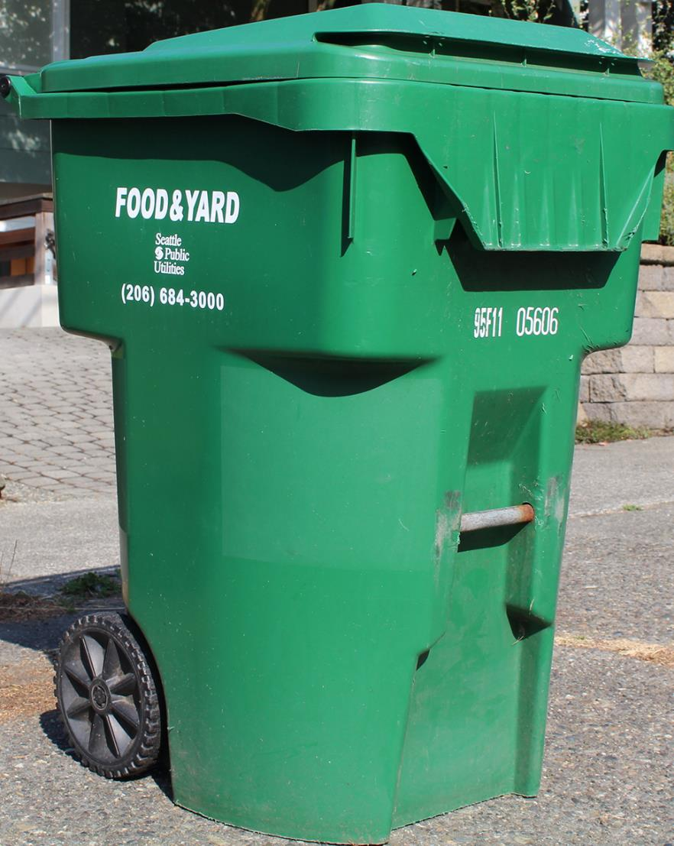
Yard Waste:
If you don’t have one of these, get one!
Organic materials in landfill:
Methane (80x worse than CO2)
Why? Decomposes without oxygen
Photograph from seattle.gov
Notes:
OK, that’s it for the lawn, but one side note: If your area has yard waste collection services and you don’t have a Yard Waste container, get one and use it. Please.
Why? Because if organic matter is taken to the landfill, it is covered up and decomposes without oxygen. When you get decomposition without oxygen, you generate Methane gas…. And while in total, Methane is a much smaller component of the greenhouse gas mix, pound for pound it is 80X worse at heating the atmosphere than is CO2.
If you put it into yard waste, it gets composted and recycled back into our yards. This simple step can save hundreds of pounds of organic material going into the landfill each year.
If you don’t have a yard wast service, you might want to consider composting at home. It is a low cost way to improve your soil. In fact you might want to compost at home even if you have a yard service. I do it specifically to bolster the quality of the soil I use in my home veggie garden.

Slide 21
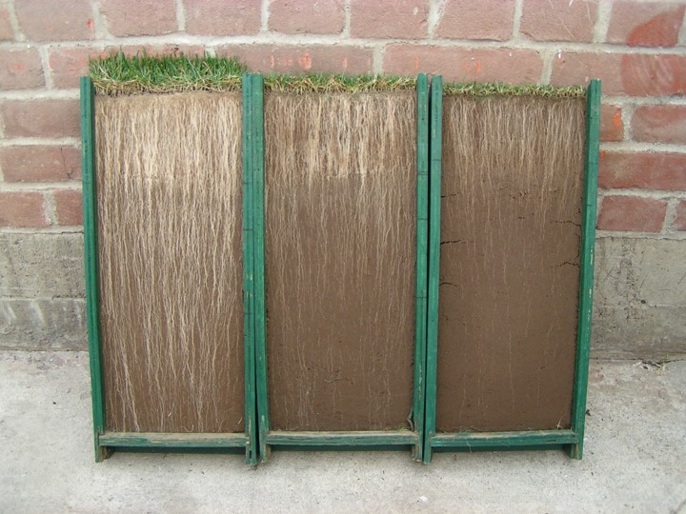
Scorecard:
  Carbon Stored: 200-1,800 pounds / acre / year
Source: Ohio State University
Go electric
Fertilize 2x max
  Lawn clippings & compost
Water: 1”/week (even August)
No “Weed &” products
Yard waste bin
Just ‘TRY’
Image courtesy of Oregon State University
Notes:
That’s it for the lawn. I hope you can see that with a few easy and inexpensive changes in the way you maintain your lawn, you can prevent a significant amount of CO2 from entering the atmosphere. And remember, lawns do also capture carbon through photosynthesis/soil food web. This is a picture from Oregon State University where they cut a profile of lawn to expose the amount of root growth difference between a short lawn, medium lawn and leaving the blades grow long. Remember my “think golf course roughs, not greens”? You can see that it can really make a difference in root growth how you maintain your lawn. Separately, Ohio State University measured the range of stored carbon to be between 200 and 1,800 pounds per acre. To me, the real point of that stat is the RANGE…. A factor of 9 difference from low to high. I don’t know how much carbon you will store in your lawn, but if you follow the guidelines of this section you are much more likely to be on the higher end of that range.
And finally…. We don’t expect you to change the way you maintain everything, all at once. The abbreviation of title of this presentation (The Resilient Yard) is TRY … and that’s all we ask is that you TRY… and hold yourself accountable. Here’s a scorecard you can use.

Slide 22
Designing & Maintaining garden beds
Primary Strategy: store more carbon!
Notes:
Ed Note: Ask for any questions on the lawn section. You should be ~ 30 minutes in. I find I’m often running about 35minutes here (people LOVE to ask about their lawns). 35 is usually fine as the final section has been shortened to accommodate. But if you are running past that… need to speed things up!
Transition: The big win in the lawn section was in reducing the ‘carbon inputs’ in maintaining your lawn. But now, with your garden beds we switch strategies and start attacking the billions of pounds of CO2 that is already in the atmosphere. The goal with your beds is to maximize the amount of CO2 you can capture and store both above and below ground.

Slide 23
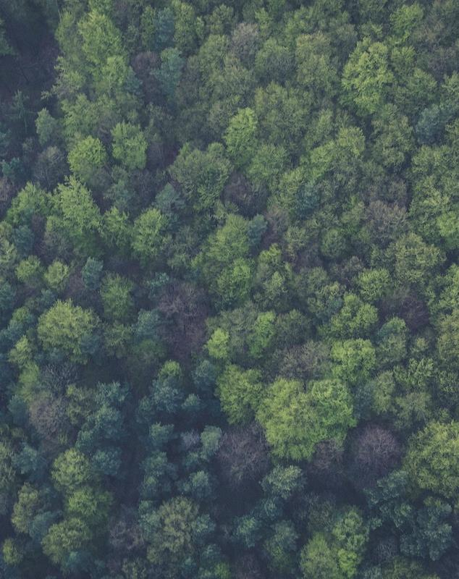
Sun’s-eye view
Forest:
Leaf-capture of every ray of sun
From spring through fall
Leaving no bare soil
Photosynthesis & Soil Food Web
Water retention & weed control
Photo credit: pexels-Markus-Spiske
Notes:
Presenter’s notes: I use the forest picture as a kind of re-set. After talking lawn, you need to pivot to the garden beds. I remind the audience of the picture of the new housing development replacing a forest in slide 4. This is what that forest could have looked like before the development (not the same picture & valid only for Western WA). Note that left undisturbed, forests compete for sunlight until they capture ALL the sun’s rays. You cannot see the forest floor. They maximize photosynthesis, which triggers the soil food web within and on the soil.
Also note that by forming a complete canopy, they both retard weed growth and maximize water retention… two characteristics you would like to optimize in your garden beds….
Now, let’s take another “Sun’s eye view”… (next slide)

Slide 24
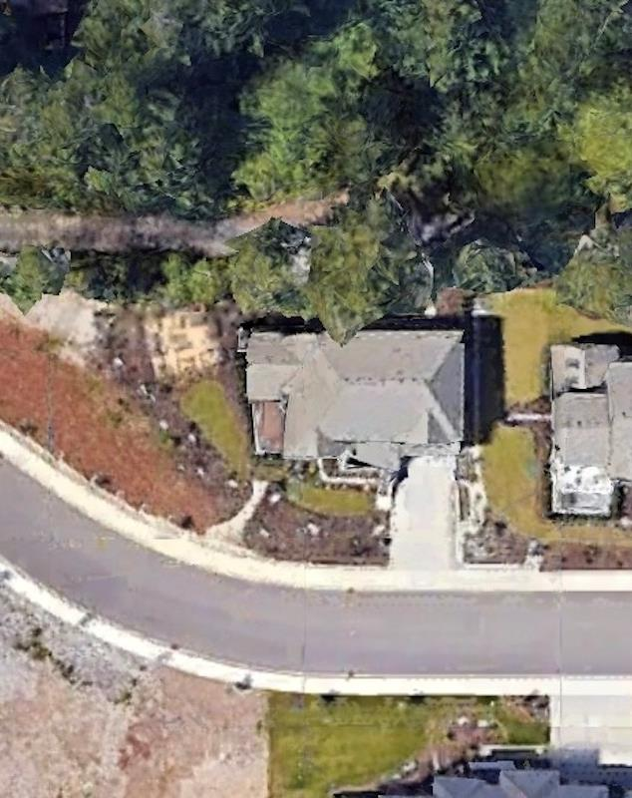
Sun’s-eye view
Housing Development:
Leaf-capture of every ray of sun
From spring through fall
Leaving no bare soil
Context:
Maintain sight lines
Pre-designed yard
Image: Google Earth
Notes:
This, too, is a once forested area replaced with another new housing development. Realistically, there is no way you will ever get back to the full tree canopy of a forest, given that there are now houses, driveways, sidewalks and streets. Further, within housing developments you might want to maintain sight lines out of windows. So, the ‘replace the forest with another forest’ model will not work.
However your yard is broken up into numerous garden beds and you can, on a bed-by-bed basis employ some of the strategies used in a forest to improve your ability to capture and store carbon, minimize weed growth and optimize water retention.
The core principle: on a bed-by-bed basis, you need to design your beds to capture every ray of sun, from spring through fall, leaving no bare soil.
You need to do this within the context of the existing layout of your yard and your desire to maintain sight lines from your windows. So, in many cases you will not be designing with forest high dimensions in mind. But you can still apply these principles at below-window height where relevant.

Slide 25

Analyze beds:
North - full shade (except…)
East - morning sun
South - full sun (bank shot!)
West - setting sun
Full Sun…. To Western Exposure….. To Eastern Exposure….. to Full Shade
Image: Google Earth
Notes:
This, and the next two slides lay out the “puzzle argument”… your yard has been chopped up into pieces and you now need to examine each piece and determine the best way for them fit together. The goal: creating a new “whole” that maximizes the carbon capturing potential of your yard.
Lawn - yep, we said you can keep it, but that doesn’t mean you cannot shrink it down. Look at lawn function: high traffic pathways & play areas. But where beds are encroaching on lawns (shrub growth), let the beds win and cut back the lawn. Where mossy: too much shade. Cut back.
Garden Beds - maximize size and look for gaps, in all dimensions: height, ground cover, and across time (early flowering AND late flowering). To do this, you need to focus in on the ‘micro-climate’ of each puzzle piece, each bed to figure out the better plants to use to fill these gaps.

Slide 26
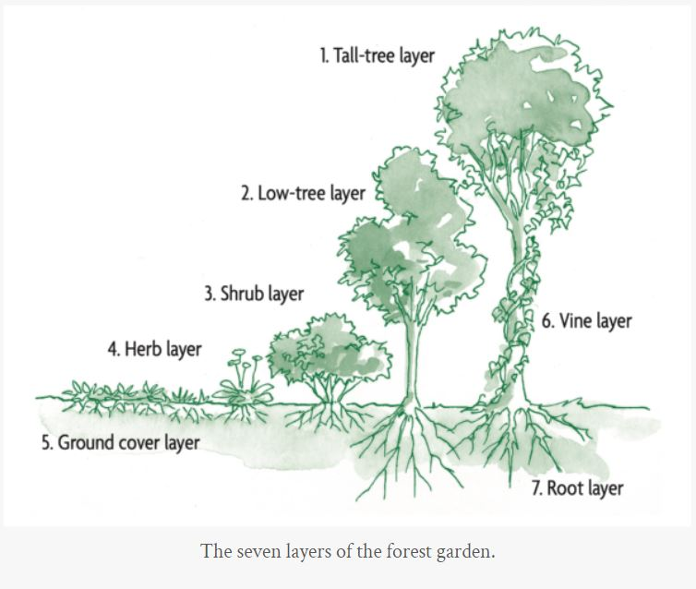
The Layers:
Trees
Shrubs
Ground Covers
Tallest to Smallest
North to South
Cover it vertically,
horizontally & across time.
https://www.chelseagreen.com/2023/designing-a-forest-garden-the-seven-story-garden/
Notes:
When selecting plants, sort them by the ‘layer’ they occupy in the bed.
The goal here is, bed by bed, to develop your own ‘micro-forest’ strategy that is suited to that bed: you want maximum leaf exposure to the sun from spring to fall (maximize carbon capture); you want to cover all empty spaces (weed prevention and soil health); and you want to do this within the context of your home… i.e. if the bed is in front of a view-window… then your entire ‘micro-forest’ has to mature at a level that doesn’t block sight lines.
So, there can be a significantly different plan for each bed, depending on the job you want it to do.
Assuming there are already plants in your beds, you are just looking for gaps that you can fill. You want to go from the north side of your bed to the south, filling with larger plants to the north and shorter plants to the south. Because of the angle of the sun in the northern hemisphere, this is the best way to capture more of the suns rays as it ‘angles’ into your yard. So you fill gaps first with a ‘tree layer’ (if applicable), then a ‘shrub layer’ in front of it and finally a ‘ground cover’ layer.

Slide 27

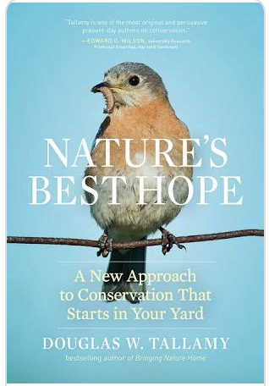
‘Theme’ for your beds:
Native plants
Xeriscaping
Pollinator gardens
Rain gardens
Permaculture
Climate adapted*
Hot, dry / water access
Help the bees!
Excess water run-off
a.k.a. ‘food forest’
Notes:
Once you’ve analyzed your beds and figured out the gaps of that bed’s ‘micro-climate’, then you can start selecting plants. Unfortunately, there is not time in this presentation to get into specific plants (there are so many!), but the internet is a good tool to use as your assistant. Here are some terms in use that can align with your specific bed/plan.
Note the * on the “Climate adapted” point above is just to remind you of the Seattle Times anecdote from slide 9 (if you chose to keep it) that choosing Native Plants are no guarantee… as our climate is now hotter than when those plants became native. So feel free to ‘look to the south’ for other native plants to try.

Slide 28
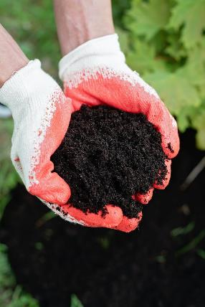
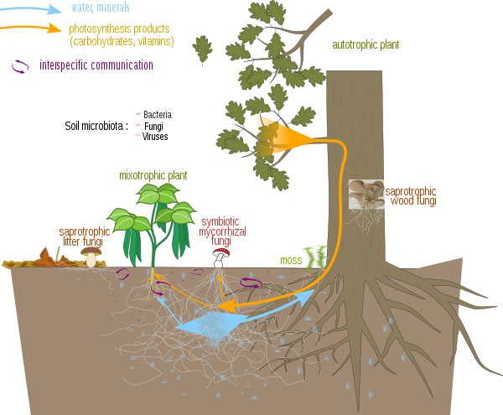
Get your hands dirty
Fundamentals:
Always building better soil
Diversify plantings to mitigate climate risk
Photo credit: pexels-
Markus-Spiske
Annual soil improvement strategy:
Compost, plant & mulch
Photosynthesis &
Soil food web
Let’s talk mycorrhizal fungi!
Image: https://en.wikipedia.org/wiki/Mycorrhiza
Notes:
Turning from planning to action: when planting (or adding plants to) your beds, it is always good practice to double down on the fundamentals: to make your yard truly ‘resilient’ in a changing climate you’ve got to have great soil & a diversity of plants.
Bonus Round! If time allows & you are feeling ambitious, here’s the place to talk MUSHROOMS! (Mycorrhizal fungi). Some notes below to help you along if you are not familiar with this:
Complete guide to mycorrhizal fungi By Sue Fisher (just background you can paraphrase to help you describe what is going on)
What is mycorrhizal fungi and how does it work? Our complete guide introduces these incredible fungi and explains how to use mycorrhizal products in the garden.
Out of sight, below the ground, the soil teems with life. Much of the living mass of soils is made up of fungi, which form extensive underground networks, working in partnership with plants and "supercharging" their root systems.
More than 90 per cent of all plant species form associations with mycorrhizal fungi. Scientific research continues to make discoveries about the world beneath our feet, revealing how important it is to take care of our soil health by adopting sustainable practices such as composting, using leaf mould and not using synthetic fertilisers.
What are mycorrhizal fungi?
The word mycorrhizal relates to "myco" (fungi) and "rhiza" (root). It refers to the symbiotic relationships that fungi have with plant roots, aiding absorption of nutrients and helping them grow. Mycorrhizal fungi pass water and nutrients to the plant, and the plant in turn supplies the fungi with some of the food that it generates by photosynthesis – the process by which plants use sunlight to transform water and carbon dioxide into oxygen and energy.
Because the fungi are far more extensive than the plants’ roots alone, they efficiently ‘mine’ the soil for nutrients and water, and the food from the plant boosts the fungi growth.
Mycorrhizal fungi have been around for hundreds of millions of years and research suggests that they are the root of all life on land. Underground, mycorrhizal fungi form an extensive network, known as mycelium, of microscopic thread-like strands or hyphae, which becomes far more extensive than the actual roots of a plant. Incredibly, the fungal network can cover up to 700 times more soil than the plant roots alone. Fungal networks also connect individual plants together to share resources in a natural ecosystem, often described as the ‘wood wide web’ for its similarities with the internet or ‘world wide web’.
The benefits to plants of mycorrhizal fungi
Gardeners can boost natural levels of mycorrhizal fungi by composting, mulching the soil with organic matter such as well-rotted horse manure, letting leaf litter remain on the soil and top-dressing with leaf mould. You can also buy mycorrhizal fungi and add it to the planting hole when planting new plants. This can help plants establish more quickly and boost healthy growth by supplying additional water and nutrients. Mycorrhizal fungi therefore help plants resist drought, produce bigger crops and flowers, resist diseases, and thrive on poor soils or adverse conditions.

Slide 29


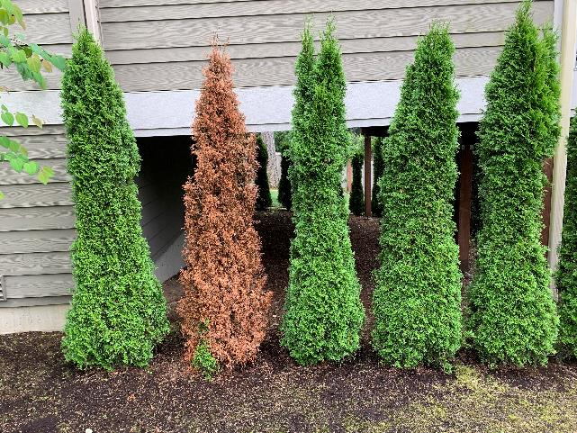
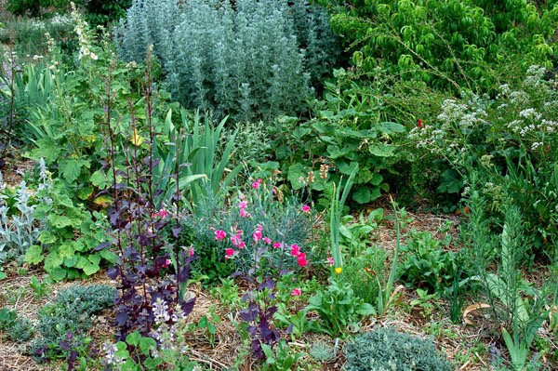
Diversify your planting
Reduces climate induced risk
Improves coverage across space & time
Attracts pest - predators
Fewer pests
Fewer weeds
Less fertilizer
Improved water retention
Photo credit: Teresa Casson (EMG) 2023
Photo credit: Mike Peronto (EMG) 2023
Notes:
Nature hates mono-cultures…. It always works to create diversity to support more life. And you want/need planting diversity to make your yard more resilient in our rapidly changing climate, because plants that thrived in cooler climates are being stressed as we continually heat up the atmosphere.
When builders install beds, it is less costly to put in just a few plant types (like these thujia’s)…but in addition to it being more risky in a changing climate, you also have less flexibility to hide dead and dying plants. In the picture at right, you could lose some of your plants to climate change in any year without anyone noticing. Not so with the plantings on the left.
So, diversifying your plantings lowers your risk, it makes it easier for you to devise planting strategies to maximize your coverage from spring to fall and covering all open ground…. It also attracts a wider range of insects both good and bad… but it is one that is more in balance and so there are more likely to be predators that keep the pests in check…. Minimizing your need to apply herbicides and pesticides. Let nature do the work for you!

Slide 30
Through the seasons…
Spring:
Fall:
Amend soil with compost
Plant shrubs & ground covers
  According to plan
Varieties that fill vertical & horizontal, above & below ground
Upgrade 2nd bed?
Leave leaf-fall on your beds, mulch with leaves for winter
Summer:
Winter:
Mulch to prevent evaporation
Water deeply & infrequently
  Morning or evening
Cover bare soil
Next year’s bed improvement plan
Plant trees in late winter
Notes:
You are summarizing the section. This slide places ideal time frames around some of the recommendations in the section: OK, so you’ve created your plan and are focusing on the fundamentals of good soil creation and diverse plantings. When is the best time(s) to perform each activity?

Slide 31


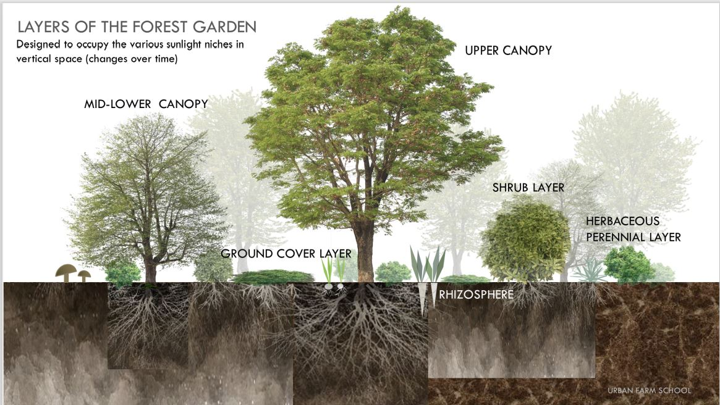
Scorecard
Enough trees canopy?
Upgrade bed(s)?
Expand beds?
Compost?
Mulch bare soil?
Image courtesy of the Urban Farm School
Notes:
And finally, here’s another scorecard so you can hold yourself accountable to making continual progress. We don’t expect you to do it all at once, just TRY and keep chipping away at it.

Slide 32

Growing Veggies at home
Strategy …
Notes:
Ask for questions on the previous section. If you are at the 45-50min mark, you’re going to make it.
Transition: The lawn section was about avoiding generating CO2 in your maintenance efforts and the Garden Beds section was about increasing overall bed ‘mass’ to capture and store more CO2…. So, what is the logic behind our recommendation to add a veggie garden to your yard?
For this, we are going ‘Big Picture’…..

Slide 33
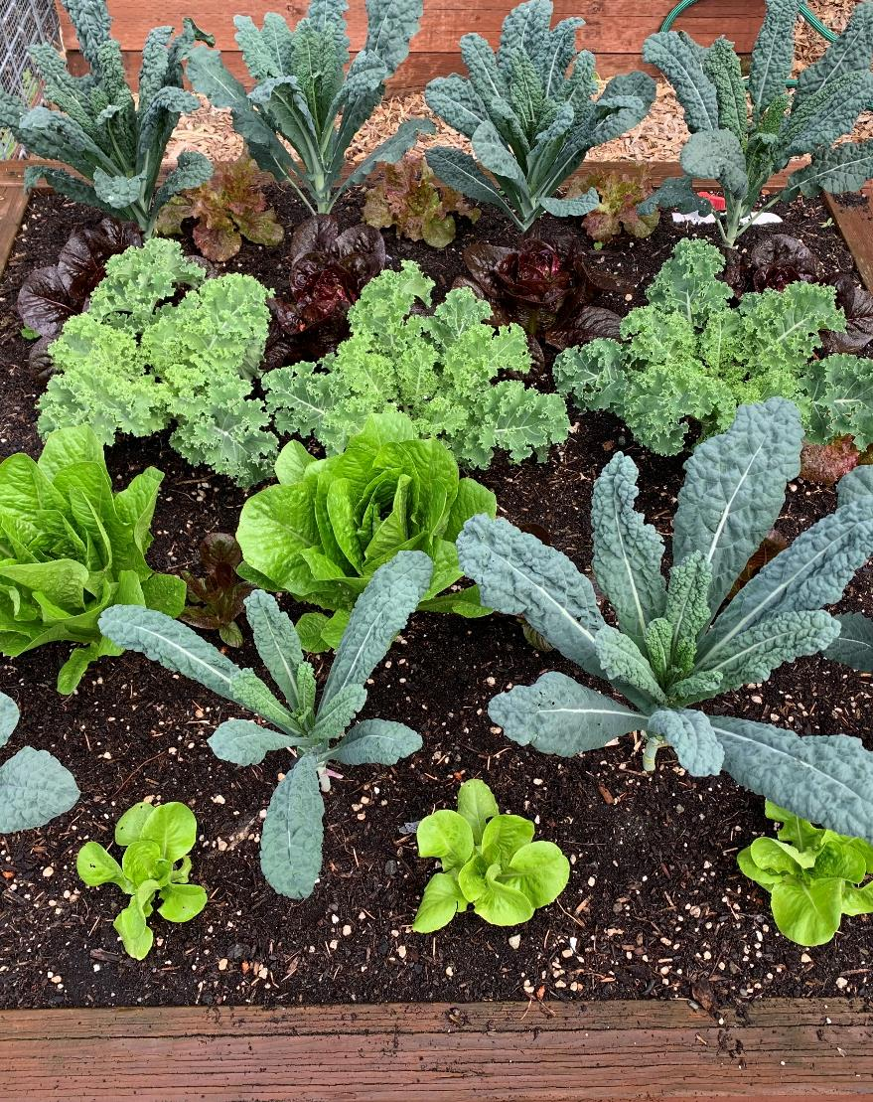
Why grow veggies?
Food Security
Worldwide Supply chains under duress
Inflation
1,494 Miles & 30% Waste
Average distance food travels to market
Average amount of food thrown into landfill
Employ Climate Friendly Practices
Easy @ home, challenging @ scale
Help pollinators, improve soil & store carbon
Healthy people & healthy planet saves lives and money!
Photo credit: Mike Peronto (EMG) 2023
Notes:
In our changing climate, our food systems are under increasing pressure: the way we currently grow food generates a lot of CO2 and must be reduced. BUT, we have to do this while continuing to INCREASE the amount of food world-wide that we produce and at little or no increase in cost. This is the equivalent of “changing the engine on a plane while in flight”. So, the agriculture industry needs a ‘break’. Remember those 40million+ acres we have in our yards? We are uniquely positioned to give them a hand.
Food Security: for the last 75 years, the industry has been focused on building world wide ‘supply chains’ … after all, we’ve become conditioned to expecting our fresh raspberries on our morning cereal in January(!)… But, with Climate Change, those supply chains are increasingly breaking and the result is inflation in our groceries.
The average distance food travels to our tables is ~1,500 miles… and it is not being transported on electric vehicles… but every bit of produce you grow in your yard travels the shortest supply chain on the planet: from your yard to your table. And grow as much as your space will allow… don’t worry about over-producing any crop because you can apply the rule of the “three F’s” (Family then Friends then Food Bank)… everything you grow will help build even a little flexibility into our increasingly brittle supply chains.
So, if you think of Climate Change in the context of a “Battle”… your home garden is the ‘Victory Garden’ for our times.
AND…when done at home, it is easy to grow veggies in a climate friendly way. Let me explain……

Slide 34
Commercial Agriculture: Climate Trends
Applied to home gardening
The Green Revolution
Home Gardening:
‘Factory Model’
Extensive tilling
Vast mono-crops
Synthetic fertilizers
Herbicides
Pesticides
Small plots
‘No-dig’
Diverse, interplanted crops
Minimize chemical inputs
Focus on improving soil
… all have negative climate impacts
…easier to do - and healthier for you
The Green Revolution is credited with saving over a billion lives
Notes:
For the last 75 years or so, we have experienced tremendous increases in food production while also decreasing the cost of the food. This has been called the ‘Green Revolution’. It applied a ‘Factory’ model to the growing of food: extensive tilling of huge tracts of land until they are pool-table flat; planting of huge acreage of mono-crops… and we know that nature fights for diversity, so to keep those crops ‘mono’ we apply ever increasing amounts of fertilizer, herbicides & pesticides…. And we now know the CO2 impact of those practices. So, agriculture needs to evolve to a new model without losing productivity and keeping costs low.
If we help out in the home garden, interestingly, because we don’t have the commercial issue of huge scale, it is easy to grow our own food in a climate friendly way: we naturally have small plots, so we don’t have to till the soil…. And we know from the beds section that by minimizing soil disturbance, we let nature create a soil structure that is superior to tilling. We all want lots of things in our home garden, so we naturally grow many crops, which attract a range of critters, including predators for the pests, so we don’t need as many pesticides. We can pull weeds by hand, cutting out the herbicides. So, with just a little guidance, home grown veggies have a much, much smaller impact on our climate. Unfortunately, we don’t have time today to go into detail on this, but I hope you can see that even a small ‘Victory Garden’ can help us better manage the ‘Big Picture’ in evolving agriculture. And besides… it’s fun!

Slide 35

The Resilient Yard: Conclusion
Lawns:
- Minimize CO2
Follow on presentations:
Lawn alternatives
    Native plants
    Pollinator beds
Beds:
Maximize capture & storage
Easy Home Gardening
Veggies:
Ease supply chain stresses
Notes:
Ed Note: You need to edit this slide to be consistent with the presentations you make in your County. All of the Follow On Presentations exist, but you may not have trained presenters in your county. So check first and only include those presentations you are equipped to give.
So that’s it for today. We covered a LOT of material, but time didn’t allow us to cover everything to the depth it deserves. But, we’ve set you up for follow-on presentations if you are interested.
The Lawn… if you want to go further and learn how to minimize your lawn area up to and including removing it entirely, or
If you want to learn more about how to plant specific types of beds, or
You want a deeper dive on home gardening… we have additional presentations on all these topics and more.
When you are filling out your evaluation form, let me know and I’ll connect you with our Speakers Bureau.

Slide 36


Questions?
Insert Name
WSU Extension Master Gardener Volunteer
Contact info
http://mastergardener.wsu.edu/
https://www.facebook.com/WSUMGProgram
WSU Extension programs and employment are available to all without discrimination. Evidence of noncompliance may be reported through your local Extension office.
CC-001
Notes:
This is ‘Must Use’ slide #4.
Standard way to end your presentation…. But for the PDF version, you need to add….

Slide 37
Resources:
The Resilient Yard
David Montgomery & Anne Bickle, What Your Food Ate,
Published in 2023 by W.W.Norton & Company. ISBN-10 1324004533
California Air Resources Board, Small Offroad Engines in California, accessed September 8, 2023, archived at https://web. a r c h i v e . o r g / w e b / 2 0 2 3 0 9 0 8 1 3 3 9 1 3 / h t t p s : // w w 2 . a r b . c a . g o v / s i t e s / default/files/2021-12/2021%20SORE%20Fact%20Sheet.pdf.
David Montgomery, Growing a Revolution, bringing our soil back to life,
Published in 2017 by W.W.Norton & Company. ISBN 978-0-393-60832-8
Lawn Care Goes Electric, Why it’s time to switch to a new generation of clean, quiet electric lawn equipment, Environment America; U.S.PIRG Education Fund; Frontier Group.
2023. https://environmentamerica.org/center/resources/lawn-care-goes-electric/
Dale Strickler, Restoring Your Soil,
Published in 2021 by Storey Publishing. ISBN 978-1-63586-224-9
Douglas W. Tallamy, Nature’s Best Hope, a new approach to conservation that starts in your yard,
Published in 2019 by Timber Press. ISBN 978-1-60469-900-5
Website. https://homegrownnationalpark.org/
Note: All Photos/Images/Graphics with label beginning ‘Credit WSU’ are copyrighted by the University and permission has been granted for this use.

Slide 38
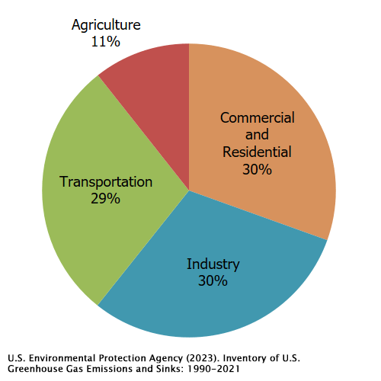
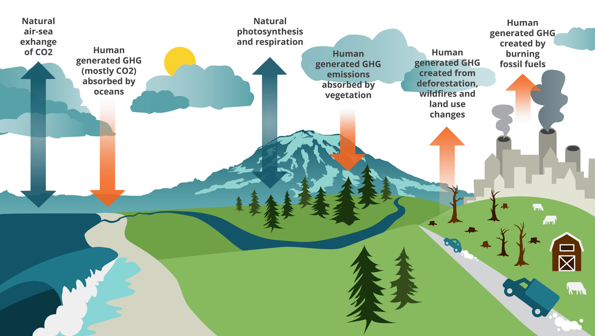
Alternate Graphics:
The Resilient Yard
https://www.piercecountywa.gov/ImageRepository/Document?documentID=98274
https://www.epa.gov/ghgemissions/sources-greenhouse-gas-emissions#:~:text=Sector in 2021-,Total Emissions in 2021 = 6,340 Million Metric Tons of CO₂,shown in the above diagram.

