Slide 1
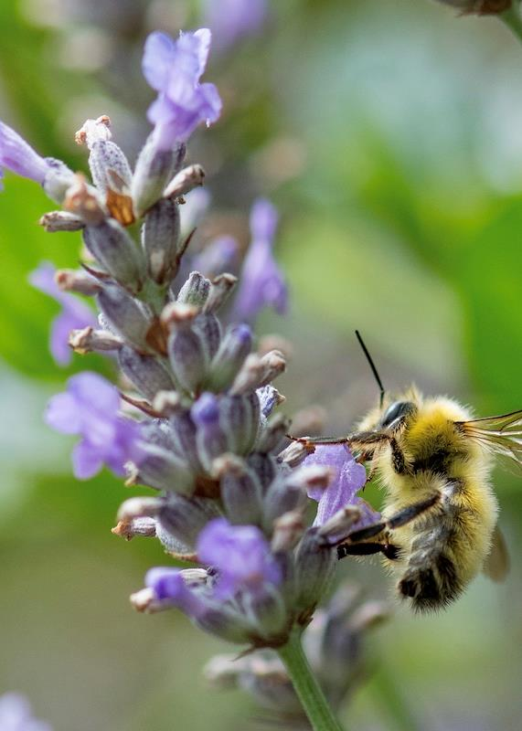






Protect our Pollinators from the Effects of Climate Change
The Resilient Yard Presentation Series
Angelina Lai and Karen Palmer
WSU Clark County Extension
Master Gardener Program
Credit: WSU-EMG Casson
CC-002

Slide 2



Extension is for everyone!
Washington State University is an affirmative-action, equal-opportunity employer. Washington State University Extension programs and materials are open to all without regard to race, color, national origin, sex, gender, gender identity, religion, age, height, weight, disability, political beliefs, sexual orientation, marital status, family status, or veteran status.
Welcome!
We are glad
you are here.
Read more on the WSU Extension website:
https://extension.wsu.edu/about-extension/extension-is-for-everyone/
Notes:
WSU Extension programs and policies are consistent with federal and state laws and regulations on nondiscrimination. Extension is for everyone, so we are glad you could join us today.

Slide 3






Resilient Washington
Our Mission: Building a Resilient Washington Together
Washington State University’s College of Agricultural, Human, and Natural Resource Sciences works to create a more resilient Washington. Our scientists, educators, students, and volunteers foster discovery and innovation across many disciplines that improve our state’s productiveness, sustainability, health, and wellbeing. Our mission embraces four pillars of endeavor:
Create an adaptable workforce
Providing a secure food supply system
Helping to maintain sustainable natural resources
Supporting thriving, healthy communities, families, and individuals
Notes:
WSU Extension is the front door to the University. It extends non-credit education to people throughout the state.
WSU Extension empowers people, organizations, businesses, and communities to find solutions for local issues.
WSU Extension is recognized for its science-based educational programs and collaboration with community partners to create a culture of life-long learning.
Such programs include 4H, Agriculture, Community and Economic Development, Youth and Families, Nutrition, Gardening and natural resources.

Slide 4



WSU Extension Master Gardener Mission
Engaging university-trained volunteers to empower and sustain diverse communities with relevant, unbiased, research-based horticulture and environmental stewardship education.
Notes:
This is ‘Must Use’ slide #2
We want to ensure that you properly ‘place’ Master Gardeners as part of the WSU Extension program, touch on our mission and point out that we have 9 guiding Priorities, of which your presentation is one.
Suggest you cover this while handing out your questions/evaluation form.
Throughout this presentation there are links to documents of various file types.
Please contact our Statewide Program Leader if you require this information in a different format.

Slide 5

Climate
Change
Teaches ways to create resilient landscapes that are adapted to our changing climate.
Impact of climate change on people, wildlife and ecosystems
We all have a role to play
Techniques for home landscapes
Photo by Pexels
Notes:
This is ‘Must Use’ slide #3. Program provided wording to ‘frame’ the Climate Change issue.
Warmer winters, hotter summers, flooding and droughts affect plant growth and impact the many organisms that interact with plants (insects, pollinators, diseases and microbes). Home gardeners have an important role to play in combating climate change. Choosing human-powered tools like push mowers, rakes and hand clippers over gas-powered tools such as lawn mowers and leaf blowers can reduce greenhouse gas emissions. Choosing resilient plants that are well adapted to your soil and climate and using research-based horticulture practices to manage soil will help keep your landscape resilient. Composting on-site closes the loop on waste and yields valuable nutrients and helps to reduce methane emissions from landfills.
This talk on [insert title] will give you a better understanding of the importance of creating resilient landscapes that can thrive in a changing climate, help you recognize that we all have a role to play in reducing the impact of climate change on our society and will provide you with specific techniques that you can use to build and maintain resilient landscapes in your own spaces.
Throughout this presentation there are links to documents of various file types.
Please contact our Statewide Program Leader if you require this information in a different format.

Slide 6
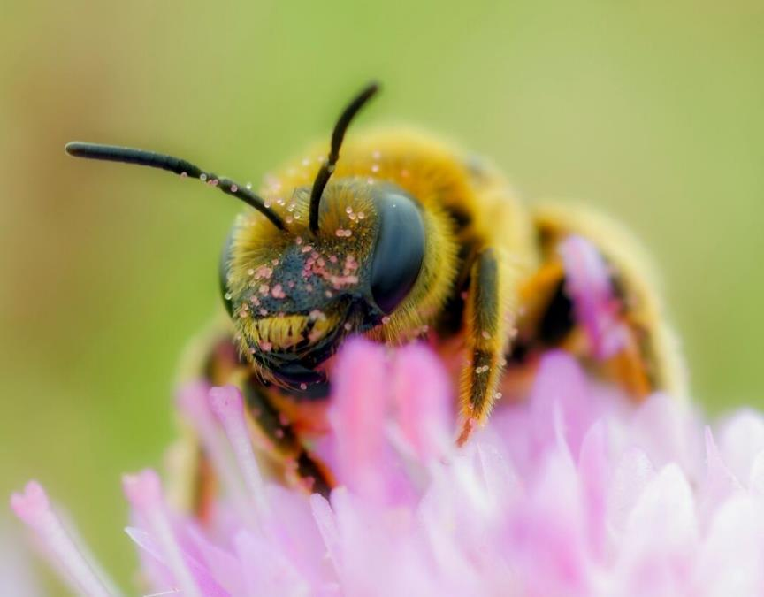
Goals
Climate Change Effects on Pollinators
Flower Anatomy
Pollination Biology
Types of Winged Pollinators
Providing Food and Forage for Pollinators
Protecting Pollinators
https://pollinators.psu.edu/landscaping-for-pollinators/what-to-plant/plants-for-bees
Notes:
Climate change is a fact of life for us now. This talk focuses on what we can do to help our pollinators weather the effects of a changing climate. In the process, we will cover how flowers and pollination works so we understand how the pollinators do their job.

Slide 7
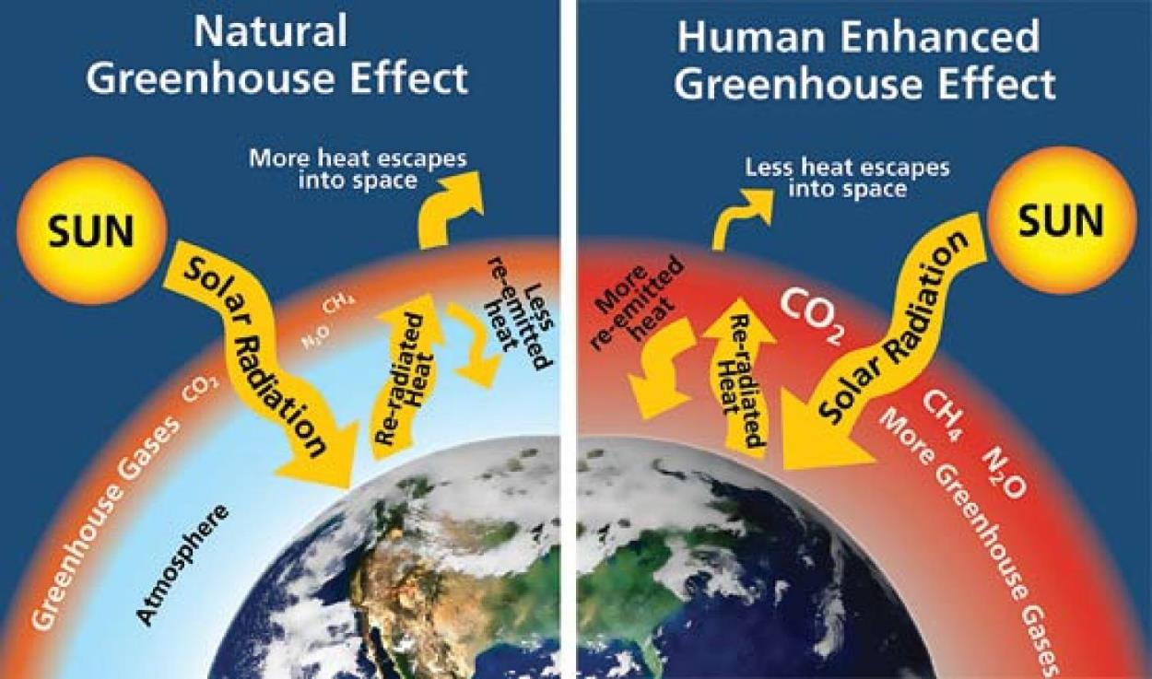
What is Climate Change?
Greenhouse gasses act like a blanket & trap the heat from the sun.
Carbon Dioxide (CO2) ~80%
Methane (CH4) ~12%
Nitrous Oxide (N2O) ~6%
Note: Earth’s carbon doesn’t change. Solid/liquid to gas is the issue.
https://www.colorado.edu/ecenter/sites/default/files/styles/large/public/page/greenhouse-effect.jpeg?itok=4X5-u6Iz
https://www.epa.gov/ghgemissions/overview-greenhouse-gases
Notes:
Presenter’s Notes: Explain the graphic. Note that in the comparison nature also emits greenhouse gasses and we need some of them to keep the planet from getting too cold. But the “Human Enhanced” side of the graphic show that we’re adding too much, and heating the planet.
Key point: BUT… just as we turned solids (coal & wood) & liquids (oil) into a gas, we can do the opposite: turn those gasses in our atmosphere back into a form where carbon can be stored, where they actually help the planet instead of warm it. That is called carbon capture…
There are lots of entrepreneurs out trying to find a cost-effective way to capture and store carbon on a world-wide scale, but so far there is only one economically feasible way to do this at scale….(next slide)

Slide 8
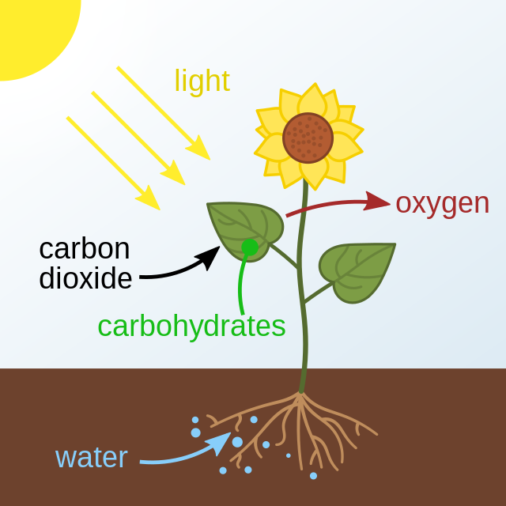
Photosynthesis!
Changes CO2 from gas to liquid
Plants convert CO2 to carbohydrates
~ 70%* to feed above ground trunk, branches, leaves
~ 30% ‘exudates’ from roots to accelerate….
Illustration credit: https://en.wikipedia.org/wiki/Photosynthesis
*What Your Food Ate by David Montgomery & Anne Bickle
Notes:
…. the Technology to convert CO2 into a liquid is called Photosynthesis, and the ‘machines’ that do it are called plants(!)
So, back to school: photosynthesis is the process where the leaves in plants, when watered and exposed to sunlight grab CO2 from the air and turn it into the oxygen we breathe and they create a liquid substance (aka plant sugars, carbohydrates, ‘exudates’) that they use to both feed themselves (~70%) and also to ‘exude’ these carbs into the soil through their roots (~30%)as a food source for the microorganisms in the soil.
So, that’s step one: the plants through their growth store carbon in solid form in their leaves, branches and trunks. And pollinators need plants for nectar!
Step two is….(next slide)

Slide 9
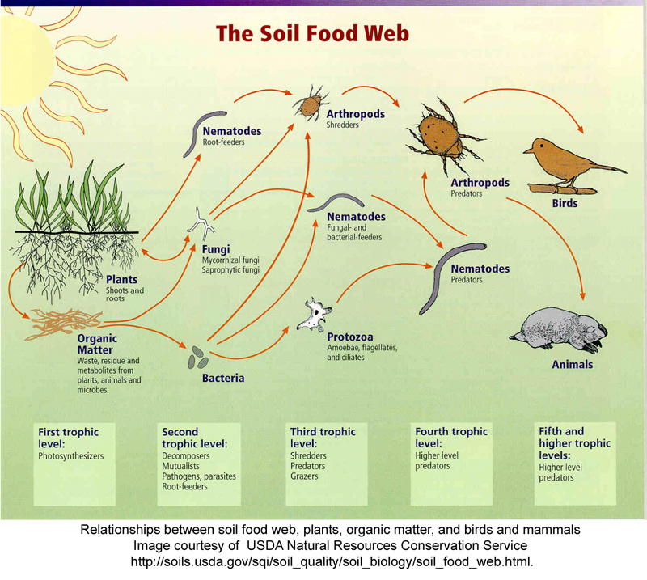
The Soil Food Web
Organisms in/on the soil comprise ~59%* of all life on earth:
Insects, earthworms, nematodes, springtails
Bacteria
Fungi
Once fed, these organisms
‘Do what living things do’
*Growing a Revolution by David Montgomery
Notes:
… The Soil Food Web….
Those root ‘exudates’ deposited by plants are an important food source for soil organisms. And there are billions upon billions of them. Almost 60% of all life on earth is either in or just on top of our soils (another UW Prof David Montgomery reference. This one from an earlier book “Growing a Revolution”). And once fed, these organisms do what living things do, they poop, multiply, attract predators and die…. All these activities return carbon to the soil where it can stay for hundreds of years.

Slide 10
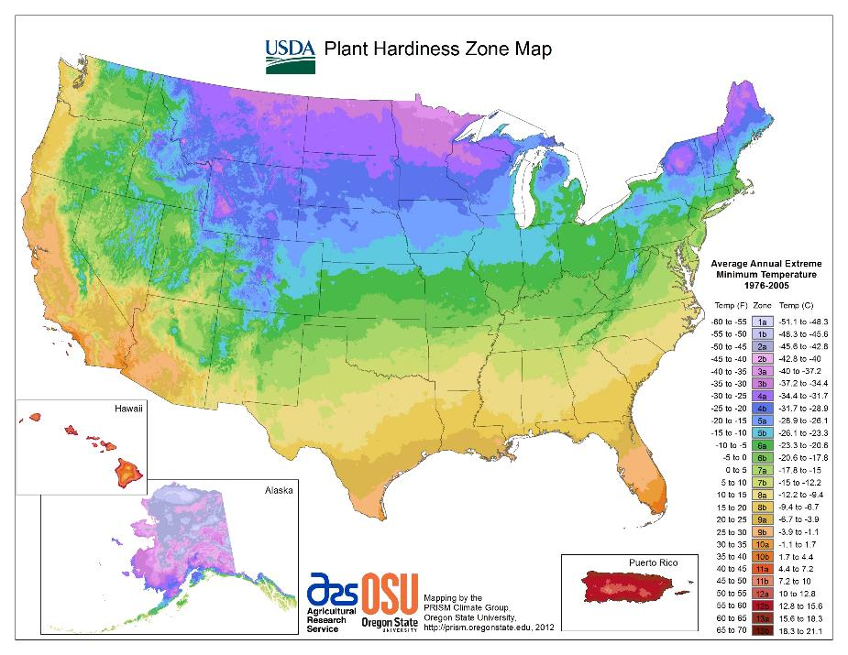
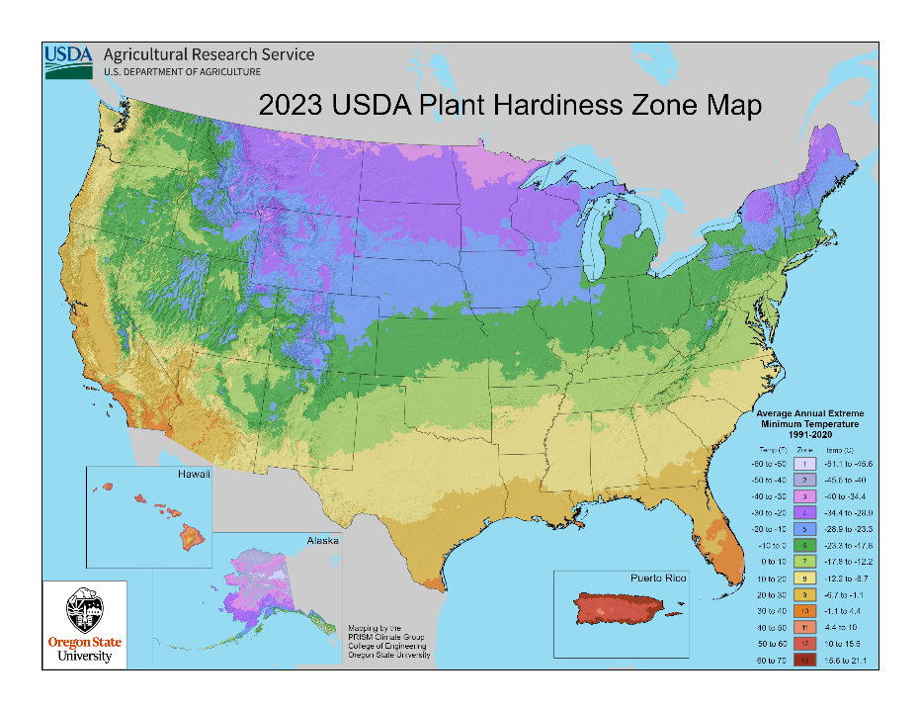
USDA Hardiness Zones
2012
2023
https://planthardiness.ars.usda.gov/pages/map-downloads
Notes:
USDA has just updated the plant hardiness zones to adjust for climate change. One can see the colder regions (purple, dark blue) are smaller and the warmer regions (tan, brown) are larger.

Slide 11
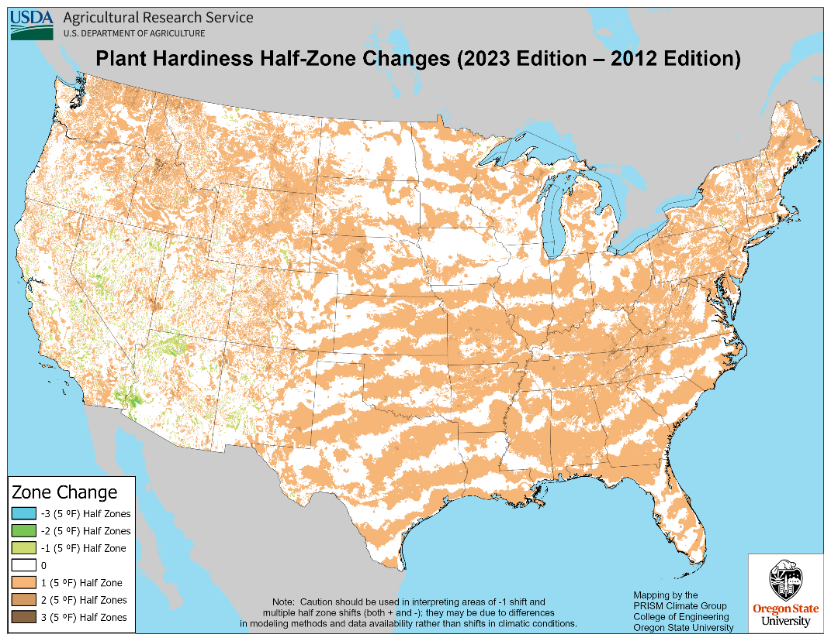
USDA Hardiness Half-Zones
Difference 2012 vs 2023
https://planthardiness.ars.usda.gov/pages/map-downloads
Notes:
The light brown areas of the map show areas of the country that have increased temperatures averaging 5 degrees. This is affecting much of the southeast, east and a little less in the northwest. The few green areas show a decrease in average temperatures by 5 degrees, but this may be due to modeling methods. It is the vast brown areas that should concern us. Changes in climate can decrease the quality of nectar for some species. Also, stressed plants can change their scent, which will confuse some pollinators who use chemical cues rather than color or flower shape to guide them the nectar.
On the plus side, an increase in temperature allows PNW gardeners to grow new flower species/varieties which may attract a wider range of pollinators or benefit the pollinators we already have.

Slide 12
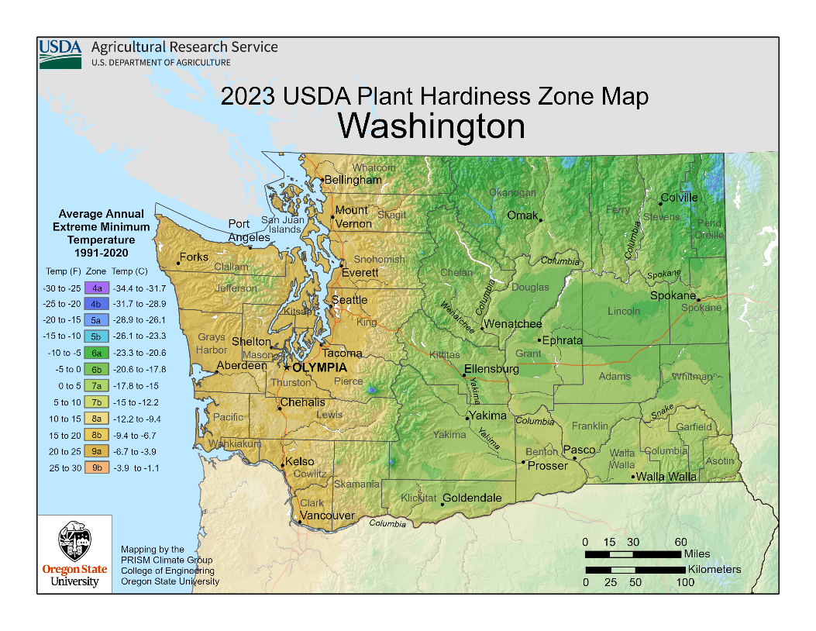
USDA Hardiness Zones for Washington
New Zones for Washington
https://planthardiness.ars.usda.gov/pages/map-downloads
Notes:
Washington State plant hardiness map updated 2023. I used to consider myself in Clark County at 700’ elevation to be in zone 7b or 8a in a mild winter. I used to regularly lose zone 8 plants. Now I’m thinking I can give some zone 8 plants another try. The gardener part of me is thrilled to have new options for my plant palette, but the environmentalist part of me worries about all the other consequences that will affect not only pollinators, but other wildlife, plant life, food production, etc.

Slide 13
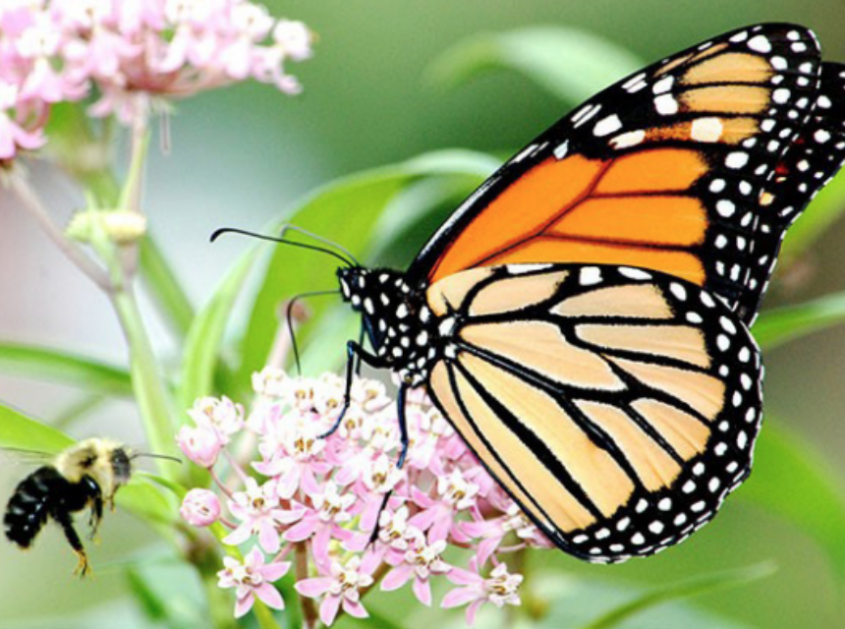
Climate Change Impact on Pollinators
Plants bloom sooner, limiting pollinator food
Drought causes less nectar, so pollinators get fewer calories
Extreme rainfall reduces flight time for pollinators
Source: www.climatehubs.USDA.gov
https://pollinators.psu.edu/pennsylvanias-pollinators
Notes:
How is it that a few degrees can affect something as little as a bee or butterfly? It is more than a slightly warmer climate. Our seasons are shifting also. Plants and insects evolved to emerge at the same time for their mutual benefit. But now plants are blooming sooner so a butterfly that depended on that specific flower is now emerging from its cocoon and the flower is done. No food for the butterfly! The butterflies may eventually change their timing but in the meantime their population will suffer. Drought stricken plants produce less nectar so there are fewer calories for the pollinators. Extreme weather events, like heavy rain, make it difficult for the pollinators to move around so it is harder to get to their food sources. When you live on nectar, you need to visit a lot of flowers!

Slide 14
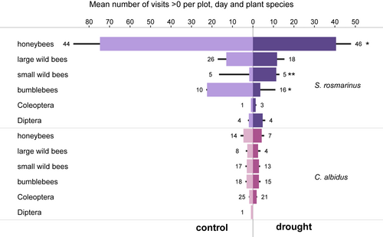
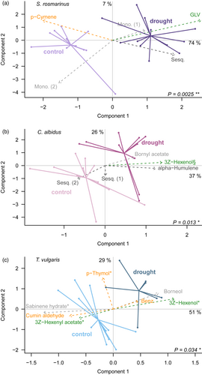
Reduced Nectar Quantity and Quality
Nectar production reduced up to 38%
Sugar content of nectar reduced up to 49%
Floral scent affected in some plant species
Floral Scent results
Source: https://besjournals.onlinelibrary.wiley.com/doi/full/10.1111/1365-2745.13974
Notes:
Detailed experimental studies of the effects of drought conditions on flowers quantify that while plants may produce the same number and size of flowers, the nectar production of individual flowers is dramatically reduced. The sugar content, which is what the pollinator insects need, is cut almost in half. Some plants emit more floral scent when drought stressed while some produce more floral scent. It is unknown if the scent difference affects bee visits, but it was observed that some bee species changed their visitation between drought stressed and unstressed flowers in a controlled environment.

Slide 15
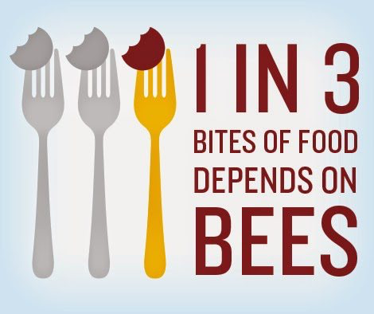
Why should we care?
They are just “bugs” after all!
  Most plants reproduce by flowers. Per USDA, “1 out of every 3 bites of food we consume depends on the work of pollinators.”
So, if you want to eat, you SHOULD care!
https://www.usalovelist.com/bee-part-solution-help-save-pollinators/
www.usda.gov/peoples-garden/pollinators
Notes:
I know – a lot of people are not fond of bugs. But since you are here, I will assume you like them. Even for those who don’t like bugs, I bet they do like to eat. Looking at crop productions world wide and those that depend on pollinators, it is determined that every third bite of our food depended on those pollinators. That number probably goes up for vegetarians.

Slide 16
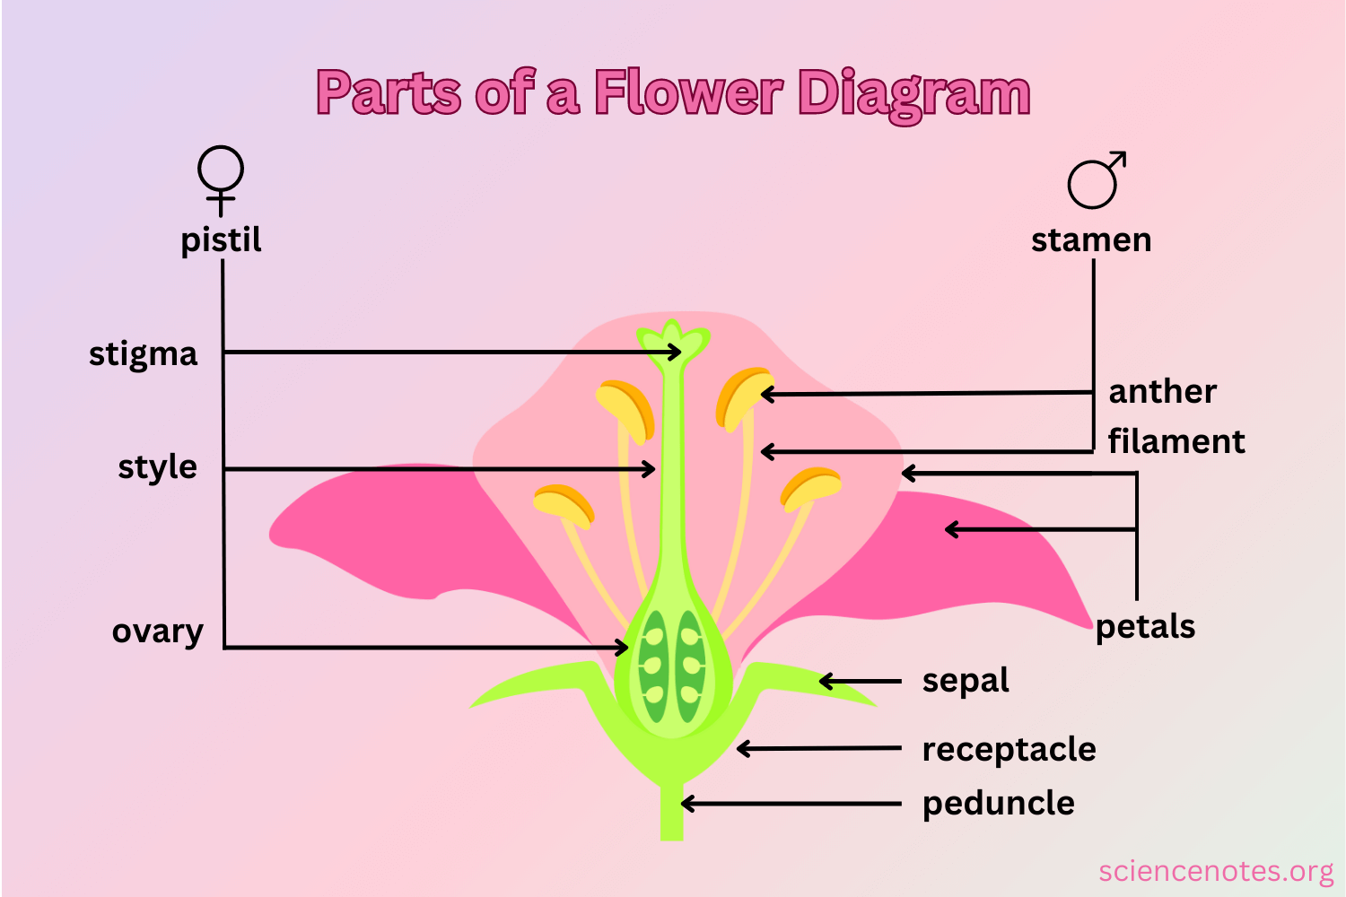
Flower Anatomy
Sepals protect the flower bud and attract pollinators
Pistil is the female part; consists of stigma, style, ovule
Stamen is the male part; consists of anther, filament
Pollen sticks in stigma; provides food for pollinators and produces new seedling
https://sciencenotes.org/wp-content/uploads/2023/05/Parts-of-a-Flower-Diagram.png
University of Florida: gardeningsolutions.ifas.ufl.edu
Notes:
Flowers on all plants, both food producing and ornamentals, are important to produce seeds that become the fruit we eat. The female pistil is usually in the center of the flower with a sticky stigma at the top. The female style is a long tubular structure that leads to the ovary, which contains the eggs cells (ovules). The male anther produces pollen, which are the male reproductive cells. The male filament simply holds up the anther. The petals attract the pollinators.

Slide 17
Pollination Biology
Pollen lands on stigma
Male cells follow down the tube, providing fertilization
Fertilized ovule becomes seed
Ovary becomes the fruit
https://sciencenotes.org/wp-content/uploads/2023/05/Parts-of-a-Flower-Diagram.png
https://web.extension.illinois.edu/gpe/case1/c1facts2d.html
Notes:
As the pollinator insect flits from flower to flower (attracted by the flower petals), they are gathering pollen. When they visit another flower, some of that pollen is deposited on the stigma, which is sticky. That pollen containing male cells travels down the style into the ovary where the female egg cells (ovules) are waiting. The ovules become fertilized and become the seed.

Slide 18
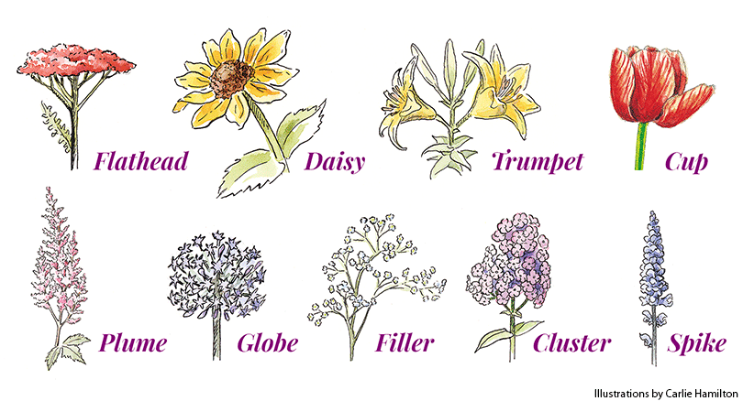
Flower Structures
Different structures attract different pollinators
Aim for a variety of flower structures in your landscape
This also provides a pleasing landscape
https://images.ctfassets.net/zma7thmmcinb/58unfKezwj53sLY1xmlCIS/bf30ae161635d7dabff271850e23cc9e/Flower-shapes-illustration-group_Carlie-Hamilton-Garden-gate-magazine.gif
Notes:
Pollinators have co-evolved with plants for the specific purposes of feeding the pollinator and pollinating the plant. Open flowers with easy landing pads attract beetles, which are not agile in flight, and non-hovering pollinators. Plants with long nectar spurs (like the mint family) attract butterflies and hummingbirds, which have a long proboscis. Visual cues (color, ultraviolet reflectance) also play a role.

Slide 19
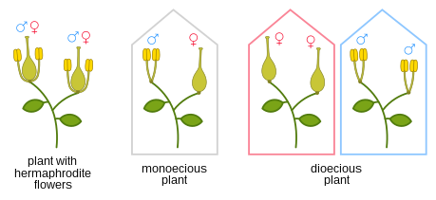
Plant Fertilization
Flowering plants are divided into two major groups.
Monoecious: Plants contain both male and female flowers.
Dioecious: Require female and male plants for pollination.
https://en.wikipedia.org/wiki/Plant_reproductive_morphology
Notes:
A note on plant biology. Flowering plants are either monoecious or dioecious. The major difference is whether more than one plant is needed for pollination. Both usually still require some type of pollination to transfer the pollen from a male flower to a female flower, whether on the same plant or different plants.

Slide 20

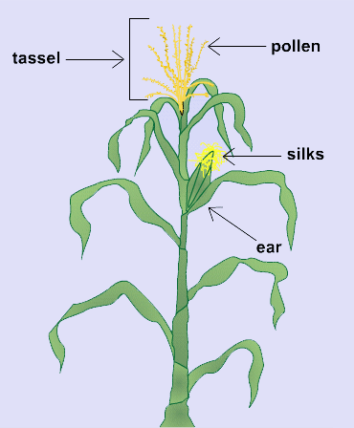
Monoecious Plants
The same plant produces both male and female flowers
Often called the “perfect” plant.
Only one plant is needed for production.
Examples: cucumber, corn, fig, apple
https://blogs.ifas.ufl.edu/pascoco/2017/12/29/monoecious-vs-dioecious-self-pollinating-vs-cross-pollinating-plants/
https://passel2.unl.edu/view/lesson/bf87afd5be26/4
Notes:
Complete flowers on a monoecious plant contain both male and female reproductive parts. Examples are tomatoes or peppers. Incomplete flowers (on the same plant) have only male or female reproductive parts. Examples are squash, corn or apples. Each still requires pollination, either by insect or wind.

Slide 21
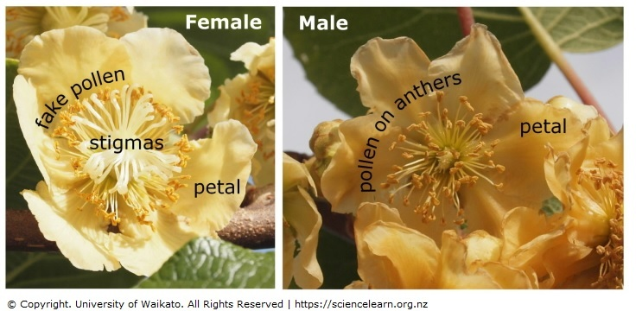
Dioecious Plants
Each plant has only male or female flowers. It is critical to have both for fruit production.
Kiwi is one example. Important to plant both a male kiwi and a female kiwi.
Other examples are spinach and asparagus.
University of Waikato: www.sciencelearn.org.nz/images/63-kiwifruit-flowers
Notes:
Since dioecious plants contain only male or female flowers, you must plant at least one of each to get fruit production. Kiwis are the most common example of the conscious choice you must make when planting. You need one male kiwi plant to provide pollen for up to 8 female plants (and no individual homeowner needs that many!). Other dioecious plants are spinach and asparagus but since you only want to eat the leaves or stalks of those plants, you don’t really care if you get seed production (unless you are trying to save seeds).

Slide 22
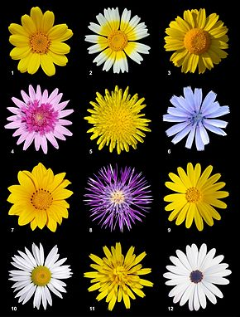
Composite Flowers
Many flowers are Composite plants
Contain many smaller florets
Examples: yarrow, coreopsis, dahlia, zinnia, goldenrod, fleabane, aster, cosmos, Black-eyed Susan, sunflower, lettuce
Ideal landing pads for bees!
https://en.wikipedia.org/wiki/Asteraceae
Notes:
Flowers in the Aster family (think daisies) are composite plants. This means that each flower contains many small florets. Each of these florets contains a nectar source. So bees absolutely love these flowers. There is a nice wide landing pad for them to sit on and they can get a lot of nectar from one spot.

Slide 23
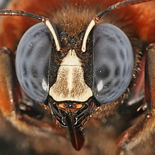
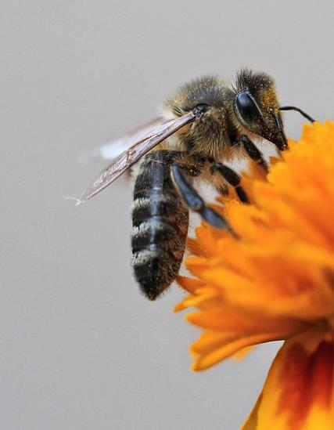
Bees = Pollination
Without bees, we don’t eat
Without bees, our yards would be dreary
https://en.wikipedia.org/wiki/Bee
Pixabay.com
Notes:
Bees are excellent pollinators. They spend their life feeding on pollen, and in the process pollinate much of our food crops and ornamental flora. A bee’s mouth parts are perfect for dipping into a flower’s pistil to collect pollen and in the process shake off pollen from a previously visited flower. There are over 4,000 species of native bees.

Slide 24
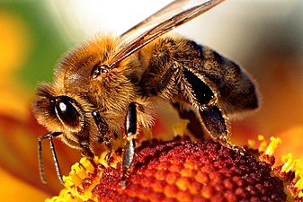
Honey Bee
Colonies live year-round
Generalist foragers
Colors seen: ultra-violet patches on flowers: blue, purple, white
A few of their favorite flowers: Russian sage, zinnia, oregano, borage, lavender, rhododendron
Western honey bee: Apis mellifera
https://en.wikipedia.org/wiki/Honey_bee
Bees.wsu.edu
Notes:
Honey bees and humans share a connection. Some homeowners keep honeybee hives on their property for pollination, honey production, and just as a hobby. Honey bees are in decline around the world so help maintain honey bee populations by reducing use of pesticides. The varroa mite is also a major source of honey bee decimation; much research is ongoing on ways to combat this disease.

Slide 25
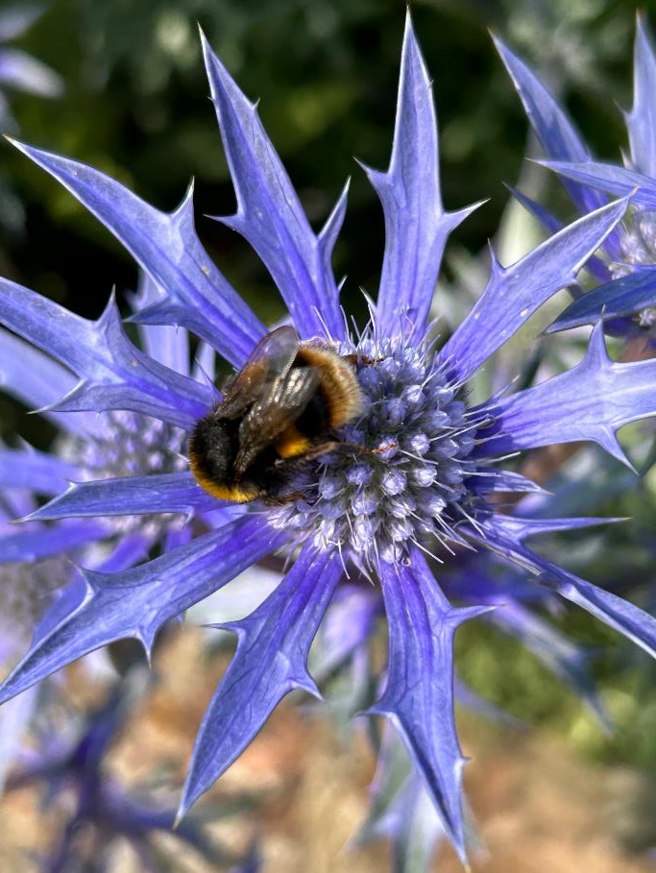
Bumble Bee
Generalist foragers
Food crops: tomatoes, watermelon, blueberries
Practice buzz pollination (cause vibrations to release pollen)
A few of their favorite flowers: Lavender, blue blossom, sunflower, columbine, salvia, blueberry
Bombus
Photo by Karen Palmer, Clark County MG, 2023
Notes:
There are over 250 species in the Bombus genus. They form colonies with a single queen. Tip of their long tongue acts as a suction cup to lap up the nectar. The name Bumble comes from the fact that they buzz. Some bumble bees nest in the ground so it is beneficial to leave some leaf litter during the winter to protect their nests. Bumble bees will often sleep in flowers overnight, which brings a smile to my face.

Slide 26
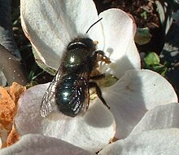
Orchard Mason Bee
Short active foraging time when fruit trees bloom
Travel only about 200 feet
Require water and mud
Food crops: fruit trees
A few of their favorite flowers: Oregon grape, apples, plums, pears, peaches, cherry, rose, salvia, thyme
Osmia lignaria
https://en.wikipedia.org/wiki/Osmia_lignaria
Notes:
Mason bees are critical for orchardists, to pollinate fruit trees. Their life cycle is geared to the same temperature range of blooming apples, pears, plums, etc. Their life span is very short – they emerge from their nest, mate, collect nectar and mud to knead into a ball, lay an egg, seal it off, and do it again, until the hole is full. Mason bee nest boxes are easy to build or purchase and install in your own garden. Mason bees are not aggressive at all.

Slide 27
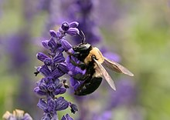
Small Carpenter Bee
Generalist forager
Nests in pithy vertical stems
Found in woodlands, gardens, meadows, prairies
A few of their favorite flowers: Morning glory, salvia, sorrel, sunflowers, caneberries
Xylocopa virginica
https://en.wikipedia.org/wiki/Carpenter_bee
Notes:
Carpenter bees sometimes have a bad name because they build their nests in wood. Understandably, some people object to critters drilling into their deck or house eaves. They do not feed on wood, just excavate to make a nest. Useful fact: they do not like painted or varnished wood! Carpenter bees look similar to bumble bees and serve a useful pollination service.

Slide 28
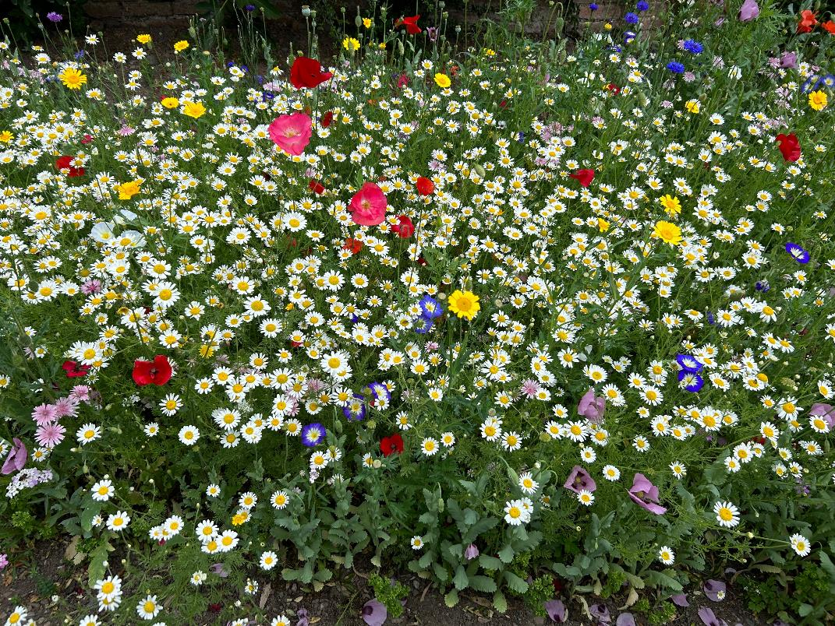
Bee “Vision”
Bees see colors
Bees see ultra-violet color
Bees see motion
Bees see brokenness
BUT…
https://news.ncsu.edu/2011/07/wms-what-bees-see/
Photo by Karen Palmer, Clark County MG, 2023
Notes:
Many flowers have unique ultraviolet color patterns to attract bees. These patterns also outline landing zones for the bees, where the nectar and pollen resides. These ultraviolet colors are not visible to humans. Bees also see distinctions between light and dark colors, which helps them identify shapes.

Slide 29
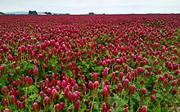
Bees don’t see red!
Yellow portion of catalpa tree flower will change color to red only after the flower is pollinated
Crimson clover has white center to be visible to bees
Isn’t nature amazing?
https://en.wikipedia.org/wiki/Trifolium_incarnatum
Notes:
Research concludes that bees see colors on a spectrum wavelength between about 300 and 650 nm. Red is 650nm and above so that explains it. While bees can use odor instead of sight to guide them to a flower, they have to already be pretty close to detect the odor. So sight is their best bet.

Slide 30
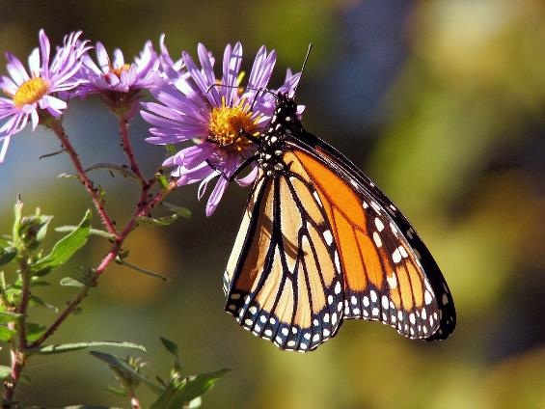
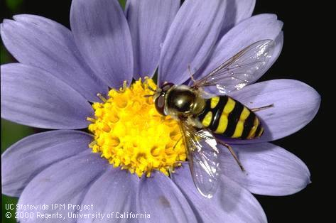
It’s Not Just Bees
Butterflies and moths are eye-catching and they also pollinate flowers
Beetles pollinate Magnolia, sweetshrub and paw paws
Flies pollinate members of the carrot family
Hummingbirds pollinate bright tubular flowers (and they see red!)
Pixabay.com
Syrphid Fly (Hover Fly)
Photo Credit: Jack Kelly Clark, UC IPM
Notes:
Most of us think of bees as our primary pollinators. But there are many other living creatures that pollinate. Flies, beetles, birds, bats. Pollinators add 217 billion dollars to the global economy (Pollinator Partnership). Pollution, chemicals, disease, and climate change are contributing to pollinator decline.

Slide 31
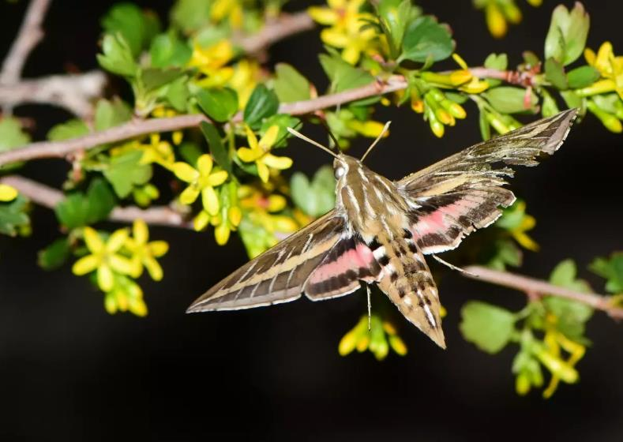
Light Pollution
Some pollinators do their work at night: moths, bats
Artificial light deters these pollinators
Artificial light causes 62% fewer insect visits
Also increases predator vulnerability
A white lined sphinx moth pollinating a shrub with bright yellow flowers. Credit: Tom Koerner/USFWS.
https://www.fws.gov/story/2023-07/dim-lights-pollinators-and-plants-night#:~:text=The%20researchers%20found%20that%20approximately,pollinators%20from%20their%20nightly%20routine.
Notes:
This is not related specifically to climate change but it does affect pollinators. Be mindful and take practical actions. Use outdoor lights only as needed for safety concerns, control via motion detectors or timers. Use warmer colored light bulbs, shield outdoor lights to eliminate light pollution drifting into the sky. Plant a moon garden for nighttime pollinators!

Slide 32
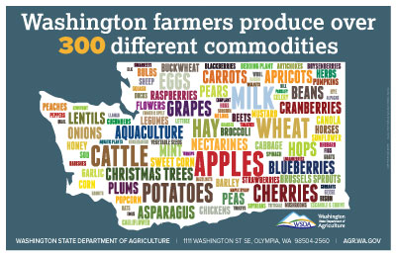
Washington State Major Food Crops
Pollinator Dependent: Apples, Cherries, Grapes, Berries, Onions
Okay, we could still grow potatoes, wheat, and hay…
Beer (hops) is good but…
70% of all other produce needs pollination – the brewery may not care but the community SHOULD*
https://agr.wa.gov/washington-agriculture
Top 10: Apples, Milk, Wheat, Cattle, Potatoes, Hay, Eggs, Hops, Cherries, Grapes
*McFleshman’s Brewing Company
www.mcfleshmans.com (2023)
Notes:
Not all Washington State crops rely on pollinators but our diet would be pretty dreary (and unhealthy) with just wheat, potatoes, beef, hops. The state economy would surely suffer without this rich variety of agriculture.

Slide 33
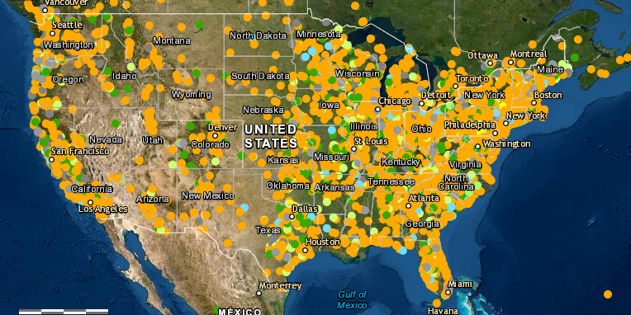
What Can A Homeowner Do?
Avoid pesticides (eliminate the use of neonicotinoids)
Plant more pollinator-friendly flowers
Provide nesting sites
Spread the word
Be on lookout for new invasive species
Current locations pledged to protect pollinators
Xerces Society, www.xerces.org
Notes:
Neonicotinoids kill indiscriminately bees, butterflies, other wildlife. Different pollinators require different flower shapes, colors, and sizes so a diversity of flowers provides habitat for a larger number of pollinators. Don’t forget that pollinators also need to forage. Caterpillars that become butterflies or moths need food sources to feed. Pollinators also need nesting sites preserved. Most don’t need us to build their nesting site – just leave it be! Agricultural pests are already expanding their over-wintering range due to climate change. Be a good citizen scientist: look out for them, capture, and report to your local extension agent.

Slide 34
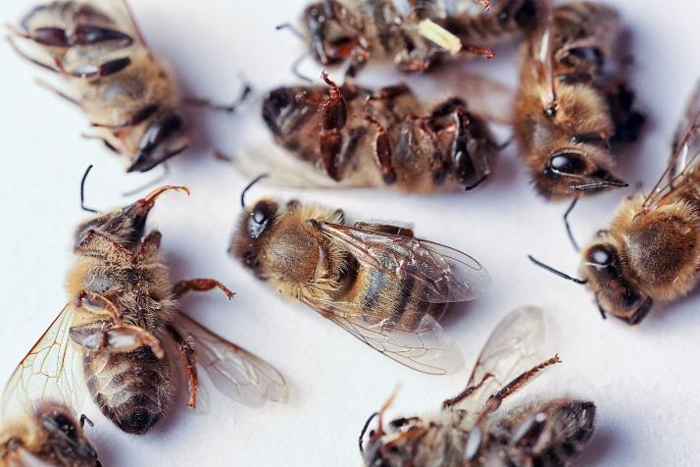
Avoid Pesticides
Insecticides are harmful to pollinators
Herbicides reduce food sources
Fungicides can have synergistic effects on bees
Search for ecological pest management strategies
Always follow label directions, even when using organic products
Pixabay.com
Notes:
Neonicotinoids kill indiscriminately bees, butterflies, other wildlife. Even organic insecticides, like Captain Jack Deadbug, have a period of time, measured in hours, where it is toxic to bees. So time of application is very important.

Slide 35
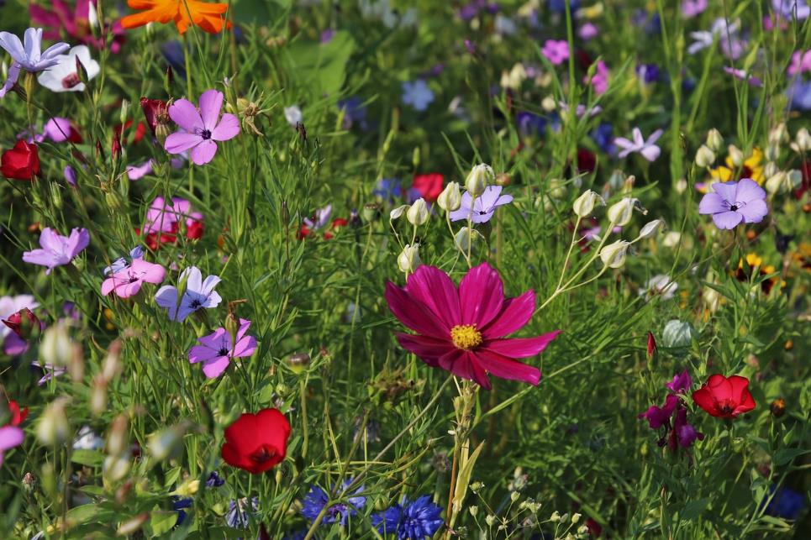
Plant a Pollinator Garden
Flowers provide nectar and pollen (think food) for pollinators
Provide different flower structures that appeal to a wide range of pollinators
Support pollinators spring through fall by providing plants with different bloom times
Pixabay.com
Notes:
Pollinators require food for themselves and their offspring. Nectar and pollen from flowers provides that food resource. In addition to providing a variety of flower structures, a range of bloom time is also helpful since different pollinators are active at different times of the year. Remember that mason bees are only active while fruit trees are blooming. Native plants are always a good idea since they have evolved with the pollinators to bloom when they need them.

Slide 36
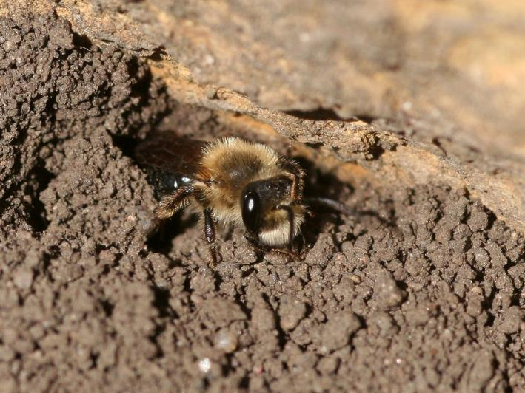
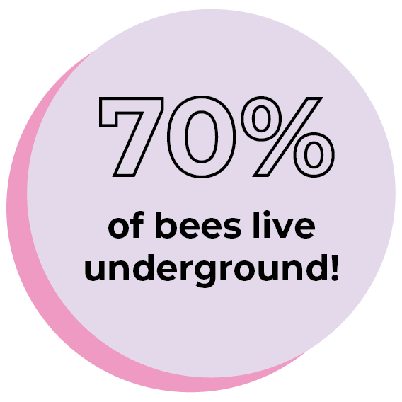
Provide nesting sites
All stages of pollinator life cycle need support, including eggs and larvae
Leave patches of bare ground and brush piles
Leave a little mess in the yard for overwintering ground bees and insects
Plant caterpillar host plants
Photo Credit: Whitney Cranshaw, Colorado State University / Bugwood.org
https://xerces.org/blog/ground-nesting-bees, Feb 2024
The Bee Conservancy: thebeeconservancy.org
Notes:
Ground nesting bees need some bare ground and protection with leaf litter for overwintering. Beetles often overwinter in small piles of yard debris (i.e., dead flower stalks and small twigs). Don’t be such a neat freak! This doesn’t mean you can’t clean up your front yard but leave a little mess somewhere in the side or backyard or areas not so visible to the street or arriving guests. Also remember that mason bees need mud to build their egg nests.

Slide 37
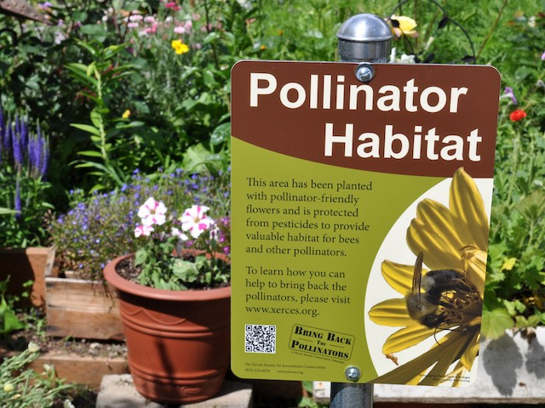
Spread the Word
Share information via social media
Invite your neighbors to “do the right thing”
Get a pollinator habitat sign from Xerces Society and post it proudly
https://xerces.org/protecting-pollinators
Notes:
When showing your garden to friends and neighbors, point out your pollinator friendly practices. Encourage others to take a few steps in the same direction. Be proud of what you do and toot your own horn.

Slide 38
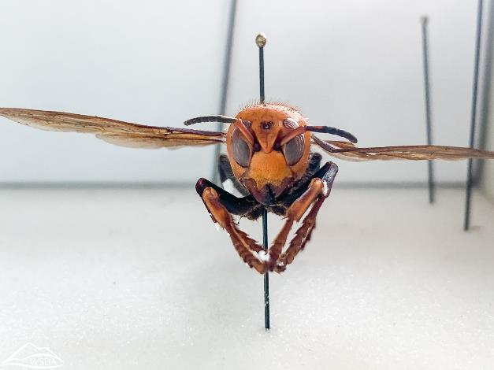
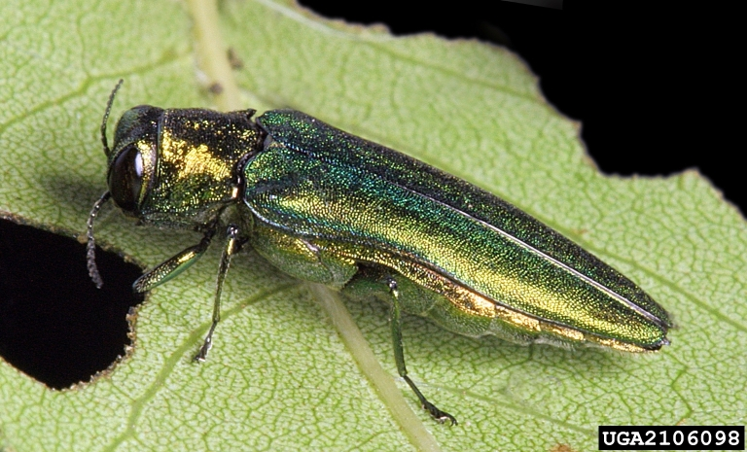
Invasive Species
Become informed about emerging invasives
Be on the lookout and capture if possible
Report to your local Extension Agent
Here are just two examples:
Northern Giant Hornet
Source and Photos: https://invasivespecies.wa.gov/find-a-priority-species/
Emerald Ash Borer
Notes:
Invasive species are not only detrimental to the agriculture industry, but can also be detrimental to pollinators. When climate change creates an environment that allows in more pest species (longer growing season, warmer winters) then they may compete with bees, or become pests of bees (like the Northern giant hornet, aka 'Murder hornets') If homeowners look for, and report invasive species before they get established, we might limit their impact, and reduce the amount of pesticides used in agriculture to combat them if they do get established.

Slide 39
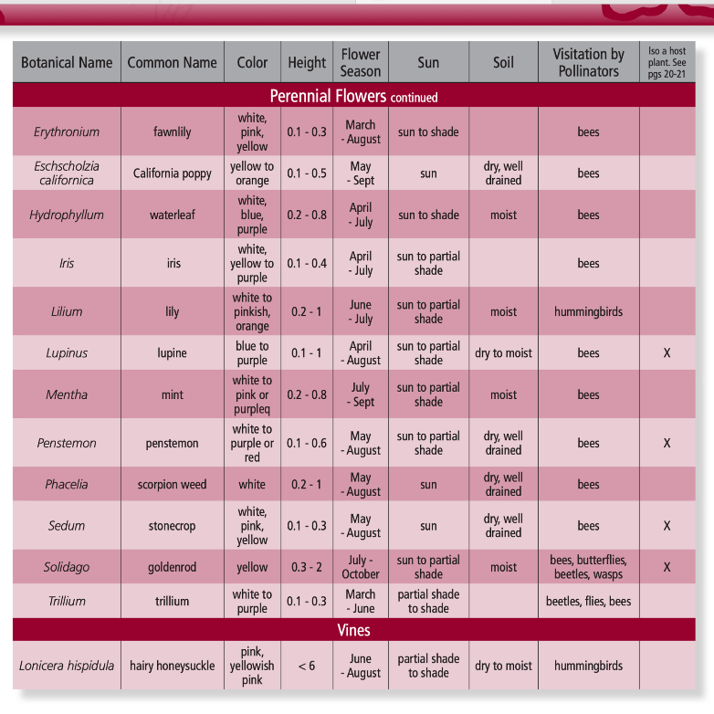
Planning a Pollinator Garden
Starting from scratch or adding to existing bed?
Sun? Shade?
Even natives need a little water to get started!
A sketch can be useful.
A list of possible plants is crucial before going to the nursery.
https://www.pollinator.org/pollinator.org/assets/generalFiles/PacificLowlandrx8_171017_090207.pdf
Notes:
Whether you are starting with a brand new landscape or redoing part of an existing landscape or just adding plants to your garden, think about pollinator friendly plants. Also remember the “right plant, right place” adage and consider light requirements, soil drainage, wind, extreme sun exposure when selecting pollinator plants. A drawing and observations of the planting area throughout the day are helpful.

Slide 40
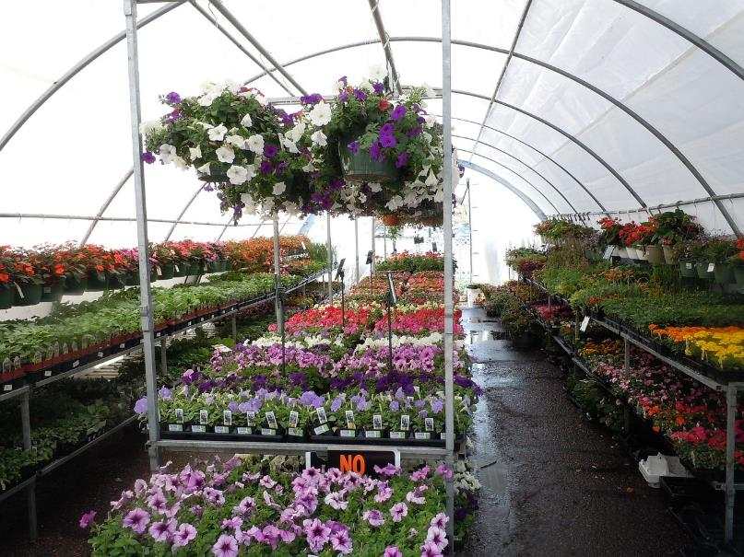
Shop for Plants
Keep in mind…
Sun exposure
Pollinator-friendly plants
Natives
Water and soil preference
Bloom time
From Borage to Zinnia, there are dozens of options
Visit www.xerces.org/publications/plant-lists for options in your growing environment
Pixabay.com
Notes:
Once you have an idea of the number of plants you need, your growing environment (sun/shade, moisture, etc) and a list of options, it is time to spend a little time shopping in nurseries. If you have multiple options, it is a good idea to visit several nurseries. Look for specialty nurseries that may focus on natives or drought tolerance. In the Pacific NW, we are blessed with many options. It is probably a good idea to have a budget in mind so you know whether to reach for the 4” pot or the 2 gallon pot. Remember, you can stagger your planting over a few years.

Slide 41
Planting for Honey Bees
Go native
Plant in clusters and clumps
Use blues, purples, whites
Umbra shaped and daisy shaped flowers for landing
Plant to attract and support the bees throughout the whole season
- Spring: Oregon grape, elderberry, snowberry, yarrow
- Summer: California poppies, iris, lupine, oregano
- Fall: Goldenrod, Joe Pye weed, purple asters, pineapple
sage, black-eyed Susan
- Winter: Hellebores, crocus, loquat
Notes:
You don’t have to manage bee boxes to keep honey bees around your yard. Choose the types of flowers they like year-round to both attract and support them. They need all the help we can give them.

Slide 42
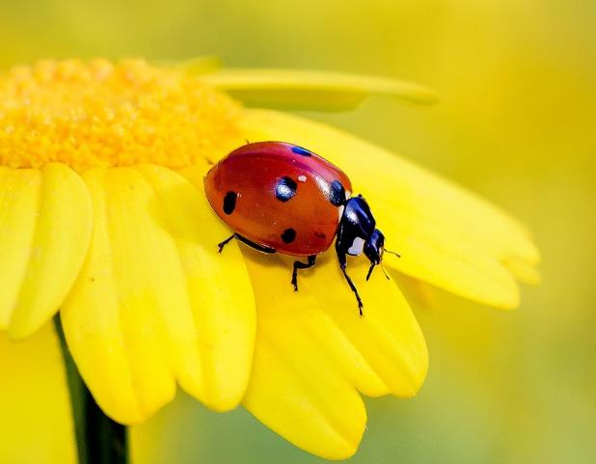
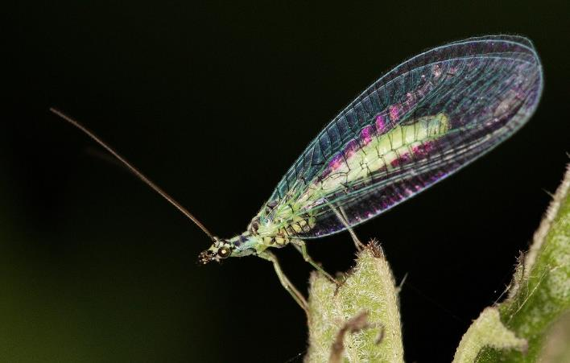
Beneficials
All these tactics will also aid beneficial insects
Lady beetles, lacewings, parasitic wasps, etc. control many pest insects naturally
Pollinate your food and take care of aphids with four easy steps!
Pixabay.com
Notes:
Beneficial insects are most useful for controlling pest insects. They are not primarily pollinators. However, controlling your pests (think small like aphids) naturally helps you reduce or eliminate pesticides, which greatly benefits our pollinators.

Slide 43

Five Easy Steps
Reduce use of pesticides (less work for you)
Plant pollinator-friendly flowers (enjoy the beauty)
Provide nesting sites (let some leaves stay on the ground – less work for you)
Toot your own horn (we all love to brag)
Watch for those invasives
Pixabay.com
Notes:
Any new endeavor is easier to achieve when you start small. So start with these. Once you feel like these are accomplished, do some research and broaden your pollinator friendly efforts. Keep adding flowers that pollinators like and watch them flock to your garden. Get into your stress-free zen.

Slide 44


Questions?
Clark County: mganswerclinic@clark.wa.gov
WSU Extension Master Gardener Volunteer
Contact info
http://mastergardener.wsu.edu/
https://www.facebook.com/WSUMGProgram
WSU Extension programs and employment are available to all without discrimination. Evidence of noncompliance may be reported through your local Extension office.
CC-002

Slide 45
Resources:
US Forest Service: https://www.fs.usda.gov/wildflowers/pollinators/Plant_Strategies/visualcues.shtml, 2024
Book: Botany in a Day, by Thomas J. Elpel,
Published in 2018 by HOPS Press LLC. ISBN: 978-1-892784-35-3
Xerces Society for Invertebrate Conservation: www.xerces.org, 2024
Book: RHS Botany for Gardeners,
Published in 2013 by Quid Publishing. ISBN: 978-1-845338336
Pollinator Partnership: www.pollinator.org, 2024
Pollinator Partnership: Selecting Plants for Pollinators
https://www.nwcb.wa.gov/pdfs/PacificLowlandrx8.pdf, 2024
Book: Encyclopedia of Northwest Native Plants, by Kathleen A. Robson, Alice Richter, and Marianne Filbert,
Published in 2008 by Timber Press. ISBN-13: 978-0-88192-863-1
U.S. Fish and Wildlife Service: How You Can Help Pollinators
https://www.fws.gov/initiative/pollinators/how-you-can-help, 2024
Pollinator Friendly Alliance: www.pollinatorfriendly.org
Note: All Photos/Images/Graphics with label beginning ‘Credit WSU’ are copyrighted by the University and permission has been granted for this use.

