Slide 1
Life Cycle Assessment for Soil-Biodegradable Plastic Mulch
Ting Chi, Liang Yu, and Oluwatunmise Dada
Notes:
Opening/title slide. Text boxes can be moved, but logos in bottom should not move.

Slide 2
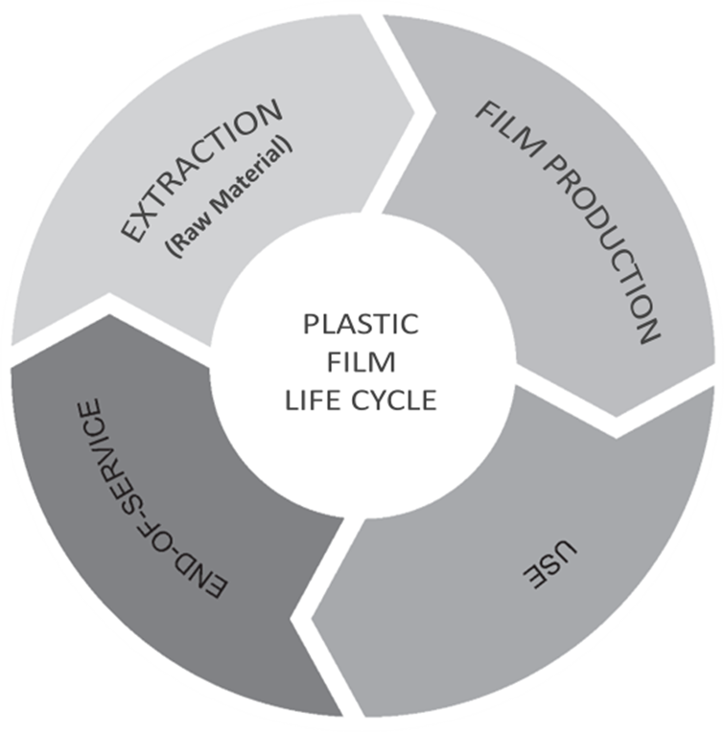
Life Cycle Assessment
The term ‘life cycle assessment (LCA),’ also called ‘life cycle analysis,’ is a structured, systematic, comprehensive, and iterative method of evaluating the environmental impact associated with the life cycle stages of a product system, from raw material acquisition/extraction to use/application and eventual disposal/end-of-life.
Notes:
The term 'life cycle assessment (LCA),' also known as 'life cycle analysis,' refers to a structured, systematic, comprehensive, and iterative method used to evaluate the environmental impact associated with the stages of a product system's life cycle. The life cycle stages of mulch films include raw material extraction or production, film production, field application, and removal, disposal, or recycling.
LCA is structured, involving well-defined stages such as goal and scope definition, life cycle inventory (LCI), life cycle impact assessment (LCIA), and results/interpretation. It is systematic because these stages follow a defined order, comprehensive as it covers the entire life cycle of a product, and iterative because any identified limitations or data availability issues often require revisions or refinements to the initial goals or scope.

Slide 3
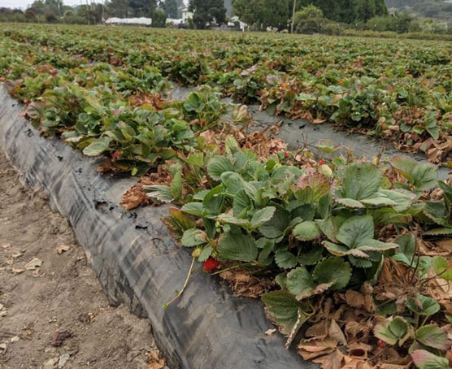
LCA for Soil-Biodegradable Plastic Mulch
Soil-biodegradable mulch (BDM) is an alternative to polyethylene (PE) mulch
Comparative cradle-to-grave environmental impacts:
Raw material production/extraction
Mulch manufacturing
Use
End-of-life strategies
Strawberries grown in California with BDM
Notes:
The rise in the use of PE mulch raises environmental concerns, necessitating sustainable alternatives. While the widespread adoption of soil-biodegradable mulch (BDM) has not been achieved, LCA reveals that BDM, especially starch-derived BDM, displays significant environmental advantages throughout its entire life cycle and is recommended as an alternative to PE mulch.
A comparative LCA involves a rigorous comparison between the environmental burdens associated with two products. Here, a comparison between BDM and traditional PE films was conducted using a comparative LCA from raw material production/extraction to mulch production, use, and end-of-life. The raw material stage involves the production and extraction of mulch film feedstocks, e.g., corn, starch, succinic acid, terephthalic acid, and other raw materials such as bauxite, barite, phosphoric acid, etc. The mulch manufacturing stage involves raw material processing into mulch film, which can include fermentation, polymerization, film extrusion, injection molding, etc. The use stage is when the mulch films are laid on crop fields. The end-of-life stage involves the fate of mulch waste after crop harvest. This can include the direct tillage of BDM into the soil or the collection of PE mulch for landfilling, incineration, and/or recycling.

Slide 4
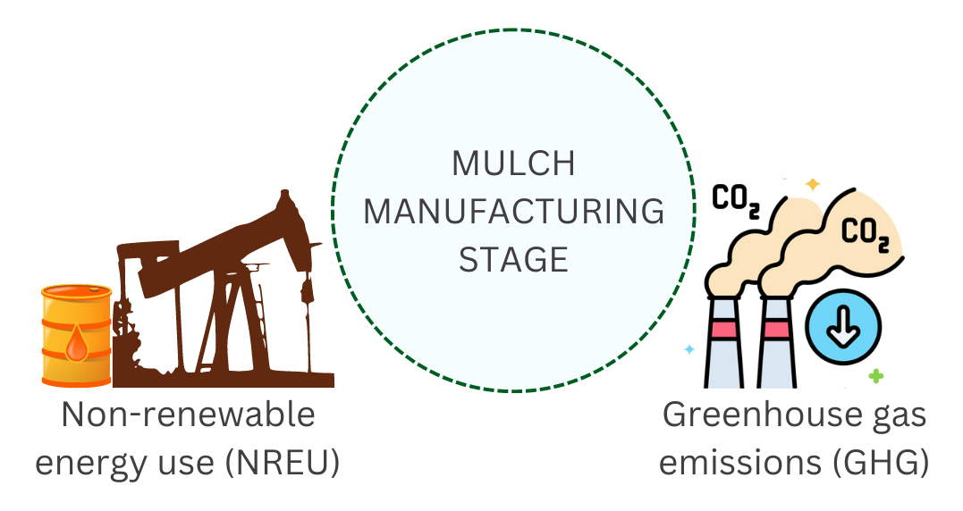
Environmental Impacts of Mulch Manufacturing
Mulch manufacturing has significant greenhouse gas emissions and energy use
BDM manufacturing uses less energy with fewer greenhouse gas emissions than PE mulch
Notes:
Notably, the material manufacturing stage of mulch film production represents a dominant portion of the overall environmental impact. BDM manufacturing displayed promising environmental benefits specifically in greenhouse gas emissions and non-renewable energy consumption compared to petrochemical-based counterparts, but notable negative impacts of eutrophication and land occupation are the major concerns, in addition to acidification and ecotoxicity.

Slide 5
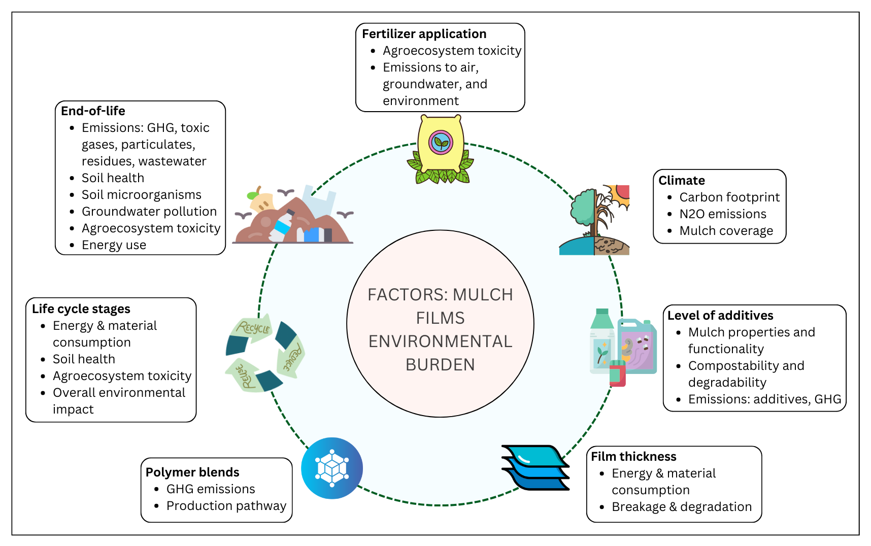
Environmental Impact of BDM Use
Environmental impacts of BDM vary based on:
Life cycle stage
End-of-life choices
Fertilizer application
Polymer blends
Additive content
Film thickness
Climate
Fertilizer application
Agroecosystem toxicity
Emissions to air, groundwater, and environment
End-of-life
Emissions: GHG, toxic gases, particulates, residues, wastewater
Soil health
Soil microorganisms
Groundwater pollution
Agroecosystem toxicity
Energy use
Climate
Carbon footprint
N₂O emissions
Mulch coverage
Life cycle stages
Energy & material consumption
Soil health
Agroecosystem toxicity
Overall environmental impact
Level of additives
Mulch properties and functionality
Compostability and degradability
Emissions: additives, GHG
Polymer blends
GHG emissions
Production pathway
Film thickness
Energy & material consumption
Breakage & degradation
Notes:
Environmental impact varies depending on factors such as life cycle stage, end-of-life strategy, fertilizer application, polymer blends, additive content, film thickness, and climate.
Life cycle stage: Specific life cycle stages disproportionately contribute to the environmental impact of both BDM and PE mulch. The manufacturing stage stands out as a dominant contributor to energy and material consumption. Yield is often comparable for both BDM and PE mulch use stages. Additionally, plastic residues left after harvest pose critical toxicity risks to soil health, plants, humans, and other organisms that ingest them.
End-of-life (EOL) strategy: Common EOL strategies for PE mulch include landfilling, recycling, incineration, on-site stockpiling, and burning. BDM is usually tilled into the soil or composted, although composting is more expensive. Priority should be given to material, heat, and energy recovery while minimizing waste streams such as toxic wastewater and particulate matter.
Direct incineration of mulch wastes with impurities results in the generation of greenhouse gases (GHGs) such as CO₂, SO₂, and NO₂. Mulch waste burning with impurities releases pollutants like dioxins, particulate matter, CO, polycyclic aromatic hydrocarbons (PAH), and furans. Leaching of toxic substances into the soil from landfills causes land and groundwater pollution. Microplastics formed by the breakage of stockpiled mulch waste deteriorate soil health and reduce the functional diversity of soil microorganisms. Washout of adsorbed agrochemicals from plastic wastes, triggered by irrigation or rainfall, into soil and groundwater causes environmental toxicity and eutrophication. Runoff of toxic wastewater into water bodies from mulch washing during recycling causes agroecosystem toxicity.
Fertilizer application: Fertilizer production and excessive applications contribute to eutrophication, acidification, and GHG emissions. Growers should optimize fertilizer applications to only apply what is needed and assimilated by the crop.
Polymer type: The composition of plastic polymers in polymer blends significantly affects environmental burdens by influencing the overall production pathway. Consequently, the manufacturing environmental impacts vary significantly from one grade of starch BDM to another. Increasing starch content and reducing polybutylene adipate terephthalate (PBAT) and polybutylene succinate (PBS) contents in co-polymer blends is encouraged for environmental sustainability.
Level of additives: Mulch additives play a crucial role in enhancing film properties and overall functionality. Minimizing additive use in BDM production is recommended, as additives may reduce compostability and degradability.
Mulch thickness: The manufacturing of thicker films require higher energy and raw material consumption. Also, thicker films are less prone to breakage with reduced plastic fragmentations, and have higher strength, making them suitable for recycling.
Climate: In semiarid regions experiencing heavy rainfall, it is advised to avoid mulching practices due to the significant increase in net global warming potential (GWP) and carbon footprint compared to scenarios with no mulch. Conversely, climates with drier seasons during key times of crop production and/or cooler soil temperature conditions are more likely to benefit from the effects of mulches on soil microclimates.

Slide 6
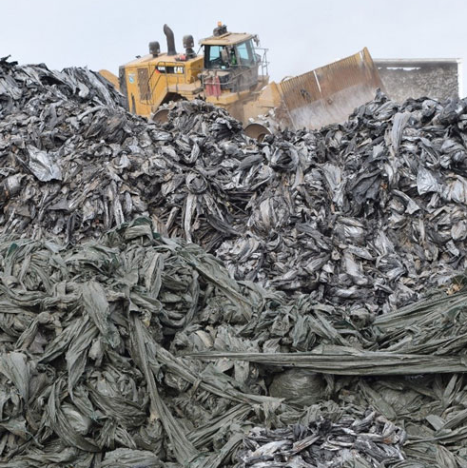
End of Life Strategies
Mitigate mulch post-use environmental impact:
Reduce soil-biodegradation period of BDM
Energy and material recovery in PE mulch
Recycling, the preferable option for PE mulch
Mechanical
Chemical
Address toxicity concerns
Mulch residue reduction
Optimized use of pesticides
Wastewater emissions reduction
PE mulch in California end-of-life
Notes:
The post-use environmental impact can nullify the benefits of other life cycle stages, as observed in PE mulch films, which pose additional environmental and economic burdens due to removal, disposal, and end-of-life. Therefore, it is essential to adopt suitable EOL strategies that minimize environmental impact.
For BDM, complete degradation within a short time is necessary to reduce mulch residue in the soil. EOL strategies that recover energy and/or material, such as recycling and incineration, should be practiced, with recycling being a preferable option for PE mulch. Ultimately, reducing plastic residue in the soil is crucial for maintaining soil health. Growers should optimize the use of agrochemicals to minimize post-harvest chemical migration into the soil and water bodies. Additionally, efforts to reduce wastewater emissions from mulch waste washing should be prioritized.

Slide 7
Resources
ISO. ISO 14044:2006 Environmental Management — Life Cycle Assessment — Requirements and Guidelines 2006. https://www.iso.org/standard/38498.html
Life Cycle Assessment of Bio‐Based Plastics: Concepts, Findings, and Pitfalls. https://onlinelibrary.wiley.com/doi/10.1002/9783527827589.ch13
Life Cycle and Environmental Cycle Assessment of Biodegradable Plastics for Agriculture. http://link.springer.com/10.1007/978-3-662-54130-2_7
Recycling, Disposal, or Biodegradable-Alternative of Polyethylene Plastic Film for Agricultural Mulching? A Life Cycle Analysis of Their Environmental Impacts. https://linkinghub.elsevier.com/retrieve/pii/S0959652622045231
A Critical Review of Biodegradable Plastic Mulch Films in Agriculture: Definitions, Scientific Background, and Potential Impacts. https://www.sciencedirect.com/science/article/pii/S0165993623004788
Barriers and Bridges to the Adoption of Biodegradable Plastic Mulches for US Specialty Crop Production. https://www.cambridge.org/core/journals/renewable-agriculture-and-food-systems/article/barriers-and-bridges-to-the-adoption-of-biodegradable-plastic-mulches-for-us-specialty-crop-production/EE78FE877DFD201AADF92734231BED69.
Risk and Uncertainty of Plastic Mulch Adoption in Raspberry Production. https://www.cambridge.org/core/journals/renewable-agriculture-and-food-systems/article/risk-and-uncertainty-of-plastic-mulch-adoption-in-raspberry-production-systems/2C3B6AA1E4842AE9A903AAFDC902D65C.

Slide 8

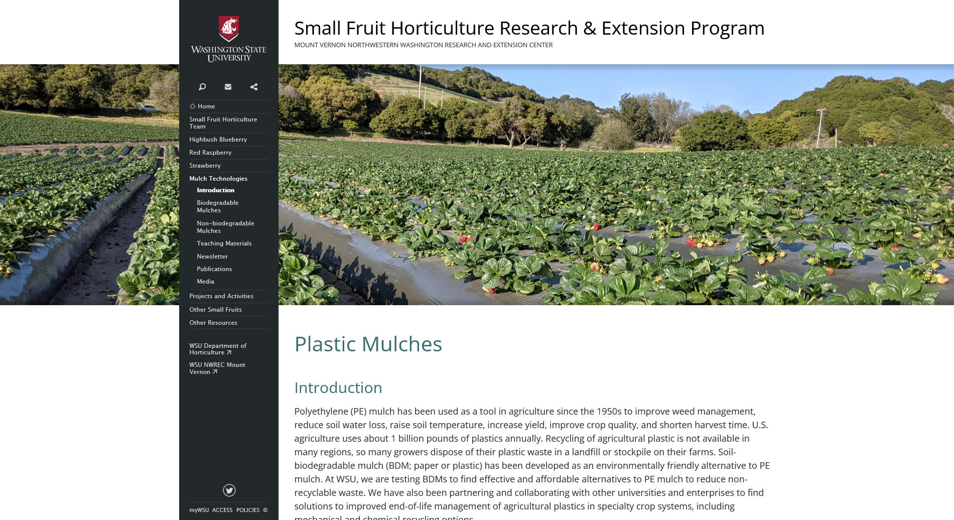
Acknowledgements + Website
This work is supported by Specialty Crops Research Initiative Award 2022-51181-38325 from the USDA National Institute of Food and Agriculture. Any opinions, findings, conclusions, or recommendations expressed in this publication are those of the author(s) and do not necessarily reflect the view of the U.S. Department of Agriculture.
https://smallfruits.wsu.edu/plastic-mulches/
Notes:
This slide is to acknowledge our funders, USDA. This slide may grow over time to include other acknowledgements. Our project website is also included.

Slide 9
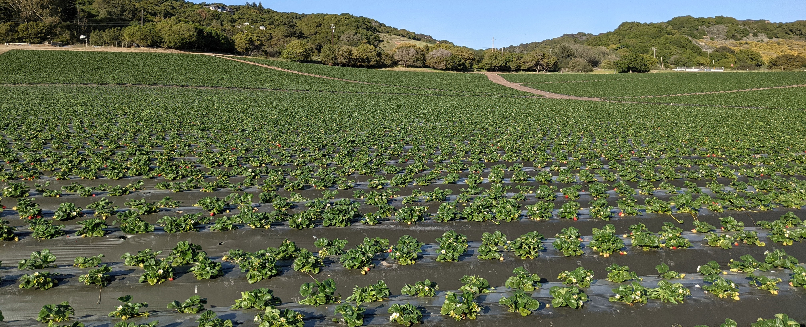
Questions?
Dr. Ting Chi
tchi@wsu.edu
509-335-8536
Notes:
This slide marks the end of the presentation and the transition point for questions and discussion with the audience.

