Slide 1
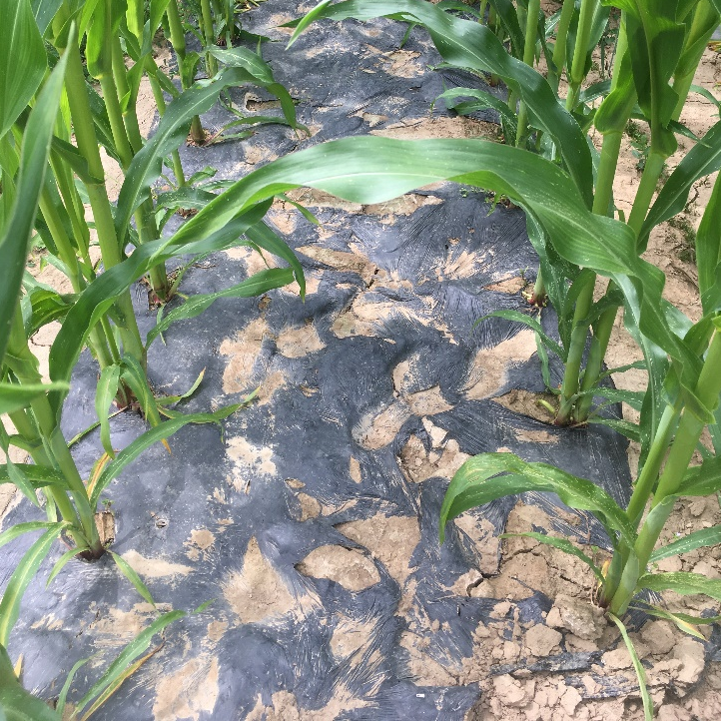
Deterioration, Degradation and Tillage of Soil-Biodegradable Mulch
Lisa DeVetter, Hang Liu and Carol Miles, Washington State University
Shuresh Ghimire, University of Connecticut
Notes:
This presentation provides information on the surface deterioration and degradation of BDMs in the field, the impact of environmental conditions, and disposal options.

Slide 2
Deterioration vs Degradation
Deterioration – loss of physical or mechanical strength, observed through physical testing, microscopic imaging, or macroscopic observation (e.g., rips, tears, and holes)
Degradation – measurable conversion or mineralization of C to CO₂ resulting in a change in the chemical structure, physical properties or appearance
ASTM defines biodegradable plastics as plastics that degrade as a result from the action of naturally occurring microorganisms such as bacteria, fungi and algae
PE is not biodegradable – polymers have chemical bonds that microbes do not have the metabolic pathways to break apart
Biodegradable plastics use natural or synthetic polymers that have similar bonds that can be broken apart by microbes
Notes:
Deterioration is loss of physical or mechanical strength, observed through physical testing, microscopic imaging, or macroscopic observation (e.g. rips, tears, and holes). Degradation is the conversion or mineralization of carbon (C) to carbon dioxide (CO₂) resulting in changes in the chemical structure, physical properties or appearance. ASTM defines biodegradable plastics as plastics that degrade from the action of naturally resulting organisms such as bacteria, fungi and algae. Polyethylene mulch (PE) is not biodegradable as polymers have chemical bonds that microbes do not have the metabolic pathways to break apart. Biodegradable plastics use natural or synthetic polymers that have similar bonds, but can be broken apart by microbes.

Slide 3
Biodegradation of BDM
Biodegradation of BDM is affected by both material properties and the degradation environment
Material properties: physical/chemical attributes and degradation mechanism
Moisture absorbency
Glass transition temperature
Cross-linking due to environmental weathering
Degradation environment
Temperature
Moisture
Microorganisms present
Notes:
The degradation of BDMs are largely affected by both mulch material properties and the degradation environment. The physical and chemical properties of mulch material and its degradation mechanism are important considerations for soil degradation. For example, materials that absorb moisture and have a glass transition temperature (Tg) at or lower than ambient temperature can degrade faster. Glass transition temperature is the point when materials transition from a glassy state (rigid) to a rubbery state (flexible). Above the glass transition temperature, materials are more flexible for moisture and microorganisms to access. Soil conditions, including soil temperature, moisture, and microorganisms present in soil, are environmental factors that influence the degradation rate.

Slide 4
Biopolymers for BDM
Polylactic acid (PLA)
Produced from lactic acid fermented from renewable resources, such as corn, by microoganisms
Glass transition temperature is ~60 °C (~140 °F); Degrades slowly under ambient conditions
Compost temperature: ~60 °C (~140 °F)
Polyhydroxyalkanoates (PHA)
A natural polyester fermented from renewable resources, such as sugar, by microorganisms
Glass transition temperature is ~5 °C (~41 °F); Degrades under ambient conditions.
Notes:
Polylactic acid (PLA) and polyhydroxyalkanoate (PHA) are the two most commonly used biopolymers to produce BDM. PLA is a synthetic polymer produced from lactic acid that is fermented by microorganisms and made from biobased materials, such as corn and sugar beet pulp. PLA has a relatively high glass transition temperature of approximately 60°C (140°F). The high glass transition temperature of PLA along with its hydrophobic nature account for its slow degradation rate under ambient conditions. Industrial compost temperature is set at around 60°C (140°F) for expedited degradation. PHA is extracted and purified from a natural polymer fermented by microorganisms from renewable resources, such as sugar and vegetable oil. The glass transition temperature of PHA is approximately 5°C (41 °F) and PHA readily degrades in ambient conditions. The cost of PHA is, however, higher than PLA.

Slide 5
Monitoring BDM Properties
Measuring BDM properties (physical and chemical) is useful to monitor deterioration and degradation throughout its life cycle:
Storage to ensure structural integrity
In the field to assess functionality
After use to assess degradation in soil or composting
Physicochemical analyses to evaluate degradation and deterioration
Physical/Mechanical: Tensile strength, elongation at break, weight loss, thickness
Chemical: Fourier transform infrared (FTIR) spectrometry, molecular weight analysis, thermal properties, nuclear magnetic resonance (NMR), ash content (elemental or thermogravimetric analysis), gel content, radiocarbon analysis
Notes:
Monitor the deterioration and degradation throughout the life cycle of the material by measuring BDM properties (physical and chemical). Monitoring is done in storage to ensure structural integrity, in the field to assess functionality, and after use to assess the degradation in soil or composting. Physicochemical analyses can be physical/mechanical (tensile strength, elongation at break, weight loss, thickness) or chemical. Chemical analysis methods include Fourier transform infrared (FTIR) spectrometry, molecular weight analysis, thermal properties, nuclear magnetic resonance (NMR), ash content (determined by elemental or thermogravimetric analysis), and radiocarbon analysis.

Slide 6
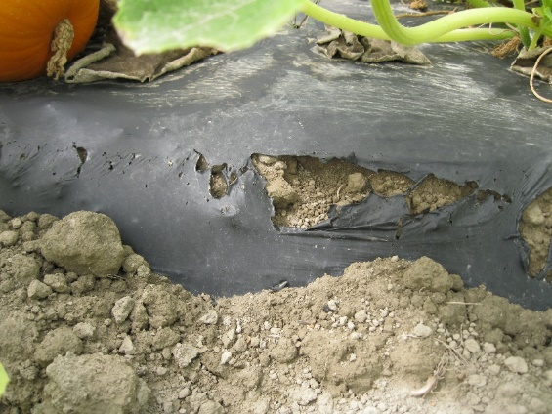
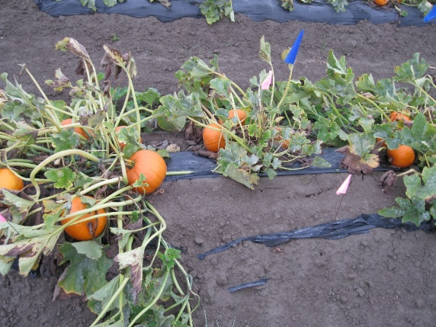
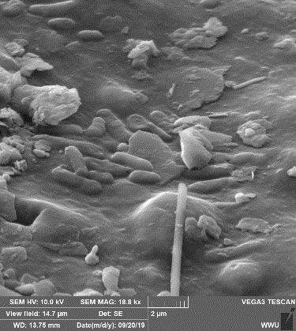
Visual Deterioration Assessment
Visual assessment of deterioration:
Decrease of area - percent soil exposure (PSE)
Photography
Colorimetry
Macroscopic observation
Scanning electron and laser confocal microscopies
BDM – percent soil exposure due to rips, tears, holes
SEM
Notes:
Visual assessment of deterioration is measured as a decrease in mulch area—percent soil exposure (PSE), photography, colorimetry, macroscopic and microscopic examination, including scanning electron and laser confocal microscopy (Fig. 1).

Slide 7
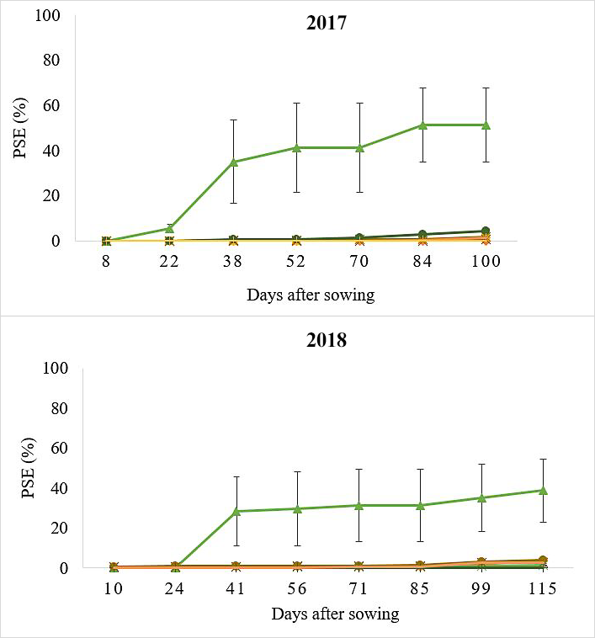

Percent Soil Exposure (PSE)
Bio360 – 18.0 μm
Clear Organix AG – 12.7 μm (2017), 17.8 μm (2018)
Exp. PLA/PHA – 25.0 μm
Naturecycle – 25.4 μm
Organix AG – 17.8 μm
Polyethylene – 25.4 μm
WeedGuardPlus – 240.0 μm
Ghimire et al., 2020a
PSE during sweet corn growing season in Mount Vernon, WA; 0 = completely intact, 100 = fully deteriorated, ratings in 1% increments up to 20%, and 5% increments thereafter; error bar is ± one standard error of the mean.
Notes:
The graph (Fig. 2) shows the PSE during the sweet corn growing season of about 16 weeks in Mount Vernon, WA in 2017 and 2018. Zero PSE denotes completely intact mulch while 100% PSE denotes completely deteriorated mulch. Ratings were in 1% increments up to 20% PSE, and in 5% increments thereafter. PSE was highest for Clear Organix AG mulch and reached 51% and 39% by the end of the season in 2017 and 2018. Other black plastic BDMs and PE mulch had minimal (<5%) deterioration throughout the growing season in both years.

Slide 8
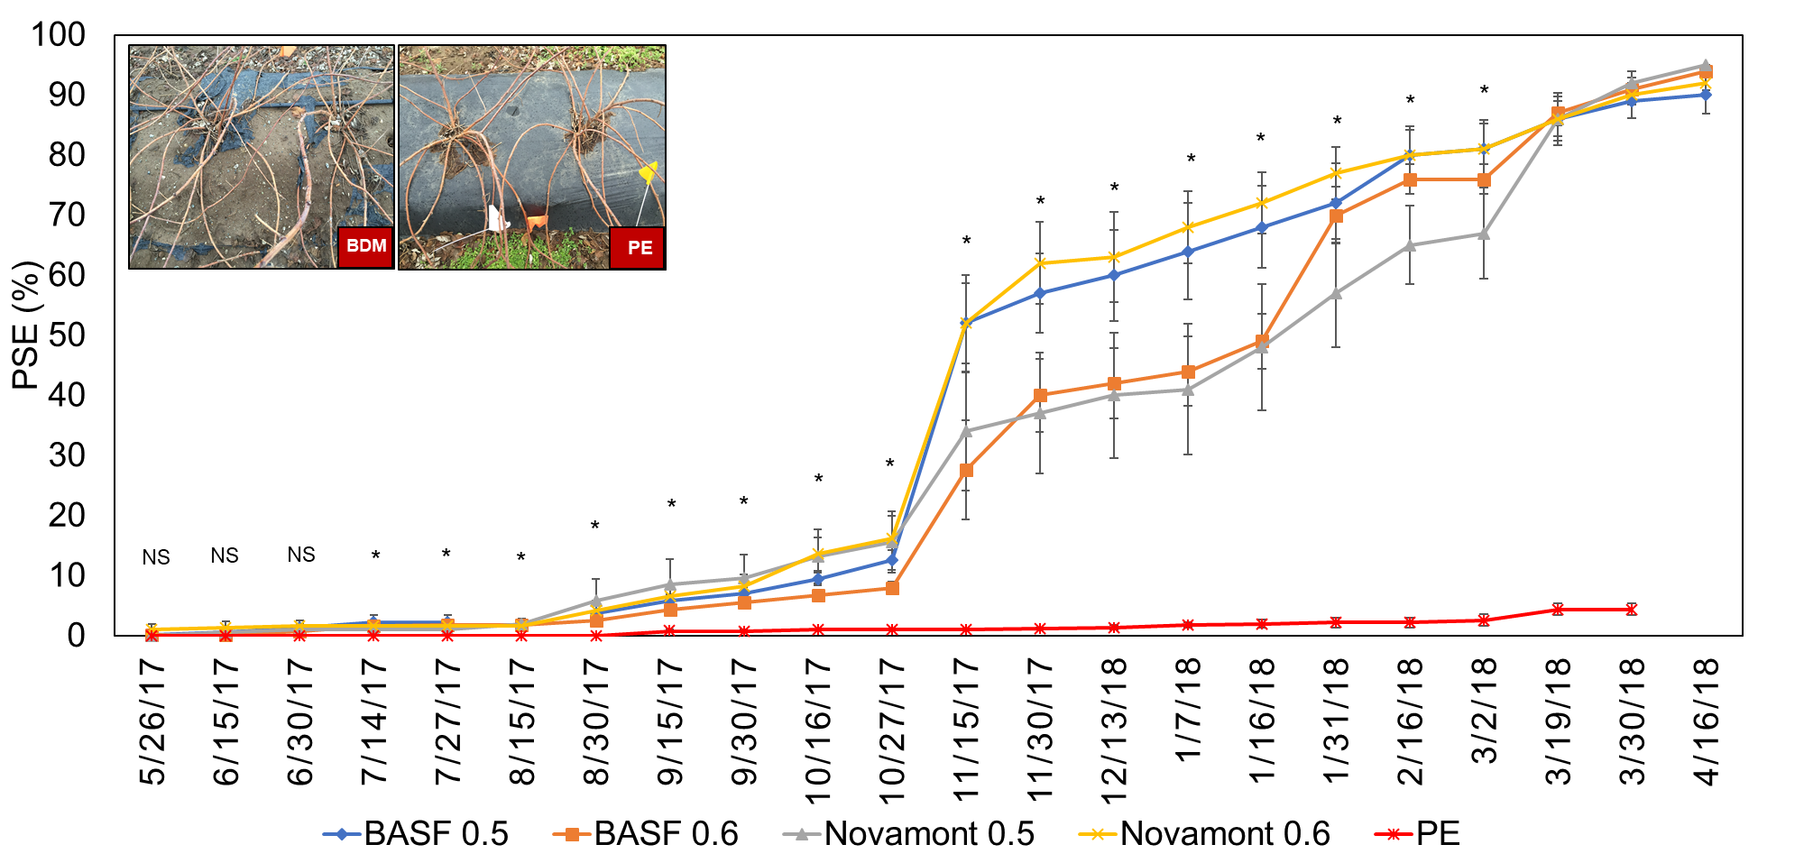
Percent Soil Exposure (PSE) in Raspberry
PSE of mulch (0.5 = 12.7 μm thickness, 0.6 = 15.2 μm thickness) in raspberry production in Lynden, WA; 0% = completely intact, 100% = fully deteriorated, ratings in 1% increments up to 20%, and 5% increments thereafter; error bar is ± one standard error of the mean.
Notes:
This graph (Fig. 3) represents the PSE for a period of 1 year during raspberry production in Lynden, WA. All the black plastic BDMs reached about 90% PSE in one year while PE mulch remained almost completely intact. At 16 weeks after mulch application, all the BDMs had less than 10% PSE which is similar to the sweet corn experiment (<5%). The black BDMs used in sweet corn production were thicker than the BDMs used in raspberry production.

Slide 9
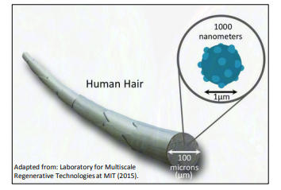
Degradation Process
Film
Fragment
Micro-particle
(1–5000 μm)
Nano-particle
(1–1000 nm)
CO₂ + Biomass
Biodegradable microplastics will form, question is residence time.
Notes:
The degradation process takes place sequentially from film to fragment to micro-particles to nano-particles to the final stage of CO2 + biomass in the soil. A human hair demonstrates the relative size of microns and nanometers. On average, thickness of PE mulch and BDMs range between 12 to 37 microns which is approximately equal to 0.5 to 1 mil.

Slide 10
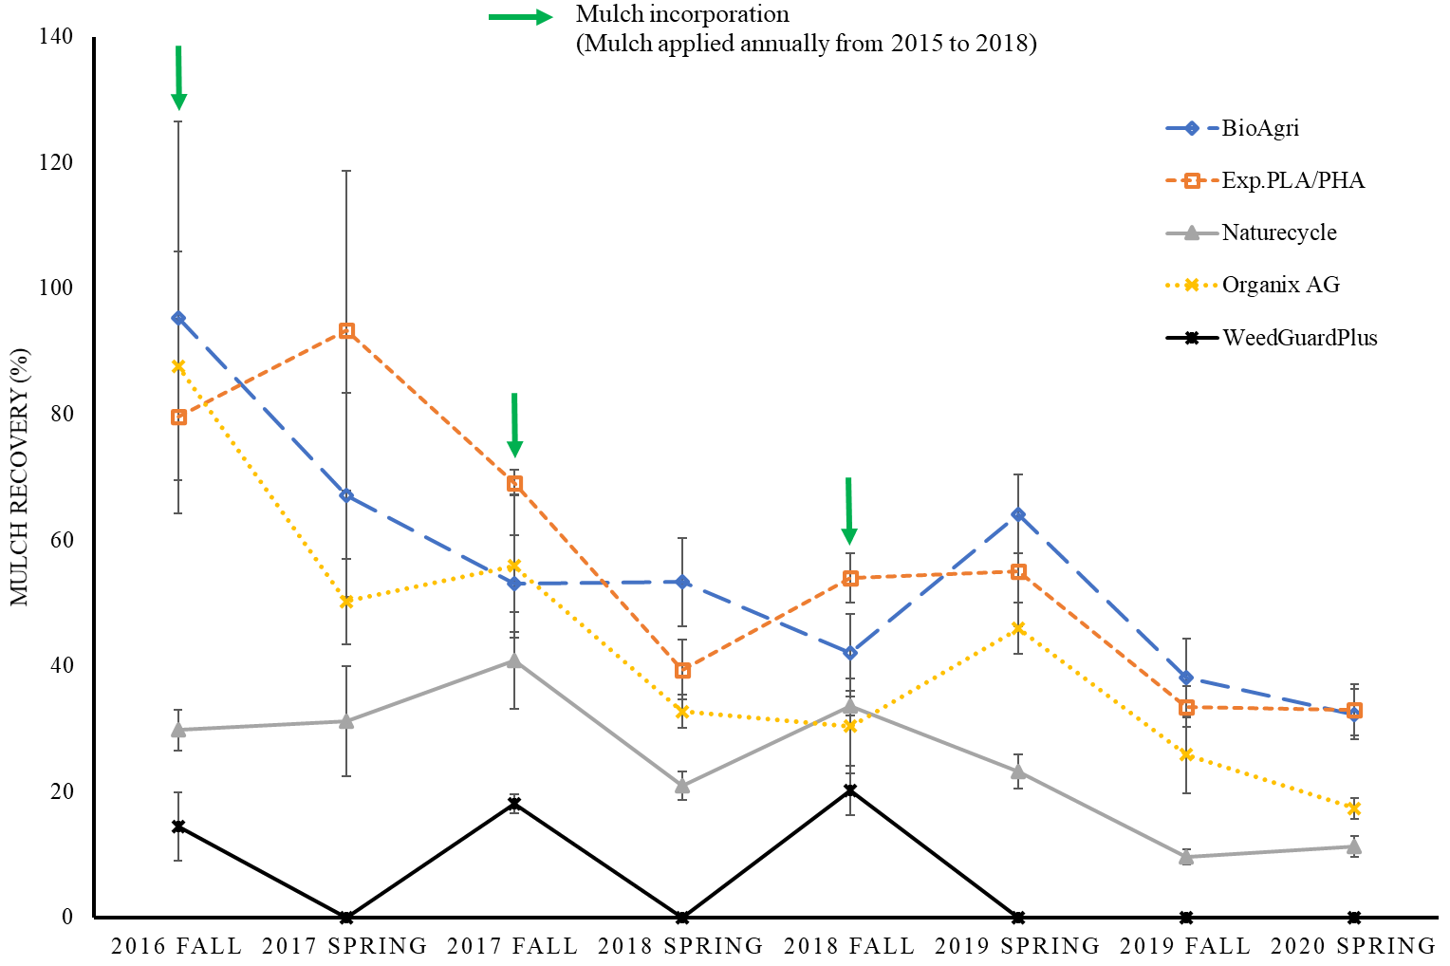
Mulch recovery after incorporation
Percent recovery of BDM fragments in Mount Vernon, WA using the soil quartering method; mulch was applied once a year for 4 years (2015-2018), plots were rototilled in spring after collecting samples and in fall before collecting samples; error bar is ± one standard error of the mean.
Notes:
The graph shows the percent mulch recovery in Mount Vernon, WA using the soil quartering method after incorporation in the field. Mulch was applied once a year for 4 years (2015 - 2018). Plots were rototilled in spring after collecting samples and in fall before collecting samples. Paper BDM (WeedGuardPlus) shows complete biodegradation each year while other plastic BDMs have different rates of biodegradation. One year after the last soil-incorporation of BDM, recovery ranges from 10% to 30%, indicating that all of these BDMs are degrading at this field site.

Slide 11
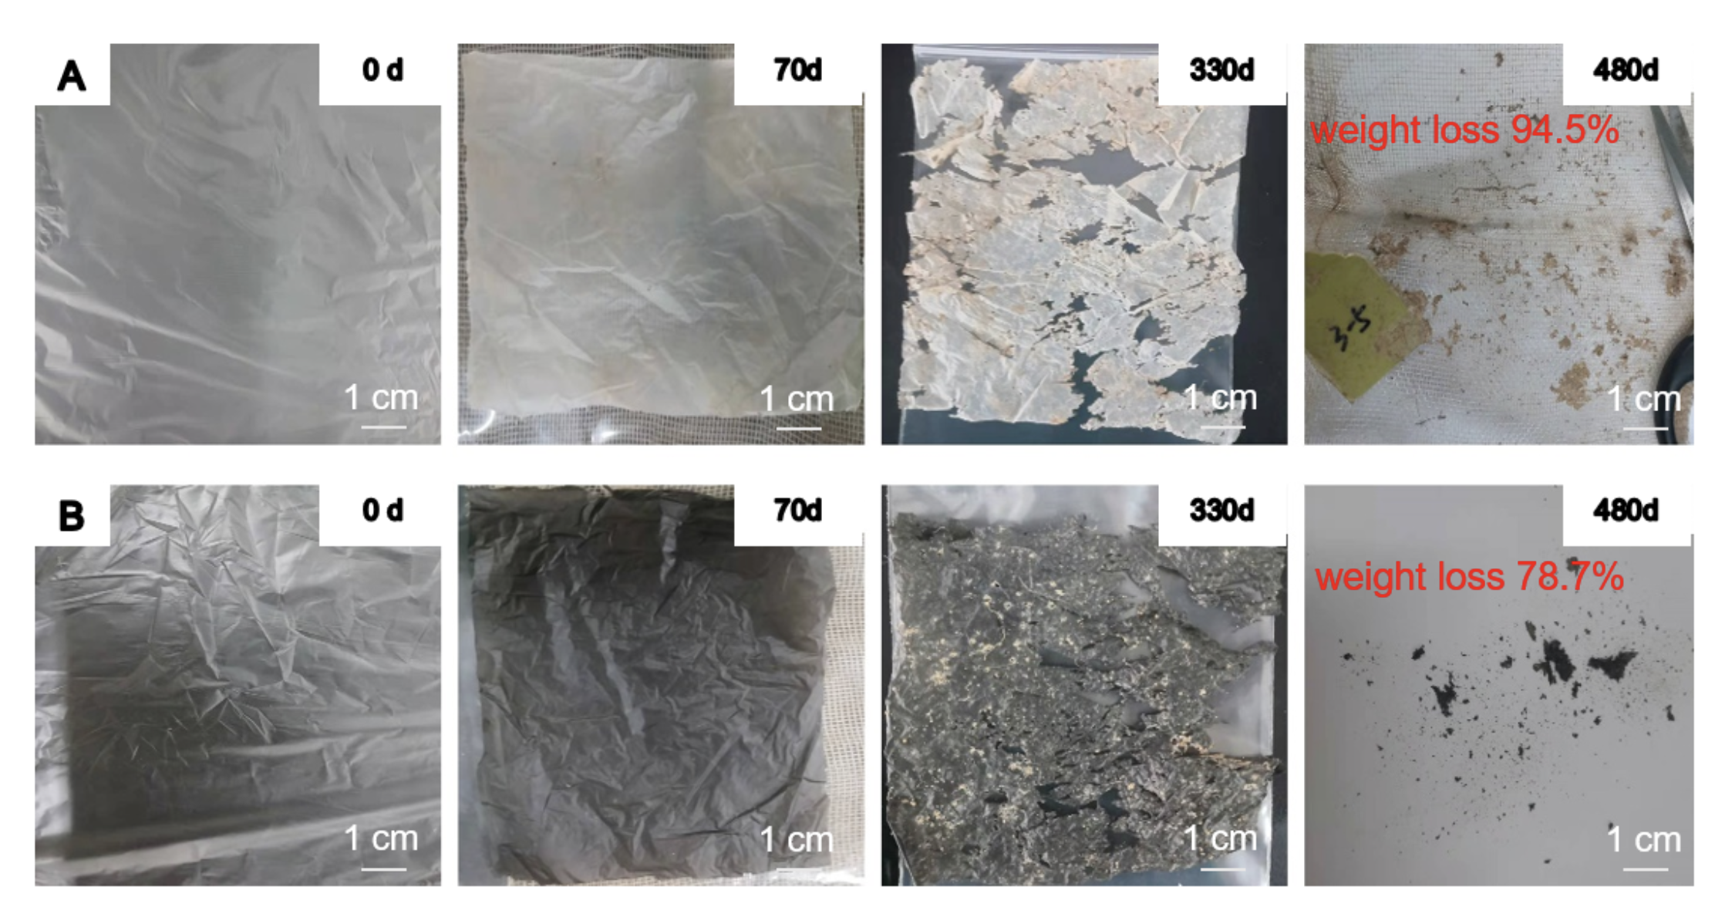
Mulch deterioraton after soil burial
PBAT (clear)
PBAT (black)
Deterioration of plastic mulch films after soil burial in Changwu, Shaanxi Province, China. (Wang et al., 2025)

Slide 12
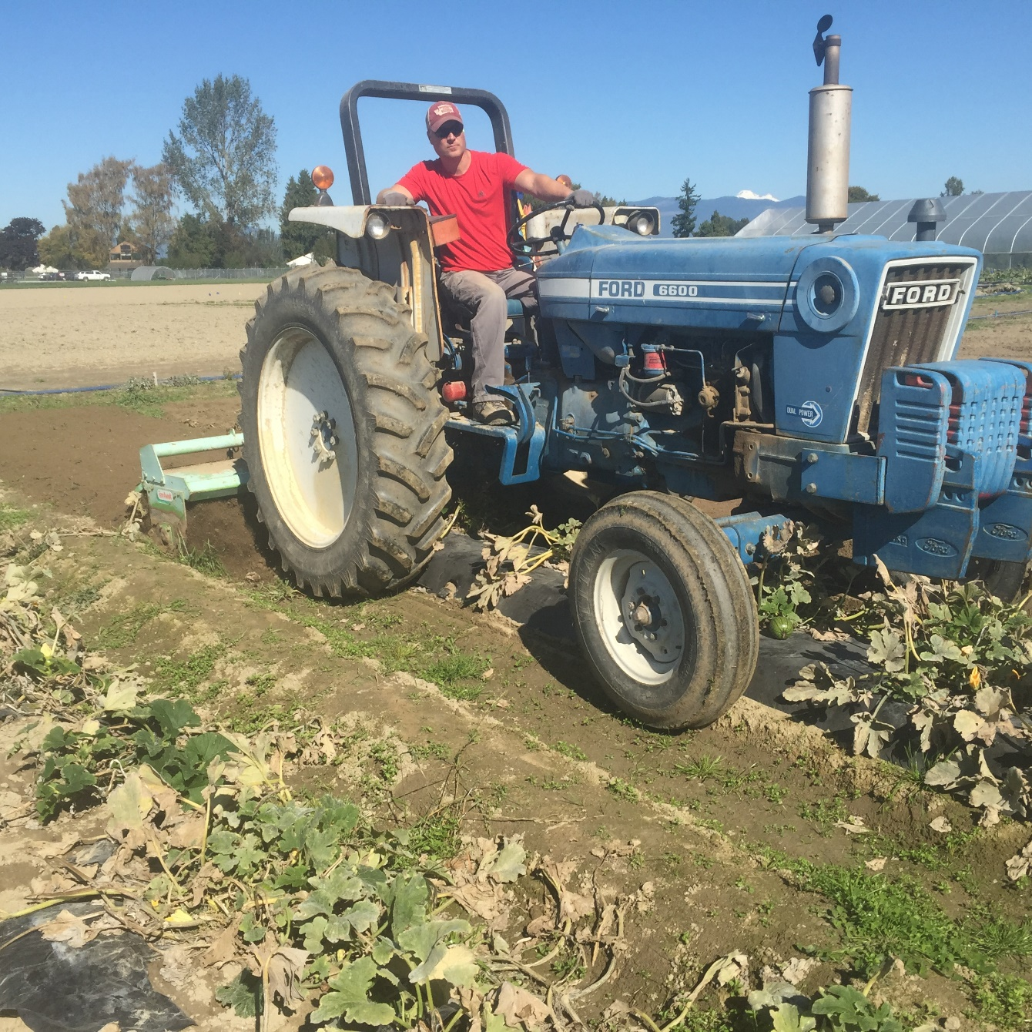
Tillage Incorporation
Rototilling in Biodegradable Mulch (A Guide to Laying and Tilling in of Biodegradable Mulch; YouTube)
Notes:
Video showing tilling in of biodegradable mulch on YouTube (https://youtu.be/aMjD4vbr9eA&t=210). Segment begins at 3:30.

Slide 13
Resources
Biodegradation – Putting Biology to Work (pdf) https://ag.tennessee.edu/biodegradablemulch/Documents/biodegradation_factsheet.pdf
Finding Out How Biodegradable Plastic Mulches Change Over Time (pdf) https://ag.tennessee.edu/biodegradablemulch/Documents/Finding_out_how_biodegradable_plastic_mulches_change_over_time_FACTSHEET.pdf
Ghimire, S., E. Scheenstra, and C. A. Miles. 2020a. Soil-biodegradable mulches for growth, yield, and quality of sweet corn in a Mediterranean-type climate. HortScience 55:317 – 325.
Ghimire, S., M. Flury, E. Scheenstra, and C. Miles. 2020b. Sampling and degradation of biodegradable plastic and paper mulches in field after tillage incorporation. Science of the Total Environment 703:1-7.
Micro- and Nanoplastic in Soil: Should We Be Concerned (pdf) https://ag.tennessee.edu/biodegradablemulch/Documents/Microplastics-soil-Factsheet-formatted.pdf
Summary and Assessment of EN 17033:2018, a New Standard for Biodegradable Plastic Mulch Films (pdf) https://ag.tennessee.edu/biodegradablemulch/Documents/EU%20regs%20factsheet.pdf
Video - Biodegradable Mulch Breakdown in Soil: Role of Microbiology (YouTube) https://youtu.be/-EqrF2y9lh0
Video - Biodegradable Mulch Installation and Till Down (YouTube) https://youtu.be/aMjD4vbr9eA
Zhang, H., C. Miles, S. Ghimire, C. Benedict, I. Zasada, H. Liu, and L. DeVetter. 2020. Plastic mulches improved plant growth and suppressed weeds in late summer-planted floricane-fruiting raspberry. HortScience 55(4): 565 – 572.

Slide 14
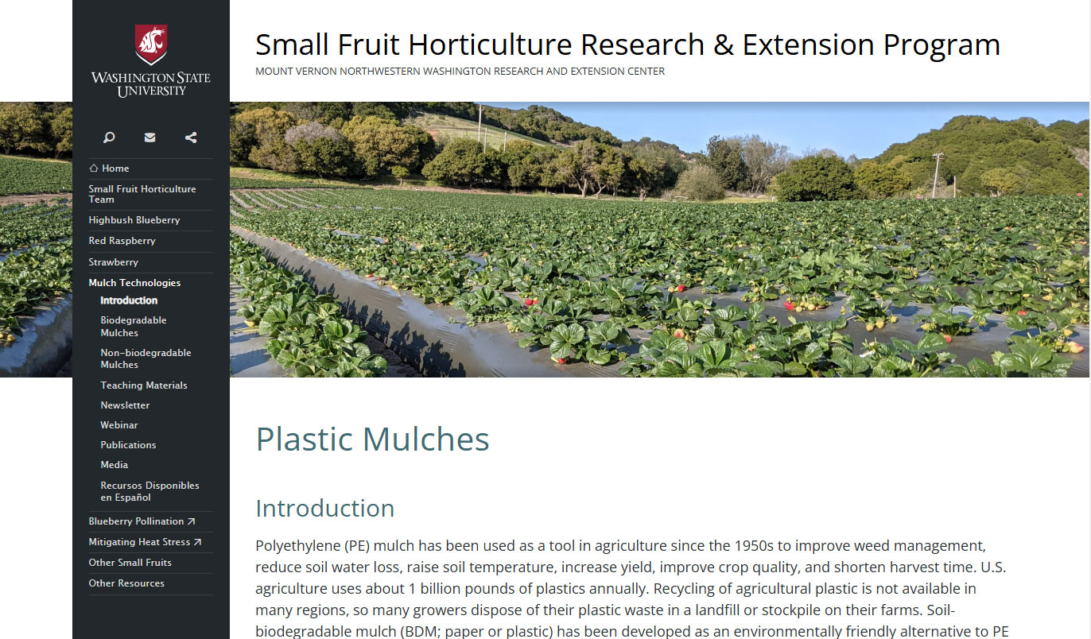

Acknowledgement + Website
This work is supported by Specialty Crops Research Initiative Awards 2016-51181-25404 and 2022-51181-38325 from the USDA National Institute of Food and Agriculture. Any opinions, findings, conclusions, or recommendations expressed in this publication are those of the author(s) and should not be construed to represent any official USDA or U.S. Government determination or policy.
Mulch Technologies Website
https://smallfruits.wsu.edu/plastic-mulches/

