Slide 1
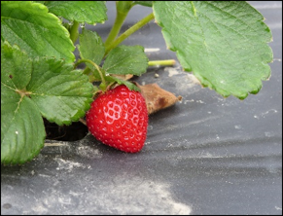
Use of Polyethylene (PE) Mulch in Strawberry Production
Lisa DeVetter, Washington State University
Mark Bolda, University of California
Pam Krone, Monterey Bay National Marine Sanctuary
Notes:
This presentation provides information on the use of polyethylene (PE) mulch in agriculture, plastic use in California berries especially strawberry, and problems with PE waste management, PE mulch recycling, removal and disposal.

Slide 2
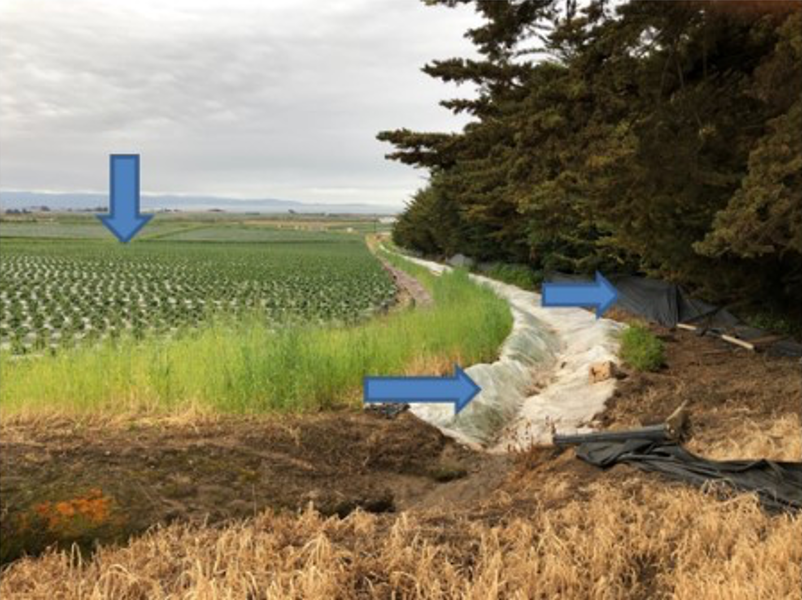
Use of Plastic in Agriculture
U.S. agriculture uses ~1 billion pounds of plastics annually¹
Mulch
Irrigation tubing
Ditch lining
Animal fencing
Fumigation tarp
¹Estimates provided by G. Jones, SWIX
Notes:
U.S. agriculture uses approximately 1 billion pounds of plastics annually in the form of mulch, irrigation tubing, ditch lining, animal fencing, fumigation tarp and many more.

Slide 3
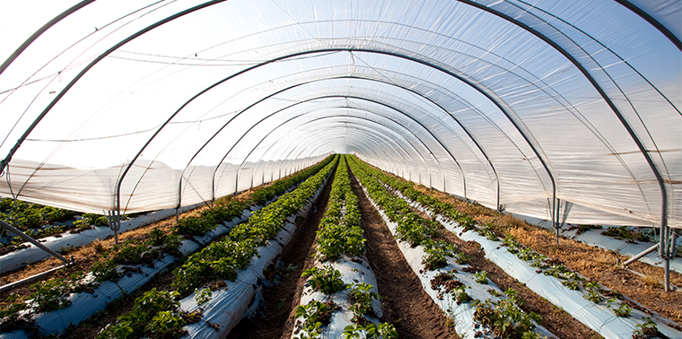
Use of PE Mulch in Agriculture
Global plastic mulch market US$7.8 billion in 2023, expected to be US$10.6 billion in 2028².
North America plastic mulch market US$964 million in 2024, expected to be US$1.7 billion by 2030³.
Use of PE mulch:
Increase length of growing season
Increase yield
Reduce use of herbicides and hand weeding
Increase water use efficiency
Help manage some diseases and insect pests
Image: iStockphoto.com/Gannet77
²Mulch Films Market Report; ³North America Mulch Market Outlook
Notes:
The global plastic mulch market was US$7.8 billion in 2023, and it is expected to be US$10.6 billion in 2028. Plastic mulch market in North America was US$964 million in 2024 and the expectation for 2030 is US$1.7 billion. Use of PE mulch increases the length of the growing season, increases yields, reduces herbicide use and hand weeding, increases water use efficiency, and helps manage some diseases and insect pests.

Slide 4
Field Plastic in CA Crops
*Field plastic includes drip tape and/or hoop house plastic and/or mulch and fumigation tarp.
Data provided by Jordan Siemens and Pam Krone
Notes:
The graph (Fig. 1) shows the amount of field plastic produced in CA crops as pounds per acre per year. Field plastic includes drip tape, hoop house plastic, and mulch and fumigation tarp. The greatest field plastic production is about 845 lbs/acre/year, from strawberry cultivation (drip tape, and mulch and fumigation tarp), followed by cane berry cultivation that produces about 550 lbs of field plastic per acre per year from drip tape, hoop house, and mulch and fumigation tarp.

Slide 5
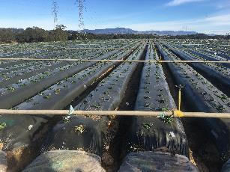
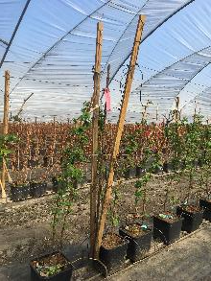
Plastic in California Berries
Some 32,000 acres of strawberry in California use bed plastic, rare not to use in this system
About 80% of the 6,000 acres of caneberries grown in California use plastic tunnel covers
Both systems use plastic extensively in other aspects of the culture: irrigation, row covers, shade cloth and more
Lots and lots and lots of plastic!
Notes:
There are 32,000 acres of strawberry in California, and most growers use bed plastic; it is rare not to use plastic mulch in this system. About 80% of the 6,000 acres of cane berries grown in CA use plastic tunnel covers. Both systems use plastic extensively in other aspects of production, like irrigation, row covers, shade cloth and more. This results in lots and lots and lots of plastic.

Slide 6
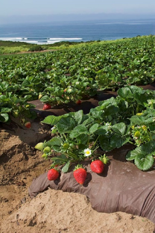
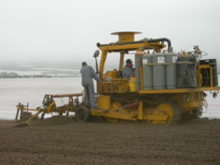
Examples PE Plastic Use in California Berries
Tunnel plastic – 6 mil+
In use since late 1990’s, partial shade for plants, keep production safe from rain, yield enhancement
Bed plastic – 1.25 to 1.5 mil
Many colors, widths and formulations (TIF, perforated, etc.)
Used to manage bed temperatures, keep fruit clean and dry, manage fumigation and ASD facets
Weed mats, shade covers, plastic pots for substrates
Drip tape – many thicknesses and formulations
Notes:
Tunnel plastic is usually 6 mil (or greater) thick, and has been in use since 1990’s to provide partial shade for plants, keep production safe from rain, and enhance yield. Bed plastic, which is usually 1.25 to 1.5 mil thick, has many colors, widths, and formulations (e.g. TIF, perforated, etc.) to meet specific crop requirements. It is used to manage bed temperatures, keep fruit clean and dry, manage fumigation and anaerobic soil disinfestation (ASD). Other examples of plastic use in CA berry production includes weed mats, shade covers, and plastic pots for substrates. Drip tape has many thicknesses and formulations.

Slide 7
Characteristics of PE
Survey of strawberry growers in six states (including CA) identified the following pros and cons of PE mulch:
Pros | Cons
Weed control (68%) | Removal (40%)
Cleaner berries (28%) | Disposal (26%)
Moisture retention (15%) | Purchase/removal/disposal costs (16%)
Earlier production (10%) | Product integrity (tears and deterioration in field (9%)
Ease of use (9%) | Runner-related problems (8%)
Increased soil temperature (8%) | Poor plant health and fruit quality (7%)
 | Animal damage (5%)
 | Excessive heat (5%)
 | Poor weed control (5%)
Goldberger et al., 2019
Notes:
A survey of strawberry growers in 6 states including CA, identified the pros and cons of PE mulch. The majority of respondents mentioned weed control followed by cleaner berries as the primary benefits of PE mulch. Removal of PE mulch followed by its disposal were the major negatives of PE mulch (Table 1).

Slide 8
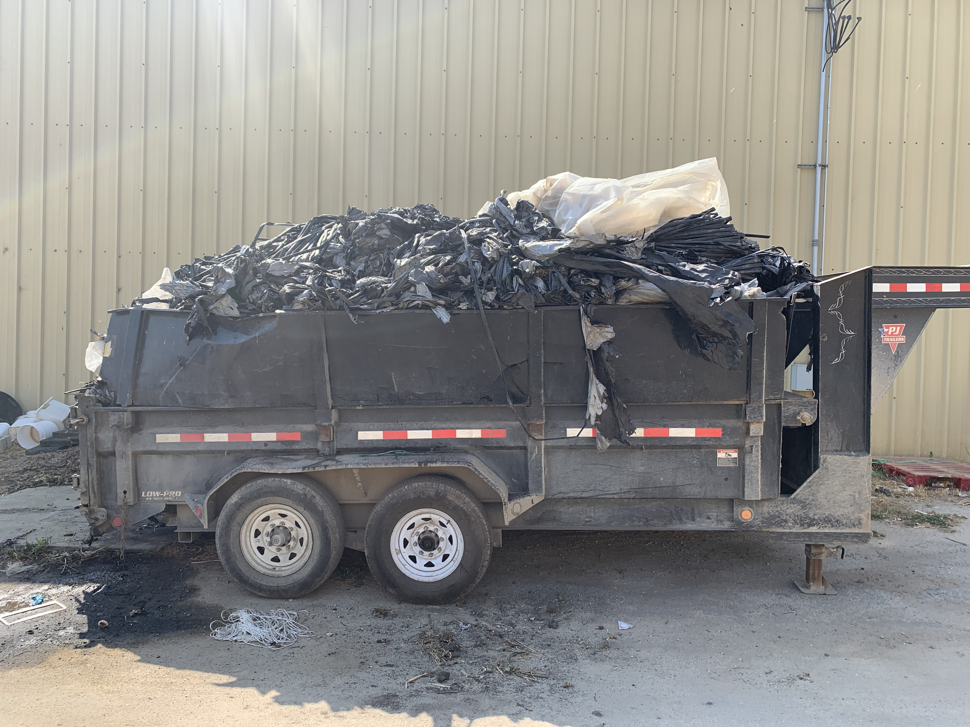
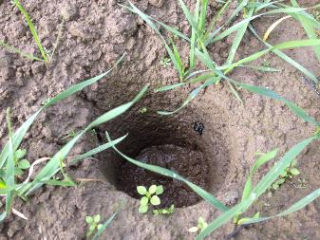
Problems with PE Waste Management
Image: D. Low, 2014
Removes topsoil (up to 1,000 lbs topsoil/acre)*
Remaining fragments can pollute soil and surrounding environment
Costs of removal and disposal at the end of each season
Not biodegradable
*Estimates provided by Zhang and DeVetter
Notes:
Problems with PE waste management include 1) costs of removal and disposal at the end of each season, 2) PE mulch is not biodegradable, 3) plastic removal also removes topsoil (up to 1,000 lbs of topsoil/acre, and 4) the remaining PE fragments in the field can pollute the soil and surrounding environment.

Slide 9
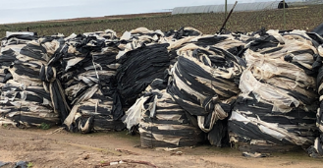
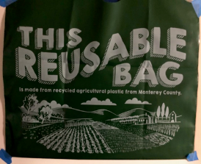
Problems with PE Mulch Recycling
Encore Recycling in Salinas, CA cannot economically recycle mulch.
Soil and plant debris adheres to mulch (up to 70% by weight)
Soil is expensive to haul
Soil can abrade the recycling equipment
Once removed, the soil needs to be disposed
There are many blends of resins in PE plastic mulch (e.g., color, layers, additives) making it difficult to find a product for reuse
When oil prices go down, this reduces the recycled plastic market
Most people do not preferentially purchase recycled product
Notes:
Problems with recycling PE mulch are 1) soil and plant debris adheres to the mulch, adding up to 50% by weight, 2) soil is expensive to haul, 3) soil can abrade the recycling equipment, 4) once removed, the soil then needs to be disposed, 5) there are many blends of resins in PE plastic mulch like, color, layers, additives making it difficult to use it in a recycled product, 6) when oil prices go down, it reduces the recycled plastic market, and 7) most people do not preferentially purchase recycled product.

Slide 10
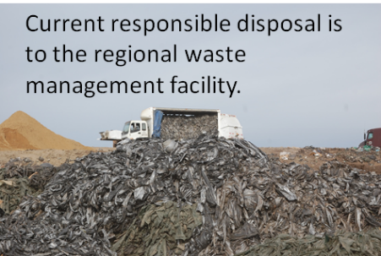
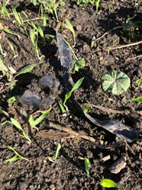
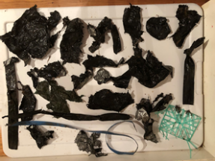
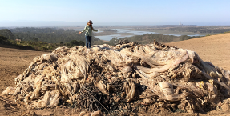
PE Mulch Removal and Disposal
Current responsible disposal is to the regional waste management facility.
Complete removal is difficult due to breakage
Bank Surveys: Mulch pieces, including microplastics, are found in river and ditch drainages; water carries these plastics to the ocean
Abandoned plastic is costly to remove
Notes:
PE mulch removal and disposal are difficult. Breakage makes complete removal difficult. Bank (riparian) surveys show that mulch pieces, including microplastics, are found in river and ditch drainages. Water carries these plastic remnants to the ocean. Responsible disposal is through the regional waste management facility.

Slide 11
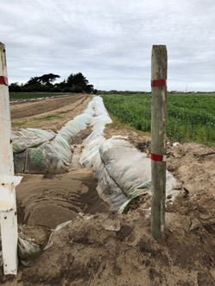
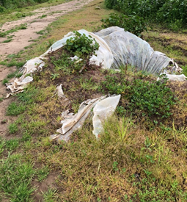
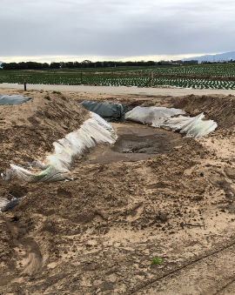
PE Plastic Mulch as a Ditch Liner
Plastic ditch linings commonly fail because plastic is not strong enough to endure water and sediment scouring.
Deer or other animals break it when they step on it.
Because it is in a water pathway, fragments can be carried to the ocean.
Notes:
Deer and other animals can break plastic when they step on it. Plastic ditch linings commonly fail because plastic is not strong enough to endure water and sediment scouring. Since ditch liner is in a water pathway, fragments can be carried to the ocean.

Slide 12
Resources
Plastic Mulch in Fruit and Vegetable Production: Challenges for Disposal (PDF)
https://ag.tennessee.edu/biodegradablemulch/Documents/Plastic_Mulch_in_Fruit_and_Vegetable_Production_12_20factsheet.pdf
Polyethylene and Biodegradable Plastic Mulches for Strawberry Production in the United States: Experiences and Opinions of Growers in Three Regions
https://journals.ashs.org/horttech/view/journals/horttech/29/5/article-p619.xml
Mulch Calculator (PDF)
https://ag.tennessee.edu/biodegradablemulch/Documents/Chen-Mulch-calculcator-introduction.pdf

