Slide 1
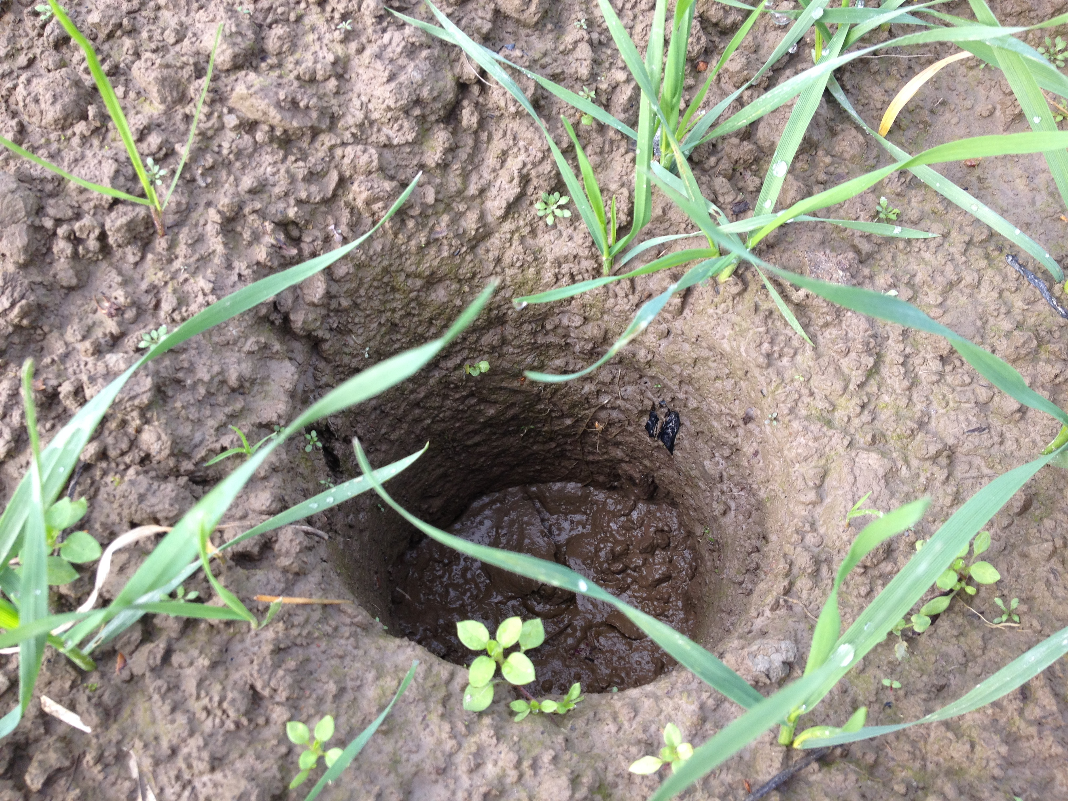






Impact of Soil-Biodegradable Plastic Mulch on Soil Health and Quality
Markus Flury, Lisa DeVetter and Deirdre Griffin LaHue, Washington State University

Slide 2
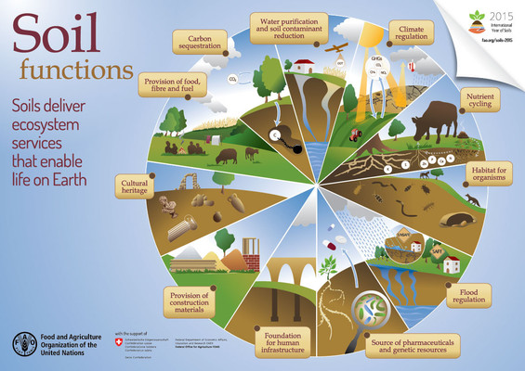
Importance of Soil
Source: https://www.fao.org/global-soil-partnership/resources/news/presentations-gsb23/en/c/284443/
Notes:
Soil health definition

Slide 3
What is Soil Health?
Soil Health Is:
“The capacity of a soil to function within ecosystem boundaries to sustain biological productivity, maintain environmental quality, and promote plant and animal health”
(USDA-NRCS, 2012)
Physical | bulk density, infiltration, penetrometer resistance, water holding capacity, aggregate stability
Chemical | pH, EC, cation exchange capacity (CEC), sodium absorption ration (SAR), N, P, K
Biological | total organic matter, respiration microbial community structures, enzymes
Notes:
Soil health definition

Slide 4
How does Mulch affect Soil Health?
Sintim and Flury, 2017
Notes:
Soil health definition

Slide 5
USDA Soil Quality Test Kit
Soil Quality Test Kit Guide
Notes:
We used the Field test kit from USDA to assess soil health

Slide 6
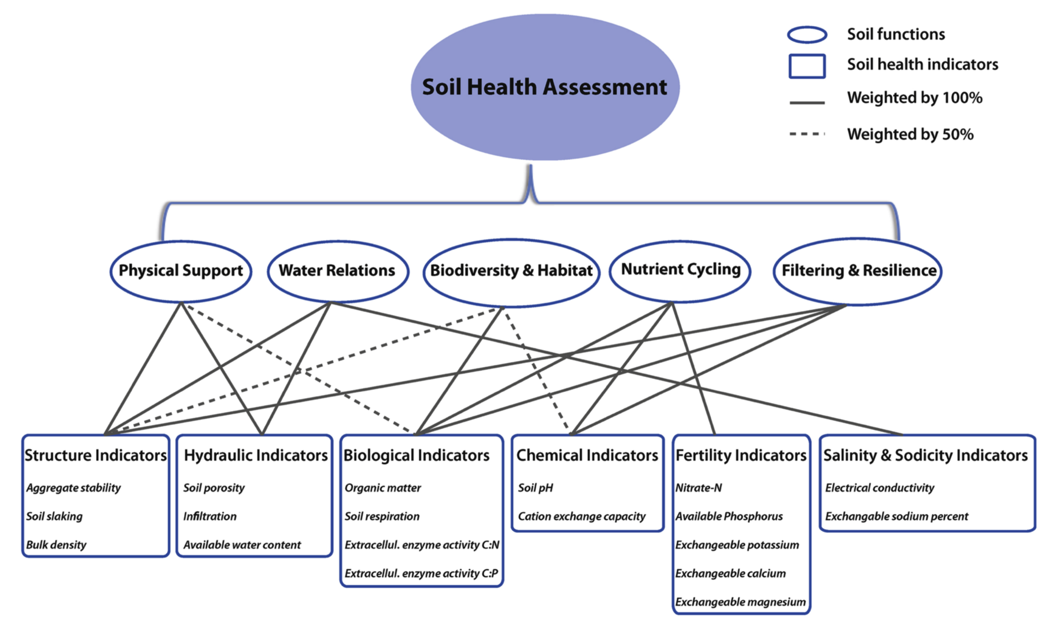
Soil Quality Assessment
Sintim et al., 2019
Notes:
Soil health is assessed by measuring a multiude of soil health parameters. These individual parameters are then grouped and weighed to form soil health indicators and soil functions

Slide 7
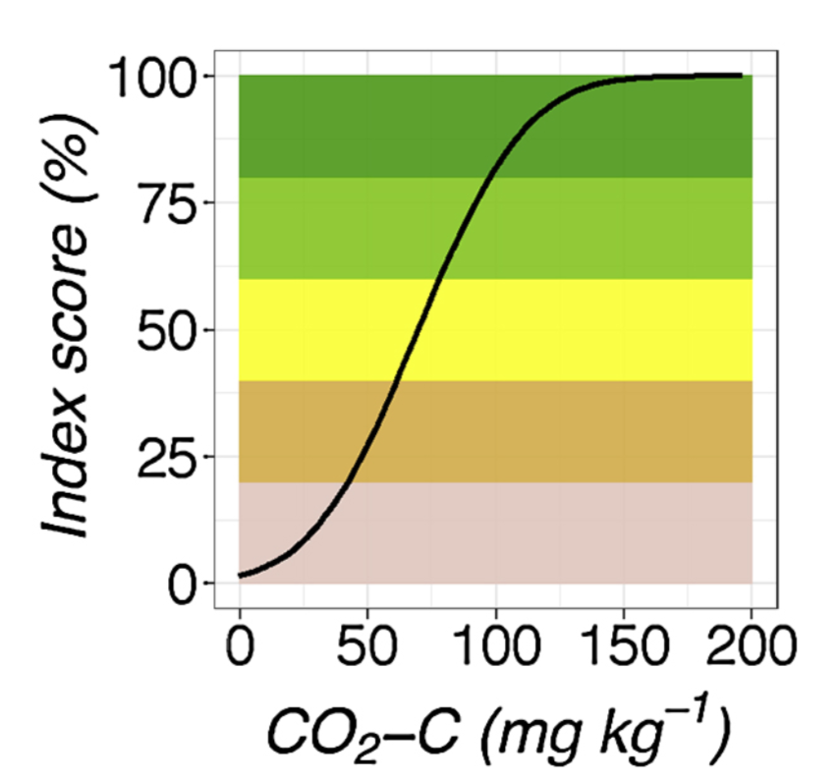
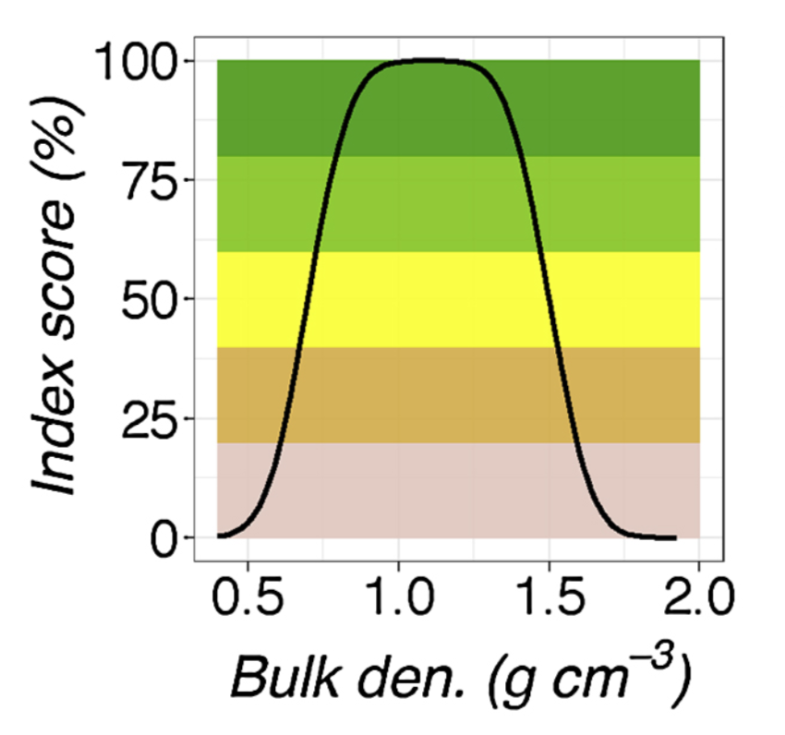
Soil Quality Assessment
Sintim et al., 2019
Notes:
Soil health paramaters are assigned an index score ranging from less favorable to more favorable for soil heatlh

Slide 8
Field Experiment 2015-2017
Mulches:
4 BDMs
Paper mulch (+ control)
PE mulch (- control)
Bare ground
Notes:
Experiment to test effects of BDM on soil health

Slide 9
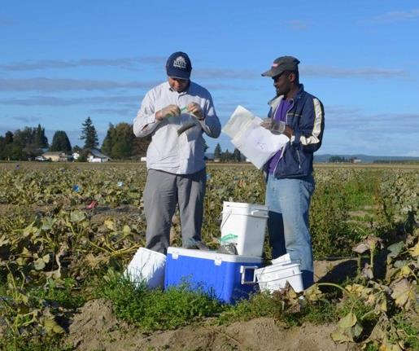
Field Experiment 2015-2017
2 and 4-year study soil parameters measured:
pH
Organic matter
Nutrients (N, P, K, etc.)
Bulk density
Aggregate stability
Slaking
Respiration
Penetration resistance
Infiltration
Site and time had greater impact on soil health variables
Notes:
Details on our 2 and 4 year experiments

Slide 10
Soil Aggregate Stability
2015-2017
Sintim et al., 2019
Notes:
Example of soil health parameter Aggregate Stability: No effects of different mulch treatments on Aggegate Stability was detected

Slide 11
Soil Microbial Communities
2015-2017
Microbial communities plotted as a principal component analysis
Different colors represent different years/seasons
Each dot represents a community, the closer together the more similar they are
Communities associate most with year/season and less with treatment
Bandopadhyay et al., 2020
Notes:
Microbial community structures were more affected by season and location than mulch treatments

Slide 12
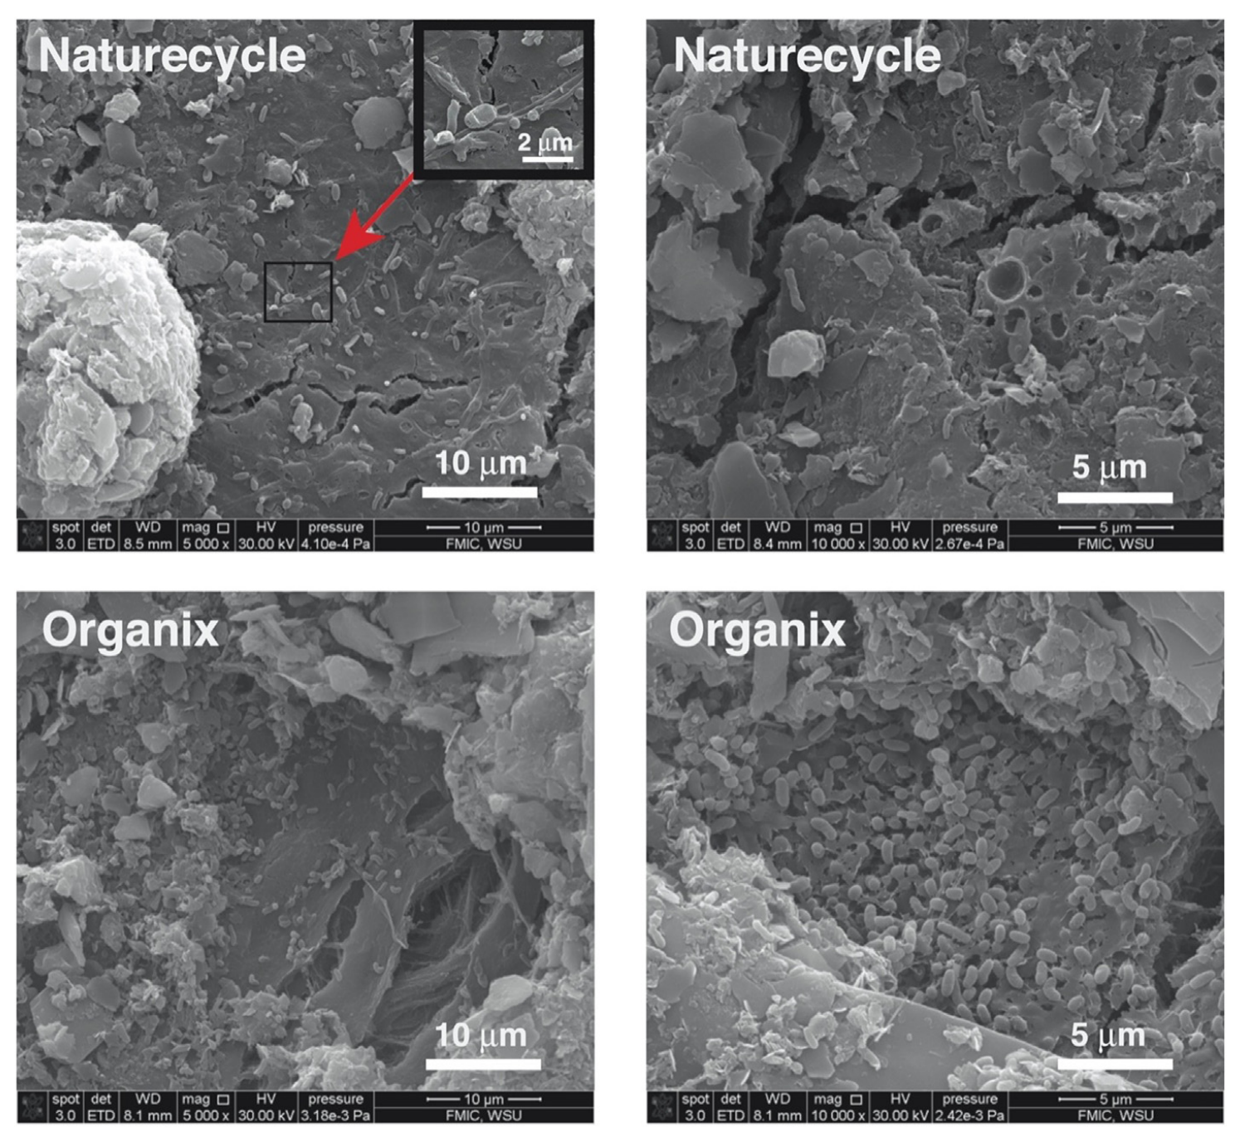
Soil Microbial Communities
Scanning electron microscope (SEM) images of mulches retrieved from the trial in Fall 2020 show colonization of mulch surfaces by microbial cells
This indicates that some mulch surfaces provide a favorable environment for microorganisms
Griffin-LaHue et al., 2022

Slide 13
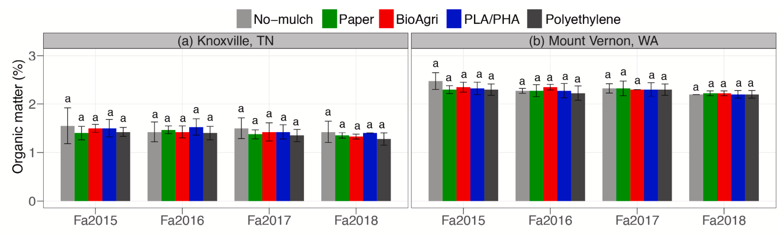
Soil Organic Matter
2015-2018
Sintim et al., 2021
Notes:
No effect of mulch treatmemts on soil organic matter

Slide 14
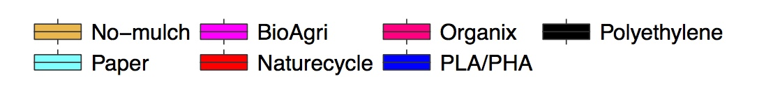
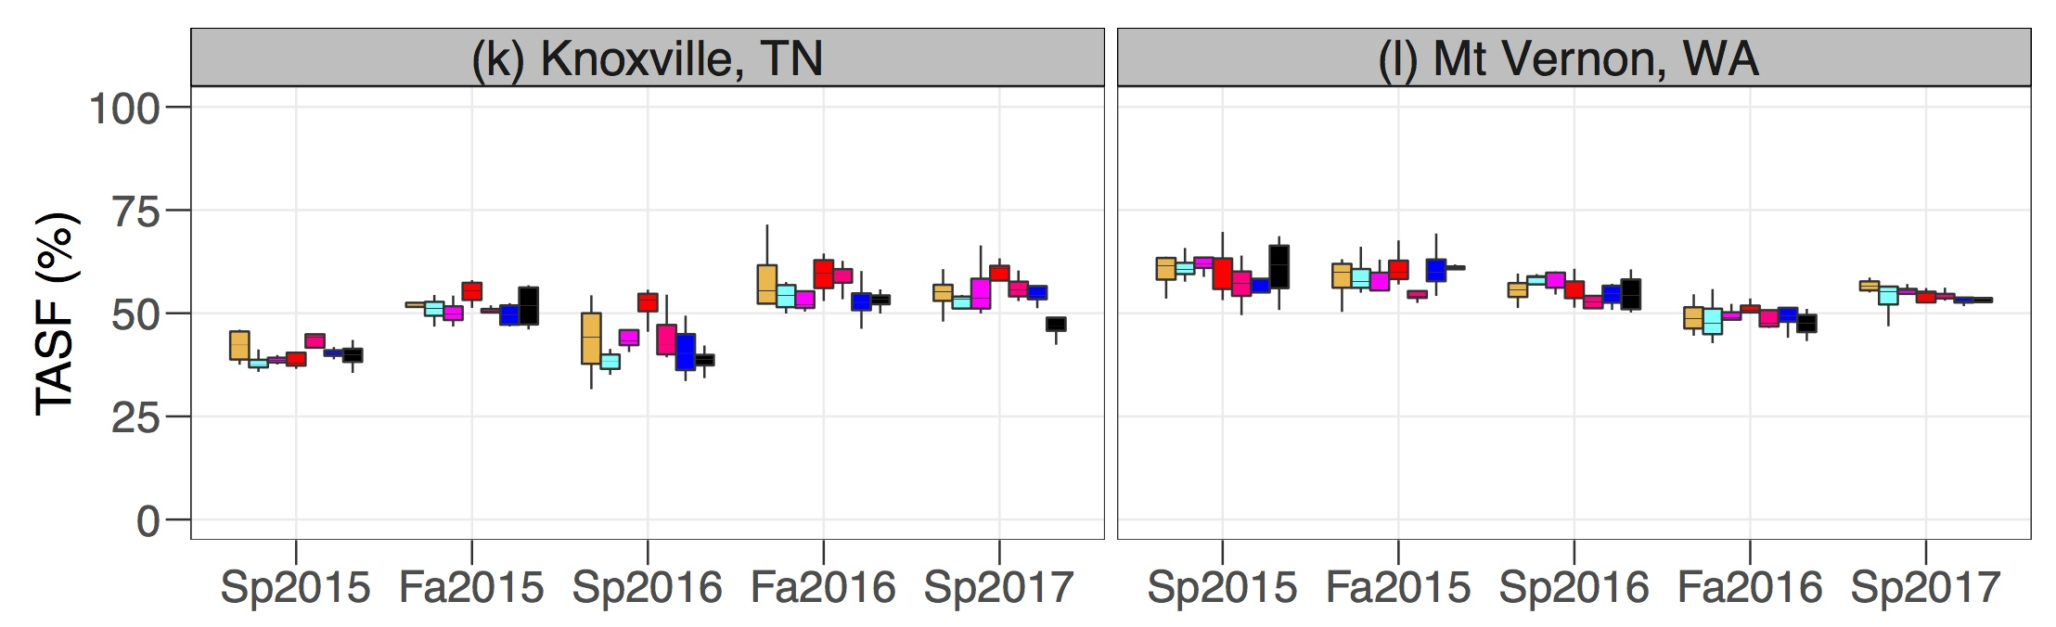
Overall Soil Health
Total Soil Health Function (%)
Sintim et al., 2019
Notes:
Overall soil health more affected by season and location than mulch treatments

Slide 15
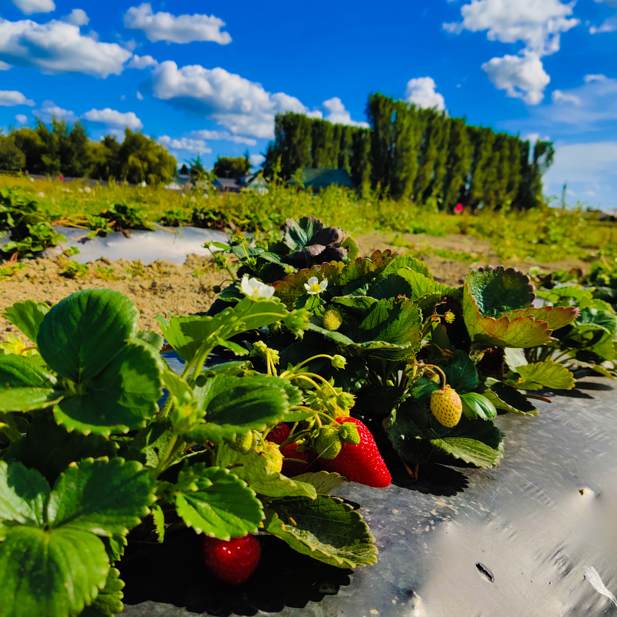
Ongoing Field Trials 2023-2026
Testing effects of BDM products in strawberry systems
Trials in WA, CA, FL, and NE beginning in 2023
Products tested:
Black PE
Black BioGuard00 (PBAT)
Green BioGuard00 (PBAT)
Black BioGuard05 (PBAT + PLA)
Green BioGuard05 (PBAT + PLA)
Evaluating effects on soil health in addition to fruit yield/quality
Benefits of Metalized mulch

Slide 16
Take Home Message
Use of various BDM products did not negatively impact overall soil health over a period of 2 to 4 years
Soil health parameters varied more among sites (Washington vs Tennessee) and season (spring vs fall)
BDM use can help minimize nitrate leaching by promoting plant growth and plant nitrate uptake
Overall, BDM appears a viable alternative to polyethylene in terms of soil health
However, evaluation under long-term studies is needed to better establish long-term effects on soil health

Slide 17
Resources
Griffin-LaHue, D., S. Ghimire, Y. Yu, E. J. Scheenstra, C. A. Miles, and M. Flury, 2022. In-field degradation of soil-biodegradable plastic mulch films in a Mediterranean climate, Sci. Total Environ., 806, 150238, https://www.sciencedirect.com/science/article/abs/pii/S0048969721053158?via%3Dihub
Bandopadhyay, S. H. Y. Sintim, and J. M. DeBruyn, 2020. Effects of biodegradable plastic film mulching on soil microbial communities in two agroecosystems. PeerJ 8:e9015, http://doi.org/10.7717/peerj.9015
Sintim, H. Y., and M. Flury, Is biodegradable plastic mulch the solution to agriculture’s plastic problem? Environ. Sci. Technol., 51, 1068–1069, 2017. (dx.doi.org/10.1021/acs.est.6b06042)
Sintim, H. Y., S. Bandopadhyay, M. E. English, A. I. Bary, J. M. DeBruyn, S. M. Schaeffer, C. A. Miles, J. P. Reganold, and M. Flur. 2019. Impacts of biodegradable plastic mulches on soil health, Agric. Ecosystems Environ., 273:36–49. https://doi.org/10.1016/j.agee.2018.12.002
Sintim, H. Y., S. Bandopadhyay, M. E. English, A. I. Bary, J. E. Liquet y Gonzalez, J. M. DeBruyn, S. M. Schaeffer, C. A. Miles, and M. Flury. 2021. Four years of continuous use of biodegradable plastic mulch: Effects on soil and groundwater quality, Geoderma, 381: 114665. https://doi.org/10.1016/j.geoderma.2020.114665
https://www.fao.org/global-soil-partnership/resources/news/presentations-gsb23/en/c/284443/

