Slide 1
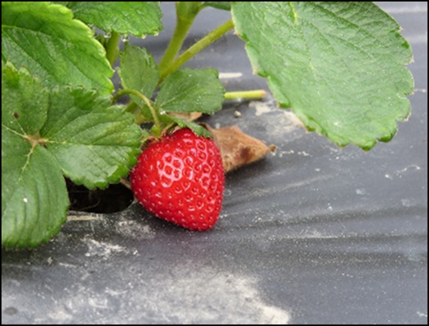






Soil-Biodegradable Plastic Mulch Professional Training
Economics of Soil-Biodegradable Mulch Use
Margarita Velandia, The University of Tennessee
Suzette P. Galinato, Washington State University
Lisa DeVetter, Washington State University
Mark Bolda, University of California

Slide 2
Overall Economic Considerations
Why adopt a new practice or new technology in agriculture?
Examples:
To improve production efficiency and crop yield
To reduce environmental footprint
To increase the profitability of production activity
What are the general economic considerations to adopt a new agricultural technology relative to standard practice?
Costs – cost of the technology (material, labor)
Benefits – reduced input costs, improved crop yield, etc.
Net profit = Revenue minus Costs → if positive, keeps the farm in business
Net profit_{Technology adoption} > Net profit_{Standard practice}
Output Price x Yield
Tech adoption costs, other variable costs and fixed costs

Slide 3
Initial Purchase Costs – BDM vs PE
Do BDMs cost more than PE mulches?
 | Plastic BDMs | PE mulch | Paper BDMs
Roll Dimensions (ft) | 4 x 4,000 | 4 x 4,000 | 4 x 1,000
Roll thickness (mil) | 0.6 | 1.0 | 9.0
Purchase cost (without input supplier discount or shipping cost)* | $270-$360 | $128-$325 | $300
Machine application | Yes | Yes | Yes
* Shipping cost can increase the base price significantly if local suppliers do not carry BDMs

Slide 4
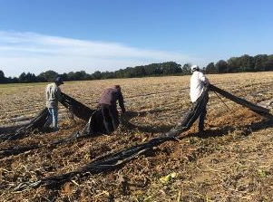
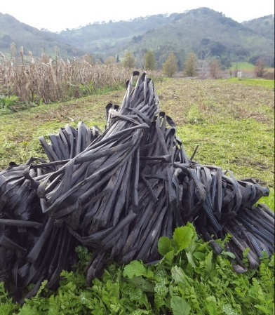
Costs of PE Mulch Use
Material cost
Cost to remove PE mulches at the end of the season
Labor hours to remove PE mulch
Cost of labor
Amount of plastic to be removed
Cost to dispose PE mulch at the end of the season
Labor cost
Transportation cost
Landfill disposal fees
Examples as of 2022: $31 to $54 per ton in TN, $40.13-$81 per ton in CA, $56-$144 per ton in WA; National average is about $58 per ton.
Some counties do not accept PE mulch for disposal

Slide 5
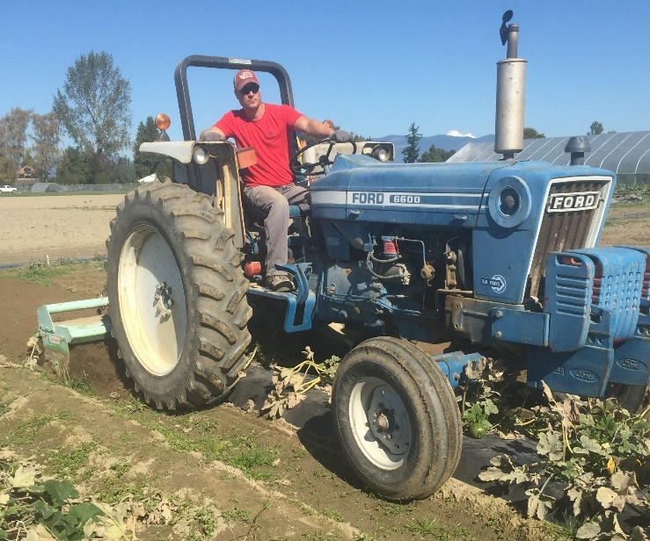
Economic Considerations for BDMs
Not all end-of-season activities related to handling of mulch will be eliminated when adopting plastic BDMs
Same as with PE mulch, drip tape must be removed before tilling BDMs into the soil
Based on 1 on-farm trial with pepper, drip tape removal required 1.6–2.4 person-hours per acre with 6-ft row spacing.
Estimates may vary due to soil, environmental conditions, and other factors
Tilling BDMs into the soil will involve operator labor (this operation may not be an additional cost if tillage is one of typical field activities done at the end of the growing season)
Rototilling BDM and crop debris into the field at the end of the crop season.

Slide 6
Economic Analysis
Changes Associated with Adopting BDM (Baseline: PE Mulch Use)
Additional Costs (AC): BDMs are more expensive than PE mulch Tilling BDMs in the soil: operator labor; assume tilling the soil is a typical end-of-season activity, therefore no additional tillage cost | Additional Income (AI): Changes in yield? Changes in prices? Are consumers willing to pay a premium for products grown with BDMs? Current assumption: No changes in prices and yields
Reduced Income (RI): Current assumption: No changes in prices and yield due to BDMs adoption | Reduced Costs(RC): Labor – reduced labor associated with end of season activities No disposal cost (e.g., transportation, disposal fee)
A. Total AC and RI | B. Total AI and RC
Net Change in Profit (B-A)

Slide 7
Economic Analysis
Assumptions:
Thickness of PE mulch: 1.0 mil
Thickness of BDM: 0.6 mil
Mulch roll size: 4 ft x 4,000 ft
Bed spacing: 6 ft
Removal and disposal: 17.25 hours/acre
No. of mulch rolls per acre: 2
Cost PE mulch/acre: 2 x $220/roll = $440/acre
Cost BDM/acre: 2 x $315/roll = $630/acre
Labor Cost: $17.20/hour
Disposal cost: $61/ton (estimated U.S. average)
Drip tape removal: 1.5 hours/acre
Changes Associated with Adopting BDM
Additional Cost (AC): $190.00 BDM material cost: $190.00 | Additional Income (AI): $0 Current assumption: No changes in prices and yields.
Reduced Income (RI): $0 Current assumption: no changes in prices and yield due to BDMs adoption | Reduced Costs(RC): $278.83 Labor savings: $270.90 Disposal savings: $7.93
A. Total AC and RI: $190.00 | B. Total AI and RC: $278.83
Net Change in Profit (B-A): $88.83

Slide 8
Sensitivity Analysis: BDM cost
At $359/roll,
Net Profit_{BDM} = Net Profit_{PE}

Slide 9
Sensitivity Analysis: Labor hours
At about 12 hours/acre,
Net Profit_{BDM} = Net Profit_{PE}

Slide 10
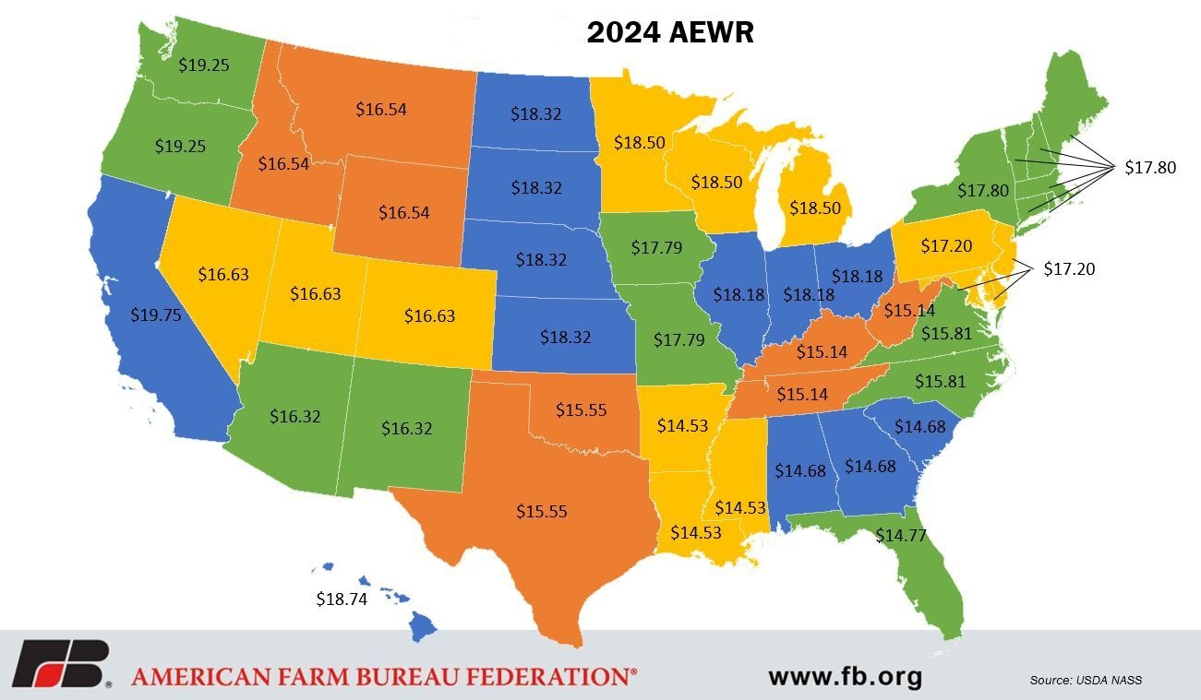

Slide 11
Sensitivity Analysis: Labor rate
At $11.60/ hour,
Net Profit_{BDM} = Net Profit_{PE}

Slide 12

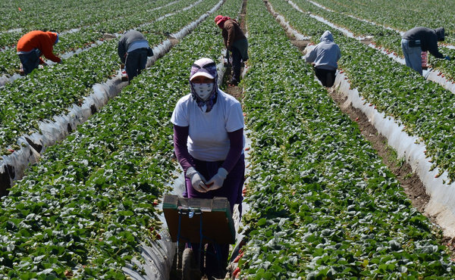
Other Notes about Labor
The farm owner is often responsible for performing cleanup activities at the end of the season
Owner’s hours often not considered a direct cash expense; may be overlooked
This unpaid labor must be calculated and included in the production costs
Implications for farms employing migrant workers
If labor hours are reduced during end-of-season activities, laborers may transfer to another farm who can employ them for longer hours

Slide 13
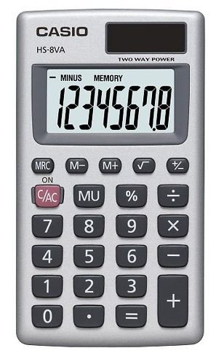
Tool - Mulch Calculator
Interactive “Mulch Calculator” assists farmers to determine the quantity of much needed and provides cost comparison to PE mulch
Available (for free) – see Resources
Two components:
Requirement Calculator - how many rolls of mulch (per acre or per hectare) need to be purchased based on roll length and spacing between bed centers
Cost Calculator – machinery cost, material cost, as well as the cost of labor to install the mulch, costs associated with clean-up activities
Image: D. Low, 2014
Chen et al., 2018

Slide 14
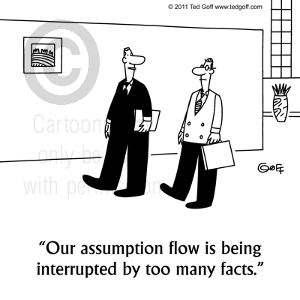
Tool - Mulch Calculator Assumptions
Required machinery and number of person-hours to install PE mulch and BDM are the same
In Cost Calculator example, PE mulch removal is by hand (machinery cost would need to be added)
Drip tape is removed simultaneously with PE mulch and 1.5 hours per acre is used for cost of removing drip tape before BDM is tilled into soil (this number can be adjusted as needed)
Image: D. Low, 2014
PE mulch is disposed in landfill for fee, while BDM is tilled into soil (thereby eliminating removal and disposal costs)
Usually takes 3 hours per acre to till BDM into soil based on field study in WA, but largely depends on type of equipment used (this number can be modified if needed)

Slide 15
Key Takeaways
Clear benefits of BDM: elimination of removal and disposal costs associated with PE mulch
BDM is potentially a more profitable alternative than PE mulch given one or a combination of the following:
Low to moderate material cost of BDM,
High labor requirement to remove and dispose PE mulch, and
High farm labor rates
Critical factors to assess the economic feasibility of BDM:
Costs – material and labor
If growers focus only on costs, they will be unable to take advantage of opportunities or benefits that can improve their net profit. So must also consider:
Benefits – cost savings, etc.
Positive Net Profit – most important to stay in business; compare with net profit when using PE mulch

Slide 16
Resources
Adverse effect wage rate – 2024
https://flag.dol.gov/wage-data/adverse-effect-wage-rates
Municipal Solid Waste Landfill Tipping Fee
Environmental Research and Education Foundation. 2023. Analysis of MSW Landfill Tipping Fees – 2022.
https://erefdn.org/2022-msw-landfill-tipping-fees/
https://www.wastetodaymagazine.com/news/eref-study-shows-msw-landfill-tip-fees-rose-sharply-in-2022/
Mulch Calculator
Chen-Mulch-calculcator-introduction.pdf (tennessee.edu)
The Economics of Adopting Biodegradable Plastic Mulch Films
Velandia-et-al-The-Economics-of-Adopting-Biodegradable-Mulch.pdf (tennessee.edu)

Slide 17
Resources
The Economic Feasibility of Adopting Plastic Biodegradable Mulches in Pumpkin Production
https://biodegradablemulch.tennessee.edu/wp-content/uploads/sites/214/2020/12/W822.pdf
https://pubs.extension.wsu.edu/economic-feasibility-of-using-alternative-plastic-mulches-a-pumpkin-case-study-in-western-washington
Dimensions and Costs of Biodegradable Plastic and Polyethylene Mulches (raspberry emphasis) https://s3.wp.wsu.edu/uploads/sites/2181/2017/06/FactSheet.CostandDimensions-2.pdf
Important Considerations for the Use of BDM in Crop Production
https://research.libraries.wsu.edu/xmlui/handle/2376/13104
Information and materials for use of mulches in small fruit production
https://smallfruits.wsu.edu/plastic-mulches/
Basic information sources, frequently asked questions, videos, and publications — BDM project website: https://www.biodegradablemulch.org

