Slide 1
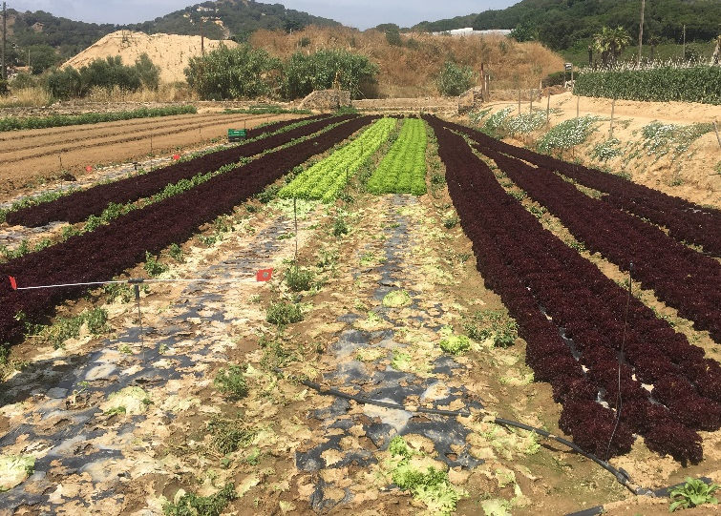




Soil-Biodegradable Plastic Mulch SARE PDP Project
Soil-Biodegradable Mulch for Organic Production
Carol Miles, Washington State University
Shuresh Ghimire, University of Connecticut
biodegradablemulch.org
https://smallfruits.wsu.edu

Slide 2

Information on Our Website
https://smallfruits.wsu.edu/plastic-mulches/
biodegradablemulch.org
https://smallfruits.wsu.edu
Notes:
BDM is an alternative to PE (polyethylene) mulch as it provides comparable crop production benefits: weed control, moisture retention, soil temperature modification, early harvest, increased yield and quality. BDMs are designed to be tilled into the soil after use, eliminating waste and disposal challenges. Note that BDMs should NOT go into recycling facilities as they will contaminate other recycled material.

Slide 3
Soil-Biodegradable Mulch
Soil-biodegradable mulch (BDM) can be a sustainable alternative to polyethylene (PE) mulch:
Provides crop production benefits comparable to PE mulch:
Weed control
Moisture retention
Soil temperature modification
Early harvest
Increase crop yield and quality
BDMs cannot go into recycling facilities, will contaminate recyclate
Designed to be tilled into the soil after use, eliminating waste and disposal challenges
biodegradablemulch.org
https://smallfruits.wsu.edu
Notes:
BDM is an alternative to PE (polyethylene) mulch as it provides comparable crop production benefits: weed control, moisture retention, soil temperature modification, early harvest, increased yield and quality. BDMs are designed to be tilled into the soil after use, eliminating waste and disposal challenges. Note that BDMs should NOT go into recycling facilities as they will contaminate other recycled material.

Slide 4
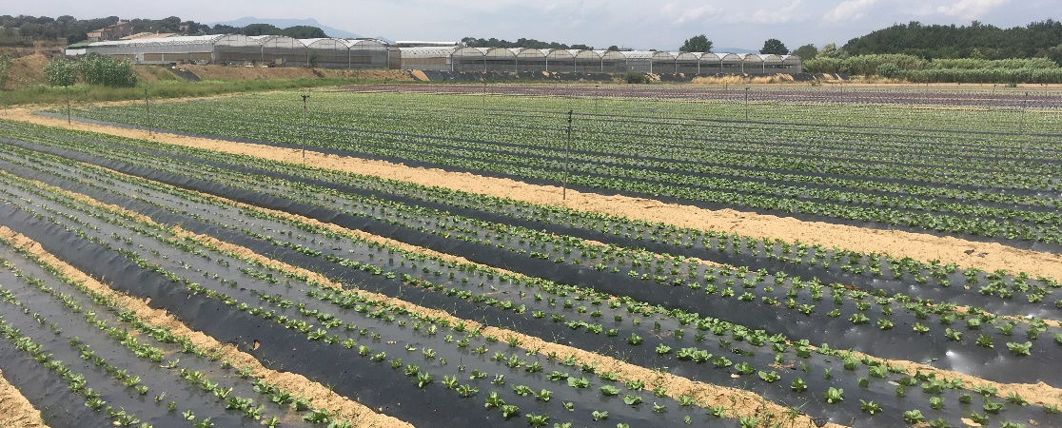
Introduction of BDM
1990 German government published call for research and development of biodegradable thermoplastics
1991 Novamont introduced Mater-Bi line
1996 Bayer BAK introduction line extrusion and injection molding grades
2009 First USDA SCBG to investigate BDMs
2014 BASF / Organix Solution BDM
biodegradablemulch.org
https://smallfruits.wsu.edu
Notes:
Introduction of BDMs began in 1990 when the German government published a call for research and development of biodegradable thermoplastics. In 1991 Novamont introduced the Mater-Bi line, and in 1996 Bayer BAK introduced line extrusion and injection molding grades. By 2014 BASF had produced BASF/Organix Solution BDM.

Slide 5




USDA National Organic Program
Biodegradable biobased mulch film was added to list of allowed substances in October 2014, but it MUST:
1. Be biobased (ASTM D6866)
2. Be produced without use of non-biobased synthetic polymers; minor additives (colorants, processing aids) not required to be biobased
3. Be produced without organisms or feedstock derived from excluded methods (i.e., synthetic, GMO)
4. Meet compostability specifications (ASTM D6400, ASTM D6868, EN 13432, EN 14995, or ISO 17088)
5. Reach ≥ 90% degradation in soil within 2 years (ISO 17556 or ASTM D5988)
biodegradablemulch.org
https://smallfruits.wsu.edu
Notes:
The USDA National Organic Program added biodegradable biobased mulch film to its list of allowed substances in October 2014. However, it MUST: a) be 100% biobased (ASTM D6866); b) be produced without use of synthetic polymers (minor additives such as colorants and processing aids not required to be biobased); c) be produced without organisms or feedstock derived from excluded methods (i.e., synthetic or GMO); d) meet compostability specifications (ASTM D6400, ASTM D6868, EN 13432, EN 14995, or ISO 17088); and e) reach ≥ 90% degradation in soil within 2 years (ISO 17556 or ASTM D5988).

Slide 6
What BDMs Are Made From
Plastic BDMs made from feedstocks that are biobased, derived from fossil fuels, or a blend of the two
Biobased polymers divided into three categories:
Extracted from natural materials | Produced by chemical synthesis | Produced by microorganisms
starch, thermoplastic starch (TPS), and cellulose | synthetic polymerization of lactic acid into polylactic acid (PLA) | polyhydroxyalkanoates (PHA)
TPS processed from high-amylose starch, cheaper than other starch feedstocks | PLA produced relatively inexpensively compared to other biobased biopolymers | Poly(hydroxybutyrate) (PHB) and poly(hydroxyvalerate) (PHV) most important commercial PHAs
biodegradablemulch.org
https://smallfruits.wsu.edu
Notes:
BDMs are made from feedstocks that are: (i) biobased, (ii) derived from fossil fuels, or (iii) a blend of the two. Biobased polymers are divided into 3 categories (Table 1): a) extracted directly from natural materials such as starch, thermoplastic starch (TPS), and cellulose; b) produced by chemical synthesis from biologically derived monomers, such as synthetic polymerization of lactic acid into polylactic acid (PLA); and c) produced by microorganisms, such as polyhydroxyalkanoates (PHA). High-amylose starch is processed into TPS by extrusion with water and alcohols at relatively high temperatures. TPS costs less than other starch feedstocks and now is the most common biobased feedstock used in plastic BDMs. PLA can be produced relatively inexpensively in large quantities compared to other biobased biopolymers. Poly(hydroxy-butyrate) (PHB) and poly(hydroxyvalerate) (PHV) are the two most important commercial PHAs. Polymers such as PLA or PHA have low mechanical properties compared to PE. Plasticizers are additives which improve the mechanical properties of the plastic during processing, and can affect post-extrusion characteristics of the plastic. The primary plasticizers that are added to TPS are alcohol (principally glycerol), polyoxyalkenes, and surfactants. Most common biobased BDM feedstocks are TPS, PLA, and PHA.

Slide 7
Feedstock Considerations
Percent biobased content not an indicator of biodegradation under field conditions: PLA and PHA require high temperatures for biodegradation
Manufacturing plastic mulch (including BDMs) involves the addition of plasticizers, fillers (e.g., CaCO₃), lubricants, nucleating agents, stabilizers and colorants/dyes
The additives used in commercial plastic BDMs may or may not be produced from GMOs
Most commercially available PLA and PHA are produced through fermentation using GM yeast and bacteria for increased productivity
Biobased mulches are not tested for the presence of GMOs: DNA degraded following fermentation and processing and not discernable using tests
biodegradablemulch.org
https://smallfruits.wsu.edu
Notes:
It is important to know that percent biobased content is not an indicator of biodegradation. For example, PLA ad PHA require high temperature for biodegradation. Manufacturing plastic mulch (including BDMs) involves the addition of plasticizers, fillers (e.g., CaCO3), lubricants, nucleating agents, stabilizers and colorants/dyes. The additives used in commercial plastic BDMs may or may not be produced from GMOs. Most commercially available PLA and PHA are produced through fermentation using GM yeast and bacteria for increased productivity. Biobased mulches are not tested for the presence of GMOs since DNA may be degraded following fermentation and processing to the point where GMO status is not discernable using available broad-spectrum quantitative polymerase chain reaction (PCR) tests.

Slide 8
Standards for Biodegradation
Intended to ensure BDM quality and integrity in agriculture
Exclude materials that claim to be biodegradable but are not fully metabolized by microbes, which results in plastic fragments in soils, causing pollution
Composting standard the first critical test of biodegradability, if BDM is not compostable, it will likely not biodegrade under field conditions
Standards do not guarantee a particular degree of performance in the field, as this depends on production system (crop, climate, soils, etc.), and mulch formulation and thickness
biodegradablemulch.org
https://smallfruits.wsu.edu
Notes:
Standards for biodegradation are intended to ensure their quality and integrity in agriculture. Standards are meant to exclude materials that claim to be biodegradable but are not fully metabolized by microbes, which results in plastic fragments in soils, causing pollution. Ability of a BDM to meet the composting standard is considered the first critical test of biodegradability; if a mulch is not compostable, it will likely not biodegrade under field conditions. Standards for BDMs do not guarantee a particular degree of performance in fields. Performance depends on the production system (crop, climate, soils, etc.) and mulch formulation and thickness.

Slide 9
BDM Standards
Standard Organization | Standard Name | Comments
European Committee for Standardization (CEN) | EN 17033 (2018) Plastics–Biodegradable Mulch Films for Use in Agriculture and Horticulture– Requirements and Test Methods | First international standard directly pertaining to biodegradable mulches by an international organization
Association Francaise de Normalisation (AFNOR) | NFU 52-001 (2005) Biodegradable Mulches for Use in Agriculture and Horticulture - Mulching Products - Requirements and Test Methods | French standard pertaining to biodegradable mulches
Ente Nazionale Italiano di Unificazione (UNI) | UNI 11495 (2013) Biodegradable Thermoplastic Materials for Use in Agriculture and Horticulture - Mulching Films - Requirements and Test Methods | Italian standard pertaining to biodegradable mulches
ASTM, International | ASTM D6400 (2012) Standard Specification for Labeling of Plastics Designed to be Aerobically Composted in Municipal or Industrial Facilities | Pertains directly to biodegradation under industrial composting conditions, and is often misrepresented¹
TUV Austria (formerly Vincotte)² | OK Biodegradable SOIL (label) | Certifies that plastic materials will biodegrade fully and will not promote ecotoxicity in the soil
¹ ISO (International Organization for Standardization) has equivalent standards
² TUV Austria is not a standards organization but is a certification body authorized by European Bioplastics, an association representing the interest of the European bioplastics industry.
Source: Dentzman and Hayes (2019)
biodegradablemulch.org
https://smallfruits.wsu.edu
Notes:
There are several BDM standards written by different countries as shown in Table 2. For example, TUV Austria certifies that plastic materials will biodegrade fully and will not promote ecotoxicity in the soil.

Slide 10
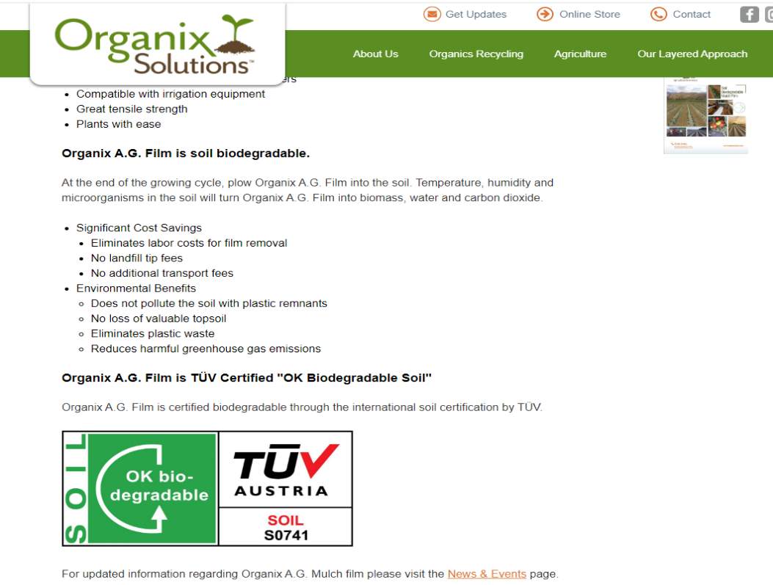
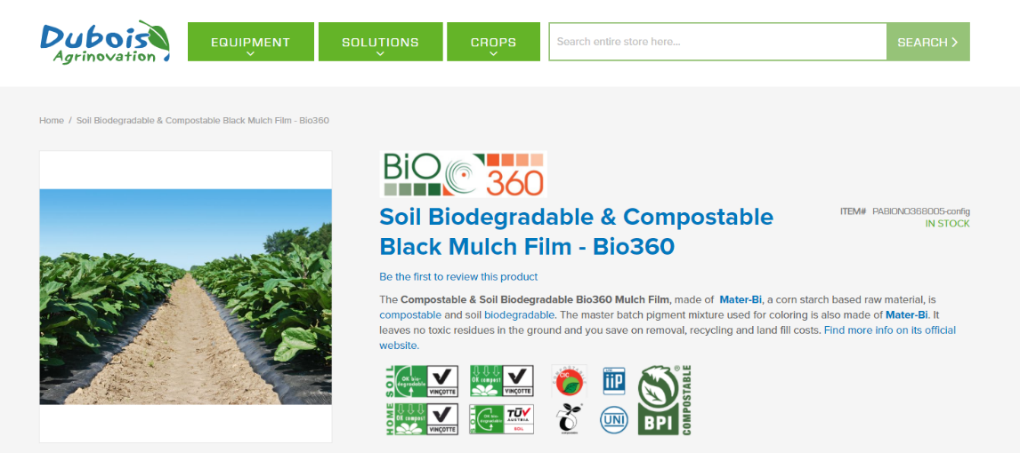
BDM Label
biodegradablemulch.org
https://smallfruits.wsu.edu
Notes:
What does the label tell you? If biodegradability test results are not included in the product label, then it should be assumed that the product does not meet the standards.

Slide 11
BDM Standards
ASTM D6400 tests biodegradation under industrial composting conditions (2012)
Most commonly cited standard for BDM
Employs standardized test method ASTM D5338:
Laboratory test that simulates industrial composting conditions: use of a compost-based medium, 58℃, etc.
≥ 90% conversion of C into CO₂ and microbial biomass within 180 days
EN 17033 European Committee for Standardization (CEN) (Jan. 2018)
1st standard for certification of biodegradable plastic mulch films in soil
Requirements regulated: composition; biodegradability in soil; ecotoxicity, dimensional, mechanical and optical properties; and the test procedures for each
≥ 90% biodegradation under aerobic conditions in natural topsoil from agricultural field or forest at 20 to 28°C within 2 years using standardized test to measure CO₂ evolution
Why 90% biodegradation and not 100%:
Difficult to measure portion of the plastic-derived C incorporated into microbial biomass
Limited precision of the biodegradability lab tests
biodegradablemulch.org
https://smallfruits.wsu.edu
Notes:
ASTM and ISO standards pertaining to biodegradable plastics are not specific to mulch. ASTM D6400 is one of the most commonly cited standards in reference to BDMs. Biodegradation under ASTM D6400 is tested under composting conditions. This standard employs a standardized test method, ASTM D5338, which utilizes a laboratory test that simulates industrial composting conditions: the use of a compost-based medium, 58℃, etc. European Standard EN 17033 released by the European Committee for Standardization (CEN) in January 2018 was the first standard put forth for certification of biodegradable plastic mulch films. Its requirements regulate composition, biodegradability in soil, and ecotoxicity, as well as dimensional, mechanical and optical properties; and test procedures are included for each. A major criterion of EN 17033 is the requirement of ≥90% biodegradation under aerobic conditions in a natural topsoil from an agricultural field or forest at 20 to 28°C conditions within 2 years, using a standardized test to measure CO₂ evolution. The reasons that 90% biodegradation and not 100% is used as a criterion in standards is that a) a significant portion of the plastic incorporated into microbial biomass is difficult to measure, and b) the limited precision of biodegradability lab tests.

Slide 12
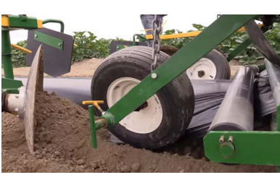
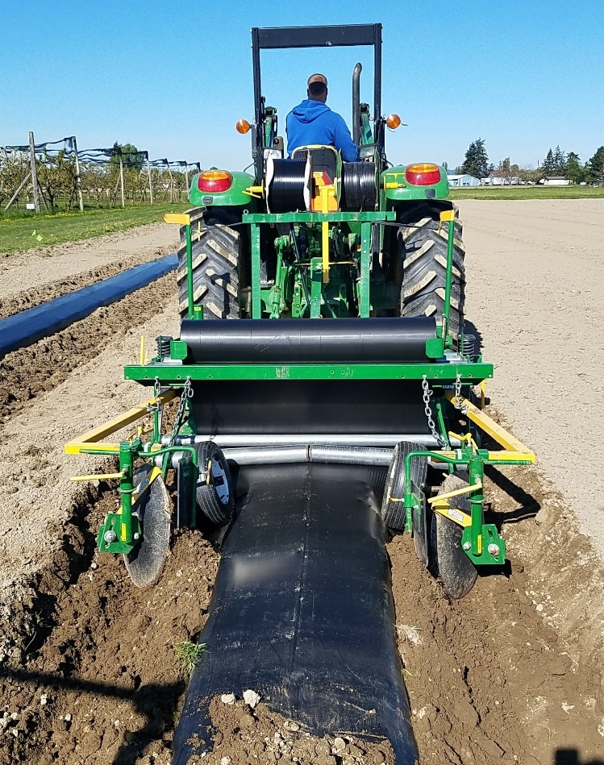
Laying BDM
Feed mulch through roller bar
  Adjust tension so mulch can easily roll
Guide wheels should rest slightly on mulch or float just above
Slowly drive forward then increase speed, laying speed same as for PE
Ghimire et al., 2017
biodegradablemulch.org
https://smallfruits.wsu.edu
Notes:
The procedure for mulch laying is similar for all mulch layers. First feed the end of the mulch roll through the roller bar and reduce the tension so it can roll easily. Pull the mulch under the guide wheels; the wheel(s) should rest lightly on the mulch or float just above it.

Slide 13
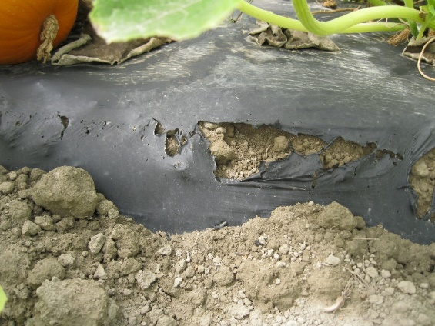
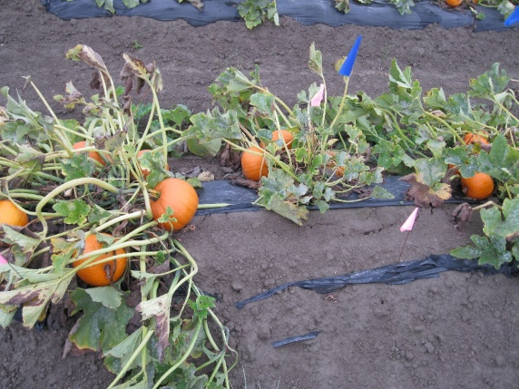
BDM Through Growing Season
Visual assessment of deterioration:
Decrease of area - percent soil exposure (PSE)
PSE– percent soil exposure due to rips, tears, holes
biodegradablemulch.org
https://smallfruits.wsu.edu
Notes:
Visual assessment of deterioration is measured as a decrease in mulch area—percent soil exposure (PSE), photography, colorimetry, macroscopic and microscopic examination, including scanning electron and laser confocal microscopy.

Slide 14
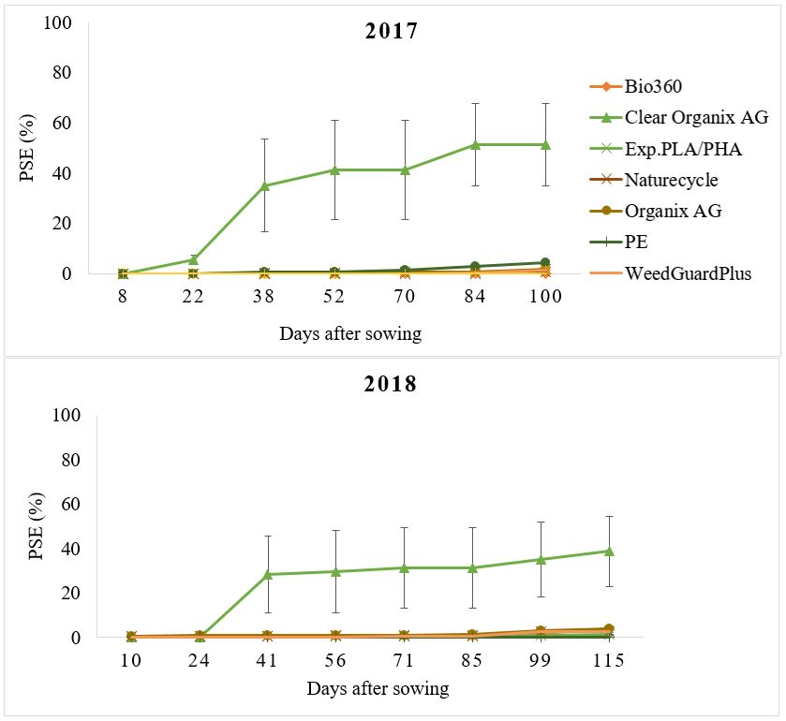

Percent Soil Exposure (PSE)
Bio360 – 18.0 μm
Clear Organix AG – 12.7 μm (2017), 17.8 μm (2018)
Exp. PLA/PHA – 25.0 μm
Naturecycle – 25.4 μm
Organix AG – 17.8 μm
Polyethylene – 25.4 μm
WeedGuardPlus – 240.0 μm
1 mil = 25.4 µm
Growing season
= 16 wk
Ghimire et al., 2020a
PSE during sweet corn growing season in Mount Vernon, WA; 0 = completely intact, 100 = fully deteriorated, ratings in 1% increments up to 20%, and 5% increments thereafter; error bar is ± one standard error of the mean.
Notes:
The graph (Fig. 2) shows the PSE during the sweet corn growing season of about 16 weeks in Mount Vernon, WA in 2017 and 2018. Zero PSE denotes completely intact mulch while 100% PSE denotes completely deteriorated mulch. Ratings were in 1% increments up to 20% PSE, and in 5% increments thereafter. PSE was highest for Clear Organix AG mulch and reached 51% and 39% by the end of the season in 2017 and 2018. Other black plastic BDMs and PE mulch had minimal (<5%) deterioration throughout the growing season in both years.

Slide 15
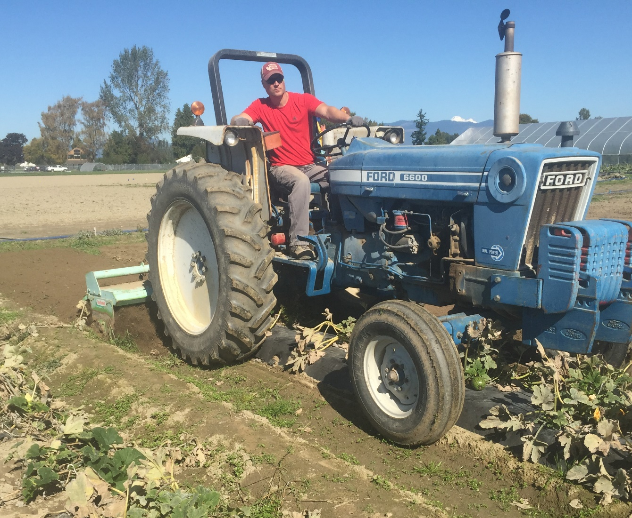
Tillage Incorporation
Video 3:30 min https://www.youtube.com/watch?v=aMjD4vbr9eA&feature=youtu.be
biodegradablemulch.org
https://smallfruits.wsu.edu
Notes:
Here is the link for the video of laying and tilling BDMs into the field, https://www.youtube.com/watch?v=aMjD4vbr9eA&feature=youtu.be

Slide 16
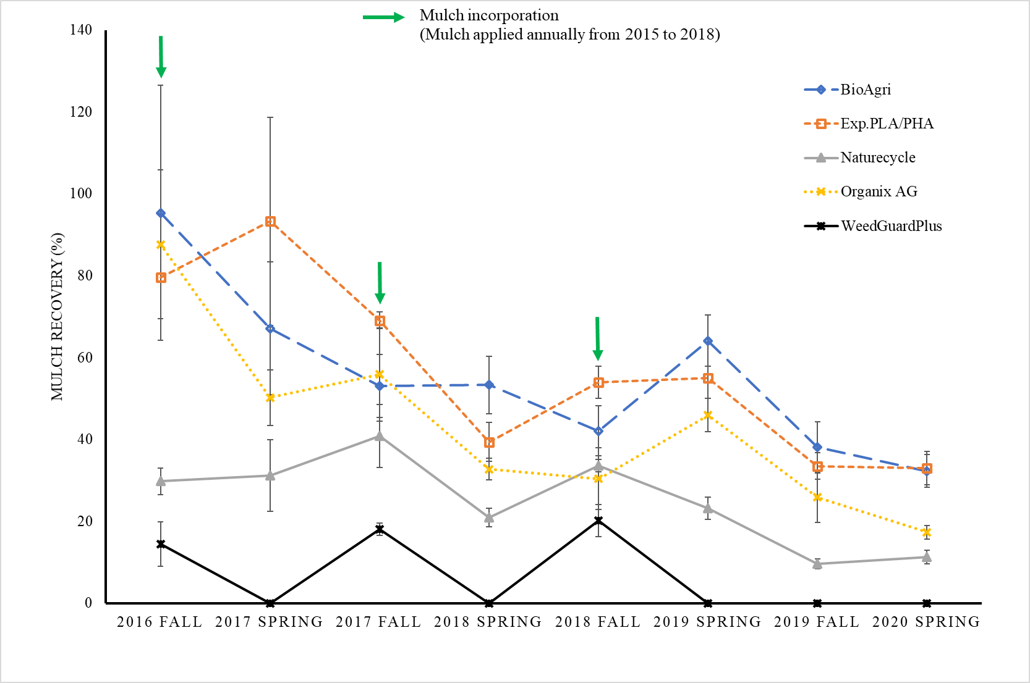
Mulch Recovery From Soil
Ghimire et al., 2020b
Percent recovery of BDM fragments in Mount Vernon, WA using the soil quartering method; mulch was applied once a year for 4 years (2015-2018), plots were rototilled in spring after collecting samples and in fall before collecting samples; error bar is ± one standard error of the mean.
Notes:
The graph (Fig. 5) shows the percent mulch recovery in Mount Vernon, WA using the soil quartering method after incorporation in the field. Mulch was applied once a year for 4 years (2015 - 2018). Plots were rototilled in spring after collecting samples and in fall before collecting samples. Paper BDM (WeedGuardPlus) shows complete biodegradation each year while other plastic BDMs have different rates of biodegradation. One year after the last soil-incorporation of BDM, recovery ranges from 10% to 30%, indicating that all of these BDMs are degrading at this field site.

Slide 17
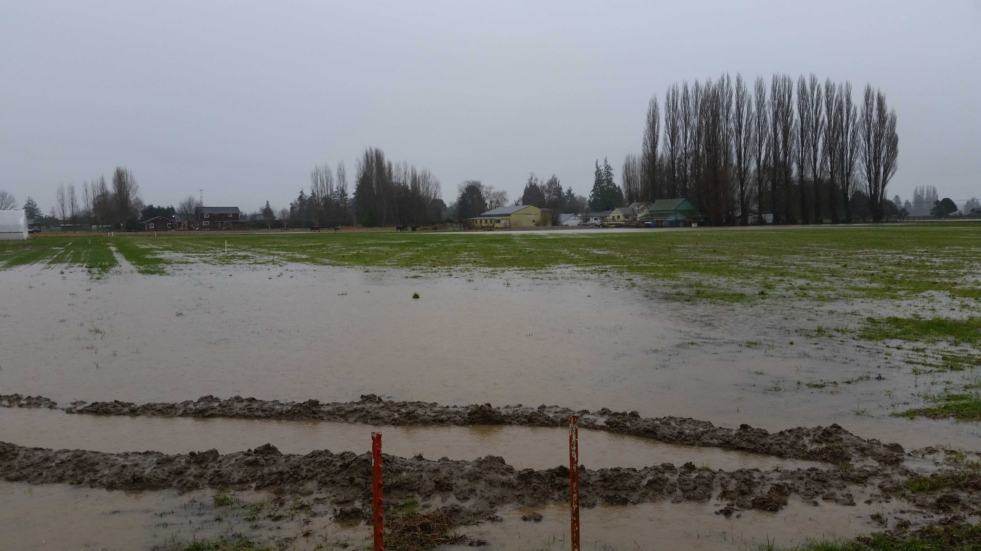
BDM Degradation
Targeted to meet laboratory tests:
Composting standard simulates industrial conditions:
Use of a compost-based medium
58℃
Soil standard simulates best case scenario:
Aerobic conditions in natural topsoil from agricultural field or forest
20 to 28°C
Standards ensure primary criteria are met:
Composition
Ecotoxicity
Dimensional, mechanical and optical properties
Winter 2015
biodegradablemulch.org
https://smallfruits.wsu.edu

Slide 18
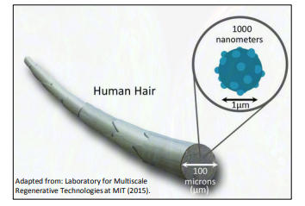
Degradation Process
Film Fragment Micro-particle Nano-particle CO₂ + Biomass
Hayes, 2019
A human hair demonstrates the relative size of microns and nanometers
Current soil assay techniques not able to distinguish BDM particles from biological residues so measuring in situ biodegradation very difficult
biodegradablemulch.org
https://smallfruits.wsu.edu
Notes:
The degradation process takes place sequentially from film to fragment to micro-particles to nano-particles to the final stage of CO2 + biomass in the soil. A human hair demonstrates the relative size of microns and nanometers (Fig. 4).

Slide 19
Approval of BDM for Organic
No plastic BDMs approved for use in certified organic production in U.S.
A New England state/certifier is allowing BDM use in organic production?
Paper BDM is allowed (WeedGuardPlusTM)
NOP-NOSB is taking feedback for spring meeting
– speak up if you have an opinion
Work with your research and extension specialists to test BDMs in your system
biodegradablemulch.org
https://smallfruits.wsu.edu
Notes:
GMOs are commonly used in the manufacture of BDM. For example, starch (corn, sugar beet) feedstocks are fermented by GM bacteria or yeast. It is difficult to determine the GMO status of the end product when the source of feedstocks is not disclosed, or when DNA is degraded after fermentation and processing and is thus not measurable. NO plastic BDMs are approved for use in certified organic production. Paper BDM (such as WeedGuardPlusTM) is allowed for organic production.

Slide 20
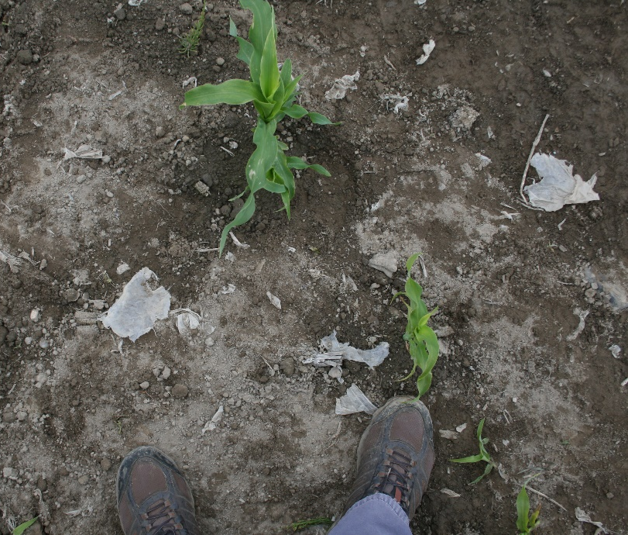
Oxo- and Photo-degradable
Oxo and photo-degradable plastic made with conventional plastic: HDPE, LDPE, PP, PS, PET or PVC
Includes additives that cause the material to become brittle and break apart into fragments when exposed to UV light, heat and/or oxygen
EU to prohibit single-use plastic products and products made from oxo-degradable plastic (European Parliament Directive 2019/904 Article 5, passed 5 June 2019 to take effect July 2021)
biodegradablemulch.org
https://smallfruits.wsu.edu
Notes:
Oxo- and photo-degradable plastics are made with conventional plastic: HDPE, LDPE, PP, PS, PET or PVC. Also included are additives that cause the material to become brittle and break apart into fragments when exposed to UV light, heat and/or oxygen (Figure 1). Oxo- and photo-degradable mulches are not biodegradable, compostable, or recyclable, and cannot be placed in anaerobic digesters. There is a resurgence in their use, due to the interest in BDMs and large price difference between BDMs and oxo- and photo-degradable mulches. European Union (EU) will prohibit single-use plastic products and products made from oxo-degradable plastic according to European Parliament Directive (EU) 2019/904 and the council of 5 June 2019 under Article 5. The member states shall apply the measures necessary to comply with Article 5 from 3 July 2021.

Slide 21
Resources
Biodegradable Mulch Film for Organic Production Systems https://ag.tennessee.edu/biodegradablemulch/Documents/BDM_for_organic_production_rev_5Apr2016.pdf
Biodegradable Plastic Mulch and Suitability for Sustainable and Organic Agriculture
http://pubs.cahnrs.wsu.edu/publications/pubs/fs103e/
Biodegradable Mulch Products https://ag.tennessee.edu/biodegradablemulch/Pages/biomulchprojects.aspx
Summary and Assessment of EN 17033:2018, a New Standard for Biodegradable Plastic Mulch Films
https://ag.tennessee.edu/biodegradablemulch/Documents/EU%20regs%20factsheet.pdf
Video - Biodegradable much: a grower's experience of general benefits and disadvantages
https://www.youtube.com/watch?v=kyvB1QxHAtE&list=PLuPJ_NR7ZnVuPh7t7erYYXcVw-h4xg0Xm
biodegradablemulch.org
https://smallfruits.wsu.edu

Slide 22
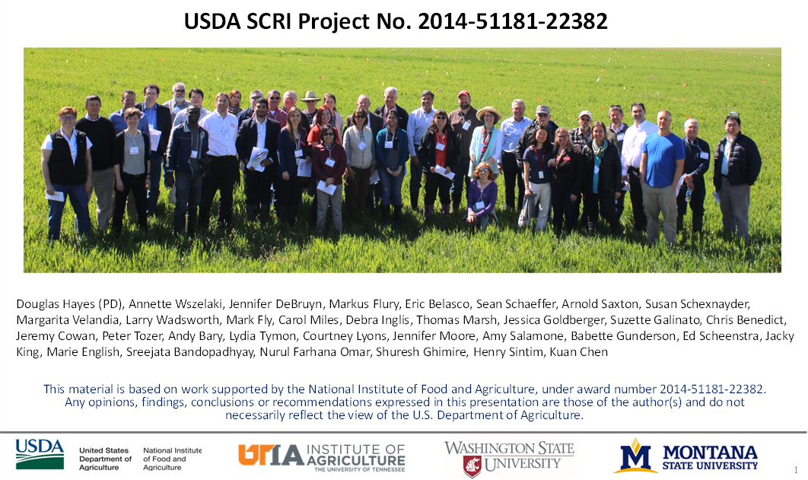
Acknowledgements
biodegradablemulch.org
https://smallfruits.wsu.edu

